Slide 1
Chapter 1
Fundamentals of Circuit Analysis

Slide 2
Vocabulary
charge
current
voltage
power
energy
passive
active
convention
element
component
generator
motor
transformer
transmission
load
source
sensor
amplifier
filter
flux
distributed
lumped
plus
minus
multiply
divided by
integral
differential
numerator
denominator

Slide 3
Outline
• Basic concepts
- Introduction
- Charge and Current
- Voltage
- Passive sign convention directions
- Power and Energy
• Circuit Elements and Basic Laws
- VAR, KCL, KVL
- Circuit Analysis based on Basic Laws

Slide 4
Introduction
What is a circuit ?
Actual circuits and idealized circuits
Circuit analysis and design
Classifications of circuits

Slide 5

What is a circuit?
Actual circuit: an interconnection of electrical components by using power to realize some functions
Tranformer
(step-up)
power
lines
Tranformer
(step-down)
Generater
Load
Electrical Power System
A/D
Display
Terminal
Sensor
Amplifier
Information Processing System
4

Slide 6
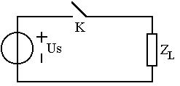
Actual Circuit and Idealized Circuits
Actual circuits: electromagnetic, electric and electronic systems
  Idealized circuits : Abstraction, mathematical modeling of real circuits
  Circuit element : idealized model, approximation of real component

Slide 7
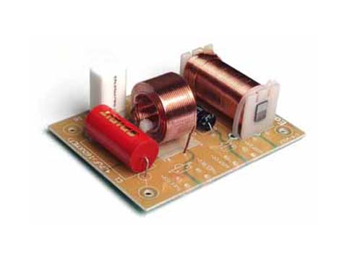
Actual circuits
Source-free filter

Slide 8

Actual circuit
北京交通大学 国家电工电子教学基地 电路理论系列课程组

Slide 9
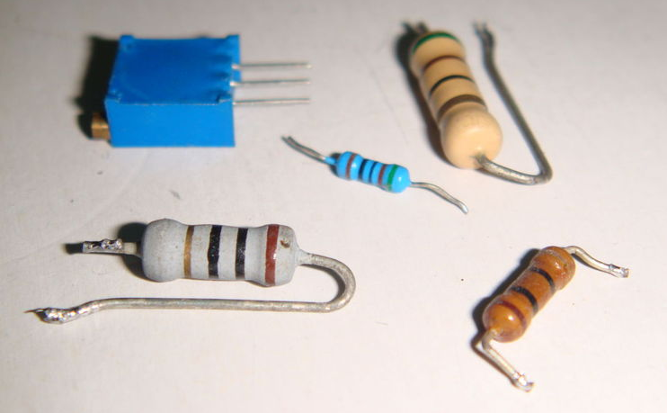
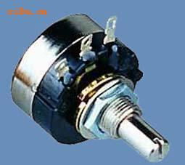
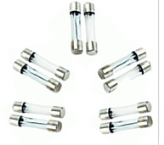
Components-Resistors

Slide 10
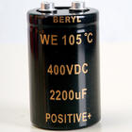
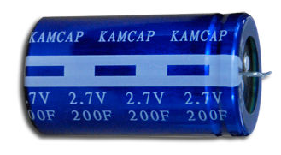
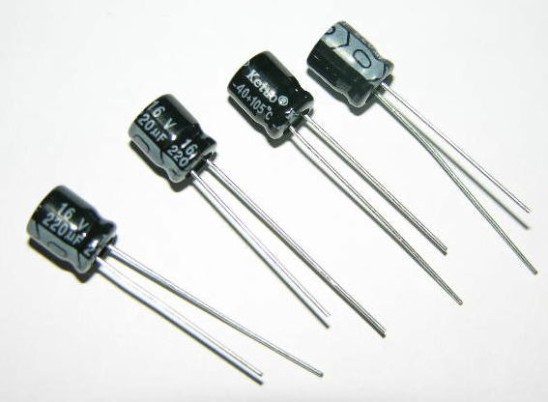
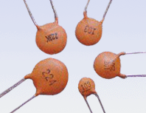
Components-Capacitors

Slide 11
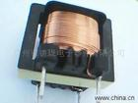
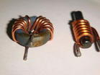
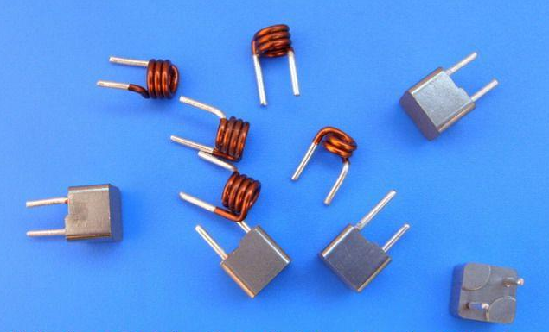
Components-Inductors

Slide 12
Actual Circuit and Idealized Circuits
Actual circuits：composed of actual circuit components
Actual
circuit
Actual components（resistor,
capacitor, inductor,
integrated circuit）
Abstract
Approximation
Definition
Element modeling
1. Maintain characteristics
2.One element may include multiple element models
Circuit
model
Element models
Circuit model：ideal element models connected by ideal wires.

Slide 13
Analysis and design
Circuit analysis
Structure & element values are known
Excitation
?
Response
Circuit design (synthesis)
Structure &/ element values to be determined
Excitation
Response
?

Slide 14
Analysis and design
Analysis is:
  the starting point in every engineering situation
  needed to understand the basic principles
  needed to do design task
  much simpler than design problem, have unique solution
  Some engr. problems require only analysis (eg. find a fault)
Notes:
How important is Analysis

Slide 15
Introduction
Classifications of circuits
  Distributed vs. Lumped
  Linear vs. nonlinear
  Active vs. passive
  Time-varying vs. time-invariant
d << λ

Slide 16
Recap
Circuit and Circuit Theory
Actual Circuits and Idealized Circuits
  Distributed vs. Lumped
  Linear vs. nonlinear
  Active vs. passive
  Time-varying vs. time-invariant

Slide 17
Charge and Current

Slide 18
Circuit variables and their units
Basic variables
  Current i
  Voltage v
  Power p
Other variables
  Charge q
  Energy w
  Flux Ф
  Time t

Slide 19
Circuit variables and their units
SI ( Systéme International ) Units
Current i (A)
Voltage v (V)
Power p (W)
Charge q (C)
Energy w (J)
Scale factor and SI prefixes
k : 10³ (kilo) M :10⁶(mega) G : 10⁹(giga) T: 10¹²(tera)
m : 10⁻³(mili) μ :10⁻⁶ (micro) n : 10⁻⁹ (nano) p: 10⁻¹²(pico)

Slide 20
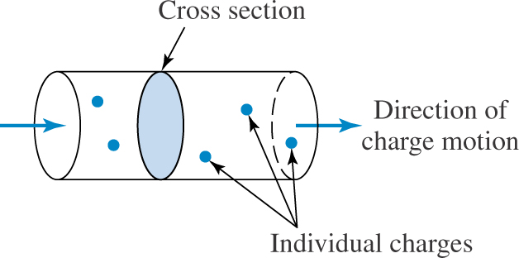
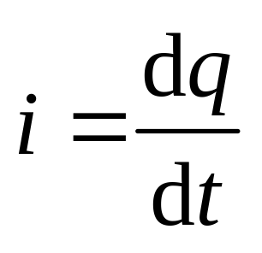
Charge and Current
Current : The rate at which charge is transferred.
Present in discrete path (in wire, not in free space, not distributed)
Has both numerical value and a direction
Direction of current : motion of positive charge
Measure of the rate at which charge is passing a given point in a specified direction.
Notes:
Water pipe

Slide 21
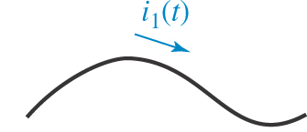
Charge and Current
Reference Direction of Current
i
i₁
i
A
B
– 3A
A part of current definition
Arrow (Reference Direction) ≠ actual direction
Can be chosen arbitrarily
Must stick to it in the problem solving procedure
Arrow + numerical value gives actual direction

Slide 22
Charge and Current
Reference Direction of Current
i
i₁
i
A
B
– 3A
Current through A :
i = – i₁
Current through B :
i = – 3A
Actual current is 3A
going left through B.

Slide 23
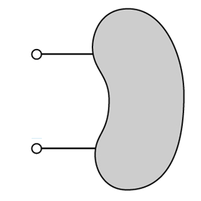
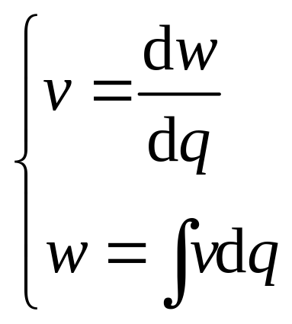
Voltage
Voltage : potential difference
a
v
b
Voltage across node pair a-b is a measure of work (energy) required to move (unity) charge from a to b (through any path ).
Voltage can exist whether a current is flowing or not.

Slide 24
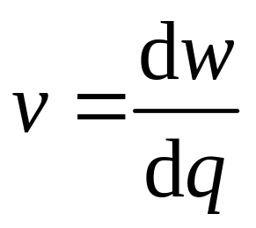
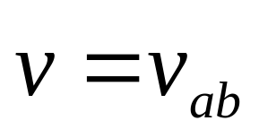
Voltage
Reference polarity of voltage
a
v
b
Use “+” / “-” sign or double-subscripts
“+” means when charge moves from “+” to “-” through an element, energy is supplied to the element.
“+” a: node a is v volts positive with respect to b.

Slide 25
Voltage
Reference polarity of voltage
a
v
b
Reference polarity (direction) ≠ actual polarity
The definition of voltage MUST include polarity sign.
A node can be assigned as zero-potential, called ground or reference node. v_{a}= potential at a.

Slide 26
Voltage
Reference polarity of voltage
v
-4(V)
a
b
A
B
c
d
v₁
A : v =v_{ab} = – v₁
B : v_{cd} = – 4V
Reference sign + numerical value = actual voltage
“+ -” can be assigned arbitrarily, but cannot be changed during analysis.

Slide 27
Passive sign convention
a
i
V, I both are defined by
a value + direction.
v
E
b
Passive sign convention :
  Current arrow is directed into the element at the
  plus-marked terminal.
  Also called associated convention of voltage and current, ref. directions at a pair of terminals.
  Useful when both v and i should be considered in analysis. Eg definition of an element by v,i .

Slide 28
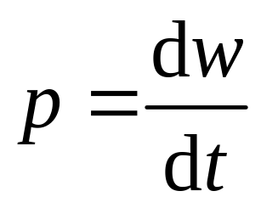
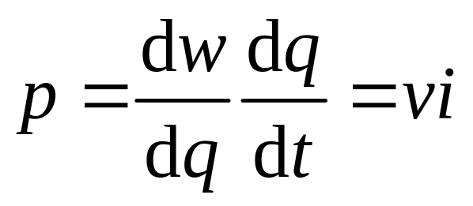
Power
Power : the rate at which energy is expended.
a
i
v
E
b
If one joule of energy is expended in transferring one coulomb of charge through the element in one second, then the rate of energy transfer is one watt.
Power : energy per coulomb per second
Notes:
Power means energy transfer is happening, charge is actually moving, so power has something to do with current.
While voltage is a potential energy, when it changes accompanied by current flowing, power is generated.

Slide 29
Power
a
i
v
E
b
If i enters “+” sign, energy is supplied to the element (absorbed by E); otherwise energy is supplied by E.
Under passive sign convention, p absorbed by E is given by p = v i .
Notes:
Power means energy transfer is happening, charge is actually moving, so power has something to do with current.
While voltage is a potential energy, when it changes accompanied by current flowing, power is generated.

Slide 30
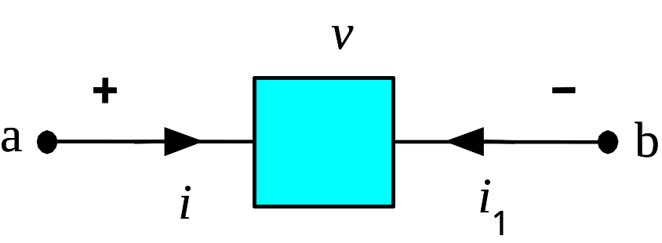
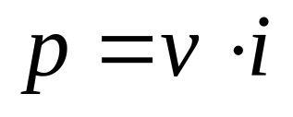
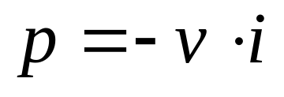
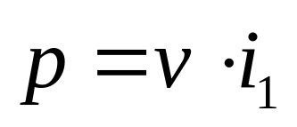
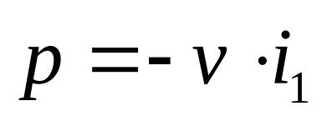
Power
The actual transfer direction of energy is determined by v, i ref. direction and value of p.
E
v =2V, i =3A
: power absorbed by E
p =2×3= 6W
: power supplied by E
p = -2×3= - 6W
: power supplied by E
p = 2×(-3)= - 6W
: power absorbed by E
p = -2×(-3)= 6W

Slide 31
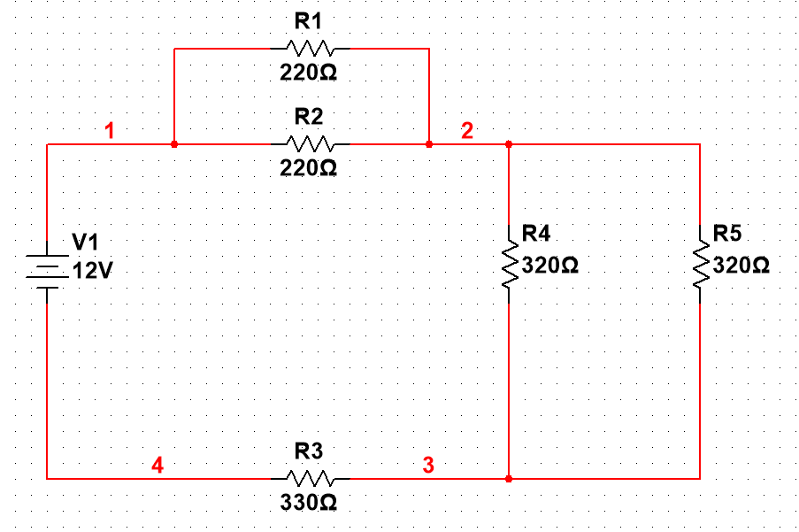
5 minutes’ exercise: Tick answers
i₂
1. v₁ and i₁ satisfy Passive Sign Convention with respect to 12V voltage source. ( )
2. i₁ and v₂ satisfy PSC with respect to R2. ( )
3. i₂ and v₂ satisfy PSC with respect to R2. ( )
4. i₃ and v₂ satisfy PSC with respect to R2. ( )
5. i₄ and v₃ satisfy PSC with respect to R4. ( )
6. i₅ and v₃ satisfy PSC with respect to R5. ( )
7. i₆ and v₄ satisfy PSC with respect to R3. ( )
i₁
i₃
+
+
v₂
-
v₃
i₄
i₅
-
i₆
+
-
v₄
8. p_{R2} = v₂i₃ ( )
9. p_{12V} = v₁i₁ ( )
10. p_{R3} = v₄i₆= - i₁v₄ ( )
Keys: 1F2F3F4F5T6T7T8F9F10T

Slide 32
Circuit Elements
Voltage and current sources
Dependent sources
Resistors

Slide 33
Voltage and Current Sources
Circuit Element
Physical device
Circuit element
Approximation
Idealization
Actual components,
devices
Mathematical
models
Physical devices :
  Various types – too many ;
  Non-ideal properties;
  Nonlinear, complex relations, many variables to characterize .

Slide 34
Voltage and Current Sources
Circuit Element
Physical device
Circuit element
Approximation
Idealization
Actual components,
devices
Mathematical
models
Circuit elements :
  A limited number of types ;
  Idealized, usually with linear and simple properties,
  A combination of several elements may be used to approximate the character of actual device.

Slide 35
Voltage and Current Sources
Circuit Element
a
i
v
E
b
“Black box” definition :completely characterized by its external v-i relationship
  Measurable at terminals
  Don’t care about its internal construction
  Property determined – irrelevant of circuits to which it is connected .

Slide 36
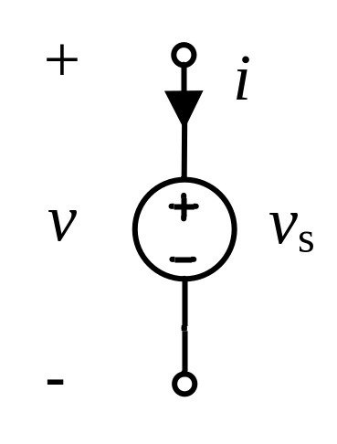
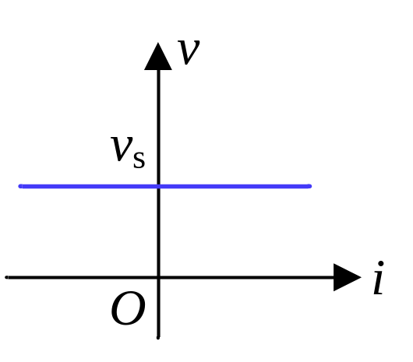
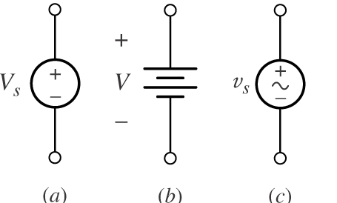
Voltage and Current Sources
Independent Voltage Sources
An independent voltage source is characterized by its terminal voltage which is completely independent of the current through it.
(a) DC or AC (b) DC (c) AC

Slide 37
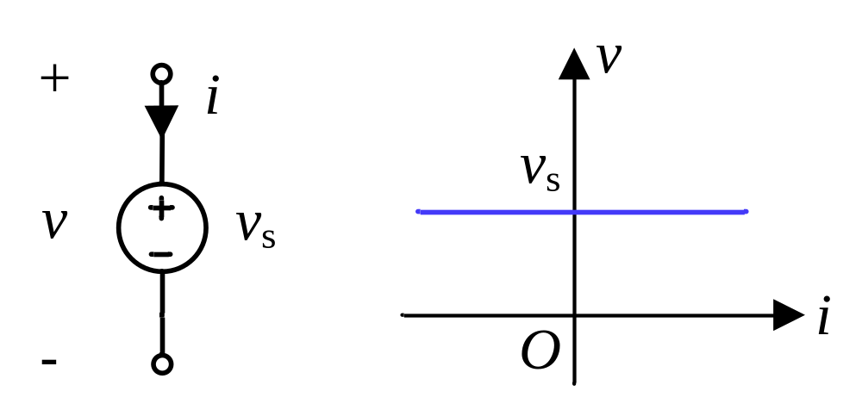
Voltage and Current Sources
Independent Voltage Sources
Ideal source : can supply any amount of current
v is independent of i: whether i>0. i<0. i=0
Current i of v_{s} is not defined, not constrained by v_{s}, but determined by the external circuit to which it is connected.

Slide 38
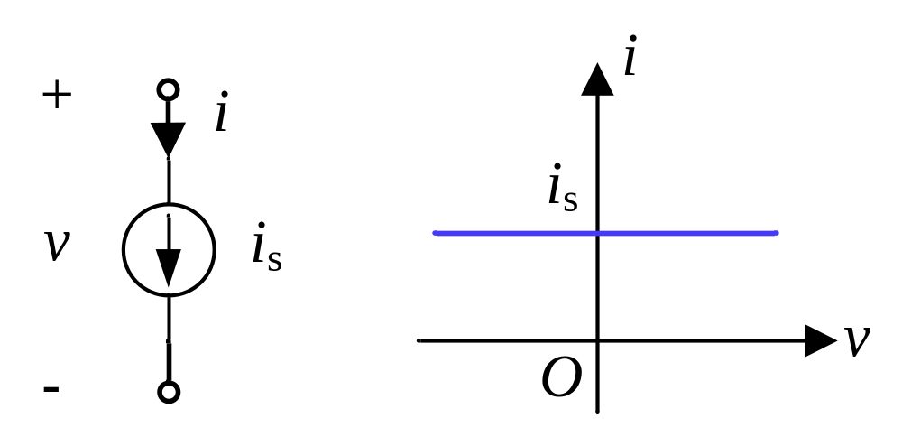
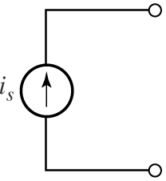
Voltage and Current Sources
Independent Current Sources
An independent current source is characterized by its terminal current which is completely independent of the voltage across it.

Slide 39
Voltage and Current Sources
Independent Current Sources
i is independent of v: whether v>0. v<0. v=0
Voltage v of CS is not defined, not constrained by CS, but determined by the external circuit to which it is connected.

Slide 40
Voltage and Current Sources
Both voltage source and current source are active element – they can supply energy.
They are not always supplying energy at any time, or in any case!
They are idealized models of actual batteries, cells, or some electronic devices.

Slide 41
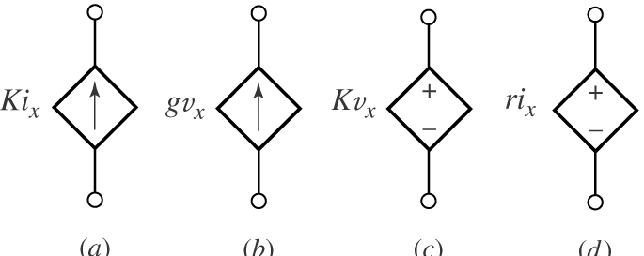
Voltage and Current Sources
Dependent Sources
The source value is determined by a voltage or current at some location (other than its own terminal) in the circuit.
Also called controlled sources.
Active element, can supply energy !
Idealized (simplified) models of electronic devices.

Slide 42
Voltage and Current Sources
Dependent Sources
i
i
v
v
The four different types of dependent sources:
(a) current-controlled current source (CCCS): i=K_{v}i_{x}
(b) voltage-controlled current source (VCCS); i=gv_{x}
(c) voltage-controlled voltage source (VCVS); v=K_{i}v_{x}
(d) current-controlled voltage source (CCVS). v=ri_{x}
Where : i_{x} and v_{x} are controlling variables.
K_{i} , g, K_{v} , r are scaling factor (control factor).
Notes:
Describe of textbook is from p22 of Funda. All other parts are written by myself.

Slide 43
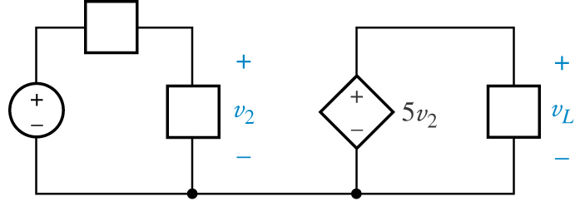
Voltage and Current Sources
Example 1.3
In the circuit below , if v₂ is known to be 3 V, find v_{L} .
v_{L} = 5v₂ = 15 V

Slide 44
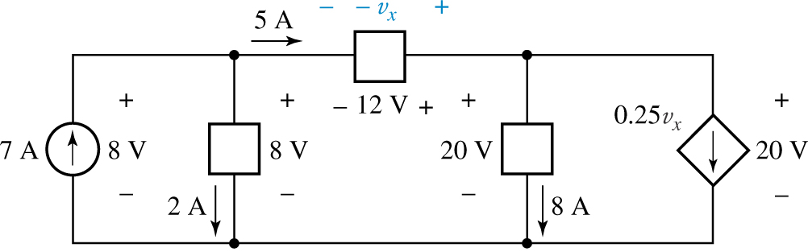
Voltage and Current Sources
Example 1.4
Find the power absorbed by each element in the circuit below.
v_{x}
v_{x} = -12 V
p_{VCCS} = 20 × 0.25 v_{x} = 20 ×0.25 (-12) = - 60W

Slide 45
Basic laws
Basic laws:
  Ohm’s law
  Kirchhoff’s Current law
  Kirchhoff’s voltage law

Slide 46
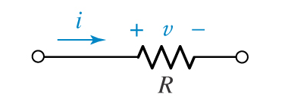
Ohm’s Law
v
v
v
i
R
i
i
o
o
Resistor : Characterized by an algebraic v-i relationship f(v,i)=0
Linear resistor (Ohm’s Law)
v = Ri
R : resistance , (V) = (Ω) (A)

Slide 47
Ohm’s Law
v
v
v
i
G
i
i
o
o
Ohm’s Law by conductance :
i = Gv
G : conductance , (A) = (S) (V)
R is normally considered positive, but negative resistance is also possible.

Slide 48
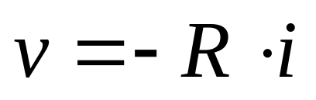
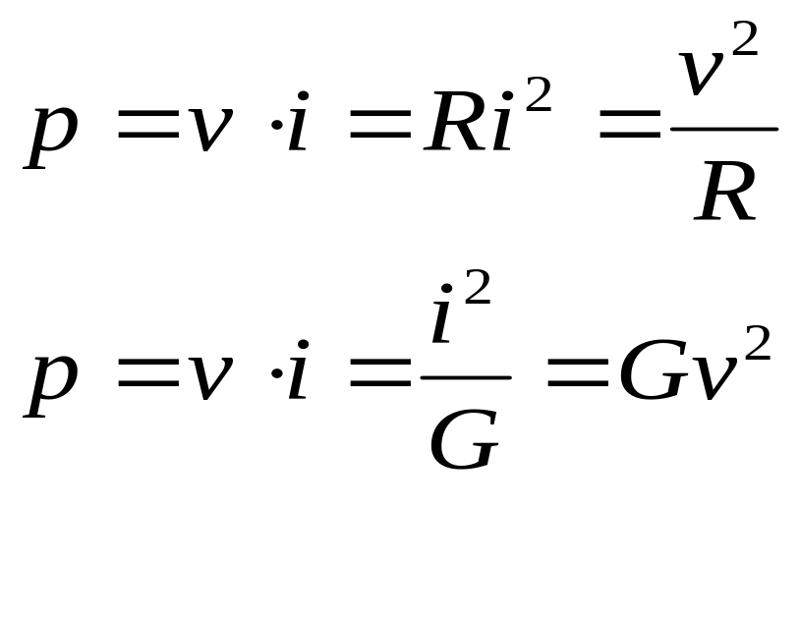
Ohm’s Law
For v, i directions not satisfying passive sign convention
v
i
R
Power absorption of resisters
v and i satisfy passive sign convention
v
i
R

Slide 49
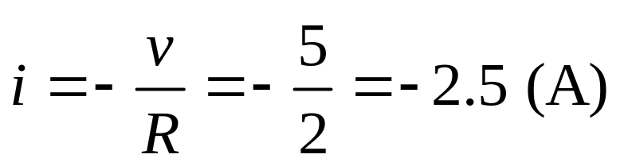
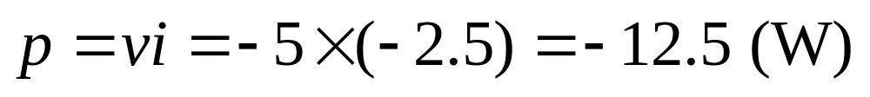
Ohm’s Law
Example 1.5
Given：R = 2(Ω), v = 5 (V) ，
Find ：i，p = ?
i
R
v
( note : v and i do not satisfy passive convention )
Solution:

Slide 50
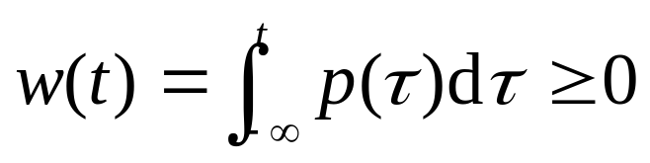
Elements, Networks and Circuits
(1) Classifications of Elements
Active elements : capable of delivering power to some external device.
Passive elements : Resistors can only receive power. But some other passive elements can supply power at some instant of time.
Strict definition of passive element by energy absorption:
Total energy absorbed by a passive element is non-negative at any time. Otherwise, it is an active one.

Slide 51
Elements, Networks and Circuits
(1) Classifications of Elements
Linear elements : Force linear relationship between two circuit variables.
Nonlinear elements : Otherwise.
For example :
Linear resistors : v-i : v = Ri
Dependent sources : v-i : v -v, or i-i relationship

Slide 52
Elements, Networks and Circuits
(2) Networks and Circuits
Network : Interconnection of two or more simple circuit elements.
Circuit : A network containing at least one closed path.
a
i
Sometimes a part of circuit is considered as a block affecting the rest of circuit just like an element. We call the part a network (having a port).
v
N
b

Slide 53
Elements, Networks and Circuits
(2) Networks and Circuits
Passive Network : A network that does not contain any active element.
Active Network : A network containing at least one active element.
Linear Network : A network that contains only linear elements.
Nonlinear Network : A network containing at least one nonlinear element.

Slide 54
Homework
1.2, 1.3, 1.5, 1.6, 1.7
Notes:
2,3,5,6,7 (KCL, KVL,voltage division)
10,11,13 simple analysis by superposition theory
16,17,18,21,22 voltage division,dependent sources

Slide 55
Basic laws
Ohm’s Law
Kirchhoff’s Current Law
Kirchhoff’s Voltage Law
  Concepts of Circuit Connection

Slide 56
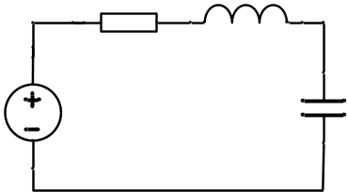
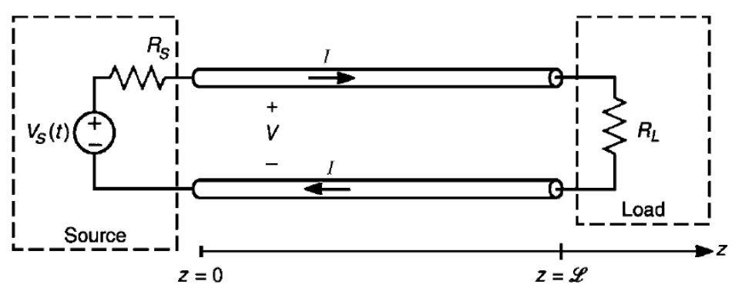
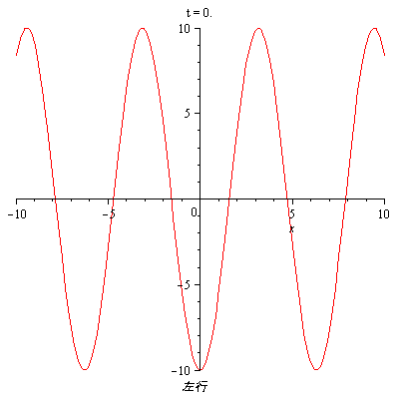
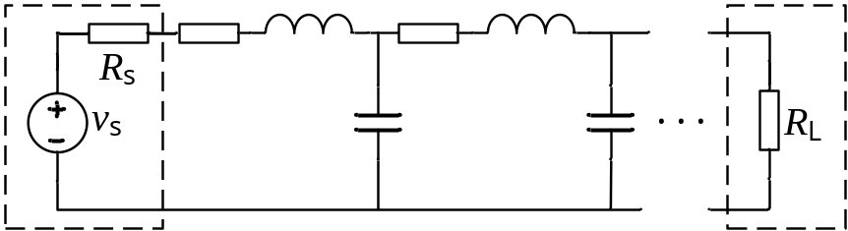
Concepts of Circuit Connection
Lumped-parameter network
  A set of finite number of ideal elements connected by ideal wires (with zero-resistance).
Distributed-parameter network
  A set of infinite number of vanishing small elements. A circuit approximation of electromagnetic phenomenon.
Only lumped-parameter network is discussed here.

Slide 57
Concepts of Circuit Connection
Implications of lumped-parameter models
  The physical size of the actual circuit is much smaller than the wavelength of working signal (v,i) in the circuit. (Frequency is adequately low).
  Variables in the circuit are therefore irrelevant of the sizes of and the distances between elements, provided the elements are connected in a fixed way. Elements are “lumped” or discrete. Wires are of zero-resistance.
  Energy is transferred only through elements and wires, not through free space. (Current flow too) .

Slide 58
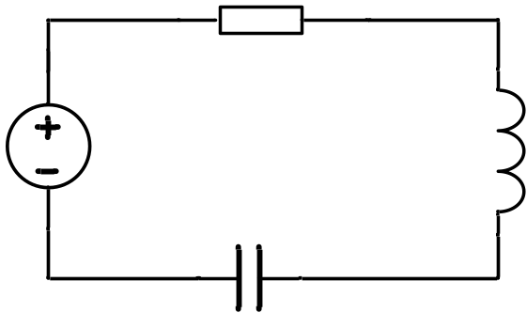
Concepts of Circuit Connection
Lumped-parameter circuits obey Kirchhoff’s
Current Law and Voltage Law.
E_{e}
Ψ
E_{m}
q
i_{c}
i_{d}

Slide 59
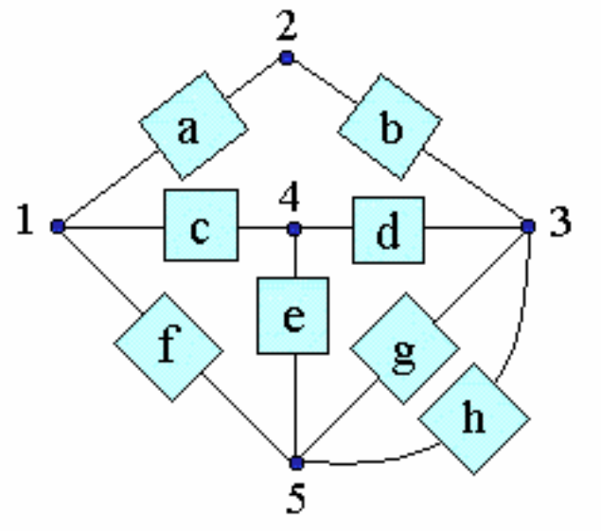
Concepts of Circuit Connection
Connection Abstraction
Node : A point at which two or more elements have a common connection.
Path : A node sequence in which no node appears more than once except the starting and ending node.
Nodes : 1, 2, 3, 4, 5
Paths : 1 -> 2 -> 3,
1-> 4 -> 5 -> 1

Slide 60
Concepts of Circuit Connection
Connection Abstraction
Loop : A closed path (starting point and ending point are the same one).
  There may or may not be an element between adjacent nodes in a path.
2
a
b
Loops : 1 -> 2 -> 3 ->4 ->1 ,
1-> 4 -> 5 -> 1,
3 –g-> 5 –h-> 3
4
1
c
3
d
e
g
f
h
5

Slide 61

Concepts of Circuit Connection
Branch : A single path composed of one element and the nodes at each end of the element.
  Sometimes a combination of elements with two terminals is also considered as a branch.
Branches : a, b, c, d, … g, h

Slide 62
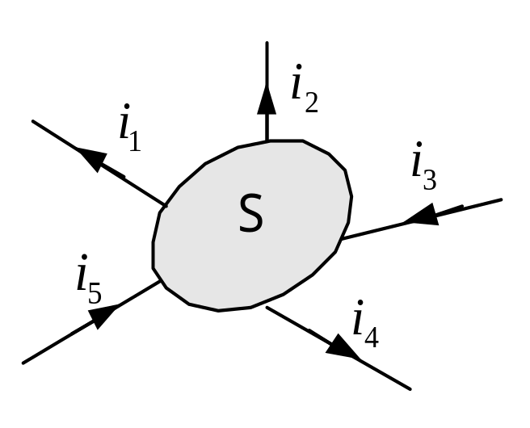
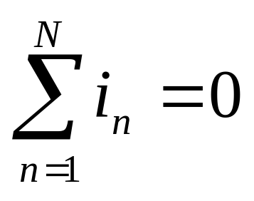
Kirchhoff’s Current Law
KCL : The algebraic sum of the currents entering any node is zero.
-3A
2A
i
3
i
2
i
1A
4
6A
i
i
1
5
– i₁ + i₂ + i₃ + i₄ – i₅ = 0
i₅ = – i₁ + i₂ + i₃ + i₄ = – 6 + 2 + (– 3) + 1 = – 6 A
“entering” can be “leaving”.
“node” can be “enclosed space“.
Can add “at any instant of time” for time-varying currents.

Slide 63
Kirchhoff’s Current Law
Independence of KCL equations
1
i
2
1
i
i
i
i
2
3
4
5
node 1 i₁ + i₂ = 0
node 2 – i₁ + i₃ + i₄ – i₅ = 0
3
node 3 – i₂ – i₃ – i₄ + i₅ = 0
3 equations are related，only 2 of 3 are independent
For a circuit with n nodes, n-1 KCL equations are independent.

Slide 64

Kirchhoff’s Current Law
i₃
Example 1.7
a
7A
Find：i₃，i₁
2A
i₂=2A
i₁
Node a ：
– i₃ + 7 – 2 = 0
i₃ = 5 (A)
Another form of KCL:
closed surface：
i₁ + i₂ + i₃ = 0
i₁ = – 7 (A)

Slide 65


Kirchhoff’s Voltage Law
KVL : The algebraic sum of the voltages around any closed path is zero.
Assume voltage polarities. Move mentally around the closed path in selected direction, write down the voltage drop:
loop1 ：– v₃ – v ₂ + v ₁ + v ₄= 0
loop2 ：– v ₄ + v ₅ + v ₆ = 0
loop3 ：– v ₃ – v ₂ + v ₁ + v ₅ + v ₆ = 0

Slide 66

Kirchhoff’s Voltage Law
Independence of KVL equations
1 ：– v₃ – v ₂ + v ₁ + v ₄= 0
2 ：– v ₄ + v ₅ + v ₆ = 0
3 ：– v ₃ – v ₂ + v ₁ + v ₅ + v ₆ = 0
Summing the two sides of eq. 1 and eq. 2 gets eq. 3, obtain 0=0. Therefore the three equations are not independent.
For a circuit having b branches and n nodes, there are b–n+1 independent KVL equations.

Slide 67



Kirchhoff’s Voltage Law
Another form of KCL:
From loop1 ： – v₃ – v ₂ + v ₁ + v ₄= 0
We have ： v ₁ + v ₄ = v ₂ + v₃ = v_{db}
Similarly： v_{dc} =v ₁ + v ₄ – v₃ = v ₁ + v ₅ + v₆ – v₃
A voltage in a circuit has a unique value that is independent of the path taken to calculate.

Slide 68






Kirchhoff’s Law
Example 1.8
Determine v_{x} , i_{x} in the circuit.
KVL gives
KCL
KVL & Ohm’s Law
KCL & Ohm’s Law

Slide 69



Example 1.9 : Determine the power absorption of each element in the following circuits.
i
10V
v
5Ω
i
10V
v
2A
i
10V
v
5Ω
2A
2A

Slide 70







Single Loop Circuit
Example 1.10
Compute the power absorbed by the controlled source .
Assume i and v_{B} directions
Write KVL equation
Applying Ohm’s law
Notes:
Power means energy transfer is happening, charge is actually moving, so power has something to do with current.
While voltage is a potential energy, when it changes accompanied by current flowing, power is generated.

Slide 71
Single Loop Circuit
In a single loop circuit, all the elements have the
same current i. (connected in series)
Analysis of the circuit:
  KVL equation + Ohm’s law to find current i .
Assume a reference direction of i.
Voltage ref directions for all elements follow passive sign convention.
Write KVL equation.
Apply Ohm’s law to resistors to get equation of i.
Solve i, then find other interested variables.

Slide 72
Single Node-Pair Circuit
In a single node-pair circuit, all the elements have the
same voltage v. (connected in parallel)
Analysis of the circuit:
  KCL equation + Ohm’s law to find voltage v .
Assume a reference direction of v .
Assign current ref direction for all elements.
Write KCL equation.
Apply Ohm’s law to resistors to get equation of v.
Solve for v, then find other interested variables.

Slide 73







Single Node-Pair Circuit
Determine the value of v and the power supplied by the independent source .
Example 1.11
Write KCL equation
Apply Ohm’s law

Slide 74


Single Node-Pair Circuit
Example 1.12
Find i₁, i₂, i₃, and i₄ .
C
A
D
B
A
C
B
D
Redraw the circuit

Slide 75





Single Node-Pair Circuit
Example 1.12
KCL :
Sum the currents to the rightmost node :
C
A
D
B

Slide 76
Homework
Read Chapter 1
1.10, 1.11, 1.13,

Slide 77

Series and Parallel Combinations of Element
(1) Elements in Series
v
a
i
c
b
i₁= i₂ = i
v₁
v₂
v = v₁ + v₂
The path from a to b includes two or more connected branches. Each connecting node in the path connect exactly two elements
Elements in series have the same current.
Total voltage is the sum of element voltages.

Slide 78

Series and Parallel Combinations of Element
(2) Elements in parallel
i₁
a
i
b
v₁= v₂ = v
i₂
i = i₁ + i₂
v
There are two or more paths from a to b, each path is a simple two terminal element.
Elements in parallel have the same voltage.
Total current is the sum of element currents.

Slide 79
Discussion
In which way are the electrical outlets used in daily life supplying power to the appliances? In parallel or In series.
How about Lighting system? What’s the difference to connect them in series and parallel?
Why is the fuse destroyed sometimes when we connect too many appliances in our house, especially with those high-power-consumption appliances such as air-conditioner, and microwave?

Slide 80

Source Connections
Series connected voltage sources can be replaced by a single source.
Parallel current sources can be replaced by a single source.

Slide 81

Source Connections
Examples of circuits with multiple sources, some of which are “illegal” as they violate Kirchhoff’s laws.
Ideal voltage sources in parallel are permitted only when each has the same voltage at every instant of time.
Ideal current sources in series are meaningful only when each has the same current, including sign, at every instant of time.

Slide 82





Reducing Resistor Combinations
Resistors in series
Seen from the source :
Can be replaced by an equivalent network.
KVL :
Ohm’s law:
Equivalent resistance:

Slide 83



Reducing Resistor Combinations
Resistors in parallel
As seen from the source, A circuit with N resistors in parallel (a) can be replaced by an equivalent circuit (b).
Beginning with a simple KCL equation,
or
Thus,
When R_{i} are all same, R_{eq}=?

Slide 84

Reducing Resistor Combinations
Resistors in parallel
A special case worth remembering is

Slide 85




Sources in Series and Parallel
How about these ?
i_{S}
v_{S}

Slide 86


Sources in Series and Parallel
N is any network or element
i_{S}
v_{S}

Slide 87


Open Circuit and Short Circuit
Ideal analog switch or electronic switch

Slide 88


Open Circuit and Short Circuit
v
v_{s}=0
v=0
Zero voltage:
Short circuit
v=0
v
Zero current:
Open circuit
v

Slide 89



Voltage and Current Division
Voltage division
We may find v₂ by applying KVL and Ohm’s law:
so
Thus,
For a string of N series resistors, we may write:
or

Slide 90




Voltage and Current Division
Current division
The current flowing through R₂ is
For a parallel combination of N resistors, the current through R_{k} is

Slide 91

Voltage and Current Division
Use voltage division to determine v_{x} .

Slide 92

Voltage and Current Division
Determine the current I_{x} if I₁ = 90 mA.

Slide 93
homework
1.16, 1.17, 1.18, 1.22

Slide 94
Summary
An electric circuit consists of electrical elements connected together.
Current is the rate of charge flow.
Voltage is the energy required to move 1 C of charge through and element.
Power is the energy supplied or absorbed per unit time. P=vi
According to the passive sign convention, absorbing power assumes a positive sign when the current enters the positive polarity of the voltage across an element.

Slide 95
Summary
An ideal voltage source produces a specific potential difference across its terminals regardless of what is connected to it. An ideal current source produces a specific current through its terminals regardless of what is connected to it.
A dependent source is one whose value depends on some other circuit variable.
A resistor is a passive element in which the voltage v across it is directly proportional to the current i through it. ---Ohm’s law,v=iR

Slide 96
Summary
A short circuit is a resistor (a perfectly conducting wire) with zero resistance (R = 0). An open circuit is a resistor with infinite resistance (R =∞).
The conductance G of a resistor is the reciprocal of its resistance:
Branch, node, loop. The number of branches b, the number of nodes n, and the number of independent loops l in a network are related as

Slide 97
Summary
Kirchhoff’s current law (KCL) states that the currents at any node algebraically sum to zero. In other words, the sum of the currents entering a node equals the sum of currents leaving the node.
Kirchhoff’s voltage law (KVL) states that the voltages around a closed path algebraically sum to zero. In other words, the sum of voltage rises equals the sum of voltage drops.

Slide 98




Summary
When two resistors R₁ and R₂ are in series, their equivalent resistance R_{eq} and equivalent conductance G_{eq} are
When two resistors R₁ and R₂ are in parallel, their equivalent resistance R_{eq} and equivalent conductance G_{eq} are
The voltage division principle for two resistors in series is
The current division principle for two resistors in parallel is

