Slide 1
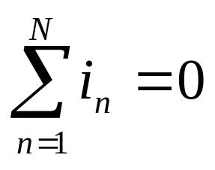
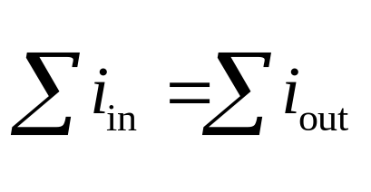
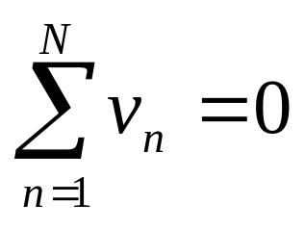
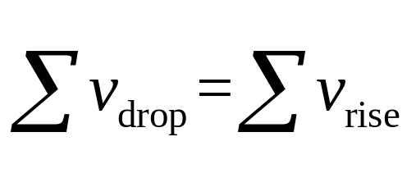
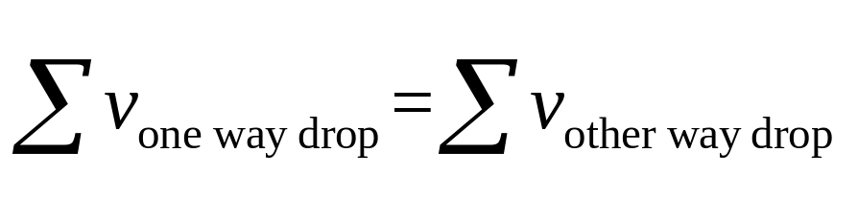
Review
VAR: Ohm’law
u=Ri
Kirchhoff’s laws
KCL
KVL
v
i
R

Slide 2
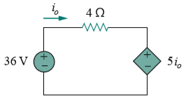
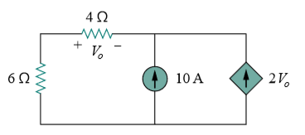
5 minutes’ exercise
1. Determine i₀ in Figure 1.
Figure 1.
2. Determine v₀ in Figure 2.
Figure 2.
Notes:
Power means energy transfer is happening, charge is actually moving, so power has something to do with current.
While voltage is a potential energy, when it changes accompanied by current flowing, power is generated.

Slide 3
Discuss in groups(10 minutes)
3v
Find v_{s} / i = ？
i
v
2
3
4Ω
i
i
Method 1:
Observation
2
1
v
v
6
Ω
12
Ω
v
s
2
1
Method 2:
Equivalence
Method 3:
Scaling
R_{in}
Input Resistance

Slide 4
Chapter 2
Circuit Analysis Techniques

Slide 5
Circuit Analysis Techniques
Equivalent analysis methods based on linearity property of circuits
  Linearity and Superposition
Source Transformation
Equivalent analysis methods based on Thevenin’s and Norton’s theorems
  Maximum Power Transfer
Systematic analysis methods
  Nodal and mesh analysis
Delta-Wye Conversion
Operational amplifier

Slide 6
Linearity and Superposition
Linearity property
  Homogeneity (scaling)
  Additivity
L(k₁x₁+k₂x₂)=k₁L(x₁)+k₂L(x₂)
L(kx)=kL(x)
L(x₁+x₂)=L(x₁)+L(x₂)
x₁
y₁
x
y
x₂
y₂
kx
ky
x₁ +x₂
y₁ +y₂

Slide 7
Linearity and Superposition
Linearity property
  Homogeneity (scaling)
  Additivity
Linear resistor
v = R i i : input, v : output
Homogeneity
kv = R ki
Additivity
v₁= R i₁
v₂= R i₂
v = R (i₁+i₂) = R i₁+ Ri₂ = v₁+v₂

Slide 8
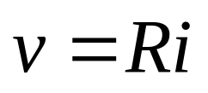
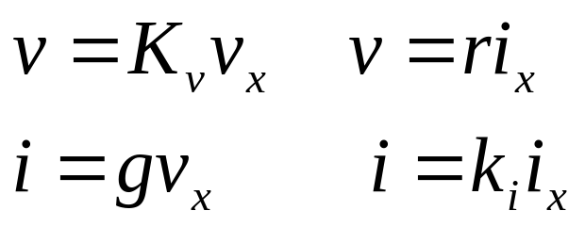
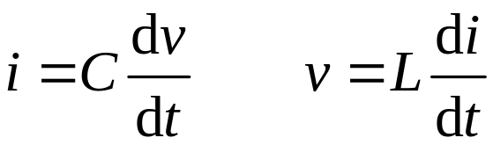
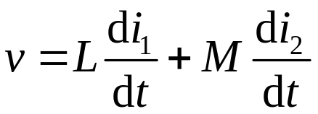
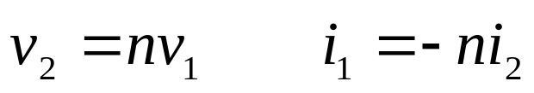
Linearity and Superposition
Linear elements
resistor
Dependent source
Capacitor and inductor
Coupled inductor
Transformer

Slide 9
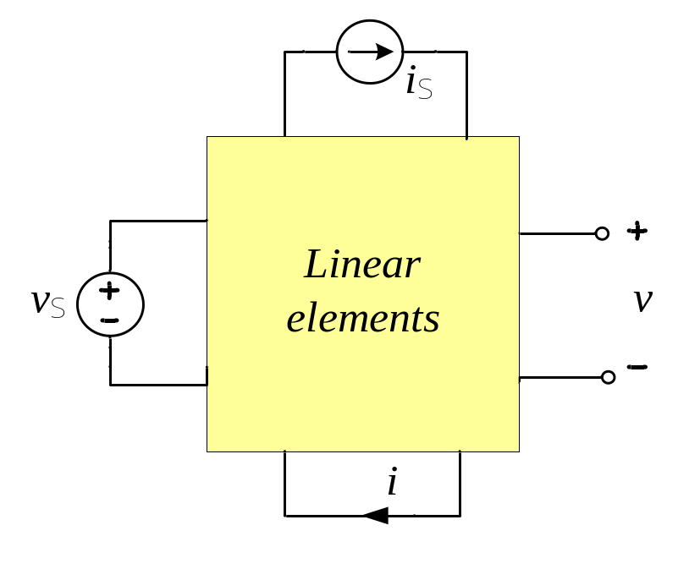
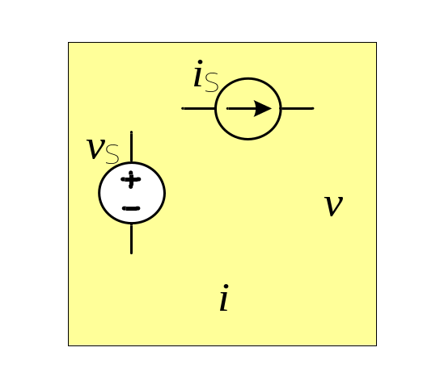
Linearity and Superposition
Linear network
a
i
Contains only linear elements.
v
N
Linear circuit
b
Contains linear elements and independent sources.

Slide 10
Linearity and Superposition
Example 2.1: Make use of scaling property.
i_{s}=3A, find v .
By homogeneity ：v=ki_{s}
Assume v =2V，find i_{s} , then determine k .
i_{s}= - 6A
Then
k =v/i_{s} = 2/(-6)= -1/3
i
1.5A
v
i
1A
5
3
1
When i_{s}=3A
v = ki_{s}= -1V
6A
i
4
Ω
1Ω
3
i
0.5A
i
9V
v
2
s
4
3V
v
2Ω
v
2Ω
2
6Ω
2V

Slide 11
Linearity and Superposition
Example 2.2 Find v_{s} / i = ？
3v
i
v
2
3
4Ω
i
i
2
1
Assume i₁=1(A)
v
v
6
Ω
12
Ω
v
s
2
1
v₁=12(V)
3v₂ + v₂ = v₁
==> v₂ = v₁/4 = 3(V)
i₂=v₂ / 6=0.5(A)
i = i₁ + i₂ = 1.5(A)
v₃ = 4i = 6(V)
v_{s} = v₂ + v₃ = 9(V)
∴ v/i = 9/1.5 = 6(Ω)

Slide 12
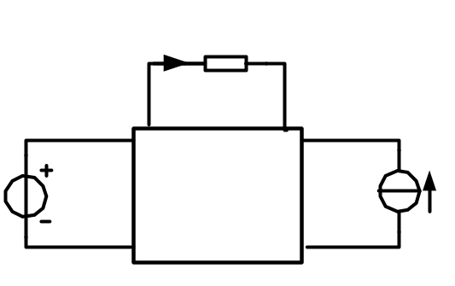
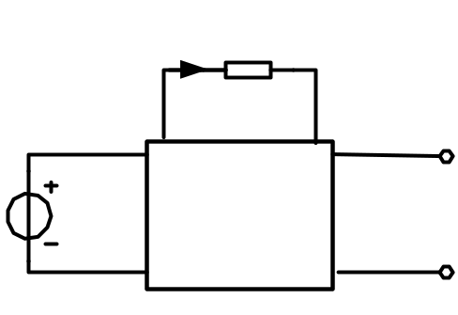
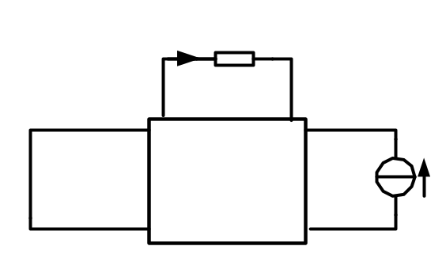
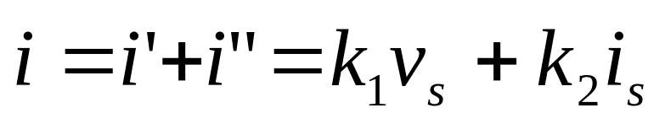
Linearity and Superposition
The superposition theorem
In any linear circuit, the voltage across (or current through) a linear element is the algebraic sum of individual voltages (or currents) caused by each independent source acting alone.
i
i’
i”
v_{s}
N₀
i_{s}
v_{s}
N₀
i_{s}=0
v_{s}=0
N₀
i_{s}
Any variable on linear elements is directly
proportional to the source value.

Slide 13
Linearity and Superposition
In general
A linear circuit is described by a set of linear equations. The solution for the unknowns (v or i ) by Cramer’s rule will prove:
Weighted sum
Where a_{k} and b_{k} are scaling constants.
Notes:
p10 previously

Slide 14
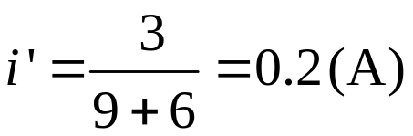
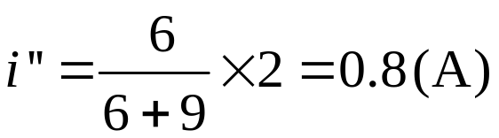



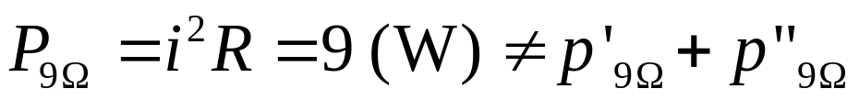
Example 2.3
Use superposition to find i and
the power absorbed by 9Ω-resistor
6
Ω
3V
9
Ω
i
2A
6
Ω
i'
6
Ω
i''
3V
9
Ω
9
Ω
2A

Slide 15
Linearity and Superposition
Superposition method
  Applies only to linear circuits
  Only voltage and current can superpose, power can not.
  An independent source acting alone : consider one independent source at a time, other independent sources are set to zero (killed, turned off, made inactive) .
  Zero voltage source = short circuit
  zero current source = open circuit
  Dependent sources are treated as linear elements, always acting.

Slide 16
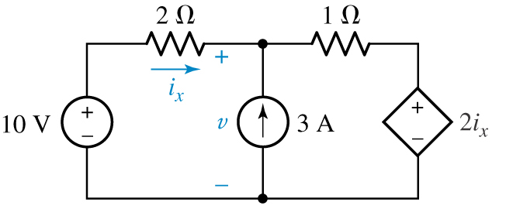
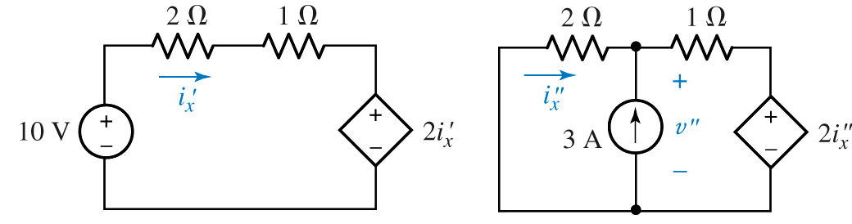
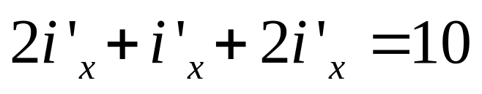
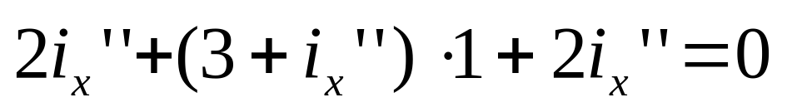
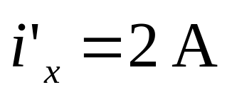
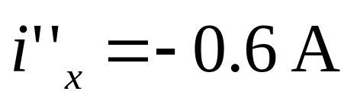
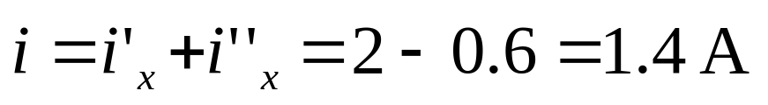
Linearity and Superposition
Example 2.4
Use superposition to find
the current i_{x}.

Slide 17
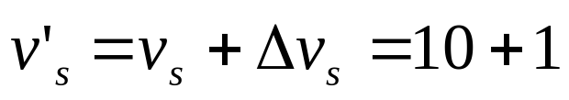

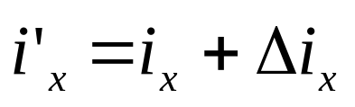
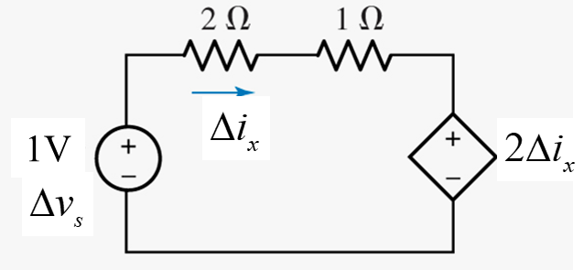
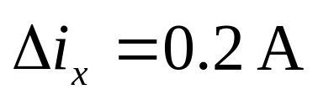
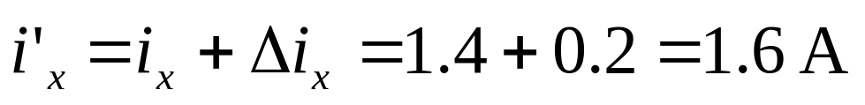
Linearity and Superposition
If 10V-voltage source changes
to 11V, what is the change of i_{x}?
Δi_{x} is caused only by Δv_{s}.
According to the previous result
Delta circuit
Small signal circuit

Slide 18
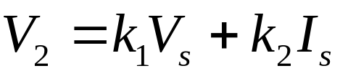
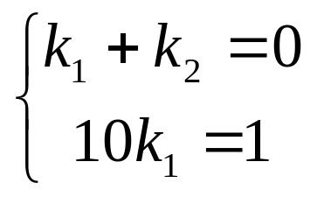
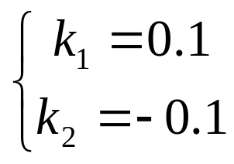
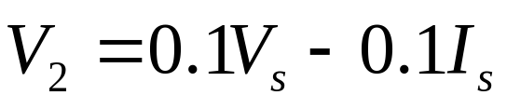
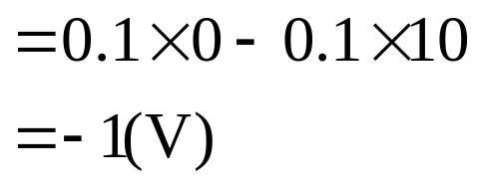
Example 2.6
The following test results are given for the circuit :
V
s
V₂=0 V when V_{S}=1 V, I_{S}=1 A ;
V₂=1 V when V_{S}=10 V, I_{S}=0 A .
Linear
Resistors
无源
V2
I
s
线性
Determine V₂ if V_{S}=0 V and I_{S}=10A.
Solution:
From the test results:

Slide 19
Homework
2.3, 2.4, 2.5, 2.7, 2.9, 2.10

Slide 20
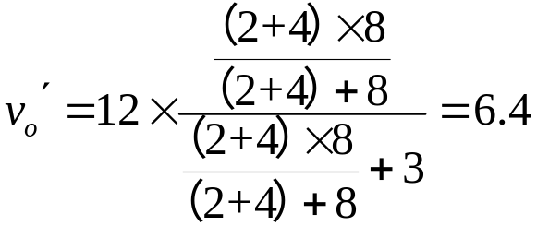
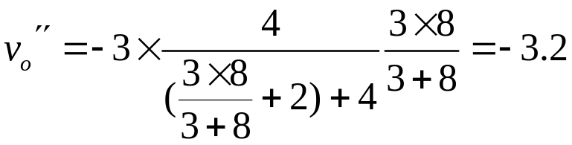

Review
Linearity and Superposition
Ex. Find v_{o} in the circuit.
2Ω
3Ω
2Ω
3Ω
4Ω
3A
v_{o}
+
-
12V
+
-
8Ω
4Ω
v_{o}′
12V
8Ω
2Ω
3Ω
4Ω
3A
v_{o}″
8Ω

Slide 21
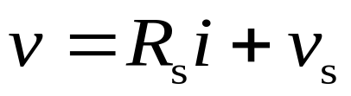
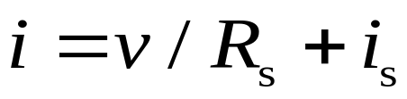
Equivalent Networks
2Ω
3Ω
2Ω
3Ω
+
-
a
+
-
4Ω
3A
v_{o}
12V
4Ω
3A
v
12V
b
8Ω
i
i
+
equivalent
+
v
N₁
v
N₂
-
?
-
When two networks have the same v-i characteristics, they are equivalent networks.

Slide 22
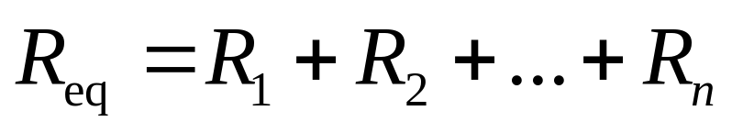
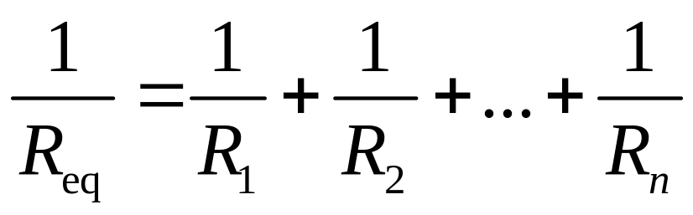
Equivalent Networks
Resistors in series , parallel , Δ or Y
i
i
+
+
v
N_{R}
v
R_{eq}
-
-
Eq. Resistors in series
Eq. Resistors in parallel

Slide 23
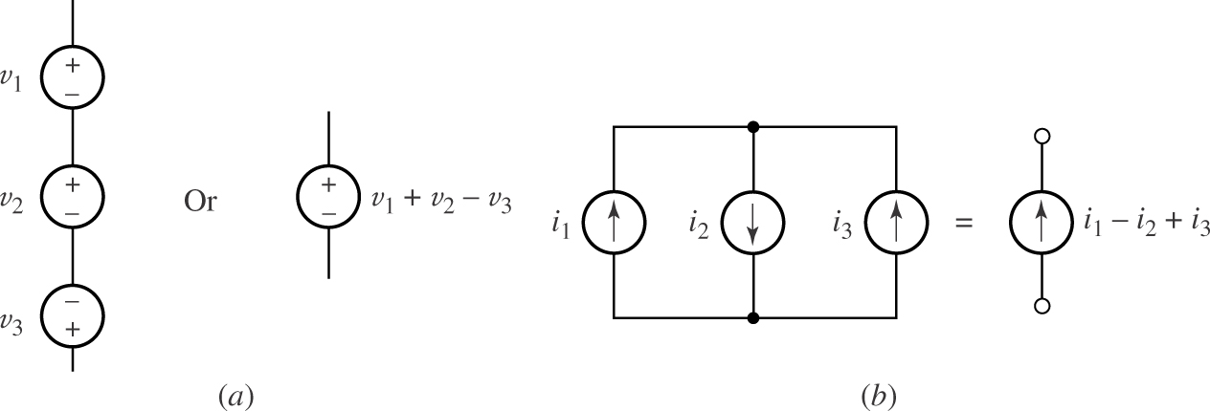
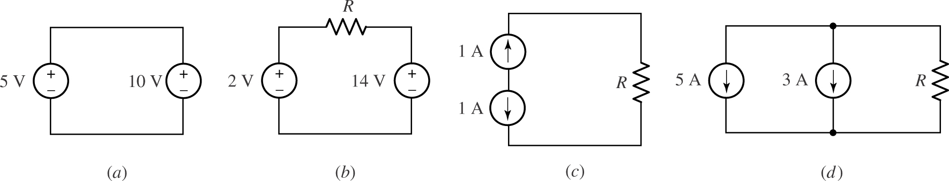
Equivalent Networks
Sources in Series and Parallel

Slide 24
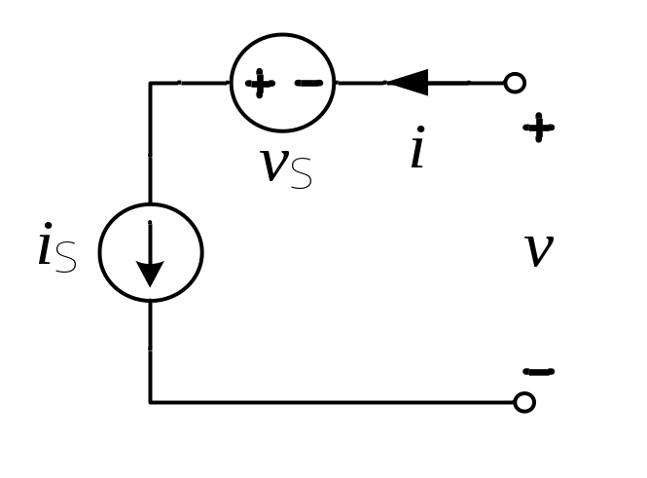

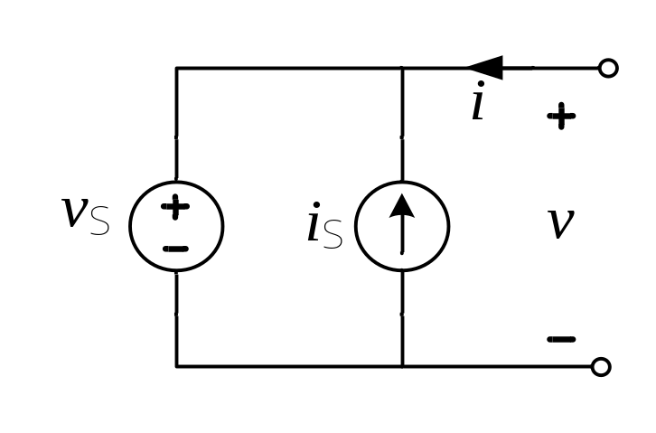

Equivalent Networks
Sources in Series and Parallel
i_{S}
v_{S}

Slide 25
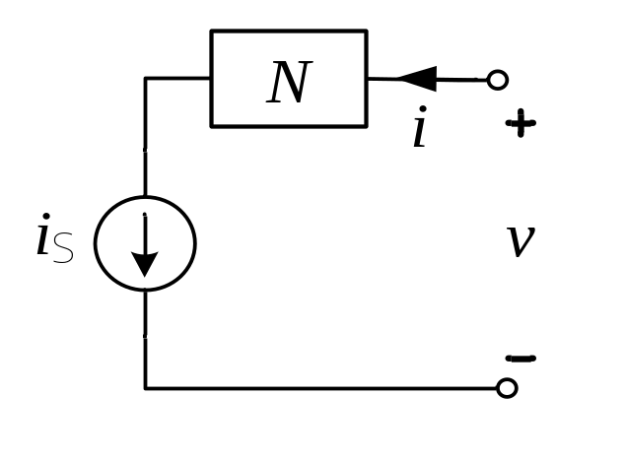
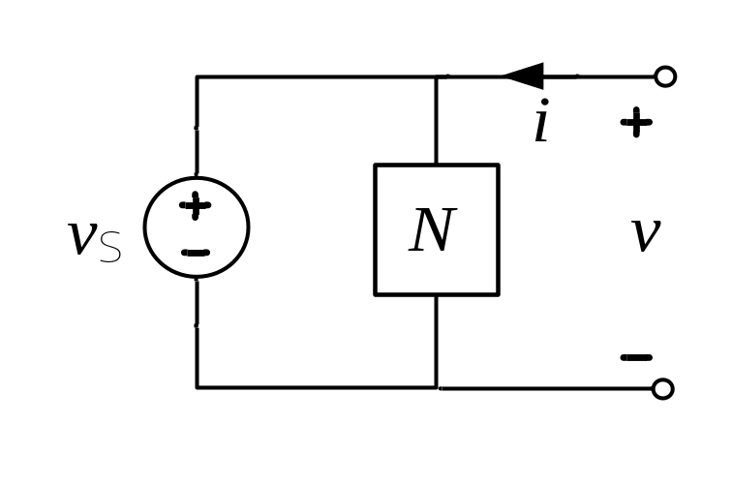
Sources in Series and Parallel with any network or element
Equivalent Networks
i_{S}
v_{S}

Slide 26


Source Transformation
Equivalent Sources
i
i
i_{s}= v_{s} / R
R_{S}
R_{p}
v
v
v_{S}
i_{S}
v_{s}= R i_{s}
(a)
(b)
Equivalent : same v - i characteristics
(a)
R_{s}= R_{p}
(b)
v_{s}= R i_{s}

Slide 27
Source Transformation
Notes
  Direction : Current arrow corresponds to “+” terminal of voltage source.
  If the associated resistor holds a controlling variable for a dependent source, be careful that variable shall not be lost.
i
i
R
v
R
v
v_{S}
i_{S}

Slide 28

Source Transformation
Example
2Ω
3Ω
4Ω
2Ω
3Ω
-
+
4Ω
3A
v_{o}
+
-
12V
12V
8Ω
v_{o}
4A
8Ω
3Ω
2A
6Ω
8Ω
v_{o}
4A
8Ω
v_{o}
2Ω
2A

Slide 29




Review
Equivalent Sources
i
i
i_{s}= v_{s} / R
R
v
R
v
v_{S}
i_{S}
v_{s}= R i_{s}
Exercise 1

Slide 30







Example
Calculate v by source transformation.
2V
5Ω
2
Ω
2
Ω
2Α
2Α

Slide 31




Example
Find v-i characteristics by simplifying circuit.
2
Ω
1Ω
v
v
1V
1
v
1Ω
1

Slide 32





Example
i - v/
1
i
2
Ω
1Ω
v
1
v
1V
v
1Ω
1
Method 1：find current through right loop, write VAR
i
v
o
1/6
v
-1/5

Slide 33

Example
2
Ω
1Ω
v
v
1V
1
v
1Ω
1
Method 2：dependent source is equivalent to 2-Ω resistor. Continue simplifying.
i
v
o
1/6
v
-1/5

Slide 34





5 minutes’ exercise
Simplify the circuit by equivalent transformation.

Slide 35

Please register
Learn the sections of 2.11& 2.16-2.21 to make up the lecture on 5th April.

Slide 36

Thevenin and Norton Equivalent Circuits
Backgrounds
  In practice a particular element (load) is variable while other part of circuit is fixed.
  Some part of a circuit is fixed and complex, but we are interested only in its external voltage-current relation.
  In above two cases a simplified equivalent circuit of the fixed part is needed.

Slide 37


Thevenin and Norton Equivalent Circuits
Thevenin theorem
A linear two-terminal circuit can be replaced by an equivalent circuit consisting of a voltage source V_{TH} in series with a resistor R_{TH}; where V_{TH} is the open-circuit voltage at the terminals and R_{TH} is the equivalent resistance at the terminals when the independent sources are turned off.
A
B
A
B

Slide 38




Thevenin and Norton Equivalent Circuits
Thevenin theorem illustrated
Thevenin equivalence
Where :

Slide 39




Thevenin and Norton Equivalent Circuits
Derivation of Thevenin theorem
Find v-i relation by superposition.
Internal independent sources act alone
External i acts alone
v = v_{oc} + v₁
Thevenin equivalent
circuit
v = v_{oc} + R₀ i

Slide 40




Thevenin and Norton Equivalent Circuits
Example
Use Thevenin theorem to find i when R_{L} =6, 16, 36 Ω.
Solution :
Disconnect load R_{L}, use superposition principle to find v_{oc}

Slide 41




Thevenin and Norton Equivalent Circuits
Example (cont.)
Turn off all independent sources in the left-side network, calculate R₀.
Draw the Thevenin equivalent circuit and connect load R_{L}.
R_{L} = 6, 16, 36 Ω :
i = 3, 1.5 , 0.75 A

Slide 42


Thevenin and Norton Equivalent Circuits
Norton theorem
A linear two-terminal circuit can be replaced by an equivalent circuit consisting of a current source I_{N} in parallel with a resistor R_{N} ; where I_{N} is the short-circuit current through terminals and R_{N} is the equivalent resistance at the terminals when the independent sources are turned off.

Slide 43


Thevenin and Norton Equivalent Circuits
Norton theorem illustrated

Slide 44






Thevenin and Norton Equivalent Circuits
Thevenin and Norton equivalent circuits

Slide 45
Thevenin and Norton Equivalent Circuits
Notes:
  Thevenin and Norton theorems apply to linear networks only.
  If a network contains dependent sources, their control variables should also be included in the same network.
  When a network contains a dependent source, R₀ may be negative.
  v_{OC} , i_{SC} may be zero; R₀ may be zero or infinity.

Slide 46




Thevenin and Norton Equivalent Circuits
Example 2.10
Determine the Thevenin and Norton equivalent of the circuit.
Method 1 : Find v_{oc}, i_{sc} and R₀ according to their definitions.
1: Find v_{oc}

Slide 47




Thevenin and Norton Equivalent Circuits
Example 2.10 (cont.)
2: Find i_{sc}
v_{x}=0 , dependent source is open circuit.
3: Determine R₀

Slide 48




Thevenin and Norton Equivalent Circuits
Example 2.11 (cont.)
3: Determine R₀ (another way)
By definition : kill the independent source
And transform the source:
Let v_{x} = 1

Slide 49






Thevenin and Norton Equivalent Circuits
Example 2.11 (cont.)
Method 2 : by source transformation

Slide 50



Thevenin and Norton Equivalent Circuits
Example 2.11 (cont.)
Method 3 : find terminal v-i relation
Apply an external source v_{x} ,
then we have
Notes:
y

Slide 51
Review
Thevenin and Norton Equivalent Circuits
Calculating steps:
1 . Find v_{oc} (i_{sc})
Set terminal a-b open (or short)circuit and find v_{oc}(or i_{sc}). All methods can be used to calculate v_{oc} (or i_{sc})including inspection method (KCL+KVL+VAR) , superposition theorem, equivalence transform, nodal analysis and mesh analysis.

Slide 52
2. Determine R₀
Method 1⎯By definition ⎯ set all independent source to zero.
Case 1: connection equivalence ⎯ fits for source free networks which consist of only resistors ⎯ connections in series, parallel, Δ or Y.
Case 2: external source applying v_{s}→ i → R₀= v_{s}/ i
( or i_{s}→v → R₀= v/ i_{s} )
⎯ fits for source free networks which contain dependent sources. Method 2 ⎯ By source transformation
R₀= v_{oc}/ i_{sc}

Slide 53



Maximum Power Transfer
The problem :
A linear circuit (or a practical source) is given. Adjust load resistor so it can receive the maximum power.
P
P
L
L
P
P
max
Maximum power happens when R_{L}= R₀
max
R
R
L
L
R
R
0
0

Slide 54
Maximum Power Transfer
Maximum power transfer theorem
Maximum power is transferred to the load when the load resistance equals the Thevenin resistance as seen from the load (R_{L}=R₀).
Note :
This will results in significant internal losses equal to or greater than the power delivered to the load.
The condition is that R₀ is fixed. Otherwise R_{TH}=0 or R_{N}>∞ will give maximum power transfer.

Slide 55






Example 2.13
Determine value of R_{L} required to get maximum power, and find the maximum power.
(1) Find the equivalent circuit seen from R_{L}
I
1
2
Ω
8Ω
I
a
20V
10Ω
R_{L}
(2) When R_{L}=Ro=5 (Ω) :
I
2
b
I
1
(3) The source efficiency is low !
2
Ω
8Ω
a
20V
10Ω
I
2
b

Slide 56
Homework
2.11, 2.13, 2.14, 2.17, 2.18, 2.19, 2.22

Slide 57
Equivalent analysis methods based on linearity property of circuits
  Linearity and Superposition
Source Transformation
Equivalent analysis methods based on Thevenin’s and Norton’s law
  Maximum Power Transfer
Systematic analysis methods
  Nodal and mesh analysis
Delta-Wye Conversion
Op amp

Slide 58
Systematic Analysis Methods
Nodal Analysis
  Nodal analysis without voltage souces
  Nodal analysis with voltage sources
  Nodal analysis with dependent sources
Mesh Analysis
  Mesh analysis without current sources
  Mesh analysis with current sources
  Mesh analysis with dependent sources
Computer-Aided Analysis

Slide 59
Nodal Analysis
Node voltage :
The voltage at a node with respect to a reference node.
I
G
1
1
a
I
G
b
G
I
c
2
2
3
3
I
4
Reference node :
Assumed to have zero potential, often called ground.
G
I
4
I
s1
d
s2
Example : v_{a} , v_{b} v_{c} are node voltages.
v_{d} = 0
Node voltages are sufficient to determine all voltages in the circuit. They are independent of each other.

Slide 60
Nodal Analysis
Nodal Analysis :
Use KCL and Ohm’s law to find node voltages.
I
G
1
1
a
I
G
b
G
I
c
2
2
3
3
I
4
G
I
4
I
s1
d
s2
Steps :
  Select a node as reference node. Assign voltages to remaining nodes.
  Apply KCL to each of the non-reference nodes. Use Ohm’s law to express resistive currents in terms of node voltages.
  Solve the resulting equation to get node voltages.

Slide 61




Nodal Analysis
KCL:
I
G
1
1
a
b
a
I
G
G
I
c
2
2
3
3
b
I
4
c
G
I
4
I
s1
d
s2
Ohm’s law :
For a circuit of n nodes, these n-1 equations are independent.

Slide 62


Nodal Analysis
Simplify :
I
G
Conductance matrix
1
1
a
I
G
b
G
I
c
2
2
3
3
I
4
G
I
4
I
s1
d
s2
Symmetrical about the diagonal.
Elements on the diagonal are positive.
Elements off diagonal are negative.
* No voltage source
No dependent source

Slide 63

Nodal Analysis
Node equation by inspection
m=n-1 : number of non-
reference nodes
(1) G_{kk} = Sum of the conductances connected to node k
(2) G_{kj} ( k ≠ j ) = Negative of the sum of conductances directly connecting node k and j .
(3) I_{skk} = Sum of all independent current sources directly connected to node k, with current entering the node treated as positive.

Slide 64





Nodal Analysis with Dependent Current Sources
Node 1:
2
3
1
Node 2:
Node 3:
Express control variables with node voltages
Write node equation as usual, treating dependent sources as independent sources.

Slide 65

Nodal Analysis with Voltage Sources
A voltage source :
relates two node voltages.
has a current not defined by itself.
Case 1 : A voltage source with one end at reference node. At the other end node voltage is known.
Case 2 : A voltage source is connected between two non-reference nodes.
Dealing with voltage sources in nodal analysis :
  Add a current variable for voltage source.
  Use super node method to avoid new current variable.
There is no way of knowing the current in advance.

Slide 66






Nodal Analysis with Voltage Sources
Method 1 :
Add a new current variable i. Treat this current as current source when writing node equations.
i
Node equations .
Constraint equation provided by the voltage source .

Slide 67



Nodal Analysis with Voltage Sources
Method 2 :
Use super node method .
A super (generalized) node is formed by inclosing a (dependent / independent) voltage source connected between two non-reference nodes.
Apply KCL to the super node :
Add constraint equations provided by the voltage source .
Notes:
1

Slide 68
Homework
2.23, 2.24

Slide 69

Recap Nodal Analysis
I
G
1
1
Node equation by inspection
a
I
G
b
G
I
c
2
2
3
3
I
4
Example for nodes a,b,c and reference node
G
4
I
s1
d
I
s2
• G_{aa} = Sum of the conductance connected to node a
• G_{ab}= Negative of the sum of conductances directly connecting node a and b ;
• G_{ac}= Negative of the sum of conductance directly connecting node a and c .
• I_{saa} = Sum of all current sources directly connected to node a, with current entering the node treated as positive.

Slide 70
Sources Treatment in Nodal Analysis (1)
Independent Sources
Select as
Node Voltage
Convert into
Current Source
Current Sources
Voltage Sources
At Right Side
of Equation,
Positive Enter in
(1)Assume Current,
Treat as Current Source
(2)Add a Constraint Equation
provided by Voltage Source

Slide 71
Sources Treatment in Nodal Analysis (2)
Dependent Sources
Treat as Independent Sources
List Nodal Equations by Inspection
Is controller Node Voltage?
Yes
Solve Equations
No
Add a Constrain Equation
Provided by
Dependent Source

Slide 72
Mesh Analysis
Planar circuit :
Can be redrawn in a plane with no branches crossing one another.
Non-planar circuit : otherwise.
2
a
b
Planar :
4
a
1
c
3
a
d
f
e
g
h
2
5
b
4
1
c
3
Non-planar
d
e
g
f
h
Mesh :
A loop which does not contain any other loop within it.

Slide 73

Mesh Current :
A current that flows only around the perimeter of a mesh.
R
R
1
2
V
I
R
I
V
s1
1
4
2
s2
R
5
R
6
Number of Meshes
branches : b Nodes: n
Meshes: m = b-(n-1)
I
3
R
V
3
s3
Sufficient to express all branch currents.
Independent of each other .
Mesh Analysis :
Use KVL and Ohm’s law to find mesh currents.
Mesh equations ⎯ KVL→

Slide 74

R
1
R
2
Mesh equations
V
I
R
I
V
s1
1
4
2
s2
R
5
R
6
Assign mesh currents to all meshes
— Clockwise or counterclockwise
I
3
R
V
3
s3

Slide 75

Mesh Analysis
R
1
R
2
Mesh Analysis by Inspection
V
I
R
I
V
s1
1
4
2
s2
R
5
R
6
I
3
R
V
3
s3
(1) R_{kk} : Sum of the resistances in mesh k.
(2) R_{kj} ( k≠ j ) : (Negative of ) the sum of the resistances in
common with meshes k and j .
(3) V_{skk} : Sum of voltage rises around mesh k.
(4) R_{kj} =R_{jk} when no dependent source exists in the circuit.

Slide 76





Mesh Analysis
Example
i₁
i₂
  Step 1 : Assign mesh currents i₁ and i₂ ⎯ Clockwise .
i₃
  Step 2 : Write mesh equations by inspection
  Step 3 : Solve equations, obtain mesh currents and other variables

Slide 77










Mesh Analysis with Dependent Source
Example : Find i₀ in the circuit.
Treat the dependent source as an independent source, then express the control variable in terms of mesh currents.
(1)
(2)
(3)
R_{kj}≠ R_{jk}

Slide 78

Mesh Analysis with Current Sources
Case 1 :
A current source exists only in one mesh : the mesh current is known.
2.5A
Case 2 :
A current source exists in two meshes, the voltage across the current source is unknown .
Method 1: Assume a voltage across the current source, treat it as a voltage source and then add a constraint equation provided by current source.
Method 2 : Use super mesh method to avoid the voltage variable.
Notes:
Power means energy transfer is happening, charge is actually moving, so power has something to do with current.
While voltage is a potential energy, when it changes accompanied by current flowing, power is generated.

Slide 79






Mesh Analysis with Current Sources
Method 1: Assume a voltage across the current source. Add a constraint equation provided by the current source.
2.5A
+
_
v
Known mesh current
v as known voltage
Constraint equation

Slide 80





Mesh Analysis with Current Sources
Method 2: Use super mesh. Remove the current source and any element connected in series with it to form a super mesh.
Mesh 1-3:
Mesh 2:
Current source constraint

Slide 81








Mesh Analysis with Dependent Sources
Example
Assume a voltage v across dependent source.

Slide 82
Homework
2.29, 2.32, 2.33

Slide 83


Delta-Wye Conversion
Three-terminal equivalent networks
1
1
i
i
1
1
v
R
v
v
12
1
v
31
12
31
R
R
R
R
2
3
12
31
i
2
i
i
i
R
3
2
v
3
3
2
23
23
v
3
2
23
(a)
(b)

Slide 84



Delta-Wye Conversion
T or Y type
π or Δ type
i₁
i₂
i₁
i₂
Two independent ports require two v-i relations
The equivalency of the two networks requires the identical v-i relation . Therefore the coefficients A, B, C, D for the two network should be the same.

Slide 85






R₁₂
1
2
R₁
R₂
R₁₃
R₃
R₂₃
3
1
2
3
（1）
Concluded to be:
Delta 3, Wye 1
（2）

Slide 86






Example
Find i .
0

Slide 87

Applications
Practical Voltage Source modeling
These practical voltage source and current model become ideal when Rs → 0 and Rp →∞

Slide 88

Application
Q13: How to measure the internal resistance of the source?

Slide 89


Wheatstone bridge
measure an unknown resistance
Fig. 2.46

Slide 90
Wheatstone bridge
How do we find the current through the galvanometer
when the Wheatstone bridge is unbalanced?
Homework:
When v=220V, R1=3000 Ω, R2=1K Ω, R3=400 Ω, Rx=600 Ω, the Galvanometer has an internal resistance of 40Ω, what is the current across the Galvanometer?
Fig. 2.46

Slide 91
The Operational Amplifier
Op Amp and Ideal Op Amp Model
Typical Op Amp Circuits
Analysis of Op Amp circuits

Slide 92

Op Amp and Ideal Op Amp Model
Op Amp :
Operational Amplifier
Practical Op Amp :
Highly integrated circuit, used to realize amplifier, mathematical operations.
  Multi-terminal devices,
  Need power supply,
  Usually have two inputs and an output
V+
-IN
OUT
+IN
V-

Slide 93
Op Amp and Ideal Op Amp Model
Op Amp Model :
V_{S+}
V_{S-}
a: v- : inverting input
b: v+ : noninverting input
c: v₀ : output
v
a
i
-
-
c
v
v
+
b
i
0
+
d
Ideal Op Amp Rules
i₋
v
v
i₋= i₊= 0 ,
v_{d} = v₊ – v₋ = 0
-
0
v
+
i₊
No current flows into either input terminal.
There is no voltage difference between the two inputs.

Slide 94






Typical Op Amp Circuits
Inverting amplifier
The goal of analysis of Op Amp is to obtain output and input relation.
v₊ = v₋ = 0
Virtual ground
i – = 0 KCL:
Or KVL:

Slide 95





Typical Op Amp Circuits
Noninverting amplifier
Node equation at v-
Virtual short-circuited

Slide 96

Typical Op Amp Circuits
Voltage follower
v
v_{o}= v₋=v₊= v_{i}
-
i
L
v
v
o
As buffer, isolator
+
R
v
L
i
R₁
v
-
i
L
v
v
o
v
R₂
+
R
i
L
v₀ is independent of R_{L}.

Slide 97
Analysis of Op Amp circuits
Analysis of Op Amp :
Find output - input relation.
Find input resistance.
Method of Analysis :
  Use nodal analysis or KCL equations.
  Start from input nodes .
  The Op amp output current is unknown, avoid the calculation of this current.

Slide 98



Analysis of Op Amp circuits
Example
Find v₀ in terms of v₁ and v₂.
Treat v₁ , v₂ and v₀ as known voltages. Write node equations at unknown voltage nodes.

Slide 99

Analysis of Op Amp circuits
Example
Find v_{out} in terms of v₁ , v₂ and v₃ .
Basic summing amplifier circuit with three inputs.
Try to find equivalent circuit of the left-side of v_{a} node.

Slide 100
Homework
2.15, 2.34, 2.36, 2.38

