Slide 1
The Operational Amplifier
Op Amp and Ideal Op Amp Model
Typical Op Amp Circuits
Analysis of Op Amp circuits

Slide 2
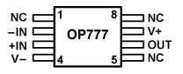
Op Amp and Ideal Op Amp Model
Op Amp :
Operational Amplifier
Practical Op Amp :
Highly integrated circuit, used to realize amplifier, mathematical operations.
Multi-terminal devices,
Need power supply,
Usually have two inputs and an output
V+
-IN
OUT
+IN
V-

Slide 3
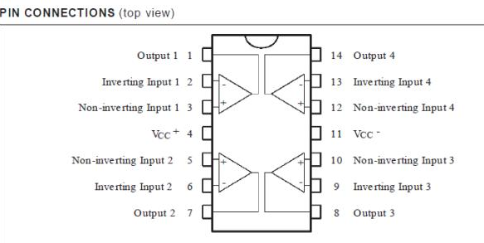
LM324 Pin Connections (Top View)

Slide 4
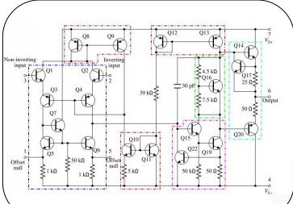
Circuit inside an op amp

Slide 5
Op Amp and Ideal Op Amp Model
Op Amp Model :
V_{S+}
V_{S-}
a: v- : inverting input
b: v+ : noninverting input
c: v_{o} : output
v
a
i
-
-
c
v
v
+
i
o
b
+
d
Ideal Op Amp Rules
i₋
v
v
i₋= i₊= 0 , v_{d} = v₊ – v₋ = 0
-
o
v
+
i₊
No current flows into either input terminal.
There is no voltage difference between the two inputs.

Slide 6
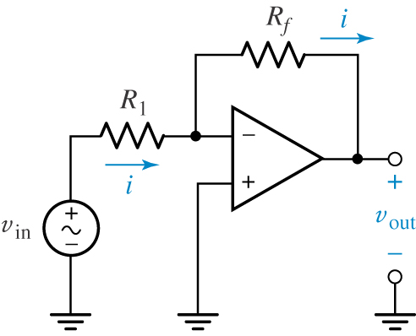
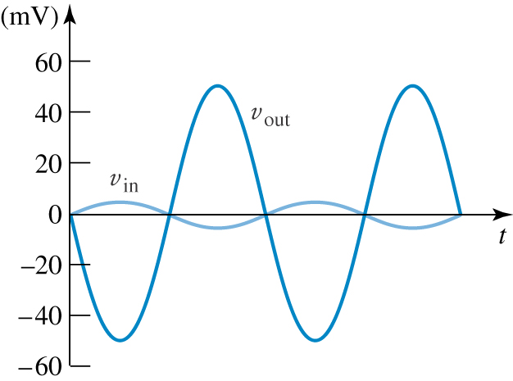
Typical Op Amp Circuits
Inverting amplifier
The goal of analysis of Op Amp is to obtain output and input relation.
v₊ = v₋ = 0
Virtual ground
i – = 0 KCL:

Slide 7
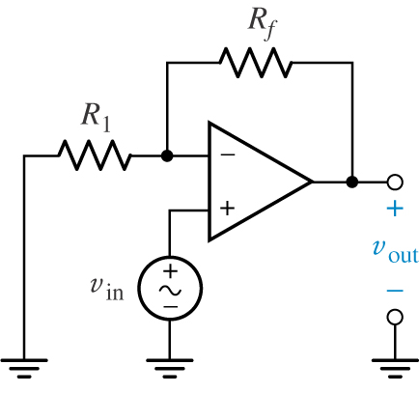
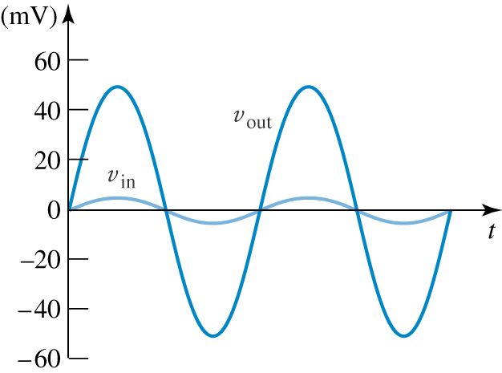
Typical Op Amp Circuits
Noninverting amplifier
Node equation at v-
Virtual short-circuited

Slide 8
Typical Op Amp Circuits
Voltage follower
v
v_{o}= v₋=v₊= v_{i}
-
i
L
v
v
o
As buffer, isolator
+
+
R
v
L
i
-
R₁
v
-
i
L
v
v
o
v
+
R₂
+
R
i
-
L
v_{o} is independent of R_{L}.

Slide 9
Analysis of Op Amp circuits
Analysis of Op Amp :
Find output - input relation.
Find input resistance.
Method of Analysis :
Use nodal analysis or KCL equations.
Start from input nodes .
The Op amp output current is unknown, avoid the calculation of this current.

Slide 10
Analysis of Op Amp circuits
Example
Find v₀ in terms of v₁ and v₂.
Treat v₁ , v₂ and v₀ as known voltages. Write node equations at unknown voltage nodes.

Slide 11
Homework
2.15, 2.34, 2.36, 2.38

Slide 12
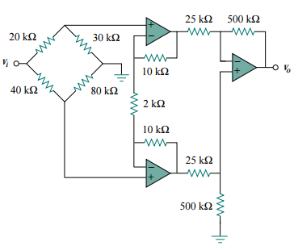

Slide 13
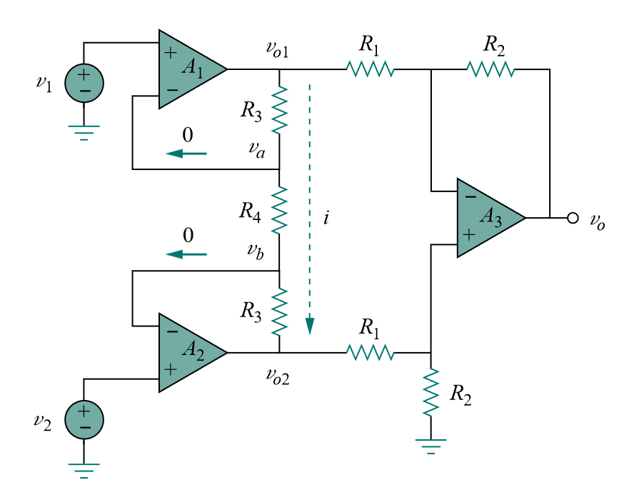
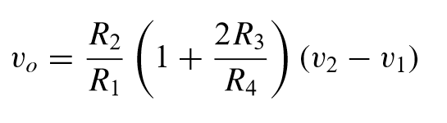
an amplifier of low level signals used in process control or measurement applications and commercially available in single-package units.

Slide 14
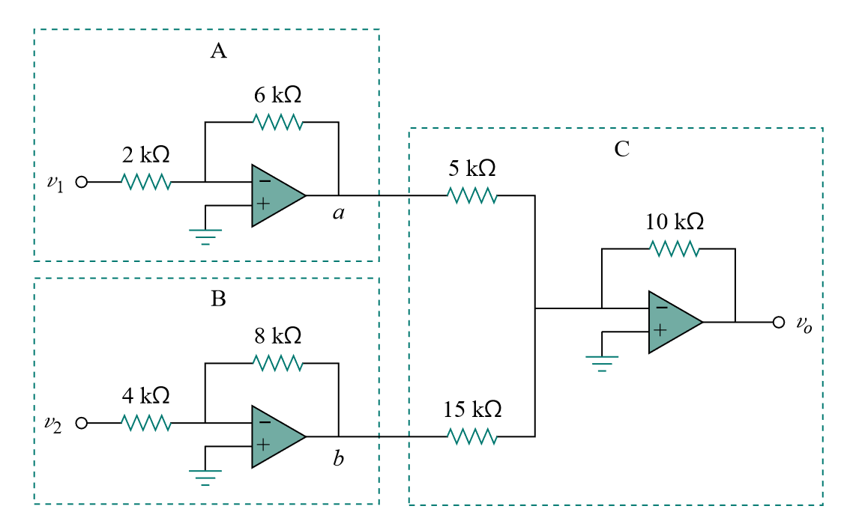

Slide 15
