Slide 1
Effectiveness of Portfolio Rebalancing by Empirical and Whole Scenario Analysis
Shan Tao, Xiang Li, Zhibo Wang
(in alphabetical order)

Slide 2
Contents
Item 1
Item 2
Item 3
Introduction
Objective
Methodologies
Approaches
Results

Slide 3
Overview
Portfolio management strategies
Buy-and-hold
Rebalancing:
regular rebalancing
continual rebalancing
Which one is more effective?

Slide 4
Supporters
Wise: With two-asset portfolios, the rebalancing is better than the passive strategy with more than 50% probability.
Gabay: With increasing time and volatility, the constant rebalancing strategy can capture an excess growth against the 'buy and hold' strategy.
Bouchey: Rebalancing is beneficial to managing risk and enhancing returns in the long run.

Slide 5
Challengers
Edesess : Rebalancing has no benefit on either increasing returns nor reducing risk.
Kitces : The value of rebalancing is dependent on the similarity of the returns among the assets in the portfolio.
Cuthbertson : The obvious benefits of rebalancing over an infinite horizon cannot guarantee that those benefits are realized over a finite horizon.

Slide 6
Project objective:
To study the effectiveness of rebalancing strategies and their efficiency using qualitative
Base our research in both simulated scenarios and actual financial market.
Consider both advantages and disadvantages of the strategies under different investment environments.
Propose another approach of rebalancing.
35
25
22

Slide 7
Methodology
rends
We split the re-balance strategy into three sub-categories, monthly-rebalance, daily-rebalance, and continuous-rebalance.
We then use Monte-Carlo simulation to generate both risk and risk-free assets under different presumed scenarios and get the distribution of the value of the portfolios under both buy-and-hold and rebalancing strategies.

Slide 8



Methodology
rends
Risk asset:
Risk-free asset:
: the total time horizon T over the number of intervals N.
: the value of the risk asset at time t
: the annual return of risk asset, i.e.
: the volatility of the return of risk asset, i.e.
: the random process which follows standard normal distribution

Slide 9
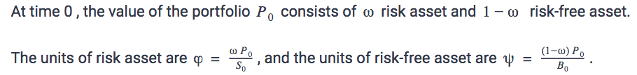
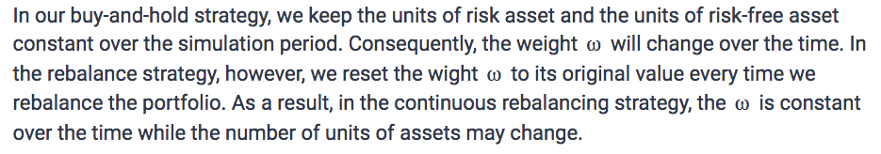
Methodology
rends

Slide 10
Methodology
rends
Parameters | Values
r | -0.05, -0.02, 0, 0.02, 0.05, 0.10, 0.15
σ | 0, 0.05, 0.1, 0.15, 0.2, 0.25, 0.3, 0.35, 0.4, 0.45, 0.5
μ | -0.5, -0.45, -0.4, -0.35, -0.3, -0.25, -0.2, -0.15, -0.1, -0.05, 0, 0.05, 0.1, 0.15, 0.2, 0.25, 0.3, 0.35, 0.4, 0.45, 0.5
dt | 1/2520
S0 | 100
B0 | 100
Cash | 1000000
ω | 0.5
We simulated 7*11*21=1617 scenarios and for each scenario we simulated 600 results.

Slide 11
Methodology
rends
Based on the results, we analyzed relationships between {μ, σ, r} and {mean, standard deviation, sharpe ratio, skewness, kurtosis} and draw plots respectively.
To clarify, here, mean represents the mean of the portfolio value at time T and so does standard deviation.

Slide 12


Methodology
rends
Hypothesis Test
1. For normality: Shapiro wilk test
2. For difference between mean: t-test
3. For difference between standard deviation: F-test

Slide 13
Methodology
rends
From Bloomberg terminal, we get daily market data of assets including market index, stock, foreign exchange and commodity over the past twenty years.
For every single asset, we estimate its μ and σ using the formulas we mentioned in the last section and compare the performance of the portfolio with real asset and that of the simulated one with close μ and σ.

Slide 14


Methodology
rends
: the units of risk assets at time t-1
is an indicator function:

Slide 15
Results
Results From Simulation
Hypothesis Test
Visualization
Results From Historical Analysis
Results From New Approach
Item 1

Slide 16
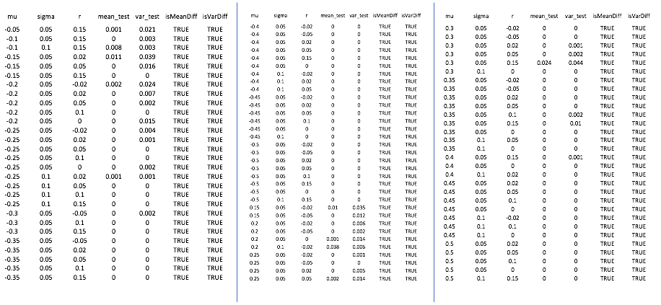
35
25
22

Slide 17
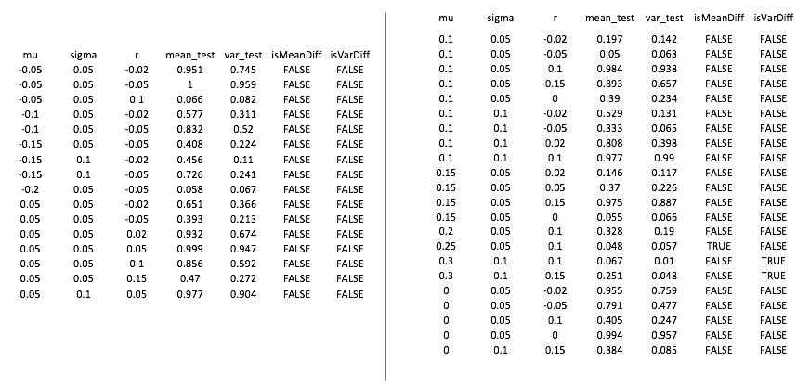
35
25
22

Slide 18
Results From Simulation
rends
 | m | s | r
Mean | √
Standard Deviation | √
Sharpe | √ |  | √
Skewness |  | √
Kurtosis |  | √

Slide 19
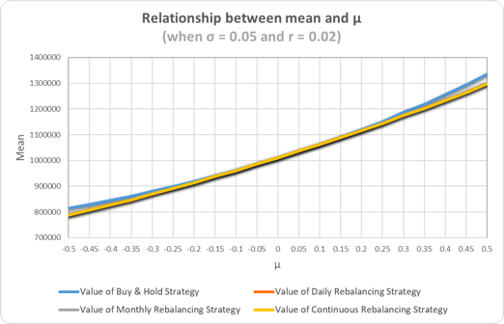
Results From Simulation
rends
Mean v.s. μ

Slide 20
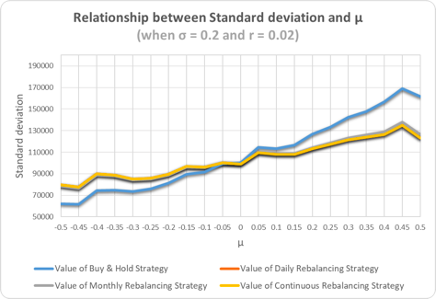
Results From Simulation
rends
Standard Deviation v.s. μ

Slide 21
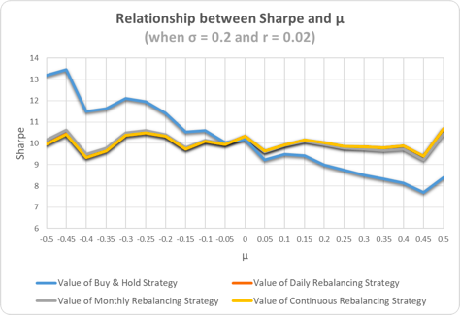
Results From Simulation
rends
Sharpe v.s. μ

Slide 22
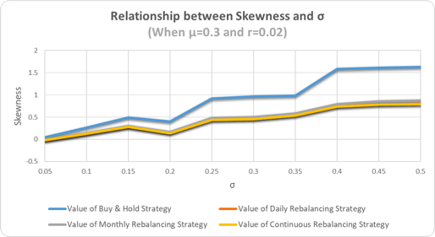
Results From Simulation
rends
Skewness v.s. σ

Slide 23
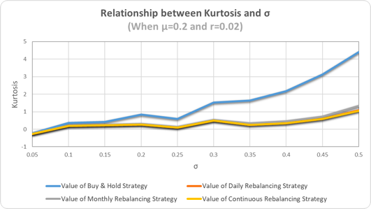
Results From Simulation
rends
Kurtosis v.s. σ

Slide 24
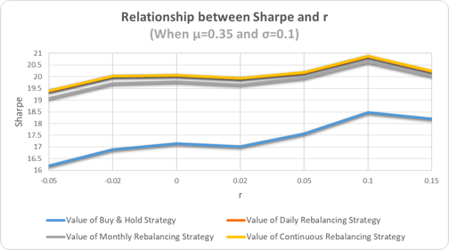
Results Of Simulation
rends
Sharpe v.s. r

Slide 25
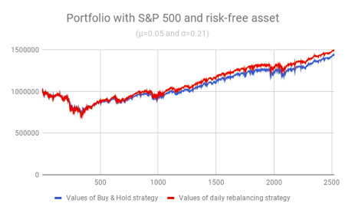
Results From Historical Analysis
rends
Portfolio with S&P 500 with risk-free asset

Slide 26
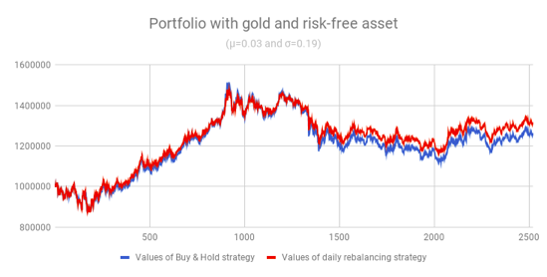
Results From Historical Analysis
rends
Portfolio with gold with risk-free asset

Slide 27
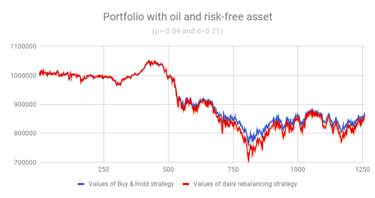
Results From Historical Analysis
rends
Portfolio with oil with risk-free asset

Slide 28
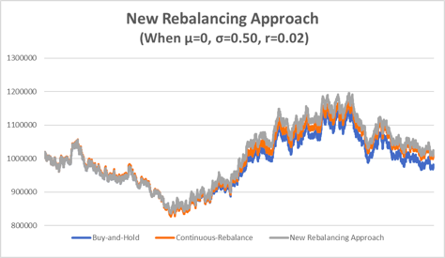
Results From New Approach
rends

Slide 29
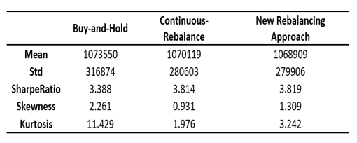
Results From New Approach
rends

Slide 30
Thanks!

