Slide 1
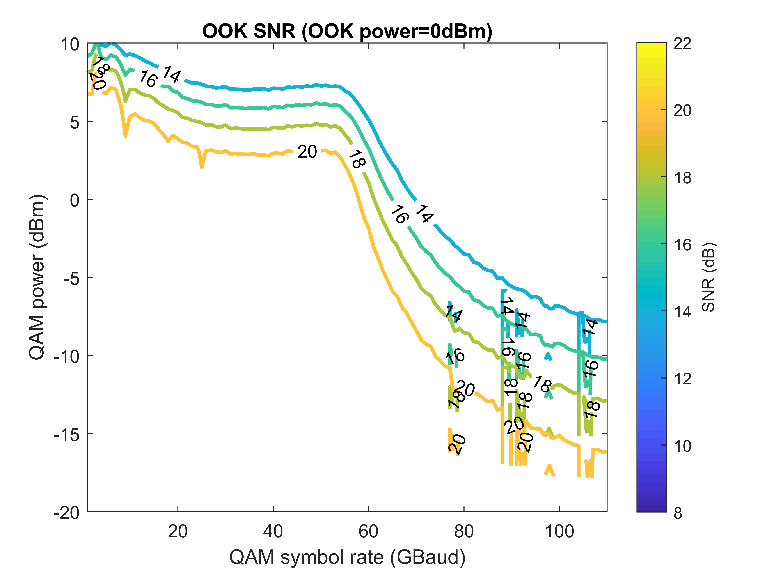
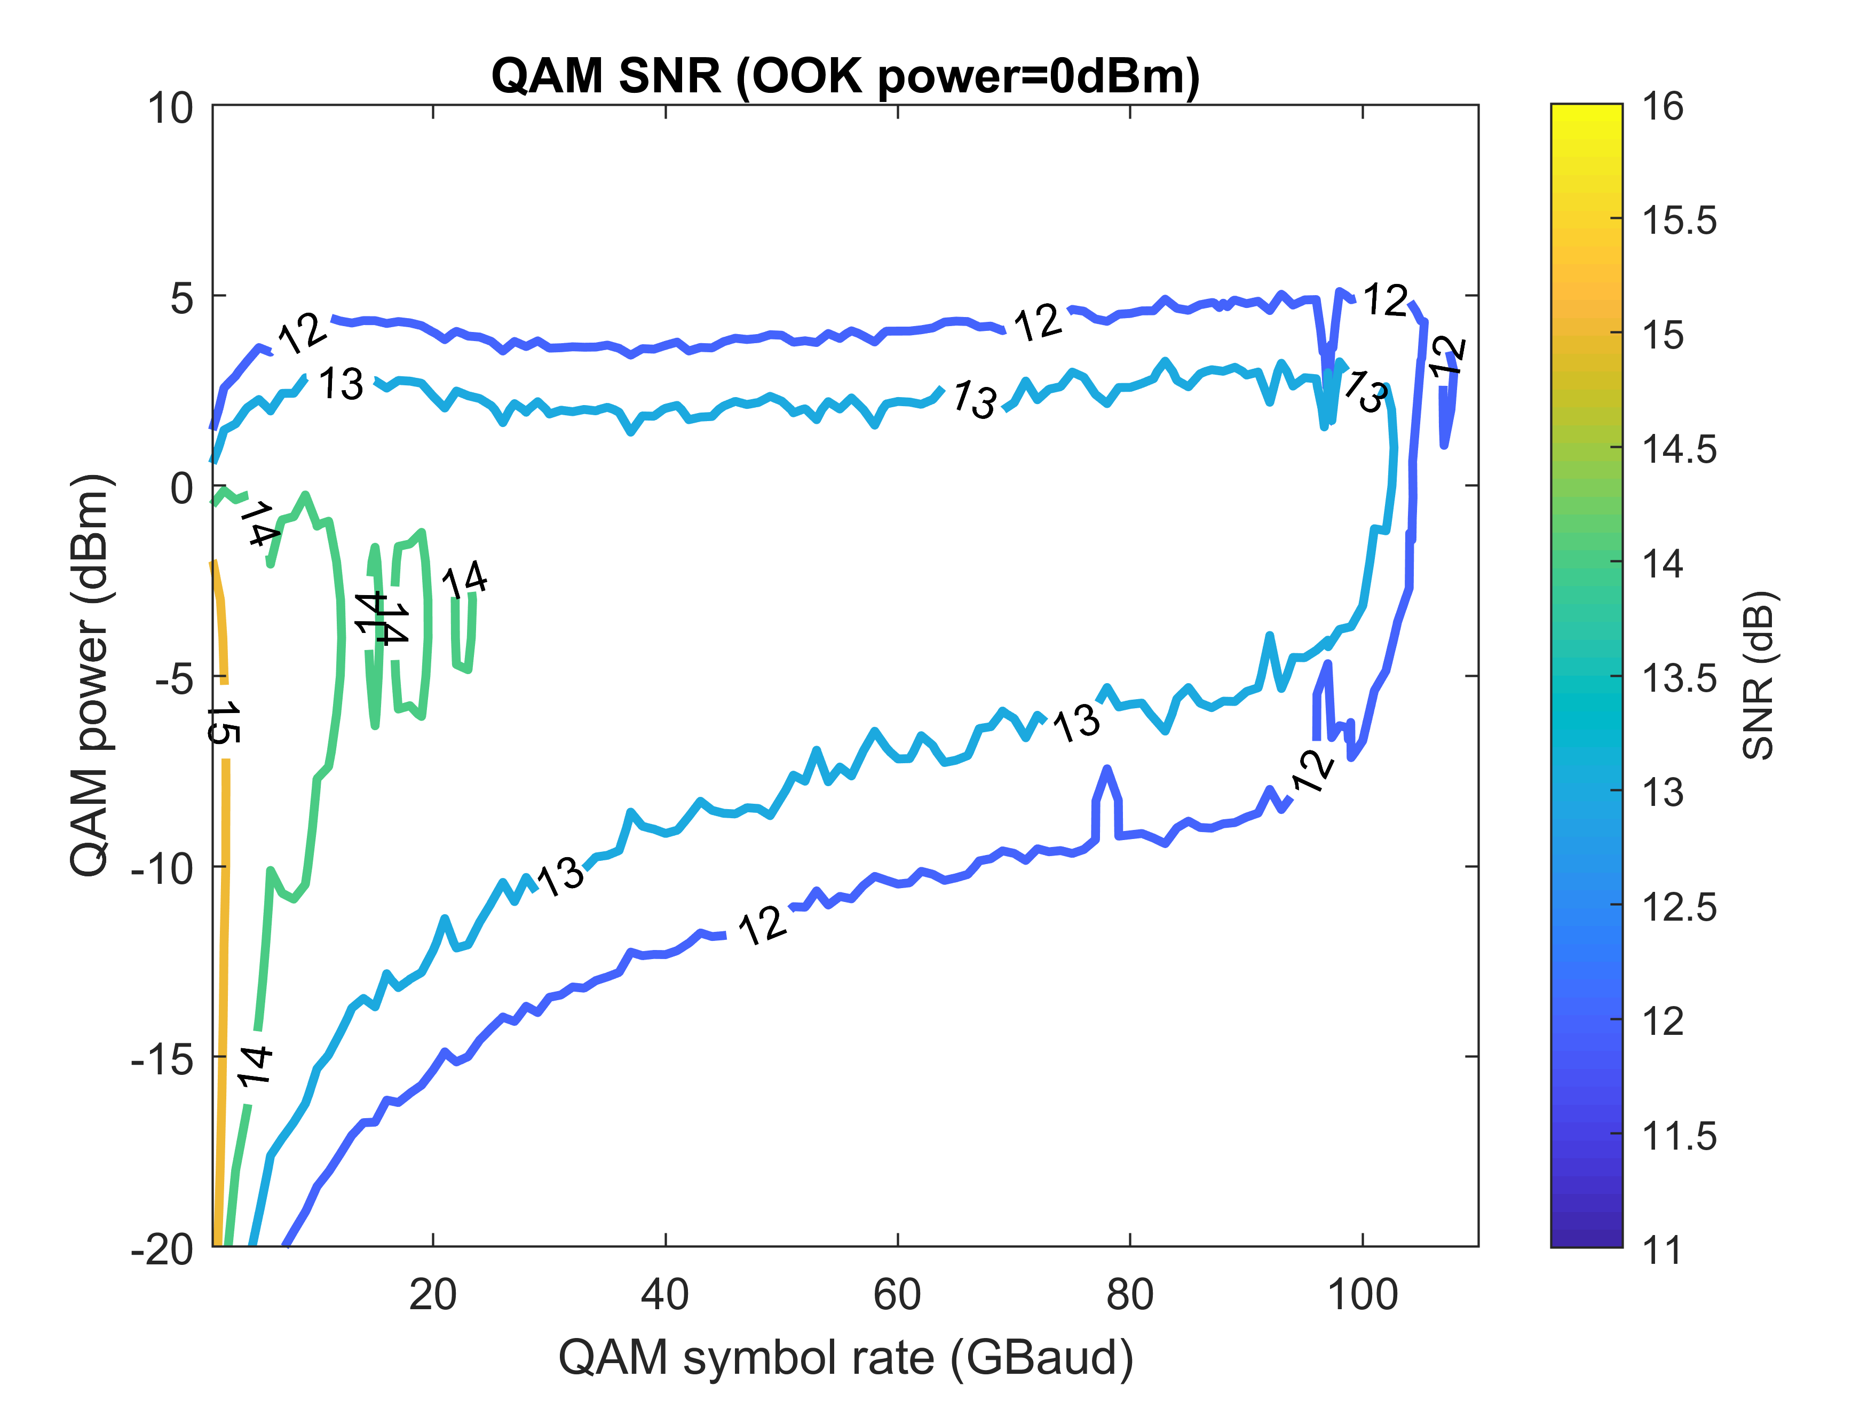
Interleaving OOK and 16QAM – Single Pol.
3OOKs: OOK+QAM+OOK+QAM+OOK, 100 GHz channel spacing

Slide 2
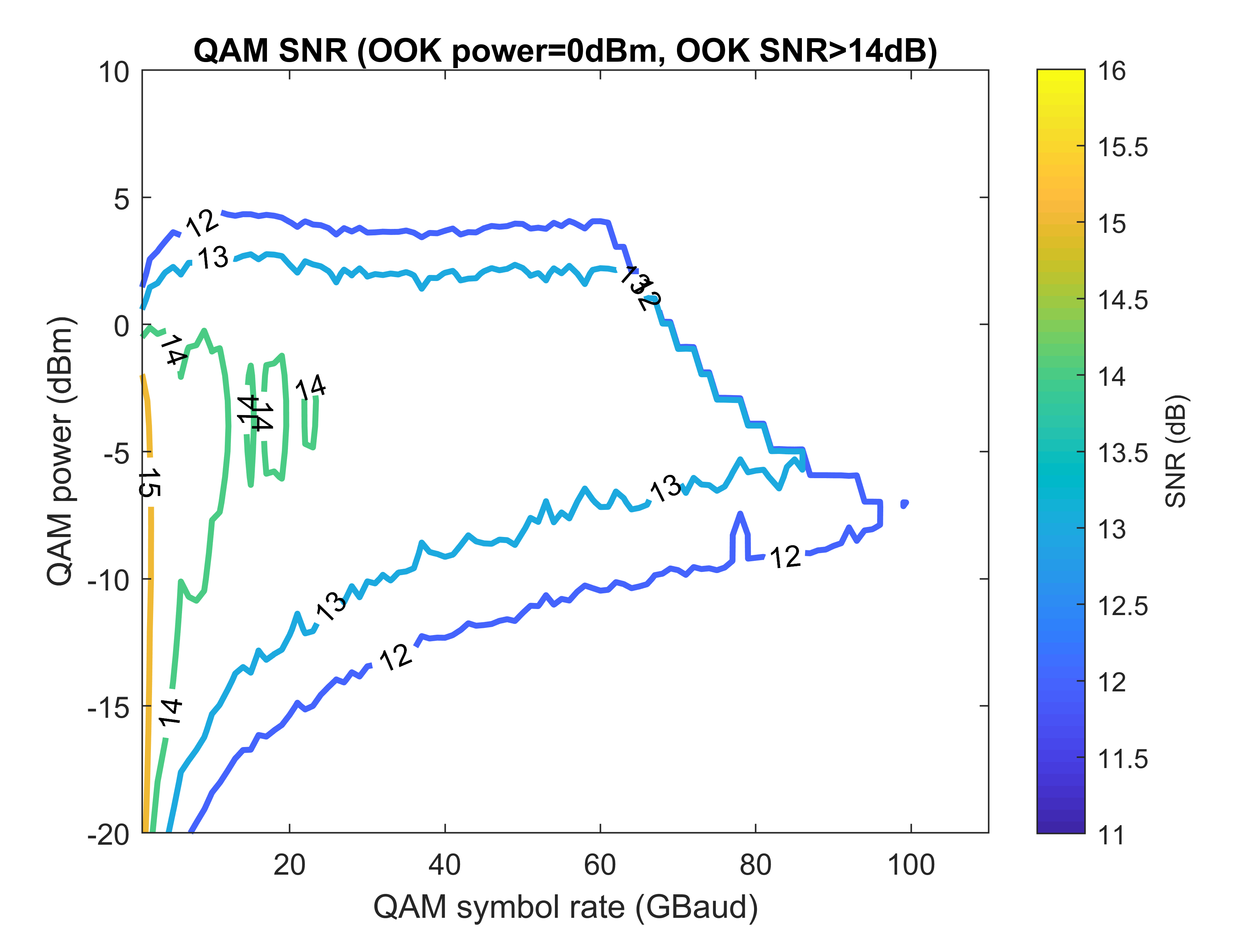
Interleaving OOK and 16QAM – Single Pol.
3OOKs: OOK+QAM+OOK+QAM+OOK, 100 GHz channel spacing

