Slide 1
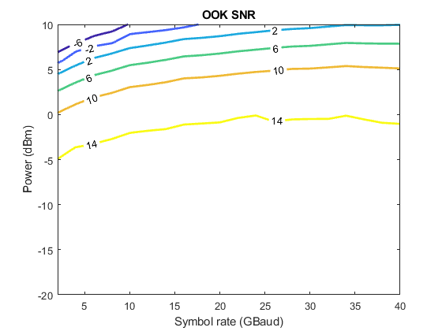
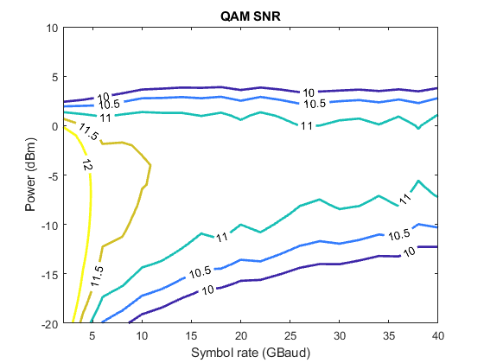
Interleaving OOK and 16QAM – Single Pol.
3OOKs: OOK+QAM+OOK+QAM+OOK, 50 GHz channel spacing

Slide 2
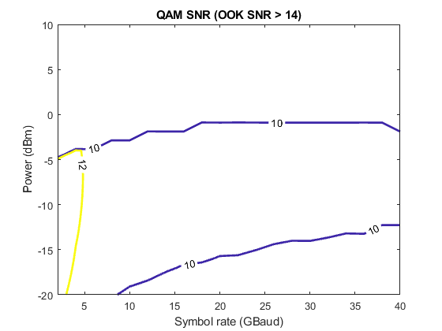
Interleaving OOK and 16QAM – Single Pol.
3OOKs: OOK+QAM+OOK+QAM+OOK, 50 GHz channel spacing

Slide 3
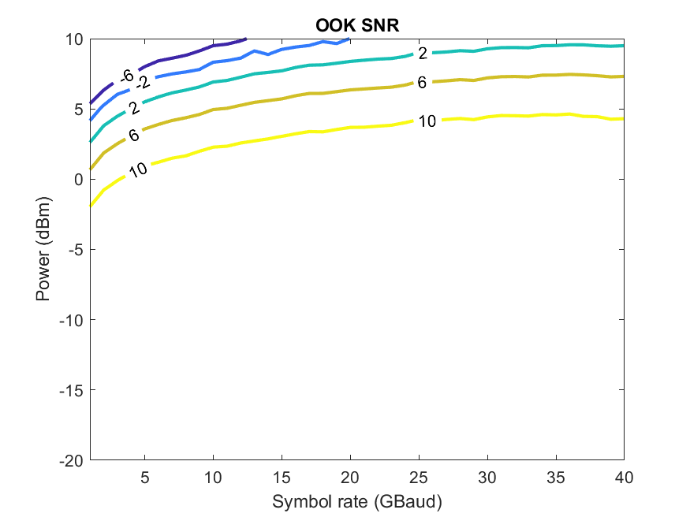
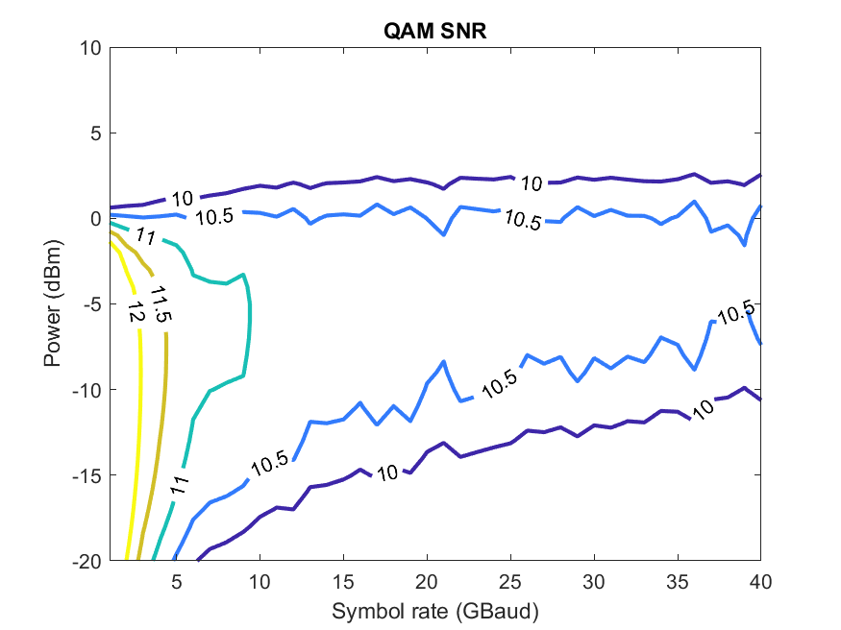
Interleaving OOK and 16QAM – Single Pol.
4OOKs: 50 GHz channel spacing

