Slide 1
Simulations
Single Polorization

Slide 2
Since Last meeting
Corrected modulation formats
Implement various signal quality measurements
EVM
SER
Simulations of SNR as a function OOK power, QAM power, and channel spacing

Slide 3
Ongoing Simulation
SNR as a function of
OOK and QAM power: [-10, 6] dBm
Channel spacing: [30, 200] GHz
Objectives
Relation between physical layer parameters and SNRs
Find the range of parameters that allows both channels to work properly

Slide 4
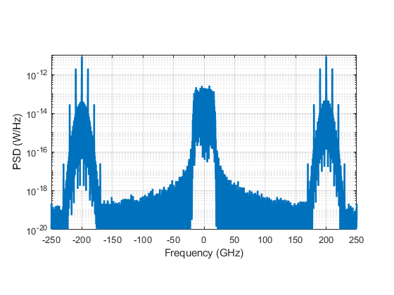
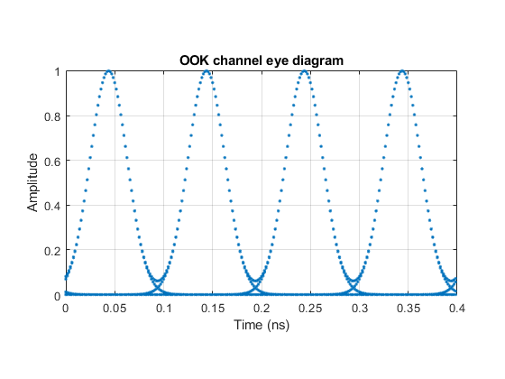
Ongoing Simulation
OOK+16QAM+OOK

Slide 5
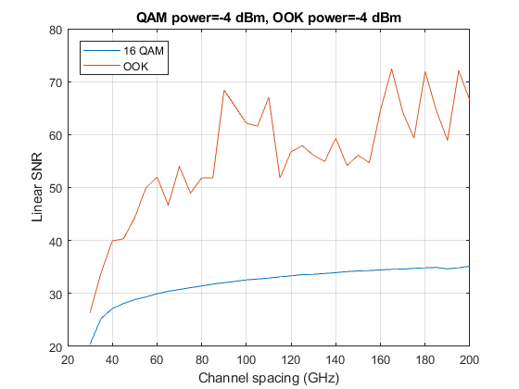
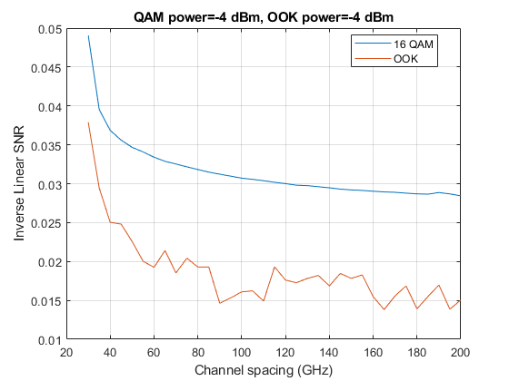
Ongoing Simulation
OOK channel has less number of symbols, so higher noise?
OOK curve will be less noisy in 1/SNR

Slide 6
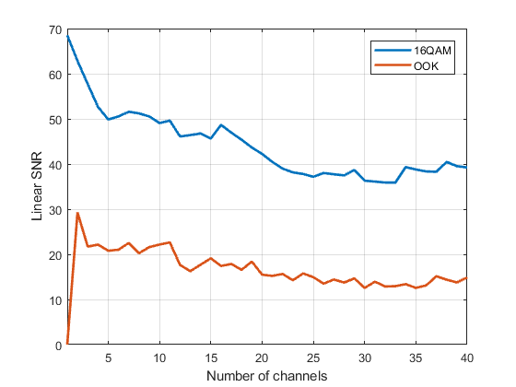
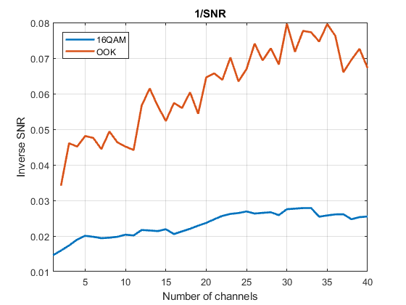
SNR vs #Channels
OOK power = -6 dBm, QAM power = 0 dBm
For both OOK and 16QAM: noise @ 2 OOK channels<=noise @ 40 OOK channels
Again, noisy OOK curves due to insufficient number of symbols

Slide 7
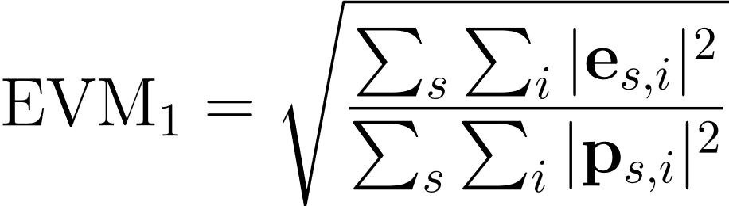
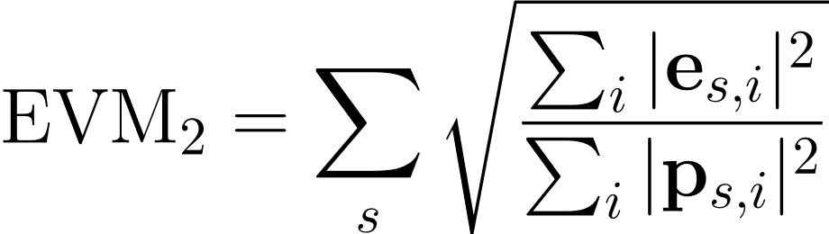
Signal Quality Measurements
or
s: constellation point
i: symbol
e: error vector
p: reference vector
The corresponding ”SNR” is the inverse of the EVM.
But EVM can reflect the properties of noise better.
The reference vector can be both blind or accurate.
And other measurements, e.g., Q factor, SER, BER, etc.
Ultimately, we should also consider the distribution of error vectors.

