Slide 1
Preliminary Results
Single Polorization

Slide 2
Simulation Setup
(82km SSMF+80km DCF) × 4 + 82km SSMF + 90km DCF
SSMF: D=17/ps/nm/km,S=0.06ps/nm²/km,α=0.2dB/km,γ=1.4(Wkm)⁻¹
DCF: FBG that compensates for S and D in equivalent length SSMF
Channels: (10 Gbps OOK)×5 + (120 Gbps 16 QAM) + (10 Gbps OOK)×5
Matched filter: root-square RRC with 0.2 roll-off for all channels
Channel spacing: 50 GHz
EDFA: NF=5.56 dB (n_{sp}=1.8)

Slide 3
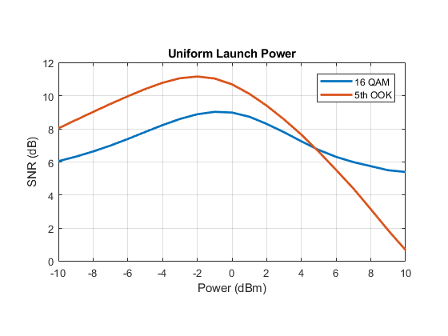
Uniform Power
SNR (16QAM and 5th OOK) vs power

Slide 4
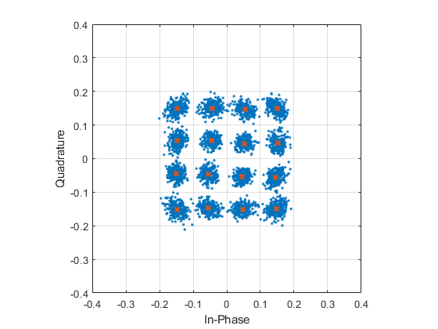
Constellation Diagram
16 QAM
Uniform power @-1dBm

Slide 5
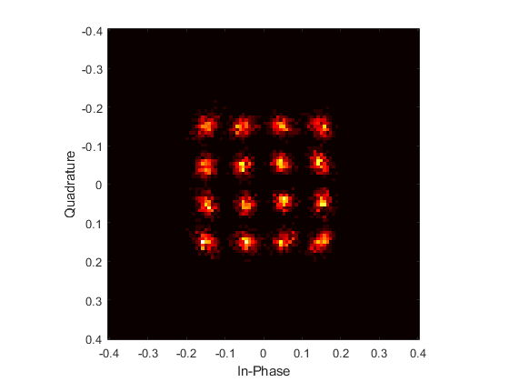
Constellation Diagram
16 QAM
Uniform power @-1dBm

Slide 6
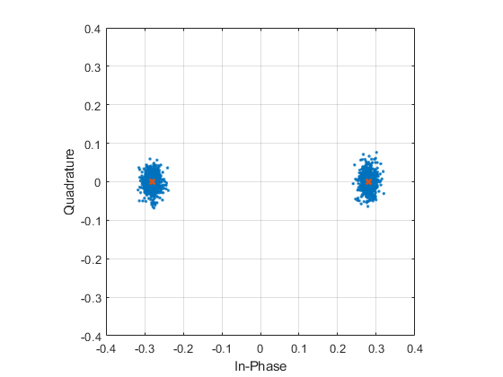
Constellation Diagram
5th OOK
Uniform power @-1dBm

Slide 7
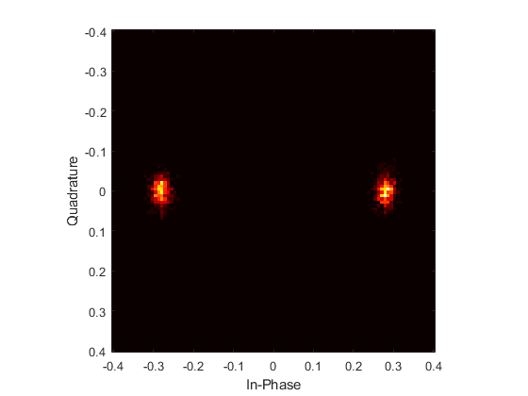
Constellation Diagram
5th OOK
Uniform power @-1dBm

Slide 8
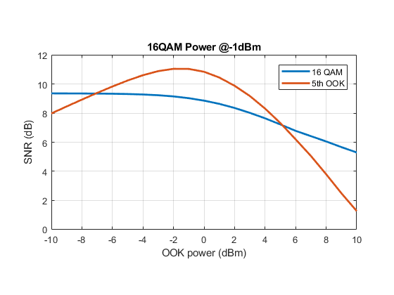
OOK Power
SNR (16QAM and 5th OOK) vs power

Slide 9
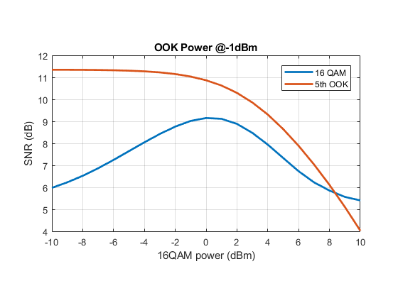
16QAM Power
SNR (16QAM and 5th OOK) vs power, when OOK fixed to -1 dBm

Slide 10
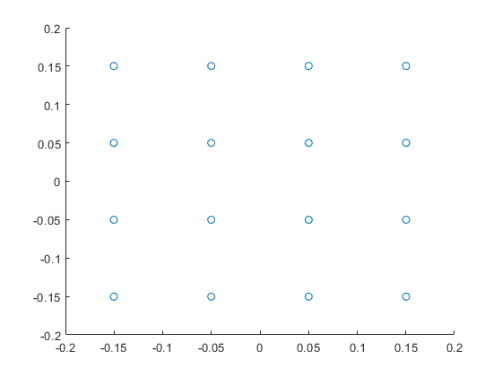
Suspiciously Low SNR
Maybe calculate SNR wrongly
When no ASE noise, γ=0, perfect constellation diagram

Slide 11
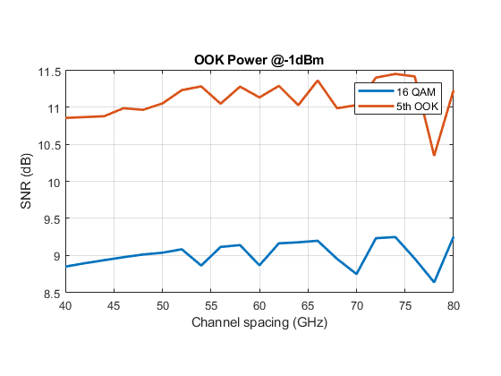
Uniform Channel Spacing
SNR (16QAM and 5th OOK) vs uniform channel spacing
Power@-1 dBm for all channels

Slide 12
Nonuniform Channel Spacing
SNR (16QAM and 5th OOK) vs channel spacing
Power@-1 dBm for all channels
Total bandwidth is fixed to 500 GHz

Slide 13
Number of Spans
SNR (16QAM and 5th OOK) vs #spans
Power@-1 dBm for all channels

Slide 14
Number of Channels
SNR (16QAM and 5th OOK) vs #channels
Power@-1 dBm for all channels

