Slide 1
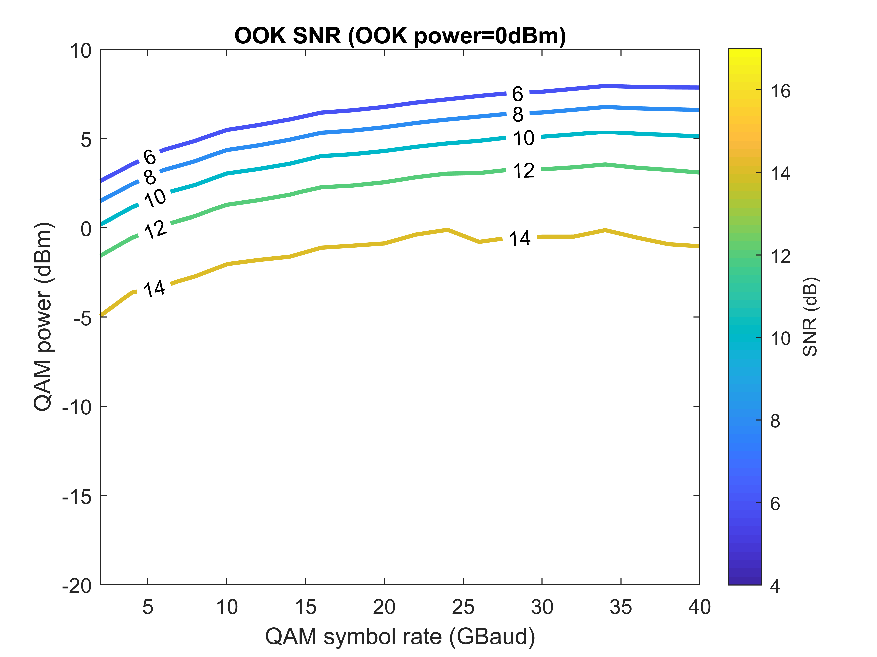
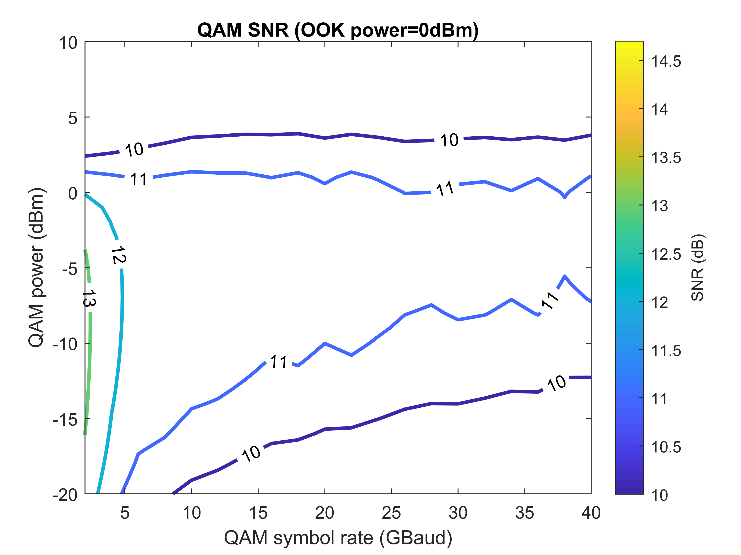
Interleaving OOK and 16QAM – Single Pol.
3OOKs: OOK+QAM+OOK+QAM+OOK, 50 GHz channel spacing

Slide 2
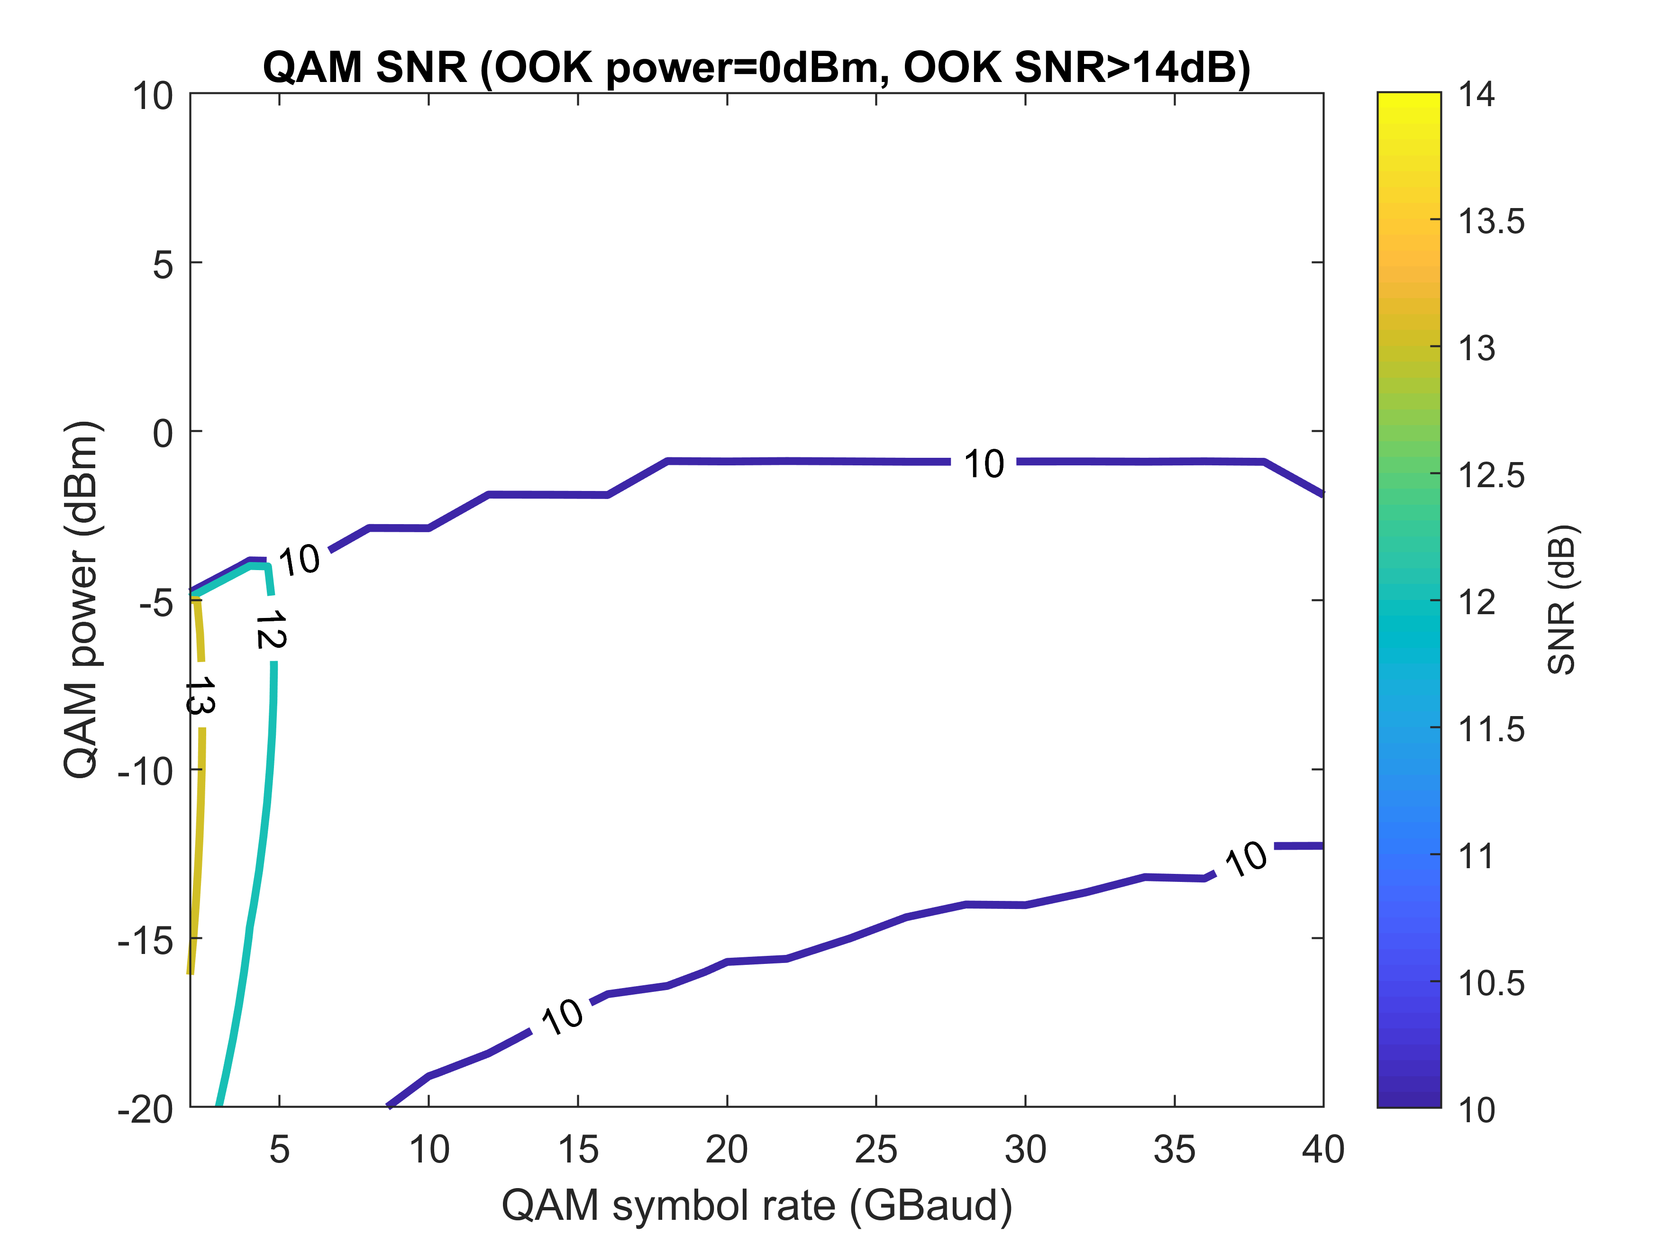
Interleaving OOK and 16QAM – Single Pol.
3OOKs: OOK+QAM+OOK+QAM+OOK, 50 GHz channel spacing

Slide 3
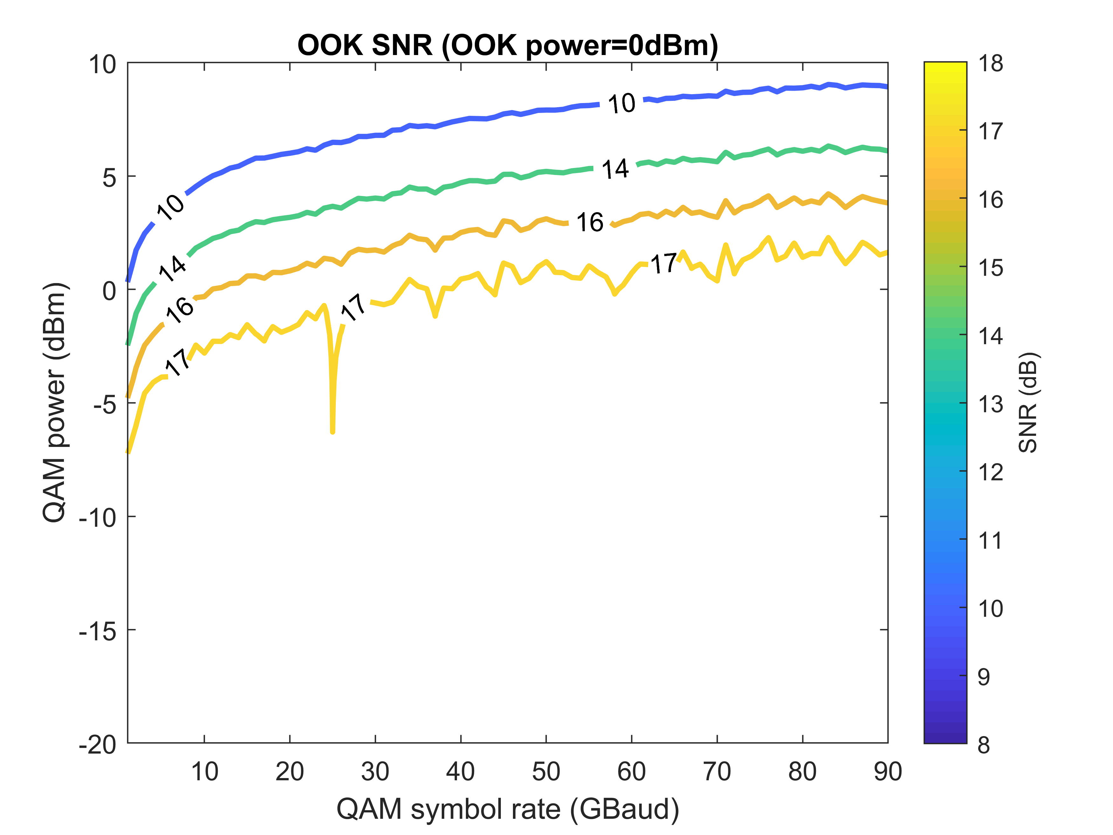
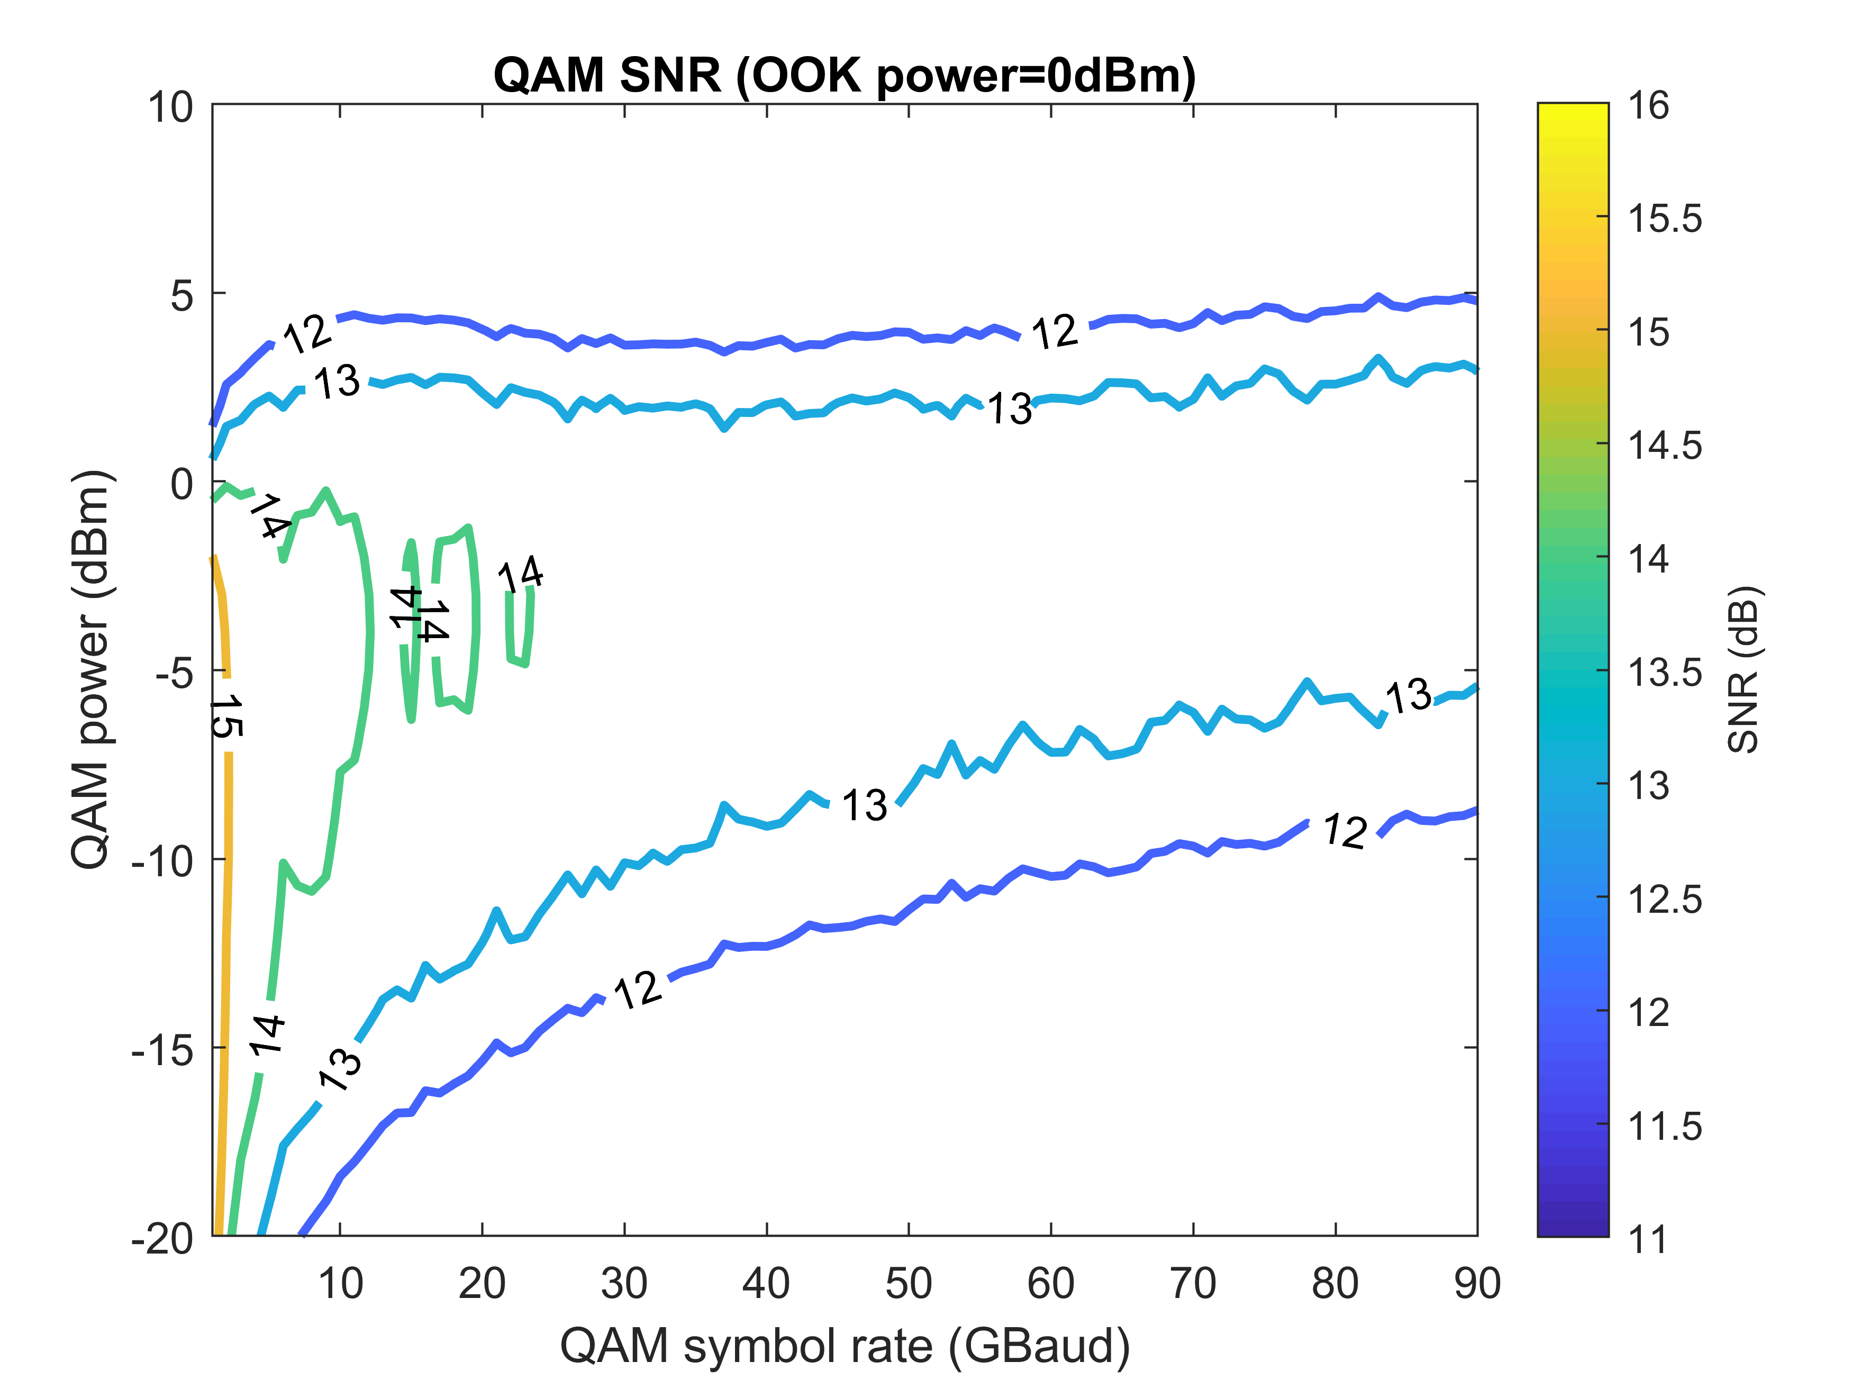
Interleaving OOK and 16QAM – Single Pol.
3OOKs: OOK+QAM+OOK+QAM+OOK, 100 GHz channel spacing

Slide 4
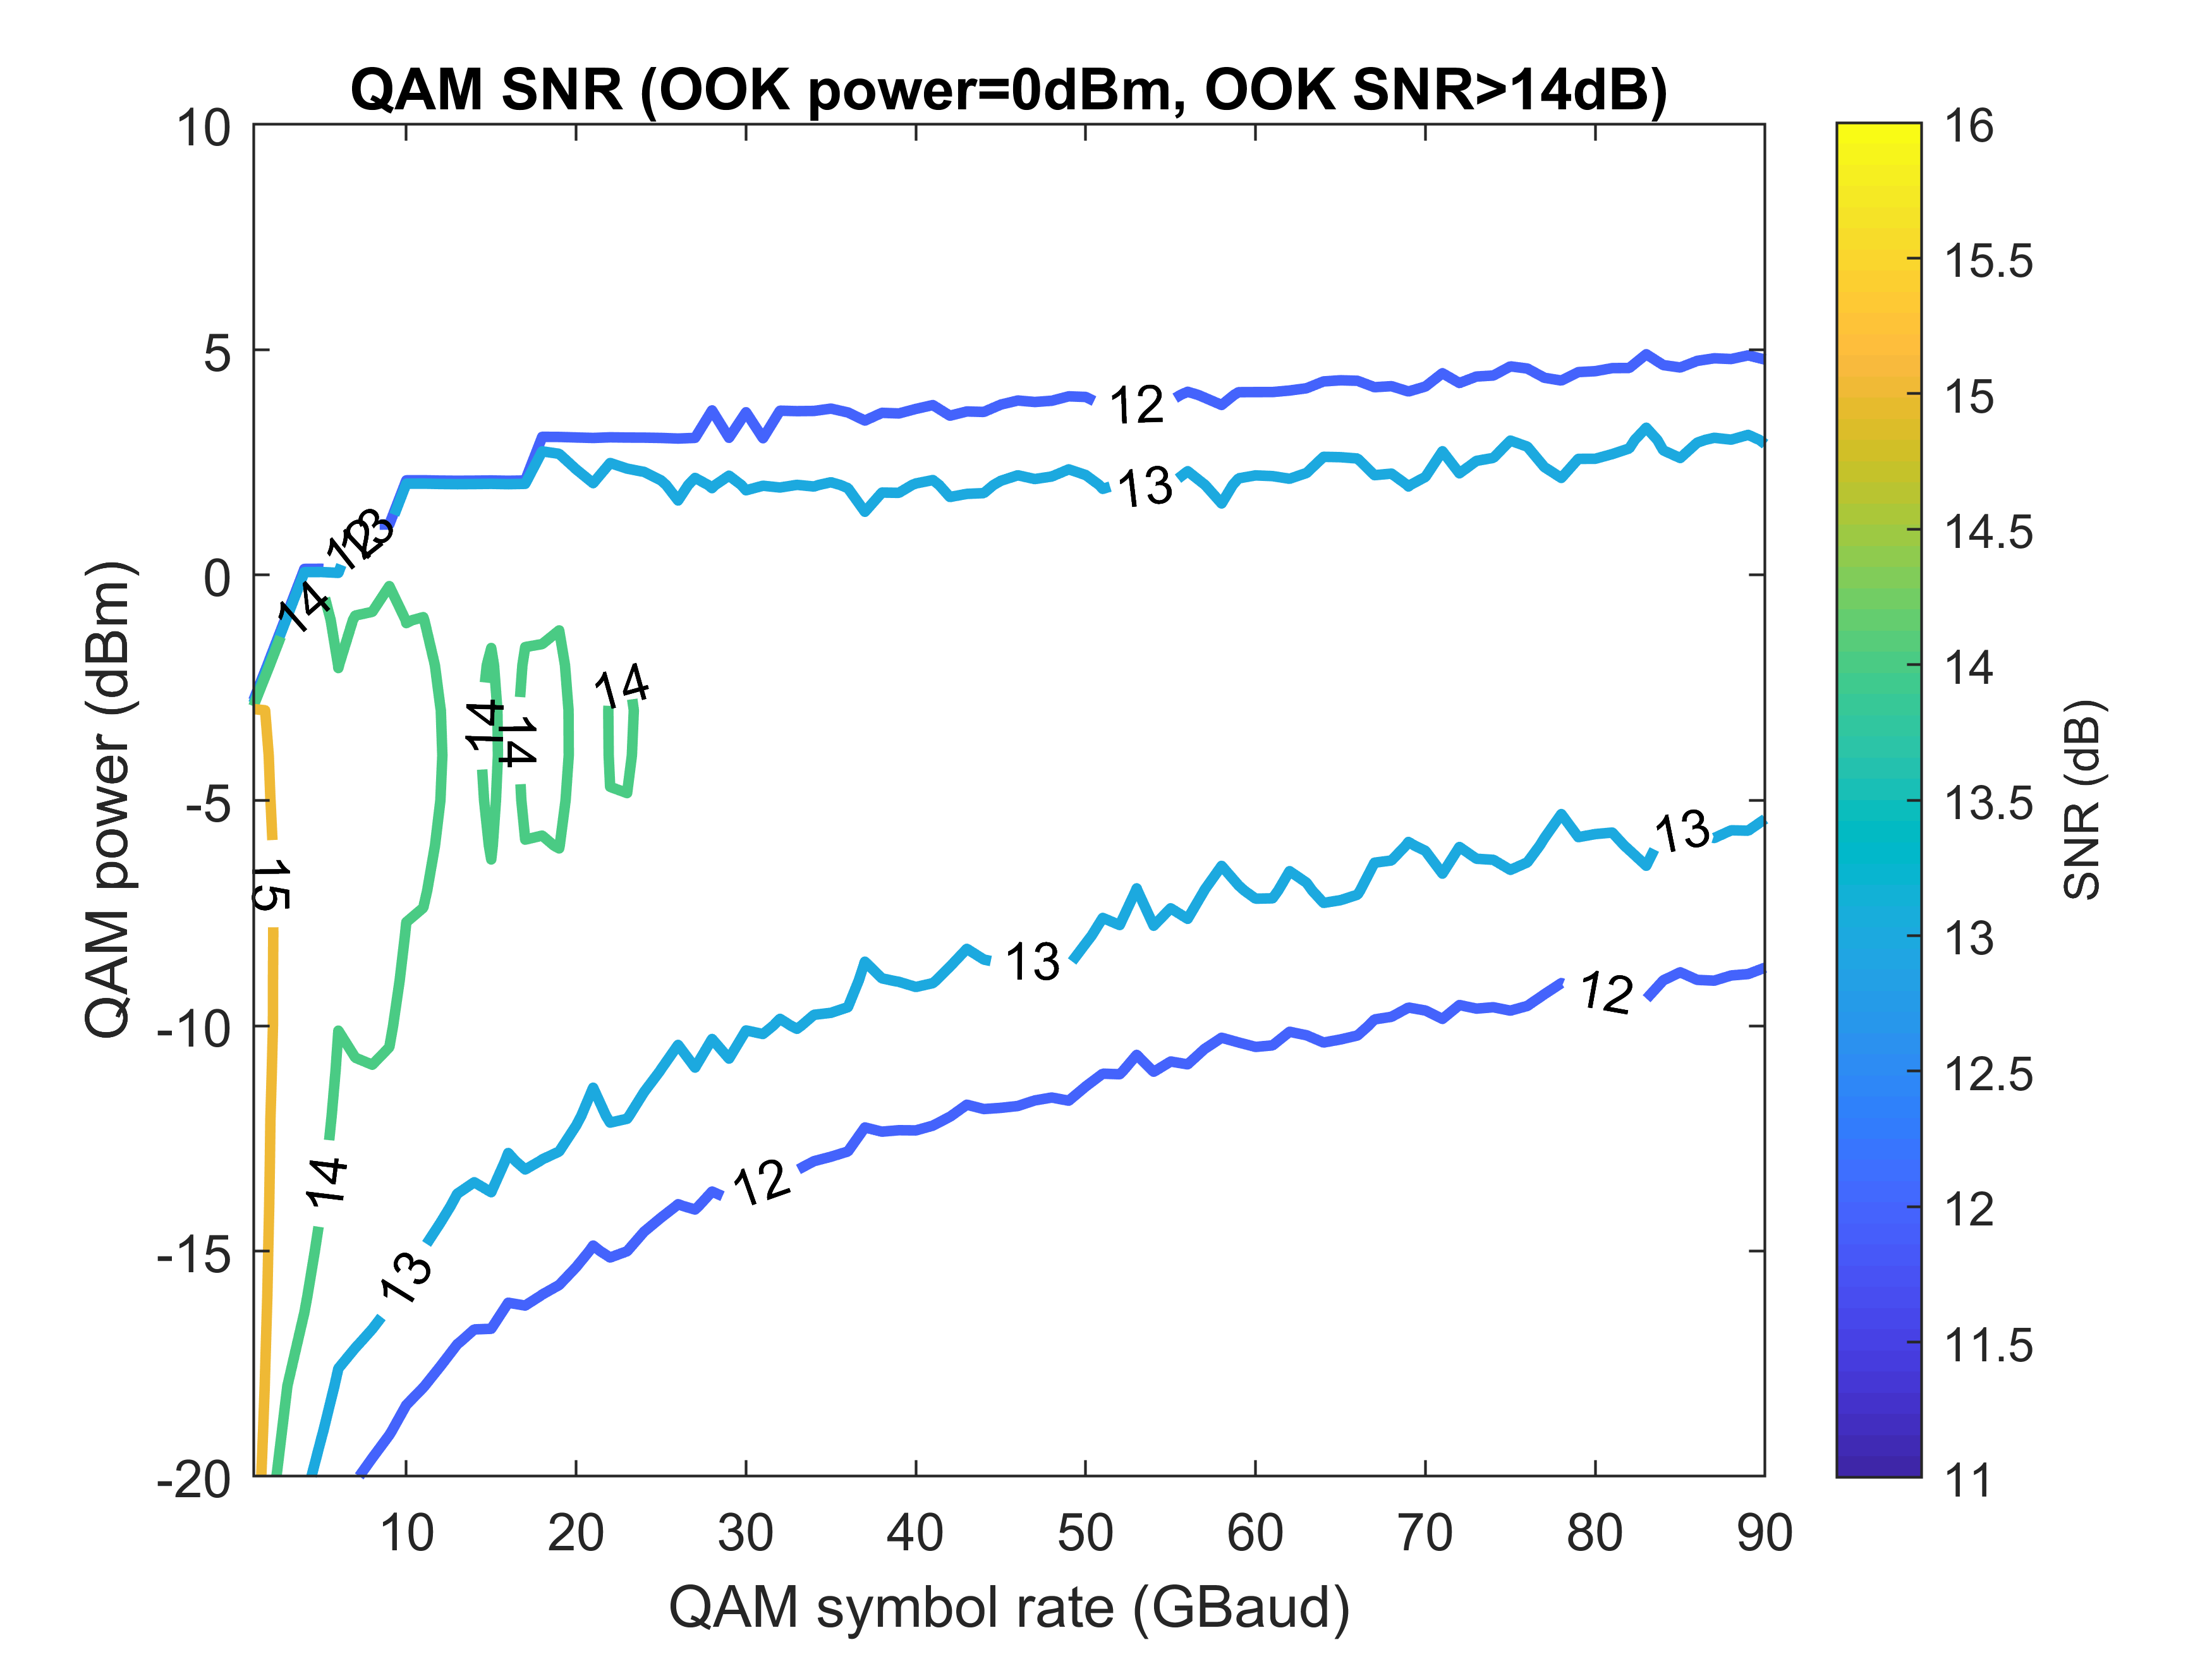
Interleaving OOK and 16QAM – Single Pol.
3OOKs: OOK+QAM+OOK+QAM+OOK, 100 GHz channel spacing

Slide 5
Interleaving OOK and 16QAM – Single Pol.
3OOKs: OOK+QAM+OOK+QAM+OOK, 150 GHz channel spacing

Slide 6
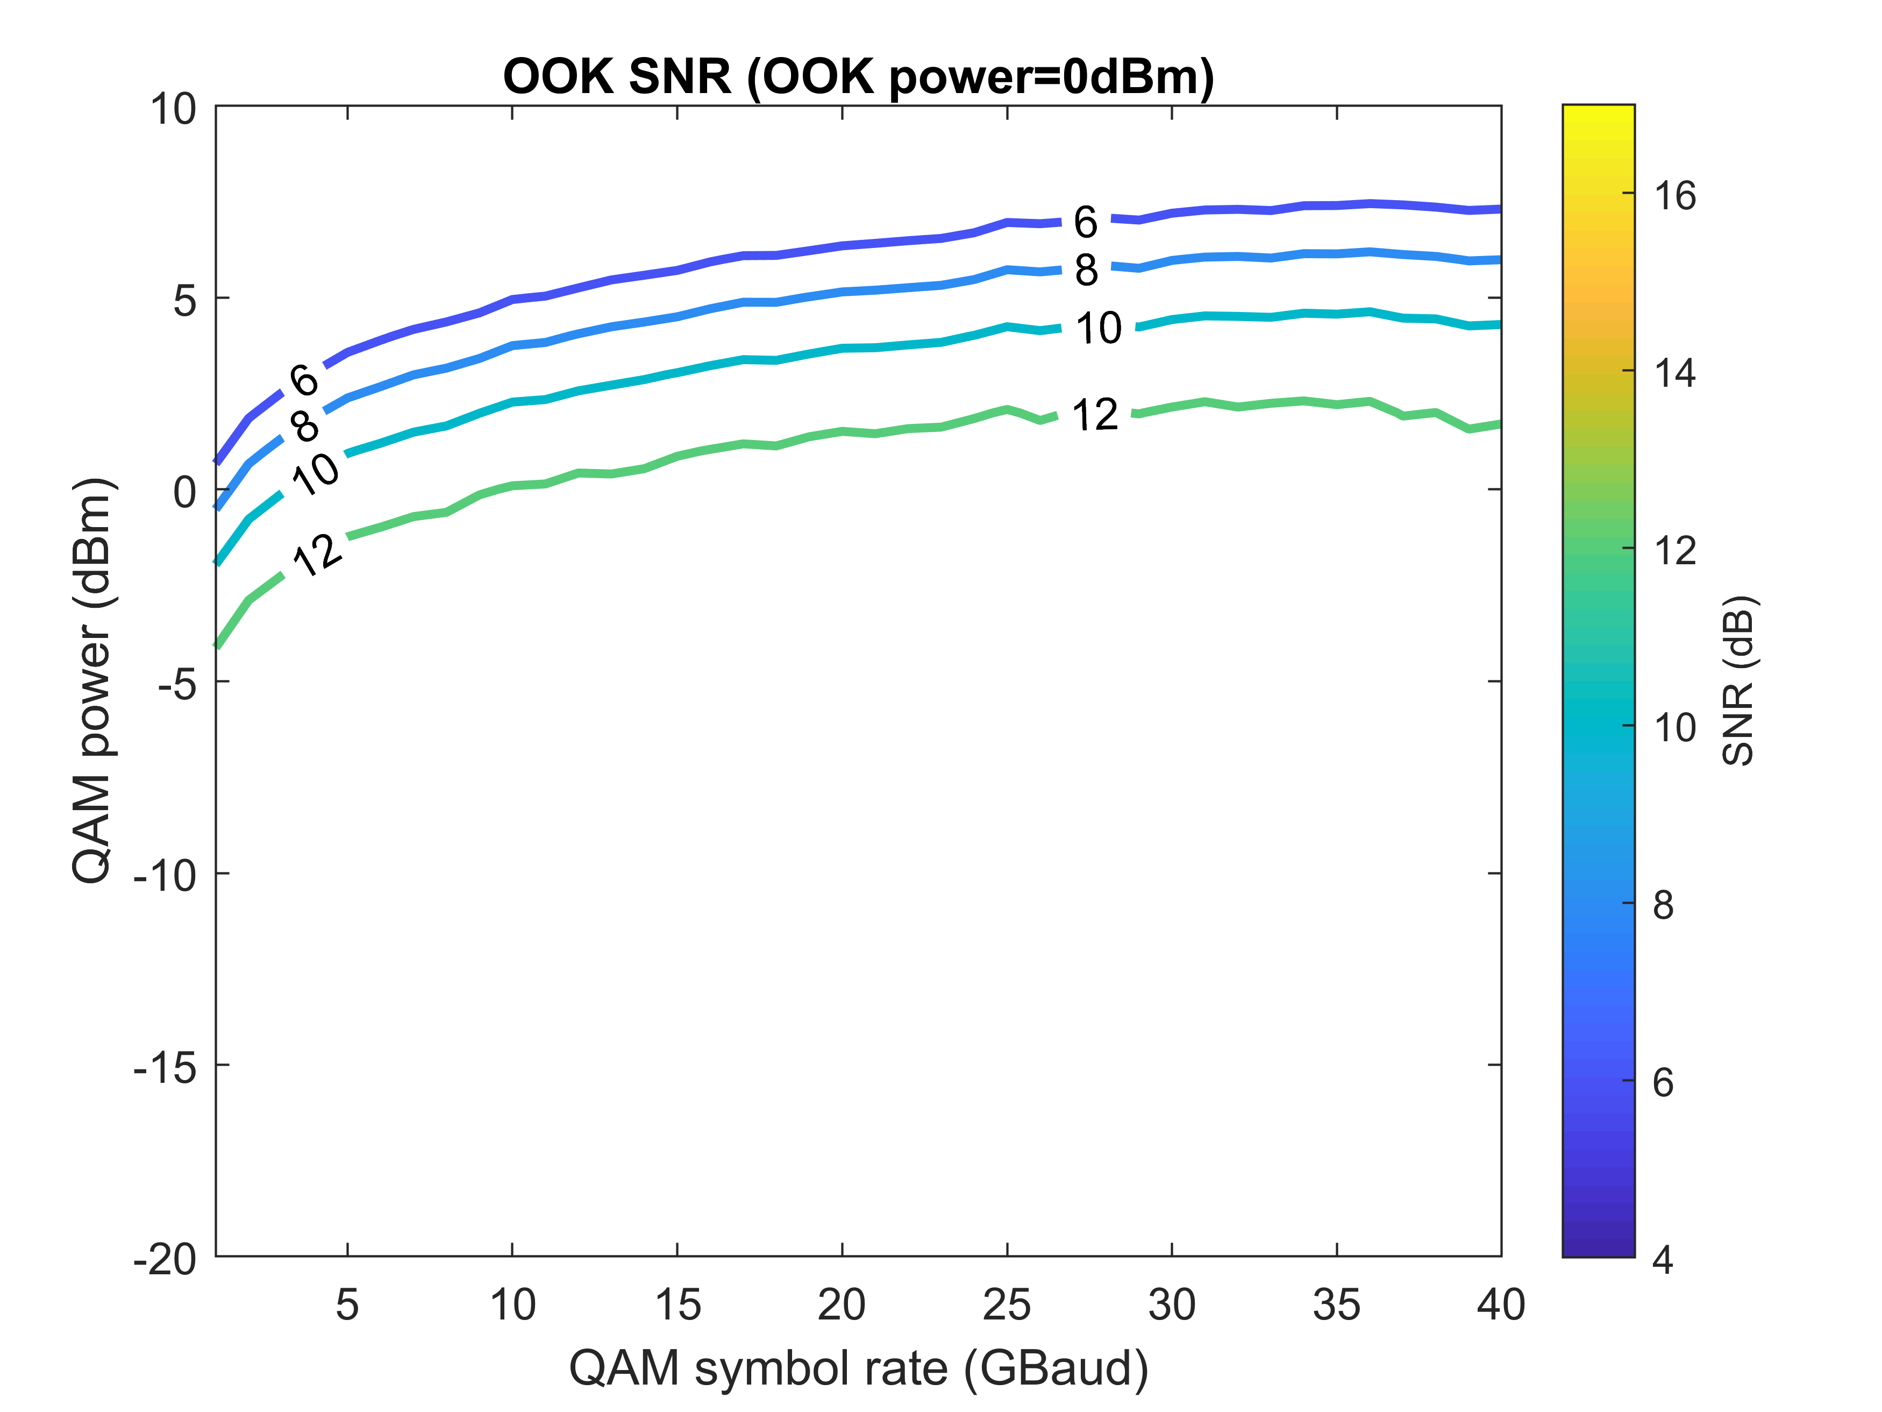
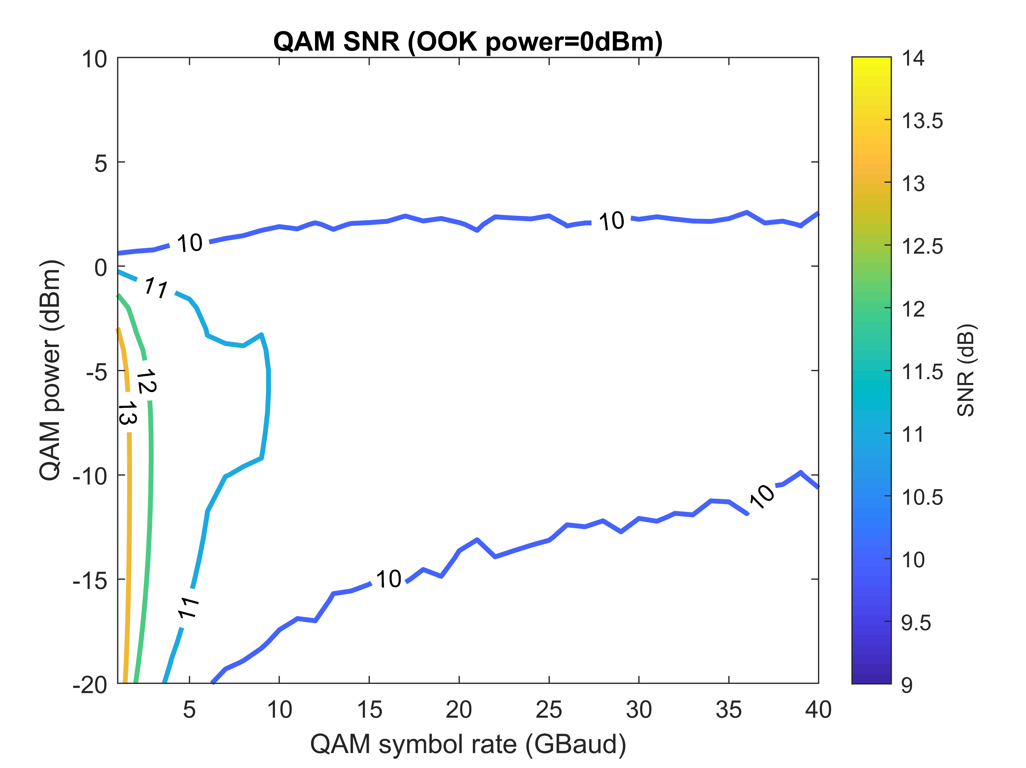
Interleaving OOK and 16QAM – Single Pol.
4OOKs: 50 GHz channel spacing

Slide 7
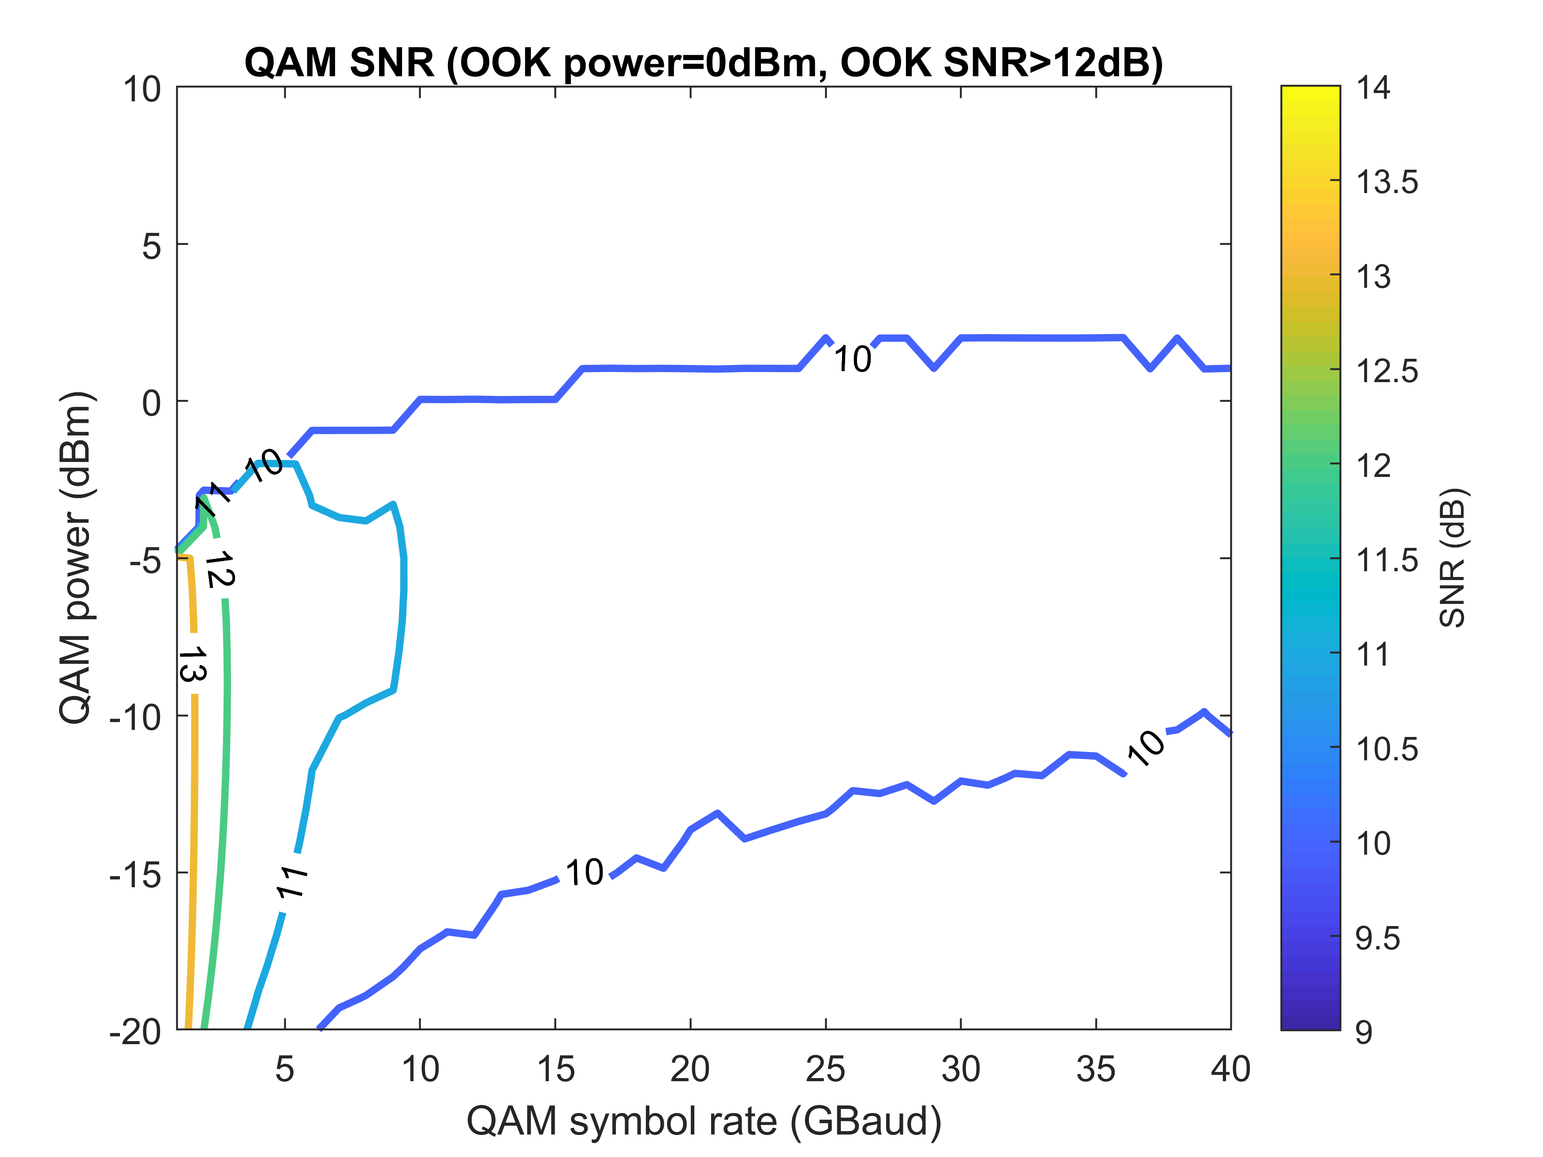
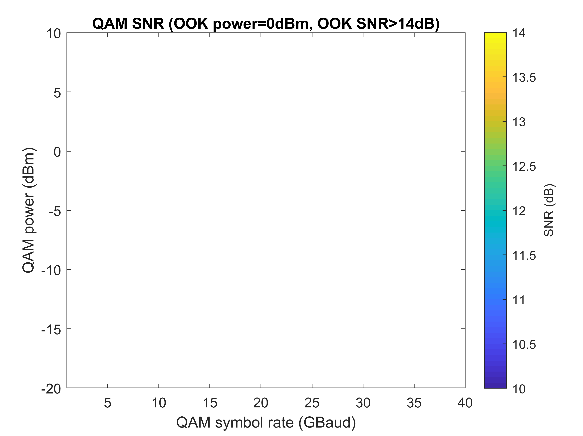
Interleaving OOK and 16QAM – Single Pol.
4OOKs: 50 GHz channel spacing

