Slide 1

Group 4- Incompatibility
Group members: Janice- Sepideh- Niki-Leon
15/1/2021
TU/e, Design Pattern and API

Slide 2
Outline
Team1
Team 2
Team 3
Comparison between teams
Improvement to current API

Slide 3
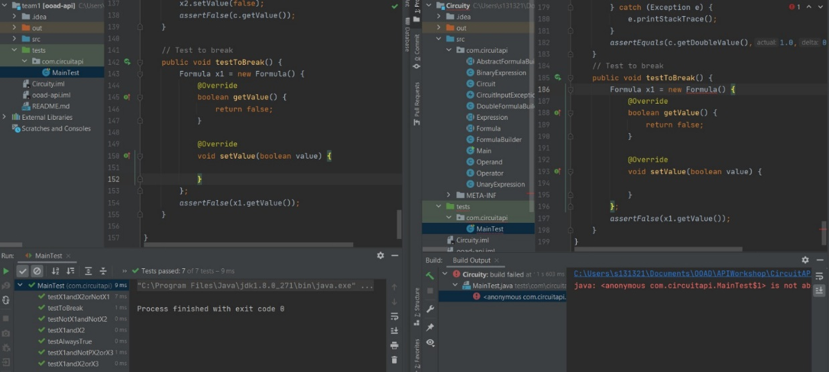
Team 1- 1)Source incompatibility
They added an abstract operation called “SetValue” with double input in abstract class called “Formula” in V2 . Because of this, we need to override the new “SetValue” with double value in the test case.
Therefore, there is source incompatibility between their first and second version. As it is illustrated in the picture, we wrote the test case to check if “Formula” class is compatible in V1 and V2. However, the same test which runs on V1, cannot run in V2.
V1
V2

Slide 4
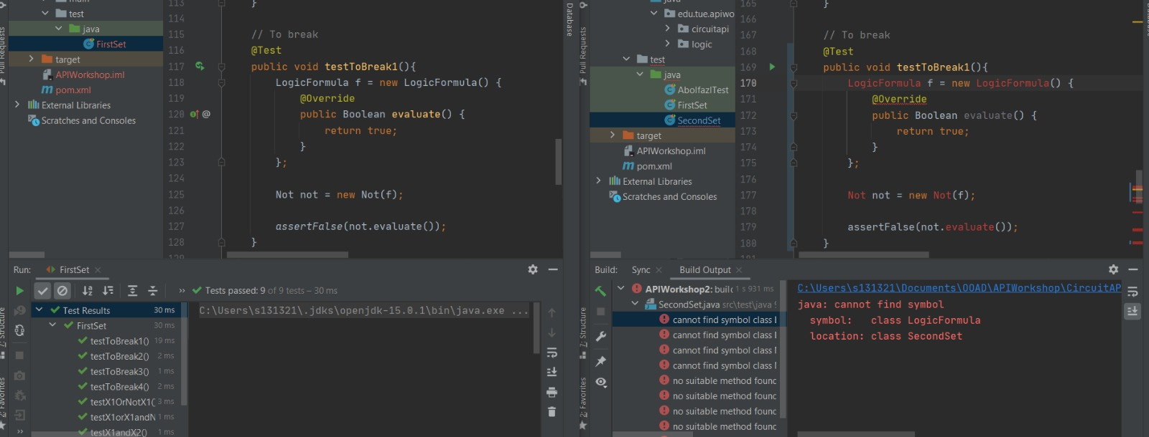
Team 2- 1)Source incompatibility
They have public “LogicFormula” in V1. Instead of “LogicFormula” class, they have public “Formula” in V2. Therefore, there is a source incompatibility.
V1
V2

Slide 5
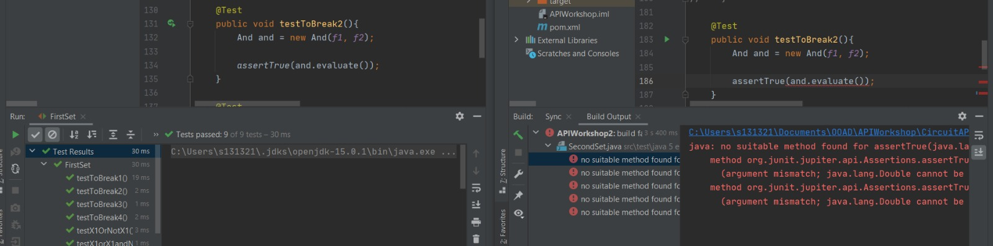
Team2- 2)Binary or functionality incompatibility
They implement “and” operation for Boolean values in V1
They only implement “and” for double values and not for Boolean values in V2. This problem is also found in “or”, “not” classes.
V1
V2

Slide 6
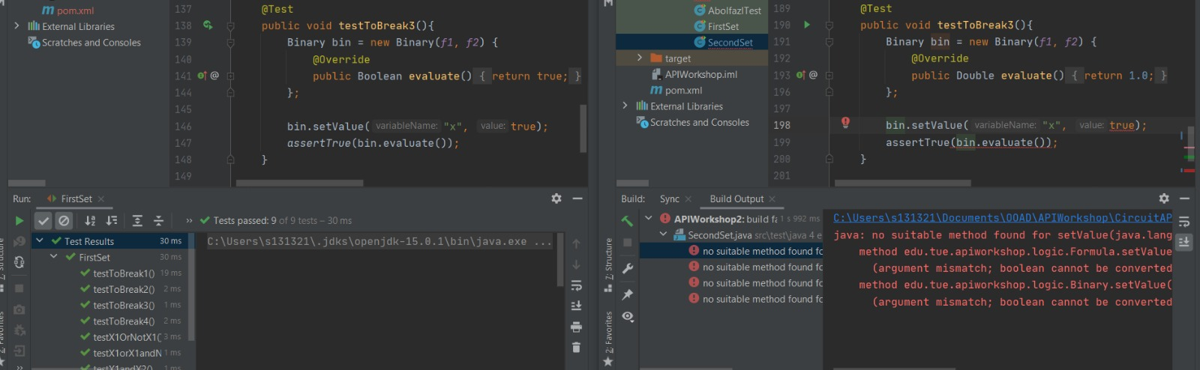
Team2- 3)Binary or functionality incompatibility
They implement “Binary” class with “setValue” with Boolean inputs in V1. However, in V2 the “setValue” method is implemented with double inputs.
This problem is also found in “Unary” class.
V1
V2

Slide 7
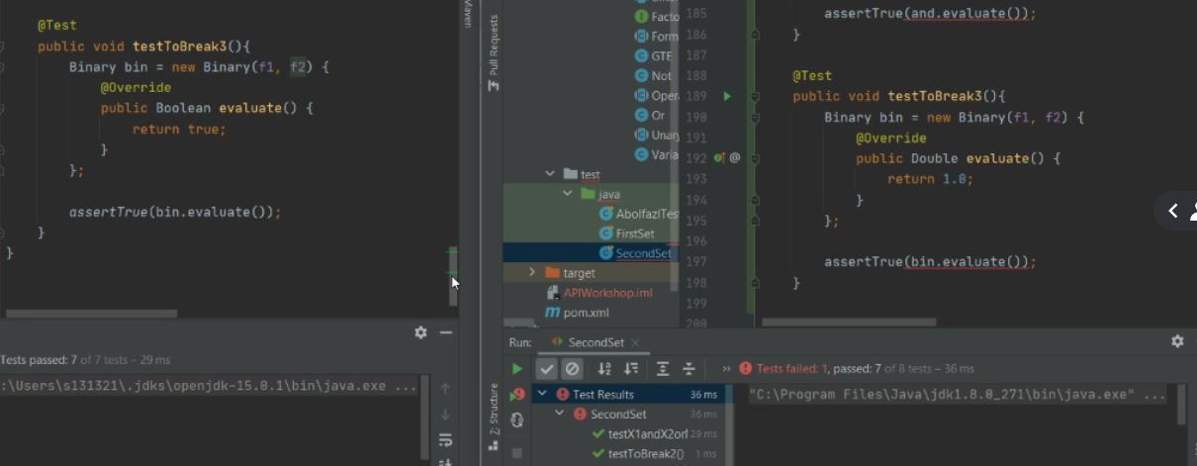
Team 2- 4)Binary or functionality incompatibility
In V1 the parent class called “LogicFormula”, has an “evaluate” method with return type Boolean. However, V2 has the “evaluate” method with return type Double.
V1
V2

Slide 8
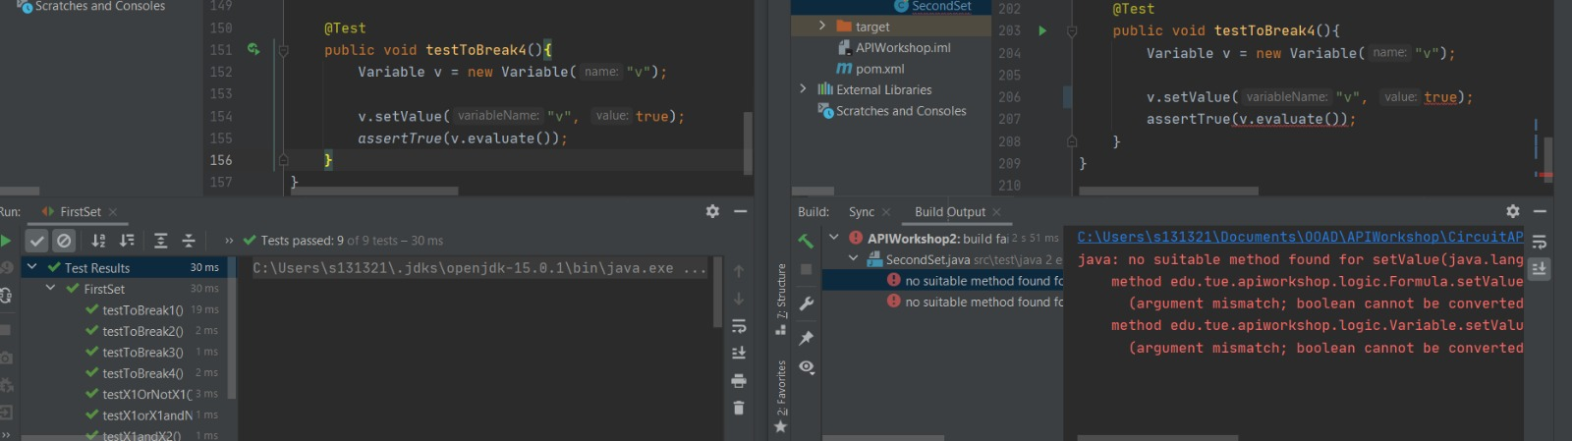
Team 2- 5)Binary or functionality incompatibility
In “Variable” class, there is a Boolean property named “Value”. However, in V2, the type of this property is changed from Boolean to Double. Therefore, they completely omitted Boolean value from V2. Hence, there is incompatibility between V1 and V2.
V1
V2

Slide 9
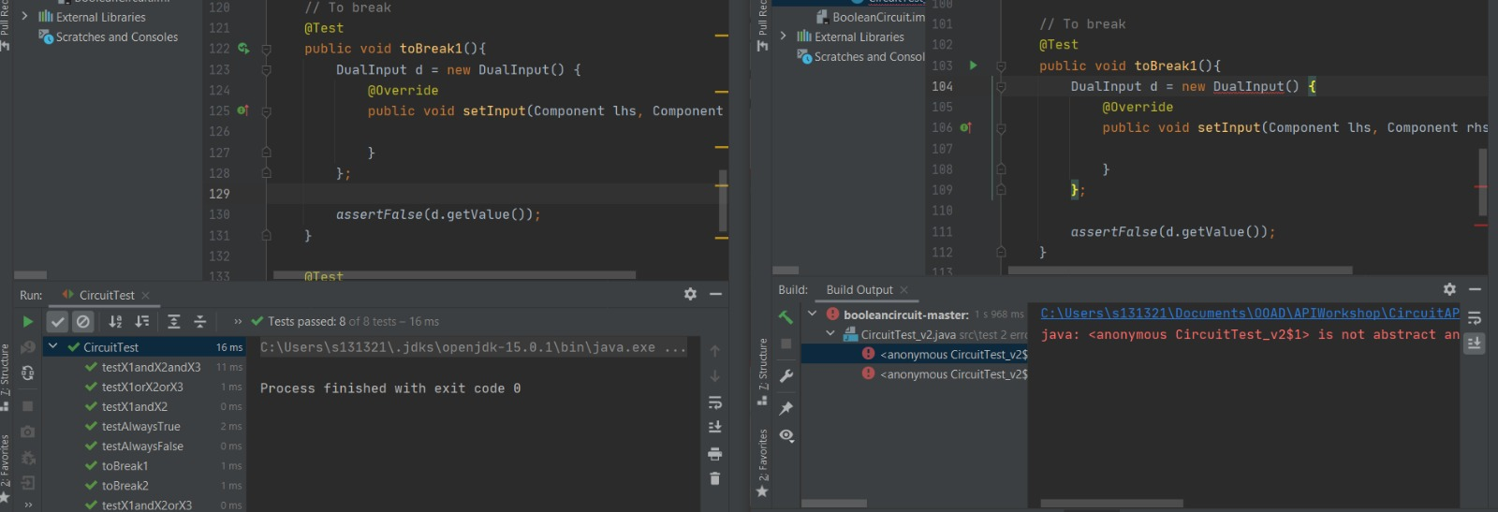
Team3- 1)Source incompatibility
An abstract "getDoubleValue" is added to the parent class “Component" in V2. This results in having to override "getDoubleValue" in the test case.
Therefore, they have source incompatibility between their first and the second versions.
V1
V2

Slide 10
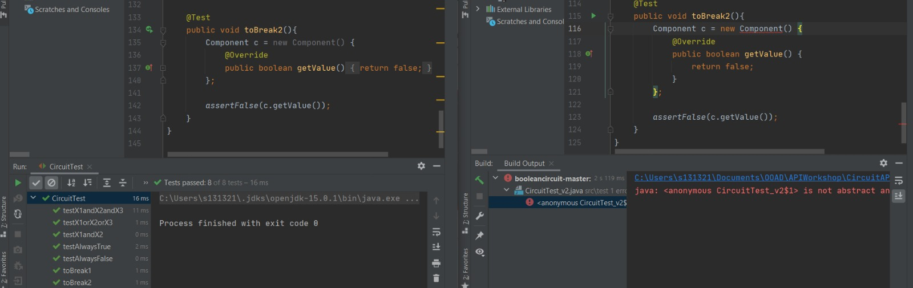
Team3- 2)Source incompatibility
Abstract method "getDoubleValue" is added to the abstract class Component. This results in having to override the method "getDoubleValue" in the test case. As you can see in the picture, the same test cannot run in V2.
V1
V2

Slide 11
Comparison between teams
Team | Source Incompatibility | Binary Incompatibility
1 | 1 | 0
2 | 1 | 7
3 | 2 | 0
In total, we found 11 incompatibilities (4 source- 7 binary)

Slide 12
Improvement to our Current API
Source incompatibility:
We should remove dependency between abstract classes and return types in our current API. We can solve source incompatibility by using generic return type.
We should not rename the existing classes in further versions.
Binary incompatibility:
Solving source incompatibilities ( for example the first point), results in solving binary incompatibility.
We should not remove the existing methods and properties which were implemented in our previous versions.

Slide 13
Thank you for your attention!
Questions?
Comments?

