Slide 1
Distributed Systems
System Models

Slide 2
Our topic today
2.1 Physical model
2.1 Architectural model
Architectural elements
  Communication paradigms
  Roles and responsibilities
  Placement
Architectural patterns
2.3 Fundamental model
Interaction model
Failure model
Security model

Slide 3
Descriptive models for distributed system design
Physical model
Most explicit description of a system.
Capture hardware composition in terms of computers and their interconnecting networks.
Architectural model
Describes a systems in terms of computational and communication task performed by computational elements.
Fundamental model
Abstract perspective in order to study the individual aspects of a system.
Three models are introduced: interaction model, failure model, and the security model.
Notes:
Inter-Process Communication (进程间通信）

Slide 4
Difficulties for and threats to distributed systems
Widely varying mode of use
Component parts of the system are subject to wide variations in workload, e.g. some web pages are accessed several million times a day.
Some parts of the systems might be disconnected or poorly connected, e.g. mobile computers.
Some applications have special requirements such as high communication bandwidth and low latency, e.g. multimedia applications.
Wide range of system environments
Distributed systems accommodate heterogeneous hardware, operating systems, networks.
Networks may differ widely in performance (wireless networks vs. LAN)
Internal threats
External threats
Notes:
Internal threats

Slide 5
Physical Model

Slide 6
Introduction to physical model
A physical model is a representation of the underlying hardware elements of a distributed system that abstracts from specific details of the computer and networking technologies employed.
Baseline physical model
Hardware and software components located at networked computers communicate and coordinate their actions by passing messages.
Very simple physical model of a distributed system.

Slide 7
Three generations of distributed systems
Early distributed systems
Emerged in the late 1970s and early 1980s because of the usage of local area networking technologies.
System typically consisted of 10 to 100 nodes connected by a LAN, with limited Internet connectivity and supported services (e.g., shared local printer, file servers).
Internet-scale distributed systems
Emerged in the 1990s because of the growth of the Internet.

Slide 8
Physical model of the internet-scale distributed system
intranet
☎
ISP
☎
☎
☎
backbone
satellite link
desktop computer:
server:
network link:

Slide 9
Three generations of distributed systems
Early distributed systems
Emerged in the late 1970s and early 1980s because of the usage of local area networking technologies.
System typically consisted of 10 to 100 nodes connected by a LAN, with limited Internet connectivity and supported services (e.g., shared local printer, file servers).
Internet-scale distributed systems
Emerged in the 1990s because of the growth of the Internet.
Infrastructure became global.
Contemporary distributed systems
Emergence of mobile computing leads to nodes that are location-independent
Need to added capabilities such as service discovery and support for spontaneous interoperation
Emergence of cloud computing and ubiquitous computing

Slide 10
Distributed system of systems
Emergence of ultra-large-scale (ULS) distributed systems
Complex systems consisting of a series of subsystems that are systems in their own right and that come together to perform particular task or tasks
Example: environmental management system for flood prediction
Consists of sensor networks deployed to monitor the state of various environmental parameters
Coupled with systems that predict the like hood for floods (running complex simulations)
Additionally early warning systems to key stakeholders via mobile phones

Slide 11
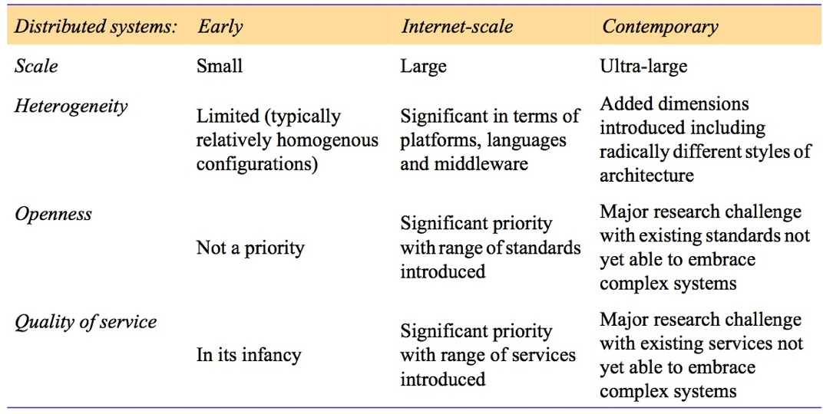
Generations of distributed systems

Slide 12
Architectural Model

Slide 13
Architectural model
An architectural model of a distributed system simplifies and abstracts the functions of the individual components of a distributed system and
  Organization of components across the network of computers.
  Their interrelationship, i.e., communicate with each other.

Slide 14

Architectural elements
What are the entities that are communicating in the distributed system?
How do they communicate, or, more specifically, what communication
paradigm is used?
What (potentially changing) roles and responsibilities do they have in the
overall architecture?
How are they mapped on the physical distributed infrastructure (what is their placement)?

Slide 15
Architectural elements
Communicating entities

Slide 16
System-oriented perspective
In distributed systems the entities that communicate are typically processes.
Exceptions:
In primitive environments such as sensor networks, operating systems does not provide any abstractions, therefore nodes communicate.
In most environments processes are supplemented by threads, so threads are more the endpoints of communications.

Slide 17
Problem-oriented perspective
Objects
Computation consists of a number of interacting objects representing units of decomposition for the problem domain.
Objects are accessed via interfaces.
Components
Resemble objects in that they offer problem-oriented abstractions, also accessed via interfaces.
Specify not only their interfaces but also the assumptions they make in terms of other components/interfaces that must be present for a component to fulfil its function.
Web services
Software application which is identified via URI
Supports direct interactions with other software agents

Slide 18
Architectural elements
Communicating paradigms

Slide 19

Types of communication paradigms
Interprocess communication
Remote invocation
Indirect communication

Slide 20
Interprocess communication
Low-level support for communication between processes in distributed systems including message parsing-primitives.
Direct access to the API offered by Internet protocols (socket programming) and support for multicast communication.

Slide 21
Remote invocation
Covering a range of techniques based on a two-way exchange between communicating entities.
Resulting in the calling of a remote operation, procedure or method
Request-reply protocols: more a pattern imposed on an underlying message-parsing service to support client-server computing
Remote procedure calls: procedures in processes on remote computers can be called as if they are procedures in the local address space
Remote method invocation: a calling object can invoke a method in a remote object

Slide 22
Indirect communication
Group communication
Delivery of messages to a set of recipients.
Abstraction of a group which is represented in the system by a group identifier
Recipients elect to receive message send to a group.
Publish-subscribe-systems
A large number of producers (publisher) distribute information items of interest (events) to a similarly large number of consumers (subscribers)
Message queues
Message queues offer a point-to-point service whereby producer processes can send messages to a specified queue and consumer processes can receive messages from the queue or being notified.

Slide 23
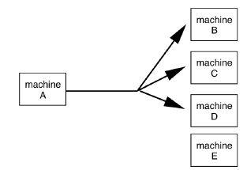
Group communication
Two kinds of group communication:
Broadcast (message sent to everyone)
Multicast (message sent to specific group)
Used for:
Replication of services
Replication of data
Service discovery
Event notification

Slide 24
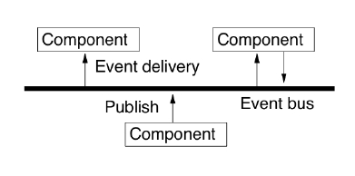
Publish-subscribe-systems
(or event-based communication)
Communication through propagation of events
Generally associated with publish/subscribe systems
Sender process publishes events
Receiver process subscribes to events and receives only the ones it is interested in

Slide 25
Architectural elements
Roles and responsibilities

Slide 26
Architectural styles
Client-Server
Peer-to-peer

Slide 27
Roles and responsibilities
Client-server

Slide 28
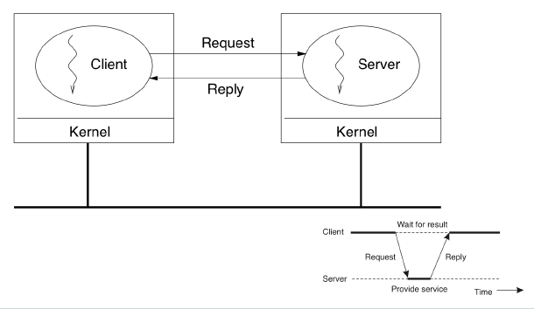
Client-server

Slide 29
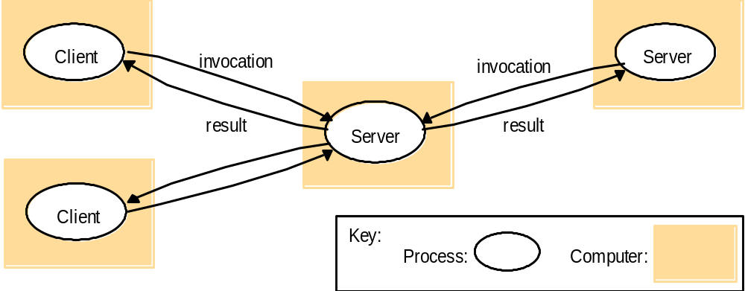
Clients invoke individual servers

Slide 30
Fundamental issue with client-server
Client-server offers a direct, relatively simple approach to the sharing of data and other resources
But it scales poorly
The centralization of service provision and management implied by placing a service at a single address does not scale well beyond the capacity of the computer that hosts the service and the bandwidth of its connections
Even though, there a several variations of the client-server architecture to respond to this problem but none of the really solve it.
There is a need to distribute shared resources much more widely in order to share the computing and communication loads amongst a much larger number of computers and network links.

Slide 31
Roles and responsibilities
Peer-to-peer

Slide 32
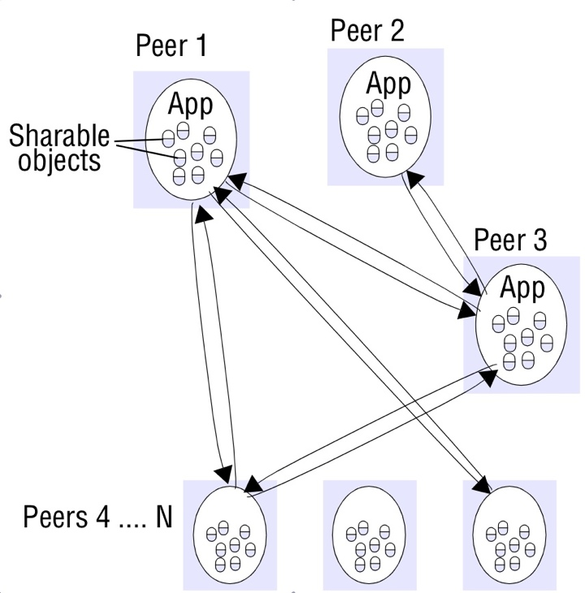
Peer-to-peer application
Is composed of a large number of peer processes running on separate computers.
All processes have client and server roles.
Patterns of communication between them depends entirely on application requirements.
Storage, processing and communication loads for accessing objects are distributed across computers and network links.
Each object is replicated in several computers to further distribute the load and to provide resilience in the event of disconnection of individual computers.
Need to place and retrieve individual computers is more complex then in client-server architecture.

Slide 33
Architectural elements
Placement

Slide 34
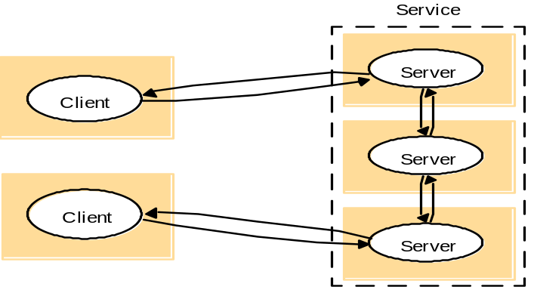
Services provided by multiple servers
Option 1
Servers partition a set of objects in which the service is based and distribute them between themselves.
Example
  In the Web in which each web server manages it own set of resources.
  User can employ a browser to access a resource at any one of the servers.
Option 2
Server maintain replicated copies of them on several hosts.
Example:
  NIS (Network Information Service) used by computers on a LAN.

Slide 35
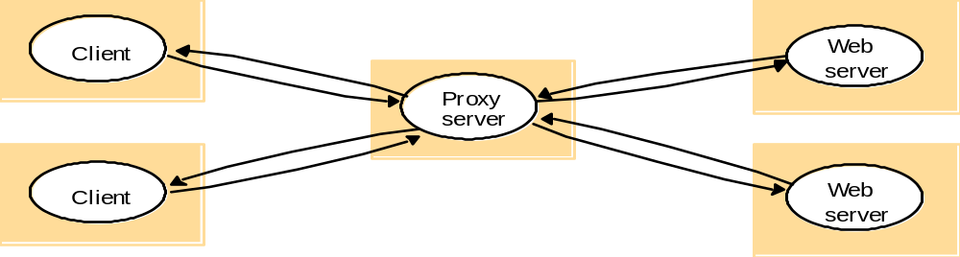
Proxy server and caches
A cache is a store of recently used data objects that is closer to the objects themselves. Caches might be co-located with each client or may be located in a proxy server that can be shared by several clients.
Process
A new object is received at a computer -> it is added to the cache store, replacing some existing objects if necessary.
Object is needed by the client process -> caching service checks the cache for an up-to-date copy.
If copy is not available, this copy is fetched.
Examples?

Slide 36
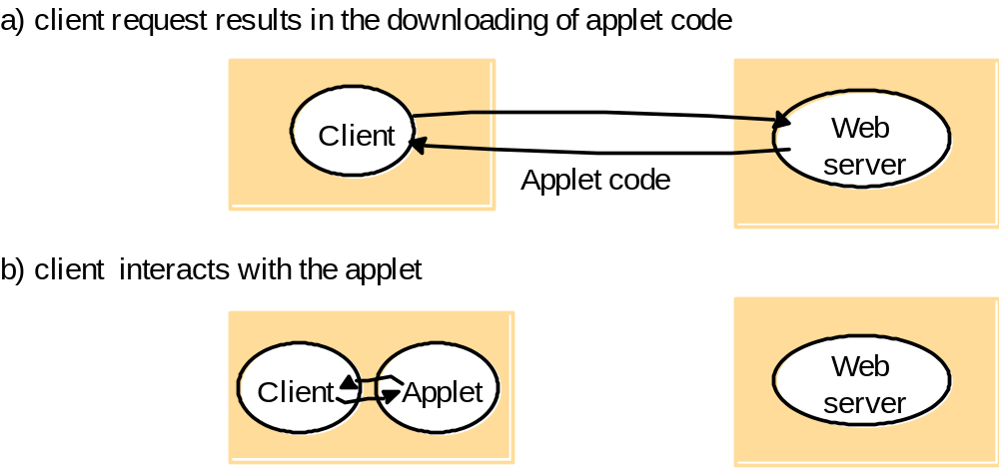
Mobile code
A typical well-known and widely-used example for mobile code are applets.

Slide 37
Mobile agents
A mobile agent is a running program (both code and data) that travels from one computer to another in a network carrying out a task on someone’s behalf, e.g. collecting information.
Benefits agents provide for creating distributed systems (Lange & Oshima, 1999)
They reduce the network load.
They overcome network latency.
They encapsulate protocols.
They execute asynchronously and autonomously.
They adapt dynamically.
They are naturally heterogeneous.
They are robust and fault-tolerant.
Examples?

Slide 38
Architectural models
Architectural patterns

Slide 39
Concept of layering
Vertical organization of services into a service layers.
Distributed services can be provided by one or more server processes, interacting with each other and with client processes in order to maintain a consistent system-wide view of the service’s resources.
Example
Network time service is implemented on the Internet based on the Network Time Protocol (NTP) by server processes running on hosts throughout the Internet that supply current time to any client that request it.

Slide 40
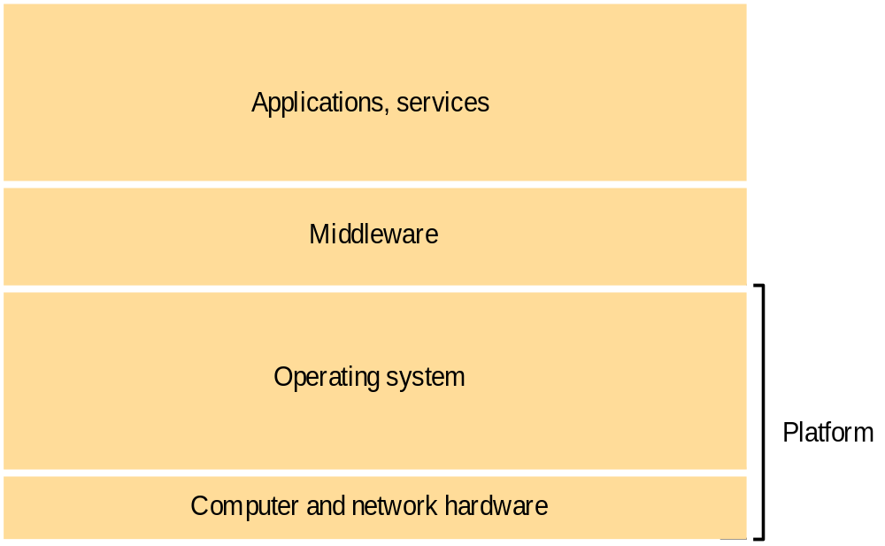
Software and hardware service layers

Slide 41
Platform
Lowest level hardware and software layers for distributed systems and applications
Characteristics
provide services to the layers above them
implemented independently in each computer
Bringing the system’s programming interface up to a level that facilitates communication and coordination between processes
Examples
x86/Windows, intel x86/Solaris, PowerPC/Mac OS X, Intel x86/Linux

Slide 42
Middleware
Is a layer of software whose purpose is to mask heterogeneity and to provide a convenient programming model to application programmers.
is represented by processes or objects in a set of computers that interact with each other to implement communication and resource-sharing support.
Is concerned with providing useful building blocks for the construction of software components that can work with one another
Limitations of middleware
Many distributed applications rely entirely on services provided by middleware to support their needs for communication and data sharing
Example, application that is suited to the client-server model such a database of names and addresses rely on middleware that provides only remote method invocation.

Slide 43
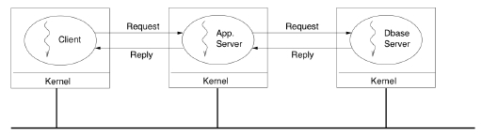
Vertical Distribution (Multi-Tier)
An extension of the client-server architecture.
Distributes the traditional server functionality over multiple servers.

Slide 44
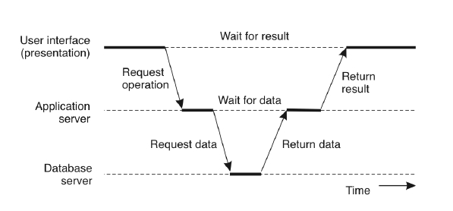
Communication in a multi-tier system

Slide 45
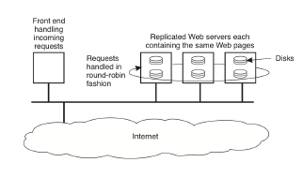
Horizontal Distribution
Involves replicating a server’s functionality over multiple computers.
Typical example: replicated Web server
Each server machine contains a complete copy of all hosted Web pages.
Client requests are passed on to the servers in a round robin fashion.
Is used to improve scalability (by reducing the load on individual servers) and reliability (by providing redundancy)

Slide 46
Thin and fat client implementations
Decomposed a typical client-server application into three logical parts
the interface part.
the application logic part, and.
the data part.
Thin client implementation
Provides a minimal user interface layer, and leave everything else to the server.
Fat client implementation
Include all of the user interface and application logic in the client.
Rely only on the server to store and provide access to data.
Implementations in between will split up the interface or application logic parts over
the clients and server in different ways.

Slide 47
Fundamental models

Slide 48

Requirements on the fundamental model
Questions that should be addressed by a system model
1. What are the main entities of the system?
2. How do they interact?
3. What are the characteristics that affect their individual and collective behavior?
Aspects of distributed systems that are considered are
Interaction
Failure
Security

Slide 49
Fundamental models
Interaction models

Slide 50
Performance of communication channels
Latency
Delay between the start of a message’s transmission from one process and the beginning of its receipt by another
It includes:
  Time taken for the first string of bits transmitted through a network to reach its destination.
  Delay in accessing the network.
  Time taken by the operating system communication services at both the sending and the receiving processes.
Bandwidth
total amount of information that can be transmitted over a computer network in a given time.
Jitter
Variation in the time taken to deliver a series of messages.

Slide 51
Two variants of the interaction model
Synchronous distributed systems
Asynchronous distributed system
The following bounds are defined:
The time to execute each step of a process has known lower and upper bounds
Each message transmitted over a channel is received within a known bounded time.
Each process has a local clock whose drift rate from real time has known bound.
There are no bounds on:
Process execution speed
Message transmission delays
Clock drift rate

Slide 52
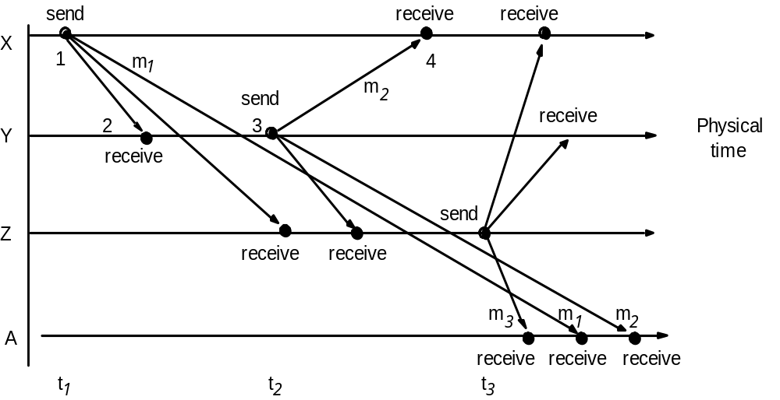
Event ordering

Slide 53
Fundamental models
Failure models

Slide 54
Introducing the failure model
The failure model defines ways in which failure may occur in order to provide an understanding of the effects of failure.
Taxonomy of failures of processes and communication channels (Hadzilacos & Toueg, 1994)
Omission failures.
Arbitrary failures.
Timing failures.

Slide 55
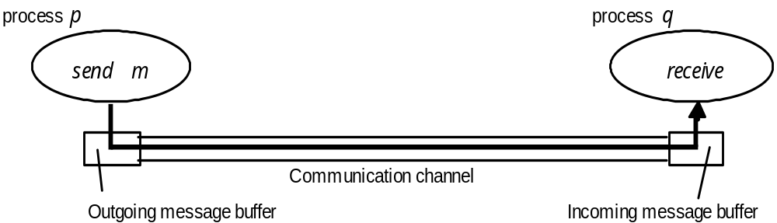
Processes and channels

Slide 56
Omission failures
Class of failure
Affects
Description
Fail-stop
Process
Process halts and remains halted. Other processes may
detect this state.
Crash
Process
Process halts and remains halted. Other processes may
not be able to detect this state.
Omission
Channel
A message inserted in an outgoing message buffer never
arrives at the other end’s incoming message buffer.
Send-omission
Process
A process completes a
send,
but the message is not put
in its outgoing message buffer.
Receive-omission
Process
A message is put in a process’s incoming message
buffer, but that process does not receive it.
Arbitrary
Process or
Process/channel exhibits arbitrary behaviour: it may
(Byzantine)
channel
send/transmit arbitrary messages at arbitrary times,
commit omissions; a process may stop or take an
incorrect step.

Slide 57
Arbitrary failures
Often called Byzantine failure.
This is the worst possible failure semantics, in which any type of error may occur.
Example of an arbitrary failure of a process.
· A process arbitrarily omits intended processes steps or takes unintended
processing steps.
Example of an arbitrary failure of a communication channel
· Message content may be corrupted, nonexistent messages may be delivered or
real messages may be delivered more than once.
· Solutions: checksum to detect corrupted messages and message sequence
numbers to detect nonexistent and duplicated messages.

Slide 58
Timing failures
Class of Failure
Affects
Description
Clock
Process
Process’s local clock exceeds the bounds on its
rate of drift from real time.
Performance
Process
Process exceeds the bounds on the interval
between two steps.
Performance
Channel
A message’s transmission takes longer than the
stated bound.
Result response being unavaible to clients.

Slide 59
Fundamental models
Security models

Slide 60
Introducing the security model
The security of a distributed system can be archived by securing the processes and the channels used for their interactions and by protecting the objects that they encapsulate against unauthorized access.

Slide 61
Summary
Three generations of distributed systems and the emergence of ultra-large-scale
(ULS) distributed systems.
Types of communication paradigms:
  · Interprocess communication
  · Remote invocation
  · Indirect communication
Architectural styles: client-server and peer-to-peer
Vertical distribution (Multi-Tier) and horizontal distribution of c/s systems
Characteristics of synchronous distributed systems and asynchronous distributed system
Omission failures, arbitrary failures, timing failure in distributed systems

