Slide 1
Distributed Systems
Mutual Exclusion &
Election Algoritms
Page 1

Slide 2
Mutual Exclusion Algorithms
Page 2

Slide 3
Process Synchronization
Techniques to coordinate execution among
processes
– One process may have to wait for another
– Shared resource (e.g. critical section) may require
exclusive access
Page 3

Slide 4
Requirements of Mutual Exclusion Algorithms
A mutual exclusion algorithm should satisfy the following properties:
Safety Property: The safety property states that at any instant, only one process can execute the critical section.
Liveness Property: This property states the absence of deadlock and starvation.
Fairness: Fairness in the context of mutual exclusion means that each process gets a fair chance to execute the critical section.

Slide 5
Centralized Systems
Mutual exclusion via:
–
–
–
–
Test & set in hardware
Semaphores
Messages
Condition variables
Page 4
Notes:
In a distributed system, shared variables (semaphores) or a local kernel cannot be used to implement mutual exclusion.

Slide 6
Distributed Mutual Exclusion
• Assume there is agreement on how a resource
is identified
– Pass identifier with requests
• Create an algorithm to allow a process to
obtain exclusive access to a resource.
Page 5
Notes:
Distributed mutual exclusion algorithms must deal with unpredictable message delays and incomplete knowledge of the system state.

Slide 7
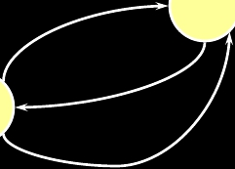
Centralized algorithm
• Mimic single processor system
• One process elected as coordinator
request(R)
grant(R)
P
release(R)
1.
2.
3.
4.
5.
Request resource
Wait for response
Receive grant
access resource
Release resource
C
Page 6

Slide 8


Centralized algorithm
If another process claimed resource:
– Coordinator does not reply until release
– Maintain queue
• Service requests in FIFO order
P2
Queue
P1
P2
request(R)
request(R)
P1
request(R)
grant(R)
P0 grant(R)
release(R)
C
Page 7

Slide 9
Centralized algorithm
Benefits
• Fair
– All requests processed in order
• Easy to implement, understand, verify
Problems
• Process cannot distinguish being blocked from
a dead coordinator
• Centralized server can be a bottleneck
Page 8

Slide 10
Token Ring algorithm
Assume known group of processes
– Some ordering can be imposed on group
– Construct logical ring in software
– Process communicates with neighbor
P0
P5
P4
P1
P2
P3
Page 9

Slide 11

Token Ring algorithm
• Initialization
– Process 0 gets token for resource R
• Token circulates around ring
– From Pi to P(i+1)mod N
• When process acquires token
– Checks to see if it needs to enter critical section
– If no, send ring to neighbor
– If yes, access resource
P
0
P5
P
1
• Hold token until done
P4
P2
token(R)
Page 10
P3

Slide 12
Token Ring algorithm
• Only one process at a time has token
– Mutual exclusion guaranteed
• Order well-defined
– Starvation cannot occur
• If token is lost (e.g. process died)
– It will have to be regenerated
• Does not guarantee FIFO order
– sometimes this is undesirable
Page 11

Slide 13
Ricart & Agrawala algorithm
• Distributed algorithm using reliable multicast
and logical clocks
• Process wants to enter critical section:
– Compose message containing:
• Identifier (machine ID, process ID)
• Name of resource
• Timestamp (totally-ordered Lamport)
– Send request to all processes in group
– Wait until everyone gives permission
– Enter critical section / use resource
Page 12

Slide 14
Ricart & Agrawala algorithm
• When process receives request:
– If receiver not interested:
• Send OK to sender
– If receiver is in critical section
• Do not reply; add request to queue
– If receiver just sent a request as well:
•
•
•
•
Compare timestamps: received & sent messages
Earliest wins
If receiver is loser, send OK
If receiver is winner, do not reply, queue
• When done with critical section
– Send OK to all queued requests
Page 13

Slide 15
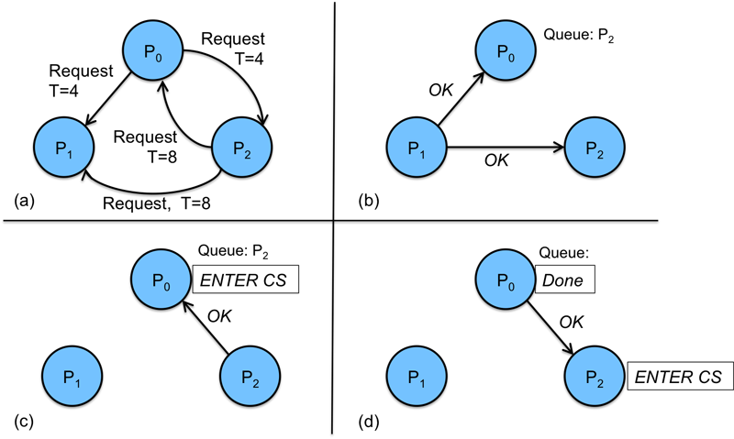
Example for Ricart & Agrawala algorithm

Slide 16
Ricart & Agrawala algorithm
• N points of failure
• A lot of messaging traffic
• Demonstrates that a fully distributed
algorithm is possible
Page 14

Slide 17
Lamport’s Mutual Exclusion
Each process maintains request queue
– Contains mutual exclusion requests
Requesting critical section :
– Process Pi sends request(i, Ti) to all nodes
– Places request on its own queue
– When a process Pj receives
Lamport time
a request, it returns a timestamped ack
Page 15

Slide 18
Lamport’s Mutual Exclusion
Entering critical section (accessing resource):
– Pi received a message (ack or release) from every
other process with a timestamp larger than Ti
– Pi’s request has the earliest timestamp in its queue
Difference from Ricart-Agrawala:
– Everyone responds (acks) … always - no hold-back
– Process decides to go based on whether its
request is the earliest in its queue
Page 16

Slide 19
Lamport’s Mutual Exclusion
Releasing critical section :
– Remove request from its own queue
– Send a timestamped release message
– When a process receives a release message
• Removes request for that process from its queue
• This may cause its own entry have the earliest timestamp in
the queue, enabling it to access the critical section
Page 17

Slide 20
Election algorithms
Page 18

Slide 21
Elections
• Need one process to act as coordinator
• Processes have no distinguishing
characteristics
• Each process can obtain a unique ID
Page 19

Slide 22
Bully algorithm
• Select process with largest ID as coordinator
• When process P detects dead coordinator:
– Send election message to all processes with higher
IDs.
• If nobody responds, P wins and takes over.
• If any process responds, P’s job is done.
– Optional: Let all nodes with lower IDs know an
election is taking place.
• If process receives an election message
– Send OK message back
– Hold election (unless it is already holding one)
Page 20

Slide 23
Bully algorithm
• A process announces victory by sending all
processes a message telling them that it is
the new coordinator
• If a dead process recovers, it holds an
election to find the coordinator.
Page 21

Slide 24

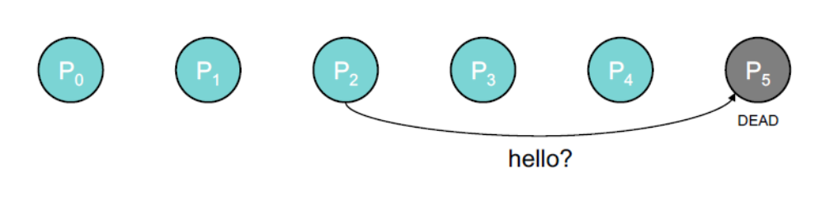
Bully algorithm
Rule: highest # process is the leader
Suppose P5 dies
P2 detects P5 is not responding

Slide 25
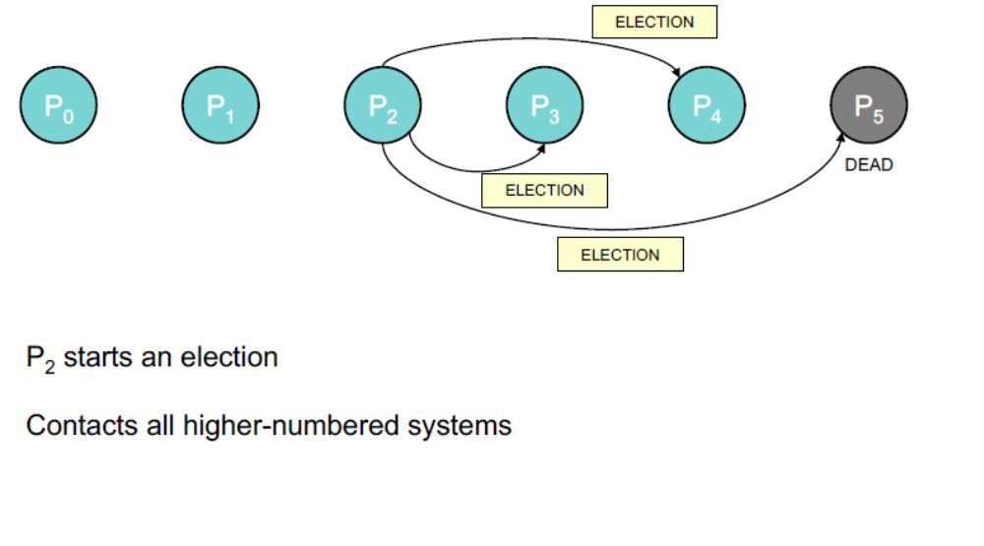
Bully algorithm

Slide 26
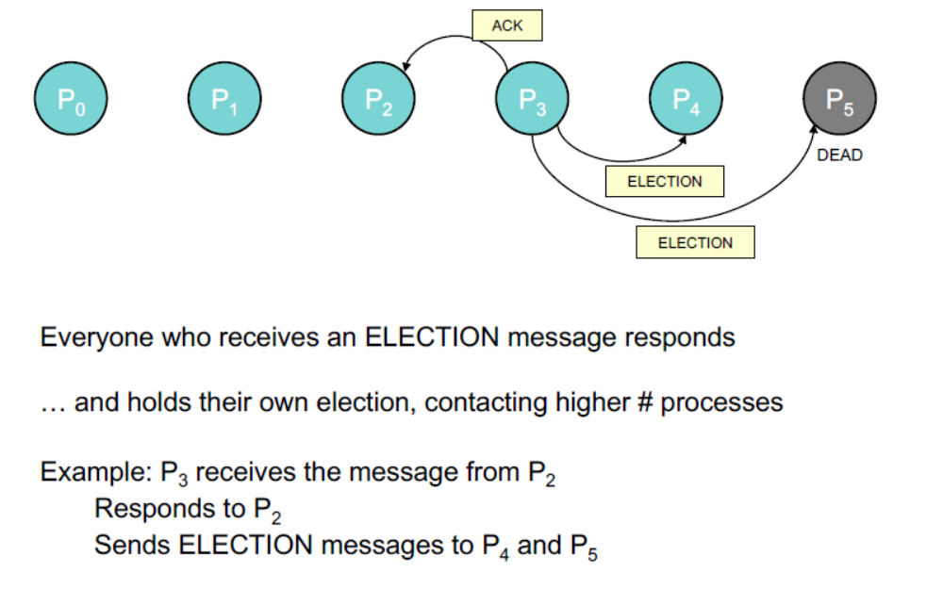
Bully algorithm

Slide 27
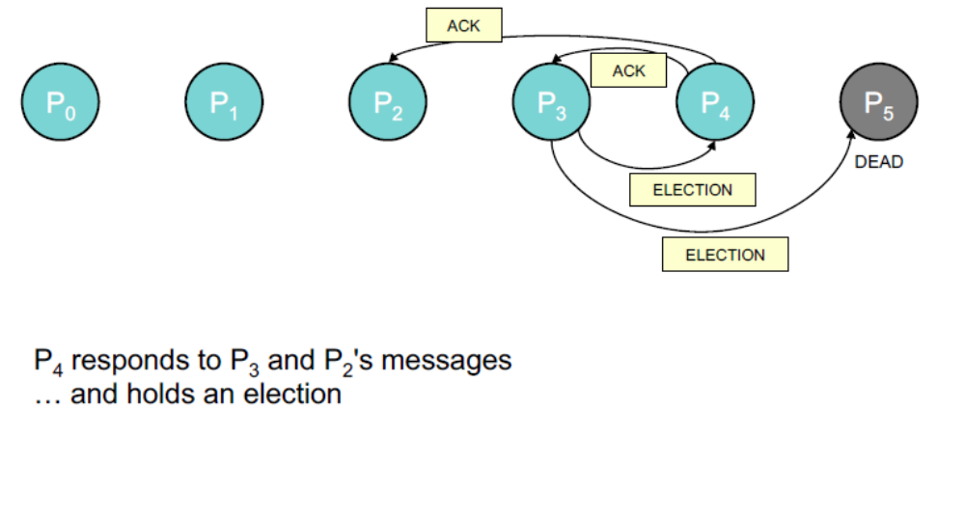
Bully algorithm

Slide 28
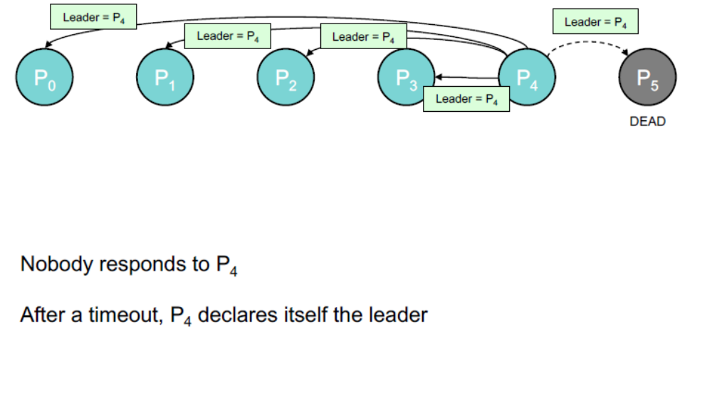
Bully algorithm

Slide 29
Ring algorithm
• Ring arrangement of processes
• If any process detects failure of coordinator
– Construct election message with process ID and
send to next process
– If successor is down, skip over
– Repeat until a running process is located
• Upon receiving an election message
– Process forwards the message, adding its process
ID to the body
Page 22

Slide 30
Ring algorithm
Eventually message returns to originator
– Process sees its ID on list
– Circulates (or multicasts) a coordinator message
announcing coordinator
• E.g. lowest numbered process
Page 23

Slide 31
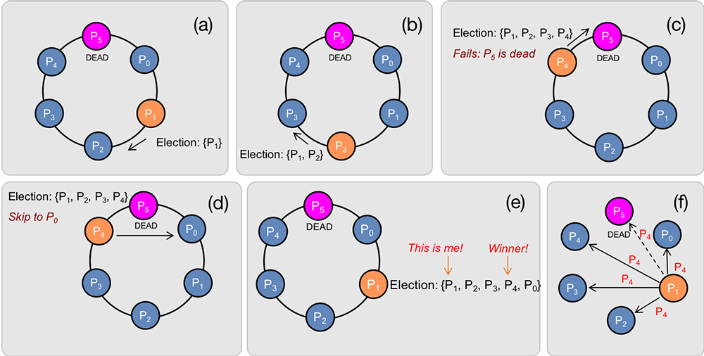
Example of Ring Algorithm

Slide 32







Problems with elections
Network segmentation
– Split brain
Rely on alternate communication mechanism
– Redundant network, shared disk, serial line, SCSI
Page 24
Notes:
One thing to watch out for with election algorithms is network partitioning: the case where processes and machines do not die but a network of machines is segmented into two or more sub-networks that cannot communicate with each other. For example, a machine might become disconnected from the network or a connection between two switches or routers may break. In this case, the machines in each segment of the network will elect their own coordinator. This can lead to the launch of replicated processes, one for each network segment and a lack of any coordination between segments. Detecting whether a machine is dead or whether it is on a partitioned network requires using an alternate communication mechanism, such as a redundant network or some shared resource to which all group members can read and write.

Slide 33
The end.
Page 25

