Slide 1
Distributed Systems
Internetworking

Slide 2
Internet Structure: Network of Networks
Internet is in a hierarchical structure
National/ International Backbone Providers (NBP)
  e.g. BBN/GTE, Sprint, AT&T, IBM, UUNet
  interconnect (peer) with each other privately, or at public Network Access Point (NAPs)
Regional ISPs
  connect into NBPs
Local ISP
  connect into regional ISPs
local
ISP
regional ISP
NBP B
NAP
NAP
NBP A
regional ISP
local
ISP

Slide 3
Internet Protocol (IP)
The IP protocol, defined in RFC 791 (1981) at Layer 3, specifies:
Internet packet format
Internet addressing
Internet routing

Slide 4

Internet Packets
An IP packet, called IP datagram, consists of two parts:
Header
  Contains source and destination address
  Fixed-size fields
Data Area (Payload)
  Variable size up to 64K
  No minimum size

Slide 5
IPv4 datagram format
IP protocol version
number
32 bits
total datagram
length (bytes)
header length
(bytes)
head.
len
type of
service
ver
length
for
fragmentation/
reassembly
“type” of data
flgs
fragment
offset
16-bit identifier
max number
remaining hops
(decremented at
each router)
time to
live
upper
protocol
header
checksum
32 bit source IP address
32 bit destination IP address
upper layer protocol
to deliver payload to
Option part (0 or more words)
e.g. timestamp,
record route
taken, specify
list of routers
to visit.
data
(variable length,
typically a TCP
or UDP segment)

Slide 6
IP Address Details
An IPv4 address has 32 bits (4 bytes) – written like 192.0.2.53
  It consists of two parts: prefix identifies network and suffix identifies host
  It was announced in Jan 2011 that all IPv4 addresses were allocated out.
An IPv6 address is 128 bits, written in hexadecimal. It looks like
  2001:0db8::53. The mark “::” means all zeros in between. So 2001:0db8::53 is 2001:0db8:0000:0000:0000:0000:0000:53
Global authority assigns unique prefix to network (ICANN)
  Internet Corporation for Assigned Names and Numbers http://www.icann.org/
Local administrator assigns unique suffix to host

Slide 7
IPv4 Addresses
The Classful Addressing:
class
A
0
network
host
1.0.0.0 to
127.255.255.255
B
10
network
host
128.0.0.0 to
191.255.255.255
C
110
network
host
192.0.0.0 to
223.255.255.255
D
1110
multicast address
224.0.0.0 to
239.255.255.255
32 bits

Slide 8
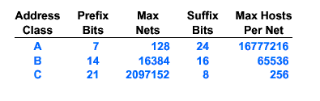
Classes and Network Sizes
Network size is determined by number of bits for hosts
  Class A large
  Class B medium
  Class C small

Slide 9
Are there enough addresses?
Unfortunately No!
  32 bits → 4 billion unique addresses.
  but addresses are assigned in chunks, most of them are not used (particularly class D addresses for multicast).
  techniques, such as CIDR, NAT, and DHCP are introduced to relief the shortage of IP addresses.
Expanding the address space!
  IPv6 128 bit addresses
  Difficult to deploy (require changes to the core of the Internet)
  The transition from IPv4 to IPv6 is very slow

Slide 10
IP address allocation by Geographical Regions
To simplify routing tables, since 1993, IP address allocation follows the geographical regions:
194.0.0.0 to 195.255.255.255 for Europe
198.0.0.0 to 199.255.255.255 for North America
200.0.0.0 to 201.255.255.255 for Central & South America
202.0.0.0 to 203.255.255.255 for Asia Pacific
Routing table size can be greatly reduced, e.g., routers outside Europe can have a single table entry for range: 194.0.0.0 - 195.255.255.255 to be routed to the nearest Europe gateway.

Slide 11
Subnets and Subnet Masks
Subnets allow a big organization (e.g., university), who received a class A or B network address, to further divide its hosts into subnets (LANs):
The host portion of address is further partitioned into subnet number and host number.
Each LAN is assigned a subnet number (subnet address).
To route an IP packet, its dest-IP addr is AND-ed with the subnet-mask, obtaining a subnet number. It is forwarded to the router of the dest-subnet:
The dest-subnet router routes the packet to dest-host using host #.
10 | Network | Subnet | Host
Subnet
mask
1 1 1 1 1 1 1 1 1 1 1 1 1 1 1 1 1 1 1 1 1 0 0 0 0 0 0 0 0 0 0

Slide 12
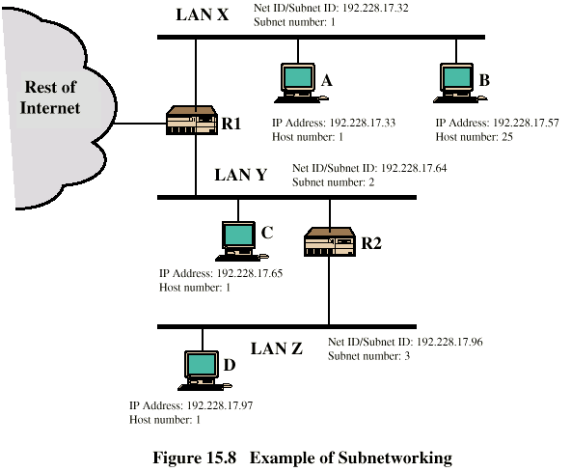
Routing Using Subnets

Slide 13
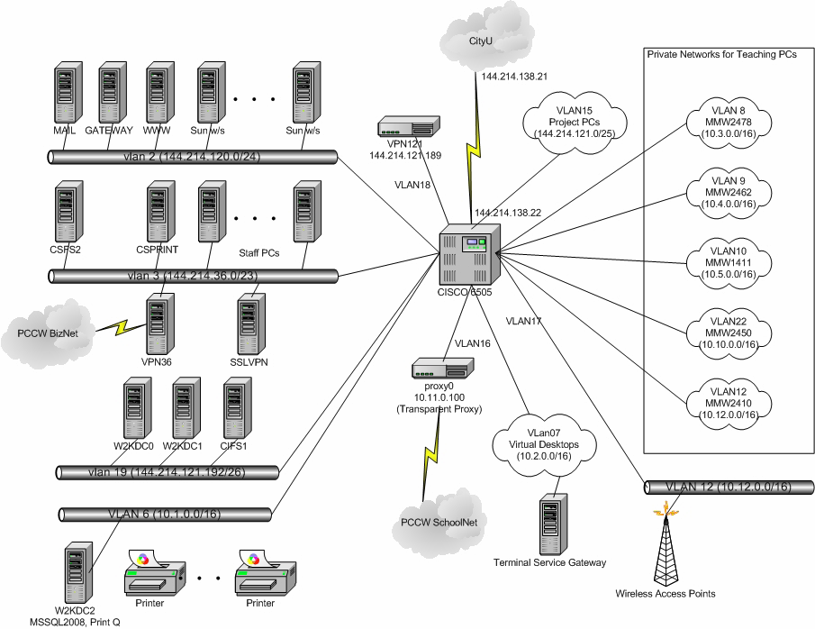
Cslab Subnet Interconnction

Slide 14
Routing Table in CSlab
CSlab has 22 LANs connected to a single router. The router is connected to CSC’s router.
The routing table is very small, only contains 22 VLANs and an entry pointing to CSC router 144.214.138.21 (0.0.0.0 for default routing).
S 169.254.0.0/16 is directly connected, Null0
172.18.0.0/24 is subnetted, 1 subnets
C 172.18.120.0 is directly connected, Vlan21
144.214.0.0/16 is variably subnetted, 8 subnets, 4 masks
C 144.214.122.0/26 is directly connected, Vlan5
C 144.214.121.0/25 is directly connected, Vlan15
……. (8 subnets)
C 144.214.121.192/26 is directly connected, Vlan19
10.0.0.0/8, unregistered address, variably subnetted, 11 subnets, 2 masks
C 10.10.0.0/16 is directly connected, Vlan22
C 10.9.0.0/16 is directly connected, Vlan14
…….. (11 subnets)
S* 0.0.0.0/0 [1/0] via 144.214.138.21 // default router
Default routing

Slide 15
CIDR-Classless InterDomain Routing
The classful addressing
  inefficient in use of address space, resulting in address space exhaustion
  e.g., it has to allocate a class B net address (for up to 65K hosts) to a network with only 1K host.
CIDR: subdivide a network addr (class A, B or C) into any length to make efficient use of IP addr space (this subdividing is visible to entire Internet).
  network portion of address of arbitrary length
  address format: a.b.c.d/x, where x is # of bits for network address
Example of CIDR subdividing a class B net address: 194.24.0.0
University | Base address | Last address | # of hosts | Written as
Cambridge | 194.24.0.0 | 194.24.7.255 | 2048 | 194.24.0.0/21
Edinburgh | 194.24.8.0 | 194.24.11.255 | 1024 | 194.24.8.0/22
Oxford | 194.24.16.0 | 194.24.31.255 | 4096 | 194.24.16.0/20

Slide 16
CIDR Routing
Each entry in CIDR routing table contains a base address and a subnet mask (same as routing in subnets).
For routing an IP packet, its destination IP addr is Boolean ANDed with the subnet mask to see if it matches the entry’s base addr (the longest match is used if multiple matches found).
The packet is routed out via the matched entry’s outgoing link.
Not all routers perform CIDR. (if all routers adopt CIDR, network portion of addresses can be of any length!)
 | Base address | Mask | Out link
C | 194.24.0.0/21 | ff.ff.f8.00 | Cambridge’s router
E | 194.24.8.0/22 | ff.ff.fc.00 | Edinburgh’s router
O | 194.24.16.0/20 | ff.ff.f0.00 | Oxford’s router
Routing table

Slide 17
NAT- Network Address Translation
To relief the shortage of IP addresses, NAT technique uses only a small number of external IP addresses for communicating with outside, and hide local IP addresses from outside (so these local IP addresses can be re-used elsewhere):
All Internet traffic to outside has to go through a NAT box, where the internal IP address (the source IP addr) is replaced by an external IP address.
The source port # field in the IP packet is replaced by the index pointing to the entry in the NAT box’s translation table. This entry contains the internal IP addr and the original source port #.
When an outside IP packet arrives at the NAT box, its destination port # is extracted and used as an index to the translation table, where the original IP addr and port # are extracted and placed back to the packet.
1048
IP: 10.0.0.1
Port: 3333
10.0.0.1
3333
IP: 202.123.211.25
Port: 1048
NAT Table

Slide 18
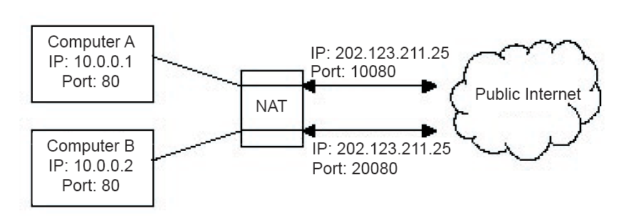
NAT in operation
Translate addresses when packets traverse through NAT.
Use port numbers to identify internal IP users.
This is a dirty way to fix the problem and only works for TCP/UDP traffic.
10080
20080

Slide 19
Dynamic Host Configuration Protocol (DHCP)
To make NAT work, three ranges of IP addresses have been declared for private use (called unregistered addresses):
10.0.0.0 – 10.255.255.255/8
172.16.0.0 – 172.31.255.255/12
192.168.0.0 – 192.168.255.255/16
The allocation of the private IP addresses is done by Dynamic Host Configuration Protocol, a service running on a router:
lease IP addresses for short time period (particularly for mobile users)
hosts may refresh addresses periodically

Slide 20
DHCP in Operation
A DHCP server may serve multiple LANs (subnets).
A DHCP relay-agent is needed on each LAN to enable hosts on this LAN to reach DHCP server via a broadcast message.
When a device (host) is booted up, it broadcasts a DHCP discover packet (to request / discover an IP address).
DHCP discover packet is intercepted by the DHCP agent on the same LAN and forwarded to the DHCP server.
Newly-booted
device
DHCP
Relay-agent
Router
DHCP
server
Other
networks
0
DHCP Discover
Packet (broadcast)

Slide 21
Address Resolution Problem
IP layer specifies the next hop router (destination) by IP addresses. When it gives an IP packet to the underlying network (e.g., Ethernet) for transmission, it needs to insert the “physical addresses” to the packet:
How to determine the MAC addr of an IP addr?

Slide 22
Network Card Hardware Address
(Ethernet address)
Ethernet addresses (48-bits), in the format of:
0e: 3c: 24: 3a: 03: 06
are hard-wired into network cards at factories.
IEEE allocates Ethernet addr to manufactures to ensure the uniqueness of Ethernet addr.
Most network cards understand only hardware addr, not IP addr at all.

Slide 23
ARP- Address Resolution Protocol
ARP provides a mapping from IP addr to physical addr. Suppose A knows B's IP addr and wants to know B’s physical addr:
A broadcasts ARP query packet, containing B's IP address
  all machines on the LAN receive ARP query
B receives ARP packet, replies to A with its (B's) physical layer address
A caches (saves) IP-to-physical address pairs until information becomes old (times out)
  soft state: information that times out (goes away) unless refreshed
ARP shell command: arp

Slide 24
ARP Cache and RARP
ARP maintains a cache of the recent IP to physical address mappings to make address translation fast
Each entry is aged (usually the lifetime is 20 minutes) forcing periodic updates of the cache
ARP replies are often broadcast so that all hosts can update their caches
RARP (Reverse ARP) protocol allows a newly booted-up host to find its own IP address from its physical address (RARP was largely replaced by DHCP).

Slide 25
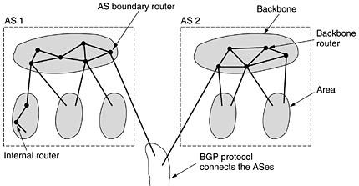
OSPF-Interior Gateway Routing Protocol
Internet consists of a large number of ASes (autonomous systems). Each AS, operated by an organization (or university), can use its own routing algorithm inside. Nevertheless, OSPF (open shortest path first) is a de facto routing standard for intra-AS routing.
An AS is often divided into numbered areas (a subnet or a set of contiguous subnets).
Each AS has a backbone, called area 0. At least one router in each area is connected to the backbone routers.
Some backbone routers (called AS boundary routers) are connected to other ASes for inter-AS routing.

Slide 26
OSPF Algorithm
OSPF abstracts the routers within the AS into a connected graph and assign weight to each edge (distance, delay, etc).
Each router periodically floods Link-State-Update message to its adjacent routers, thus each router knows the topology within the area.
Intra-area routing: each router uses the link state database and runs the shortest path to the destination router.
Inter-area routing: the source router → backbone → the destination area → destination router
Inter-AS routing, the source router → backbone → AS boundary router → destination AS boundary router (via BGP) → dest-router

Slide 27
BGP – Exterior Gateway Routing Protocol
Inter-AS traffics are routed by BGP (Border Gateway Protocol):
Exterior gateway protocol concerns more on routing policies, such as no transit traffic through certain ASes, no relay for certain ASes, etc.
BGP is a distance vector protocol. Each entry in routing table contains: dest, next-hop-to-dest, distance (# of hops). It always chooses the next hop neighbor with the shortest distance to a destination to forward the packet, called next-hop-routing.
Each BGP router exchanges routing info with its neighbors (distances & next-hop to all destinations). After collecting the info from neighbors, a BGP router can update (build up) its own routing table.

