Slide 1
Distributed Systems
Group Communication
Page 1

Slide 2





Modes of communication
• unicast
– 1 1
– Point-to-point
• anycast
– 1 nearest 1 of several identical nodes
• netcast
– 1 many, 1 at a time
• multicast
– 1 many
– group communication
• broadcast
– 1 all
Page 2

Slide 3
Groups
Groups are dynamic
– Created and destroyed
– Processes can join or leave
• May belong to 0 or more groups
Send message to one entity
– Deliver to entire group
Deal with collection of processes as one
abstraction
Page 3
Notes:
Example: mailing list

Slide 4
Design Issues
• Closed vs. Open
– Closed: only group members can sent messages
• Peer vs. Hierarchical
– Peer: each member communicates with group
– Hierarchical: go through coordinator
• Managing membership
– Distributed vs. centralized
• Leaving & joining must be synchronous
• Fault tolerance?
Page 4
Notes:
This will effect how the groups behave or send messages.
No messages should be received by a member after leaving a group.

Slide 5
Implementing
Group Communication
Mechanisms
Page 5

Slide 6

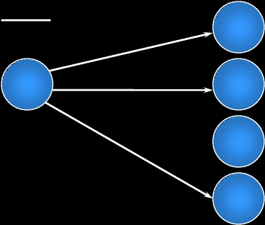
Hardware multicast
Hardware support for multicast
– Group members listen on network address
send addr=a1
listen addr=a1
listen addr=a1
listen addr=a1
Page 6

Slide 7
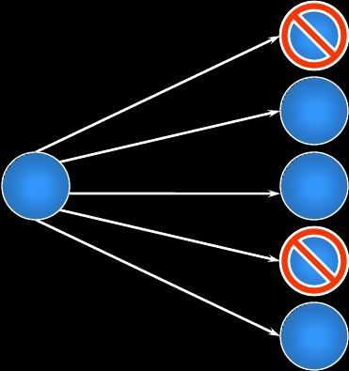
Hardware broadcast
Hardware support for broadcast
– Software filters multicast address
• May be auxiliary address
discard id=m
accept id=m
accept id=m
discard id=m
accept id=m
broadcast(id=m)
Page 7
Notes:
While this method generates overhead for machines that are not members of the group, it requires the sender to only send out a single message.

Slide 8

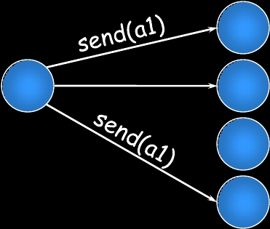
Software: netcast
Multiple unicasts (netcast)
– Sender knows group members
listen local addr=a1
send(a3)
listen local addr=a3
listen local addr=a1
Page 8

Slide 9
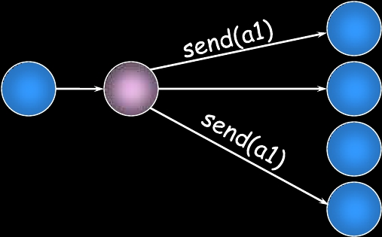
Software
Multiple unicasts via group coordinator
– coordinator knows group members
coordinator
send(a1)
listen local addr
listen local addr
send(c)
listen local addr
Page 9

Slide 10
Reliability of multicasts
Page 10
Notes:
Remote procedure calls (RPC) were, for many applications, more convenient and intuitive than the send/receive (write/read) model provided by sockets. Remote procedure calls, however, do not lend themselves to group communication. RPC is based on a function call model wherein a procedure is called and a value returned as a result. If we try to apply this to group communication, one message is sent to the group to invoke the procedure. The return value is not clear now, since every member of the group may generate one. RPC just does not expect this behavior. We have to fall back on send/receive primitives when working with a group.

Slide 11
Atomic multicast
Atomicity
Message sent to a group arrives at all group members
• If it fails to arrive at any member, no member will
process it.
Problems
Unreliable network
• Each message should be acknowledged
• Acknowledgements can be lost
Message sender might die
Page 11
Notes:
One desirable property for certain types of group communication is that of ensuring that all group members get a message

Slide 12
Achieving atomicity
(2-phase commit variation)
Retry through network failures & system downtime
Sender and receivers maintain persistent log
1. Send message to all group members
•
•
•
Each receiver acknowledges message
Saves message and acknowledgement in log
Does not pass message to application
2. Sender waits for all acknowledgements
•
Retransmits message to non-responding members
–
Again and again… until response received
3. Sender sends “go” message to all members
•
•
Each recipient passes message to application
Sends reply to server
Page 12
Notes:
Persistent log maintain in a disk or non-volatile mememory

Slide 13
Achieving atomicity
All members will eventually get the message
Phase 1:
– Make sure that everyone gets the message
Phase 2:
– Once everyone has confirmed receipt, let the
application see it
Page 13

Slide 14
Reliable multicast
Best effort
– Assume sender will remain alive
– Retransmit undelivered messages
• Send message
• Wait for acknowledgement from each group
member
• Retransmit to non-responding members
Page 14
Notes:
a best-effort attempt at reliability but makes no guarantees in the case where the sender is unable to transmit or receive messages to other group members

Slide 15
Unreliable multicast
• Basic multicast
• Hope it gets there
Page 15

Slide 16
Message ordering
Page 16
Notes:
To make group communication easy to use and understand, two properties are desirable:
atomicity: message arrives everywhere
first-in-first-out (FIFO) message ordering: consistent message ordering.

Slide 17
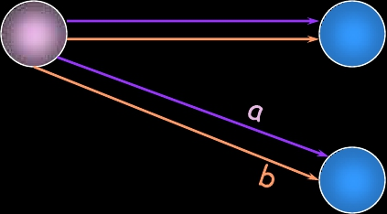
Good Ordering
order received
a, b
a, b
Page 17
message a
message b
Process 0

Slide 18
Bad Ordering
order received
a, b
b, a
Page 18
message a
message b
Process 0

Slide 19
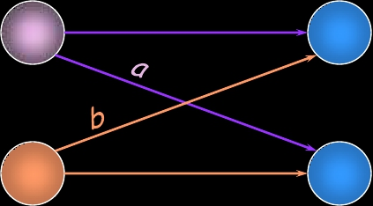
Good Ordering
order received
a, b
a, b
Page 19
message a
message b
Process 0
Process 1

Slide 20
Bad Ordering
order received
a, b
b, a
Page 20
message a
message b
Process 0
Process 1

Slide 21
Sending versus Delivering
• Multicast receiver algorithm decides when to
deliver a message to the process.
• A received message may be:
– Delivered immediately
(put on a delivery queue that the process reads)
– Placed on a hold-back queue
(because we need to wait for an earlier message)
– Rejected/discarded
(duplicate or earlier message that we no longer want)
Page 21

Slide 22

Sending, delivering, holding back
sender
receiver
delivering
Multicast sending
algorithm
?
discard
delivery
queue
hold-back
queue
sending
Multicast receiving
algorithm
Page 22

Slide 23
Global time ordering
• All messages arrive in exact order sent
• Assumes two events never happen at the
exact same time!
• Difficult (impossible) to achieve
Page 23

Slide 24
Total ordering
• Consistent ordering everywhere
• All messages arrive at all group members in the same
order
1. If a process sends m before m’
then any other process that delivers m’
will have delivered m.
2. If a process delivers m’ before m” then
every other process will have delivered m’
before m”.
• Implementation:
– Attach unique totally sequenced message ID
– Receiver delivers a message to the application only
if it has received all messages with a smaller ID
Page 24

Slide 25
Causal ordering
• Partial ordering
– Messages sequenced by Lamport or Vector
timestamps
If multicast(G, m) -> multicast(G, m’)
then every process that delivers m’ will
have delivered m
• Implementation
– Deliver messages in timestamp order per-source.
Page 25
Notes:
Relax ordering further and considering the ordering in relate messages.

Slide 26
Sync ordering
• Messages can arrive in any order
• Special message type
– Synchronization primitive
– Ensure all pending messages are delivered before
any additional (post-sync) messages are accepted
Page 26

Slide 27
FIFO ordering
• Messages can be delivered in different order
to different members
• Message m must be delivered before message
m’ iff m was sent before m’ from the same
host
If a process issues a multicast of m
followed by m’, then every process that
delivers m’ will have already delivered m.
Page 27

Slide 28
Unordered multicast
• Messages can be delivered in different order
to different members
• Order per-source does not matter.
Page 28

Slide 29





Multicasting considerations
atomic
Reliability
reliable
unreliable
Message Ordering
Page 29

Slide 30
IP Multicasting
Page 30

Slide 31
IP Broadcasting
• 255.255.255.255
– Limited broadcast: send to all connected networks
• Host bits all 1 (128.6.255.255, 192.168.0.255)
– Directed broadcast on subnet
Page 31

Slide 32

IP Multicasting
Class D network created for IP multicasting
1110
28-bit multicast address
224.0.0.0/4
224.0.0.0 – 239.255.255.255
Host group
– Set of machines listening to a particular multicast
address
Page 32

Slide 33
IP multicasting
• Can span multiple physical networks
• Dynamic membership
– Machine can join or leave at any time
• No restriction on number of hosts in a group
• Machine does not need to be a member to
send messages
Page 33

Slide 34
IP multicast addresses
• Addresses chosen arbitrarily
• Well-known addresses assigned by IANA
– Internet Assigned Numbers Authority
– RFC 1340
– Similar to ports – service-based allocation
• FTP: port 21, SMTP: port 25, HTTP: port 80
224.0.0.1:
224.0.0.2:
224.0.1.16:
224.0.1.2:
224.0.1.7:
all systems on this subnet
all multicast routers on subnet
music service
SGI’s dogfight
Audionews service
Page 34

Slide 35
LAN (Ethernet) multicasting
LAN cards support multicast in one (or both) of
two ways:
– Packets filtered based on hash(mcast addr)
• Some unwanted packets may pass through
• Simplified circuitry
– Exact match on small number of addresses
• If host needs more, put LAN card in multicast
promiscuous mode
– Receive all hardware multicast packets
Device driver must check to see if the packet
was really needed
Page 35

Slide 36
LAN (Ethernet) multicasting example
Intel 82546EB Dual Port Gigabit Ethernet
Controller
10/100/1000 BaseT Ethernet
Supports:
- 16 exact MAC address matches
- 4096-bit hash filter for multicast frames
- promiscuous unicast & promiscuous multicast
transfer modes
Page 36

Slide 37

IP multicast on a LAN
• Sender specifies class D address in packet
• Driver must translate 28-bit IP multicast group to
multicast Ethernet address
– IANA allocated range of Ethernet MAC addresses
for multicast
– Copy least significant 23 bits of IP address to
MAC address
Bottom 23 bits
• 01:00:5e:xx:xx:xx
of IP address
• Send out multicast Ethernet packet
– Contains multicast IP packet
Page 37

Slide 38
IP multicast on a LAN
Joining a multicast group
Receiving process:
– Notifies IP layer that it wants to receive
datagrams addressed to a certain host group
– Device driver must enable reception of Ethernet
packets for that IP address
• Then filter exact packets
Page 38

Slide 39
Beyond the physical network
Packets pass through routers which bridge
networks together
Multicast-aware router needs to know:
– are any hosts on a LAN that belong to a multicast
group?
IGMP:
– Internet Group Management Protocol
– Designed to answer this question
– RFC 1112 (v1), 2236 (v2), 3376 (v3)
Page 39
Notes:
In the case of multicasting, a multicast-aware routed needs to know whether there are any hosts on a physical network that belong to a multicast group.

Slide 40
IGMP v1
• Datagram-based protocol
• Fixed-size messages:
– 20 bytes header, 8 bytes data
•
•
•
•
4-bit version
4-bit operation (1=query by router, 2=response)
16-bit checksum
32-bit IP class D address
Page 40

Slide 41
Joining multicast group with IGMP
• Machine sends IGMP report:
– “I’m interested in this multicast address”
• Each multicast router broadcasts IGMP
queries at regular intervals
– See if any machines are still interested
– One query per network interface
• When machine receives query
– Send IGMP response packet for each group for
which it is still interested in receiving packets
Page 41
Notes:
When the first process on a machine joins a multicast group。。。。。

Slide 42
Leaving a multicast group with IGMP
• No response to an IGMP query
– Machine has no more processes which are
interested
• Eventually router will stop forwarding packets
to network when it gets no IGMP responses
Page 42
Notes:
The machine never sends a report when a process leaves the group.

Slide 43
IGMP enhancements
• IGMP v2
– Leave group messages added
– Useful for high-bandwidth applications
• IGMP v3
– Hosts can specify list of hosts from which they
want to receive traffic.
– Traffic from other (unwanted) hosts is blocked by
the routers and hosts.
Page 43

Slide 44
IP Multicast in use
• Initially exciting:
– Internet radio, NASA shuttle missions,
collaborative gaming
• But:
– Few ISPs enabled it
– Required tapping into existing streams (not good
for on-demand content)
– Industry embraced unicast instead
Page 44

Slide 45
IP Multicast in use
• IPTV is emerging as the biggest user of IP
multicast
• Traffic is within the provider’s network
– QoS: typically mix of ATM and/or IP
• 2.5 Mbps VBR video
• 256 kbps CBR voice
• Remainder: ABR for IP traffic
– Unicast for video on demand
– Multicast for live content
• Send IGMPv2 message to join a channel when switching
• Burst of unicast data to get the I-frame to ensure 150
msec channel switching times.
Page 45

Slide 46
The end.
Page 46

