Slide 1
Advanced Computer Networking
Qin Yang (yqin@ieee.org)
Computer Science Department
Shenzhen Graduate School
Harbin Institute of Technology
Introduction
1-<number>

Slide 2
Reference Books
Computer Networks
Fourth Edition, By Andrew S. Tanenbaum , Prentice Hall, 4th edition, Published
Computer Networking: A top-down approach, by James Kurose, K. W. Ross, Addison Wesley

Slide 3
Course and TA information
http://mcc.hitsz.edu.cn, course information

Slide 4
Assessment Methods
Final grade will be determined as follows:
  —20% homework&class presentations
  —30% project
  —50% exams
Introduction
1-<number>

Slide 5
Chapter 1: Introduction
Our goal:
get “feel” and terminology
more depth, detail later in course
approach:
  use Internet as example
Overview:
what’s the Internet
what’s a protocol?
network edge
network core
access net, physical media
Internet/ISP structure
performance: loss, delay
protocol layers, service models
network modeling
Introduction
1-<number>

Slide 6
Chapter 1: roadmap
  1.1 What is the Internet?
  1.2 Network edge
  1.3 Network core
  1.4 Network access and physical media
  1.5 Internet structure and ISPs
  1.6 Delay & loss in packet-switched networks
  1.7 Protocol layers, service models
  1.8 History
Introduction
1-<number>

Slide 7





What’s the Internet: “nuts and bolts” view
millions of connected computing devices: hosts = end systems
running network apps
communication links
  fiber, copper, radio, satellite
  transmission rate = bandwidth
routers: forward packets (chunks of data)
router
workstation
server
mobile
local ISP
regional ISP
company
network
Introduction
1-<number>

Slide 8


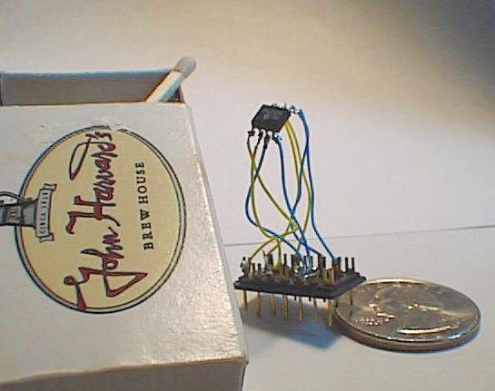

“Cool” internet appliances
Web-enabled toaster +
weather forecaster
IP picture frame
http://www.ceiva.com/
World’s smallest web server
http://www-ccs.cs.umass.edu/~shri/iPic.html
Internet phones
Introduction
1-<number>

Slide 9
What’s the Internet: “nuts and bolts” view
protocols control sending, receiving of msgs
  e.g., TCP, IP, HTTP, FTP, PPP
Internet: “network of networks”
  loosely hierarchical
  public Internet versus private intranet
Internet standards
  RFC: Request for comments
  IETF: Internet Engineering Task Force
router
workstation
server
mobile
local ISP
regional ISP
company
network
Introduction
1-<number>

Slide 10
What’s the Internet: a service view
communication infrastructure enables distributed applications:
  Web, email, games, e-commerce, file sharing
communication services provided to apps:
  Connectionless unreliable
  connection-oriented reliable
Introduction
1-<number>

Slide 11
What’s a protocol?
human protocols:
“what’s the time?”
“I have a question”
introductions
… specific msgs sent
… specific actions taken when msgs received, or other events
network protocols:
machines rather than humans
all communication activity in Internet governed by protocols
protocols define format, order of msgs sent and received among network entities, and actions taken on msg transmission, receipt
Introduction
1-<number>

Slide 12


What’s a protocol?
a human protocol and a computer network protocol:
Hi
TCP connection
request
Hi
TCP connection
response
Got the
time?
Get http://www.awl.com/kurose-ross
2:00
<file>
time
Q: Other human protocols?
Introduction
1-<number>

Slide 13
What’s a protocol?
Case study: web server:
1: type URL of web page
2. Your computer will send a connection request message to the web server and wait for reply.
3. The web server will receive your message and return a connection reply message.
4. Knowing that it is now okay to request the web document, your computer then sends the name of the webpage it wants.
Introduction
1-<number>

Slide 14
Chapter 1: roadmap
  1.1 What is the Internet?
  1.2 Network edge
  1.3 Network core
  1.4 Network access and physical media
  1.5 Internet structure and ISPs
  1.6 Delay & loss in packet-switched networks
  1.7 Protocol layers, service models
  1.8 History
Introduction
1-<number>

Slide 15
A closer look at network structure:
network edge: applications and hosts
network core:
  routers
  network of networks
access networks, physical media: communication links
Introduction
1-<number>

Slide 16
The network edge:
end systems (hosts):
  run application programs
  e.g. Web, email
  at “edge of network”
client/server model
  client host requests, receives service from always-on server
  e.g. Web browser/server; email client/server
peer-peer model:
  minimal (or no) use of dedicated servers
  e.g. Skype, BitTorrent, KaZaA
Introduction
1-<number>

Slide 17
Network edge: connection-oriented service
Goal: data transfer between end systems
handshaking: setup (prepare for) data transfer ahead of time
  Hello, hello back human protocol
  set up “state” in two communicating hosts
TCP - Transmission Control Protocol
  Internet’s connection-oriented service
TCP service [RFC 793]
reliable, in-order byte-stream data transfer
  loss: acknowledgements and retransmissions
flow control:
  sender won’t overwhelm receiver
congestion control:
  senders “slow down sending rate” when network congested
Introduction
1-<number>

Slide 18
Network edge: connectionless service
Goal: data transfer between end systems
  same as before!
UDP - User Datagram Protocol [RFC 768]:
  connectionless
  unreliable data transfer
  no flow control
  no congestion control
App’s using TCP:
HTTP (Web), FTP (file transfer), Telnet (remote login), SMTP (email)
App’s using UDP:
streaming media, teleconferencing, DNS, Internet telephony
Introduction
1-<number>

Slide 19
Chapter 1: roadmap
  1.1 What is the Internet?
  1.2 Network edge
  1.3 Network core
  1.4 Network access and physical media
  1.5 Internet structure and ISPs
  1.6 Delay & loss in packet-switched networks
  1.7 Protocol layers, service models
  1.8 History
Introduction
1-<number>

Slide 20
The Network Core
mesh of interconnected routers
the fundamental question: how is data transferred through net?
  circuit switching: dedicated circuit per call: telephone net
  packet-switching: data sent thru net in discrete “chunks”
Introduction
1-<number>

Slide 21
Network Core: Circuit Switching
End-end resources reserved for “call”
link bandwidth, switch capacity
dedicated resources: no sharing
circuit-like (guaranteed) performance
call setup required
Introduction
1-<number>

Slide 22
Network Core: Circuit Switching
network resources (e.g., bandwidth) divided into “pieces”
pieces allocated to calls
resource piece idle if not used by owning call (no sharing)
dividing link bandwidth into “pieces”
  frequency division
  time division
Introduction
1-<number>

Slide 23
Circuit Switching: FDM and TDM
Example:
FDM
4 users
frequency
time
TDM
frequency
time
Introduction
1-<number>
Notes:
Two simple multiple access control techniques.
Each mobile’s share of the bandwidth is divided into portions for the uplink and the downlink. Also, possibly, out of band signaling.
As we will see, used in AMPS, GSM, IS-54/136

Slide 24
Circuit Switching: FDM and TDM
FDM: common in the radio and television broadcast. Not in cellular telephony.
FDM not support a large user population.
TDM: can be dynamically allocated different bandwidth shared by giving them fewer or more time slots.
TDM: mobile station can use the time slots which it is not transmitting to do other jobs
TDM: mobile station less power than FDM
TDM: longer delay, synchronize problem.
Introduction
1-<number>

Slide 25
Numerical example
How long does it take to send a file of 640,000 bits from host A to host B over a circuit-switched (TDM) network?
  All links are 1.536 Mbps
  Each link uses TDM with 24 slots/sec
  500 msec to establish end-to-end circuit
Let’s work it out!
Introduction
1-<number>

Slide 26
Network Core: Packet Switching
each end-end data stream divided into packets
user A, B packets share network resources
each packet uses full link bandwidth
resources used as needed
resource contention:
aggregate resource demand can exceed amount available
congestion: packets queue, wait for link use
store and forward: packets move one hop at a time
  Node receives complete packet before forwarding
Bandwidth division into “pieces”
Dedicated allocation
Resource reservation
Introduction
1-<number>

Slide 27
Packet Switching: Statistical Multiplexing
100 Mb/s
Ethernet
A
C
statistical multiplexing
1.5 Mb/s
B
queue of packets
waiting for output
link
D
E
Sequence of A & B packets does not have fixed pattern, shared on demand ➔ statistical multiplexing.
TDM: each host gets same slot in revolving TDM frame.
Introduction
1-<number>

Slide 28
Packet-switching: store-and-forward
L
R
R
R
Takes L/R seconds to transmit (push out) packet of L bits on to link of R bps
Entire packet must arrive at router before it can be transmitted on next link: store and forward
delay = 3L/R (assuming zero propagation delay)
Example:
L = 7.5 Mbits
R = 1.5 Mbps
delay = 15 sec
more on delay shortly …
Introduction
1-<number>

Slide 29
Packet switching versus circuit switching
Packet switching allows more users to use network!
1 Mb/s link
each user:
  100 kb/s when “active”
  active 10% of time
circuit-switching:
  10 users
packet switching:
  with 35 users, probability > 10 active less than .0004
N users
1 Mbps link
Q: how did we get value 0.0004?
Introduction
1-<number>

Slide 30
Packet switching versus circuit switching
Is packet switching a “slam dunk winner?”
Great for bursty data
  resource sharing
  simpler, no call setup
Excessive congestion: packet delay and loss
  protocols needed for reliable data transfer, congestion control
Q: How to provide circuit-like behavior?
  bandwidth guarantees needed for audio/video apps
  still an unsolved problem (chapter 7)
Q: human analogies of reserved resources (circuit switching) versus on-demand allocation (packet-switching)?
Introduction
1-<number>

Slide 31
Chapter 1: roadmap
  1.1 What is the Internet?
  1.2 Network edge
  1.3 Network core
  1.4 Network access and physical media
  1.5 Internet structure and ISPs
  1.6 Delay & loss in packet-switched networks
  1.7 Protocol layers, service models
  1.8 History
Introduction
1-<number>

Slide 32
Access networks and physical media
Q: How to connect end systems to edge router?
residential access nets
institutional access networks (school, company)
mobile access networks
Keep in mind:
bandwidth (bits per second) of access network?
shared or dedicated?
Introduction
1-<number>

Slide 33
Residential access: point to point access
Dialup via modem
  up to 56Kbps direct access to router (often less)
  Can’t surf and phone at same time: can’t be “always on”
ADSL: asymmetric digital subscriber line
  up to 1 Mbps upstream (today typically < 256 kbps)
  up to 8 Mbps downstream (today typically < 1 Mbps)
  FDM: 50 kHz - 1 MHz for downstream
  4 kHz - 50 kHz for upstream
  0 kHz - 4 kHz for ordinary telephone
Introduction
1-<number>

Slide 34
Residential access: cable modems
HFC: hybrid fiber coax
  asymmetric: up to 30Mbps downstream, 2 Mbps upstream
network of cable and fiber attaches homes to ISP router
  homes share access to router
deployment: available via cable TV companies
Introduction
1-<number>

Slide 35
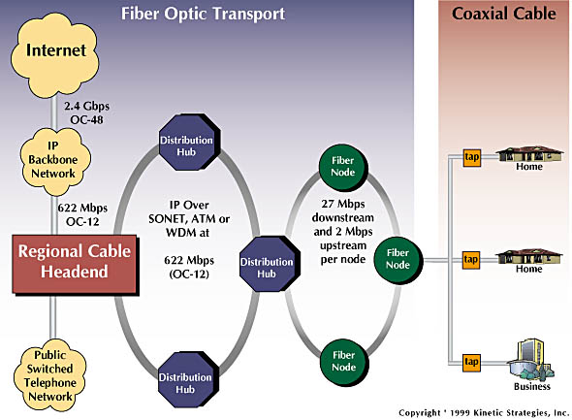
Residential access: cable modems
Diagram: http://www.cabledatacomnews.com/cmic/diagram.html
Introduction
1-<number>

Slide 36

Cable Network Architecture: Overview
Typically 500 to 5,000 homes
cable headend
cable distribution
network (simplified)
home
Introduction
1-<number>

Slide 37
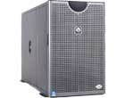
Cable Network Architecture: Overview
server(s)
cable headend
cable distribution
network
home
Introduction
1-<number>

Slide 38
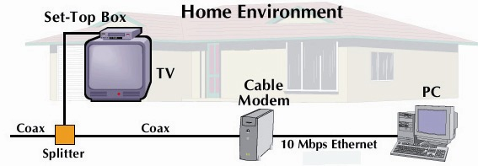
Cable Network Architecture: Overview
cable headend
cable distribution
network (simplified)
home
Introduction
1-<number>

Slide 39
Cable Network Architecture: Overview
FDM:
C
O
N
T
R
O
L
V
I
D
E
O
V
I
D
E
O
V
I
D
E
O
V
I
D
E
O
V
I
D
E
O
V
I
D
E
O
D
A
T
A
D
A
T
A
1
2
3
4
5
6
7
8
9
Channels
cable headend
cable distribution
network
home
Introduction
1-<number>

Slide 40
Company access: local area networks
company/univ local area network (LAN) connects end system to edge router
Ethernet:
  shared or dedicated link connects end system and router
  10 Mbs, 100Mbps, Gigabit Ethernet
LANs: chapter 5
Introduction
1-<number>

Slide 41
Wireless access networks
shared wireless access network connects end system to router
  via base station aka “access point”
wireless LANs:
  802.11b/g (WiFi): 11 or 54 Mbps
wider-area wireless access
  provided by telco operator
  3G ~ 384 kbps
    Will it happen??
  GPRS in Europe/US
router
base
station
mobile
hosts
Introduction
1-<number>

Slide 42
Home networks
Typical home network components:
ADSL or cable modem
router/firewall/NAT
Ethernet
wireless access
point
wireless
laptops
to/from
cable
headend
cable
modem
router/
firewall
wireless
access
point
Ethernet
Introduction
1-<number>

Slide 43
Physical Media
Twisted Pair (TP)
two insulated copper wires
  Category 3: traditional phone wires, 10 Mbps Ethernet
  Category 5:
  100Mbps Ethernet
Bit: propagates between
transmitter/rcvr pairs
physical link: what lies between transmitter & receiver
guided media:
  signals propagate in solid media: copper, fiber, coax
unguided media:
  signals propagate freely, e.g., radio
Introduction
1-<number>

Slide 44


Physical Media: coax, fiber
Fiber optic cable:
glass fiber carrying light pulses, each pulse a bit
high-speed operation:
  high-speed point-to-point transmission (e.g., 10’s-100’s Gps)
low error rate: repeaters spaced far apart ; immune to electromagnetic noise
Coaxial cable:
two concentric copper conductors
bidirectional
baseband:
  single channel on cable
  legacy Ethernet
broadband:
  multiple channels on cable
  HFC
Introduction
1-<number>

Slide 45
Physical media: radio
signal carried in electromagnetic spectrum
no physical “wire”
Bidirectional (omni )
propagation environment effects:
  reflection
  obstruction by objects
  interference
Radio link types:
terrestrial microwave
  e.g. up to 45 Mbps channels
LAN (e.g., Wifi)
  11Mbps, 54 Mbps
wide-area (e.g., cellular)
  e.g. 3G: hundreds of kbps
satellite
  Kbps to 45Mbps channel (or multiple smaller channels)
  270 msec end-end delay
  geosynchronous versus low altitude
Introduction
1-<number>

Slide 46
Chapter 1: roadmap
  1.1 What is the Internet?
  1.2 Network edge
  1.3 Network core
  1.4 Network access and physical media
  1.5 Internet structure and ISPs
  1.6 Delay & loss in packet-switched networks
  1.7 Protocol layers, service models
  1.8 History
Introduction
1-<number>

Slide 47
Internet structure: network of networks
roughly hierarchical
at center: “tier-1” ISPs (e.g., MCI, Sprint, AT&T, Cable and Wireless), national/international coverage
  treat each other as equals
Tier-1 providers also interconnect at public network access points (NAPs)
Tier-1 providers interconnect (peer) privately
Tier 1 ISP
NAP
Tier 1 ISP
Tier 1 ISP
Introduction
1-<number>

Slide 48
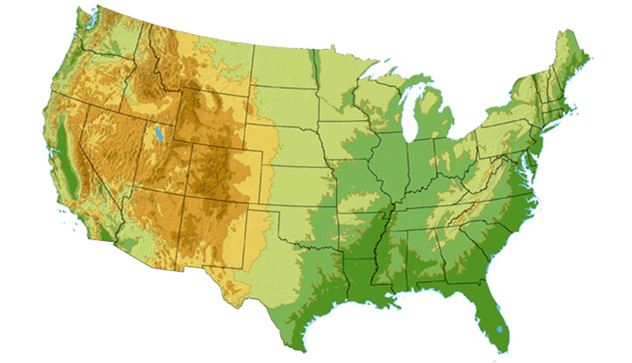

Tier-1 ISP: e.g., Sprint
Sprint US backbone network
DS3 (45 Mbps)
OC3 (155 Mbps)
OC12 (622 Mbps)
OC48 (2.4 Gbps)
Seattle
Tacoma
POP: point-of-presence
to/from backbone
Stockton
New York
Cheyenne
Chicago
Pennsauken
…
peering
….
Relay
San Jose
Roachdale
Wash. DC
Kansas City
Anaheim
…
…
…
Atlanta
to/from customers
Fort Worth
Orlando
Introduction
1-<number>

Slide 49
Internet structure: network of networks
“Tier-2” ISPs: smaller (often regional) ISPs
  Connect to one or more tier-1 ISPs, possibly other tier-2 ISPs
Tier-2 ISPs also peer privately with each other, interconnect at NAP
Tier-2 ISP pays tier-1 ISP for connectivity to rest of Internet
tier-2 ISP is customer of
tier-1 provider
Tier-2 ISP
Tier-2 ISP
Tier 1 ISP
NAP
Tier 1 ISP
Tier 1 ISP
Tier-2 ISP
Tier-2 ISP
Tier-2 ISP
Introduction
1-<number>

Slide 50
Internet structure: network of networks
“Tier-3” ISPs and local ISPs
  last hop (“access”) network (closest to end systems)
local
ISP
Tier 3
ISP
local
ISP
local
ISP
local
ISP
Local and tier- 3 ISPs are customers of
higher tier ISPs
connecting them to rest of Internet
Tier-2 ISP
Tier-2 ISP
Tier 1 ISP
NAP
Tier 1 ISP
Tier 1 ISP
Tier-2 ISP
Tier-2 ISP
Tier-2 ISP
local
ISP
local
ISP
local
ISP
local
ISP
Introduction
1-<number>

Slide 51
Internet structure: network of networks
a packet passes through many networks!
local
ISP
Tier 3
ISP
local
ISP
local
ISP
local
ISP
Tier-2 ISP
Tier-2 ISP
Tier 1 ISP
NAP
Tier 1 ISP
Tier 1 ISP
Tier-2 ISP
Tier-2 ISP
Tier-2 ISP
local
ISP
local
ISP
local
ISP
local
ISP
Introduction
1-<number>

Slide 52
Chapter 1: roadmap
  1.1 What is the Internet?
  1.2 Network edge
  1.3 Network core
  1.4 Network access and physical media
  1.5 Internet structure and ISPs
  1.6 Delay & loss in packet-switched networks
  1.7 Protocol layers, service models
  1.8 History
Introduction
1-<number>

Slide 53
How do loss and delay occur?
packets queue in router buffers
packet arrival rate to link exceeds output link capacity
packets queue, wait for turn
packet being transmitted (delay)
A
B
packets queueing (delay)
free (available) buffers: arriving packets
dropped (loss) if no free buffers
Introduction
1-<number>

Slide 54
Four sources of packet delay
1. nodal processing:
  check bit errors
  determine output link
2. queueing
  time waiting at output link for transmission
  depends on congestion level of router
transmission
A
propagation
B
nodal
processing
queueing
Introduction
1-<number>

Slide 55
Delay in packet-switched networks
3. Transmission delay:
R=link bandwidth (bps)
L=packet length (bits)
time to send bits into link = L/R
4. Propagation delay:
d = length of physical link
s = propagation speed in medium (~2x10⁸ m/sec)
propagation delay = d/s
Note: s and R are very different quantities!
transmission
A
propagation
B
nodal
processing
queueing
Introduction
1-<number>

Slide 56

Caravan analogy
100 km
100 km
ten-car
caravan
toll
booth
toll
booth
Cars “propagate” at
100 km/hr
Toll booth takes 12 sec to service a car (transmission time)
car~bit; caravan ~ packet
Q: How long until caravan is lined up before 2nd toll booth?
Time to “push” entire caravan through toll booth onto highway = 12*10 = 120 sec
Time for last car to propagate from 1st to 2nd toll both: 100km/(100km/hr)= 1 hr
A: 62 minutes
Introduction
1-<number>

Slide 57
Caravan analogy (more)
100 km
100 km
ten-car
caravan
toll
booth
toll
booth
Yes! After 7 min, 1st car at 2nd booth and 3 cars still at 1st booth.
1st bit of packet can arrive at 2nd router before packet is fully transmitted at 1st router!
  See Ethernet applet at AWL Web site
Cars now “propagate” at
1000 km/hr
Toll booth now takes 1 min to service a car
Q: Will cars arrive to 2nd booth before all cars serviced at 1st booth?
Introduction
1-<number>

Slide 58
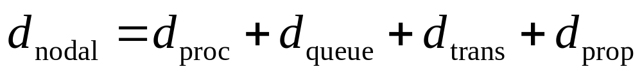
Nodal delay
d_{proc} = processing delay
  typically a few microsecs or less
d_{queue} = queuing delay
  depends on congestion
d_{trans} = transmission delay
  = L/R, significant for low-speed links
d_{prop} = propagation delay
  a few microsecs to hundreds of msecs
Introduction
1-<number>

Slide 59

Queueing delay (revisited)
R=link bandwidth (bps)
L=packet length (bits)
a=average packet arrival rate
traffic intensity = La/R
La/R ~ 0: average queueing delay small
La/R -> 1: delays become large
La/R > 1: more “work” arriving than can be serviced, average delay infinite!
Introduction
1-<number>

Slide 60
“Real” Internet delays and routes
What do “real” Internet delay & loss look like?
Traceroute program: provides delay measurement from source to router along end-end Internet path towards destination. For all i:
  sends three packets that will reach router i on path towards destination
  router i will return packets to sender
  sender times interval between transmission and reply.
3 probes
3 probes
3 probes
Introduction
1-<number>

Slide 61
“Real” Internet delays and routes
traceroute: gaia.cs.umass.edu to www.eurecom.fr
Three delay measurements from
gaia.cs.umass.edu to cs-gw.cs.umass.edu
1 cs-gw (128.119.240.254) 1 ms 1 ms 2 ms
2 border1-rt-fa5-1-0.gw.umass.edu (128.119.3.145) 1 ms 1 ms 2 ms
3 cht-vbns.gw.umass.edu (128.119.3.130) 6 ms 5 ms 5 ms
4 jn1-at1-0-0-19.wor.vbns.net (204.147.132.129) 16 ms 11 ms 13 ms
5 jn1-so7-0-0-0.wae.vbns.net (204.147.136.136) 21 ms 18 ms 18 ms
6 abilene-vbns.abilene.ucaid.edu (198.32.11.9) 22 ms 18 ms 22 ms
7 nycm-wash.abilene.ucaid.edu (198.32.8.46) 22 ms 22 ms 22 ms
8 62.40.103.253 (62.40.103.253) 104 ms 109 ms 106 ms
9 de2-1.de1.de.geant.net (62.40.96.129) 109 ms 102 ms 104 ms
10 de.fr1.fr.geant.net (62.40.96.50) 113 ms 121 ms 114 ms
11 renater-gw.fr1.fr.geant.net (62.40.103.54) 112 ms 114 ms 112 ms
12 nio-n2.cssi.renater.fr (193.51.206.13) 111 ms 114 ms 116 ms
13 nice.cssi.renater.fr (195.220.98.102) 123 ms 125 ms 124 ms
14 r3t2-nice.cssi.renater.fr (195.220.98.110) 126 ms 126 ms 124 ms
15 eurecom-valbonne.r3t2.ft.net (193.48.50.54) 135 ms 128 ms 133 ms
16 194.214.211.25 (194.214.211.25) 126 ms 128 ms 126 ms
17 * * *
18 * * *
19 fantasia.eurecom.fr (193.55.113.142) 132 ms 128 ms 136 ms
trans-oceanic
link
* means no response (probe lost, router not replying)
Introduction
1-<number>

Slide 62
Packet loss
queue (aka buffer) preceding link in buffer has finite capacity
when packet arrives to full queue, packet is dropped (aka lost)
lost packet may be retransmitted by previous node, by source end system, or not retransmitted at all
Introduction
1-<number>

Slide 63
Chapter 1: roadmap
  1.1 What is the Internet?
  1.2 Network edge
  1.3 Network core
  1.4 Network access and physical media
  1.5 Internet structure and ISPs
  1.6 Delay & loss in packet-switched networks
  1.7 Protocol layers, service models
  1.8 History
Introduction
1-<number>

Slide 64
Protocol “Layers”
Networks are complex!
many “pieces”:
  hosts
  routers
  links of various media
  applications
  protocols
  hardware, software
Question:
Is there any hope of organizing structure of network?
Or at least our discussion of networks?
Introduction
1-<number>

Slide 65
Organization of air travel
ticket (purchase)
baggage (check)
gates (load)
runway takeoff
airplane routing
ticket (complain)
baggage (claim)
gates (unload)
runway landing
airplane routing
airplane routing
a series of steps
Introduction
1-<number>

Slide 66

Layering of airline functionality
ticket (purchase)
baggage (check)
gates (load)
runway (takeoff)
airplane routing
ticket (complain)
baggage (claim
gates (unload)
runway (land)
airplane routing
ticket
baggage
gate
takeoff/landing
airplane routing
airplane routing
airplane routing
departure
airport
intermediate air-traffic
control centers
arrival
airport
Layers: each layer implements a service
  via its own internal-layer actions
  relying on services provided by layer below
Introduction
1-<number>

Slide 67
Why layering?
Dealing with complex systems:
explicit structure allows identification, relationship of complex system’s pieces
  layered reference model for discussion
modularization eases maintenance, updating of system
  change of implementation of layer’s service transparent to rest of system
  e.g., change in gate procedure doesn’t affect rest of system
layering considered harmful?
Introduction
1-<number>

Slide 68
Internet protocol stack
application: supporting network applications
  FTP, SMTP, HTTP
transport: process-process data transfer
  TCP, UDP
network: routing of datagrams from source to destination
  IP, routing protocols
link: data transfer between neighboring network elements
  PPP, Ethernet
physical: bits “on the wire”
application
transport
network
link
physical
Introduction
1-<number>

Slide 69
Encapsulation
source
message
M
application
transport
network
link
physical
segment
H_{t}
M
H_{t}
datagram
H_{n}
H_{n}
H_{t}
M
frame
H_{l}
H_{n}
H_{t}
M
link
physical
switch
destination
H_{n}
H_{t}
M
network
link
physical
M
application
transport
network
link
physical
H_{l}
H_{n}
H_{t}
M
H_{n}
H_{t}
M
H_{t}
M
H_{n}
H_{t}
M
H_{l}
H_{n}
H_{t}
M
router
Introduction
1-<number>

Slide 70
Chapter 1: roadmap
  1.1 What is the Internet?
  1.2 Network edge
  1.3 Network core
  1.4 Network access and physical media
  1.5 Internet structure and ISPs
  1.6 Delay & loss in packet-switched networks
  1.7 Protocol layers, service models
  1.8 History
Introduction
1-<number>

Slide 71

Internet History
1961-1972: Early packet-switching principles
1961: Kleinrock - queueing theory shows effectiveness of packet-switching
1964: Baran - packet-switching in military nets
1967: ARPAnet conceived by Advanced Research Projects Agency
1969: first ARPAnet node operational
1972:
  ARPAnet public demonstration
  NCP (Network Control Protocol) first host-host protocol
  first e-mail program
  ARPAnet has 15 nodes
Introduction
1-<number>

Slide 72
Internet History
1972-1980: Internetworking, new and proprietary nets
1970: ALOHAnet satellite network in Hawaii
1974: Cerf and Kahn - architecture for interconnecting networks
1976: Ethernet at Xerox PARC
ate70’s: proprietary architectures: DECnet, SNA, XNA
late 70’s: switching fixed length packets (ATM precursor)
1979: ARPAnet has 200 nodes
Cerf and Kahn’s internetworking principles:
  minimalism, autonomy - no internal changes required to interconnect networks
  best effort service model
  stateless routers
  decentralized control
define today’s Internet architecture
Introduction
1-<number>

Slide 73
Internet History
1980-1990: new protocols, a proliferation of networks
1983: deployment of TCP/IP
1982: smtp e-mail protocol defined
1983: DNS defined for name-to-IP-address translation
1985: ftp protocol defined
1988: TCP congestion control
new national networks: Csnet, BITnet, NSFnet, Minitel
100,000 hosts connected to confederation of networks
Introduction
1-<number>

Slide 74
Internet History
1990, 2000’s: commercialization, the Web, new apps
Early 1990’s: ARPAnet decommissioned
1991: NSF lifts restrictions on commercial use of NSFnet (decommissioned, 1995)
early 1990s: Web
  hypertext [Bush 1945, Nelson 1960’s]
  HTML, HTTP: Berners-Lee
  1994: Mosaic, later Netscape
  late 1990’s: commercialization of the Web
Late 1990’s – 2000’s:
more killer apps: instant messaging, P2P file sharing
network security to forefront
est. 50 million host, 100 million+ users
backbone links running at Gbps
Introduction
1-<number>

Slide 75
Introduction: Summary
Covered a “ton” of material!
Internet overview
what’s a protocol?
network edge, core, access network
  packet-switching versus circuit-switching
Internet/ISP structure
performance: loss, delay
layering and service models
history
You now have:
context, overview, “feel” of networking
more depth, detail to follow!
Introduction
1-<number>

