Slide 1
Network Performance Analysis & Evaluation

Slide 2
Network Study & Research
Some Myths about the Network Problem
  Congestion occurs when the demand is greater than the available resources: ΣDemand>Available Resources
    E.g. Insufficient router memory, slow processors (of routers), low bandwidth links, etc.
  As resources become less expensive, the problem of congestion will be solved automatically?

Slide 3
Congestion discussion
Congestion is caused by a shortage of buffer space and will be solved when memory becomes cheap enough to allow infinitely large memories?
Congestion is caused by slow links. The problem will be solved when high-speed links become available?
Congestion is caused by slow processors. The problem will be solved when the speed of the processors is improved?
- If not one, then all of the above developments will cause the congestion problem to go away?

Slide 4
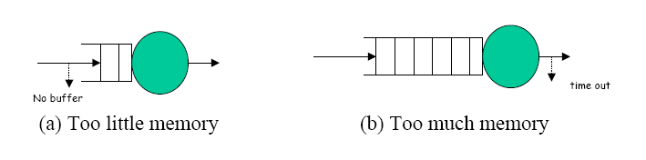
Could the congestion problem be solved with a large buffer space?
Too little memory:
  too much traffic will lead to buffer overflow and packet loss
• Too much memory:队列太长，延时太长超时导致重发。
  the queues and the delays can get so long that by the time the packets come out of the switch, most of them have already timed out and have been retransmitted by higher layers packets (or their retransmissions) have to be dropped after they have consumed precious network re-sources.
• Too much memory in the intermediate nodes is as harmful as too little memory.

Slide 5
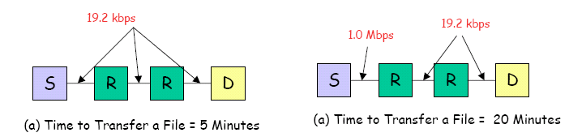
Could the congestion problem be solved with high-speed links?
Introducing high-speed links without proper congestion control can lead to reduced performance the same speed
  (a) The time to transfer a particular file was five minutes.
  (b) The link between the first two nodes was replace by a fast 1 Mbits link, the transfer time increased to 20 Minutes!
With the high-speed link, the arrival rate to the first router became much higher than the departure rate, leading to long queues, buffer overflows, and packet losses that caused the transfer time to increase.
The protocols have to be designed specifically to ensure that this increasing range of link speeds does not degrade the performance.

Slide 6
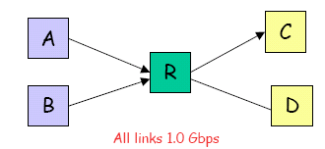
Could the congestion problem be solved with high-speed processors?
Similar to that for links. Introduction of a high-speed processor in an existing network may increase the mismatch of speeds and the chances of congestion.
Introducing high-speed links without proper schemes Congestion occurs even if all links and processors are of the same speed.
An example of the balanced configuration
- Assume all processors and links have a throughput capacity of 1 Gbits. A simultaneous transfer of data from nodes A and B to node C can lead to a total input rate of 2 Gbits per second at the router R while the output rate is only 1 Gbits per second, thereby, causing congestion.

Slide 7
Solutions?
Congestion in networks is a dynamic problem. It cannot be solved with static solutions alone.
We need protocol designs that protect networks in the event of congestion.
The explosion of high-speed networks has led to more unbalanced networks that are causing congestion.
In particular, packet loss due to buffer shortage is a symptom not a cause of congestion.
Solution: proper protocols and mechanisms design, e.g. Admission Control, Scheduling, et. al

Slide 8
Interesting Readings
Quality of Service Control in High-speed Networks, by H.J. Chao, John Wiley,2002
Internet QoS: Architectures and Mechanisms for Quality of Services , Z. Wang , Morgan Kaufmann ,2001
Specification of guaranteed quality of service, S. Shenker , RFC 2212, Sept 1997
S. Keshav, An Engineering Approach to Computer Networking: ATM Networks, the Internet, and the Telephone Network, Addison-Wesley, 1997.

Slide 9
Markov Process
We observe discrete time process which permit the particle to occupy discrete positions and permit transitions between these positions only at discrete time.
B
3/4
1/4
A
1/4
1/4
3/4
1/4
C
1/2

Slide 10
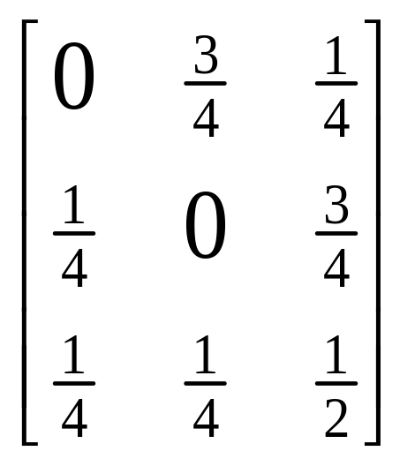
Discrete Time Process离散时间过程
Consider the hippie who hitchhikes from city to city across the country.
Transition probability matrix P =

Slide 11

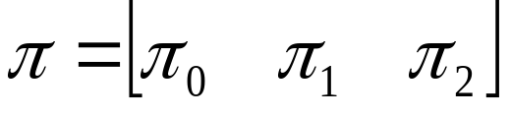
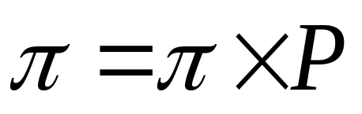
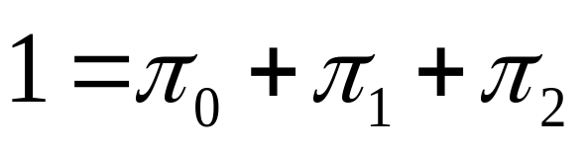
Discrete Time Process
We further define the probability vector
We may define that:
We also have

Slide 12
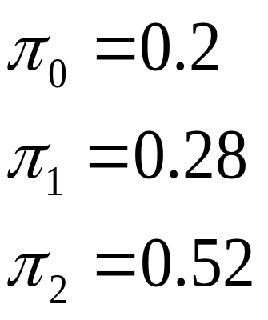
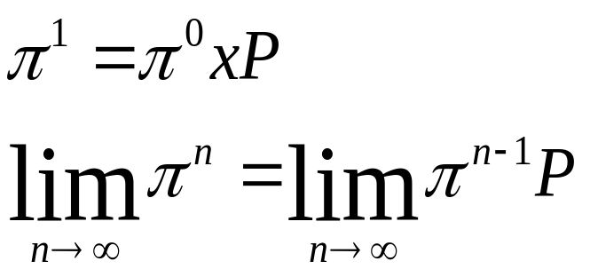
Discrete Time Process
We can solve the equation and get the the solution:
We have a method for
calculating

Slide 13
Discrete Time Process
Note that the solution is independent of the initial state vector.
Applying this to the example, assuming the hippie begins in different city.

Slide 14
Queuing Theory
To specify a queuing system, we need to specify these six parameters. A shorthand notation is called Kendall notation in the form A/S/m/B/K/SD

Slide 15
Queuing Theory
1. Arrival Process: called interarrival times. The most common arrival process is the so-called Poisson arrivals, which means independent and identically distributed (IID) and exponentially distributed.
  M: Exponential, Ek Erlang with parameter K, D: Deterministic, G: General
2. Service Time Distribution: The distribution most commonly used is the exponential distribution.

Slide 16
Queuing Theory
Number of servers:
System Capacity: The maximum number of customers who can stay may be limited due to space capacity, buffer size.
Population size: The total number of potential customers who can ever come to the computer center. In most systems, it is finite. However, when it is large, we assume that the size is infinite.
Service Discipline: First come/First served, last come/First served, Last come, First served with preempt and Resume.

Slide 17



Queuing Theory
Key variables in the analysis of single queue:
  interarrival time,
  Mean arrival rate = 1/E[ ].
  S service time per job.
  mean service rate per server, = 1/E[s]. The total service rate for m servers is m
  N number or jobs in the system, include number of jobs in the queue and number of jobs receiving service.
  R response time includes both the time waiting and the time receiving service.
  W waiting time

Slide 18
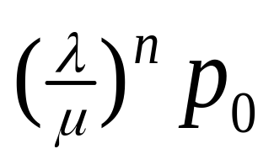
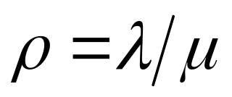
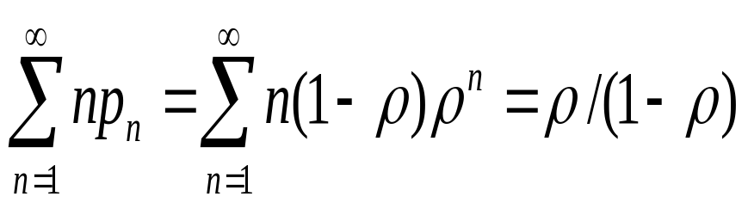
Queuing Theory
State transition diagram
M/M/1: The expression of probability of n jobs in the system: Pn= , let
The mean number of jobs in the system is given by: E[n] =
0
1
2
J+1

Slide 19
Queuing Theory
What is the utilization of the server.
What is the mean response time ( later)
M/M/m queue:

Slide 20
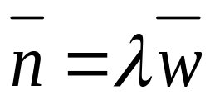
Little’s Result
One of most commonly used theorems:
Mean No. in the system = arrival rate x mean response time
It applies to all system or parts of system in which the number of jobs entering the system is equal to those completing service.
Even in the systems in which some jobs are lost due to finite buffers, the law can be applied to the part of the system consisting of the waiting and serving positions. In other words, the effective arrival rate of jobs entering the system should be used.

Slide 21
Little’s Result
Example: A monitor on a disk server showed that the average time to satisfy an I/O request was 100 milliseconds. The I/O rate was about 10 requests per second. What was the mean number of requests at the disk server?
Mean number in the disk server = arrival rate x response time= (10 requests/second) x (0.1 second) = 1 requests

Slide 22
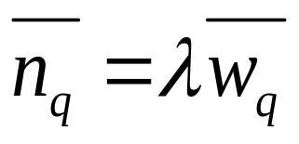
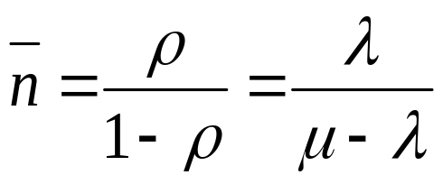
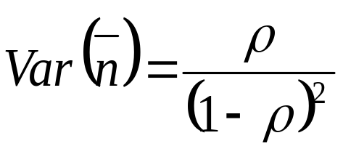
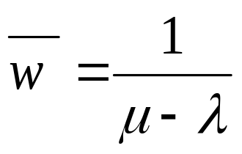
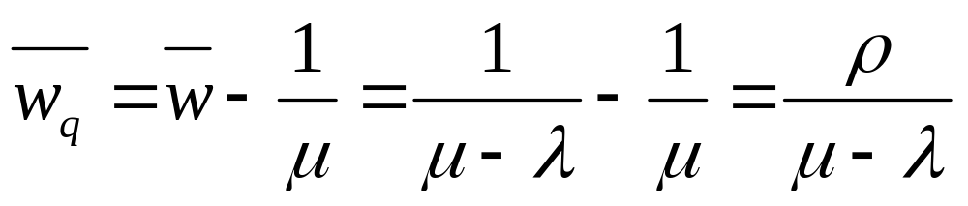
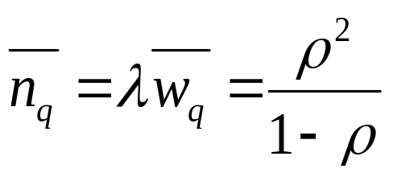
Recall from Little’s result:
Note, the followings are for M/M/1:

Slide 23




Hence, Little’s result can be used to compute various statistics as well as to verify the correctness of some of the statistics collected directly from the simulation
  For instance, based on the information on , and the utilization factor, one can compute and to verify the corresponding statistics collected from the simulation
Note that at steady state, throughput is approximately equal to the arrival rate
  One can hence estimate based on and vice versa using Little’s result

Slide 24
Priority Queue
Different from regular queuing system (with FCFS), priority queuing system based on privileges, with arriving packets being divided into several priority class.
What is the utilization of priority queue?(multi-media, instructions…)

Slide 25
Priority Queue
Basic concepts for priority systems:
1. Pre-emptive queue: service of a customer can be interrupted when a customer with a higher priority class arrives. 优先队列
2. Non-preemptive queue: customers’ service can never be interrupted.非优先队列

Slide 26



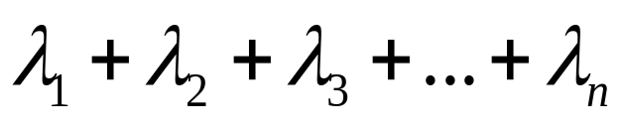

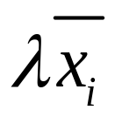
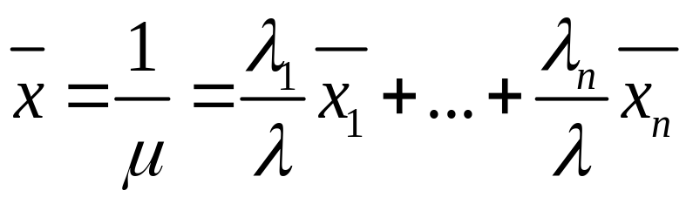
M/G/1 Non-preemptive queue
Key variables in the analysis of non-preemptive queue:
  arrival rate of customers with priority class i
  mean service time for each customer with priority class i, second moment is .
  total arrival rate =
  utilization of each class of customers =
  average service time is given by

Slide 27
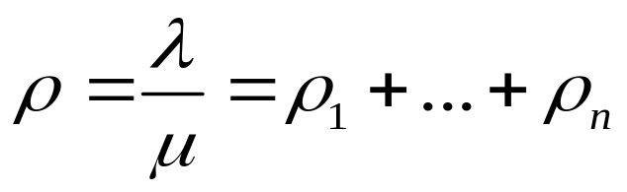
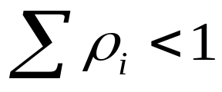
M/G/1 Non-preemptive queue
Key variables in the analysis of non-preemptive queue:
  System utilization is given by
Note: the system will reach equilibrium only when . If the condition is violated, some of priority classes will not reach equilibrium.

Slide 28

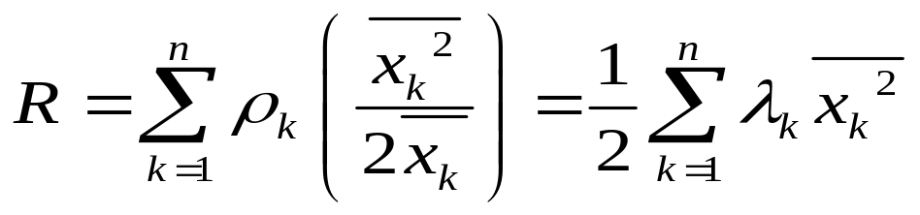
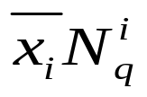
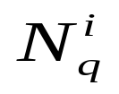
For customer of Class i who arrives at the system
the mean waiting time in the queue contains following four parts:
  The mean residual service time
  The mean total service time of those customers of the same class ahead of him/her in the waiting queue, is .
  is the average customer numbers in queue for class i.

Slide 29
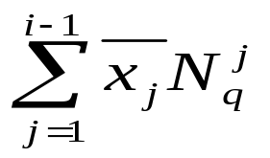

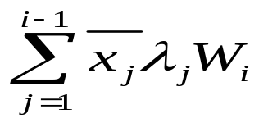
  The mean total service time of those customers of Class j(j<i) found in the system at the arrival time,
  The mean total service time of those customers of Class j(j<i) arriving at the system while customer is waiting in the queue, .

Slide 30
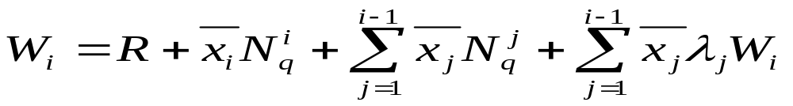
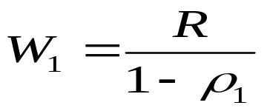
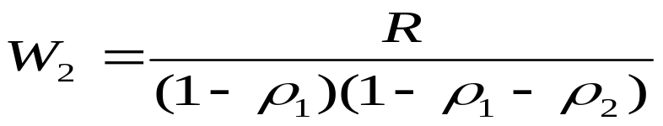
Hence, For customer of Class i who arrives at the system, his/her mean waiting time in the queue is given by:
For Class 1 customers :
For Class 2 customers :
In general, For Class i customers :

Slide 31
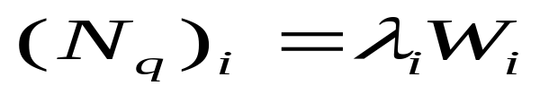

Performance Measurement
Given the mean waiting time, non-preemptive queuing systems can be measured by:
  Average customer numbers of each class in their own waiting queue:
  Total time a customer of Class i spend in the system:

Slide 32

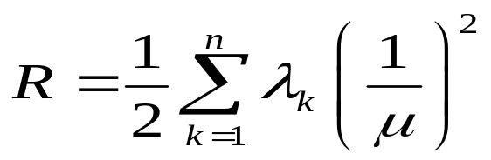
Performance Measurement
  Total time a customer of Class i spend in the system:
  If service times of all customers are exponentially distributed with a mean of , then R can be rewrite as:

Slide 33

Priority Queue
Example: A packet switch network has two type of packets. Data packets with fixed length of 4800 bits and control packets with fixed length of 192 bits. On average, there are 15% control packets and 85% data packets present in the network. Arriving rate for each switching node follows Poisson distribution at rate
=4 packets per second, all links operate at 19.2 kbps. Calculate:
The average waiting time for both type of packets at a switching node.
The waiting times for two packet types respectively, with non-preemptive priority scheme, where control packets have a higher priority.

Slide 34






Priority Queue
Solution
Given: Data packets , and
Control packets , and
and
,

Slide 35
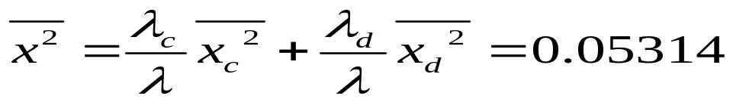
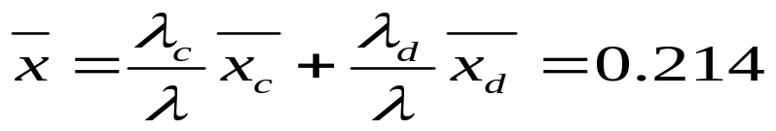
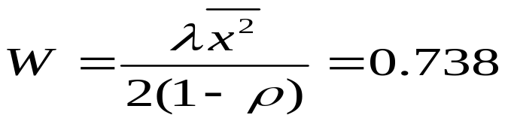
Priority Queue
Solution
Without priority scheme, the combined stream can be modeled as an M/G/1 queue
Therefore
s

Slide 36


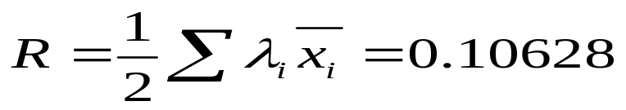
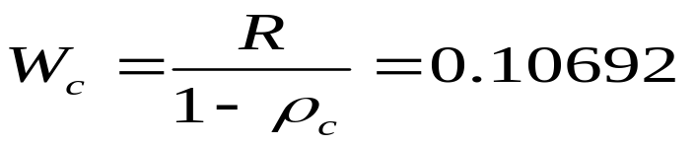
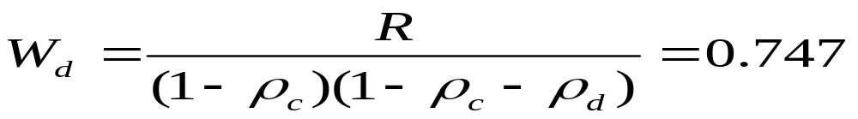
Priority Queue
Solution
With priority incorporated
Therefore
s
s

