Slide 1
Advanced Computer Networks Modeling & Simulation
Dr. Yang Qin(csyqin@hit.edu.cn)

Slide 2
Ref:
1. A. M. Law and W. D. Kelton, Simulation Modeling & Analysis, 1999, McGraw Hill
Hoover and Perry, Simulation – A Problem Solving Approach, Addison Wesley, 1989

Slide 3
SIMULATION: Overview
Defn:
Construction of an abstract model representing some system in the real world, and then conduct computer-based experiments with the model to describe, explain, and predict the behaviour of the real system.
构建一个抽象模型来代表真实世界，模拟实验来描述、解释、预测真实系统的行为
The technique can be viewed as a combination of MODELLING and MEASUREMENT
  It requires a model of the SYSTEM, a model of the WORKLOAD and a SIMULATOR
  The SIMULATION describes the essentials of the system as a series of equations and relationships, embedded in a computer program

Slide 4
Widely used by practitioners because of
  high degree of realism can be included in the simulation models
  provides a testing ground to gain insight into the functioning of systems
Many simulation systems have been designed specifically around existing or proposed systems
  each simulation would probably have to be custom tailored to the individual system
  major changes to include other systems would entail a complete rewriting
    systems differ so much in their organization and operations

Slide 5
determining what to include in the simulation is a difficult question
  if the level of detail in the simulation is too fine
    the simulator may be too expensive to use
    i.e. requires long computation time and/or large amount of memory
  if the detail is too gross, the result may be misleading

Slide 6
Levels of Details 细节多少问题
Simulation based on too few details might not yield reliable results, whereas with too much details, simulation becomes too costly.
The right level of details depend on:
  The purpose of the performance evaluation task
  The degree of understanding of the system to be modeled
  Its environment
  The output statistics required

Slide 7
E.g. The design of a model that simulates the CPU execution of instructions.
  Detailed microscopic simulation is necessary if we are interested in the CPU design
At the other extreme, a simulation model may represent a router as a single entity
  e.g. In the design of a computer network, the allocation of processing power and communication links are the major issues to be investigated

Slide 8
Reasons for using Simulation
Performance Evaluation
  project the behavior of an existing or proposed system under a wide range of environmental conditions
  provides excellent results for Selection Evaluation between different alternatives
Design Aid
  A simulation model of a system under development is often used in making design decisions and determining the probable effects of alternate design schemes
Project Planning
  Simulation is used for projecting performance or future behavior of proposed systems

Slide 9
When to use Simulation?
The real network does not exist
Experimentation with the real network may cause serious disruptions
There is a need to study the past, present, or future behavior of the network
Mathematical modeling of system is too complex
Mathematical models have no simple and practical analytical or numerical solutions

Slide 10
Advantages of using Simulation
System performance under new workload/new configuration can be evaluated more efficiently
Can get result faster
Generally less costly (**)
A model is less risky to experiment with

Slide 11
Limitation of Simulation
Neither a science nor an art, but a combination of both.
Iterative, experimental problem solving technique.
  Expensive in terms of manpower and computer time.
Generally yields suboptimum solutions.
Difficult in validation.
Collection, analysis, and interpretation of results require a good knowledge of probability and statistics.
Difficult to trace sources of errors.

Slide 12
Simulation Vs. Analytic Modeling
Simulation Modeling
Adv:
  can model and study systems of arbitrary complexity
  provide an effective experimental environment which will not impact on operations and will compress much simulated experience into a short time period
Disadv:
  often costly to develop and run the simulation programs
  can be very difficult to establish the validity of the model
  generally not easy to give interpretations to the relationships between input parameters and performance measures

Slide 13
Analytic Modeling
Adv:
  concise in problem description
  ease of evaluating the impact of changes in inputs on output measures
  may be able to produce optimum solution in some cases
  usually less costly to compute numerical results
  easier to give interpretations to results
Disadv:
  solution to complex models are not available
  assumptions regarding system description may be unrealistic
  mathematical formulation necessary to reflect the desired degree of realism may be intractable

Slide 14
Types of Simulations
A simulation using hardware or firmware is called emulation.
We will introduce the variety of simulations.

Slide 15
Discrete Vs. Continuous Simulation
Discrete System
State of system changes by discrete values and at discrete time instants
e.g. A queuing system
  the number of jobs in the queue increases by 1 when a job joins the queue, and decreases by 1 when a job finishes service
Continuous System
State of system changes continuously and smoothly over time
  typically modeled by a set of differential equations 微分方程
E.g. A dam: state is water level
E.g. Velocity or Voltage

Slide 16
Self-driven Vs Trace-driven Simulations
Trace-driven Simulator
  Driven by historical input data is called trace-driven. Workload is a deterministic sequence of resource demands which can be built artificially or extracted from an event trace obtained from an existing system
  An event trace is a time record of important events that occurred while a system is processing its natural workload or some benchmark
  The recorded trace data is then edited and translated into a form suitable for simulator input

Slide 17
Self-driven Simulator
  the inter-arrival time of jobs and service time are described by a probability distribution functions
  任务和服务时间是一个概率分布模型
  drive the simulator by using the random sequences corresponding to a prob. dist. 随机序列对应概率分布
    e.g. the arrival time t(i) is determined by adding the inter-arrival time X(i) to the previous arrival time
    t(i) = t(i-1) + X(i)

Slide 18
BASIC STEPS IN A SIMULATION STUDY
Outline the objective of the study, e.g.
概述研究目标
  Prediction of system performance for a given set of inputs
  Evaluate of alternative system design strategies
  Control input for a given level of performance
Have a clear understanding of the system and identify
  The essential characteristics (i.e. factors that affect the model most)
  The input parameters
  The measures that best characterize the system performance

Slide 19
Design a model for the system.
  A model is an ABSTRACTION of the system obtained by capturing the essential system characteristics.
  Any simplifying assumptions made should be mentioned and justified.
  For a complex system, a structural approach should be used:
    e.g. a top-down refinement of a system into subsystems and then to entities, attributes, events, etc., or
    a bottom-up approach of modeling subsystems, and then combining subsystem models into a total system model.
Design and implement a simulation program for the model developed.

Slide 20
Run acceptance tests on the program.
  Apply inputs to the program which will result in predictable results, even though these inputs may not be representative of the inputs to the real system.
Estimate the input parameters for the system.
  By observing the real system and characterize the system parameters as constants or probability distributions.
  If the system is still in planning stage, estimate the parameters from observations made in existing systems that are similar in nature.

Slide 21
Validate the model
  The process of checking the consistency of the model with the real system
  Determine if the model represent correctly a certain aspect of the system
  Provides info. for the analyst to refine the model
  The development of a useful model is therefore a REPEATED process of model refinement.
Design the simulation experiments
  Since random numbers are used in the execution, one may rerun the program with a new set of random numbers and expect to see results which differ from other runs.

Slide 22
Run the simulation program with selected values for the system parameters, and collect data for the desired performance measures
Analysis and interpretation of the output data
  statistical methods should be used to support the conclusions of the study
NOTE:
The above steps need not be pursued strictly in sequence; it is possible to do several steps in parallel.
  E.g. One may begin collecting data while still observing the system to gain understanding.
One should always be ready to discard false starts and start over again.

Slide 23
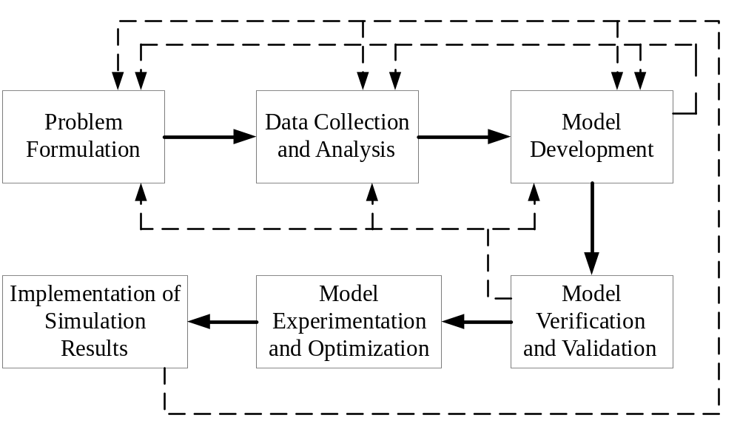

Slide 24
Transient Removal
The steady-state performance, the performance which after the system has reached a stable state, is of interest. The initial part is called transient state.
Main difficulty: not possible to define exactly what constitute the transient and when that ends.
Some heuristic methods:

Slide 25
Transient Removal
Long runs
Proper initialization
Truncation ( variability during steady is less)
Initial data deletion
Moving average of independent replications
Batch means ( running a very long simulation and dividing it up into several parts)

Slide 26
Stopping Criteria
Variance estimation
Some systems never reach a steady state, using terminating simulations.

Slide 27
Discrete Event Simulation - Terminology
Entity - a component of the system (can be the system itself)
Attribute - a property of an entity
  Example: A Single Server Queue
    Arrival Queue Server Departure
Entity | Attribute
Server | Service rate
Customer | Service requirement
Queue | Discipline (e.g. FIFO, LIFO)
System | Customer inter-arrival time

Slide 28
State
  Description of system based on its crucial entities
    e.g. For single server queue: state is the number of customers in the system
Event
  instantaneous operation which changes the state of the system, e.g.
    customer arrival
    customer departure
Activity
  started and terminated by related events

Slide 29
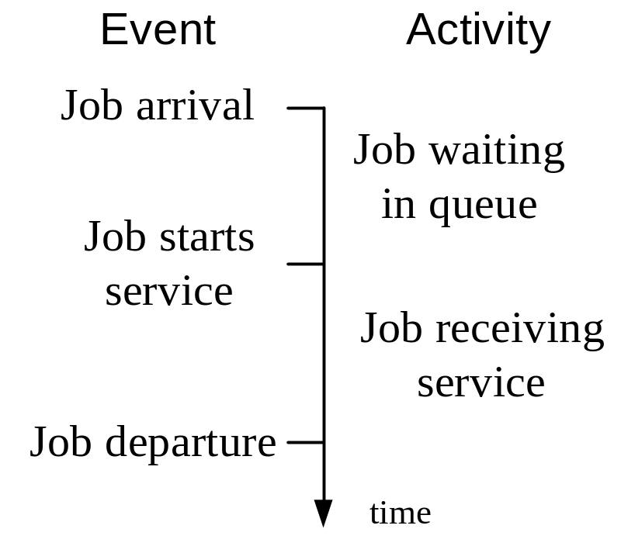
    e.g. Single server queue
Note: “Job start service” is a Conditional Event, i.e. its occurrence is affected by the other events, as it occurs only when
  An arrival finds the server idle, or
  A departure left behind a non-empty queue

Slide 30
Input parameters
  attribute that an investigator varies among experiments
  e.g. jobs inter-arrival time, service time, # of servers
Performance measures
  measures which characterizes system performance
  e.g. utilization factor, mean waiting time, mean # of jobs in system
Note:
  If the system is empty when a job arrives, the "wait in queue" activity takes zero time and the events "job arrival" and "start service" occur at the same time.
  If the server is busy when a job arrives, the "job starts service" event occurs at the same time as the event "job departure" for the job preceding it according to the queuing discipline.

Slide 31
Scheduling of Events
the event list may consist of 2 future events
  when the next job arrive
  when the server will finish servicing the current job in service
each time an arrival or service completion occurs, the simulator determines how long it will be until the next time this type of event will occur and adds this to the current clock time
  this sum is inserted into the event list

Slide 32
Simulation Tools
Simulation Tools
consists of simulation languages and simulators
Simulation languages
  provide basic mechanism for constructing a discrete event simulator for general systems
  can be implemented using general purpose programming languages such as FORTRAN, PASCAL, C, etc.
  There are also special purpose simulation languages that have built in facilities for scheduling events and gathering basic statistics
    e.g. GPSS, SIMSCRIPT, SIMULA

Slide 33
Simulator
Simulator
  A graphic interface is usually provided for user to specify the system model
  User needs not to worry about programming the simulation details and data collection
  E.g. Opnet, Comnet, NS2, Glomosim

Slide 34
Approaches to Discrete Simulation
Process Approach
concentrate on the progress of a transaction as it passes through the model
the program flow describes the operations on a transaction as it moves from creation to termination
internally, each transaction is required to maintain a record indicating its current status
  e.g. the conditions that must be satisfied in order for the transaction to move to the next block in the flow of the model
  these conditions may be the passage of simulated time, or a set of event results involving other transactions

Slide 35
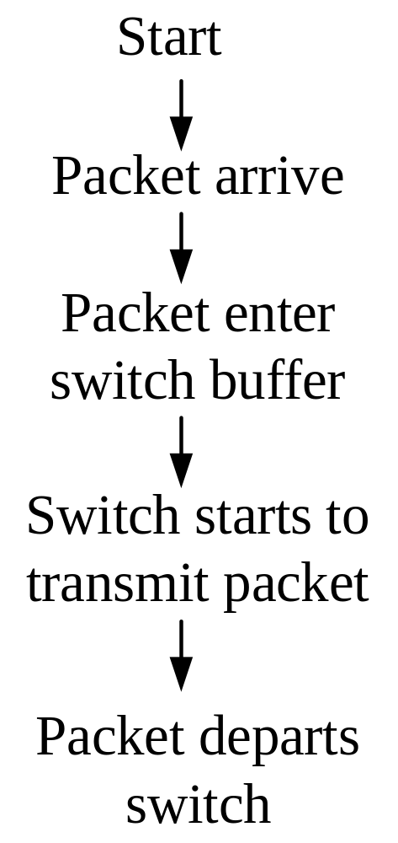
E.g.

Slide 36
Event Scheduling Approach
take advantage of the fact that the system state remains unchanged between events
  consider only the time instants at which events occur
a clock ( a variable) is used to keep track of simulation time which corresponds to real time in the system being simulated
the basic technique is to be advanced to the time of next event and simulate the system changes as indicated by the event type
a detailed description of actions performed is provided whenever an event occurs
a programmer writes routines which describe the effect of each event on the system
  the events routine may operate on the attributes of entities and schedule/cancel events

Slide 37
a list of scheduled events is maintained and ordered by time activation
time is advanced to the next schedule event
all events that may occur in that instant of time are simulated by execution of the appropriate event routines

Slide 38
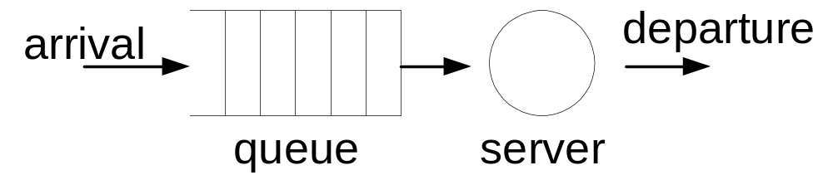
Example: Single-server queuing system
System state uniquely determined by status of server and the number of customers waiting
System state remains constant unless there is an arrival or departure
Build model to advance simulation clock at arrival and departure times

Slide 39
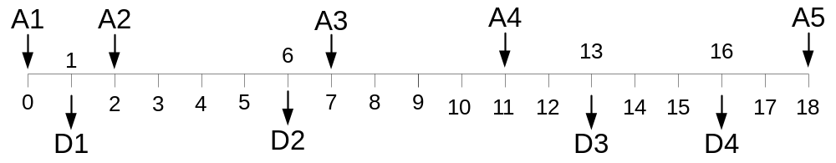
Inter-arrival time | 2 | 5 | 4 | 7
Service time | 1 | 4 | 6 | 3
Clock time | 0 | 1 | 2 | 6 | 7 | 11 | 13 | 16 | 18
Event type | A1 | D1 | A2 | D2 | A3 | A4 | D3 | D4 | A5

Slide 40
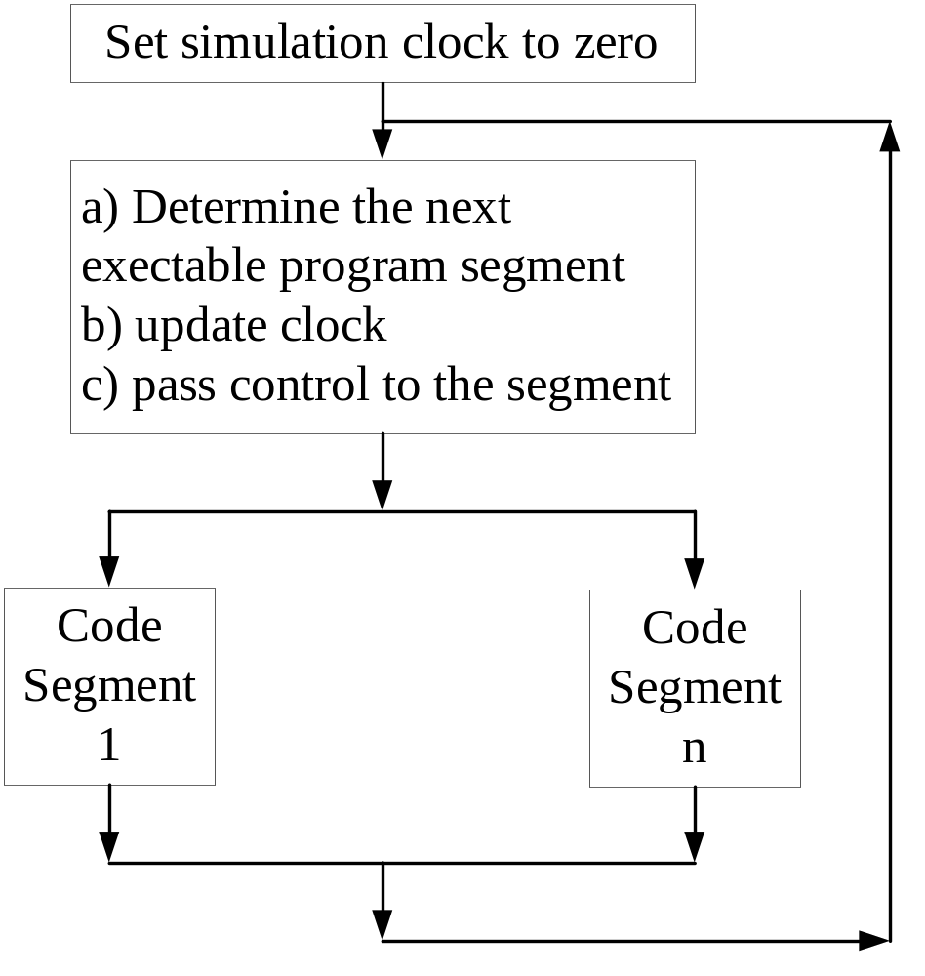
Structure of a
simulation program

Slide 41
Event Scheduling Approach
Keep track of all future events in an event list.
A simulation program based on this approach can be divided into 3 parts:
  Initialization:
  The data structures used in the program are set to the appropriate values to reflect the state of the system at simulation time zero.

Slide 42
  Main Loop:
  The following two steps are repeated until the condition to terminate the simulation is satisfied
    Delete the earliest event from the event list and set clock to time of this event
    Call the appropriate event subroutine to perform the steps required according to the event type.
  Future events may be scheduled in these steps.
  (Schedule event = add event to event list)
  Output routine:
For output of data collected in the main loop.

Slide 43
Methods of leaving the Main Loop
Call the output routine when the number of jobs served has reached some pre-specified quantity.
Schedule a special event of type "End of Simulation" during initialization with event time equal to the desired termination time.
The output routine is entered directly when this event occurs.
Stop scheduling arrivals when a pre-specified length of simulation is reached, and call the output routine when there are no more events in the event list.

Slide 44
Example: Single Server Queue
Initialization:
a) Set N (# in system) to zero
b) Set queue to empty
c) Set server to idle
d) Set event list to empty
e) Set clock to zero
f) Schedule the FIRST ARRIVAL event
g) Enter the Main Loop

Slide 45
Event Subroutines:
1. Arrival Event
a) Increment N by 1
b) Schedule the NEXT arrival event
Event time = clock + interarrival time
c) If server is idle, call subroutine for
"Start Service" Event
2. Start Service Event
a) Remove first job from queue
b) Set server to busy
c) Schedule a Departure Event
Event time = clock + service time

Slide 46
3. Departure Event
a) Decrement N by 1
b) Set server to idle
c) If queue is non-empty, call subroutine for
"Start Service" Event

Slide 47
Simulation
/*external definition for single server queuing system */
#include <stdio.h>
#include <math.h>
#include “head.h”
#define Q_LIMIT 100 /* limit on queue length */
#define BUSY 1
#define IDLE 0
Int next_event_type, number_custs_delayed, num_delays_required, num_events
Int num_in_q, server_status;
Float mean_interarrival, mean_service, time_arrival[Q_LIMIT+1],… time_next_event[3];
…
void initialize (void);
void timing (void);
void arrive(void)
void depart(void);
void report (void);
void update_time (void);
File *infile, *outfile;

Slide 48
Simulation
main ()
{
infile = fopen (“mm1.in”, “r”)
outfile = fopen (mm1.out”, “w”);
num_events = 2;
/* read input */
initialize();
while (num_cust_delayed < num_delays_require){
timing(); /*determine the next event */
update_time_avg_status(); /* invoke the appropriate event function.*/
switch (next_event_type) {
case 1:
arrive();
break;
case 2:
depart();
break;
}}

Slide 49
Simulation
void initialize()
{
sim_time = 0.0;
server_status = IDLE;
time_next_event[1]=sim_time+expo(mean_interarrival);
time_next_event[2] = 1.0e+30;
….
}
void timing()
{ int I;
float min_time_next_event=1.0e+29;
next_event_type = 0;
for (I=1; I<=num_events;I++)
if (time_next_event[I] < min_time_next_event) {
min_time_next_event = time_next_event[I];
next_event_type = I; }
…

Slide 50
Simulation
void arrive()
{
time_next_event[1]=sim_time+expon(mean_interarival);
if (server_status ==Busy) {
…
…}
else {
……}
void depart()
{ int I; float delay;
if (num_in_q ==0){
server_status = IDLE;
time_next_event[2] = 1.0e+30}
else {
…
…
}

Slide 51
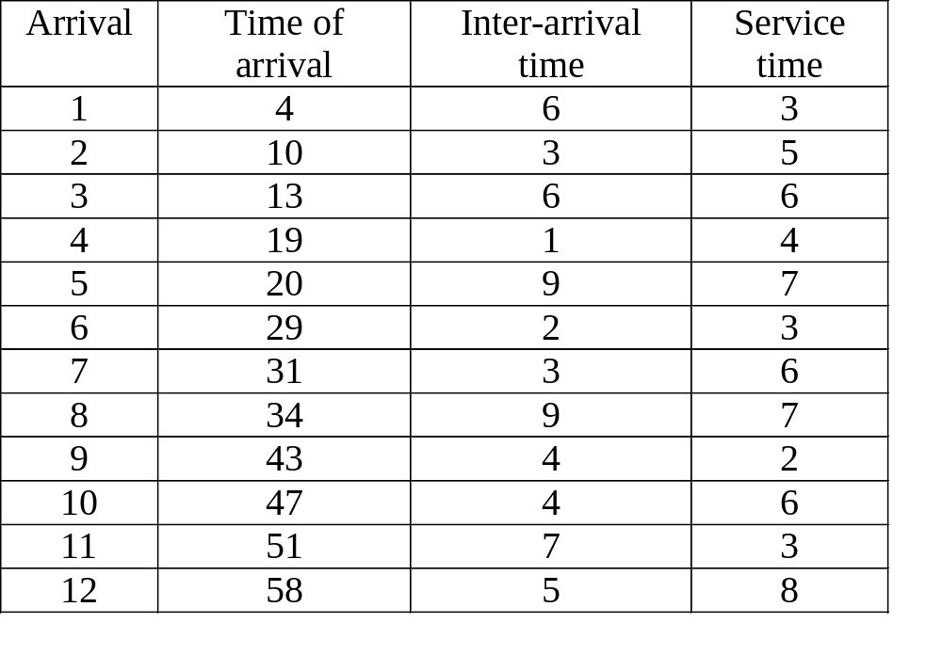
Statistics Collection
Simulation is used to study the properties of systems.
Two general properties:
  mean number of jobs in system
  mean time in system
E.g.

Slide 52
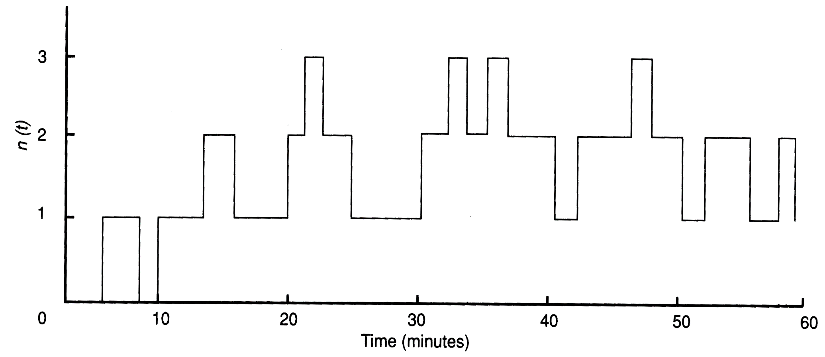
Profile of packets in the system

Slide 53
The area under the profile of packets in the system represents the number of minutes all packets spend in the system
  divide this quantity by the numbers of packets that entered the system, we have an estimate of the mean time a single packet spends in the system
  divided by the length of simulation, we have an estimate of the mean number of packets in the system
Hence, let
  n(t) = # of customers in the system at t
  k = # of arrivals
  T = length of simulation

Slide 54

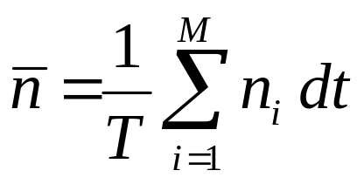
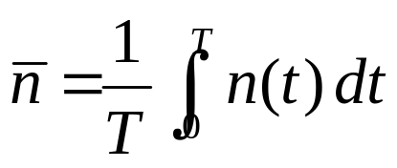

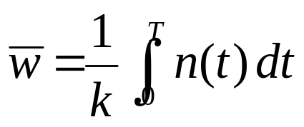
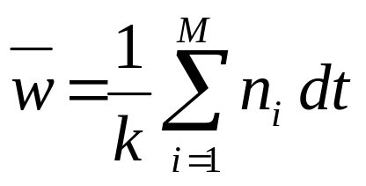
  = mean # of jobs in the system
  or
  Where M = number of time intervals
    n_{i} = number of packets in buffer during the time
    interval [t_{i-1}, t_{i})
    dt = time interval width
  = mean time a job is in the system
    or

Slide 55
Data Collection for Waiting Time: Mean and Variance
Initialization - Add the following steps:
NWAIT = 0 (# of jobs observed waiting)
SWAIT = 0 (Sum of waiting time)
SQWAIT = 0 (Sum of square of waiting time)
Subroutine for Arrival Event
Replace step c) by:
c) Enter arriving customer to queue and save his time of arrival (given by clock)

Slide 56
Subroutine for Start Service Event -
Replace step a) by:
a) Remove first customer from queue and retrieve his time of arrival
Waiting time = Clock - Time of Arrival
NWAIT = NWAIT + 1
SWAIT = SWAIT + Waiting Time
SQWAIT = SQWAIT + (Waiting Time)**2
Output Routine - Add the following steps:
Mean Waiting Time = SWAIT / NWAIT
Variance = (SQWAIT - SWAIT**2/NWAIT) / (NWAIT-1)

Slide 57
Utilization Factor: % of simulation time the server is busy
  Data collection by accumulating total busy time
Initialization
SBUSY = 0 (Total busy time)
Start Service Event
Replace step c) by:
c) Determine customer's service time
SBUSY = SBUSY + Service Time
Schedule Departure at Clock + Service Time
Output Routine - Add the following step:
Utilization factor = SBUSY / Clock
Note: data for utilization factor can also be collected by accumulating the total idle time.

Slide 58
Other statistics:
Throughput, γ = C/T
  Where C is the number of completions and T is the duration of the simulation
  Example: If a simulation runs for T=60 sec and the number of packets processed is 107,452
  throughput = 107452/60 packets/sec
  = 1791 packets/sec
Node utilization, ρ = B/T
  Where B is the node busy time
Mean service time per packet, T_{s} = B/C
Note that utilization ρ can also be expressed as
  ρ = γ T_{s}

Slide 59
Input Generation
Input parameters such as inter-arrival time and service time are often modeled by random variables with some given distributions
A mechanism is therefore needed to generate variants for a wide class of distributions.
This can be done if a sequence of random numbers uniformly distributed between 0 and 1 is available.

Slide 60
Random Number Generator
Basic Requirements
Sequence of numbers generated are independent from each other
Numbers are uniformly distributed between 0 and 1
Consideration for Designing Random Number Generators
Independence and Uniformity
  Statistical tests can be used to detect deviations from these requirements;
The sequence of numbers should be reproducible;
Efficiency of algorithm (storage efficiency and computational efficiency)
Long period, i.e. the number of distinct random numbers generated before repetition occurs must be sufficiently large.

Slide 61
Pseudo-random Number Generator
Numbers are generated using arithmetic methods according to some deterministic formula.
Sequence is completely determined by the initial number, called the SEED.
Linear Congruential Generation Method
  observation: In multiplication and division, the lower order digits are more difficult to predict, exhibiting no obvious pattern or sequence
    Y_{i} = (a Y_{i-1} + C) mod M Y₀ is the seed
  After Y_{i} is generated, it can be normalized over the interval
    (0, 1) by U_{i} = Y_{i} / M

Slide 62
Full period (length M) is achieved if
C is relatively prime to M
a mod q = 1 for each prime factor q of M
(i.e. every prime factor of M is also a prime factor of a-1)
a mod 4 = 1 if 4 is a factor of M
(i.e. if M is a power of 4 then 4 is also a factor of a-1)
Often M is chosen as 2^{k} to simplify the operation.
If M = 2^{k} and C = 0, the maximal period is M/4 provided that
a mod 8 is 3 or 5.

Slide 63
Example:
a = 7, C = 3, M = 10, Y₀ = 3
Random sequence: 3, 4, 1, 0, 3, 4, 1, …
a = 4, C = 2, M = 9, Y₀ = 3
Random sequence: 3, 5, 4, 0, 2, 1, 6, 8, 7, 3, 5, …

Slide 64

Suggested choice for a, C and M
In a binary machine, choose M to be 2^{k}
Select a such that
  a mod 8 = 5
  M/100 < a <
  the binary digits of a has no obvious pattern
Select C to be an odd integer with
C/M ≈ 0.21132

Slide 65
Random Number Generation
One of the important cautions in implementing LCG is that the properties are guaranteed only if the computations are done exactly, without any round-off errors. This means that the computation should be done using integer arithmetic without overflow.
Second problem in implementing LCGs is that the product aXn_1 can exceed the largest integer allowed in the system. One solution to this problem due to Schrage (1979) is based on the following identity:

Slide 66
Random Number Generation
ax mod m = g(x) + mh(x)
where g(x) = a(x mod q) – r(x div q) and
h(x) = (x div q) – (ax div m)
here, q = m div a, r = m mod a. It can be shown that for all x’s in the range 1,2,…, m-1, the expression involved in computing g(x) are all less than m-1. And also if r<q, h(x) is either 0 or 1. Thus, the operation ax, which could cause overflow, need not be executed.

Slide 67
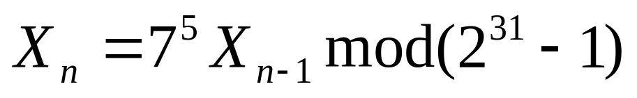
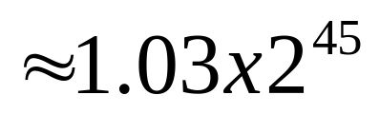
Random Number Generation
Example: Xn = 16807 Xn-1 mod 2,147,483,647 or
The product aXn-1 can be as large as 16,807x2,147,483,647
A straightforward implementation of the generator using integer arithmetic will produce integer overflow unless the machine support 46 bits or larger integer.

Slide 68
Random Number Generation
In this case: a = 16,807
m = 2,147,483,637
q = m div a = 12,773
r = m mod a = 2,836
Can be implemented by Schrage method when it needed.
One method to test, X10,000 with X0=1, is 1,043,618,065.

Slide 69
Random number generation
Extended Fibonacci generators
Xn =Xn-1+Xn-2 mod m
Xn = Xn-5 + Xn-17 mod 2k
Combined generators: adding random numbers obtained by two or more generators.

Slide 70
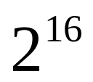
Random Number Generation
If an algorithm produces L-bit-wide random numbers, the randomness is guaranteed only when all L bits are used to form successive random numbers. E.g. Xn = (25173 Xn-1 + 13849) mod , starting with seed of X0=1, the first 5 numbers and their binary representation are listed:

Slide 71

Random Number Generation
25173 01100010 01010101
12345 00110000 00111001
54509 11010100 11101101
27825 01101100 10110001
55493 11011000 11000101
In general the lth bit follows a cycle of length .

Slide 72
Random Number Generation
Seed Selection
  Do not use zero
  Avoid even values
  Do not subdivide one stream, if {u1, u2..} is the sequence generated using a single seed u0, the analyst may use u1 to generate inter arrival times, u2 to generate service times, and so forth. Correlation caused.
  Reuse seeds in successive replication

Slide 73
Advantages of Pseudo-random Number Generator
The sequence of numbers can be reproduced if the seed is saved.
  Useful for comparison of alternative design strategies, and for program debugging.
By using the last number in one run as the seed for the next run, one can avoid using the same sequence if more than one run of the same simulation is required.

Slide 74
Random number generation
Myths
  A complex set of operations leads to random results: using a sequence of operations where the final result is difficult to guess does not necessarily mean that the resulting sequence will pass the tests for independence.
  A single test such as the chi-square test is sufficient to test the goodness
  Random numbers are unpredictable: a truly random should be, however it is not the case with pseudo-random

Slide 75
Random number generation
  Some seeds are better than others: in general, generators whose period or randomness depends upon the seed should not be used.
  Accurate implementation is not important: e.g. neglecting overflows is a common mistake.

Slide 76
Statistical Test of Pseudorandom Numbers
For a uniformly distributed function between 0 and 1,
E(x) = 1/2
Var(x) = 1/12
and if x_{i} and x_{i+1} are independent then the expected value of the autocorrelation factor x_{i}x_{i+1} is
E(x_{i}x_{i+1} ) = E(x_{i})E(x_{i+1})
= 1/4

Slide 77
Inverse Transformation Method for Random Variety Generation
Recall:
Since the summation of p_{i}, for all i, equals to 1, the cumulative distribution function, F(x), of any probability density function, f(x), will have a value between 0 and 1.
If u is a random variable uniformly distributed between 0 and 1, and x is a random variable with cumulative distribution function F(x),
F(x) = u
then x = F⁻¹(u)
x is a random variable with distribution function F(x).

Slide 78
Basic Method:
a) Generate u
b) Select variety x such that F(x) = u
i.e. x = F⁻¹(u)

Slide 79
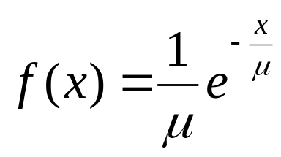
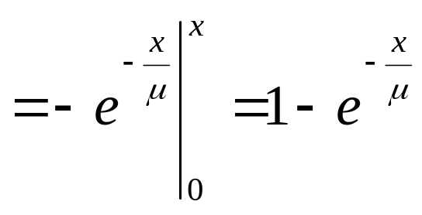
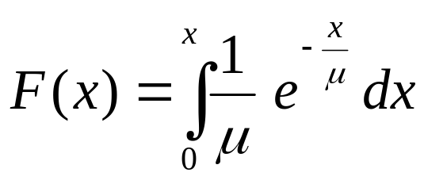
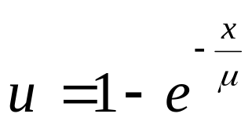
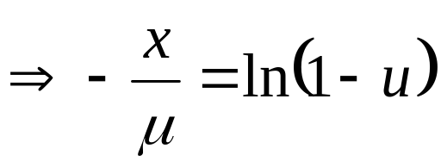
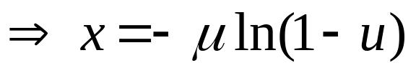
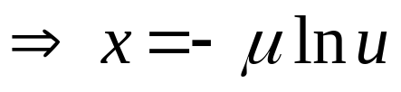
Example:
Exponential function

Slide 80
Example:
Uniform distribution
f(x) = 1 / (b-a)
F(x) = (x-a) / (b-a)
u = (x-a) / (b-a)
⇒ x = a + (b-a) u

Slide 81
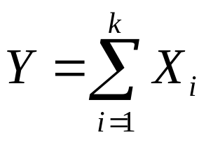
Convolution method
Generate random variates from sum of easily generated, independent random variables
Example: The Erlang-k distribution can be expressed as
where X_{i} are independent and identically distributed (iid) exponential random variables, each with mean μ

Slide 82
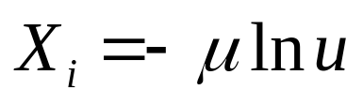
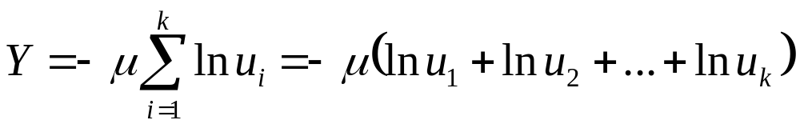
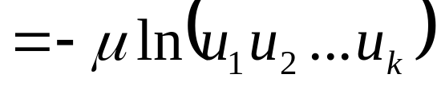
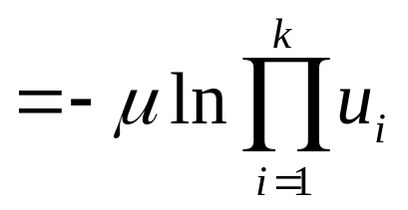
As

Slide 83
Hypo- and Hyper- Exponential functions
In practice, the measured distribution of service times for the various resources tends to differ quite substantially from the exponential distribution.
The coefficient of variation, c = standard deviation/mean
In many experiments,
CPU service time has been found to have c >> 1
I/O service time has c < 1

Slide 84
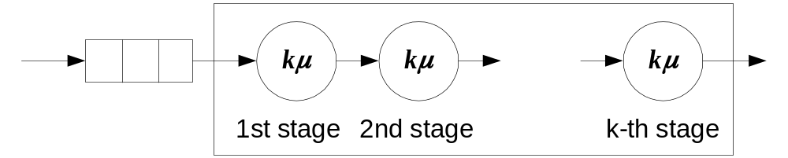
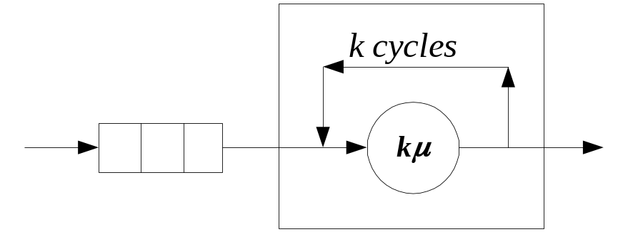
Hypo-exponential distribution (c < 1)
Also known as Erlang-k distribution
Can be obtained by either connecting k exponential servers in series, where each has service rate kμ
or a job entering the service facility will visit the exponential server with service rate kμ for k times

Slide 85
Hyper-exponential distribution (c > 1)
Can be represented by a mixture of exponential distributions
Suppose that there are k types of messages, each type occurring with probability w_{i}, i = 1,2, …, k
A message of type i has a service time exponentially distributed with mean 1/μ_{i} , i = 1,2, …, k
Note: This system is different from a service station with k parallel servers: while a job is in one of the k-stages, a new job cannot enter the system.
●
1
w
1
●
2
w
2
w
3
●
k

Slide 86
Variety Generation for Hypo- and Hyper- exponential distributions
Hypo-exponential distribution:
a) Generate k exponential variates, each with parameter μ
b) Variety = sum of these k variates
Hyper-exponential distribution (for two types of messages only):
a) Generate a uniform random number, u
b) If u less than p
then
generate an exponential variate with parameter μ₁
else
generate an exponential variate with parameter μ₂

Slide 87
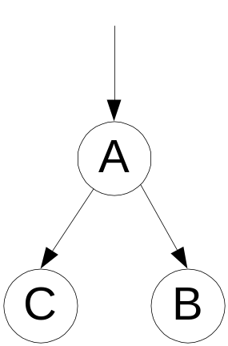
Example:
Traffic arriving to node A is modeled as a Poisson process with arrival rate λ = 10 arrivals/hr. Arrivals are alternately sent to B and C. An analyst requires the inter-arrival time, Y between successive arrivals at C, which is known to be the sum of two inter-arrival times at A. Generate the random variable Y.

Slide 88
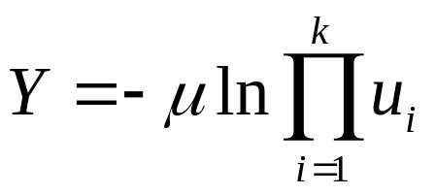
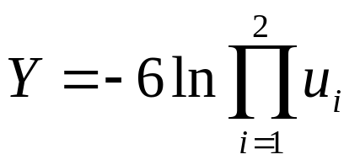
Example (cont’d):
The inter-arrival time of A is μ = 1/λ = 0.1 hr (or 6 min).
Since the inter-arrival time, Y, at C is the sum of two inter-arrival time at A, Y is the sum of two exponential random variables each with mean μ equals to 6 minutes.
As
when μ = 6 in and k = 2, Y can be generated from
If u₁=0.937 and u₂=0.217
Y = -6 ln(0.937x0.217) = 9.558 min

Slide 89
Variate Generation for Common Continuous Distributions
Uniform
f(x) = 1 / (b-a)
F(x) = (x-a) / (b-a)
Variate = a + (b-a)u
Exponential
f(x) = b e^{-bx} where b > 0
F(x) = 1 - e^{-bx}
Variate = -ln(u) / b
Erlang-k
a) Generate k exponential variates, each with parameter b
b) Variate = Sum of these k variates

Slide 90
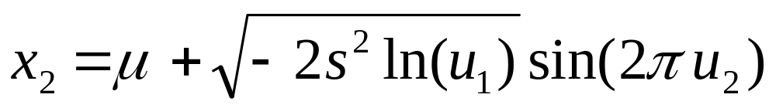
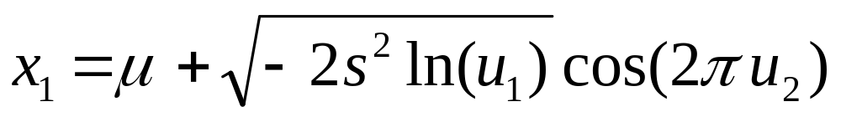
Hyper-exponential
a) Generate u
b) If less than p
then generate an exponential variate with parameter b
else generate an exponential variate with parameter c
Normal - an approximation method
a) generate two random numbers u₁ and u₂
b) two normal variates can be computed from

Slide 91
Variation Generation for Common Discrete Distributions
Bernoulli(p):
  random occurrence with two possible outcomes
  P(x) = 1- p (if x = 0), p (if x = 1), 0 ( otherwise).
  Range (0,1).
  Bernoulli (p) random variable X can be thought of as the outcome of an experiment that either “fails” or “succeeds”.
Geometric Geom(p):
  Number of failures before the first success in a sequence of independent Bernoulli trials with probability p of success on each trial;

Slide 92
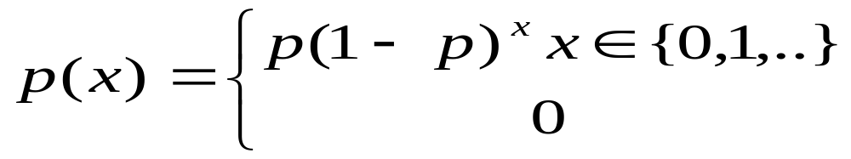
Variation Generation for Common Discrete Distributions
  Mass
  Range {0, 1,2,..}
  What is probability for the success at 1st, 2nd,…
Binomial bin(t,p)
  Number of success in t independent Bernoulli trials with probability p of success on each trial.

Slide 93
Error Control in Simulation
Simulation is stochastic in nature
  cause for variability of the observed results
  true value of the variable will have to be estimated from the measured values
Other sources which affect the final results
  Errors in the data used
  errors associated with the method of collection, analysis, and interpretation of simulation output

Slide 94
Mistakes in Simulation
Inappropriate level of detail:
  Simulation allows a system to be studied in more detail than analytical modeling.
  Analysis requires several simplifications and assumptions. In other works, an analytical model is less detailed.
  Assuming that a more detailed model is a better model since it makes fewer assumptions is not true!
  A detailed model may require more detailed knowledge of input parameters, which if not available, may make the model inaccurate.

Slide 95
Mistakes in Simulation
  It is better to start with a less detailed model, get some results, study sensitivities, and introduce details in the areas that have the highest impact on the results.
Improper language:
  Special purpose languages require less time for model development and ease several common tasks.
  General purpose languages are more portable and provide more control over the efficiency and run time of the simulation.

Slide 96
Mistakes in Simulation
Unverified Models:
  Simulation models are generally large computer programs, and unless special precautions are taken, it is possible to have several bugs, which would make the conclusions meaningless.
Invalid Models:
  Even if a simulation program has no errors, it may not represent the real system correctly because of incorrect assumptions about the system’s behavior.
  It is essential that the models be validated to ensure that the conclusion reached would be the same as those obtained from the real system.

Slide 97
Mistakes in Simulation
Improperly handled initial conditions:
  The initial part of a simulation trajectory is generally not representative of the system in a steady state.
Too short simulations,
  save their own time as well as computer’s time, and may not be representative of the real system.

Slide 98
Mistakes in Simulation
Poor random number generator:
  It is safer to use a well-known generator that has been extensively analyzed than to develop one’s own.
Improper selection of seeds:
  The seed for different random number streams should be carefully chosen to maintain independence among the streams.

Slide 99
MODEL VERIFICATION AND VALIDATION
To build a simulation model, must pass through several stages:
  Real system
  Conceptual model
    contains the essential elements of the system
  Logical model
    contains the logical relationships among the elements of the system
  Computer model (i.e. simulation model)

Slide 100
Verification
the process of determining if the operational logic of the model (the computer program) corresponds to the flow chart logic (logical model)
  i.e. determine if the logic of the model is correctly implemented
  main features:
    proving program correctness
    structured walkthrough
Validation
the process of confirming that the model is an adequate representation of the original system and is capable of imitating its behavior reasonably accurately within the domain of its intended applications

Slide 101
Verifying the Logical Model
Should verify:
the logical model must contain all the events included in the conceptual model
logical model should process events in correct order
all variables changed by the occurrence of an event are correctly updated
all mathematical functions and relationships are correct
all statistics and measures are updated correctly when an event occurs
Method:
structured walk-through

Slide 102
Sources of Errors
Modeling Errors
  use of invalid models
  important to verify and validate the model
Computer Programming Errors
  arithmetic and logical errors
  truncation and round-off errors in numerical values
Parameter Estimation Errors
  the estimates of the MEAN and VARIANCE based on Finite Samples are seriously corrupted by the INITIAL BIAS

Slide 103
Sampling Errors
  the validity of the assumed distribution for a given set of observation must be established before it is used
  random variates are generated based on the pseudo-random numbers
    poor random number generators can cause serious errors in simulation
    since random numbers are used to select values from the distribution and produce the set of values in random sequence, these processes produce sampling errors
      SET Effect and SEQUENCE Effect
      Set Effect: due to the difference between the set of values produced by the sampling process and the theoretical distribution
      Sequence Effect: probability distribution assumes the existence of an infinite population, discrete simulation can only produce finite samples

Slide 104
Verifying the Computer Model
verify the computer program is a correct implementation of the logical model
Methods:
Structured Programming Methods
  e.g. Top-Down design, Modularity, Stepwise Refinement
  segments of the model can be verified separately
Tracing the Simulation
  display the flow of entities through the model, or
  print out the sequences of processes and event execution
  can also use the interactive debugger

Slide 105
Program Testing
  bottom-up test (i.e. unit test)
  top-down test
Verifying with Analytical Models
  by properly selecting data and parameters for the simulation model, make the simulation model equivalent to an analytic model
  compare the output of the simulation to the analytic model
Verifying using Graphics
  use on-line animation when execute the program
  may be able to detect errors by watching the program steps through the simulation one event at a time

Slide 106
Validating the Simulation Model
Comparisons of the model output to the real system
  a commonly used method
  usually use Student's t test to test the hypothesis of equality of means
  problems:
    measures from the real system may include elements or effects that have been excluded out in the simulation
    real system does not exist
    can only use a similar system

Slide 107
Delphi method
  used only when very little hard data is available on the problem
  in general, questionnaire and controlled data input are sent to a group of experts a few times until the analyst can have an expert's prediction of the system's response to the inputs or structural changes being considered
Validation by behavior at extremes
  Sometimes the real system can be observed under extreme conditions whereby an unusual situation arises
  Very useful in validating the model by comparing the system performance under extreme condition to the simulation result

