Slide 1
SIMULATION: Data Analysis
Comparisons of the model output to the real system
to develop an acceptable level of confidence that the performance measures predicted by the model is applicable to the real system
if a model fails to reproduce the behavior of the system under existing environment, one can hardly expect it to give meaningful predictions under new environments
Typical Method
Estimate the model parameters
Run simulation program with the estimated parameter values and collect data for the desired performance measures
Verify that the data collected from the simulation runs are consistent with those measured in the real system

Slide 2
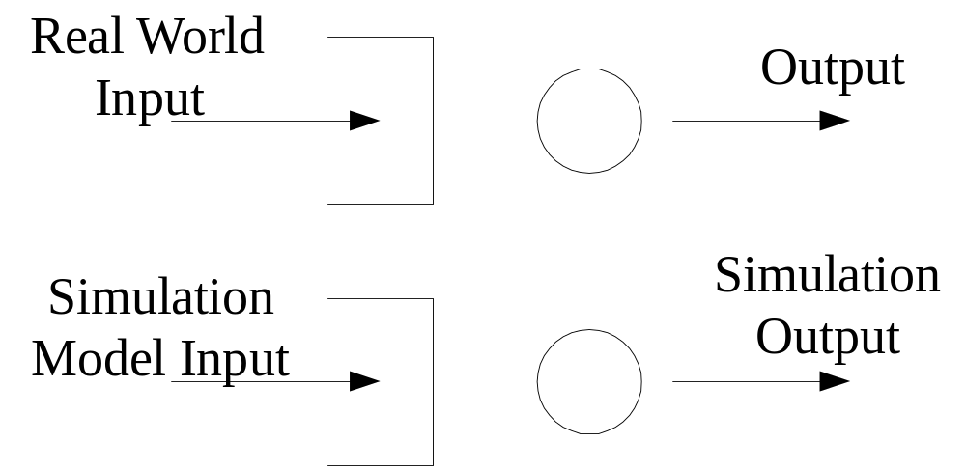
INPUT ANALYSIS
Valid input to a simulation model giving unrealistic output implies an invalid simulation model
Valid simulation input assists in simulation model validation

Slide 3


Need for Estimation
Real-world system is liked a black box concealing fixed unknowns such as mean packet service time, mean inter-arrival time, etc.
Need to determine unknowns at some level of accuracy to simulate real-world system, i.e. needs estimation
Use data from the system to find estimates of unknowns
Estimates of unknowns will represent unknowns in simulation
Example: to estimate the mean service time in a system, we may choose
  The smallest service time in a sample
  Arithmetic average of service times in a sample
Convention: if is the unknown mean service time, is often used as an estimate of

Slide 4

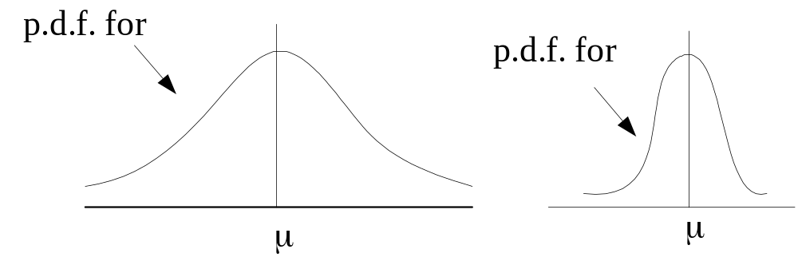
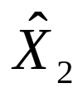
General properties of Estimates
Estimates are random variables; hence, estimates have
  Probability density functions (p.d.f.s)
  Means and variance
In general, an estimate having a smaller variance is better

Slide 5
In the above example, both and are estimates of an unknown parameter μ
The estimate is more likely to give a wider range of values than is
  The variance of is greater than the variance of
  Hence, the estimate is a better estimate than the estimate

Slide 6
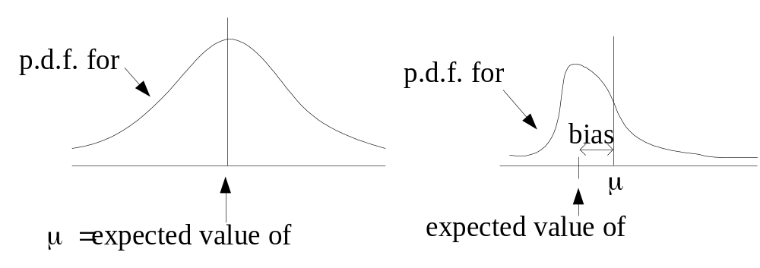

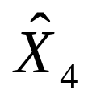
Biased and Unbiased Estimates
When the expected value of an estimate coincides with the parameter being estimated, the estimate is defined as an unbiased estimate of the parameter
If the estimate is not unbiased, it is defined as a biased estimate
However, a small variance for an estimate is usually the most important consideration in determining the estimate of choice when the bias in the estimate is not very large

Slide 7
Maximum Likelihood Estimates (MLE)
The most popular way in estimating unknown parameters using a sample of data if a specific probability function is assumed
MLE produces estimates with small variance, i.e. maximizing the likelihood (probability) of the estimates having the values of the unknown parameters
MLE Properties
  MLE is unbiased and normally distributed, and has the smallest variance of all estimates for very large sample sizes
  If MLE is unbiased for any sample size, it has the smallest variance of all possible estimates from the given sample size, i.e. it is the best of all biased and unbiased estimates possible

Slide 8
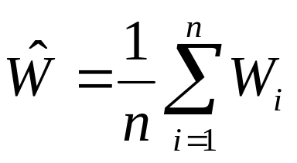
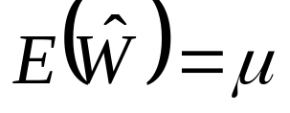

Properties of Estimates
If W₁, W₂, …, W_{n} are n independent waiting time random variables from a given system with mean waiting time μ, then E(W_{i}) = μ for all i = 1,2,…,n, implying W_{i} is an unbiased estimated of μ for all i
If we define the estimate
then and is also an unbiased estimate of μ
Q: using the average or the individual W?

Slide 9
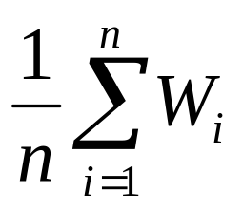
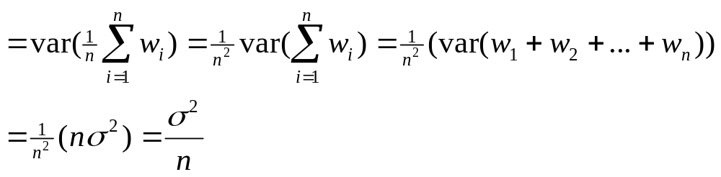
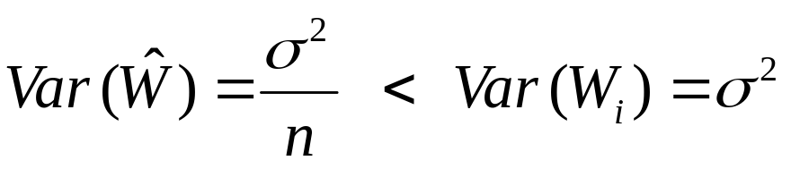
If variance of the waiting time in system is σ², then
Var(W_{i}) = σ² for all i
Var( ) = variance of
As
the arithmetic average is a better estimate than any of the individual waiting times W_{i}

Slide 10
Recognising Underlying Distributions
One of the important aspects to understand about input to a real-world system is what probability distribution function best represents the input for simulation purposes.
We need to identify a theoretical probability distribution that matches, in a statistical sense, real-world behaviors such as inter-arrival and service patterns.
  probability distributions used in simulation models are usually determined from historical/observed data
Approach: assume some theoretical distribution and compare it with representative real-world data
  If the difference between the real-world and the assumed theoretical is too large, reject the theoretical distribution
  Determine if the prob. dist. chosen is valid by using "goodness-of-fit" test

Slide 11
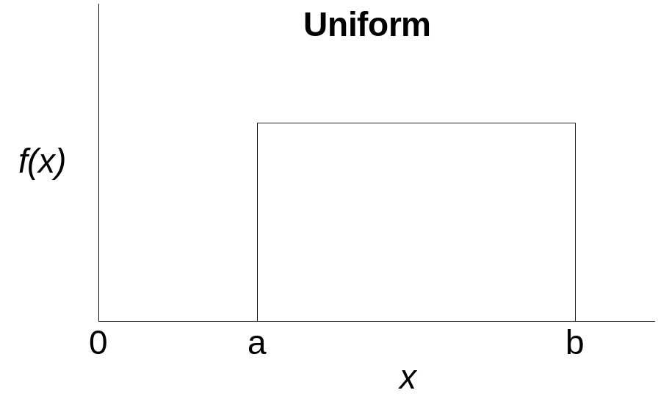
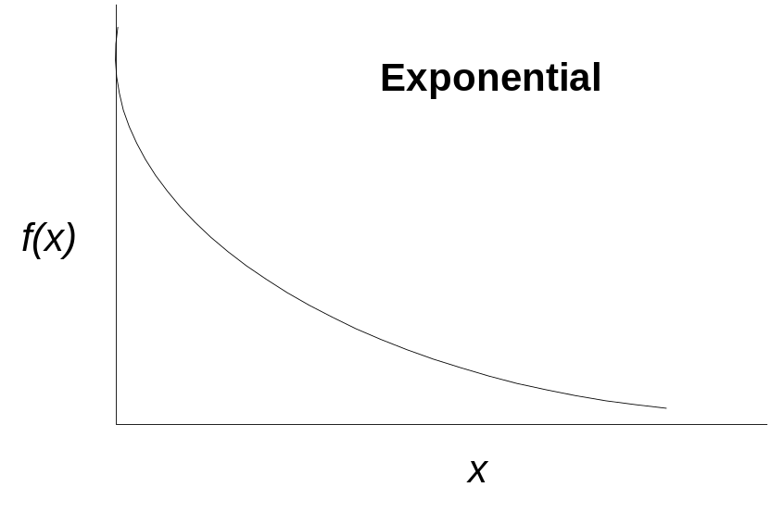

Slide 12
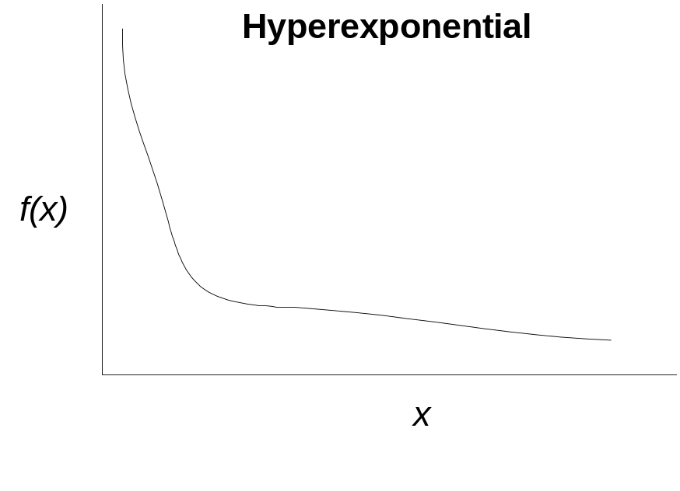
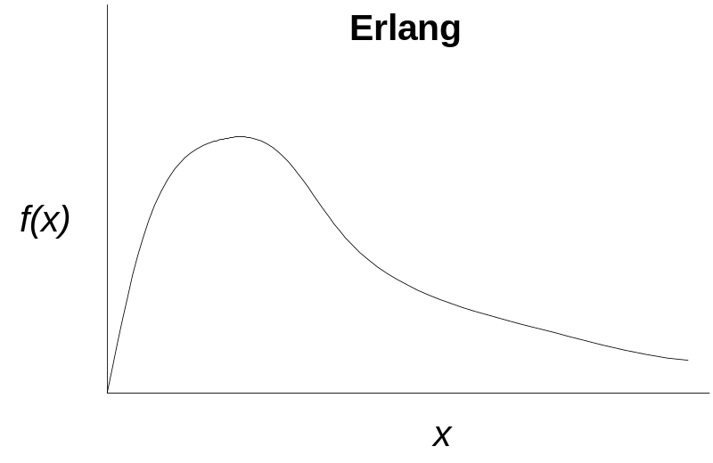
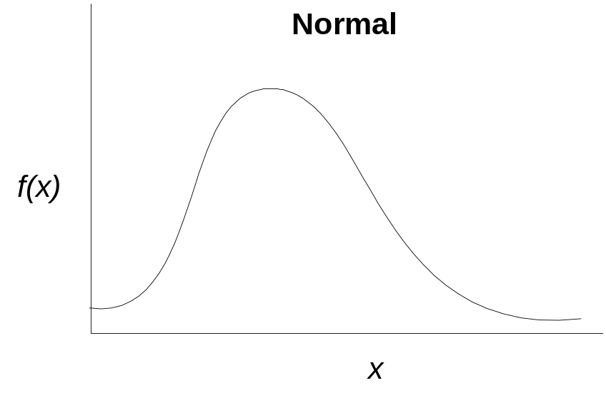

Slide 13

Chi-Square (χ²) test
Based on the observed data, generate a histogram with k groups with frequency in group i, O_{i}, being the number of observations in interval [a_{i-1}, a_{i})
You may start with N equal intervals (however, intervals need not necessary to be the same size)
The number of groups, N, can be determined as follow:
Sample size (n) | N
20 | Don’t use Chi-square test
50 | 5 to 10
100 | 10 to 20
>100 | to n/5

Slide 14
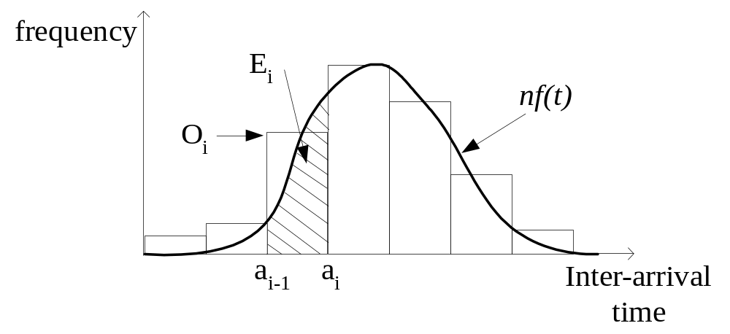
let [a_{i-1},a_{i}) be the boundaries of cell i
(i.e. put sample data in N groups)
let f(t) be the hypothesized theoretical prob. density function
let n be the no. of sample points

Slide 15
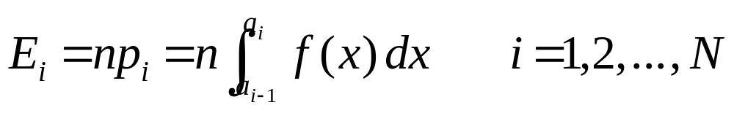
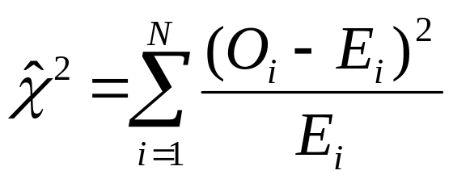
then
the theoretical freq. in cell i is
The test statistics is chi-square distribution
with degree of freedom
df = N - m- 1
where m is the no. of parameter estimated from the data
and E_{i} is the observed frequency in cell i

Slide 16
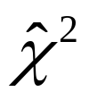
if the computed value of is less than that from the Chi-square table, we will accept the hypothesis that the prob. dist. chosen is valid at a certain confidence level
Note: it is recommended that the expected frequency E_{i} in cell i contain no less than 5 points.
  If E_{i} < 5 for any i, group two or more groups so that all E_{i}’s≥ 5
  Recalculate O_{i} for all i if re-grouping is needed

Slide 17
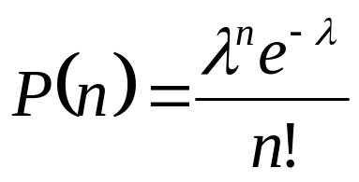
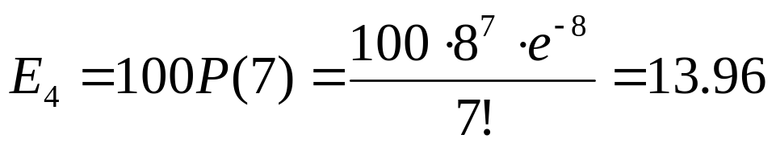
Example
Observed 800 packets arrive over 100 seconds
Assume that the arrival process is Poisson
Prob{n packets arrived in a sec} =
where n = 0,1,2, …, and λ is the theoretical mean no. of
packets arriving per sec.
λ is estimated as 800/100=8
From the observation, 9 groups has been decided
E_{i} is calculated as follow:
  E.g. the interval for E₄ is [7,8)

Slide 18
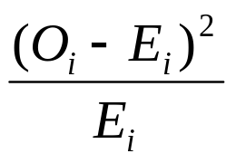
The result is summarized as follow:
Group i | 1 | 2 | 3 | 4 | 5 | 6 | 7 | 8 | 9
Interval i | [0,5) | [5,6) | [6,7) | [7,8) | [8,9) | [9,10) | [10,11) | [11,12) | [12,∝)
O_{i} | 6 | 11 | 10 | 14 | 12 | 19 | 7 | 9 | 12
E_{i} | 9.96 | 9.16 | 12.21 | 13.96 | 13.96 | 12.41 | 9.93 | 7.22 | 11.19
 | 1.58 | 0.37 | 0.40 | 0.0001 | 0.27 | 3.50 | 0.86 | 0.44 | 0.058

Slide 19
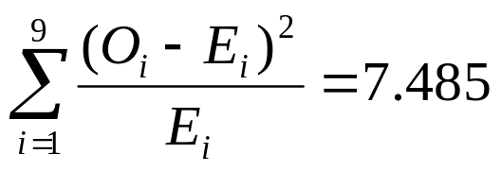
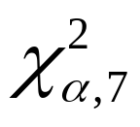
From the above, we have
The degree of freedom = N-m-1= 9-1-1=7
with m=1 as we have estimated one unknown parameter λ
With α=0.05, =14.1 > 7.485, we cannot reject that the real-world process is Poisson
  We conclude that input arrival process is Poisson

Slide 20
K-S test
Named after statisticians A. N. Kolmogorov in 1933 and N. V. Smirnov in 1939.
K-S test allows one to test if a given sample of n observations is from a specified continuous distribution.
Based on the observation that the difference between the observed CDF Fo(X) and the expected CDF Fe(X) should be small.

Slide 21
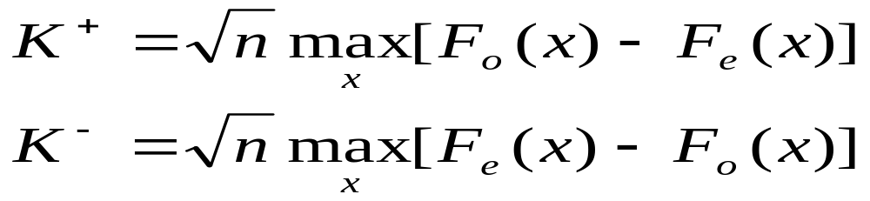

K-S Test
The symbols below denote the maximum observed deviations above and below the expected CDF in a sample of size n:
If K+ and K- are smaller than , listed in K-S distribution, the observation are said to come from the specified distribution at the α level of significance.

Slide 22
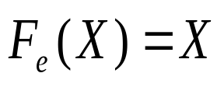
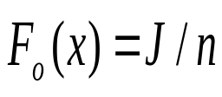
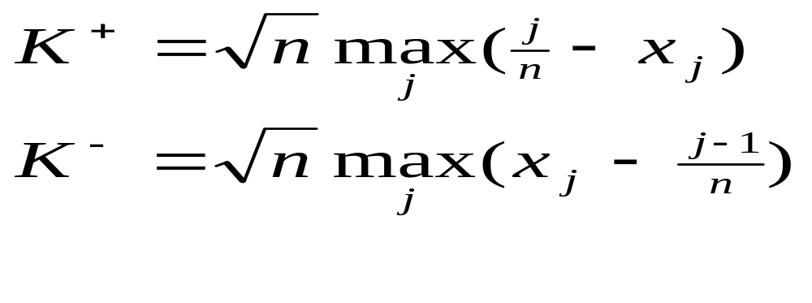
K-S Test
From random numbers distributed uniformly between 0 and 1, the expected CDF is
and if x is greater than j-1 other observations in a sample of n observations, then the observed CDF is . Therefore, to test whether a sample of n random number is from a uniform distribution, first sort the observation in an increasing order. Let the sorted numbers be {x1, x2, …xn} such that Xn-1<Xn. Then:

Slide 23
K-S Test
E.g. Thirty random numbers are generated using a seed of 15 in the following LCG: Xn =3Xn-1 mod 31, the numbers are 14, 11, 2, 6, 18, 23, 7, 21, 1, 3, 9, 27, 19, 26, 16, 17, 20, 29, 25, 13, 8, 24, 10, 30, 28, 22, 4, 12, 5, 15.
The normalized numbers obtained by dividing the sequence by 31, then sort them. J from 1 to 30, we have Xj as following: 0.03226, 0.06425, 0.09677, 0.12903, 0.16129, 0.19355, 0.22581, 0.25806, 0.29032, 0.32258, 0.35484, 0.38710, 0.41935, 0.45161, 0.48387, 0.51613, 0.54839, 0.58065, 0.61290, 0.64516, 0.67742, 0.70968, 0.74194, 0.77419, 0.80645, 0.83871, 0.87097, 0.90323, 0.93548, 0.96774

Slide 24
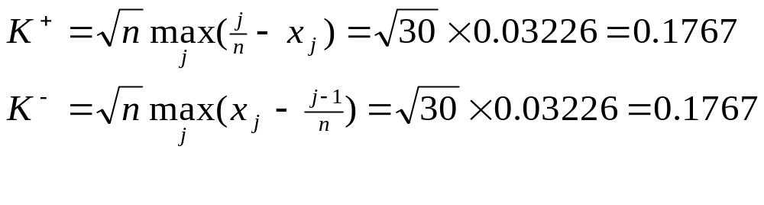
K-S Test
The corresponding (j/n –Xj) and (Xj – (j-1)/n) can be calculated according to different value of j. K-S statistics can be computed as follows:
Since K[0.9, 30] for n=30 and α=0.1, is 1.0424. Hence both K+ and K- are less than the value from table, the random number sequence passes the K-S test at this level of significance.

Slide 25
Testing Comparison
K-S test is specifically designed for small samples and continuous distributions. This is opposite of the chi-square test.
K-S test is based on the difference between observed and expected cumulative probabilities (CDFs) while the chi-square test is based on the differences between observed and hypothesized probabilities (Pdf’s).
K-S test uses each observation in the sample without any grouping, while chi-square test requires. In this sense, a K-S test makes better use of the data. One of the problems in using chi-square test is proper selection of the cell boundaries.

Slide 26
OUTPUT ANALYSIS
When analyzing statistical data, usually assume:
the samples are independent
the process is time invariant
when the sample size is large (>30), the sample mean is a normally distributed random variable

Slide 27
In discrete event simulation, the above assumptions are generally not true.
  Here, the waiting times of jobs are highly serially correlated.
  Once the waiting line builds up, every jobs joining the line faces a long wait
  Conversely, during the periods of time when there is a small or no waiting line, all arrivals wait for short periods, or do not wait at all.
Hence, the standard statistical should not be applied directly.
However, sometimes, our interest is to compare two simulation results so as to evaluate alternative policies.
  Here, precise estimate of output values is unnecessary.

Slide 28
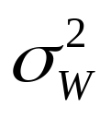
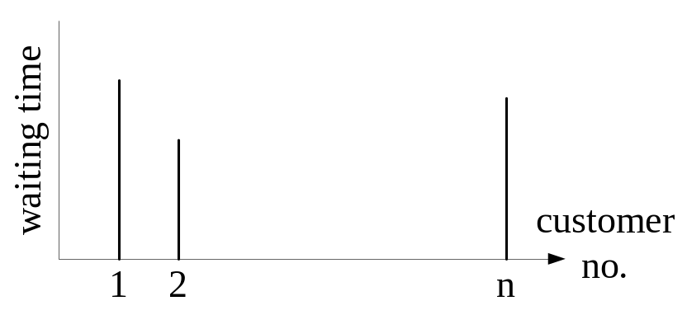
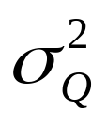
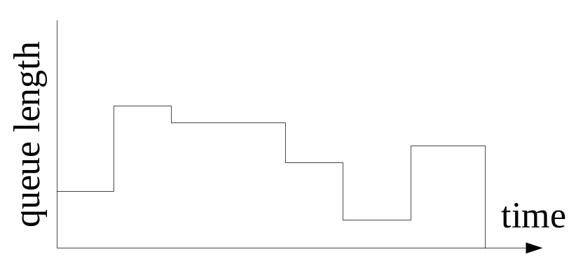
There are two types of output
Observation based
  E.g. waiting times of n customers, w_{i}, i =1,…,n
  Need to determine E(W) and
Time-weighted
  E.g. queue length in 0 ≤ t ≤ T
  Need to determine E(Q) and

Slide 29
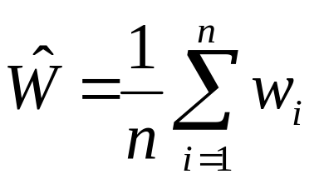
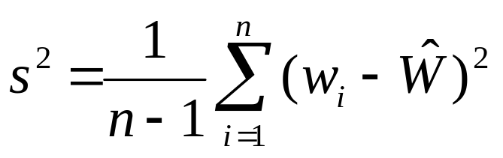


For observation based output, the mean and the variance of waiting time are:
and
where w_{i} is the i^{th} job waiting time
is an unbiased point estimator of E(W) since E( )=E(W)
s² is an unbiased point estimator of since E(s²)=

Slide 30
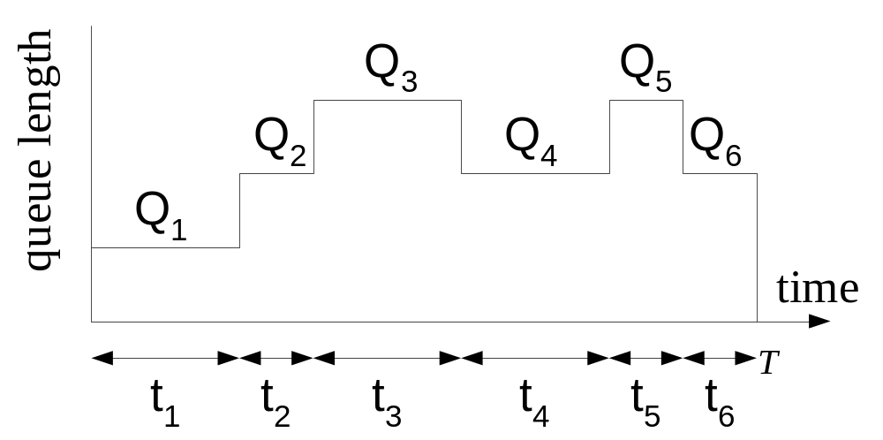
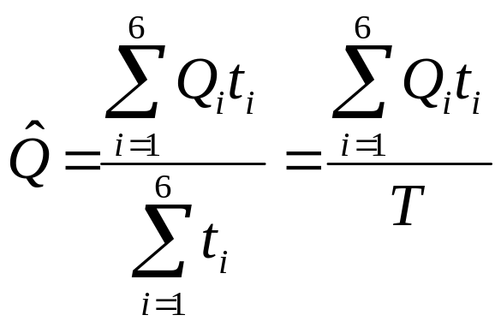
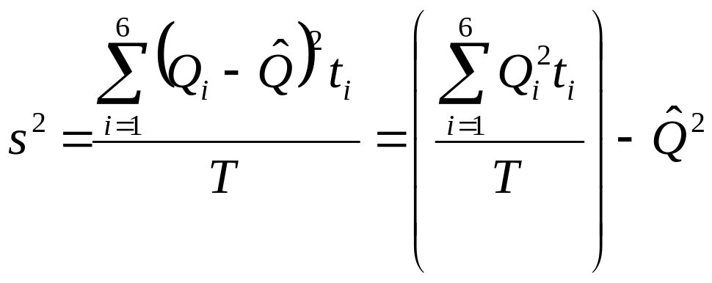
For time-weighted output:

Slide 31


Note that is an unbiased point estimator of E(Q) since
E( )=E(Q)
However, s² is a biased point estimator of since E(s²)≠

Slide 32
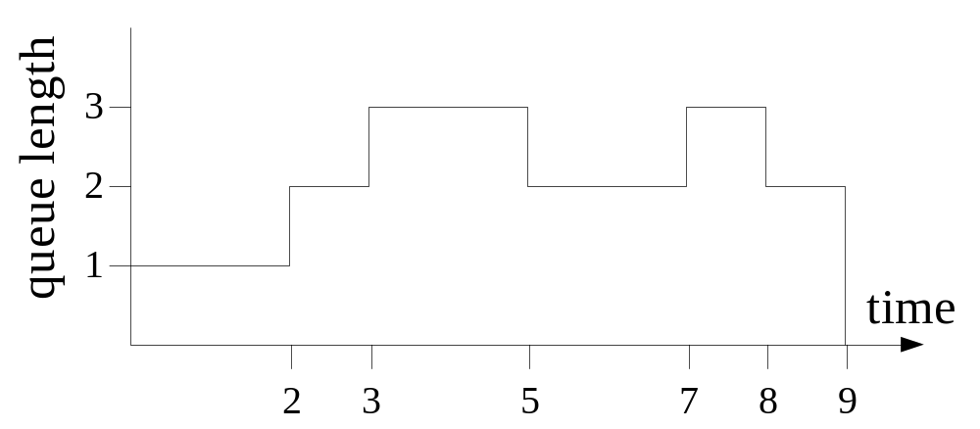
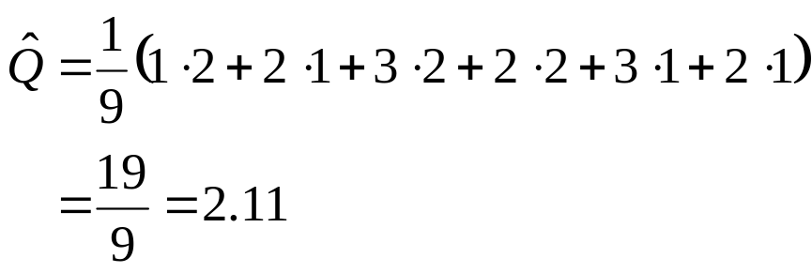
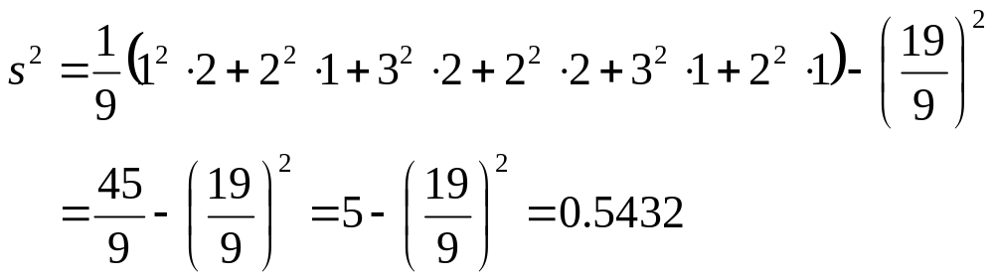
Example

Slide 33
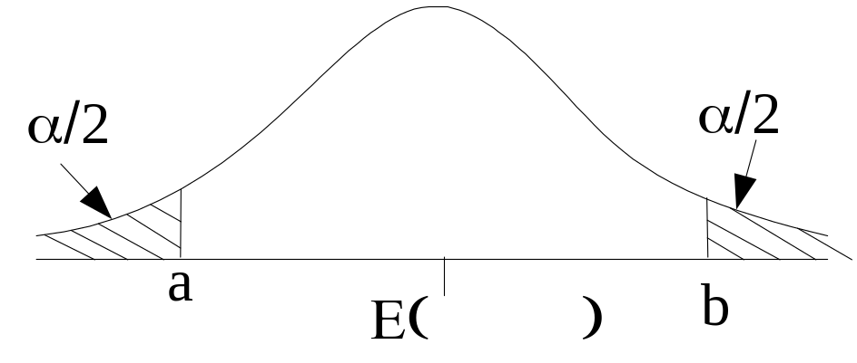
Confidence Interval Estimation
α is the probability of rejecting a good model
Find a and b such that Prob{a ≤ E( ) ≤ b} = 1- α
A 100(1- α)% confidence interval for E( ) = E(W) is [a,b]
In general, the interval [a,b] is more useful than the point estimate
when the variance of the point estimator is large

Slide 34
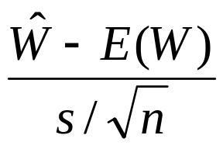
Recall
E( )=E(W)
E(s²) =
Var( ) = s²/n
It can be shown that
approximately follows the t distribution with n-1 degrees of freedom

Slide 35
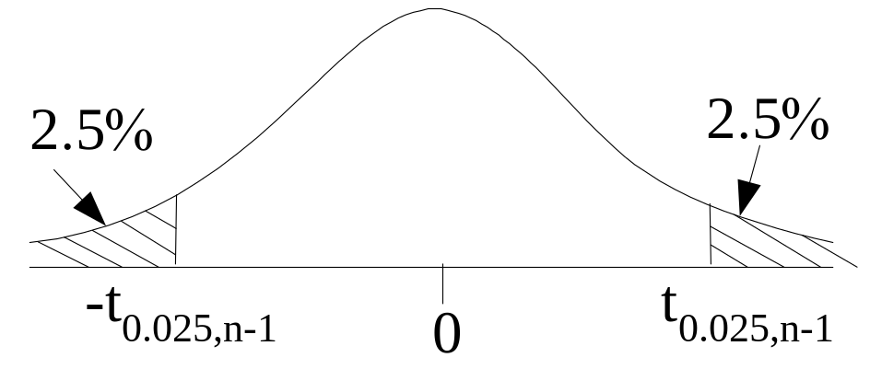
t-distribution
For sample size n=6, C.I.=[-2.571,2.571] (t_{0.025,5} = 2.571)
For sample size n=11, C.I.=[-2.228,2.228] (t_{0.025,10} = 2.228)
For the same confidence level, a larger sample size gives a narrower range

Slide 36
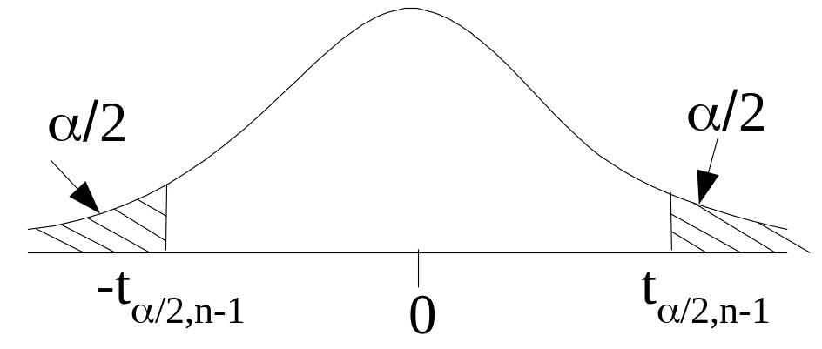
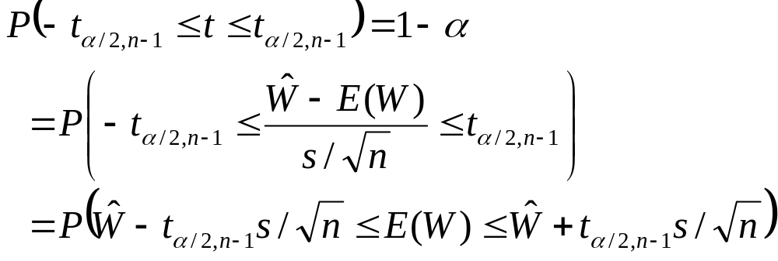
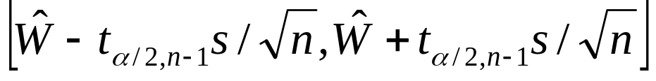
Confidence Interval Generation
The 100(1-α)% confidence interval for E(W) is

Slide 37
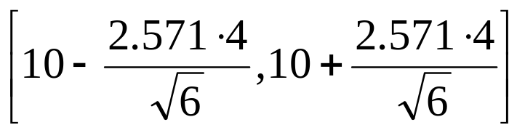
Example
Sample size = 6
Sample average waiting time = 10 sec
Standard deviation of the waiting time = 4 sec
The 95% confidence interval for the mean waiting time E(W) is
that is [5.8,14.2] sec
(Note: t_{0.025,5} = 2.571)

Slide 38
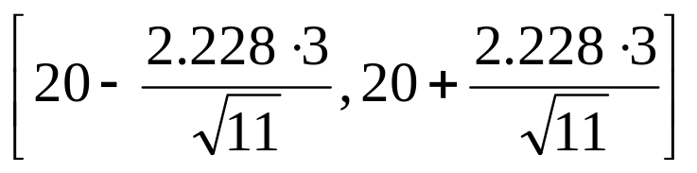
Example
11 different queue lengths have been observed at a switch during a period T
Sample queue length time-weighted average = 20 packets
Sample queue length time-weighted standard deviation = 3 packets
The 95% confidence interval for the mean queue length E(Q) is
that is [17.98, 22.02] packets
(Note: t_{0.025,10} = 2.228)

Slide 39
Terminating Vs. Non-terminating Systems
discrete-event systems can be categorized as being either terminating or non-terminating
requires different output analysis methods
Terminating Systems:
Events that drive the system stop occurring at some point in time
There may be reoccurring cycle, but each cycle starts off fresh
The end state of one cycle will not affect the starting state of the next cycle, i.e. each cycle is independent from the others
E.g.
  Bank
  A computer system that operates between 8 a.m. and 10 p.m. every day
  Two gamblers toss coins

Slide 40
Non-terminating Systems:
Events occur indefinitely
A single cycle will continue indefinitely and there is no terminating event
E.g.
  Jobshop
  Airport
  Hospital

Slide 41
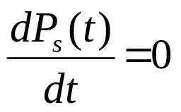
Transient and Steady-State Properties
In general, a terminating system may not be able to reach the steady state
  however, this is not always true!!!
Let s(t) = system state at t
P_{s}(t) = Prob. that the system is in state s at time t
then the system is in steady state relative to state variable s if
otherwise the system is in transient state
Note: In steady state, the system will still switch from state to state as in the transient phase; however, it is the state variable's probability distribution gets stabilized over time

Slide 42
Examples:
Systems that can achieve steady state:
A jobshop receives orders at a constant mean rate.
  Non-terminating and can achieve steady state
Highway toll booths during rush hour (7 a.m. to 9 a.m.)
  if the traffic intensity does not change over the 2 hours, and the arrival rate is substantial, the system will pass through its transient phase very quickly
  a terminating system

Slide 43
Systems that will not achieve steady state:
A health center that schedules the number of physicians to reflect the patient arriving pattern throughout the 24-hour day.
  Non-terminating
  can never reach the steady state because the patient arrival mean rate and the number of physicians keep changing
Users of a time-shared computer system connect to the system between 8 a.m. and 5 p.m.
  terminating
  cannot achieve steady state because the rate at which users connect to the system varies throughout the day
In general,
in terminating system, we are interested in the transient behavior
in non-terminating system, we are interested in the steady state behavior

Slide 44


Output Analysis for Terminating System
Recall:
and
where observations x_{i} are INDEPENDENT. (why (n-1) not n? The sum of all n differences are 0?)

Slide 45
REPLICATION method:
used to ensure that the observations are independent;
the simulation is executed a number of times, with each replication independent of the others;
For a simulation replicated R times, with n_{i} observations in the
i-th simulation, let
W_{ij} = j-th observation of the waiting time on the i-th replication
where
i = 1,2,...,R and j = 1,2,..., n_{i}
and Q_{i}(t) be the queue length observed at time t for the i-th replication, where 0 ≤ t ≤ T

Slide 46




For each replication, we have
and
The estimates for the system are:

Slide 47


The variance of W and Q are given by

Slide 48




Confidence intervals:
  and
are t statistics with R-1 degrees of freedom
The 100(1-α)% CI for E(W) is
The 100(1-α)% CI for E(Q) is

Slide 49
For terminating system, we are interested in the transient behavior as well
For each replication, observations are made at designated points in time or upon the occurrence of designated events.
For a simulation replicated R times, with K intermediate observations in each simulation, let
x_{ij} = j-th observation on the i-th replication
where
i = 1,2,...,R and j = 1,2,..., K

Slide 50




Let
y_{i} = some overall performance measure during the i-th replication
then
and

Slide 51



The confidence intervals for E(x_{ij}) and E(y_{i}) are
and
Hence, the half width of the confidence interval is

Slide 52
Truncation
Transient Removal: In truncation, the variability is measured in terms of range– the minimum and maximum of observations.
Giving a sample of n observations {x1, x2,..xn}, the truncation method consists of ignoring the first L observations and then calculating the minimum and maximum of the remaining n-L observations.
This step is repeated for L=1,2,..(n-1) until the (L+1)th observation is neither the minimum nor maximum of the remaining observations.

Slide 53
Truncation
E.g, consider the following sequence of observations: 1,2,3,4,5,6,7,8,9,10,11,10,9,10,11,10,9,10,11,10,9…
Ignoring the first observation, the remaining is (2,11). Since the second observation is equal to the minimum, 2. The transient phase is longer than 1. Go ahead with L=2,3,..

Slide 54
Output Analysis for Non-terminating Systems
Problems:
Covariance between Samples
  sets of data gathered are generally not independent
  variance estimates will be biased
Run Length
  Although the system itself may be non-terminating, the simulation must eventually be terminated.
  If system terminated too early, may not have a representative simulation
  Impractical to make extremely long run for very complex system

Slide 55
Initial Condition Bias
  very often simulation runs are initiated with the system in an IDLE state with no jobs in the system
  NOT representative of a state usually encountered during normal operation of the system
  output may undergo large fluctuations before achieving Steady State
    i.e. the current behavior is independent of its starting initial conditions and the probability of being in one of its states is given by a fixed probability function
    Note: the individual behaviors will continue to show their inherent variability, but the variations of the sample mean will balance out
  the sample mean that includes early arrivals will be biased if our interest is to estimate the steady state performance

Slide 56
Methods to reduce the initial bias
  Start the simulation in IDLE state and run for a sufficiently long period of time
    the effect of bias on estimates of mean and variance is negligibly small
  Start the simulation nearer to the steady state
    e.g. steady state obtained in the previous runs
  Run simulation for a period of time called "WARMING-UP Period"
    during which no statistics are collected (or collected statistics are discarded)
    start collecting statistics at the end of the warming-up period
    problem: must decide when steady state conditions begin

Slide 57
Replication of Simulation Runs
similar to the one used for terminating systems
must avoid (or minimize) the effect of the initial conditions
the estimation of sample mean and variance requires independent samples
  repeat simulation R times for the same sample size with the same starting conditions, but with different streams of random numbers
the sample mean is given by the overall mean of the R replications

Slide 58



let x_{ij} be the j-th observation in the i-th run
the estimates of the mean waiting time and its variance for large R are
where = mean of the i-th run
problem with using this method:
  high computation cost for repeating the initial warm up period and the uncertainty of the length of the transient phase
  Bias cannot be removed by adding replications

Slide 59




Example: The following shows the queuing delay of packets
The average queuing delay is
and variance

Slide 60

For a 95% confidence interval, α=0.05
t_{α/2,4} = t_{0.025,4} = 2.776
The 95% confidence interval for the queuing delay is

Slide 61
Batch Mean
A simulation is run for a long period of time, and its output is divided into BATCHES of equal size
  i.e. periodically record and then reset the statistical measures
If the Batch Length is sufficiently long
  the individual batches can be treated as independent samples
  sample mean and variance can be computed
  the initial bias needs to be eliminated only once at the beginning of the simulation by discarding the first few batches

Slide 62
the assumption that the individual batches are independent is not strictly true
  the final state of a batch becomes the initial state of the next batch
  autocorrelation exists
  to reduce the autocorrelation, consecutive batches are separated by intervals in which the outputs from the simulation are discarded
problem:
  no simple formula to determine the batch size and the length of the interval separating consecutive batches
  Note: We can determine if the batches are independent by using the RUNS TEST.

Slide 63
RUNS TEST
The test is based on the number of ascending and descending runs, indicated by the sign of the difference between successive elements in the sample.
Test the hypothesis H₀: the occurrence of the observations are independent.
E.g. The sign of the differences for the following are:
10.1, 12.2, 9.7, 6.1, 4.2, 5.9, 6.8, 5.5
+ - - - + + -
1 2 3 4
thus giving 2 runs up and 2 runs down, i.e. total of 4 runs

Slide 64

Let R = total number of runs
If there are n independent observations, then
E(R) = (2n - 1) / 3
and Var(R) = (16n - 29) / 90
E.g. R = 28, n = 40
E(R) = 26.3
Var(R) = 6.78
Normalizing R, we get
= (28 - 26.3)/2.60
= .65
When Z is compared to the critical value of Z_{.05}=1.96, we cannot reject H₀.

Slide 65
Regenerative Method
Regenerative Systems: systems where identical states recur at random intervals of time
  i.e. the system REGENERATES itself at random intervals in time
Regeneration point: the time at which the system states recur
  the regeneration points are computed with respect to a particular set of values of system variables chosen as reference point
  is a system state in which the future behavior of the system is independent of the system's past history
  e.g. when there are no jobs queuing or being served and the server is idle can be used as a reference point

Slide 66
Regenerative cycle: the interval between two regeneration points
  during which, the number of activities taking place in the simulation may vary
Note: It is possible that even if regeneration points exists, the parameters of the system may be such that it never reaches them
  e.g. In a single-server queuing system where jobs arrive at 3/min and each takes on average 1 min to serve, the system may never reach the idle state again.

Slide 67



To illustrate, for the i-th cycle, to estimate the system's property X using the ratio of two random variables Y_{i} and T_{i}, such that
E(X) = E(Y)/E(T)
where X = mean job waiting time
Y = total waiting time of all jobs during cycle
T = No. of jobs arriving in cycle
Let n = no. of cycle observed
and
then

Slide 68


To get the confidence interval on E(X),
let
D_{i} = Y_{i} - E(X)T_{i}
and
Var(D) = Var(Y) + E(X)²Var(T) - 2E(X)Cov(Y,T)
then
where

Slide 69

Output Validation
We compare model output with real-world system output when model and system input are similar

Slide 70
Hypothesis Testing
useful in testing if two means obtained from different simulation environments are significantly different in the statistical sense
observations must be independent and must be drawn from a normal population

Slide 71
The Elements of a Statistical Test
Null Hypothesis, H_{o}
  the hypothesis to be tested
Alternative Hypothesis, H_{a}
  the hypothesis to be accepted in case H_{o} is rejected
Test Statistic
  a function of the sample measurements upon which the statistical decision will be based
Rejection (or Critical) Region
  if the computed value of the test statistic falls in the rejection region, we reject the null hypothesis
Defn.: Type I error - rejection of H_{o} when H_{o} is true
α - prob. of a type I error

Slide 72

Simple case: compare the mean with a specific value
Null hypothesis: H_{o}: µ = µ₀
Alternative hypothesis: A₁: µ ≠ µ₀
A₂ : µ > µ₀
A₃ : µ < µ₀
where µ₀ is a specified value.
accept or reject the null hypothesis using t-test with n-1degree of freedom ( s is sample variance )

Slide 73
let α be the desired level of significance (0< α <1), and t_{n-1,α} as the critical value of the t-distribution such that
P(t > t_{n-1,α} ) = α
condition for rejecting the null hypothesis:
accepting condition for
alternative hypothesis rejecting H_{o}
A₁: µ ≠ µ₀ | t₀ | > t_{n-1,α/2}
A₂ : µ > µ₀ t₀ > t_{n-1,α}
A₃ : µ < µ₀ t₀ < -t_{n-1,α}

Slide 74

E.g.
From an existing system, the measured mean waiting time = µ₀
From a simulation model, n mean waiting times are collected
Sample mean =
Sample variance = s²
Population mean µ and population variance σ² are not known
t-Test: Null hypothesis H₀: = µ₀
Under H₀
has t-distribution with degree of freedom n-1
At level of significance α = 5%, reject H₀ if
t₀ < -t_{.975,n-1} or t₀ > t_{.975,n-1}

Slide 75




Example: Avg. waiting time from the real system is 18.1 sec, and the data from the simulation system are:
From the simulation:
For 95% CI, with t_{0.025,9} = 2.262 < t₀, we will reject the hypothesis
Note: for 99% CI, t_{0.005,9} = 3.25 > t₀, the hypothesis will be accepted

Slide 76

Testing the equality of two population means
Null hypothesis: H_{o}: µ₁ = µ₂
Alternative hypothesis: A₁: µ₁ ≠ µ₂
A₂ : µ₁ > µ₂
A₃ : µ₁ < µ₂
which represents a t-distribution with n = n₁ + n₂ - 2 degrees of freedom

Slide 77
accepting condition for
alternative hypothesis rejecting H_{o}
A₁: µ₁ ≠ µ₂ | t₀ | > t_{n,α/2}
A₂ : µ₁ > µ₂ t₀ > t_{n,α}
A₃ : µ₁ < µ₂ t₀ < -t_{n,α}
E.g.
Simulation 1: 24.1, 40.2, 26.7, 42.4, 20.3, 31.6, 49.8, 39, 34.5, 31.4
Simulation 2: 15.7, 19.5, 9.2, 15.3, 14.3, 29, 40, 23.2, 24.3, 28.6
For 95% CI, t_{0.025,18}=2.101

Slide 78





E.g.
Simulation 1: 24.1, 40.2, 26.7, 42.4, 20.3, 31.6, 49.8, 39, 34.5, 31.4
Simulation 2: 15.7, 19.5, 9.2, 15.3, 14.3, 29, 40, 23.2, 24.3, 28.6
For 95% CI, t_{0.025,18}=2.101 < t₀, reject the hypothesis

Slide 79

To compare the model with the real system with N independent different set of input:
  D_{i} = O_{i} – E_{i} for i = 1,…,N are i.i.d. random variable with mean μ_{D}
  If model equates to real-world, μ_{D} = 0

Slide 80





Let
  is an unbiased estimate of the mean μ_{D}
  If μ_{D} = 0, then is a t statistics with (N-1) degrees of freedom
  Reject the model if is not in the interval [-t_{α/2,N-1}, t_{α/2,N-1}]

Slide 81
Experiments Design
The goal is to obtain the maximum information with the minimum number of experiments.
Terminology:
Response variable, the outcome of an experiments is called the response variable. E.g. throughput,

Slide 82
Experiments Design
Factors: Each variable that affects the response variable and has several alternatives is called a factor. E.g., there are 5 factors in the workstation design, CPU type, memory size, number of disk driver, workload used, user’s educational level.
Levels: The value that a factor can assume are called its levels. E.g. CPU has 3 levels: PIV, PIII, PII, etc…

Slide 83
Experiment Design
Primary factor: the factors whose effects need to be quantified are called primary factor.
Secondary factor: factors that impact the performance but we are not interested in quantifying.
Replication: repetition of all or some experiments is called replication.

Slide 84
Experiments Design
Design: An experimental design consists of specifying the number of experiments, the factor level combinations for each experiment, the number of replications. E.g. in the workstation case, we perform corresponding to all possible combinations of levels of 5 factors: 3*3*4*3*3. We could repeat each experiment 5 times.

