Slide 1
Lecture 5: The Transport Layer
(Internet Transport Protocols)
Advanced Computer Network
Yang Qin
Department of Computer Science
Shenzhen Graduate School
Harbin Institute of Technology

Slide 2
Layer 4: The Transport Layer
An Overview of Layer 4
TCP (Transmission Control Protocol)
UDP(User Datagram Protocol)

Slide 3
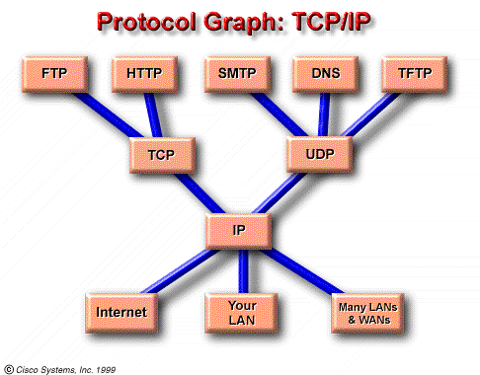
Layer 4: The Transport Layer

Slide 4
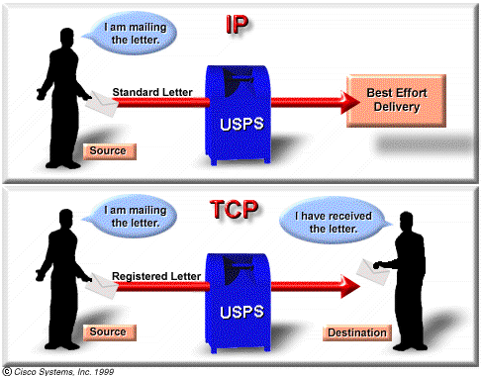
The TCP/IP Protocol Stack
IP is a Layer 3 protocol and TCP is a Layer 4 protocol. TCP is connection-oriented and ensures reliability but IP is connection-less with best effort attempts at delivery.

Slide 5
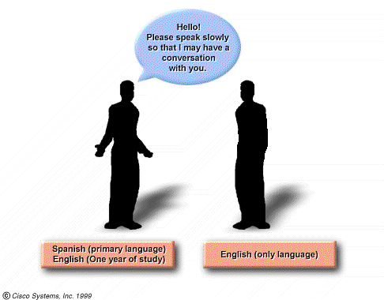
Flow control and reliability of the transport layer can be compared to a student who studies only one year of a foreign language, then visits the country that uses that language. Whenever the student tries to join a conversation, he or she has to ask everyone, frequently, to repeat his/her words (reliability) and to speak slowly (flow control).

Slide 6
Layer 4: The Transport Layer
TCP :
  connection-oriented
  reliable
  divides outgoing messages into segments
  reassembles messages at the destination station
  re-sends anything not received
UDP:
  connectionless
  unreliable
  transmit messages
  provides no software checking for segment delivery (unreliable)
  does not reassemble incoming messages
  uses no acknowledgments
  provides no flow control

Slide 7
Layer 4: The Transport Layer
An Overview of Layer 4
TCP (Transmission Control Protocol)
UDP(User Datagram Protocol)
An application: NAT and PAT

Slide 8
TCP Service Model
Applications access TCP services through “sockets”
Socket is presented as “(IP address，port)”
Every connection is expressed as (socket_{source}, socket_{destination}), which is a point-to-point full-duplex channel
TCP does not support multicast and broadcast

Slide 9
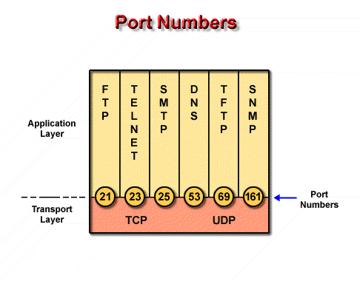
TCP Service Model
Both TCP and UDP use port numbers to keep track of different conversations that cross the network at the same time
Application software developers have agreed to use the well-known port numbers that are defined in RFC1700
Port numbers below 255 are reserved for TCP and UDP public applications.

Slide 10
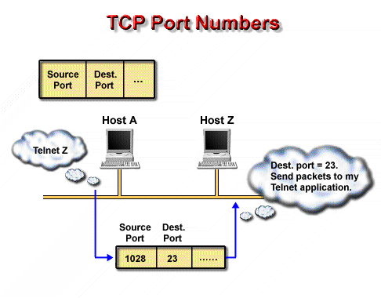
Originating source port numbers are dynamically assigned by the source host. Usually, it is a number larger than 1023.

Slide 11
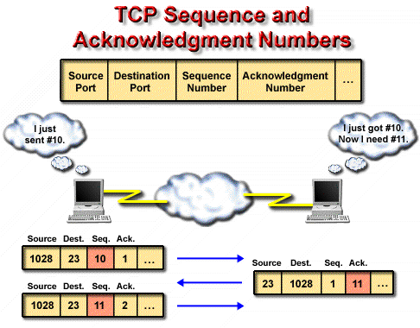
Sequence and acknowledgment numbers is necessary for TCP to track since two successive IP packets may in many instances NOT travel the same path and arrive at the destination host out of order.

Slide 12
TCP Service Model
Problems must be solved in TCP:
  Reliable transfer
  Flow control
    Sliding window
    congestion avoidance…
  Connection management
    Establish connection：three handshakes
    Release connection： four handshakes

Slide 13
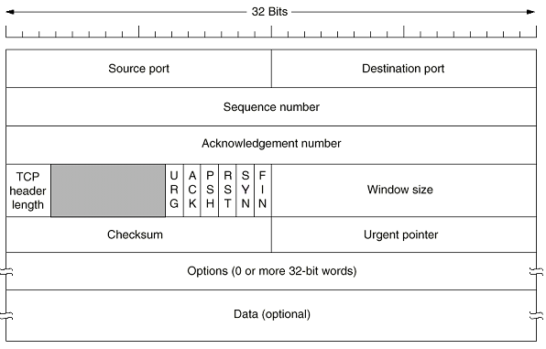
TCP Protocol
TCP Segment Header

Slide 14
Field definitions in the TCP segment:
  source port - number of the calling port
  destination port - number of the called port
  sequence number - number used to ensure correct sequencing of the arriving data, 32 bits
  acknowledgment number - next expected TCP octet, 32bits
  TCP header length (HLEN)– number of 32-bit words in the header
  reserved - set to zero, 6 bits
  code bits - control functions (such as setup and termination of a session)
  window - number of octets that the sender is willing to accept
  checksum - calculated checksum of the header and data fields
  urgent pointer - indicates the end of the urgent data
  option-one option - maximum TCP segment size
  data - upper-layer protocol data

Slide 15
TCP Protocol
Code Bits:
  URG：work with the urgency pointer to send the urgency data
  ACK：this segment is an ACK segment
  PSH：No data cache will done in both source and destination host. Data will be send or receive immediately
  RST：reset the connection because of the faults unable to be recovered
  SYN：indicate connection establishing
  FIN：indicate connection releasing

Slide 16
TCP Protocol
Hosts exchange data by using segment(TPDU) between each other
Each segment has a header of 20 bytes(except optional parts) and 0 or more data bytes
The size of the segment must be matched with IP packets，and also must satisfy the demand of bottom layers. For example, the MTU(Maximal Transfer Unit) of Ethernet is 1500 bytes
Each byte has a 32 bits sequence number
Sliding window protocol is used in TCP to control the data flow. In the protocol, the sequence number of the ACK segment is just the sequence number ought to be received

Slide 17
TCP Connection Management
Recall: TCP sender, receiver establish “connection” before exchanging data segments
initialize TCP variables:
  seq. #s
  buffers, flow control info (e.g. RcvWindow)
client: connection initiator
Socket clientSocket = new Socket("hostname","port number");
server: contacted by client
Socket connectionSocket = welcomeSocket.accept();
Three way handshake:
Step 1: client host sends TCP SYN segment to server
  specifies initial seq #
  no data
Step 2: server host receives SYN, replies with SYNACK segment
  server allocates buffers
  specifies server initial seq. #
Step 3: client receives SYNACK, replies with ACK segment, which may contain data

Slide 18
TCP: Establish Connection
Setup connection: three handshakes
  Server: executes LISTEN and ACCEPT primitive，and monitors passively
  Client: executes CONNECT primitive, generate a TCP segment with SYN=1 and ACK=0,which stands for connection request
    The first handshake

Slide 19
TCP: Establish Connection
  Server receives the TCP segment and check if there is service process monitoring the required port.
    If none process is monitoring the port, answer a TCP segment with RST=1
    If there is any service process monitoring the port, the process can decide reject or accept the connection request
      If accept the connection, send a TCP segment with SYN=1 and ACK=1 to acknowledge the connection, and request the connection to the other side(the second handshake)
  When receives the acknowledgement, the client will send a segment with SYN=0 and ACK=1 to acknowledge the connection (the third handshake)

Slide 20
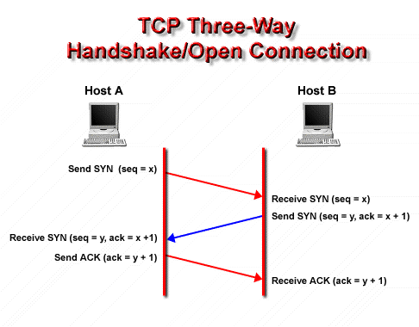
A three-way handshake/open connection sequence synchronizes a connection at both ends before the transferred data reaches the ends.
  If each of the two hosts wants to establish a connection to the other one, only one connection will be established

Slide 21
TCP: Establish Connection
TCP A TCP B
1. CLOSED LISTEN
2. SYN-SENT --> <SEQ=100><CTL=SYN> --> SYN-RECEIVED
3. ESTABLISHED <-- <SEQ=300><ACK=101><CTL=SYN,ACK> <-- SYN-RECEIVED
4. ESTABLISHED --> <SEQ=101><ACK=301><CTL=ACK> --> ESTABLISHED
5. ESTABLISHED --> <SEQ=101><ACK=301><CTL=ACK><DATA> --> ESTABLISHED
Basic 3-Way Handshake for Connection Synchronization
Note that the ACK does not occupy sequence number space (if it did, we
would wind up ACKing ACK's!).

Slide 22
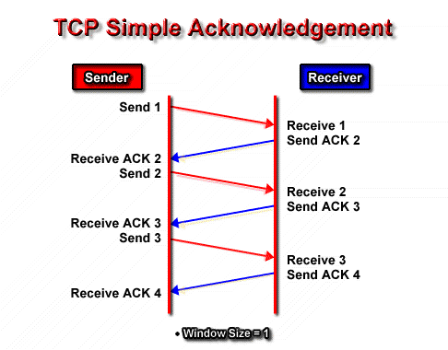
TCP: Data Transfer

Slide 23
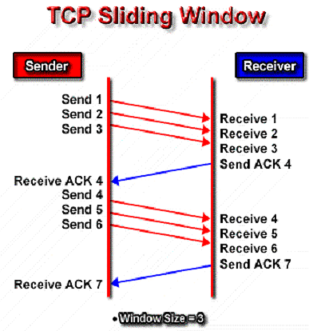
TCP: Data Transfer
Window size refers to the number of messages that can be transmitted before receiving an acknowledgment.
  The larger the window size number (bytes), the greater amount of data that can be transmitted.
Sliding window refers to the fact that the window size is negotiated dynamically during the TCP session.

Slide 24
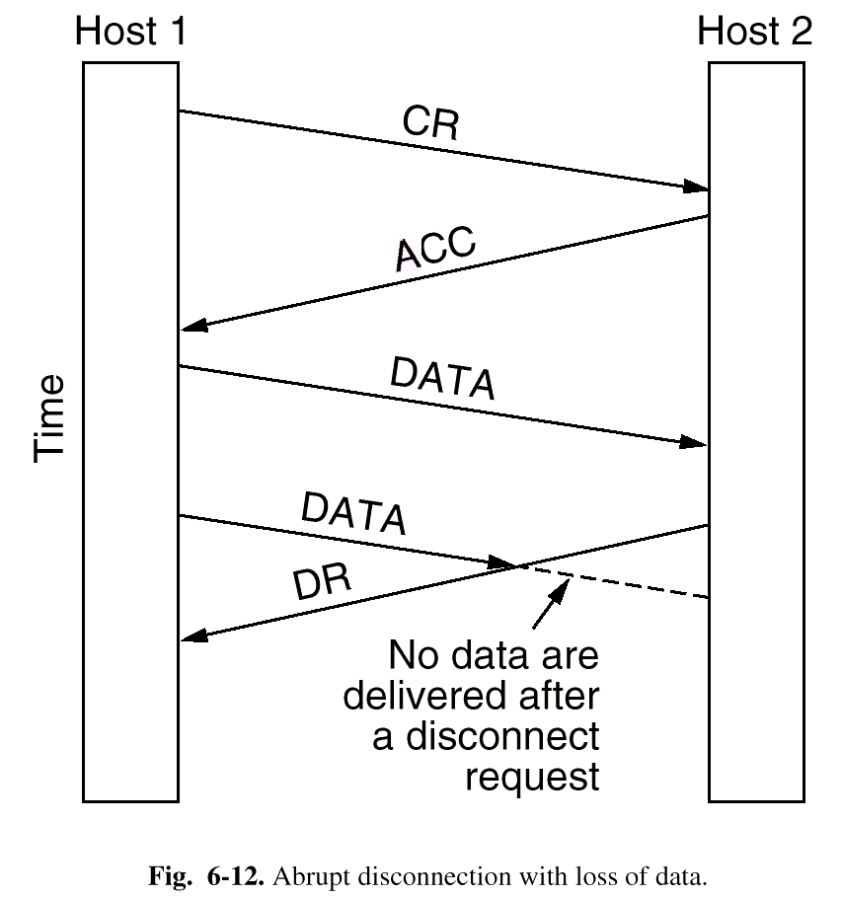
TCP: Release Connection
Two way to release the connection
  Asymmetry way：if one host releases the connection, the connection is released
    Easy to implement, while data is in danger
    Not a good choice for TCP

Slide 25
TCP: Release Connection
Symmetry way is adopted in TCP
The full duplex connection in TCP is often treated as two simplex connection, that is, releasing the connection must need four handshakes----one simplex connection for two
While just as we have mentioned, the second FIN segment can be combined with the first FIN ACK segment into a single one. if we do so, only three segment (handshakes) is enough

Slide 26
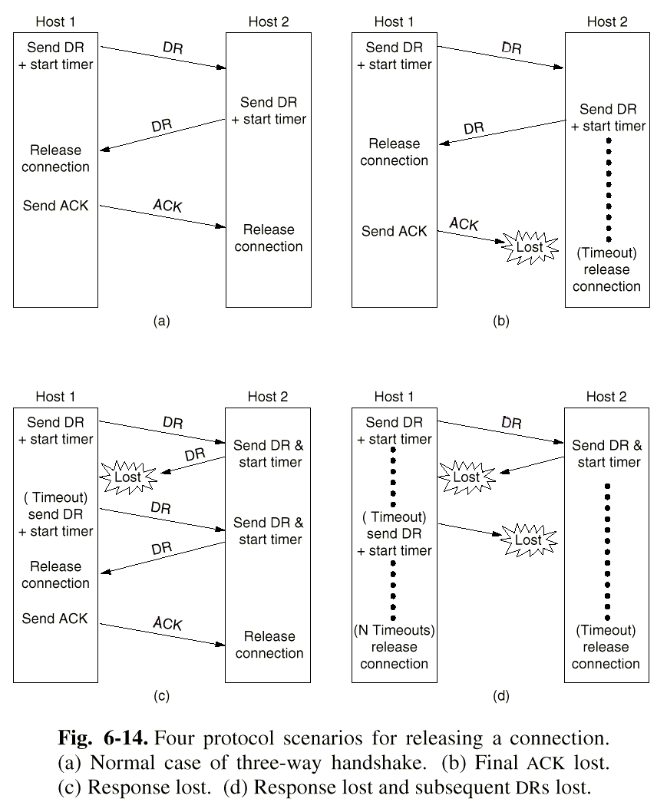

Slide 27

TCP Connection Management (cont.)
Closing a connection:
client closes socket: clientSocket.close();
Step 1: client end system sends TCP FIN control segment to server
Step 2: server receives FIN, replies with ACK. Closes connection, sends FIN.
client
server
close
FIN
ACK
close
FIN
ACK
timed wait
closed

Slide 28
TCP Connection Management (cont.)
Step 3: client receives FIN, replies with ACK.
  Enters “timed wait” - will respond with ACK to received FINs
Step 4: server, receives ACK. Connection closed.
Note: with small modification, can handle simultaneous FINs.
client
server
closing
FIN
ACK
closing
FIN
ACK
timed wait
closed
closed

Slide 29


TCP Connection Management (cont)
TCP server
lifecycle
TCP client
lifecycle

Slide 30
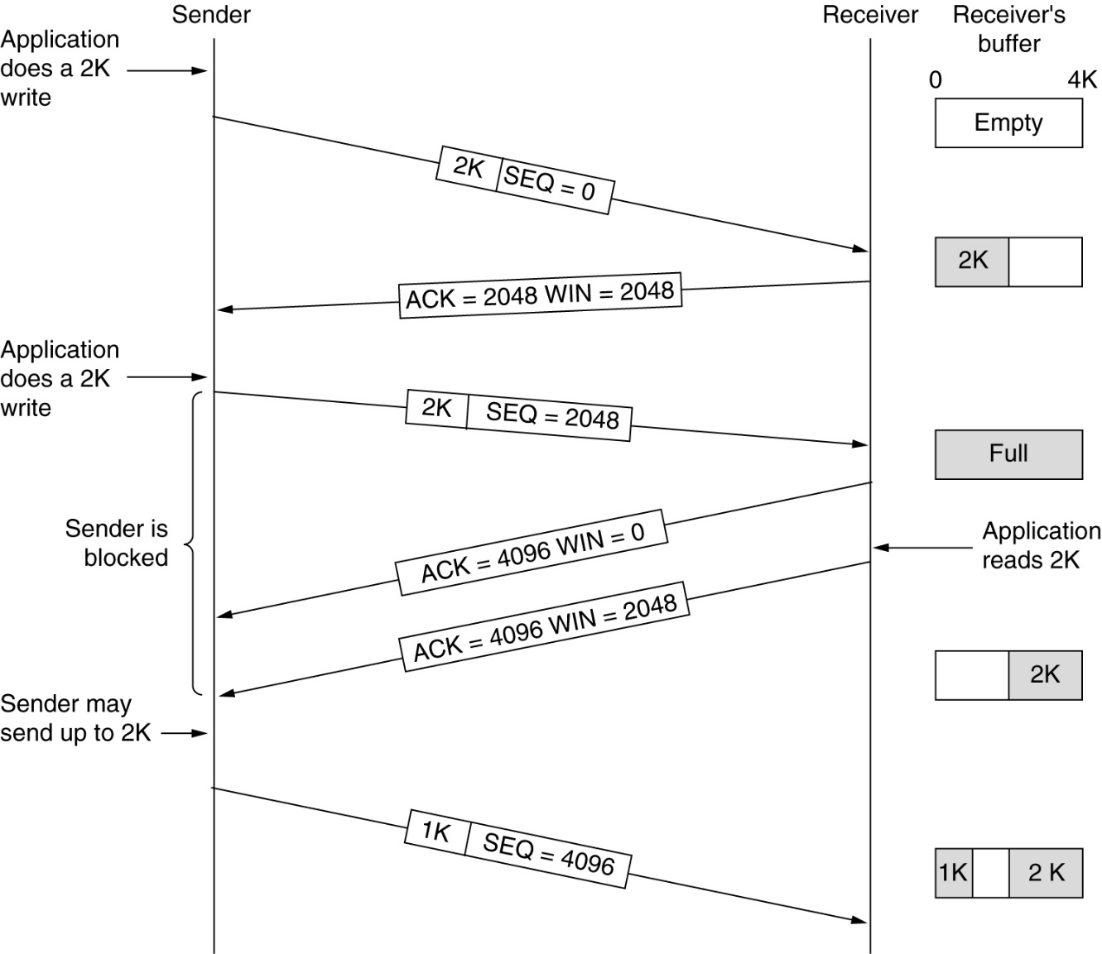
TCP Transmission Policy
Window management in TCP.

Slide 31
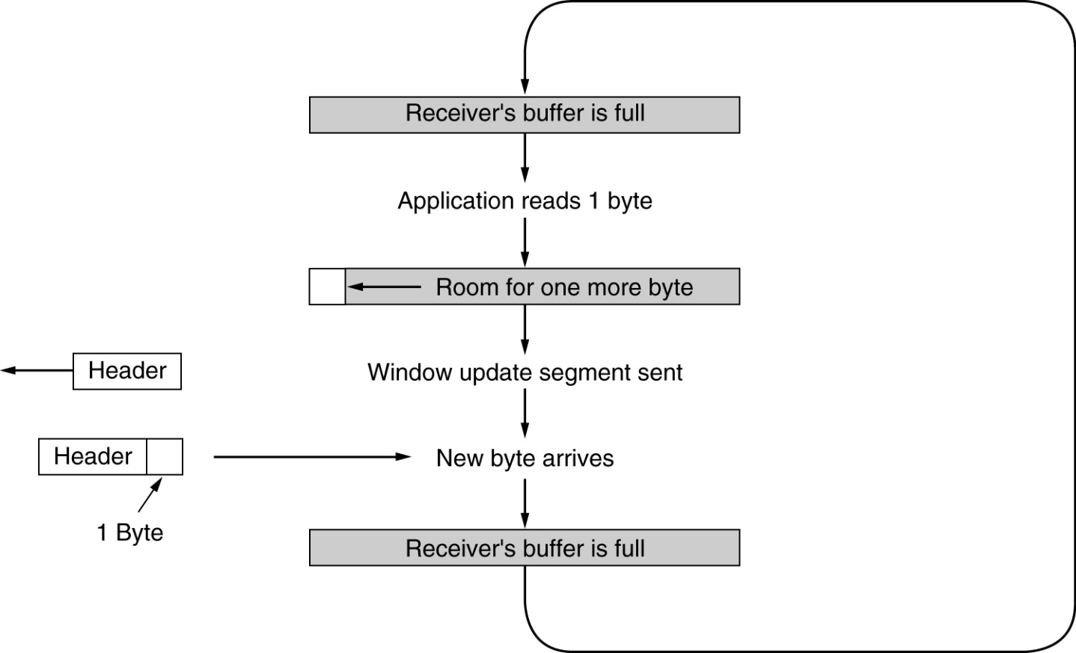
TCP Transmission Policy (2)
Nagle algorithm: one-byte sender problem
Clark algorithm: one-byte receiver problem
Silly window syndrome.

Slide 32
TCP reliable data transfer
TCP creates rdt service on top of IP’s unreliable service
Pipelined segments
Cumulative acks
TCP uses single retransmission timer
Retransmissions are triggered by:
  timeout events
  duplicate acks
Initially consider simplified TCP sender:
  ignore duplicate acks
  ignore flow control, congestion control

Slide 33
TCP sender events:
data rcvd from app:
Create segment with seq #
seq # is byte-stream number of first data byte in segment
start timer if not already running (think of timer as for oldest unacked segment)
expiration interval: TimeOutInterval
timeout:
retransmit segment that caused timeout
restart timer
Ack rcvd:
If acknowledges previously unacked segments
  update what is known to be acked
  start timer if there are outstanding segments

Slide 34
TCP sender
(simplified)
NextSeqNum = InitialSeqNum
SendBase = InitialSeqNum
loop (forever) {
switch(event)
event: data received from application above
create TCP segment with sequence number NextSeqNum
if (timer currently not running)
start timer
pass segment to IP
NextSeqNum = NextSeqNum + length(data)
event: timer timeout
retransmit not-yet-acknowledged segment with
smallest sequence number
start timer
event: ACK received, with ACK field value of y
if (y > SendBase) {
SendBase = y
if (there are currently not-yet-acknowledged segments)
start timer
}
} /* end of loop forever */
Comment:
SendBase-1: last
cumulatively
ack’ed byte
Example:
SendBase-1 = 71;
y= 73, so the rcvr
wants 73+ ;
y > SendBase, so
that new data is
acked

Slide 35
TCP: retransmission scenarios
Host A
Host B
Host A
Host B
Seq=92, 8 bytes data
Seq=92, 8 bytes data
Seq=100, 20 bytes data
timeout
ACK=100
Seq=92 timeout
X
ACK=100
loss
ACK=120
Seq=92, 8 bytes data
Sendbase
= 100
Seq=92, 8 bytes data
SendBase
= 120
Seq=92 timeout
ACK=120
ACK=100
SendBase
= 100
SendBase
= 120
premature timeout
time
time
lost ACK scenario

Slide 36
TCP retransmission scenarios (more)
Host A
Host B
Seq=92, 8 bytes data
ACK=100
timeout
Seq=100, 20 bytes data
X
loss
SendBase
= 120
ACK=120
time
Cumulative ACK scenario

Slide 37
TCP ACK generation [RFC 1122, RFC 2581]
Event at Receiver
Arrival of in-order segment with
expected seq #. All data up to
expected seq # already ACKed
Arrival of in-order segment with
expected seq #. One other
segment has ACK pending
Arrival of out-of-order segment
higher-than-expect seq. # .
Gap detected
Arrival of segment that
partially or completely fills gap
TCP Receiver action
Delayed ACK. Wait up to 500ms
for next segment. If no next segment,
send ACK
Immediately send single cumulative
ACK, ACKing both in-order segments
Immediately send duplicate ACK,
indicating seq. # of next expected byte
Immediate send ACK, provided that
segment startsat lower end of gap

Slide 38
Fast Retransmit
If sender receives 3 ACKs for the same data, it supposes that segment after ACKed data was lost:
  fast retransmit: resend segment before timer expires
Time-out period often relatively long:
  long delay before resending lost packet
Detect lost segments via duplicate ACKs.
  Sender often sends many segments back-to-back
  If segment is lost, there will likely be many duplicate ACKs.

Slide 39
Fast retransmit algorithm:
event: ACK received, with ACK field value of y
if (y > SendBase) {
SendBase = y
if (there are currently not-yet-acknowledged segments)
start timer
}
else {
increment count of dup ACKs received for y
if (count of dup ACKs received for y = 3) {
resend segment with sequence number y
}
a duplicate ACK for
already ACKed segment
fast retransmit

Slide 40

TCP Flow Control
flow control
receive side of TCP connection has a receive buffer:
sender won’t overflow
receiver’s buffer by
transmitting too much,
too fast
speed-matching service: matching the send rate to the receiving app’s drain rate
app process may be slow at reading from buffer

Slide 41
TCP Flow control: how it works
Rcvr advertises spare room by including value of RcvWindow in segments
Sender limits unACKed data to RcvWindow
  guarantees receive buffer doesn’t overflow
(Suppose TCP receiver discards out-of-order segments)
spare room in buffer
= RcvWindow
= RcvBuffer-[LastByteRcvd - LastByteRead]

Slide 42
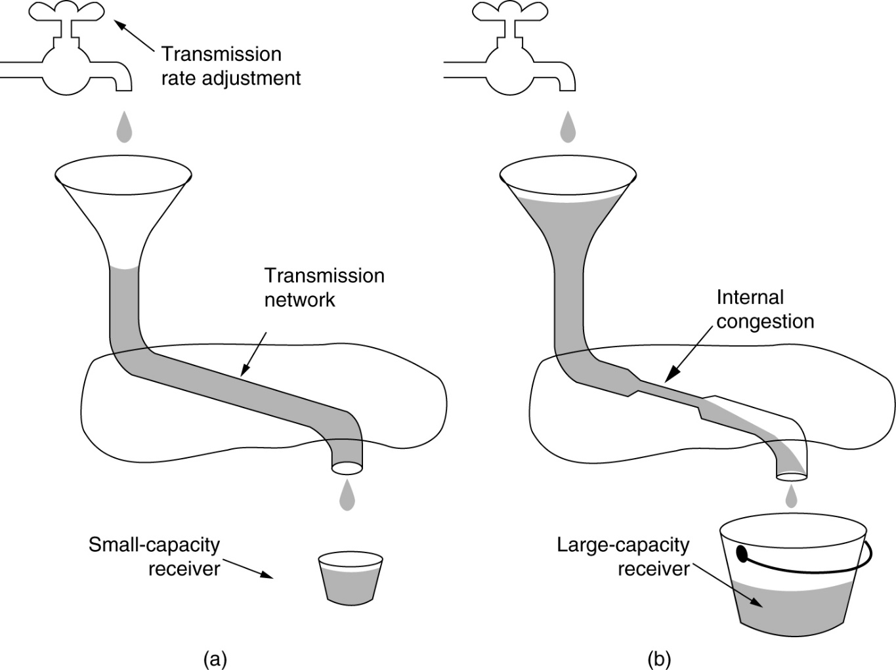
TCP Congestion Control
(a) A fast network feeding a low capacity receiver.
(b) A slow network feeding a high-capacity receiver.

Slide 43
Principles of Congestion Control
Congestion:
informally: “too many sources sending too much data too fast for network to handle”
different from flow control!
manifestations:
  lost packets (buffer overflow at routers)
  long delays (queueing in router buffers)
a top-10 problem!

Slide 44

Causes/costs of congestion: scenario 1
two senders, two receivers
one router, infinite buffers
no retransmission
Host A
λ_{in} : original data
λ_{out}
Host B
unlimited shared output link buffers
large delays when congested
maximum achievable throughput

Slide 45
Causes/costs of congestion: scenario 2
one router, finite buffers
sender retransmission of lost packet
Host A
λ_{in} : original data
λ_{out}
λ'_{in} : original data, plus retransmitted data
Host B
finite shared output link buffers

Slide 46
Causes/costs of congestion: scenario 2
always: (goodput)
“perfect” retransmission only when loss:
retransmission of delayed (not lost) packet makes larger (than perfect case) for same
λ
=
λ
in
out
λ
>
λ
in
out
λ
in
λ
out
R/2
R/2
R/2
R/3
λ_{out}
λ_{out}
λ_{out}
R/4
λ_{in}
R/2
λ_{in}
R/2
λ_{in}
R/2
a.
b.
c.
“costs” of congestion:
more work (retrans) for given “goodput”
unneeded retransmissions: link carries multiple copies of pkt

Slide 47
Causes/costs of congestion: scenario 3
Q: what happens as and increase ?
λ
four senders
multihop paths
timeout/retransmit
in
λ
in
Host A
λ_{in} : original data
λ_{out}
λ'_{in} : original data, plus retransmitted data
finite shared output link buffers
Host B

Slide 48

Causes/costs of congestion: scenario 3
Host A
λ_{out}
Host B
Another “cost” of congestion:
when packet dropped, any “upstream transmission capacity used for that packet was wasted!

Slide 49
Approaches towards congestion control
Two broad approaches towards congestion control:
Network-assisted congestion control:
routers provide feedback to end systems
  single bit indicating congestion (SNA, DECbit, TCP/IP ECN, ATM)
  explicit rate sender should send at networks
End-end congestion control:
no explicit feedback from network
congestion inferred from end-system observed loss, delay
approach taken by TCP

Slide 50
Case study: ATM ABR congestion control
RM (resource management) cells:
sent by sender, interspersed with data cells
bits in RM cell set by switches (“network-assisted”)
  NI bit: no increase in rate (mild congestion)
  CI bit: congestion indication
RM cells returned to sender by receiver, with bits intact
ABR: available bit rate:
“elastic service”
if sender’s path “underloaded”:
  sender should use available bandwidth
if sender’s path congested:
sender throttled to minimum guaranteed rate

Slide 51

Case study: ATM ABR congestion control
two-byte ER (explicit rate) field in RM cell
  congested switch may lower ER value in cell
  sender’ send rate thus minimum supportable rate on path
EFCI bit in data cells: set to 1 in congested switch
  if data cell preceding RM cell has EFCI set, sender sets CI bit in returned RM cell

Slide 52

TCP congestion control: additive increase, multiplicative decrease
Approach: increase transmission rate (window size), probing for usable bandwidth, until loss occurs
  additive increase: increase CongWin by 1 MSS every RTT until loss detected
  multiplicative decrease: cut CongWin in half after loss
Saw tooth
behavior: probing
for bandwidth
congestion window size
time

Slide 53
TCP Congestion Control: details
How does sender perceive congestion?
loss event = timeout or 3 duplicate acks
TCP sender reduces rate (CongWin) after loss event
three mechanisms:
  AIMD
  slow start
  conservative after timeout events
sender limits transmission:
LastByteSent-LastByteAcked
≤ CongWin
Roughly,
CongWin is dynamic, function of perceived network congestion
CongWin
rate =
Bytes/sec
RTT

Slide 54
TCP Slow Start
When connection begins, CongWin = 1 MSS
  Example: MSS = 500 bytes & RTT = 200 msec
  initial rate = 20 kbps
available bandwidth may be >> MSS/RTT
  desirable to quickly ramp up to respectable rate
When connection begins, increase rate exponentially fast until first loss event

Slide 55
TCP Slow Start (more)
When connection begins, increase rate exponentially until first loss event:
  double CongWin every RTT
  done by incrementing CongWin for every ACK received
Summary: initial rate is slow but ramps up exponentially fast
Host A
Host B
one segment
RTT
two segments
four segments
time

Slide 56

Refinement
Q: When should the exponential increase switch to linear?
A: When CongWin gets to 1/2 of its value before timeout.
Implementation:
Variable Threshold
At loss event, Threshold is set to 1/2 of CongWin just before loss event

Slide 57
Refinement: inferring loss
After 3 dup ACKs:
  CongWin is cut in half
  window then grows linearly
But after timeout event:
  CongWin instead set to 1 MSS;
  window then grows exponentially
  to a threshold, then grows linearly
Philosophy:
3 dup ACKs indicates
network capable of
delivering some segments
timeout indicates a “more alarming” congestion scenario

Slide 58
Summary: TCP Congestion Control
When CongWin is below Threshold, sender in slow-start phase, window grows exponentially.
When CongWin is above Threshold, sender is in congestion-avoidance phase, window grows linearly.
When a triple duplicate ACK occurs, Threshold set to CongWin/2 and CongWin set to Threshold.
When timeout occurs, Threshold set to CongWin/2 and CongWin is set to 1 MSS.

Slide 59
TCP sender congestion control
State | Event | TCP Sender Action | Commentary
Slow Start (SS) | ACK receipt for previously unacked data | CongWin = CongWin + MSS, If (CongWin > Threshold) set state to “Congestion Avoidance” | Resulting in a doubling of CongWin every RTT
Congestion Avoidance (CA) | ACK receipt for previously unacked data | CongWin = CongWin+MSS * (MSS/CongWin) | Additive increase, resulting in increase of CongWin by 1 MSS every RTT
SS or CA | Loss event detected by triple duplicate ACK | Threshold = CongWin/2, CongWin = Threshold, Set state to “Congestion Avoidance” | Fast recovery, implementing multiplicative decrease. CongWin will not drop below 1 MSS.
SS or CA | Timeout | Threshold = CongWin/2, CongWin = 1 MSS, Set state to “Slow Start” | Enter slow start
SS or CA | Duplicate ACK | Increment duplicate ACK count for segment being acked | CongWin and Threshold not changed

Slide 60
TCP throughput
What’s the average throughout of TCP as a function of window size and RTT?
  Ignore slow start
Let W be the window size when loss occurs.
When window is W, throughput is W/RTT
Just after loss, window drops to W/2, throughput to W/2RTT.
Average throughout: .75 W/RTT

Slide 61
TCP Fairness
Fairness goal: if K TCP sessions share same bottleneck link of bandwidth R, each should have average rate of R/K
TCP connection 1
TCP
connection 2
bottleneck
router
capacity R

Slide 62
Why is TCP fair?
Two competing sessions:
Additive increase gives slope of 1, as throughout increases
multiplicative decrease decreases throughput proportionally
R
equal bandwidth share
loss: decrease window by factor of 2
congestion avoidance: additive increase
Connection 2 throughput
loss: decrease window by factor of 2
congestion avoidance: additive increase
R
Connection 1 throughput

Slide 63
Fairness (more)
Fairness and UDP
Multimedia apps often do not use TCP
  do not want rate throttled by congestion control
Instead use UDP:
  pump audio/video at constant rate, tolerate packet loss
Research area: TCP friendly
Fairness and parallel TCP connections
nothing prevents app from opening parallel connections between 2 hosts.
Web browsers do this
Example: link of rate R supporting 9 cnctions;
  new app asks for 1 TCP, gets rate R/10
  new app asks for 11 TCPs, gets R/2 !

Slide 64
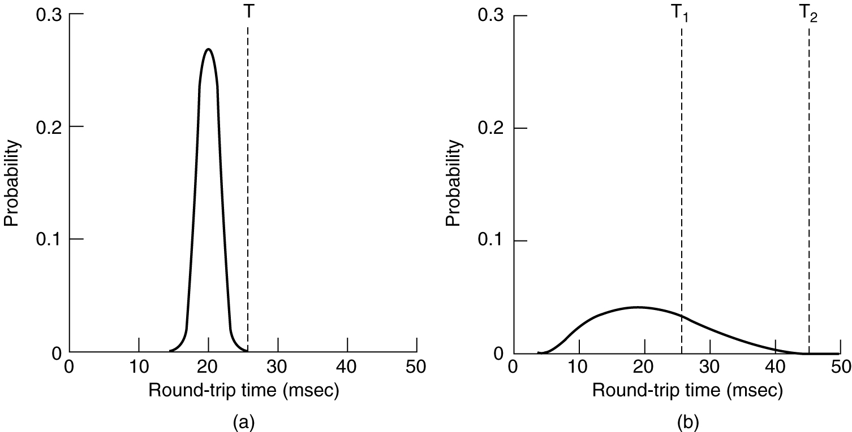
TCP Timer Management
Retransmission Timer: timeout=RTT+4xD
  D=αD+(1- α)|RTT-M|, M estimated value, RTT expected value
Persistence Timer
Keepalive Timer
(a) Probability density of ACK arrival times in the data link layer.
(b) Probability density of ACK arrival times for TCP.

Slide 65
Delay modeling
Notation, assumptions:
Assume one link between client and server of rate R
S: MSS (bits)
O: object size (bits)
no retransmissions (no loss, no corruption)
Window size:
First assume: fixed congestion window, W segments
Then dynamic window, modeling slow start
Q: How long does it take to receive an object from a Web server after sending a request?
Ignoring congestion, delay is influenced by:
TCP connection establishment
data transmission delay
slow start

Slide 66
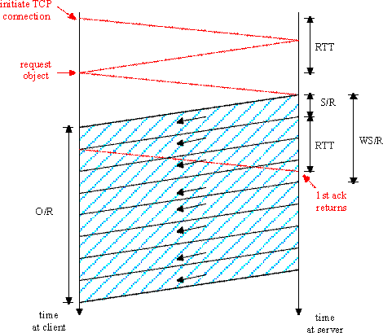
Fixed congestion window (1)
First case:
WS/R > RTT + S/R: ACK for first segment in window returns before window’s worth of data sent
delay = 2RTT + O/R

Slide 67
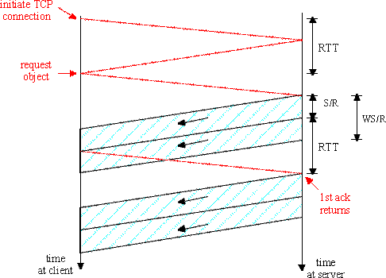
Fixed congestion window (2)
Second case:
S/R < RTT + S/R: wait for ACK after sending window’s worth of data sent
K=O/ws
delay = 2RTT + O/R
+ (K-1)[S/R + RTT - WS/R]

Slide 68
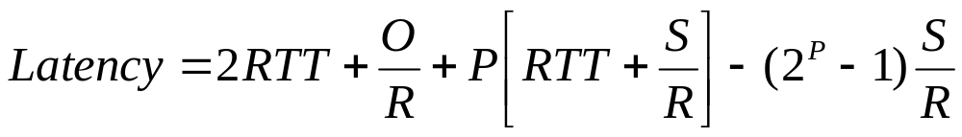

TCP Delay Modeling: Slow Start (1)
Now suppose window grows according to slow start
Will show that the delay for one object is:
where P is the number of times TCP idles at server:
- where Q is the number of times the server idles
if the object were of infinite size.
- and K is the number of windows that cover the object.

Slide 69
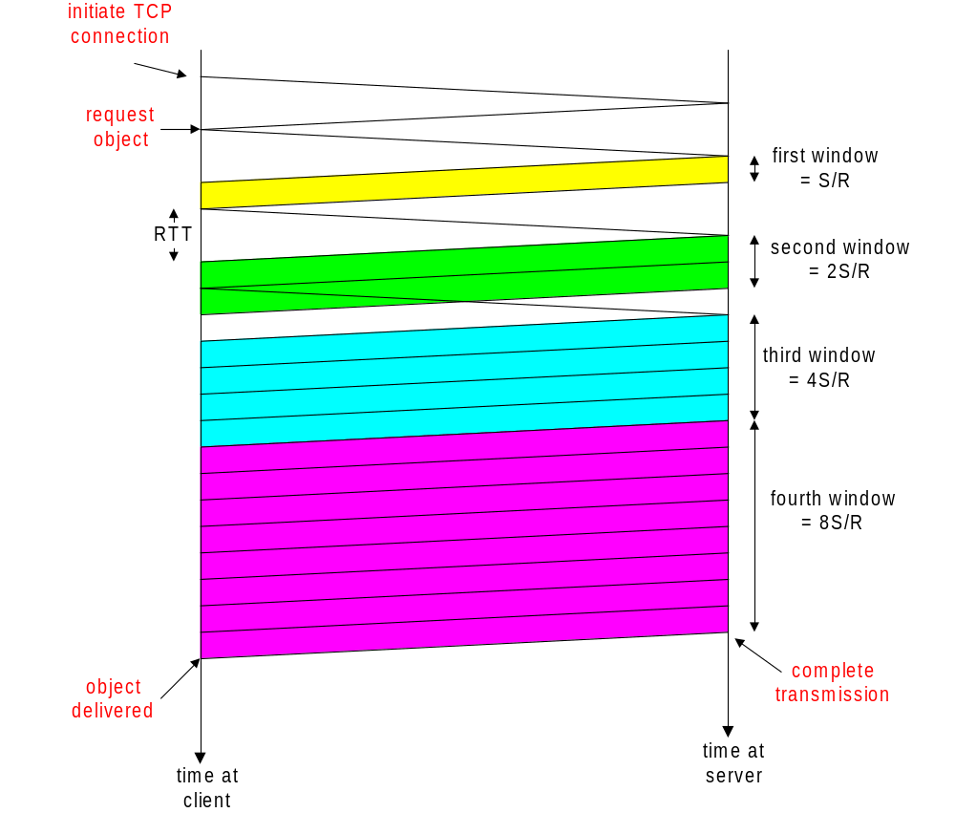
TCP Delay Modeling: Slow Start (2)
Delay components:
2 RTT for connection estab and request
O/R to transmit object
time server idles due to slow start
Server idles:
P = min{K-1,Q} times
Example:
O/S = 15 segments
K = 4 windows
Q = 2
P = min{K-1,Q} = 2
Server idles P=2 times

Slide 70
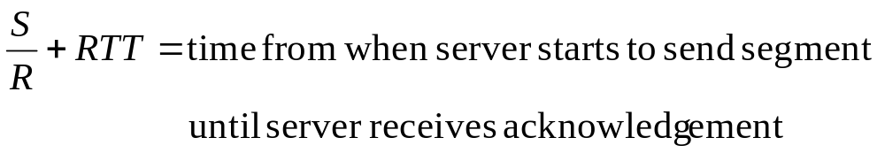
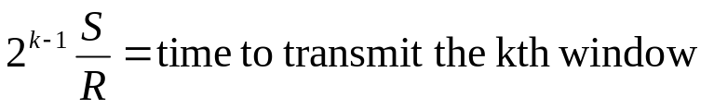
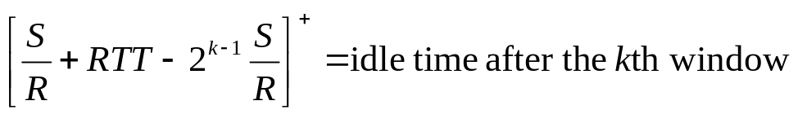
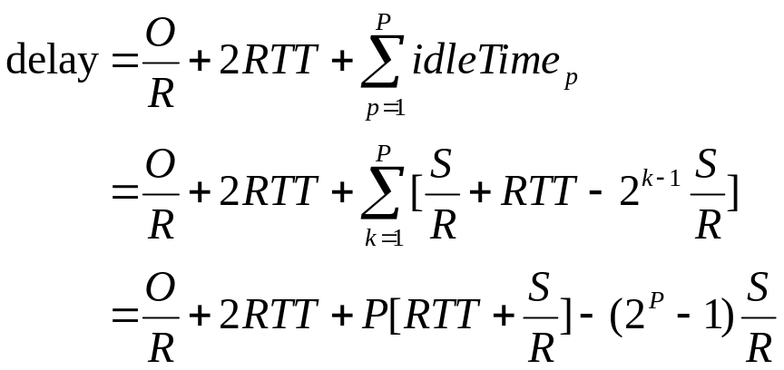
TCP Delay Modeling (3)

Slide 71
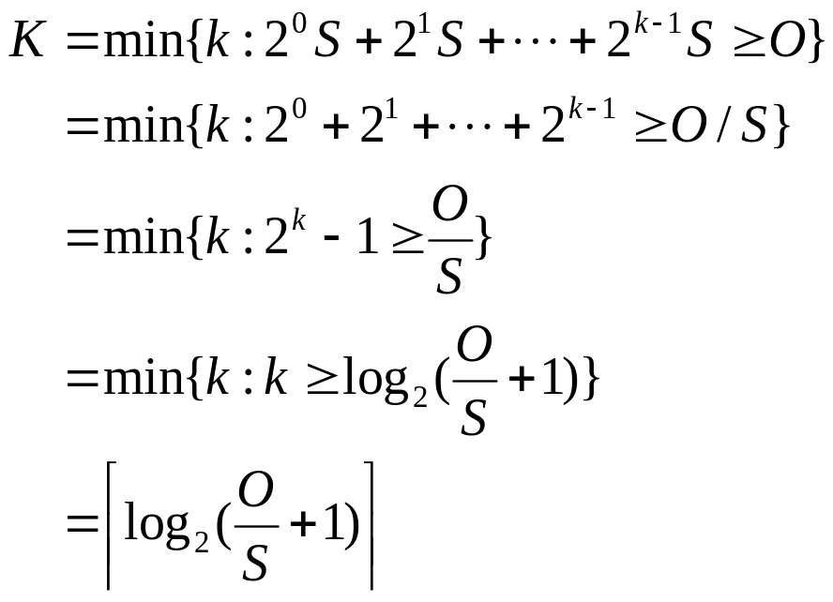
TCP Delay Modeling (4)
Recall K = number of windows that cover object
How do we calculate K ?

Slide 72
Layer 4: The Transport Layer
An Overview of Layer 4
TCP (Transmission Control Protocol)
UDP(User Datagram Protocol)

Slide 73
UDP (User Datagram Protocol)
Why do we need UDP?
  No connection establishment (which can add delay)
  Simple: no connection state at sender, receiver
  Small segment header
  No congestion control: UDP can blast away as fast as desired

Slide 74
UDP (User Datagram Protocol)
Connectionless:
  no handshaking between UDP sender, receiver
  each UDP segment handled independently of others
Often used for streaming multimedia applications
  loss tolerant
  rate sensitive
UDP are used in:
  RIP: To send the route information periodically
  DNS: Simple network management protocol, Avoid the delay to setup the TCP connection
  SNMP: When congestion, SNMP must still runable. Without the congestion and reliability control mechanism, UDP has better performance than TCP under the circumstances.
  Other protocols include TFTP, DHCP,DNS
Add reliability at application layer if necessary

Slide 75
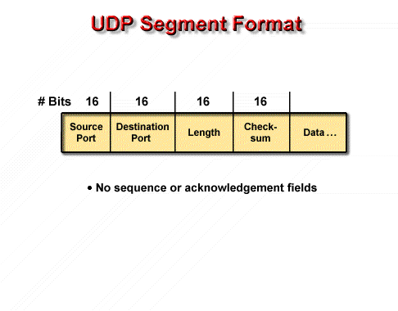
UDP (User Datagram Protocol)

Slide 76
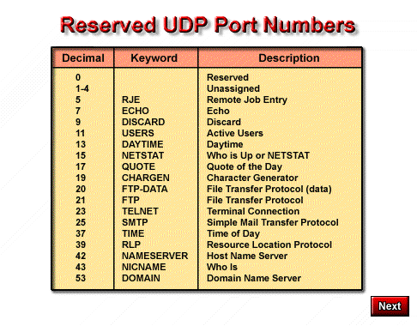

Slide 77
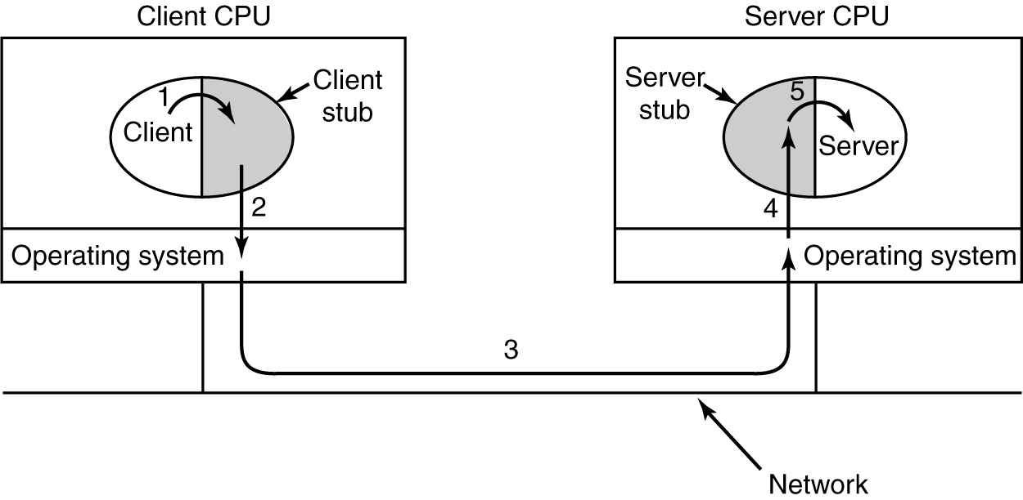
Remote Procedure Call
Steps in making a remote procedure call. The stubs are shaded.

Slide 78
Layer 4: The Transport Layer
An Overview of Layer 4
TCP (Transmission Control Protocol)
UDP(User Datagram Protocol)

