Slide 1
QoS Control

Slide 2
References:
Zheng Wang, Internet QoS: Architectures and Mechanisms for Quality of Services, Morgan Kaufmann, 2001.
H.J. Chao and X. Guo, Quality of Service Control in High-speed Networks, John Wiley & Sons, Inc., 2002.
J. Wroclawski, “Specification of the controlled-load network element service,” RFC 2211, Sept 1997.
S. Shenker, C. Partridge and R. Guerin, “Specification of guaranteed quality of service,” RFC 2212, Sept 1997.

Slide 3
Integrated Services
Recall:
Traditionally, Internet has provided best-effort service
To provide different QoS commitments, IETF developed the integrated services model
  Require resource reservation for every data flow
  A flow is a distinguishable stream of related IP packets that results from a single user activity and requires the same QoS (RFC1633)
  A flow is different from a TCP connection
    A flow is unidirectional
    There can be more than one receiver of a flow (multicast)

Slide 4
Background functions
Routing agent
Reservation
agent
Management
agent
Admission
control
Routing database
Traffic control database
Forwarding functions
Classifier & route selection
Packet scheduler
Input
driver
Output driver

Slide 5
The integrated services model composes of background functions and forwarding functions
Background functions:
  Reservation protocol:
    Use to reserve resources on routers and end systems for a new flow at a given level of QoS.
    Maintains flow-specific state information.
    Updates the traffic control database used by the packet scheduler to determine the service provided for packets of each flow.
  Routing protocol
    It maintains a database that gives the next hop address for each destination address

Slide 6
  Admission control:
    To determine if a router has the necessary resources to accept a new flow at the requested QoS
    The determination is done based on the current level of commitment to other reservations and/or the current load on the network
  Management agent
    It can modify the traffic control database and direct the admission control module in order to set the admission control policies

Slide 7
Forwarding functions:
  Packet classifier and route selection:
    To identify flows that are to receive a certain level of service
    To identify the next hop address
  Packet scheduler:
    To handle the forwarding of different packet flows in a manner that ensures that QoS commitments are met
      Manages one or more queues for each output port
      Determines the order in which queued packets are transmitted and the selection of packets for discard, if necessary

Slide 8
IS service is defined on two levels
  1. A number of general classes of service, each of which provides a certain general type of service guarantees
  2. Within each class, the service for a particular flow is specified by a number of parameters
Requires packet scheduling and buffer management on a per-flow basis
  Note that as the number of flows and line rate increase, it becomes very difficult and costly for the routers to provide integrated service
Three service classes: Controlled-load service, guaranteed service, and best effort service

Slide 9
Controlled Load
Traffic Shaping and Policing
  What and why is traffic shaping and traffic policing
  Leaky Bucket
  Token Bucket Traffic

Slide 10
Traffic Policing
  Question:
  A connection accepted by Call admission control, it’s QoS can be satisfied, if the source obeys the traffic descriptor.
What happens if the traffic flow violates the initial contract?
  Answer: The network may not maintain acceptable performance
What can be done?
  Traffic Policing is performed by the network to ensure that the parameter specified by the user are being complied.
Traffic Policing
  The process of monitoring and enforcing the traffic flow
• What Traffic Policing do?
  Discard the nonconforming traffic
  Tag the nonconforming traffic ( with lower priority)

Slide 11
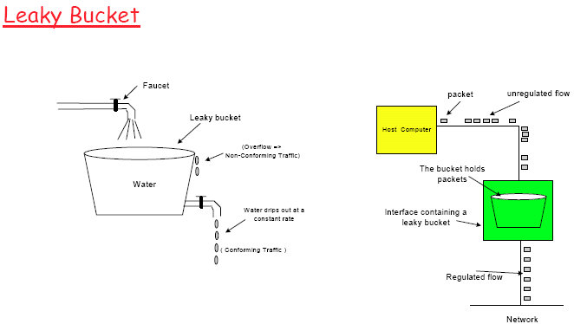
Provides traffic shaping: Input bursty. Output rate controlled.
• Provides traffic policing: Ensure that users are sending traffic within specified limits. Excess traffic discarded

Slide 12
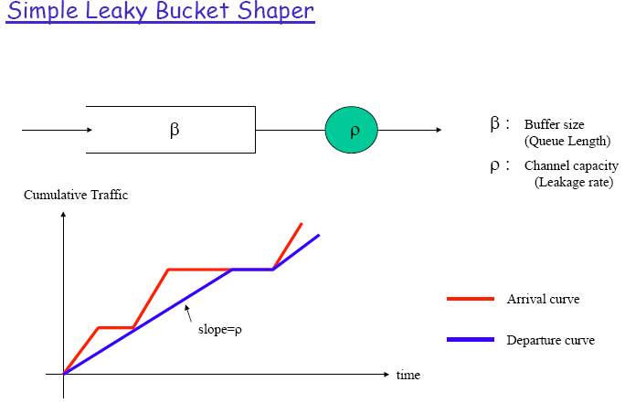

Slide 13
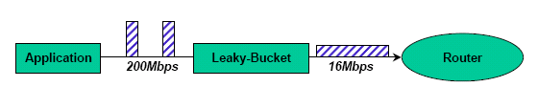
Design Example
Sender max. transmission rate of 200Mbps
- Router capacity is 16Mbps
- Application generates data in burst of 8Mb, with a burst length of 40ms, once every second.

Slide 14
Design Example
First make sure the router can possibly handle the traffic:
  Then determines C for the leaky bucket:
  Average data rate generated by application is:
  Total = 8Mb/1s = 8Mbps < router’s capacity (16Mbps)
Then determines C for the leaky bucket:
  Let A be arrival rate, and T be burst length (in seconds), then
  C ≥ max{(total received in time t)-(total tx in time t)|∀t}
  = A*t - r*t = (A-r)t
  = (200-16)*0.04
  = 7.36Mb or 0.92MB

Slide 15
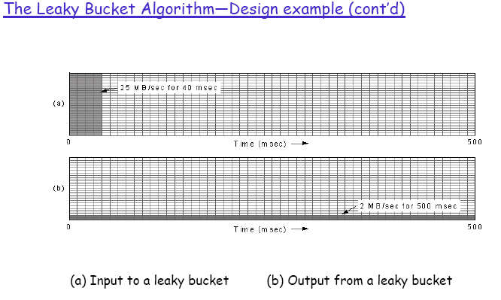

Slide 16
Token Bucket Traffic Shaper
Why a token bucket traffic shaper?
  Leaky bucket: the output rate is constant when the buffer is not empty;
  only CBR is allowed.
Token Bucket Shaper (Dual-bucket Shaper)
2 buckets
  – One buffer for data
  – One buffer for a pool of tokens: tokens are generated at a constant rate
More flexible: allows for some burstiness in the traffic as long as it is under a certain limit
Conforming packets are passed through without further delay

Slide 17
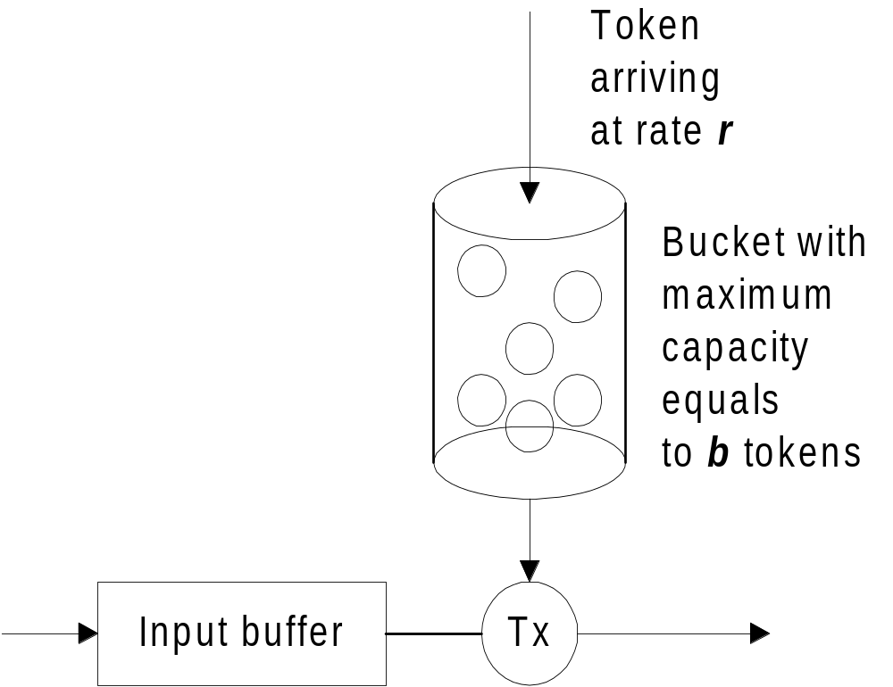
To provide controlled-load service, a token bucket device is used for shaping/policing the incoming traffic

Slide 18
The token bucket is defined by 2 parameters:
  the token arrival rate, r or ρ (in bytes per second)
  the bucket depth, b (in bytes)
A packet is transmitted only if tokens are available ; otherwise, it is rejected or waits in the buffer for tokens if input buffer space is available
The token bucket allows transmission of an initial burst of length b; then the transmission continues at rate ρ.
  no more than b+ρT bytes can be transmitted through the token bucket in any time interval T

Slide 19
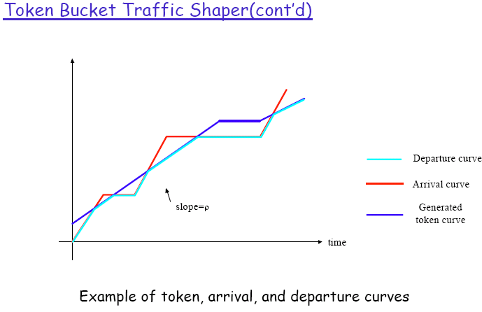

Slide 20
The Token Bucket Algorithm
– Differences from Leaky Bucket:
Allows some burstiness (up to bucket size).
Allows a host to save tokens for future use.
  Widely implemented in IP switch / routers.
  Determining the length of the max-rate burst:
Let: S be burst length; C be token capacity; ρ be token arrival rate; M be max output rate
Since: (a) Max size of output burst = C + ρS bytes, and
(b) but it must also equals MS bytes
Hence: C + ρS = MS
or S=C/(M−ρ)

Slide 21

Token Bucket Shaper Design Example
Question:
  Consider the arrival traffic characterized by a token bucket with parameters ρ (average rate) = 1 Mbps, M (maximum rate) = 2 Mbps, and C (token depth) = 100Kb. What is the minimum rate r that needs to be allocated by a router in order to guarantee a delay no larger than 50 ms?

Slide 22
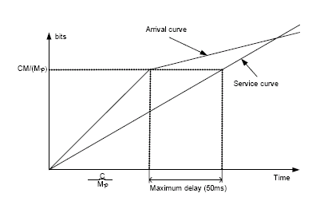
Token Bucket Shaper Design Example (cont’d)
We consider the worst case where the maximum burst length is given by
S=C/(M-ρ)
Then the maximum accumulative amount of arrival traffic to the router is MS=MC/(M-ρ)
We can draw the arrival and service curve as follows

Slide 23
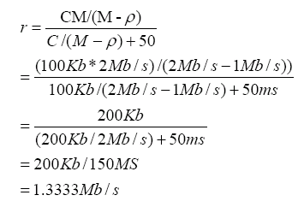
The minimum rate needs to be allocated by the router in order to guarantee a delay no larger than 50 ms is just the slope of the service curve. From the above figure, we can see the slope is given by:
The minimum rate r that needs to be allocated by a router in order to guarantee a delay no larger than 50 ms=1.333Mb/s

Slide 24
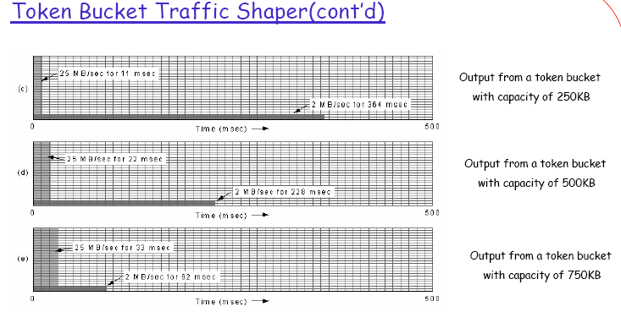

Slide 25
QoS Control --RSVP

Slide 26
Resource Reservation

Slide 27
Ref:
1. L. Zhang, S. Deering, D. Estrin, S. Shenker and D. Zappala, “RSVP: A new resource ReSerVation protocol,” IEEE Network, Vol. 7, pp. 8-18, Sept 1993.
2. B. Braden, L. Zhang, S. Berson, S. Herzog and S. Jamin, “Resource ReSerVation protocol (RSVP) – version 1 functional specification,” RFC 2205, Internet Engineering Task Force, Oct 1997.
3. P. Pan and H. Schulzrinne, “YESSIR: A Simple Reservation Mechanism for the Internet,” ACM SIGCOMM Computer Communication Review, vol. 29, no. 2, pp. 89-101, Apr 99.

Slide 28
Multimedia on the Internet
Objective:
To support new distributed applications such as remote video, multimedia conferencing, data diffusion, and virtual reality, etc.

Slide 29
Characteristics of these applications:
Applications are very sensitive to the Quality of Service their packets receive
  The best-effort service model is not good enough
  Should allow flows, i.e. data traffic streams, to reserve network resources
These applications are often multipoint-to-multipoint with several senders and receivers
  e.g. multiparty conferencing where each participant is both a sender and a receiver of data

Slide 30
To support multicasting service and a variety of QoS, the network architecture requires the following components:
  Flow Specification
    Describe both the characteristics of the traffic stream sent by the source and the service requirements of the application
    Ref.: RFC 1363, RC 1190
  Routing
    Routing protocols that support QoS and multicast
    ST 2+ (RFC 1819), Core Based Tree (CBT), Mrouted

Slide 31
  Resource Reservation
    To provide guarantee QoS for a particular data flow, it is necessary to set aside certain resources, such as buffer, bandwidth, etc.
      i.e. need to create and maintain resource reservation on each link along the transport path
    RSVP (RFC 2205)
  Transport Protocols
    For supporting real-time applications
    RTP (RFC 1889), XTP

Slide 32
  Admission Control
    As network resources are limited, the network cannot satisfy all reservation requests
    An admission control mechanism is needed to determine which reservation requests are to be accepted and which to be denied
  Packet Scheduling
    When a network switch receives the packets from a number of streams, it has to decide which is the next packet to be transmitted
    The packet scheduler will actually determine the quality of service that the network can provide
    E.g. Weighted Fair Queuing, Worst-case Weighted Fair Queuing, Real-time Virtual Clock

Slide 33
Resource ReSerVation Protocol (RSVP)
Overview:
Protocol for resource reservation on top of IP for real-time traffic
  RSVP is NOT a routing protocol
  Routes are determined by the routing protocol
A simplex protocol, i.e. reserves resources in only one direction (from source to receiver)
  Bidirectional resource reservation requires both end systems to initiate separate reservations

Slide 34
Receiver initiates and maintains the resource reservations
  Enables RSVP to accommodate heterogeneous receivers in a multicast group
    Each receiver may reserve a different amount of resources
    Not all receivers have the same processing capacity for incoming data
    Different receivers may require different quality of service
    E.g. if layered encoding is used for video signal
      some receivers will have enough processing power to decode low-resolution signal only
      some paths may have enough bandwidth for low resolution signal only

Slide 35
  Cater for dynamic nature of membership in multicast groups
    Reservation must hence be dynamic such that separate dynamic reservations are needed for each member
  Allow end-users to specify their application needs
    E.g. In audio conferencing, usually only one person, or at most a few persons, will talk at the same time. Hence, it is adequate to reserve only resources from a few simultaneously audio channels.

Slide 36
Receiver should be able to switch between channels
  E.g. In multiparty conference, a receiver may want to watch one or a few participants at a time and would like to switch among various participants.
  Hence, receiver should be able to
    control which data stream is carried on the reserved resources
    switch among channels
Reservations from different receivers, i.e. downstream branches of the multicast tree, to the same source can be merged as reservations travel upstream

Slide 37
RSVP Architecture
Host
Router
Appli-
RSVP
cation
RSVP
RSVP
process
Routing
process
Policy
process
Policy
control
control
Data
Admission
Admission
control
control
Classi-
Packet
Classi-
Packet
fier
scheduler
fier
scheduler
Data
Data

Slide 38
RSVP Operation - Overview
Receivers use RSVP to deliver its request to the routers along the data streams paths towards the sources
  RSVP is used to negotiate connection parameters with the routers
  If a reservation is setup, RSVP is also responsible for maintaining the router and host states to provide the requested service

Slide 39
The RSVP process in each node performs local procedures for reservation setup and enforcement
  Policy control: determines if the application is allowed to make the reservation
    In future, authentication, access control and accounting for reservation may also be implemented by the policy control
  Admission control: keeps track of the system resources and determines whether the node has sufficient resources to supply the requested QoS

Slide 40
The RSVP daemon checks both the policy control and admission control procedures
If either check fails, an error is returned to the application that originate the request
If both checks succeed, the RSVP daemon sets parameters in packet classifier and packet scheduler to obtain the requested QoS
  Packet classifier determines the QoS class for each packet
  Packet scheduler orders packet transmission to achieve the promised QoS for each stream

Slide 41
RSVP uses two basic messages: Path and Resv
Path messages are sent periodically from the sender to the multicast address
  Path message is sent from source to receivers via the paths decided by the routing protocol
  Path state is stored in each node along the way
    Contains at least the unicast IP address of the previous hop node, which is used to route the Resv messages hop-by-hop in the reserve direction from the receivers
  Contains the description of the traffic characteristics, Tspec and Adspec, and the IP address of the source
  Info. is used by the receivers to find reserve path to the sender and to determine the amount of resources need to be reserved

Slide 42
Resv messages are used by the receivers for setting up reservations
  Contains reservation parameters
  Resv messages travel toward the senders by following exactly the reverse of the routes which data packets will use
  Resv messages are delivered to the sender hosts so that the hosts can set up appropriate traffic control parameters for the first hop
Path
Path
S
R3
Rx
R1
Path
Path
Resv
Resv
Resv
Resv
R2

Slide 43
Reservation merging
  When there are multiple receivers, the resource is not reserved for each receiver
    The resource is shared up to the point where the paths to different receivers diverge
Path
Rx1
Path
R3
Resv
S
Path
R1
Path
Path
Resv
Resv
Rx2
Resv
Resv
R2
Path
Path
Resv
R4
Rx3
Resv

Slide 44
  RSVP merges the reservation requests from different receivers at the point where multiple requests converge
    A reservation moving upstream will stop at the point where there is already an existing reservation that is equal or greater than that being requested
    This helps to reduce the RSVP traffic when there are many receivers in the multicast tree

Slide 45
Specifying Resource Requirement (RFC 2210)
Source
The source provide the Sender Tspec to RSVP
  Flows towards the receivers
Sender Tspec
  Carries the traffic specification generated by each data source, i.e. describe the traffic the application expects to generate
    Token bucket rate
    Token bucket size

Slide 46
    Peak data rate
    Minimum packet size
      This includes the application data and protocol headers at or above IP level
      Used by the network node to compute the bandwidth overhead needed to carry the flow over a particular link-level technology and hence to compute the amount of bandwidth to be allocated to the flow
    Maximum packet size

Slide 47
Source/Intermediate Network Elements
Adspec is generated at either the source or the intermediate network elements
Adspec
  Flows towards the receivers
  Info. carried in the Adspec may be changed by network elements along the path to the receiver

Slide 48
  Describe the properties of the data path, i.e. contains info. about the availability of a specific QoS and the requirements of the sending application
    Global Break bit
      this bit is set if a router not supporting RSVP is encountered
      usually set by a network element that supports RSVP and is aware of the gap in integrated services coverage
      use to inform the receiver that the Adspec may be invalid
    hop count
    estimate bandwidth available (min. of individual link bandwidths along the path)
    min. path latency (summation of individual link latencies)
    Path Max. Transmission Unit (MTU): min. of MTUs of individual link along the path

Slide 49
Reservation and Filtering
Receiver
Initiates the RSVP reservation and the request is sent towards to source
  A RSVP reservation request consists of a flowspec and a filter spec
Flowspec contains a Receiver_Tspec and Rspec
  Receiver_Tspec
    Describe the level of traffic for which resources should be reserved
    Specify the bucket rate, bucket size, peak data rate, min. and max. packet size
  Rspec
    Describe the level of QoS service desired
    Specify the desired bandwidth and delay guarantees
    Used by packet scheduler
  Specify the amount of resources to be reserved but NOT which data stream can use the resources

Slide 50
Reservation and Filtering (contd)
Filter spec defines the data stream, i.e. the flow, to receive the QoS defined by the flowspec
  Used by packet classifier
  The data stream using the resources can by changed by the receiver without changing the amount of reserved resources
  This is used to support switching between different channels

Slide 51
Reservation Styles
Reservation style is a set of options that specifies how the reserved resources can be used by different data streams
One option specifies the reservation class
  Distinct reservations: a reservation is for each sender in each session
  Shared reservations: a reservation is used by a set of senders that are known not to interfere with each other
Another option controls the selection of senders
  Explicit: specify a list of selected senders
  Wildcard: the reserved resources are for all senders to the session

Slide 52
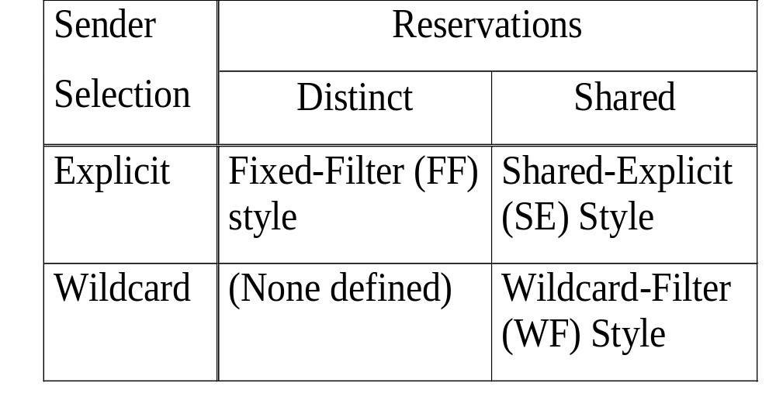
3 reservation styles have been defined:

Slide 53
Wildcard-filter (WF) Style
  A single reservation is created and is shared by flows from all upstream senders
    i.e. any packets destined to the multicast group can use the reserved resources
  A shared pipe whose size is the largest of the resource requests for that link from all receivers, independent of the number of senders using it
  Suitable for applications in which there are multiple data sources but they are unlikely to transmit simultaneously
  Symbolic representation:
    WF ( * {Q})
    where * represents wildcard sender selection and Q is the flowspec

Slide 54
Fixed-filter (FF) Style
  A distinct reservation request is created for data packets from each sender
  The total reservation on a link for a given session is the total of the FF reservations for all requested senders
  FF reservations requested by different receivers, but the same sender, must be merged to share a single reservation in a given node
  Symbolic representation:
  FF ( S{Q})
    where S is the selected sender and Q is the flowspec
    For multiple FF reservation: FF(S1{Q1}, S2{Q2}, …)
      The total reservation is the sum of Q1, Q2, …for all requested senders

Slide 55
Shared-explicit (SE) Style
  A single reservation is created and is shared by a set of explicit senders
  The set of senders is specified by the receiver making the reservation
  The receiver can switch between senders by informing the intermediate nodes
  The packet classifier of the intermediate will filter off those flows that are not selected by the receiver
  Symbolic representation:
    SE ( (S1,S2, …) {Q})
    where S1, S2, … are senders and Q is the flowspec

Slide 56
Note:
WF and SE are appropriate for multicast applications in which application-specific constraints make it unlikely that multiple data sources will transmit simultaneously
  e.g. In audio conferencing, a limited number of people talk at the same time
  Each receiver might issue a WF or SE reservation request for a couple of audio channels
FF creates independent reservations for flows from different senders
  More appropriate for video signals if video from all participants need to be displayed

Slide 57
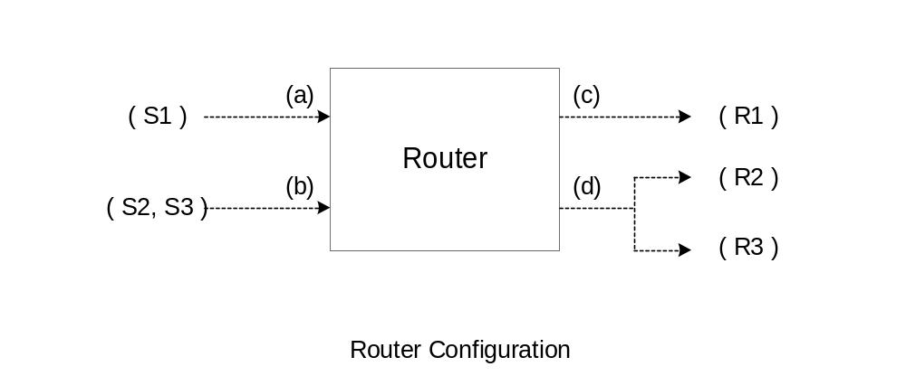
Example:

Slide 58
Example (cont’d)
A router has two incoming interfaces (a) and (b), and two outgoing interfaces (c) and (d)
Three upstream senders: S1, S2 and S3
Three downstream receivers: R1, R2 and R3
Assume that (d) is connected to a broadcast LAN, i.e. replication occurs in the network, and R2 and R3 are reached via different next hop routers (not shown)
Data packets from each Si are routed to both outgoing interfaces

Slide 59
Example (cont’d)
Wildcard-Filter (WF) style
Send Reserve Receive
WF( *{4B} )
WF( *{4B} )
(a)
*{4B}
(c)
WF( *{3B} )
WF( *{4B} )
WF( *{2B} )
*{3B}
(d)
(b)

Slide 60
Example (cont’d)
Fixed-Filter (FF) style
Send Reserve Receive
FF( S1{4B} )
FF( S1{4B}, S2{5B} )
S1{4B}
(a)
(c)
S2{5B}
FF( S1{3B}, S3{B} )
FF(S2{5B}, S3{B})
S1{3B}
FF( S1{B} )
(b)
S3{B}
(d)

Slide 61
Example (cont’d)
Shared-Explicit (SE) style
Send Reserve Receive
SE(S1{3B})
SE((S1,S2){B})
(a)
(S1,S2){B}
(c)
SE((S1,S3){3B})
SE((S2, S3){3B})
(S1,S2,S3)
SE(S2{2B})
(b)
{3B}
(d)

Slide 62
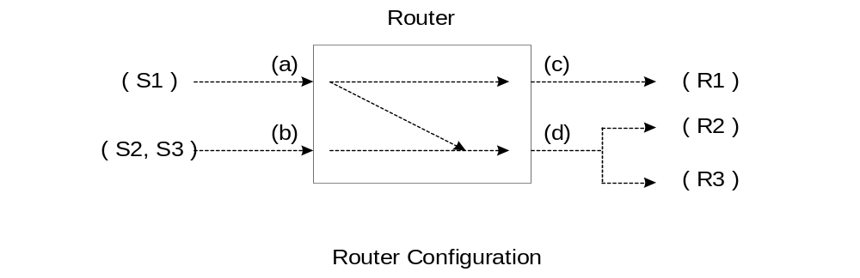
Example:
In the previous example, data packets from S1, S2 and S3 are forwarded to both outgoing interfaces
Here, packets from S2 and S3 are forwarded only to outgoing interface (d)
  There may be a shorter path to R1 via some other router

Slide 63
Example (cont’d)
Wildcard-Filter (WF) style
Send Reserve Receive
WF( *{4B} )
WF( *{4B} )
(a)
*{4B}
(c)
WF( *{3B} )
WF( *{3B} )
WF( *{2B} )
*{3B}
(d)
(b)

Slide 64
Scalability
Reservation merging leads to the primary advantages of RSVP – scalability
  Large number of users can be added to a multicast group without increasing the data traffic significantly
A single physical interface may receive multiple reservation requests from different next hops for the same session and with the same filter spec
  RSVP should install only one reservation on that interface
  The installed reservation should have an effective flowspec that is the "largest” of the flowspecs requested by the different next hops
Similarly, a Resv message forwarded to a previous hop should carry a flowspec that is the "largest" of the flowspecs requested by the different next hops

Slide 65
RSVP Operation
A source joining a multicast group will consult its routing protocol to obtain the routes.
A Path message carrying the Tspec, and may also includes the Adspec, from the source will be sent downstream.
The Path message is used to update the Path state of each switch along the path. The Path state includes:
  The incoming link upstream to the source
  The outgoing link downstream from the source to the receivers in the group
  The Path state is used to route the reservation in the reverse direction
  Note: the Tspec will not be modified by the switch on its way from the source to the receivers; however, the break bit in the Adspec may be modified by the switch if a network element not supporting RSVP is encountered

Slide 66
When a path message arrives a switch, the switch will
  Checks to see if it already has the path state for the named group; if not, a path state will be created
  Obtains the outgoing interface(s) of the path message from the routing protocol
  Update its table of incoming and outgoing links
  Record the source address if the path message indicates that the application may require a filtered reservation
  The path message is forwarded if it is from a new source or there is a change in routes

Slide 67
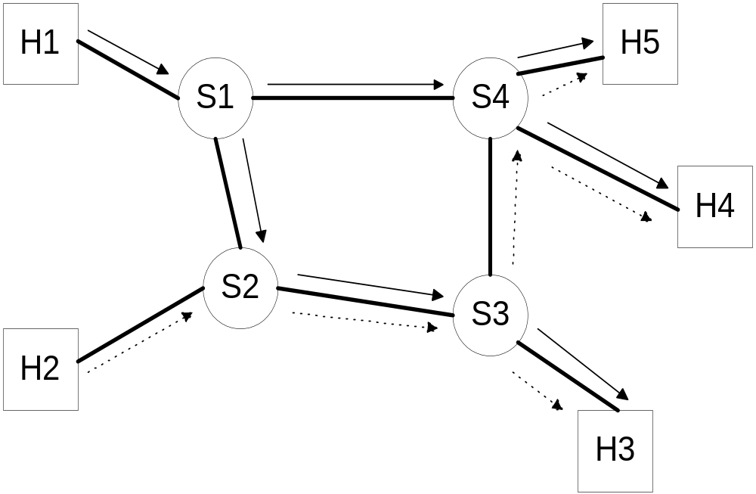
Example

Slide 68
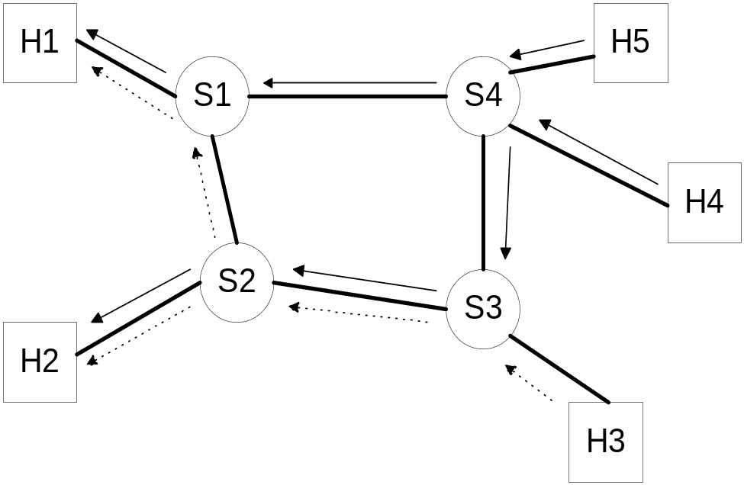
When a receiver receives the path message and if it would like to create a reservation, a Reservation message (Resv) which carries the Flowspec will be forwarded back towards the sources by reversing the paths of the path message
  hence forming a sink tree from each receiver to all the sources

Slide 69
When a switch receives the reservation message
  If resources cannot be allocated to the request, a RSVP ResvError messages are sent back to all the receiver and the reservation message is discarded
    Note: a reservation request may embody a number of requests merged together
  If the reservation is established, the info. in the reservation message is used to maintain the reservation state at the switch
  The switch will also try to merge the requests for the same multicast group by pruning those carry a request for reserving a smaller, or equal, amount of resources than the previous request
  The reservation message is forwarded to the next switch upstream if new (extra) resources are needed

Slide 70

Examples:
Reservation with wildcard filtering
Audio conferencing among 5 participants
Each host behaves as a source and receiver
Audio rate: b
H2
H3
R1
R2
R3
H4
H1
H5

Slide 71
  Assumed that the routing protocol has built a multicast routing tree from each source
  Note: With wildcard filtering, the switches will not record the source information
  H1, …, H5 all send path messages to address m1
  Suppose H1 sends the first path message
in
out
L1
m1:
in
out
L7
m1:
L6
L3
L4
L2
m1:
in
out
L6
L5
L7
H2
H3
L2
L3
R1
L6
R2
L7
R3
L4
L1
H4
H1
L5
H5

Slide 72
  Next, H5 sends path message, creating more state in routers
in
out
L1
L6
m1:
in
out
L7
m1:
L1
L6
L3
L4
L2
m1:
in
out
L5
L6
L5
L6
L7
H2
H3
L2
L3
R1
L6
R2
L7
R3
L4
L1
H4
H1
L5
H5

Slide 73
  H2, H3, H4 send path messages, completing the path state tables
in
out
L1
L2
L6
m1:
in
out
L3
L4
L7
m1:
L1
L6
L3
L4
L7
L2
m1:
in
out
L5
L6
L7
L5
L6
L7
H2
H3
L2
L3
R1
L6
R2
L7
R3
L4
L1
H4
H1
L5
H5

Slide 74
H1 wants to receive data from all senders but only wants enough bandwidth for ONE audio stream
  H1 sends the reservation message(b, wildcard filter) upstream to all sources
  With wildcard filter, any sender can use the reserved bandwidth
H2
H3
L2
L3
R1
L6
R2
L7
R3
L4
L1
H4
H1
L5
H5

Slide 75
  When a router receives the reservation message
    it reserves bandwidth b on the downstream link towards H1
  When a host receives the reservation message
    it sets up appropriate traffic control parameters for the first hop
in
out
L1
L2
L6
m1:
in
out
L3
L4
L7
m1:
L3
(b)
(b)
L2
L4
L7
L1
L6
m1:
in
out
L5
L6
L7
L5
L6
(b)
L7
H2
H3
b
b
L2
b
L3
b
R1
L6
L7
b
b
R2
R3
L4
H4
L1
b
L5
H1
H5

Slide 76
When H2 wants to create a reservation
  H2 sends a reservation message (b, wildcard filter) to R1
  R1 will forward the message to H1 ONLY, as it has forwarded an identical request over R2 previously
After all receivers have sent RSVP reservation messages, an amount b of resources have been reserved over each of the seven links
in
out
L1
L2
L6
m1:
in
out
L3
L4
L7
m1:
L3
(b)
(b)
(b)
L4
L7
L1
L2
L6
m1:
in
out
L5
L6
L7
L5
L6
(b)
L7
H2
b
H3
b
b
L2
b
L3
b
R1
L6
L7
b
b
R2
R3
L4
H4
L1
b
b
L5
H1
H5

Slide 77
What if multiple senders (e.g. H3, H4 and H5) send data over the same link (e.g. link 6) simultaneously?
  Arbitrary interleaving of packets
  L6 flow policed by leaky bucket: if H3+H4+H5 sending rate exceeds b, packet loss will occur
in
out
L1
L2
L6
m1:
in
out
L3
L4
L7
m1:
L3
(b)
(b)
(b)
L4
L7
L1
L2
L6
m1:
in
out
L5
L6
L7
L5
L6
(b)
L7
H2
b
H3
b
b
L2
b
L3
b
R1
L6
L7
b
b
R2
R3
L4
H4
L1
b
b
L5
H1
H5

Slide 78
Consider the situation where each receiver requested 2b of bandwidth
  2b would be reserved on every link even though those links directly from the hosts, i.e. L1, L2, L3, L4 and L5, need only reserve b since there is only a single source from the host
  unfortunately, the switches will not maintain a list of sources from upstream; hence, they do not have the information on the number of sources upstream
  problem: over-reserving of resources on some network links

Slide 79
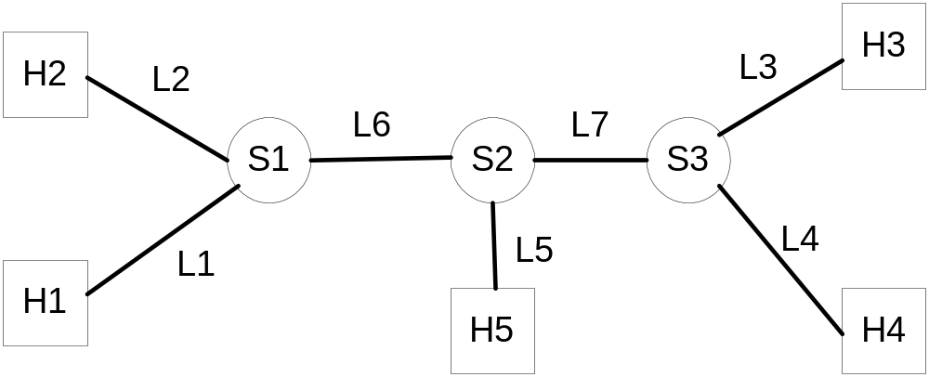
2. Reservation with fixed-filtering or shared explicit
filtering

Slide 80
Scenario:
H2, H3, H4 and H5 are receivers and H1, H4 and H5 are sources
With fixed/shared explicit filtering, each switch will keep a list of sources associated with their previous hops
Assumed that S1, S2 and S3 have received path messages from all sources but no reservations have yet been made

Slide 81
S1’s path state
S2’s path state
S3’s path state
In | L1, L6
Out | L2(H1 via H1; H4 via S2; H5 via S2) L6(H1 via H1)
In | L5, L6, L7
Out | L5(H1 via S1; H4 via S3) L6(H4 via S3; H5 via H5) L7(H1 via S1; H5 via H5)
In | L4, L7
Out | L3(H1 via S2; H4 via H4; H5 via S2) L4(H1 via S2; H5 via S2) L7(H4 via H4)

Slide 82
H2 wants to receive packets from H4, i.e. fixed-filtering, and would like to reserve bandwidth of B
  H2 sends a reservation message R2(B, H4) to S1
  When S1 receives R2
    Check that H4 is one of the source
    Identify that packets from H4 come from S2
    S1 reserves bandwidth B over L2
    S1 forwards R2(B,H4) over L6 to S2
  When S2 receives R2(B,H4)
    S2 reserves B over L6
    S2 forwards the message toS3

Slide 83
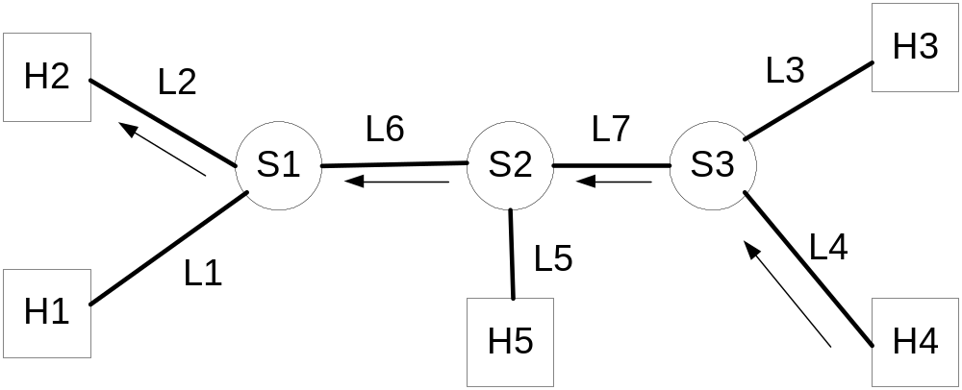
  When S3 receives R2(B,H4)
    S3 reserves B over L7
    S3 forwards the message to H4
  When R2 reaches H4, a pipe from H4 to H2 is reserved

Slide 84
H5 now sends a reservation message R5((H1,H4){2B})
  a shared-explicit filtering
  When S2 receives R5((H1,H4){2B})
    S2 reserves 2B over L5
    S2 forwards R5 over L6 and L7
  When S1 receives R5 ((H1,H4){2B})
    S1 finds that there is only one source going out L6; hence only B is reserved over L6
    S1 passes the R5 message to H1
  When S3 receives R5 ((H1,H4){2B})
    S3 finds that there is only one source going out L7 and a fixed-filter reservation has been established
    S3 does not reserve any more resources
    S3 also does not forward the request to L4

Slide 85
Suppose H4 now terminates both receiving and sending without sending any teardown messages
  All H4 related state in the switches will time out
  S1 stops forwarding R2(B,H4) from H2 and returns an RSVP error message to H2
  S2 forwards future R5((H1,H4){2B}) reservation refreshes to the L6 direction only since there are no more sources in L7 direction
S1 | L2(src: H1,H1 | H5,S2) |  | L6(src:H1,H1)
S2 | L5(src: H1,S1) | L6(src:H5,H5) | L7(src:H1,S1 | H5,H5)
S3 | L3(src:H1,S2 | H5,S2)

Slide 86
Dynamic Networks and Maintaining the Reservation
Problems:
What if network topology changes?
How to cater for dynamic membership changes?
The reservation states RSVP builds at the routers are soft state
  The RSVP daemons at the source and receivers need to send Path and Resv messages periodically to maintain the reservation states
  If the state is not refreshed after certain timeout period, the state will be deleted from the switch

Slide 87
  This mechanism prevents resources from being orphaned when a receiver fails to send an explicit tear-down message or the underlying route changes
    When a route or membership changes, the routing protocol running underneath RSVP forwards future path messages along the new route(s) and reaches new members

Slide 88
  As IP is used to carry the RSVP messages, occasional losses can be tolerate if at least one of the K consecutive messages get through (default: K=3)
  The refresh messages are sent once every R seconds (default: R=30)
  To avoid periodic message synchronisation, the actual refresh period for each message is randomised in the range of [0.5R, 1.5R]
  Each Path and Resv message carries the value of R
    Hence, a local node can determine its state lifetime L, which is L ≥ 1.5 RK
  Note: RSVP also has two teardown messages, PathTear and ResvTear, to speed up state removals

Slide 89
Problems with RSVP
RSVP was perceived as a light-weighted reservation protocol
  However, the implementations are weighing in at between 10,000 and 30,000 lines of code

Slide 90
Features that contribute to its complexity:
  Receiver orientation/diversity:
    Individual receivers within a multicast group are allowed to request different levels of service guarantees
    Separation between reservation and path-finding messages
  Implementation complexity:
    As reservation requests are generated from downstream, keeping track of next hops can become difficult and CPU intensive
    As RSVP is an out-of-band protocol, applications need to be modified, either to take advantage of kernel-level support for RSVP or to convey their resource requirements to some external agent that makes reservations on their behalf

