Slide 1
Digital Image Processing Technology and Application
Representation & Description
Luguangm@gmail.com

Slide 2
Contents
This lecture will cover:
  Over view
  Representation
  Boundary descriptor

Slide 3
Overview
After an image has been segmented into regions. Representation and description should be considered.
Representation and description used to make the data useful to a computer.
Representing region in 2 ways
  In terms of its external characteristics (its boundary)  focus on shape characteristics.
  In terms of its internal characteristics (its region)  focus on regional properties, e.g., color, texture.
Sometimes, we may need to use both ways.

Slide 4
Overview
Choosing a representation scheme, however is only the part of the task of making data useful to computer.
The next task is to describe the region based on the chosen representation.
For example:
  Representation  boundary.
  Description  length of the boundary, orientation of the straight line joining its extreme points, and the number of concavities in the boundary.

Slide 5
Sensitivity
Feature selected as descriptors should be as insensitive as possible to variations in
  size
  translation
  rotation
Following descriptors satisfy one or more of these properties.

Slide 6
Representation
Segmentation techniques yield raw data in the form of pixels along a boundary or pixels contained in a region.
These data sometimes are used directly to obtain descriptors.
Standard uses techniques to compute more useful data (descriptors) from the raw data in order to decrease the size of data.

Slide 7
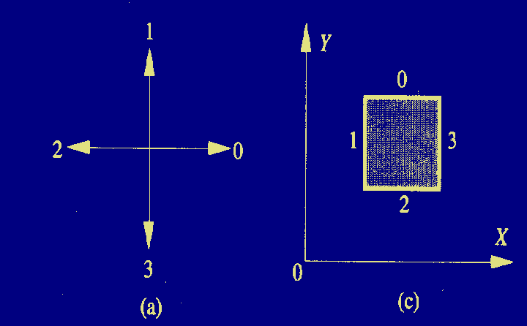
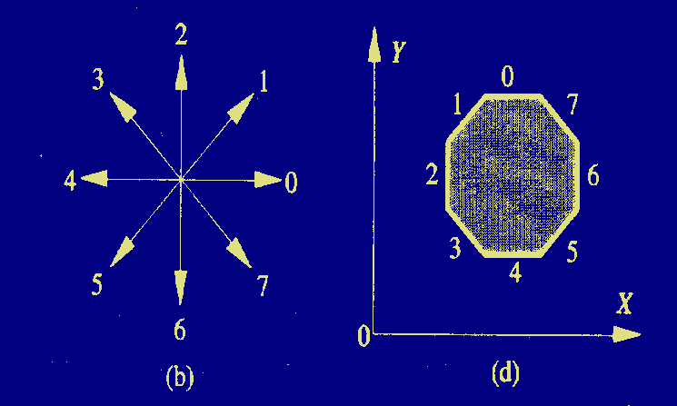
Chain Codes
4 Directional chain code:
0321
8 Directional chain code:
07654321

Slide 8
Chain Codes
Unacceptable because
  The resulting chain of codes tends to be quite long.
  Any small disturbances along the boundary due to noise or imperfect segmentation cause changes in the code that may not be related to the shape of the boundary.

Slide 9
Chain Codes
Circumvent the problems by
  Resample the boundary by selecting a larger grid spacing.
  Then, as the boundary is traversed, a boundary point is assigned to each node of the large grid, depending on the proximity of the original boundary to that node.
  However, different grid can generate different chain codes.
  The accuracy of the resulting code representation depends on the spacing of the sampling grid.

Slide 10
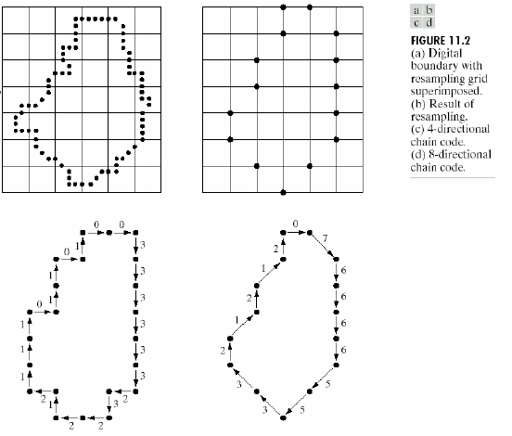
Chain Codes
0033333323221211101101
076666553321212

Slide 11
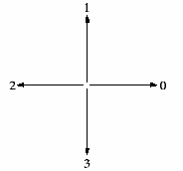
Normalized Chain Codes
The chain code of a boundary is depend on the starting point.
However, the code can be normalized with respect to the starting point by a straightforward procedure.
We simply treat the chain code as a circular sequence of direction numbers and redefine the starting point so that the resulting sequence of numbers form an integer of minimum magnitude.
0
0
1
3
1
3
0
0
3
3
1
1
2
2
2
2
1 0 1 0 3 3 2 2
3 3 2 2 1 0 1 0
0 1 0 3 3 2 2 1

Slide 12
Normalized Chain Codes
The chain code can be also normalized by using the first difference of the chain code. Then it is insensitive to rotation.
0
0
0
(2)
1
0
1
0
3
3
2
2
(3)
2
1
2
1
0
0
3
3
1
3
1
3
0
3
3
1
3
3
0
3
0
3
3
1
3
3
0
3
0
2
3
3
1
Rotate 90 degree
1
2
2
2
If original chain code is: M_{N}=a₀a₁…a_{n-1}, N=4 or 8
And The first difference chain code is: M’_{n}=b₀b₁…b_{n-1}
Then b₀=(a₀-a_{n-1}) MOD N, b_{i}=(a_{i}-a_{i-1}) MOD N
Size normalization can be achieved by altering the size of the re-sampling grid.

Slide 13
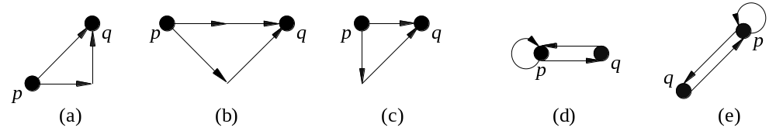
Chain Code Smoothing
Chain code smoothing template:
Broken arrowhead：Original 8- Directional chain code between pixels p and q
Real line arrowhead: The smoothed chain code.

Slide 14
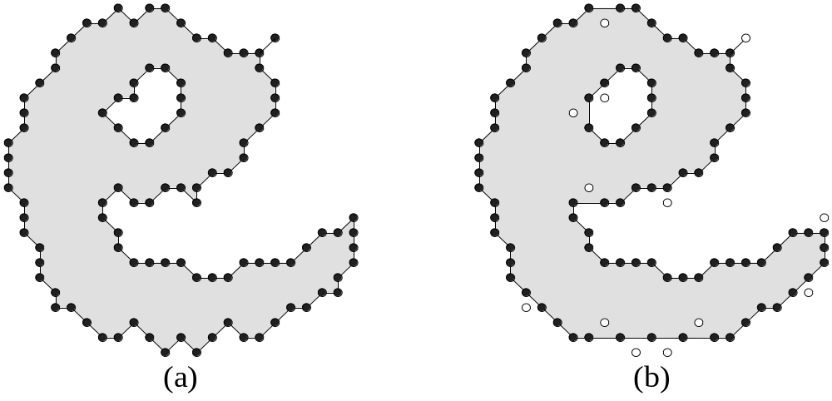
Chain Code Smoothing
Chain code smoothing example:

Slide 15
Polygonal Approximations
Boundary can be approximated with arbitrary accuracy by a polygon.
For a closed curve, the approximation is exact when the number of the segments in the polygon is equal to the number of points in the boundary.
The goal: Try to capture the “essence” of the boundary shape with the fewest possible polygonal segments.
Not trivial and time consuming.
Three methods:
  Minimum perimeter polygons
  Merging techniques
  Splitting techniques

Slide 16
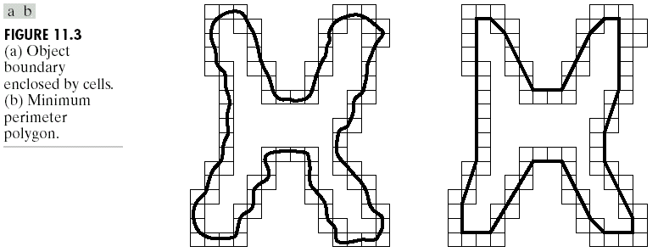
Minimum Perimeter Polygons

Slide 17
Merging Techniques
Merging based on average error or other criteria.
Merge points along the boundary, until the distance exceeds a preset threshold.
When the condition occurs, the parameters of the line are stored, the distance is set to 0.
The procedure is repeated, merging new points along the boundary until the distance again exceeds the threshold.
At the end of the procedure the intersections of adjacent line segments form the vertices of the polygon.

Slide 18
Merging Techniques
An Example:
h
i
j
g
k
f
3
e
a
2
1
b
d
c
Problem: the vertices in the resulting approximation do not always correspond to inflections (such as corners) in the original boundary.

Slide 19
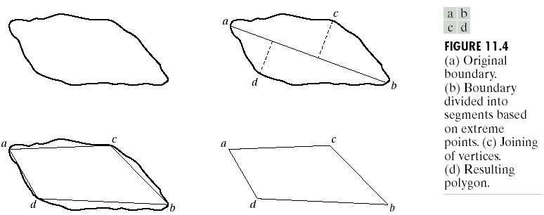
Splitting techniques
Splitting technique is to subdivide a segment successive into two parts until a specified criterion is satisfied.
Find the major axis.
Find max axes which perpendicular to major axis and has distance greater than a threshold.
Repeat until we can’t split anymore.

Slide 20
Splitting techniques
h
h
i
i
j
g
j
g
k
f
k
f
e
e
a
a
b
d
b
d
c
c
Different thresholds lead to different results.

Slide 21
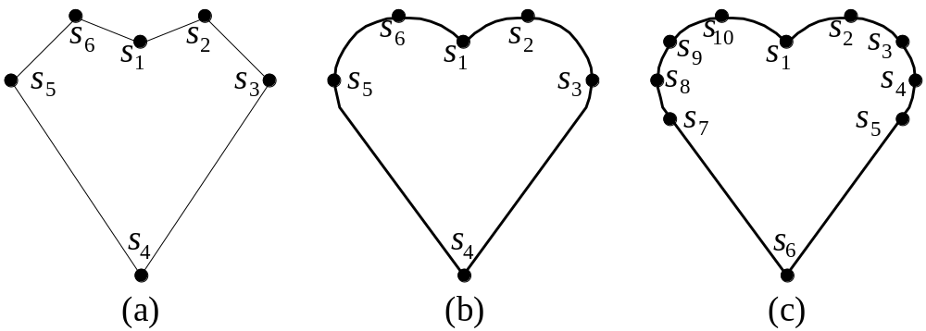
Landmark Points
Landmark Points (地标点或标志点)

Slide 22
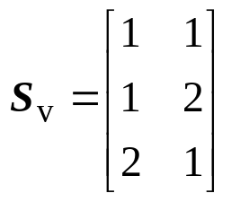
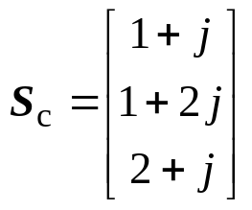
Landmark Points
Landmark points expression:
S₁ = (1, 1)，S₂ = (1, 2)，S₃ = (2, 1)
Method | Expression | Note
2n-vector | S_{o} = [1, 1, 1, 2, 2, 1] | S_{o}是一个2n×1的实坐标矢量
2n-set | S_{f} = {1, 1, 1, 2, 2, 1} | S_{f} 是一个包含2n个实坐标的集合
Matrix |  | S_{v} 是一个n×2 的矩阵，每行包含一个标志点的x-和y-实坐标
Plural-plane |  | S_{c}是一个n× 1 的复数矢量，每个复数表示一个标志点的x-和y-坐标

Slide 23
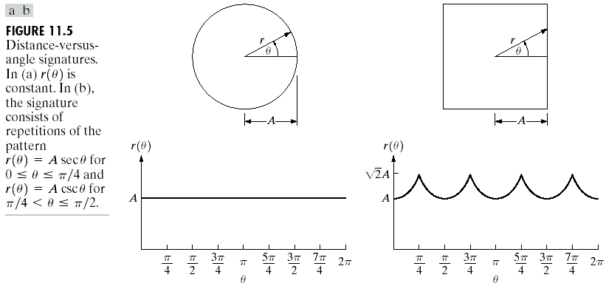
Signatures
Map 2D function to 1D function.
One of the simplest way is to plot the distance from the centroid to the boundary as a function of angle.

Slide 24
Signatures
Signatures are invariant to translation.
Normalization with respect to rotation can be achieved by finding a way to select the same starting point.
One way to do so is to select the starting point as the point farthest from the centroid, if the point happens to be unique and independent of rotational for each shape of interest.

Slide 25
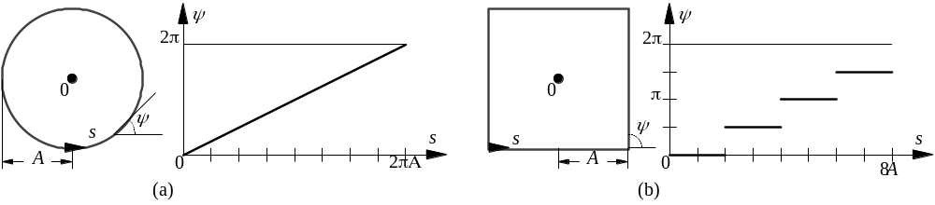
Signatures
ψ – s curve（切线角为弧长的函数）
From each point along the object boundary, make a tangent, ψ is tangent angle respecting to the reference x axis. s is the length of the arc.

Slide 26
Boundary Segments
Decomposing a boundary into segments often is useful.
Decomposition reduces the boundary’s complexity and thus simplifies the description process.
Convex hull is a powerful tool for robust decomposition of the boundary.
Convex hull H of an arbitrary set S is the smallest convex set containing S.

Slide 27
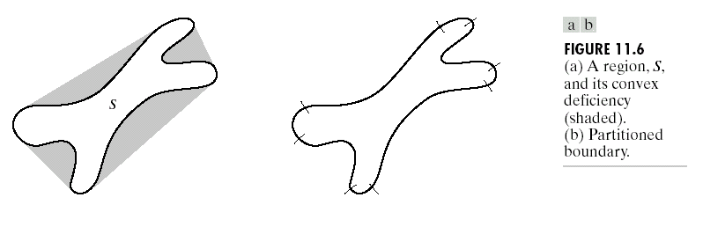
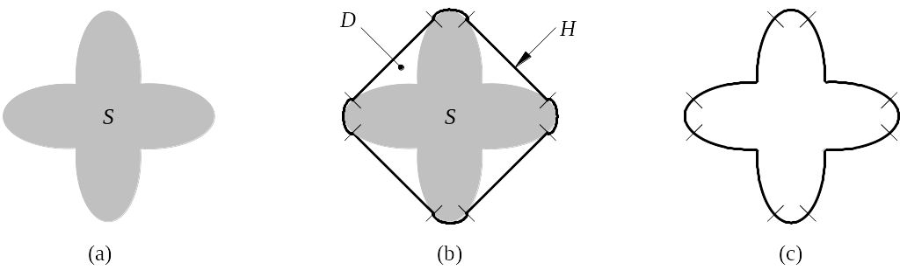
Boundary Segments
H=S+D
The set different H-S is called convex deficiency D (凸形缺陷) of the set S.
D

Slide 28
Boundary Segments
The region boundary can be partitioned by following the contour of S and marking the points at which a transition is made into or out of a component of the convex deficiency.
In practice, digital boundaries tend to be irregular because of digitization, noise. These effect usually result in convex deficiency:
  To smooth a boundary prior to partitioning.
  Use a polygonal approximation first.

Slide 29
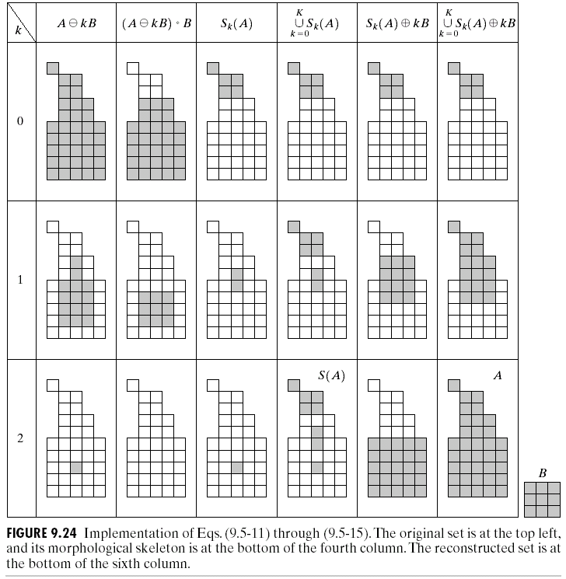
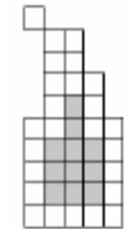
Skeletons
We already discussed the basics of skeleton using morphology. However, as noted in that section, the procedure made no provision for keeping the skeleton connected.
The algorithm developed here corrects that problem.

Slide 30
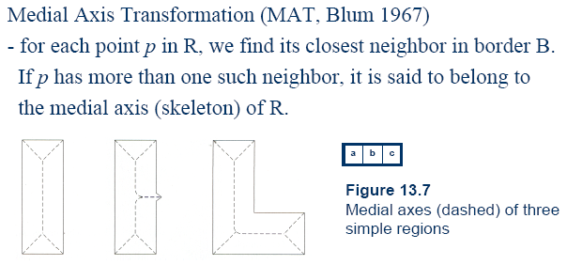
Skeletons
B
R

Slide 31
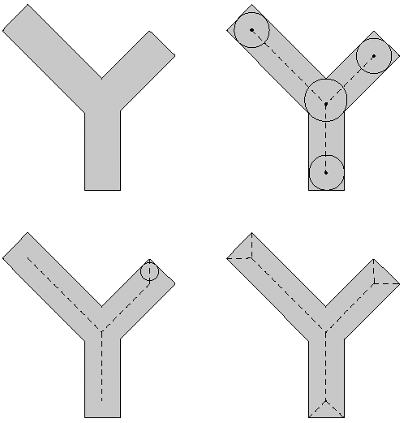
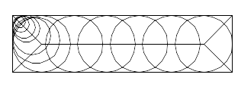
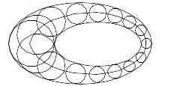
Skeletons
The same results would be obtained with the maximum disk of section 9.5.7

Slide 32
Skeletons
Although the MAT of a region yields an intuitively pleasing skeleton, directly implementation of this definition is expensive computationally.
Numerous algorithms have been proposed for improving computational efficiency.
Typically, these are thinning algorithm that iteratively delete edge points of a region subject to the constraints that deletion of these points:
  1)Does not remove end points.
  2)Does not break connectivity.
  3)Does not cause excessive erosion of the region.

Slide 33
Skeletons
Assume region points have value 1 and background points have value 0.
Here we will introduce a method that consists two steps applied to the contour points of the given region.
Contour points, as define in Section 2.5.2, are any pixels with value 1, and having at least one 8-neighborhood value 0.

Slide 34
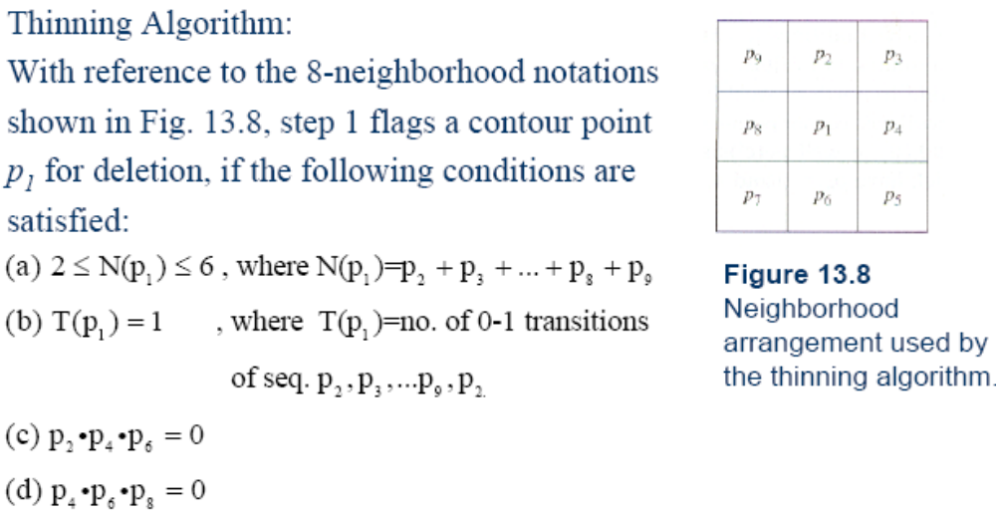
Skeletons
11.8
11.8

Slide 35
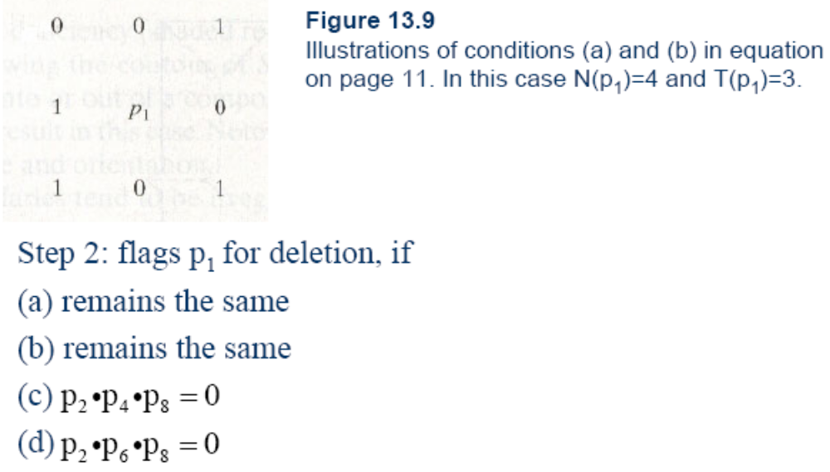
Skeletons
11.9

Slide 36
Skeletons
Step 1 applied to every border pixel in the binary region under consideration.
If one or more of conditions (a)-(d) are violated, the value of the point is not changed, if all conditions are satisfied, the point is flagged for deletion.
However, the point is not deleted until all border points have been processed.
After step 1 has been applied to all border points, those flagged points are deleted.
Then step 2 applied to the resulting data in exactly the same manner as step 1.

Slide 37
Skeletons
Thus one iteration of the thinning algorithm consists of:
Applying step 1 to flag border points for deletion;
Deleting the flagged points;
Applying step 2 to flag the remaining border points for deletion;
Deleting the flagged points.
This basic procedure is applied iteratively until no further points are deleted.

Slide 38
Skeletons
0 | 1 | 0
0 | p | 0
0 | 0 | 0
1 | 1 | 1
1 | p | 1
1 | 0 | 1
1 | 1 | 1
1 | p | 1
1 | 1 | 1
N(p₁)=1
N(p₁)=7
N(p1)=8
0 | 0 | 0
1 | p | 1
0 | 0 | 0
1 | 1 | 0
1 | p | 0
0 | 0 | 0
0 | 0 | 0
0 | p | 1
0 | 1 | 1
T(p₁)=2
p₄ or p₆=0
p₂ or p₈=0

Slide 39
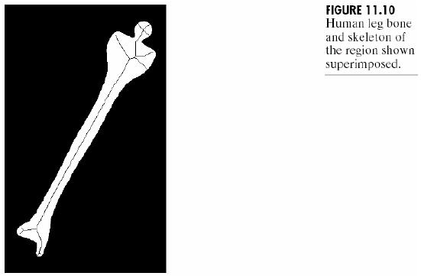
Skeletons

Slide 40
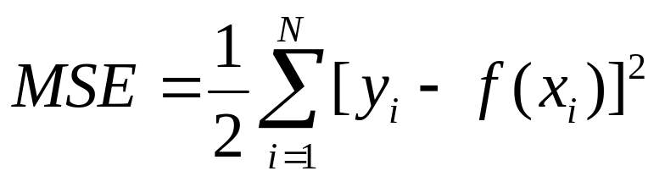
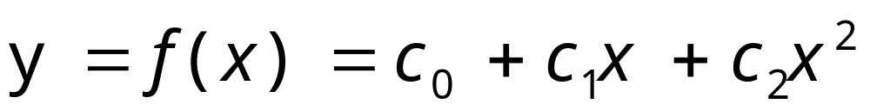
Boundary Fitting
Curve fitting: given a point set (x_{i}, y_{i})，find out a function f (x), and let the MSE (Mean square error) of below expression is the smallest:
N is the point number
If we assume f(x) is a Parabolic Curve, it expression is:

Slide 41
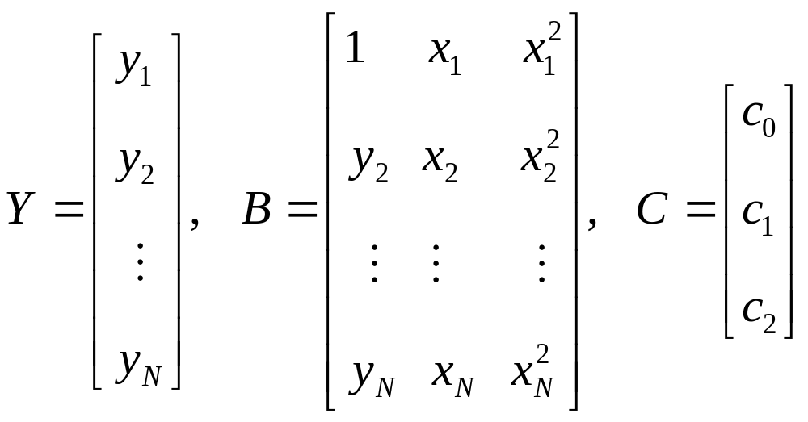
Boundary Fitting
Curve fitting is the process to ensure optimal parameter. It can be solved by classic least square method. Let:
Error vector:
E=Y－BC

Slide 42
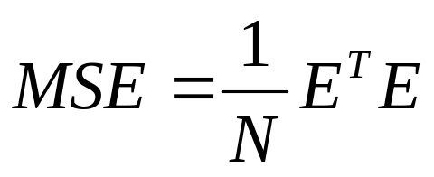
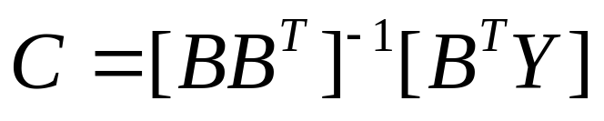
Boundary Fitting
Mean square error:
Optimal solution is:
Matrix [BB^{T}］⁻¹B^{T} is called the pseudo inverse matrix of B (伪逆矩阵).
We can easily spread it to other coefficient form, such as Circle, Ellipse, Two order quadratic equation, Three order quadratic equation, …
Matlab toolbox is very powerful to do this kind of work.

Slide 43
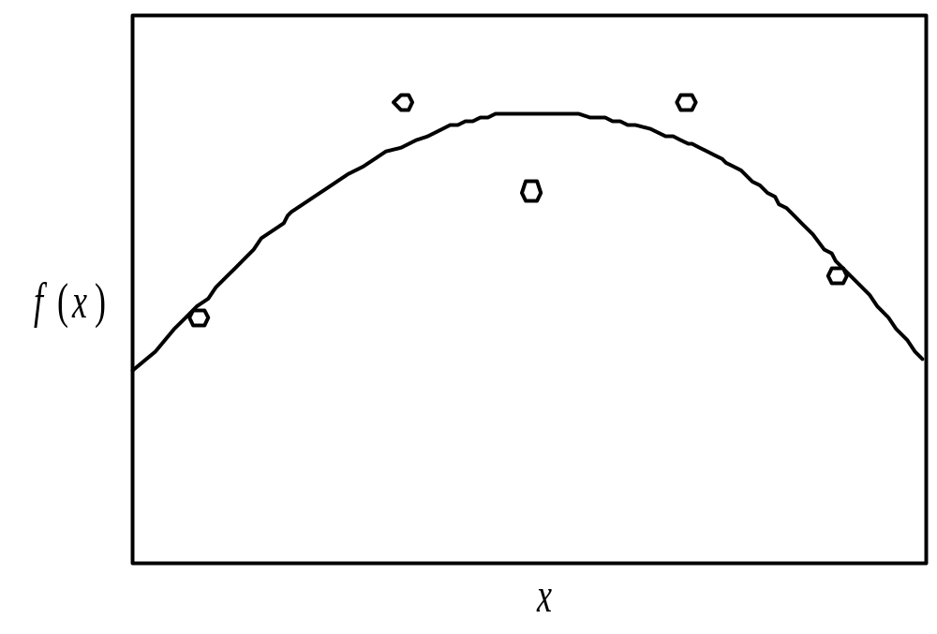
Boundary Fitting
Fitting result

Slide 44
Boundary Descriptors
Position
Direction
Length of boundary
Diameters
Eccentricity
Curvature
Shape Number

Slide 45
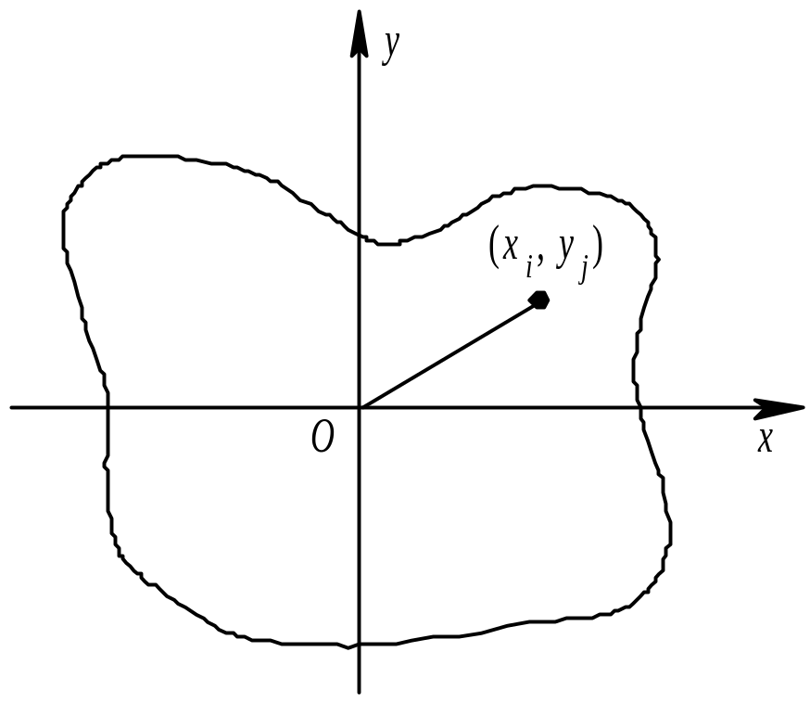
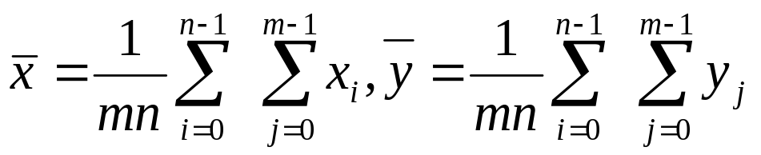
Position
Center of Mass:

Slide 46
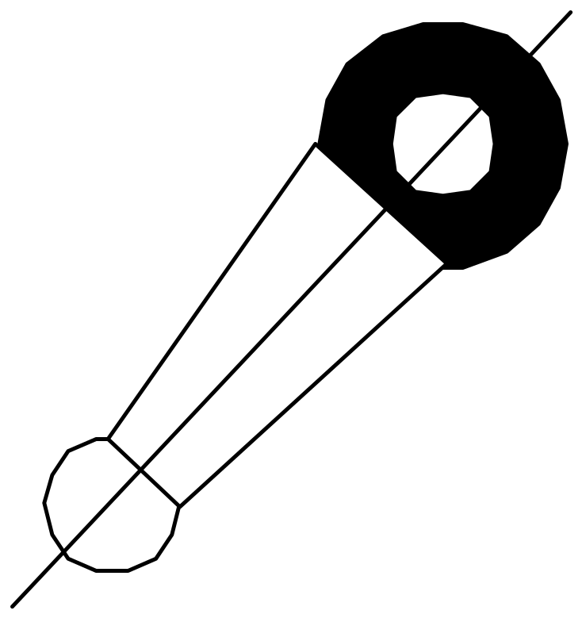
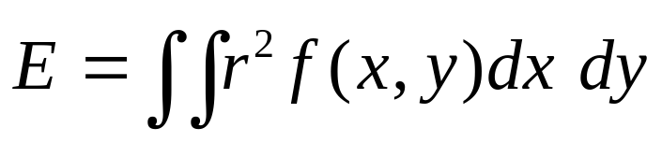
Direction
It is difficult to define the direction of the object. If the object is thin and long, then we can define the direction of long axis is the direction of the object.
Usually, use the minimum 2 order moments to define the direction. That is to find a line, and minimize the following moment:
r is the distance from point（x , y）to the line.

Slide 47
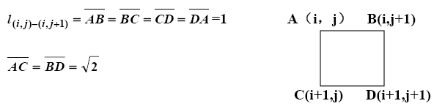
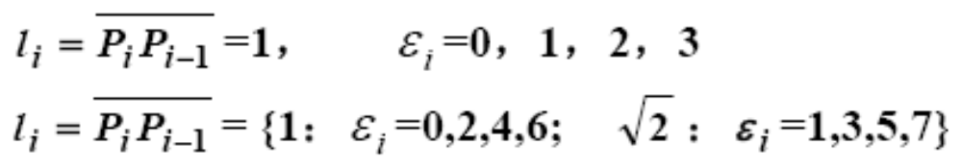
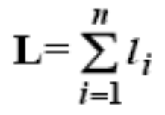
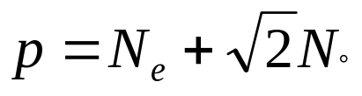
Length of a Boundary
The number of pixels along a boundary.
D(i+1,j)
C(i+1,j+1)
4 directional chain code:
8 directional chain code:
N_{e}: the number of even in the chain code.
N_{o}: the number of odd in the chain code.

Slide 48
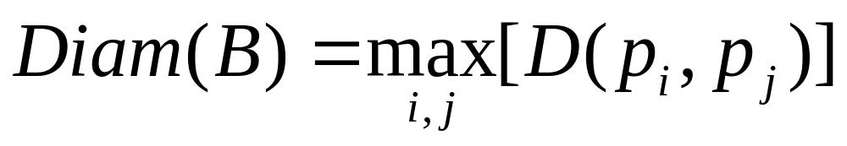
Diameters
D is a distance measure
p_{i} and p_{j} are points on the boundary B
Also called Major axis.

Slide 49
Eccentricity
Ratio of the major to the minor axis.
Major axis = the line connecting the two extreme points that comprise the diameter.
Minor axis = the line perpendicular to the major axis.
A
Eccentricity=A/B
B

Slide 50
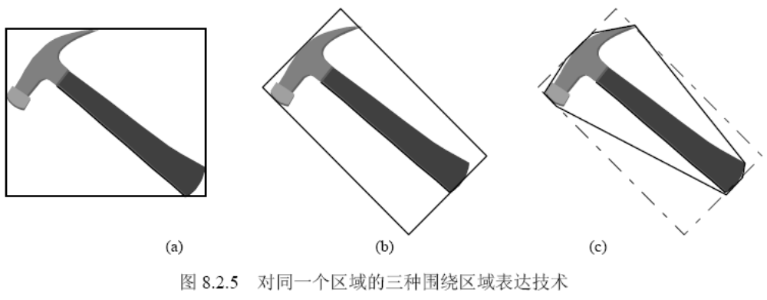
Enclose Area
(1)Feret box (外接盒): defined direction
(2)minimum enclosing rectangle，MER (最小外接矩形): arbitratry direction
(3) Convex hull (凸包)

Slide 51
Minimum Enclosing Rectangle
y
y
Minimum Enclosing Rectangle
O
x
O
x
Rectangle
(
a
)
(
b
)

Slide 52
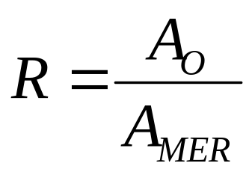
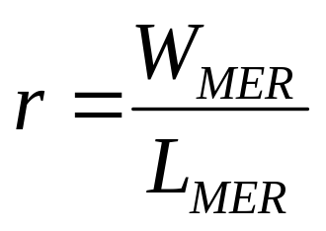
Minimum Enclosing Rectangle
Rectangle degree:
A_{O} is the area of the object, A_{MER} is the area of MER. The value of R is in [0, 1], When the object is a rectangle, R=1.0, for a circle, R=π/4, and for thin-long object, R will be smaller.
W_{MER} and L_{MER} are the width of length of MER, we can use r to distinguish thin-long object from circle or rectangle object.

Slide 53
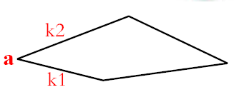
Curvature
The rate of change of slope
Difficult to do as digital boundaries tend to be locally “ragged”
Using the difference between the slopes of adjacent boundary segments (which represented as straight lines)
E.g.: k1, and k2 are the slopes of two neighbor lines, and then the curvature at point a is k1-k2.

Slide 54
Curvature
As the boundary if traversed in the clockwise direction, a vertex point p is said to be the part of convex if the change in slope at p is nonnegative. Otherwise, p is said to belong to a concave.
Line (if the change is less than 10 degrees) and corner (changes exceeds 90 degrees)

Slide 55
Summary
We have looked at:
  Over view
  Representation
  Boundary descriptor

