Slide 1

Machine Learning
Chapter 4 Artificial Neural Network（ANN）
ML-ANN Dr. Ding Yuxin

Slide 2
4.5 Multilayer Networks And The Backpropagation Algorithm
Multilayer networks are capable of expressing a rich variety of nonlinear decision surface
output layer
hidden layer
input layer
ML-ANN Dr. Ding Yuxin

Slide 3
4.5.1 A Differentiable Threshold Unit
What type of unit shall is required for constructing multilayer networks?
  represent highly nonlinear functions
  suitable for gradient descent (differentiable)
So the unit (neuron) should be
  whose output is a nonlinear function of its inputs
  Whose output is also a differentiable of its inputs
ML-ANN Dr. Ding Yuxin

Slide 4
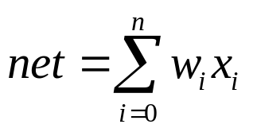
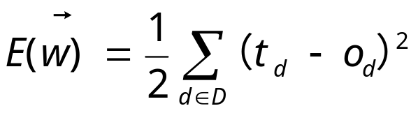
Sigmoid Unit
X₀=1
x₁
w₁
w₀
o=σ(net)=1/(1+e^{-net})
w₂
x₂
Σ
o
.
.
.
w_{n}
σ(y)=1/(1+e^{-y}) (sigmoid function)
dσ(y)/dy= σ(y) (1- σ(y))
x_{n}
Derive gradient decent rules for training one sigmoid function
∂E/∂w_{i} = -Σ_{d}(t_{d}-o_{d}) o_{d} (1-o_{d}) x_{i}
ML-ANN Dr. Ding Yuxin

Slide 5
Characteristics of Sigmoid unit
  a smoothed, differentiable threshold function
  Sigmoid function (logistic function, Squashing function)
  Its output ranges between 0 and 1
  Increasing monotonically
  Its derivative is easily expressed in terms of its output
Other differentiable functions
  Increase the steepness of the sigmoid unit( e^{-ky})
  tanh（双曲正切）
ML-ANN Dr. Ding Yuxin

Slide 6
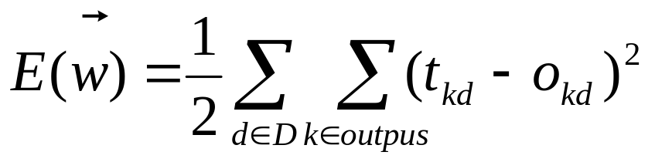
4.5.2 The Backpropagation Algorithm
Learns the weights for a multilayer network
  Employs gradient descent minimize the squared error between the network output values and the target values
  Redefining E to sum the errors over all of the network output units
ML-ANN Dr. Ding Yuxin

Slide 7
Difficulties in BP Learning
  Search a large hypothesis space
  Error surface can have multiple local minima
However, in practice BP has been found to produce excellent results
ML-ANN Dr. Ding Yuxin

Slide 8
Backpropagation Algorithm
Initialize each w_{i} to some small random value
Until the termination condition is met, Do
  For each training example <(x₁,…x_{n}),t> Do
    Input the instance (x₁,…,x_{n}) to the network and compute the network outputs o_{k}
    For each output unit k
      δ_{k}=o_{k}(1-o_{k})(t_{k}-o_{k})
    For each hidden unit h
      δ_{h}=o_{h}(1-o_{h}) Σ_{k in outputs} w_{k,h} δ_{k}
    For each network weight w_{j,i} Do
      w_{j,i,}=w_{j,i}+Δw_{j,i} where
      Δw_{j,i}= η δ_{j} x_{j,i}
      (Note:x_{j,i} ：output of unit i, corresponding to w_{j,i} )
_{j}
w_{j,i}
x_{j,i}
_{i}
ML-ANN Dr. Ding Yuxin

Slide 9
Notation:
  An index is assigned to each node in the network, where a “node” is either an input to the network or the output of some unit in the network
  x_{ji} denotes the input from node i to unit j
  w_{ji} denotes the corresponding weight
  δ_{n} denotes the error term associated with unit n
node j
w_{j,i}
x_{j,i}
node i
w_{i,k}
node k
x_{i,k}
ML-ANN Dr. Ding Yuxin

Slide 10
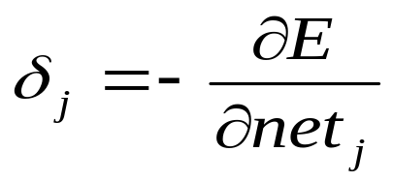
Remarks on the algorithm
  Network structure
    feedforward networks containing two layers of sigmoid units
    units at each layer connected to all units from the preceding layer
  The incremental, or stochastic gradient descent version of BP
  like the delta rule, it update each weight in proportion to (Δw_{j,i}= η δ_{j} x_{j,i} , delta rule: Δw_{i}=η(t - o)x_{i})
    The learning rate η
    The input value x_{ji} on w_{j,i}
    The error item of the unit j ( )
ML-ANN Dr. Ding Yuxin

Slide 11
Understanding δ_{j} (Δw_{j,i}= η δ_{j} x_{j,i} , Δw_{i}=η(t - o)x_{i})
    δ_{k} for output unit k
      δ_{k} is (t_{k}-o_{k}) , multiplied by the factor o_{k}(1-o_{k}), (the derivative of the sigmoid function)
      δ_{k}=o_{k}(1-o_{k})(t_{k}-o_{k})
    δ_{h} for hidden unit h
      no direct target values to calculate the error of hidden units’ values.
      The error is calculate by summing the error terms δ_{k} for each output unit influenced by h, weighting δ_{k} by w_{kh}
      δ_{h}=o_{h}(1-o_{h}) Σ_{k in outputs} w_{k,h} δ_{k}
ML-ANN Dr. Ding Yuxin

Slide 12
The true gradient descent algorithm of BP
  summing the δ_{j}x_{ji} values over all training examples before altering weight values
Termination conditions
  A fixed number of iterations through the loop
  The error falls below some threshold
  The error on a separate validation set of examples meets some criterion
  Termination criterion is important: error, overfitting
ML-ANN Dr. Ding Yuxin

Slide 13
4.5.2.1 Adding Momentum
An variation developed for BP
  making the weight update on the nth iteration depend partially on the update that occurred during the (n-1)th iteration
  Δw_{ji}(n)=ηδ_{j}x_{ji}+αΔw_{ji}(n-1)
  0<=α<1, Δw_{ji}(n-1) is called momentum
  Understanding
    Momentum tends to keep the ball rolling down in the same direction.
    Effect 1: keeping the ball rolling through local minima, or along flat regions
    Effect 2: gradually increasing the step size of the search in regions where the gradient is unchanging, thereby speeding convergence
ML-ANN Dr. Ding Yuxin

Slide 14
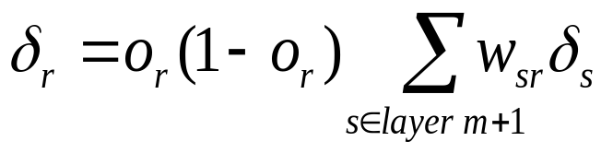
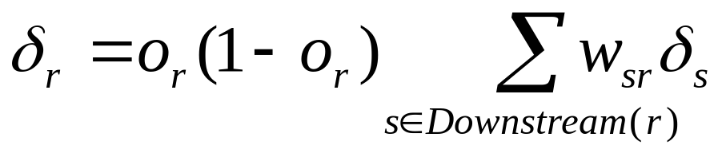
4.5.2.2 Learning In Arbitrary Acyclic Networks
Learning algorithm for feedforward networks of arbitrary depth.
  The δ_{r} value for a unit r in layer m is computed from the δ_{s} values at the next deeper layer m+1
  This algorithm is generalized to any directed acyclic graph. For internal units r:
  Downstream(r) is the set of units immediately downstream from unit r in the network: all units whose inputs include the output of unit r.
ML-ANN Dr. Ding Yuxin

Slide 15
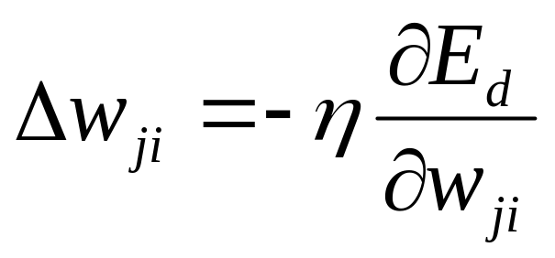
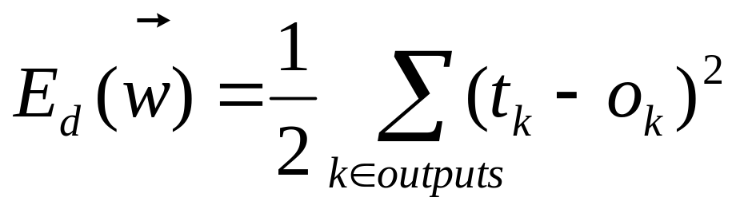
4.5.3 Derivation of the Backpropagation Rule
The stochastic gradient descent algorithm of BP
  for each training example d, weights are updated by descending the gradient of the error E_{d} with respect to this single example
ML-ANN Dr. Ding Yuxin

Slide 16
Notation Specification
x_{ji}，the ith input to unit j
w_{ji}，the weight associated with the ith input to unit j
net_{j}，the weighted sum of inputs for unit j
o_{j}，the output computed by unit j
t_{j}，the target output for unit j
σ，the sigmoid function
outputs，the set of units in the final layer of the network
Downstream(j)，the set of units whose immediate inputs include the output of unit j
ML-ANN Dr. Ding Yuxin

Slide 17
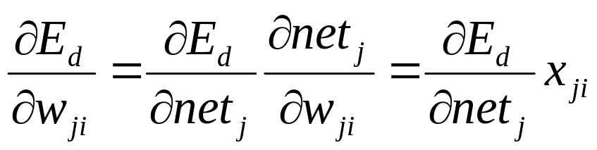
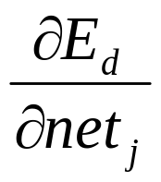
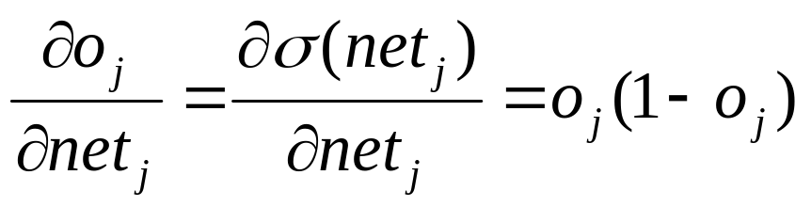
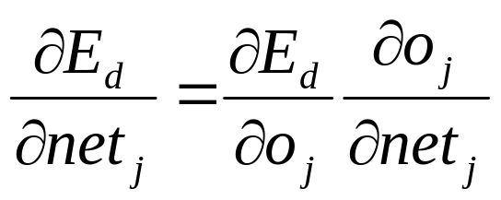
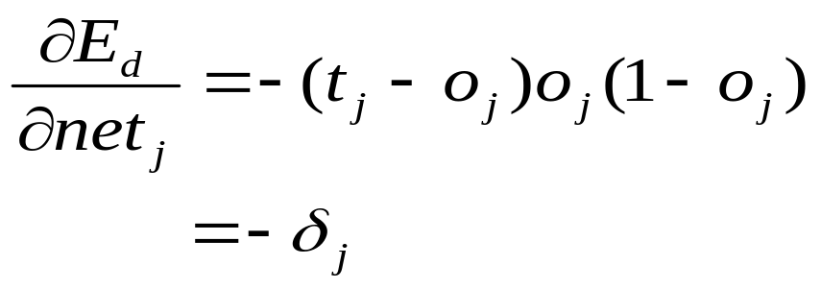
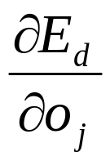
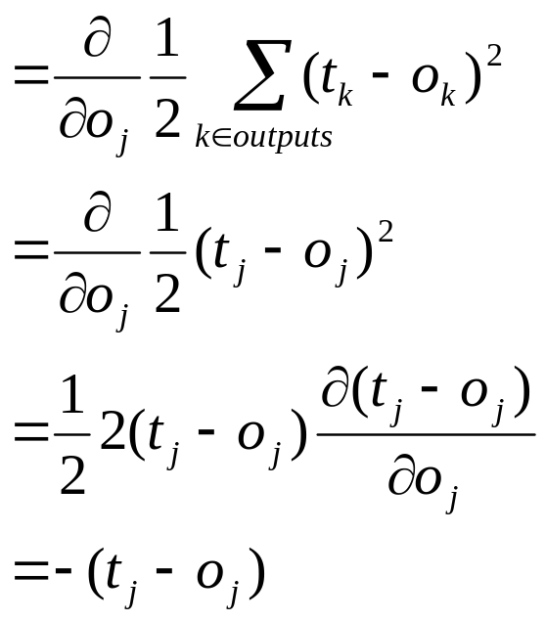
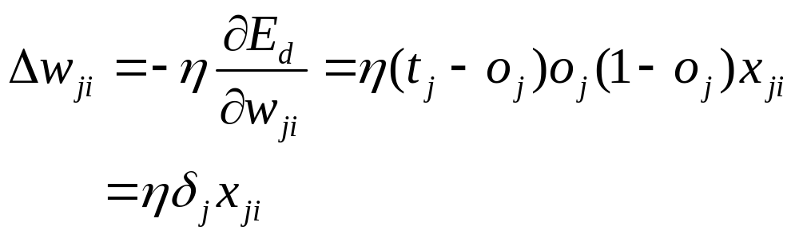
, for ,two case is considered
Output units
ML-ANN Dr. Ding Yuxin

Slide 18
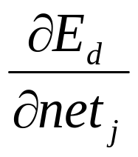
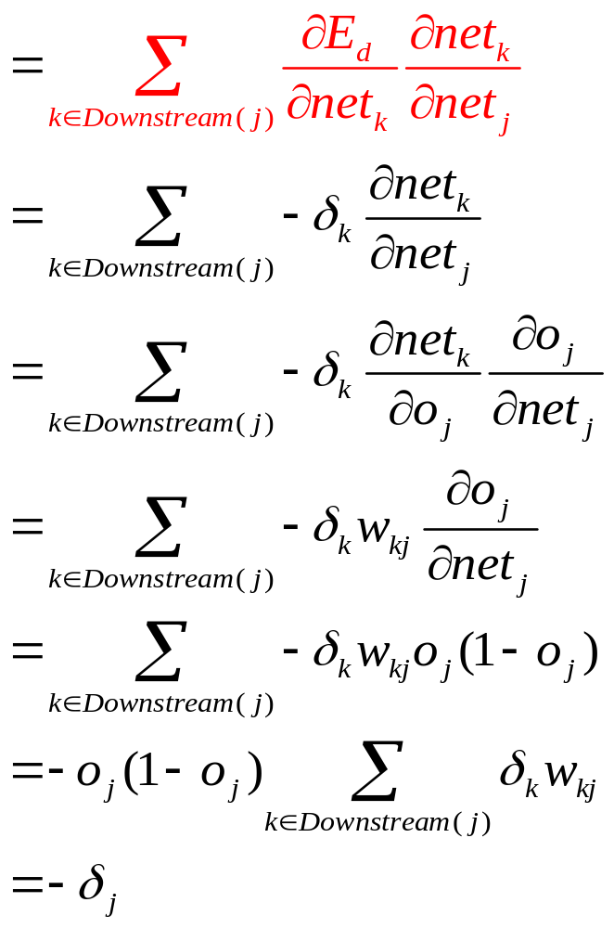
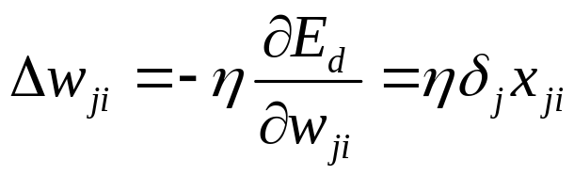
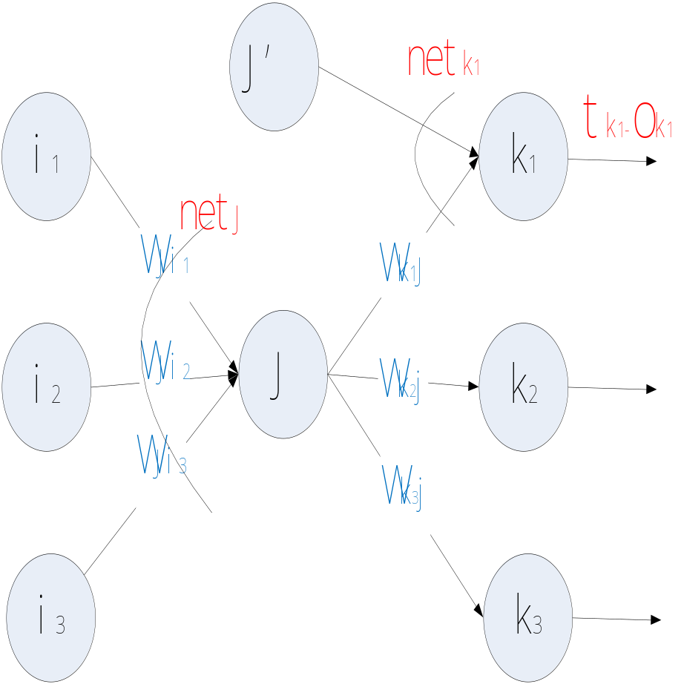
Hidden Unit
ML-ANN Dr. Ding Yuxin

Slide 19
4.6.1 Converge and Local Minima
  BP is only guaranteed to converged toward some local minimum in E
  the error surface may contain many local minima
  gradient descent can become trapped in any of those
ML-ANN Dr. Ding Yuxin

Slide 20
  BP is still a highly effective function approximation method in practice
  Large amount of weights provide “escape routes” for escaping the local minimum
  The manner network weights evolve
    in the early stage, network weights=0, the network represents a smooth function (approximating a linear function)
    With the weights growing, they can represent highly nonlinear functions (have more local minima in the weight space)
    At this point, weights have already moved close enough to the global minimum that even the local minima are acceptable
ML-ANN Dr. Ding Yuxin

Slide 21
Heuristics to the problem of local minima:
  Add a momentum term
  Use stochastic gradient rather than true gradient descent
  Train multiple networks, selected the best (performance over a validation set).
ML-ANN Dr. Ding Yuxin

Slide 22
4.6.2 Representational Power of Feedforward Networks
Bool function: using two layers of units.
  one scheme for representing an arbitrary bool function：
    One input vector only activates one hidden unit, implements the output unit as an OR gate
ML-ANN Dr. Ding Yuxin

Slide 23
Bounded Continuous Functions:
  two layers of units: sigmoid units at the hidden layer + linear units at the output layer
  arbitrarily small error
Arbitrary functions:
  three layers of units (two sigmoid layers + one linear output layer)
Note: the network weight vectors reachable by gradient descent from the initial weight values may not include all possible weight vector
ML-ANN Dr. Ding Yuxin

Slide 24
4.6.3 Hypothesis Space Search and Inductive Bias
Hypothesis Space of BP
  n-dimensional Euclidean and continuous space
  E is differentiable
    So the gradient descent algorithm can organize the space search for the best h
Inductive Bias of BP
  depends on
    1. the gradient descent search
    2. the way in which the weight space spans the space of representable functions.
  roughly characterize as smooth interpolation between data points
ML-ANN Dr. Ding Yuxin

Slide 25
4.6.4 Hidden Layer Representations
Useful intermediate representations at the hidden unit layers
  new hidden layer features
    not explicit in the input
    properties of the input instances that are most relevant to learning the target function
  When more layers of units are used, more complex features can be invented
  It is a key feature of ANN learning.
    allows the learner to invented features not explicitly introduced by the human designer
ML-ANN Dr. Ding Yuxin

Slide 26
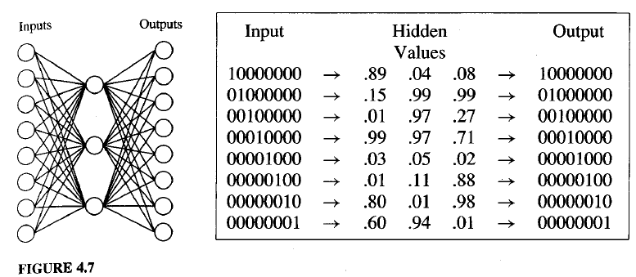
2003.12.18
ML-ANN Dr. Ding Yuxin

Slide 27
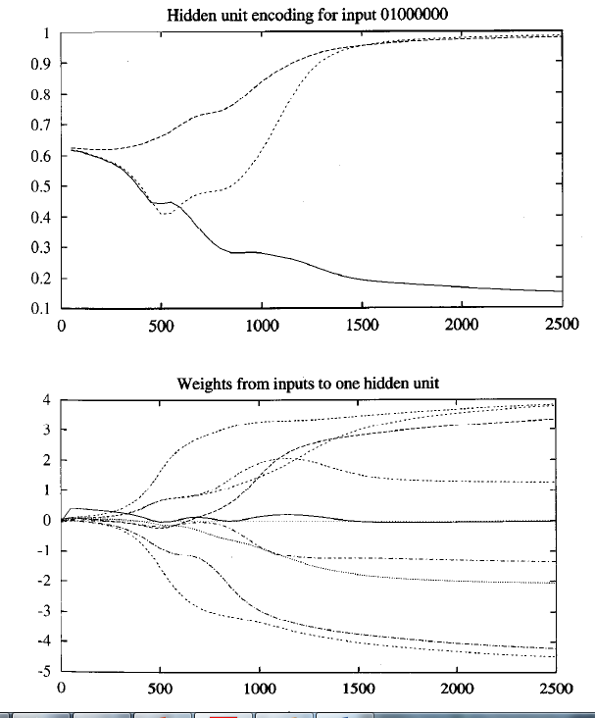
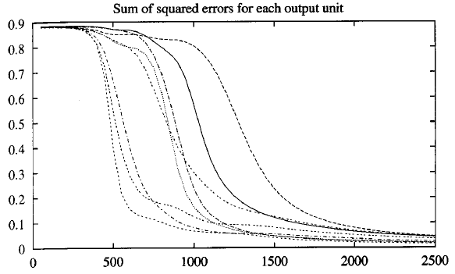
2003.12.18
ML-ANN Dr. Ding Yuxin

Slide 28
4.6.5 Generalization, Overfitting, and Stopping Criterion
Condition for terminating the weight update loop
  One choice: stop when the error E falls below a threshold
    Problem: overfitting
Generalization accuracy
  the accuracy with which it fits examples beyond the training data
Overfitting(Fig 4-9, next page)
  the weights are being tuned to fit idiosyncrasies(个体特有的习性) of the training examples
  The large number of weight parameters provides many degrees of freedom for fitting such idiosyncrasies
ML-ANN Dr. Ding Yuxin

Slide 29
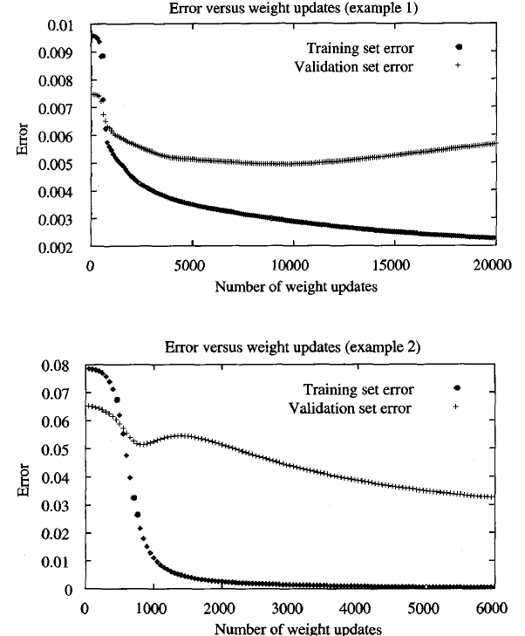
2003.12.18
ML-ANN Dr. Ding Yuxin

Slide 30
Why does overfitting tend to occur during later iterations
  the weights are initialized to small random value, only smooth surface are describable
  As training proceeds, weights begin to grow, the complexity of the learned surface increases
  Given enough weight-tuning iterations, overly complex surface is created to fit noise
ML-ANN Dr. Ding Yuxin

Slide 31
Overcome the overfitting problem
  weight decay
    Decrease each weight by some small factor during
      equivalent to include a penalty term corresponding to the total magnitude of the network weights in E.
      the motivation is to keep weights values small, to bias learning against complex decision surface(see section 4.8.1)
  Cross-validation approach
    drive the gradient descent search using the training set
    monitors the error using a validation set
    Need more training samples
ML-ANN Dr. Ding Yuxin

Slide 32



  k-fold cross validation
    Used to avoid overfitting for small training sets.
    The m examples are partitioned into k disjoint subsets, each of size m/k.
    run k times, each time using a subset as the validation set and combing the other subsets for training set
    Cross-validation approach for BP is used to determine the number of iterations that yield the best performance, calculate the mean
    A final run of BP is performed iterations
ML-ANN Dr. Ding Yuxin

Slide 33
4.7 An Illustrative Example: Face Recognition
Training data
  Images of 20 different people
  32 images per person
    Different expression
      Happy, sad, angry, neutral
    Face direction
      Left, right, straight ahead, up
    Others
      wearing sunglasses, background behind the person, clothing
  In total 624 greyscale images
    resolution of 120x128
    pixel value： 0 --- 255
task：learning the direction a person is facing
ML-ANN Dr. Ding Yuxin

Slide 34
4.7.2 Design Choices
Input encoding
  Representation 1: extract edges, regions of uniform intensity, or other feature.
    problem ：lead to a variable number of features, whereas the ANN has a fixed number of inputs
  Representation 2: one network input per pixel
    Fixed number of input
    the pixel intensity values were linearly scaled to range from 0 to 1(so that network input would have values in the same interval as the hidden unit and output unit activations)
ML-ANN Dr. Ding Yuxin

Slide 35
4.7.2 Design Choices
Output encoding
  using a single output unit
  Using four distinct output units
    the highest-valued output is taken as the network prediction, (called as a 1-of-n output encoding)
Why choosing the 1-of-n output encoding
  Provides more degree of freedom for representing the target function
  Provide a confidence measure
ML-ANN Dr. Ding Yuxin

Slide 36
Target value for 4 output units
  One obvious choice <1,0,0,0>...
  We use values of 0.1 and 0.9, <0.9,0.1,0.1,0.1>...
  Why avoiding use 0 and 1
    Sigmoid unit can not produce such output values
    Avoid forcing the weights to grow without bound
    Values of 0.1 and 0.9 are achievable using a sigmoid unit with finite weights
ML-ANN Dr. Ding Yuxin

Slide 37
Network graph structure
  How many units and how to interconnect them
    a layered network , feedforward connections
      two layers of sigmoid units
    Number of hidden units
      3, test accuracy of 90%, 5 minutes on Sun SParc5 , 260 training images
      30, one to two percent higher , nearly 1 hour
  Number of hidden units
    some minimum number of hidden units is required
    the extra hidden units do not dramatically affect generalization accuracy
    Overfit: increasing the number of hidden units often increase the tendency to overfit the training data
ML-ANN Dr. Ding Yuxin

Slide 38
Other learning parameters
  Learning rate :0.3, momentum : 0.3
    Lower values produce roughly equivalent generalization accuracy, but longer training times
    Too high values, training fails to converge
  Full gradient descent was used
  Weights in the output units were initialized to small random values
  Input unit weights were initialized to zero
  The number of training iterations:
    decide by a training set and a separate validation set.
  The final network :
    having the highest accuracy over the validation set
  The final reported accuracy:
    measured over a third set of test examples
ML-ANN Dr. Ding Yuxin

Slide 39
4.7.3 Learned Hidden Representations
Output weights after 1 iteration
  Weights from input units to hidden units after 1 iteration (see next page)
Output weights after 100 iteration
  Weights from input units to hidden units after 100 iteration (see next page)
ML-ANN Dr. Ding Yuxin

Slide 40
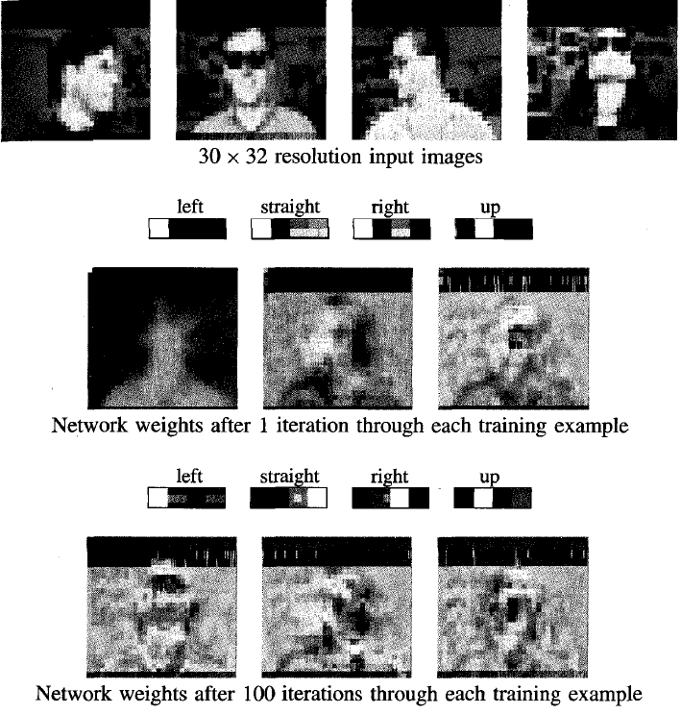
2003.12.18
ML-ANN Dr. Ding Yuxin

Slide 41
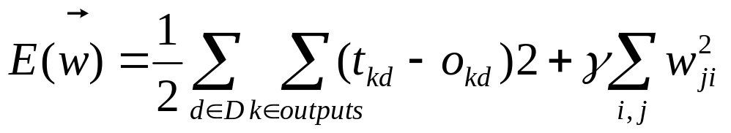
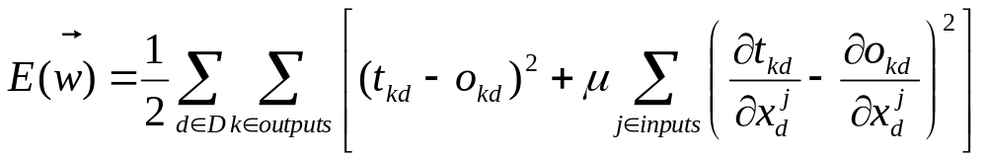
4.8.1 Alternative Error Functions
Adding a penalty term
  seek weight vectors with small magnitudes, thereby reduce the risk of overfitting
Adding a term for error in the slop or derivative of the target function
ML-ANN Dr. Ding Yuxin

Slide 42
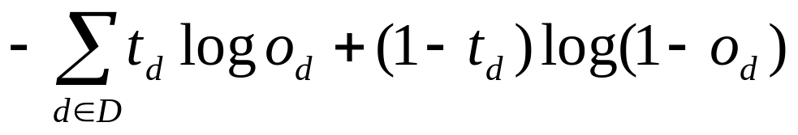
Minimize the cross entropy of the network with respect to the target values
  It is for learning a probabilistic function
  Cross entropy：
  Chapter 6 discusses when and why the most probable h is the one that minimizes this cross entropy
ML-ANN Dr. Ding Yuxin

Slide 43
4.9 summary and further reading
learning real-valued and vector-valued functions over continuous and discrete-valued attributes
robust to noise in the training data
BP is the most common algorithm for ANN learning
H considered by BP is the space of all functions that can be represented by assigning weights to the given, fixed network of interconnected units
Feedforward networks containing 3 layers of units are able to approximate any function to arbitrary accuracy
BP searches the H using gradient descent to iteratively reduce the error in the network to fit training examples
ML-ANN Dr. Ding Yuxin

Slide 44
Gradient descent converge to a local minimum.
gradient descent is a potentially useful method for searching many continuously parameterized hypothesis spaces where the training error is a differentiable function
BP can invent new features that are not explicit in the input
Overfitting and Cross-validation
ML-ANN Dr. Ding Yuxin

Slide 45
Homework:4.2,4.3, 4.5,4.7 (p.91 or p.125)
2003.12.18
ML-ANN Dr. Ding Yuxin

