Slide 1
Machine Learning
Chapter 8 Instance-Based Learning

Slide 2
8.1 Introduction
Instance based learning methods
  Training : simply store training samples
  a new instance is classified by retrieving a set of similar related training samples
A key difference of IBL：
  Construct a different approximation to the target function for each new instance
    a local approximation to the target function
  Advantage？
    use a collection of less complex local functions to approximate a complex function

Slide 3
Introduction(2)
Disadvantage of IBL：
  Cost of classification is high
    Indexing training samples
  Similar instances may be a large distance apart
    Sometimes target concept depends on only a few attributes
We will learn
  k-Nearest neighbor learning and its variants
  Locally weighted regression
  Radial basis function network
  Case-based reasoning
  Lazy learning and eager learning
Notes:
Cost of classification is high
Nearly all computation takes place at classification time
Techniques for efficiently indexing training samples are very important
Considering all attributes for classification
if the target concept depends on only a few attributes, then the true “similar” instances may well be a large distance apart.

Slide 4
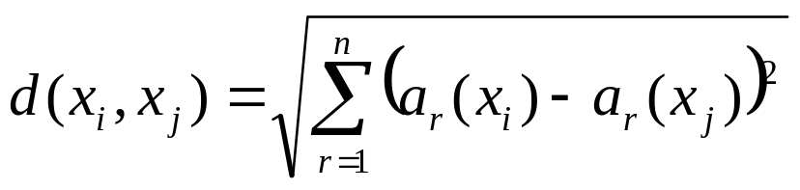
8.2 k-Nearest Neighbor Learning
The most basic IBL method
  Assumes all instances correspond to a points in R^{n}, and represented as a feature vector <a₁(x), ..., a_{n}(x)>
  The distance between two instances x_{i} and x_{j} is defined as
  The target function f: R^{n}→V
    V can be discrete valued or real valued

Slide 5
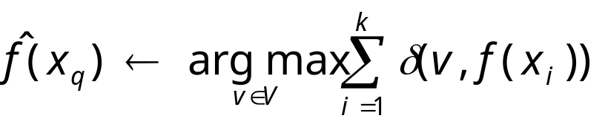
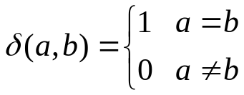
k-Nearest Neighbor Learning （2）
Learning discrete-valued target function
  f: R^{n}→V，V={v₁,...,v_{s}}
KNN for approximating f: R^{n}→V
  Training algorithm
    For each training sample <x,f(x)>, add it to the list training_examples
  Classification algoritnm
    Given a query instance x_{q} to be classified
    Select K instances that are nearest to x_{q}，x₁...x_{k}
      Return
      Where

Slide 6
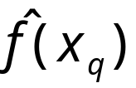
k-Nearest Neighbor Learning （3）
is the most common value among the k nearest training samples
  depends on the number of nearest neighbors, see Fig.8-1 (Next Page)
The implicit general function learned by k-Nearest Neighbor algorithm？
  Fig. 8-1shows the shape the decision surface induced by 1-Nearest Neighbor.
  Voronoi diagram

Slide 7
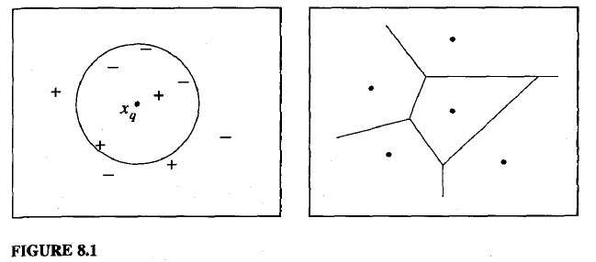

Slide 8
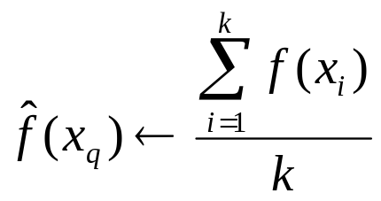
k-Nearest Neighbor Learning （3）
Approximate real valued target function
  Calculate the mean value of the k nearest training samples
  approximate f: R^{n}→R as

Slide 9
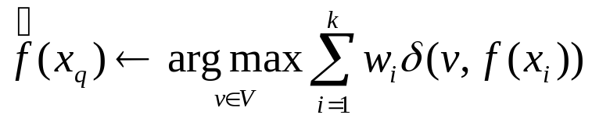
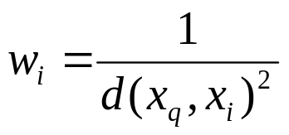

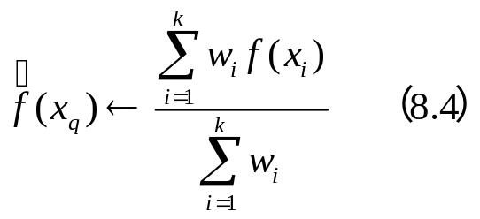
8.2.1 Distance-Weighted Nearest Neighbor Algorithm
An improvement to KNN
  Weight the contribution of each neighbor according to their distance
  If d(x_{q}, x_{i})² = 0，we assign =f(x_{i}).
  If there are several such training samples, we assign the majority classification among them
For continuous-valued target function

Slide 10
Distance-Weighted Nearest Neighbor Algorithm（2）
Using all training samples to classify a query point
  Add distant weighting for all samples
    very distant samples will have very little effect on
  Disadvantage:
    classifier will run more slowly
  A global method and A local method
Shepard method
  Using a global method to approximate a real-valued target function

Slide 11
8.2.2 Remarks on K-NN algorithm
The distance-weighted K-NN is robust to noisy training data.
  It can smooth out the impact of isolated(孤立的) noisy training samples.
Inductive bias of k-NN：
  the classification of an instance x_{q} will be most similar to the classification of other instances that are nearby in Euclidean distance.
One practical issue of k-NN: curse of dimensionality
  The distance is calculated based on all attributes.
  In many cases only a few attributes are relevant to determining the classification.
    K-NN will be misleading

Slide 12
Remarks on K-NN algorithm（2）
Approach to overcoming curse of dimensionality:
  Weight each attribute differently, which corresponds to stretching the axes in the Euclidean space.
    Stretch the jth axis by z_{j}
Another approach
  Completely eliminate the least relevant attributes from instance space Z_{j}=0
    Efficient cross-validation methods (leave-one-out) for selecting attributes
  Locally stretching the axes
Notes:
Weight each attribute differently, which corresponds to stretching the axes in the Euclidean space.
Shortening the axes corresponding to less relevant attributes
Stretch the jth axis by z_{j}, test different values，choose one that can minimize the classification error
repeating this process multiple times to get a more accurate weighting factors

Slide 13
Remarks on K-NN algorithm （3）
One additional issue: building efficient memory indexing to find neighbors
  Various methods have been developed for indexing the stored training samples
    KD-tree stores instances at the leaves of a tree，near by instances stored at the same or near by nodes.
    By testing selected attributes of x_{q}，the KD tree sorts the new query x_{q} to the relevant leaf

Slide 14

A Note on Terminology
Terminology from statistical pattern recognition
  Regression：approximating a real-valued target function
  Residual：the error in approximating the target function
  Kernel function：
    the function of distance that is used to determine the weight of each training sample.
    K: w_{i}=K(d(x_{i}, x_{q}))

Slide 15
8.3 Locally Weighted Regression
The Nearest-neighbor approaches approximate target function f(x) at the single query point x=x_{q}
Locally weighted regression is a generalization of the K-NN
  Approximate to f over a local region surrounding x_{q}
  Uses nearby or distance-weighted training examples to form this local approximation to f
    For example, using a linear function, a quadratic function, neural network to approximate f
2003.12.18

Slide 16


Locally Weighted Regression（2）
The general approach in locally weighted regression ：
  Construct an that fits the training samples in the neighborhood surrounding x_{q}
  Calculating using
  Delete the description of
2003.12.18

Slide 17

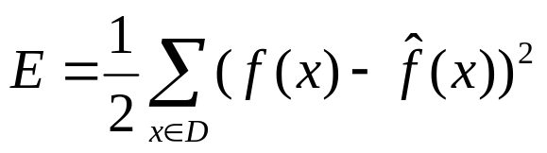
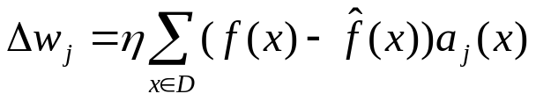
8.3.1 Locally weighted Linear Regression
One case of weighted regression：using a linear function to approximate target function near x_{q}
  ai(x): the ith attribute of instance x
Define the error function over the training set
the training rule
2003.12.18

Slide 18
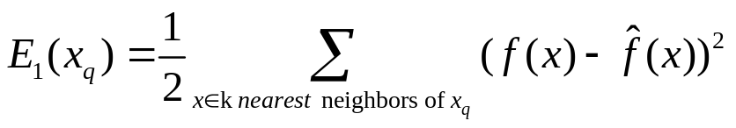
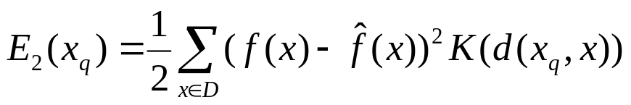
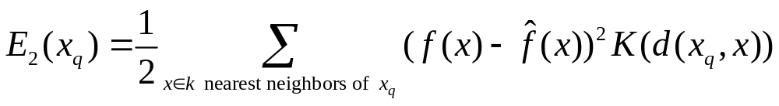
Locally weighted Linear Regression （2）
Three possible error function E(x_{q})
  Minimize the squared error over just the k nearest neighbors
  Minimize the squared error over D, while weighting the error of each d by some decreasing function K
  Combine 1 and 2
2003.12.18

Slide 19
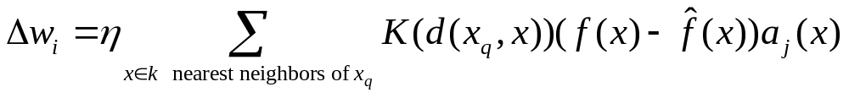
Locally weighted Linear Regression （3）
Criterion 2 is perhaps the best, however it requires significant computation
Criterion 3 is a good approximation of criterion two，its advantage is the computation cost is low
The gradient descent rule for criterion 3 is as follows
2003.12.18

Slide 20
8.3.2 Remarks on LWR
In most cases, the target function is approximated by a constant, linear, or quadratic function, because：
  The cost of fitting more complex function is high
  These simple approximations model the target function quite well over a sufficiently small sub-region
2003.12.18

Slide 21
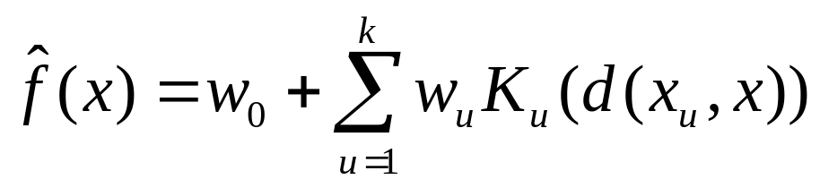

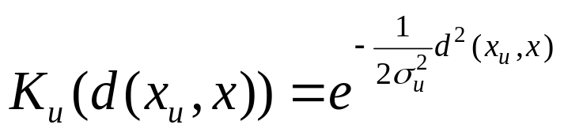
8.4 Radial Basis Functions
Radial basis functions
  used for function approximation
  closely related to distance-weighted regression and ANN
The hypothesis to be learned
is a global approximation to f(x)
  K_{u}(d(x_{u},x)) is defined as a Gaussian function
  each K_{u}(d(x_{u},x)) is localized to a region
Notes:
x_{u} is an training sample
kernel function K_{u}(d(x_{u},x)) increases as d(x_{u},x) decreases
k is the number of kernel functions

Slide 22


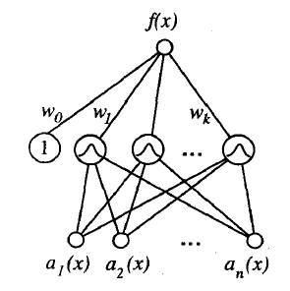
Radial Basis Functions （2）
(Gaussian Kernel) can approximate any function with arbitrarily small
  provided a sufficiently large number of k
  provided the width of each kernel can be separately specified
can be seen as a two layers of network
  The first layer computes K_{u}(d(x_{u},x))，
  The second layer computes of a linear combination of the first-layer units
A two-stage training of RBF
  Determine the number of k，and choose the values of x_{u} and
  Define the global error function, and learn the weights w_{u}

Slide 23


Radial Basis Functions （3）
Method for Choosing the number of hidden units
  Allocate a kernel function for each training sample<x_{i}, f(x_{i})>
    Each training sample <x_{i},f(x_{i})> only locally influence f(x_{i})
      x_{i} is the center and are the same
    advantage : RBF can fit training dada exactly
      for any set of m training samples, the weights w₀...w_{m} can be set so that for each training sample.

Slide 24
Radial Basis Functions （4）
  Choosing a set of kernel functions smaller than the number of training samples
    More efficient, especially the training samples is large
    The centers of the kernel functions distribute uniformly throughout X
    Alternatively, centers can distribute nonuniformly, especially instances distribute nonuniformly over X
      Randomly select a subset of training samples as the kernel function centers
      Clustering instances, and add a kernel function centered at each cluster

Slide 25
Radial Basis Functions （5）
radial basis function networks provide a global approximation to the target function
The value for any given kernel function is non-negligible only when the input falls into a local region
RBF network is viewed as a smooth linear combination of many local approximation to the target function
Advantage of RBF network: can be trained much more efficiently, due to the fact that the input layer and the output layer are trained separately

Slide 26
8.5 Case-based Reasoning
Instance-based methods share three key properties：
  Lazy learning method
  Classify new query instances by analyzing similar instances
  Represent instances as real-valued points in an n-dimensional Euclidean space
CBR has the first two of these principles, but not the third
  using more rich symbolic descriptions to represent instances
  using more elaborate method to retrieve similar instances
2003.12.18

Slide 27
Case-based Reasoning （2）
Application of CBR
  Design of mechanical devices
  Reasoning about new legal cases based on previous rulings
  Solving planning and scheduling problem
    reusing and combining portions of previous solutions to similar problems
2003.12.18

Slide 28
Case-based Reasoning （3）
A sample：CADET system employs CBR to design mechanical devices（Fig. 8-3）
  data
    A library contain 75 previous designs and design fragments
    Each instance is represented by its structure and its qualitative(定性的) function
  New design problem
    finding the corresponding structure for the desired function
2003.12.18

Slide 29
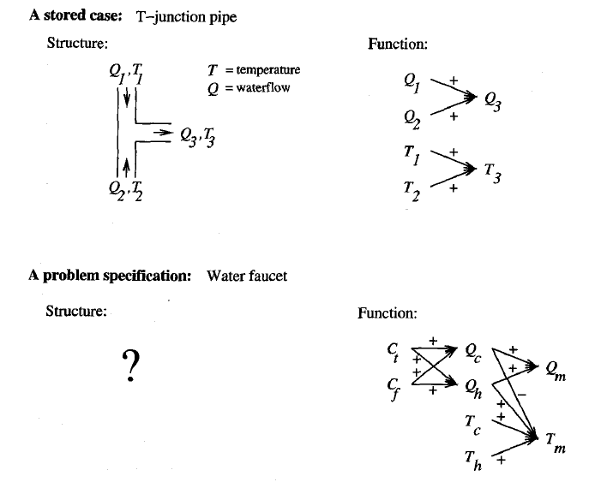
2016.12.18

Slide 30
Case-based Reasoning （3）
  Learning method
    Given the functional specification, CADET search the library and find the matched cases
      If find an exact match, return the case as a suggested solution
      Or , CADET find cases match subgraphs of the desired functional specification
        Search for subgraph isomorphisms between two function graphs
        Elaborate（加工） the original specification graph to create functionally equivalent graphs
    By retrieving multiple cases, the entire design can be pieced together
2016.12.18

Slide 31
Case-based Reasoning （4）
The process of producing a final solution from multiple cases are complex
  require to design portions of the system from first principles
  or require to backtracking on earlier retrieved portions, therefore rejecting previous retrieved cases
  CADET has very limited capabilities
    Relies heavily on the user for the adaptive process
2003.12.18

Slide 32
Case-based Reasoning （5）
Difference between CADET and k-NN
  Instances represented by rich symbolic descriptions
    require a different similarity metric
  Combine Multiple retrieved cases to solve new problem
    the process is very different (relying on knowledge-based reasoning)
  A tight coupling between case retrieval, knowledge-based reasoning, and problem solving.
To summarize，CBR is an IBL method
  Instances have rich relational descriptions
  Solving the current query rely on knowledge-based reasoning and search-intensive methods
2003.12.18

Slide 33
8.6 Remarks on Lazy learning and Eager learning
Lazy learning method：k-NN, locally weighted regression, CBR
Eager learning method：radial basis function
Difference between the two methods：
  computation time: training time and classification time
  the inductive bias
    Lazy method considers the query instance xq when deciding how to generalize beyond the training data D
    Eager method cannot
  The generalization accuracy
  Key point：
    a lazy learner has the option of representing the target function by combination of many local approximations
    an eager learner must commit at training time to a single global approximation
2003.12.18

Slide 34
Remarks on Lazy learning and Eager learning （2）
Can eager method use multiple local approximations?
  Radial basis function network
RBF provide a global approximation
  This global approximation is represented as a linear combination of multiple local kernel functions
  However, the local approximation are not specifically targeted to the query point
2003.12.18

Slide 35
Summary
IBL :
  Lazy learning method
  need not form an explicit hypothesis of the target
  Instead, they form a different local approximation to the target function for each query instance
Advantage of IBL：
  model complex target function by a collection of less complex local approximations
  the information in training samples is never lost
Issues of IBL：
  Efficiency of labeling new instance
  Determining an appropriate distance metric
  Negative impact of irrelevant features
2003.12.18

Slide 36
Summary（2）
k-Nearest Neighbor
Locally weighted regression methods
  a generalization of k-NN
Radial basis function networks
  a type of ANN constructed from localized kernel functions
  can be seen as a blend of IBL and ANN
CBR
  an IBL in which instances are represented by complex logical descriptions
2003.12.18

