Slide 1
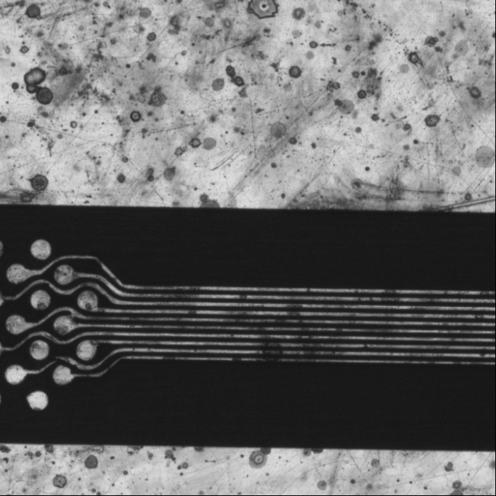
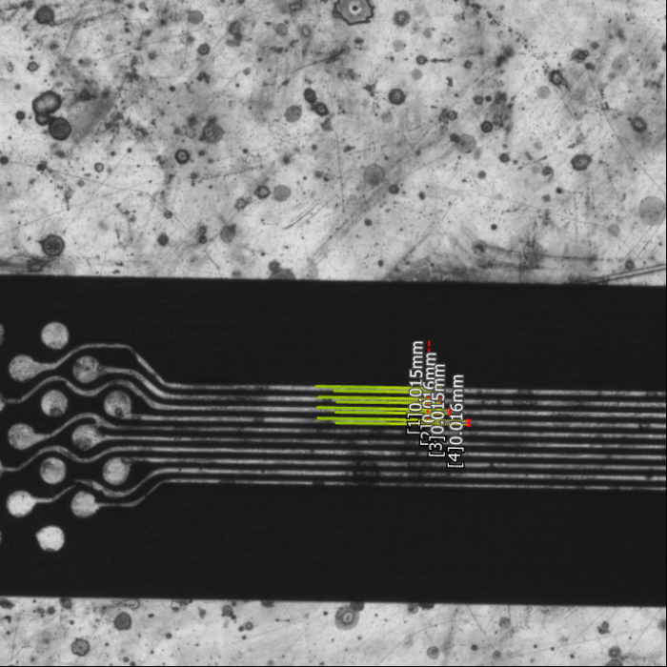
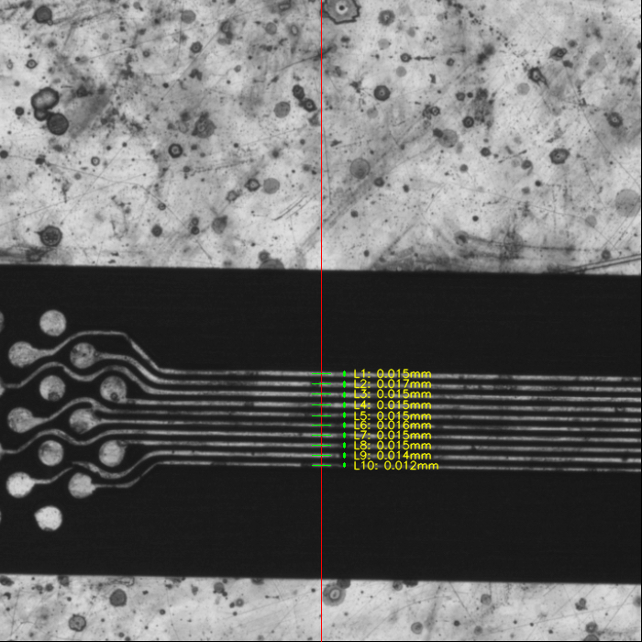
Original
Ground Truth
Predicted

Slide 2
Ground Truth
Predicted
[1] 0.015mm
[2] 0.016mm
[3] 0.015mm
[4] 0.016mm
[1] 0.015mm
[2] 0.017mm (+0.001)
[3] 0.015mm
[4] 0.015mm (-0.001)
[5] 0.015mm
[6] 0.016mm
[7] 0.015mm
[8] 0.015mm
[9] 0.014mm
[10] 0.012mm

Slide 3
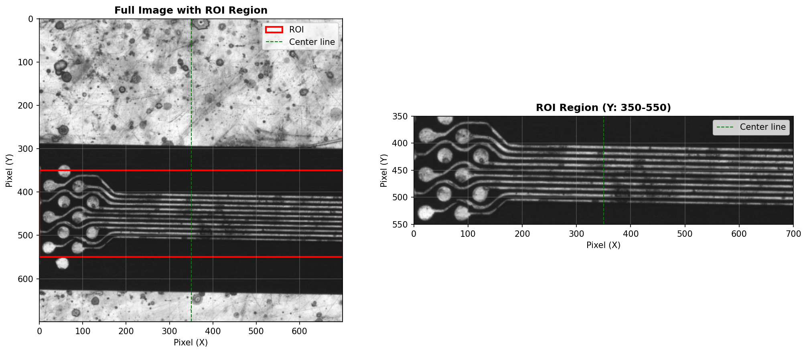
前處理→ROI→Peak Detection→Excel產出+生圖+SingleProcess/BatchProcess

