Slide 1
Create Uncertainty for AMIC with Monte Carlo
Leon King

Slide 2
A few ways to have uncertainty in AMIC
1st : Monte‑Carlo Dropout (quick & dirty approximate Bayesian): Idea: interpret Dropout at test time as sampling from an approximate posterior – you don’t change your weights into distributions, you simply
2nd: True Bayesian Layer via Variational Bayesian Linear.

Slide 3
Codes for 1st way
def mc_dropout_predict(
if device is None:
device = next(model.parameters()).device
sent = sent.to(device)
digits = digits.to(device)
mask = mask.to(device)
# Enable dropout at inference
model.train()
# collect T predictions
preds = []
with torch.no_grad():
for _ in range(T):
sig_out, _, _ = model(sent, digits, mask, use_mask=use_mask)
preds.append(sig_out) # each sig_out: (batch_size,)
# stack to (T, batch_size)
preds = torch.stack(preds, dim=0)
# posterior mean and variance
mean_pred = preds.mean(dim=0) # (batch_size,)
var_pred = preds.var(dim=0) # (batch_size,)
return preds, mean_pred, var_pred

Slide 4
Class Synthesizer
class Synthesizer(nn.Module):
def __init__(self, vocab_size, weight_matrix, hidden_dim, n_layers, max_relative_position= 2, pivot=0.5,drop_prob=0.2,num_heads=1, reduced_dim=100):
def forward(self, sent, digits, mask, use_mask = False):
#p2 = torch.norm(sent, p=2, dim=1)
# sent=self.tanh(sent)*5
p2 = sent
'''
for s in sent:
print(s.size())
for m in mask:
print(m.size())
'''
###################
# out = out * mask_1
if use_mask == True:
'''
o1 = sent[0] * mask
o2 = sent[1] * mask.unsqueeze(-1)
o3 = sent[2] * mask.unsqueeze(-1)
out = (o1, o2, o3)
'''
out = sent * mask
else:
out = sent
save_out = out
# out = torch.multiply(out,mask)
out = self.dropout(out)
out = torch.mean(out,1)
out = out.reshape((batch_size,1))
#out = torch.cat((out, digits), dim=1)
# out = self.fc3(out)
#out = self.tanh(out)
out = torch.mean(out,1)
# sigmoid function
sig_out = self.sig(out)
# reshape to be batch_size first
sig_out = sig_out.view(batch_size, -1)
sig_out = sig_out[:, -1] # get last batch of labels
# return last sigmoid output and hidden state
return sig_out, p2, save_out

Slide 5
summarize_mc_samples
def summarize_mc_samples(samples):
samples = np.array(samples)
mean_p = samples.mean()
var_p = samples.var()
lower, upper = np.percentile(samples, [2.5, 97.5])
prob1 = (samples > 0.5).mean()
prob0 = 1 - prob1
# basic 0/1 classification by mean threshold
label_by_mean = int(mean_p > 0.5)
# uncertainty flag if CI crosses 0.5
certain = (lower > 0.5) or (upper < 0.5)
return {
"mean_p": mean_p,
"var_p": var_p,
"ci_95%": (lower, upper),
"prob1": prob1,
"prob0": prob0,
"label": label_by_mean,
"certain?": certain
}

Slide 6
# 4) loop over each example in the batch
B = samples_np.shape[1]
for i in range(B):
samp_i = samples_np[:, i] # (T,)
stats = summarize_mc_samples(samp_i) # dict with mean_p, var_p, ci_95%, prob1, etc.
row = {
'true_label': labels_np[i],
'model_output': det_out_np[i],
'mean_p': stats['mean_p'],
'var_p': stats['var_p'],
'ci_lower': stats['ci_95%'][0],
'ci_upper': stats['ci_95%'][1],
'prob1': stats['prob1'],
'prob0': stats['prob0'],
'mean_label': stats['label'],
'certain': stats['certain?']
}
results.append(row)

Slide 7
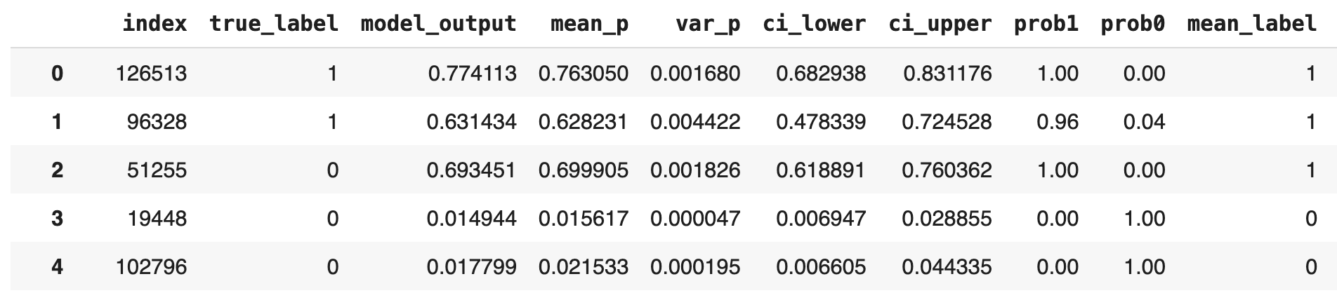
Data Uncertrainty

Slide 8
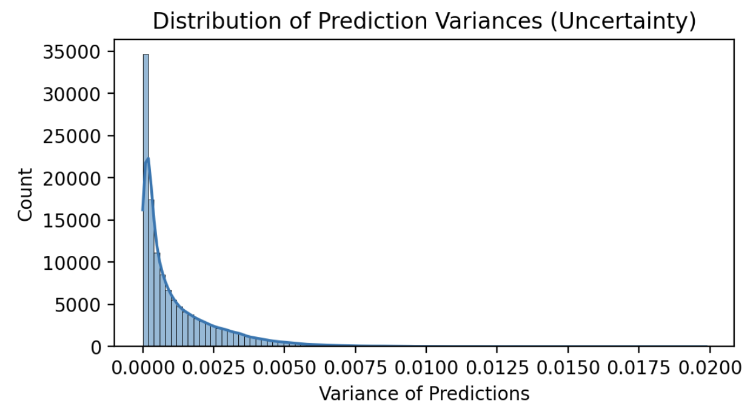
Distribution of Prediction Uncertainties

Slide 9
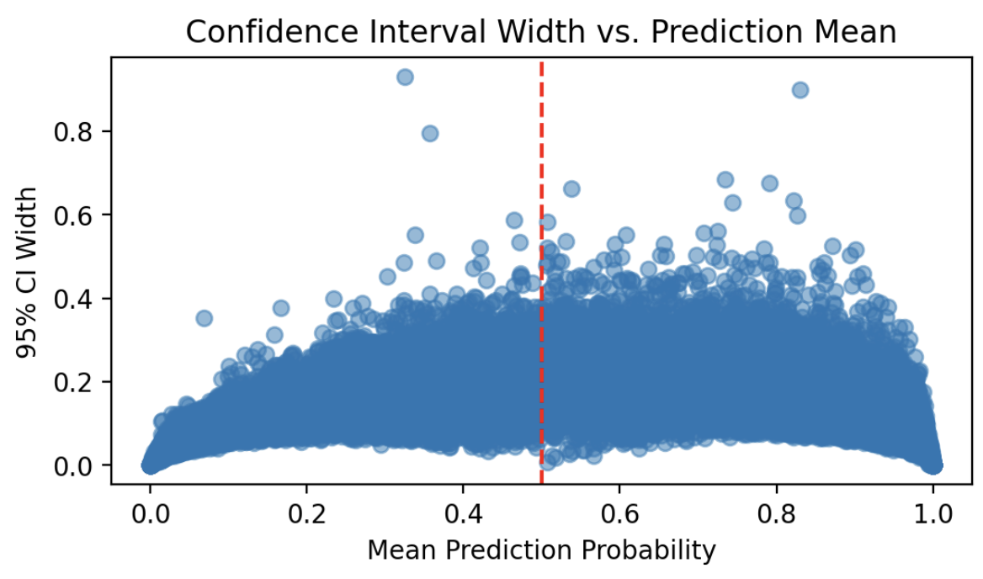
Confidence Interval Width vs. Prediction Mean

Slide 10
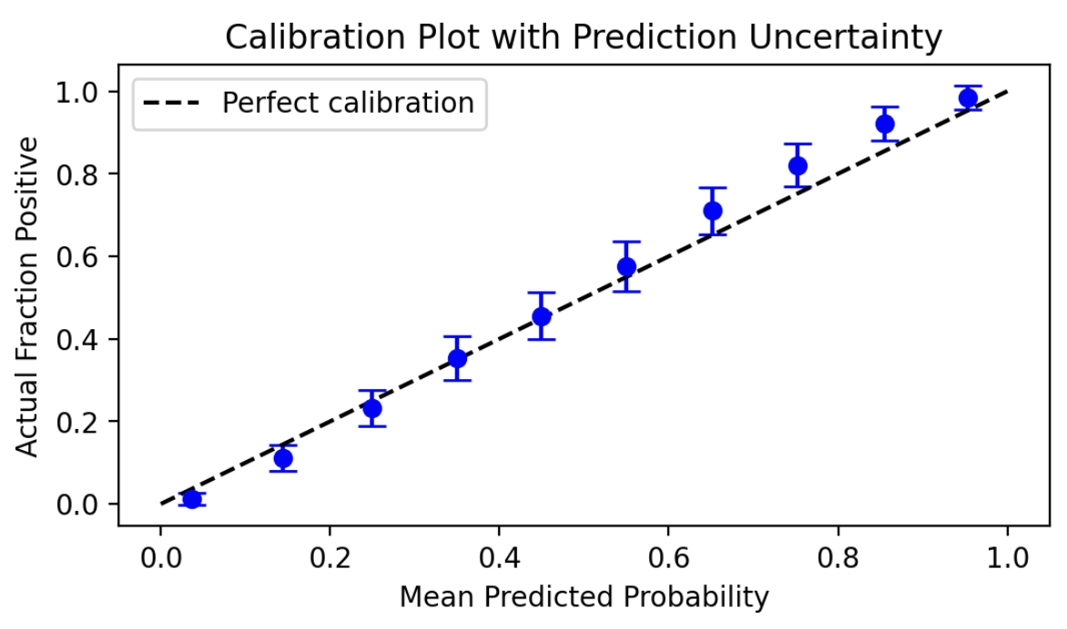
Calibration Plot with Uncertainty

Slide 11
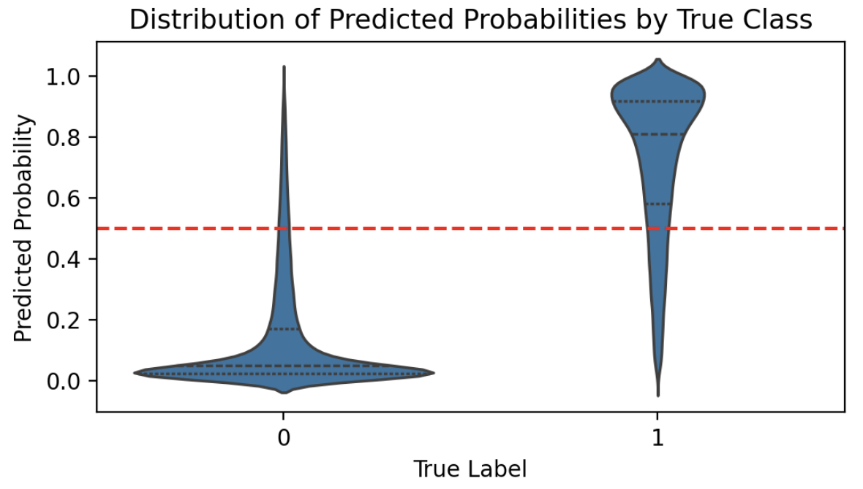
Violin Plots of Prediction Distributions by True Class

Slide 12
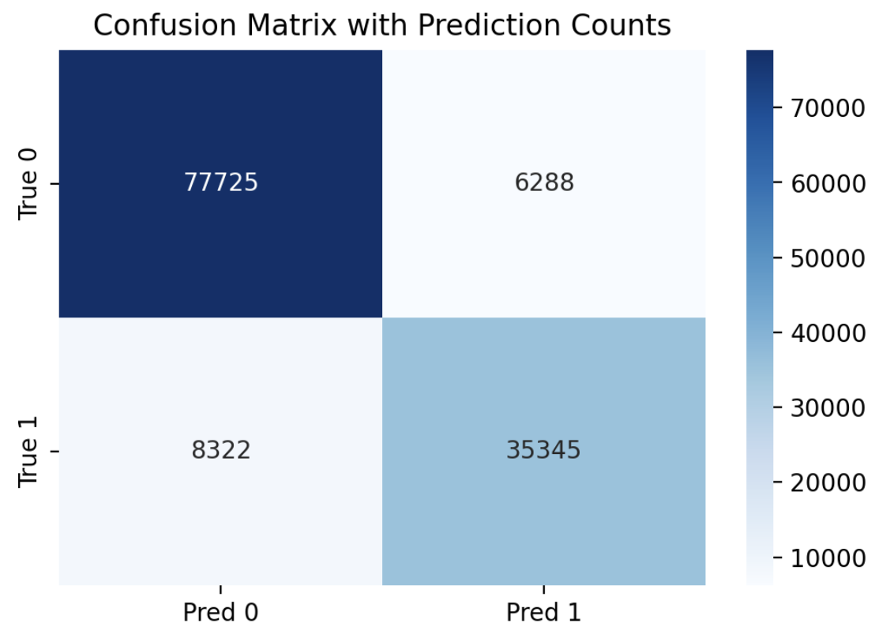
Uncertainty Heatmap by Prediction and True Label

Slide 13
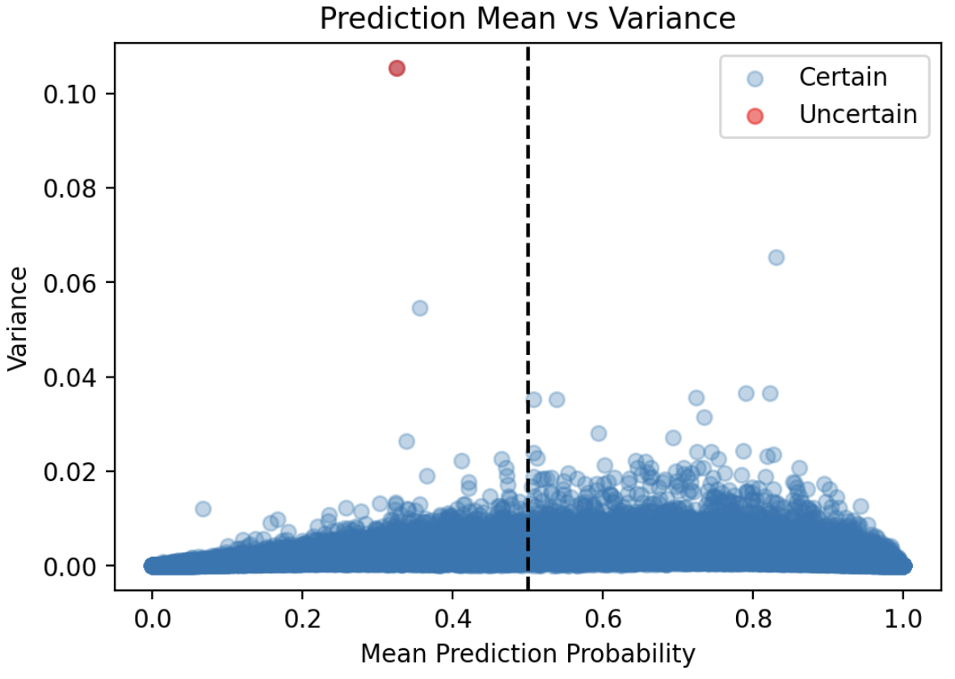
Most Uncertain Predictions Analysis

