Slide 1
Parallel Computing

Slide 2
Simulation involves performing many independent tasks.

Slide 3
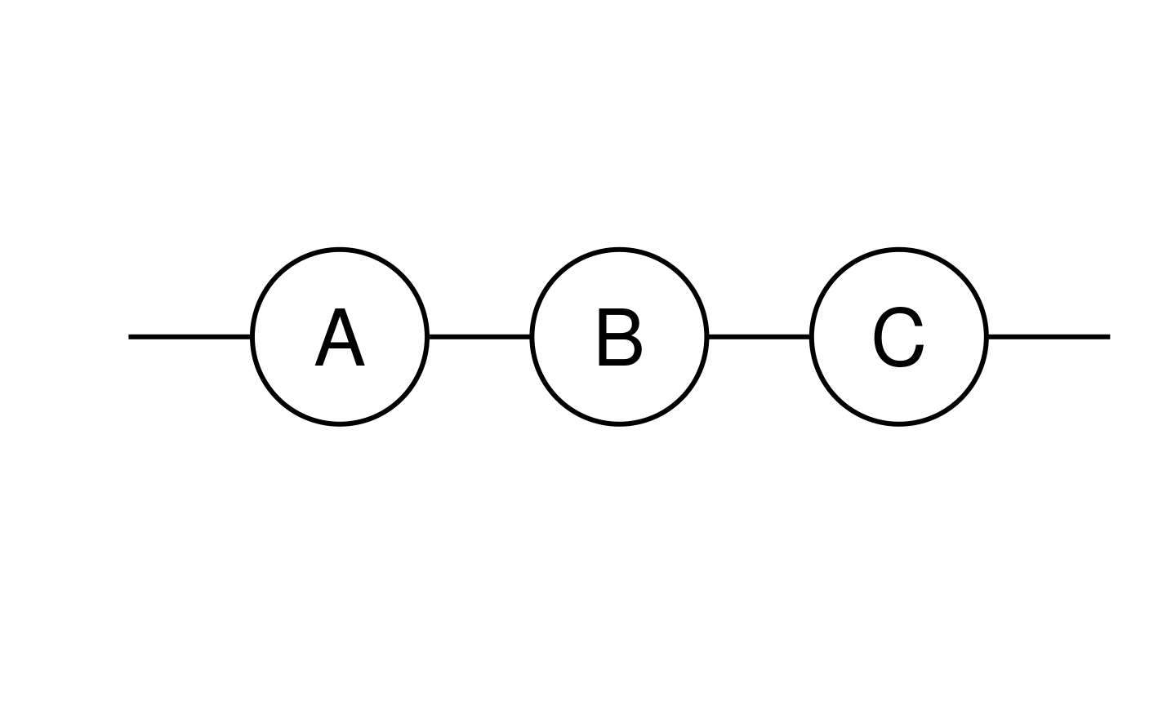
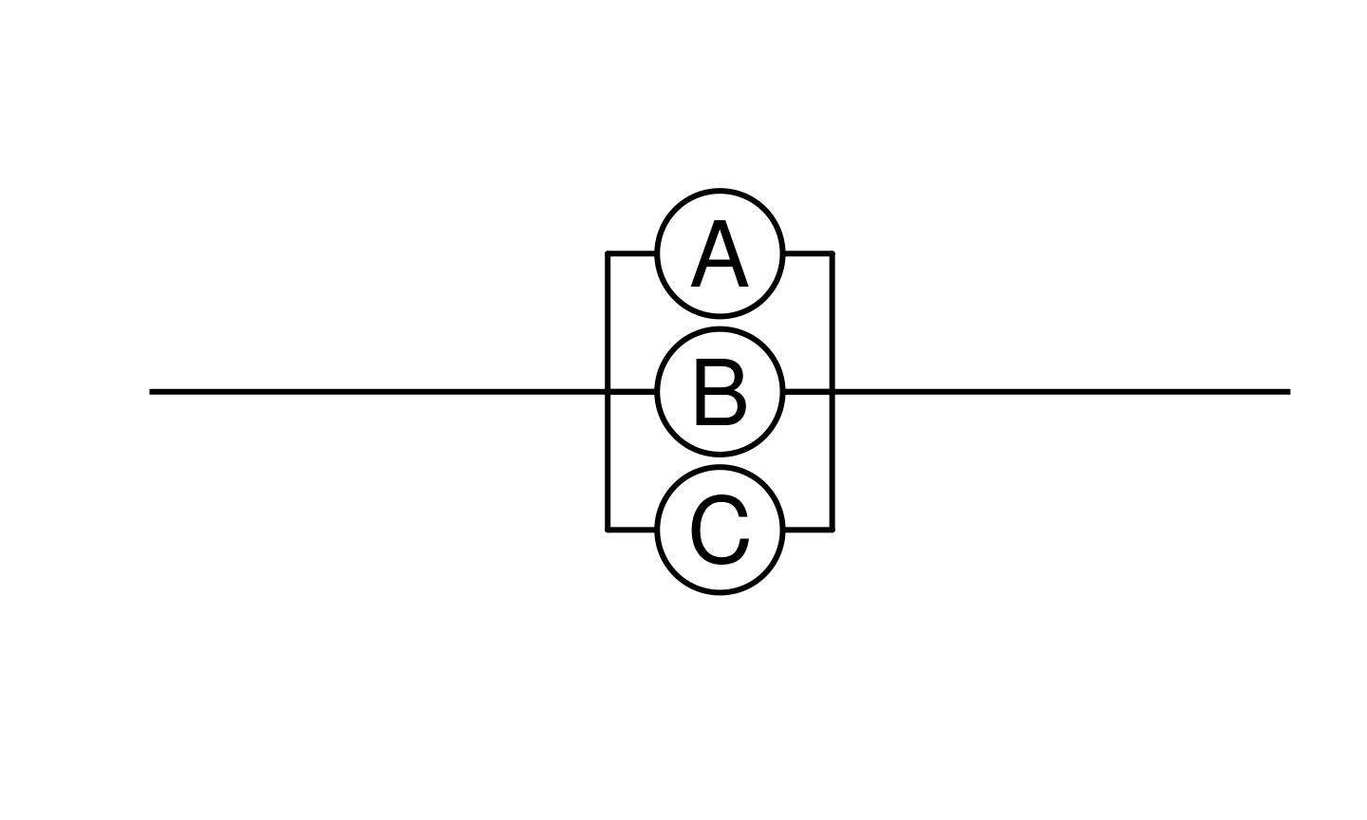
Dependent, sequential tasks
Independent, parallel tasks

Slide 4


Possible approaches
Number of
computers
is fixed
Number of
computers
is variable

Slide 5


Single computer – run jobs in sequence
Number of
computers
is fixed
Number of
computers
is variable

Slide 6
Single computer with multiple cores – run jobs in parallel
Number of
computers
is fixed
Number of
computers
is variable

Slide 7
Rent a single computer with many cores – run jobs in parallel
Number of
computers
is fixed
Number of
computers
is variable

Slide 8
Rent many computers – run jobs in parallel
Number of
computers
is fixed
Number of
computers
is variable

Slide 9
Rent many (but variable number of) computers – run jobs in parallel
Number of
computers
is fixed
Number of
computers
is variable

