Slide 1

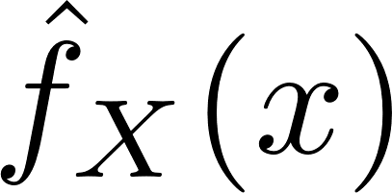


Slide 2
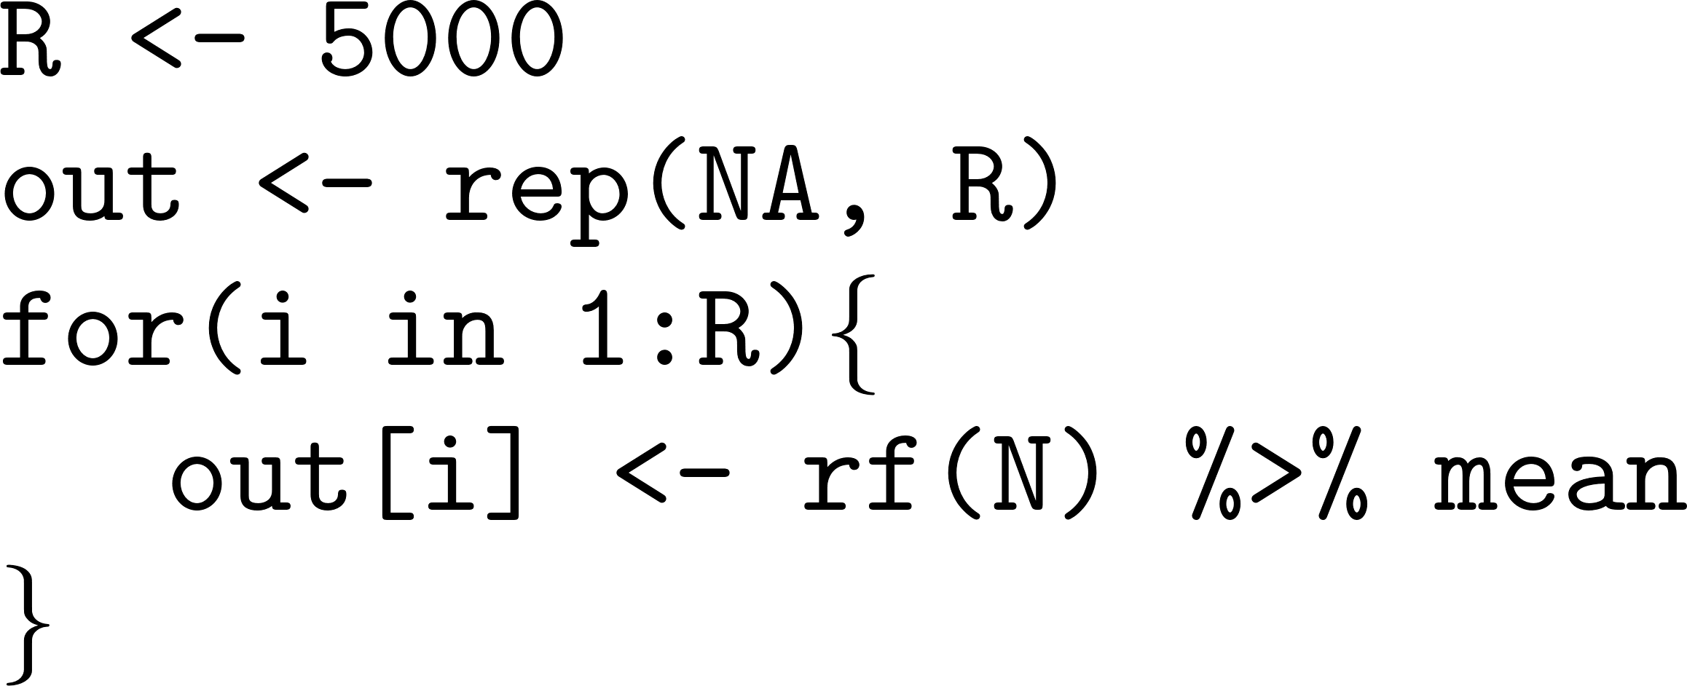
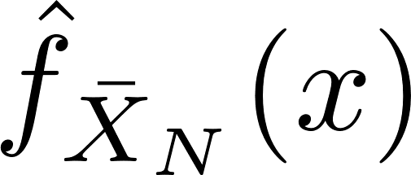

Slide 3




Slide 4


Variable type | CI with CLT Shortcut | R command
Continuous |  | t.test (t interval) Hmisc::bincomf (Wilson)
Bernoulli |  | prop.test
Events per period time |  | poisson.test

