Slide 1
amazon
2023 Summer Data Scientist Internship
Location – Boston
Léon Yuan
Second-year PhD in Statistical Science

Slide 2
01
Confidentiality Agreement
02
Team and Competitors
03
Leadership Principles
04
Introduction
Outlines
05
Problem Statements
06
Measurements
07
Time Series Modelling
08
Compare TS models
09
Domains

Slide 3


Our Founder
Our CEO
2021
JEFF BEZOS
ANDY JASSY

Slide 4
Confidentiality Agreement
Amazon's non-disclosure agreement (NDA) is a legally enforceable contract that protects confidential information.
Any Amazon employee/intern is not allowed to share any data, results, graphs, business decisions, modeling details during and after employment.

Slide 5







Subsidiaries

Slide 6


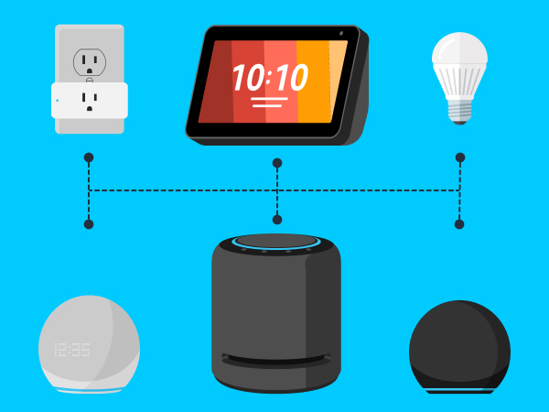
What is Alexa?
Alexa is a cloud-based evolving artificial intelligence assistant service that helps customers everyday life tasks, for example playing music, voice control home appliances, asking general knowledge, placing online shopping lists, telling jokes and so on.
Team

Slide 7
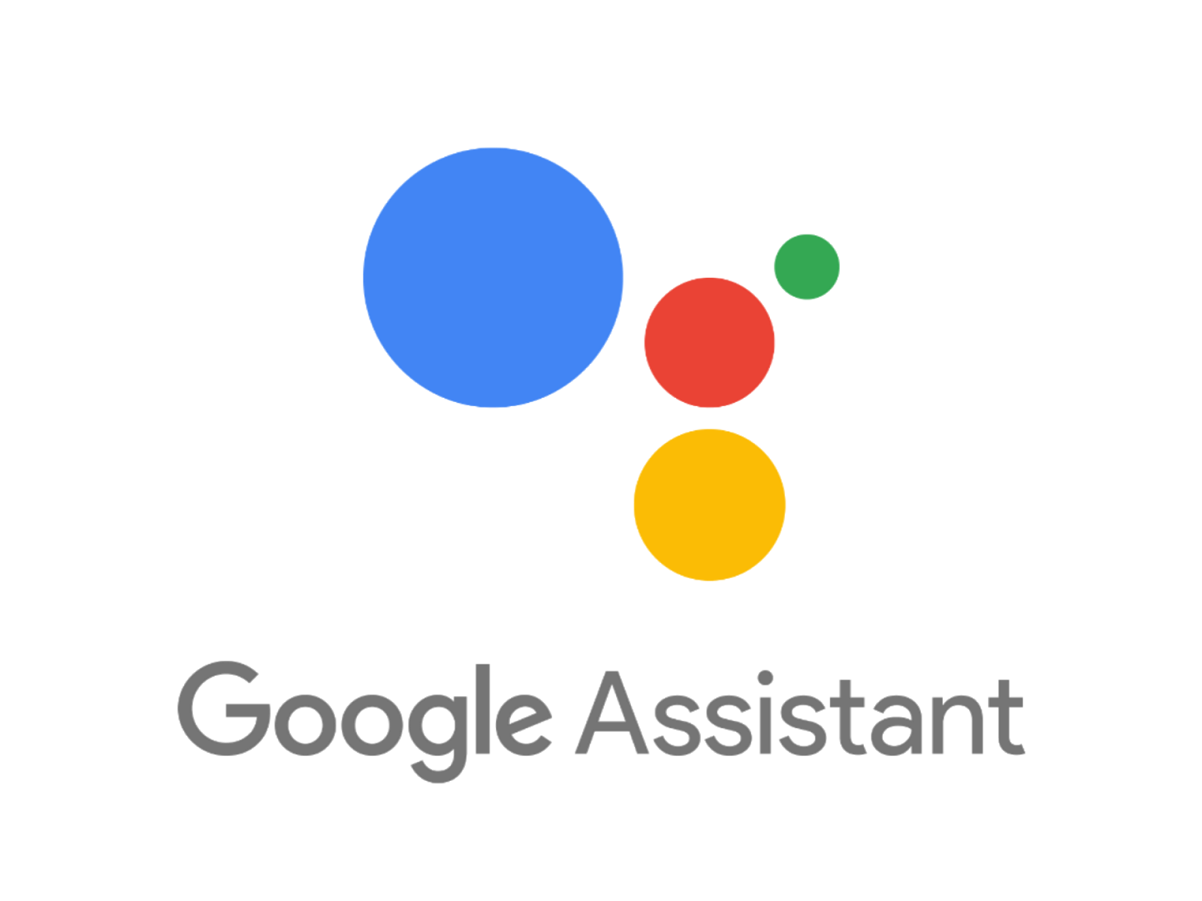
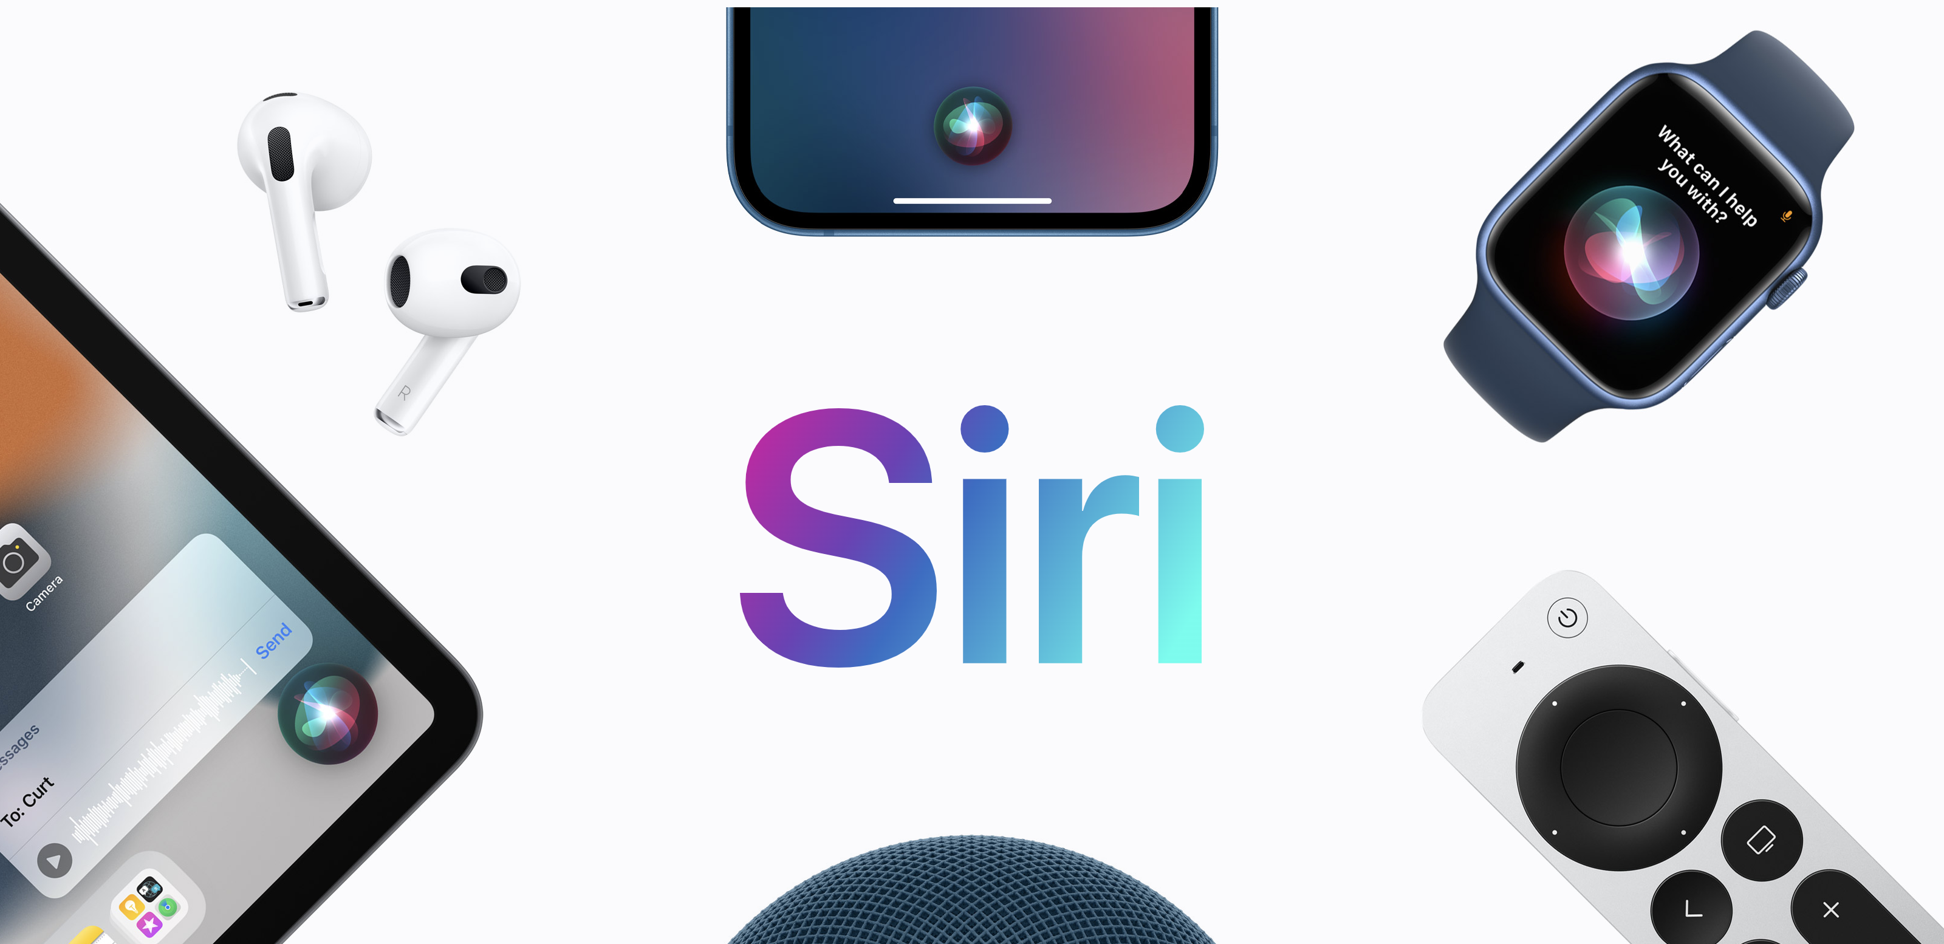

Competitors!
Apple
Google
Microsoft

Slide 8

Leadership Principles
“We use our Leadership Principles every day, whether we’re discussing ideas for new projects or deciding on the best way to solve a problem. It’s just one of the things that makes Amazon peculiar.”
Customer Obsession
Ownership
Have Backbone; Disagree and Commit
Invent and Simplify
Are Right, A Lot
Deliver Results
Learn and Be Curious
Hire and Develop the Best
Strive to be Earth’s Best Employer
Insist on the Highest Standards
Think Big
Success and Scale Bring Broad Responsibility
Bias for Action
Frugality
Earn Trust
Dive Deep

Slide 9
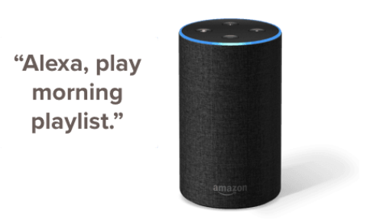

Introduction
Record, Transmit
Text
automatic speech recognition (ASR)
Natural Language Understanding (NLU)
Ranking
Collect, Storage
Around 71 Millions US customers data daily
Text to Speech (TTS)
Sensitive Data
Customer Privacy Matters the most

Slide 10






Introduction – Scope
Amazon alexa provides worldwide service.

Slide 11
Problem Statements
The NLU and LLM are not able to 100% correctly recognize and process the customer spoken languages.
There is a machine learning algorithm to detect the defective processing and recognition.
Detecting the anomaly defective utterance helps improve our NLU and LLM, eventually customer satisfactory.

Slide 12
Measurements
There are many alexa key performance indicators.
Monitor these KPIs to detect defective utterance.
These KPIs are generating each day forming time series.
Build times series models on KPIs to detect anomaly.

Slide 13
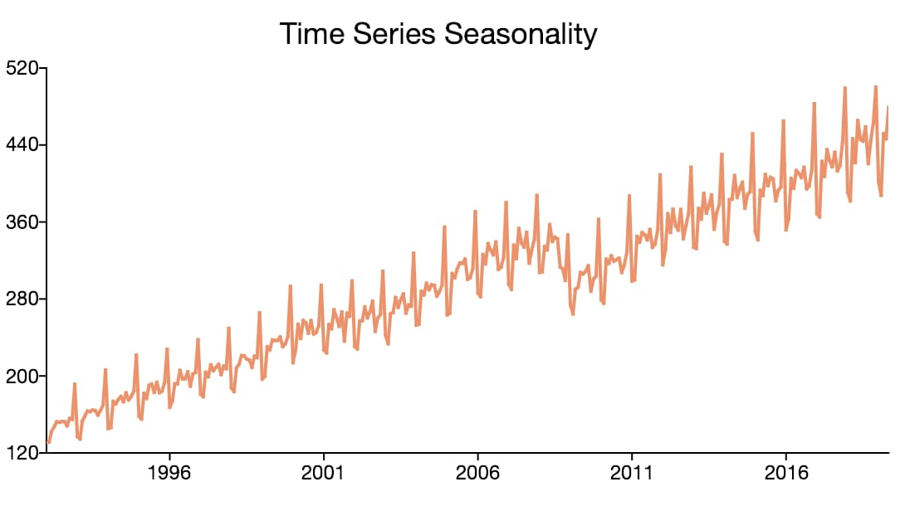
Time Series Modelling
Holt-Winters Models
Prophet Model
Neural Prophet Model
Seasonal ARIMA Model
Neural Network Autoregressive Model
Dynamic Regression with SARIMA error Model
Ensemble Model of selected single TS models
Grouped Cross Model
Hierarchical Nested Model

Slide 14
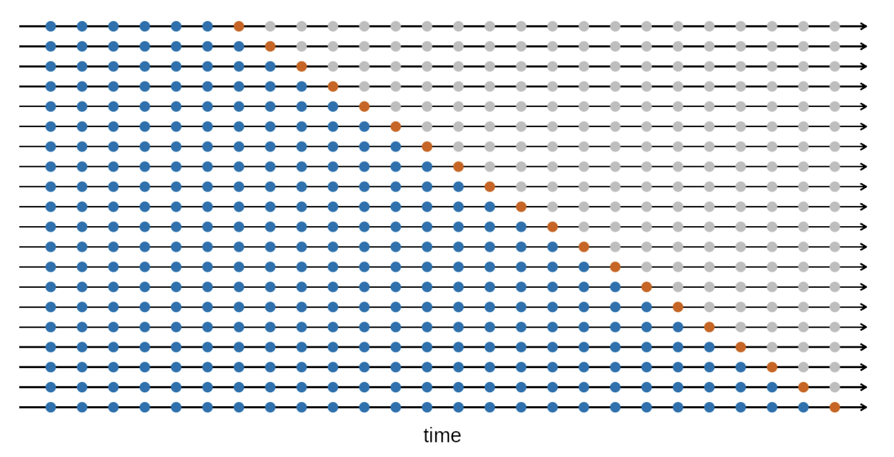
Compare different models
All measurements are calculated with time series cross validation method.
AIC
BIC
AICc
MAE
RMSE
MAPE
Coverage Probability
Winker Score
https://otexts.com/fpp3/

Slide 15




Domains
Run each time series model on all these domains

Slide 16
Strive to be Earth's Best Employer
Through this intern experience,
I extremely recommend to work at Amazon!
Job Applications
slidechef

Slide 17
thanks!

