Slide 1
Paper Presentation
Paper: “LEARNING THE DIFFERENCE THAT MAKES A DIFFERENCE WITH COUNTERFACTUALLY-AUGMENTED DATA”
Léon Lee Yuan
2nd-year PhD in Statistical Science

Slide 2

Learning the difference that makes a difference with counterfactually-augmented data
Author: Divyansh Kaushik, Eduard Hovy, Zachary C. Lipton
School: Carnegie Mellon University
Location: Pittsburgh PA, USA
Year: 2020
Link: https://arxiv.org/abs/1909.12434
GitHub: https://github.com/acmi-lab/counterfactually-augmented-data
Their data is public for reproducibility

Slide 3
Examples in sentiment classification
This movie is good. Model classifies this review as positive.
This movie is not good. Model still classifies this review as positive.
Because this model associates all review containing “good” as positive. However, it doesn’t learn the whole semantics and ignore negation word, “not”.

Slide 4
Examples in email spam filter
“We are glad to offer you this position at our company…” Spam filter model can label this email as spam.
“We offer you a free pre-approved credit card if you drop by our shop today!” Spam filter model can correctly label this email as spam.
This spam filter model only looks at the frequent spam words such as “free”, “offer” instead of the whole actual contents.

Slide 5
Problem
In natural language processing, some classification models or spam detection models and so on mistakenly rely on spurious correlations instead of actual semantic understanding.
This issue can make models only perform well on the training data but fail to perform well on a generalized data.
Notes:
Training data is always limited. This can lead to models memorizing patterns that happen to be in the data, but which don't truly reflect the relationship between text and labels. This leads to a problem we call overfitting. We want our models to learn the true signal, not just memorize our training examples. – from Gemini advanced

Slide 6
Idea
The authors designed a human-in-the-loop system for counterfactually manipulating documents.
By adding these counterfactually data into the training set, the authors hope to force models to learn the truly underlying semantic instead of spurious associations.
Notes:
With counterfactual augmentation, we're essentially saying to the model: "Here's a text that clearly should be positive, and here's an almost identical text that should be negative. You need to learn what the real difference between the two is, rather than relying on accidental patterns.” – Gemini Advanced

Slide 7
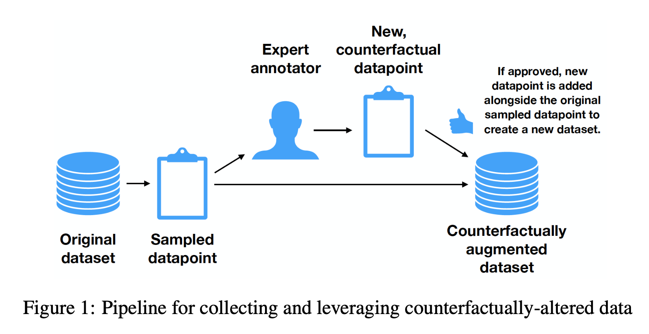
Methods
Edit each text to contradict its original labels.
Edits make text remain coherent.
No unnecessary edits are made.

Slide 8
Two experimental tasks: Sentiment Analysis
IMDB dataset: train/validation/test splits are 1707, 245 and 488 examples, respectively.
Two-way classification: positive and negative.
Example: “The movie was great!” (positive)
->
“The movie was awful!” (negative)

Slide 9
Two experimental tasks: Natural Language Inference
SNLI dataset: train/validation/test splits are1750, 250, and 500 pairs, respectively.
Three-way classification: entailment, contradiction, and neutral
Example: “Premise: Students are doing their homework.”
“Original Hypothesis: Students are studying. (Entailment)”
-> “New Hypothesis: Students are playing. (Contradiction)”

Slide 10
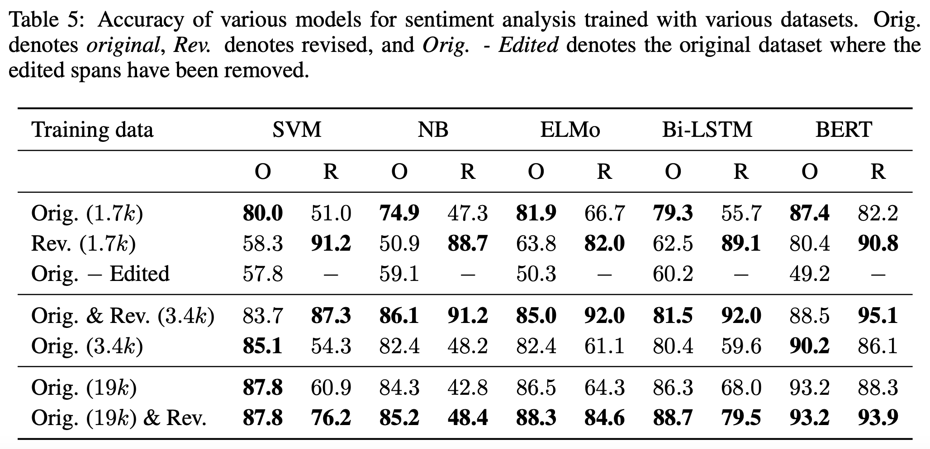
Models and Results
SVM
Naïve Bayes
Bi-LSTM
ELMo-LSTM
BERT

Slide 11
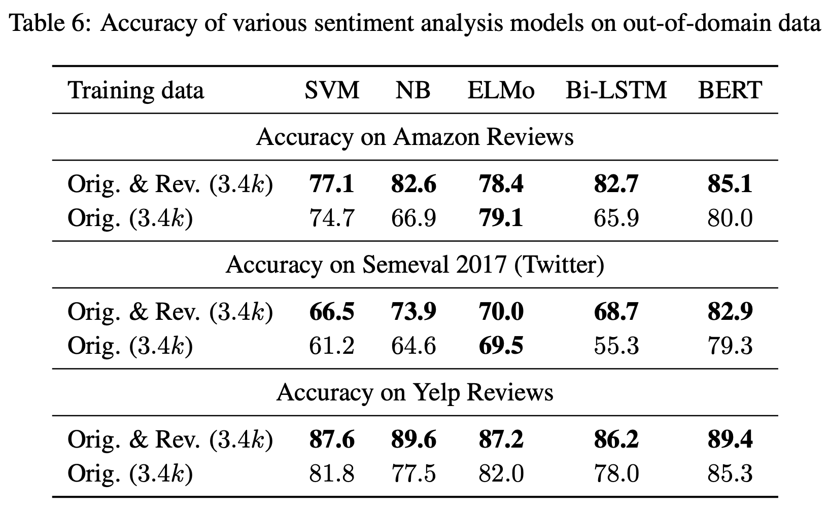
Generalization on out-of-domain data
Amazon Reviews
Twitter Sentiment
Yelp Reviews

Slide 12
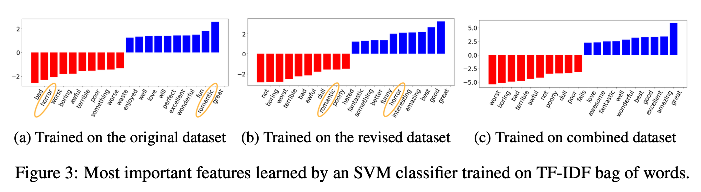
An example of what is learned by this method
This counterfactually-augmented method helps models to classify Movie reviews by adjective words instead of movie genre terms.

Slide 13
Conclusions
Performance Improvement: On sentiment analysis and natural language inference tasks, models trained with counterfactual outperform models trained only on original data.
Robustness: Models becomes less sensitive to spurious patterns and more resilient to variations in the data.
Beyond: This method has the potentials to be valuable in other NLP domains.

