Slide 1
Principal Component Analysis
STAT 6345
March 21, 2023

Slide 2
Outline
Overview of PCA
PCA Theory
PCA Data Overview
PCA Results and Interpretation
PCA Limitations
Overview of Nonlinear PCA (“NLPCA”)
NLPCA Sub-types
NLPCA Data Overview
NLPCA Results and Interpretation

Slide 3
Overview of PCA
Unsupervised method for dimension reduction
As old as 1901 (Pearson)
Decomposes large, multivariate relationships
Reduces “high” dimensional data to lower dimensional manifolds
Reduction results in uncorrelated components
Can allow investigators to understand and interpret lower dimensional structure

Slide 4
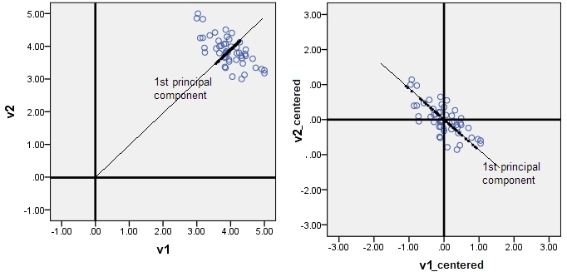



PCA Theory
Consider our centered sample data:
Recall the expression for sample covariance:
Therefore, in matrix form we have:

Slide 5



PCA Theory
Recall the singular value decomposition (SVD) form:
We can substitute this SVD form in our expression for sample covariance:
Which we can simplify:
Because U is orthogonal, this reduces to:

Slide 6




PCA Theory
Because D is a triangular matrix, this gives us:
We can show that V gives us the eigenvectors:
And because V is orthogonal, we get:
Which is the matrix form for the expression of the eigenvectors, V, and the eigenvalues, which are the diagonal elements of D²

Slide 7
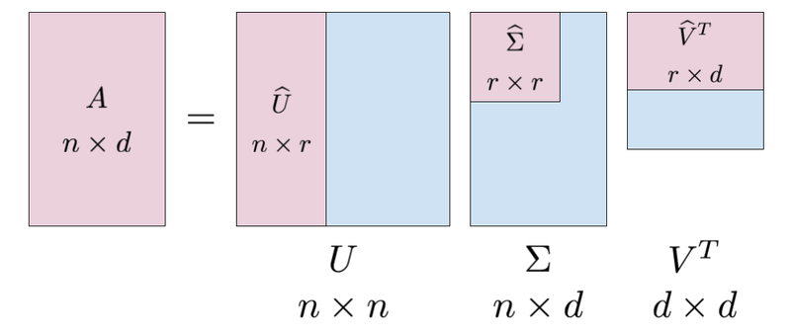
PCA Theory
Principal components are therefore given by:
Because the singular values in D (and their corresponding vectors) are ordered, (i.e. d₁ ≥ d₂ ≥ … ≥ d_{p}), the principal components given by UD are also ordered by largest variance.
So:
UD - Principal components
V - Principal component “loadings”
U - Principal component “scores”

Slide 8
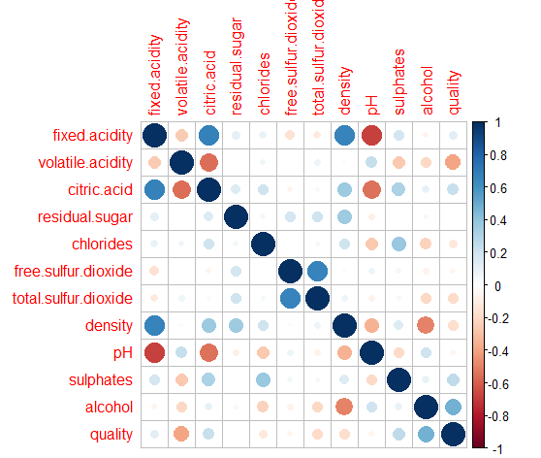
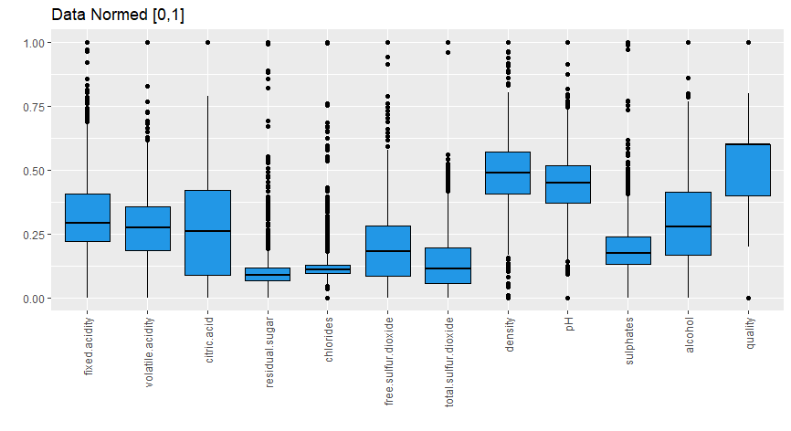
PCA Data Overview
Physicochemical properties of Portugese red wine
Cortez et al., 2009 - University of Minho (Portugal)
11 physical properties of 1599 samples
Also includes a “quality” score: median score of 3 blind taste tests for each sample
All data is numerical
11 physical properties are continuous
Quality is discrete
No missing values

Slide 9
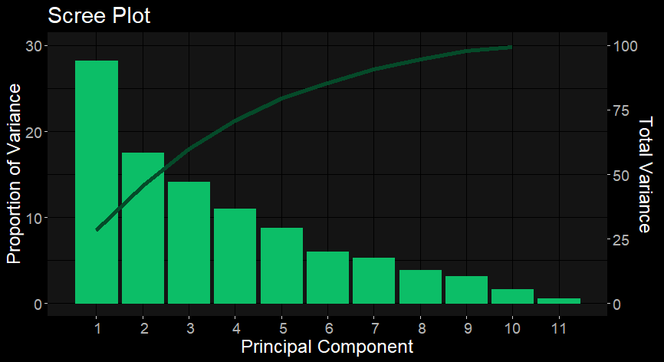
PCA Results
No clear elbow (PC2 is debatable but not useful)
Instead, use “80% rule” which suggests 6 PC’s

Slide 10
PCA Results
 | PC1 | PC2 | PC3 | PC4 | PC5 | PC6 | PC7 | PC8 | PC9 | PC10 | PC11
fixed.acidity | 0.489 | -0.111 | 0.123 | -0.230 | 0.083 | -0.101 | 0.350 | -0.178 | 0.194 | 0.250 | 0.640
volatile.acidity | -0.239 | 0.275 | 0.450 | 0.079 | -0.219 | -0.411 | 0.534 | -0.079 | -0.129 | -0.366 | 0.002
citric.acid | 0.464 | -0.152 | -0.238 | -0.079 | 0.059 | -0.070 | -0.105 | -0.378 | -0.381 | -0.622 | -0.071
residual.sugar | 0.146 | 0.272 | -0.101 | -0.373 | -0.732 | -0.049 | -0.291 | 0.300 | 0.008 | -0.093 | 0.184
chlorides | 0.212 | 0.148 | 0.093 | 0.666 | -0.247 | -0.304 | -0.370 | -0.357 | 0.111 | 0.218 | 0.053
free.sulfur.dioxide | -0.036 | 0.514 | -0.429 | -0.044 | 0.159 | 0.014 | 0.117 | -0.205 | 0.635 | -0.248 | -0.051
total.sulfur.dioxide | 0.024 | 0.569 | -0.322 | -0.035 | 0.222 | -0.136 | 0.094 | 0.019 | -0.592 | 0.371 | 0.069
density | 0.395 | 0.234 | 0.339 | -0.174 | -0.157 | 0.391 | 0.170 | -0.239 | 0.021 | 0.240 | -0.567
pH | -0.439 | 0.007 | -0.058 | -0.004 | -0.268 | 0.522 | 0.025 | -0.561 | -0.168 | 0.011 | 0.341
sulphates | 0.243 | -0.038 | -0.280 | 0.551 | -0.226 | 0.381 | 0.447 | 0.375 | -0.058 | -0.112 | 0.070
alcohol | -0.113 | -0.386 | -0.472 | -0.122 | -0.351 | -0.362 | 0.328 | -0.218 | 0.038 | 0.303 | -0.315

Slide 11
PCA Results
 | PC1 | PC2 | PC3 | PC4 | PC5 | PC6 | PC7 | PC8 | PC9 | PC10 | PC11
fixed.acidity | 0.489 |  |  |  |  |  | 0.350 |  |  |  | 0.640
volatile.acidity |  |  | 0.450 |  |  | -0.411 | 0.534 |  |  | -0.366
citric.acid | 0.464 |  |  |  |  |  |  | -0.378 | -0.381 | -0.622
residual.sugar |  |  |  | -0.373 | -0.732
chlorides |  |  |  | 0.666 |  | -0.304 | -0.370 | -0.357
free.sulfur.dioxide |  | 0.514 | -0.429 |  |  |  |  |  | 0.635
total.sulfur.dioxide |  | 0.569 | -0.322 |  |  |  |  |  | -0.592 | 0.371
density | 0.395 |  | 0.339 |  |  | 0.391 |  |  |  |  | -0.567
pH | -0.439 |  |  |  |  | 0.522 |  | -0.561 |  |  | 0.341
sulphates |  |  |  | 0.551 |  | 0.381 | 0.447 | 0.375
alcohol |  | -0.386 | -0.472 |  | -0.351 | -0.362 | 0.328 |  |  | 0.303 | -0.315

Slide 12
PCA Results
 | PC1 | PC2 | PC3 | PC4 | PC5 | PC6
fixed.acidity | 0.489
volatile.acidity |  |  | 0.450 |  |  | -0.411
citric.acid | 0.464
residual.sugar |  |  |  | -0.373 | -0.732
chlorides |  |  |  | 0.666 |  | -0.304
free.sulfur.dioxide |  | 0.514 | -0.429
total.sulfur.dioxide |  | 0.569 | -0.322
density | 0.395 |  | 0.339 |  |  | 0.391
pH | -0.439 |  |  |  |  | 0.522
sulphates |  |  |  | 0.551 |  | 0.381
alcohol |  | -0.386 | -0.472 |  | -0.351 | -0.362
Interpretation (the real challenge)
PC1: Acidity
PC2: Smoothness? (Stability?)
PC3: Bitterness
PC4: Salt/Sugar contrast
PC5: “Dryness” (opposite of sweet)
PC6: Aroma?
← Alcohol may have a ‘masking’ effect

Slide 13
Why non-linear PCA?
There are some assumptions and limitations to the ordinary PCA.
PCA assumes correlations between variables due to Pearson
PCA is fixed and unable to change it, thus is sensitive to outliers
PCA has to use complete dataset
PCA works well on linear relationship dataset
PCA can only be applied to continuous dataset
https://www.keboola.com/blog/pca-machine-learning

Slide 14
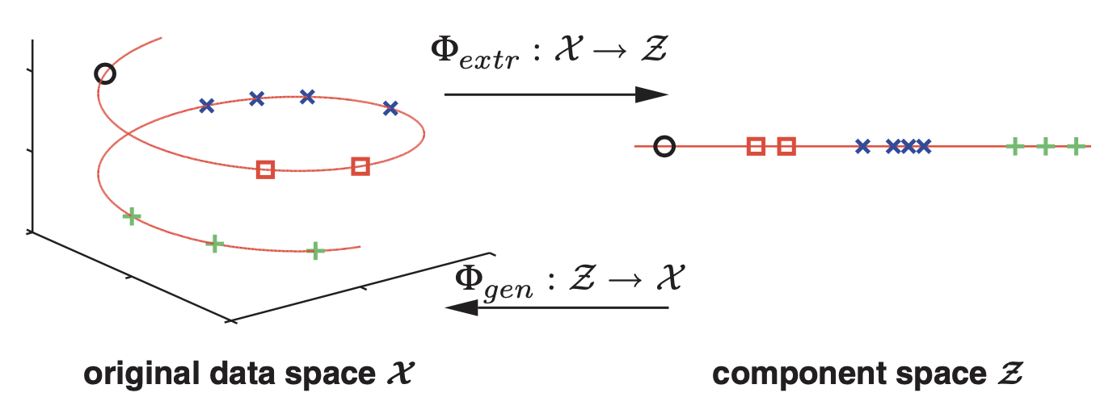
Nonlinear Dimensionality Reduction
Standard Nonlinear Data
Hierarchical NLPCA
Circular PCA
Inverse NLPCA
Notes:
Nonlinear dimensionality reduction. Illustrated are three- dimensional samples that are located on a one-dimensional subspace, and hence can be described without loss of information by a single variable (the component). The transformation is given by the two functions Φextr and Φgen. The extraction func- tion Φextr maps each three-dimensional sample vector (left) onto a one-dimensional component value (right). The inverse mapping is given by the generation function Φgen which transforms any scalar component value back into the original data space. Such helical trajectory over time is not uncommon in molecular data. The horizontal axes may represent molecule concentrations driven by a circadian rhythm, whereas the vertical axis might represent a molecule with an increase in concentration

Slide 15
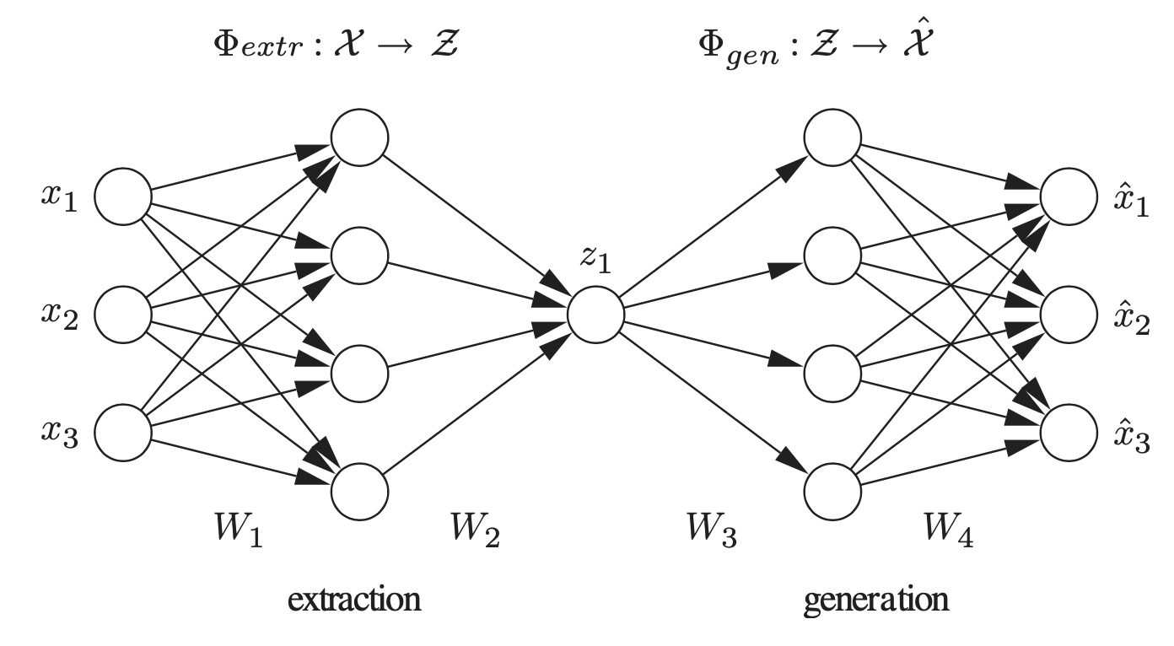

Standard Nonlinear PCA
Notes:
Standard autoassociative neural network. The network output xˆ is required to be equal to the input x. Illustrated is a 3-4-1-4-3 network architecture. Biases have been omitted for clarity. Three-dimensional samples x are compressed to one component value z in the middle by the extraction part. The inverse generation part reconstructs xˆ from z. The sample xˆ is usually a noise-reduced representation of x. The second and fourth layer, with four nonlinear units each, enable the network to perform nonlinear mappings. The network can be extended to extract more than one component by using additional units in the component layer in the middle

Slide 16
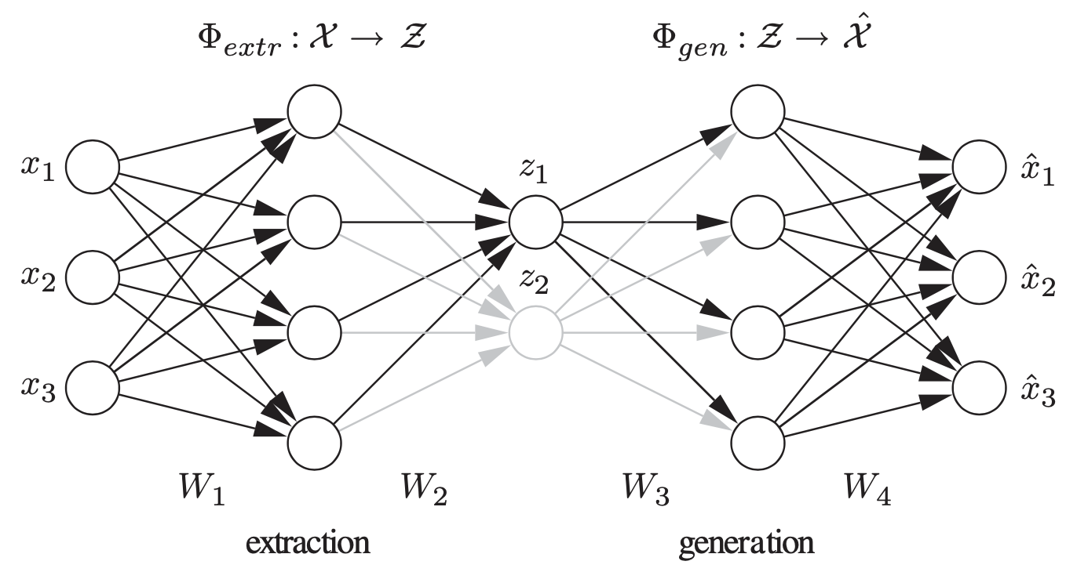


Hierarchical NLPCA
Notes:
Hierarchy, in this context, is explained by two important properties: scala- bility and stability. Scalability means that the first n components explain the maximal variance that can be covered by a n-dimensional subspace. Stability means that the i-th component of an n component solution is identical to the i-th component of an m component solution.
Yet, we may want to give a stronger emphasis to optimal single or subspace feature explanations. This trade-off could be balanced by weighting the error terms E1 and E1,2 by use of a hyper-parameter α:
Hierarchical NLPCA. The standard autoassociative network is hierar- chically extended to perform the hierarchical NLPCA (h-NLPCA). In addition to the whole 3-4-2-4-3 network (grey+black), there is a 3-4-1-4-3 subnetwork (black) explicitly considered. The component layer in the middle has either one or two units which represent the first and second components, respectively. Both the error E1 of the subnetwork with one component and the error of the total network with two components are estimated in each iteration. The network weights are then adapted at once with regard to the total hierarchic error E = E1 + E1,2

Slide 17
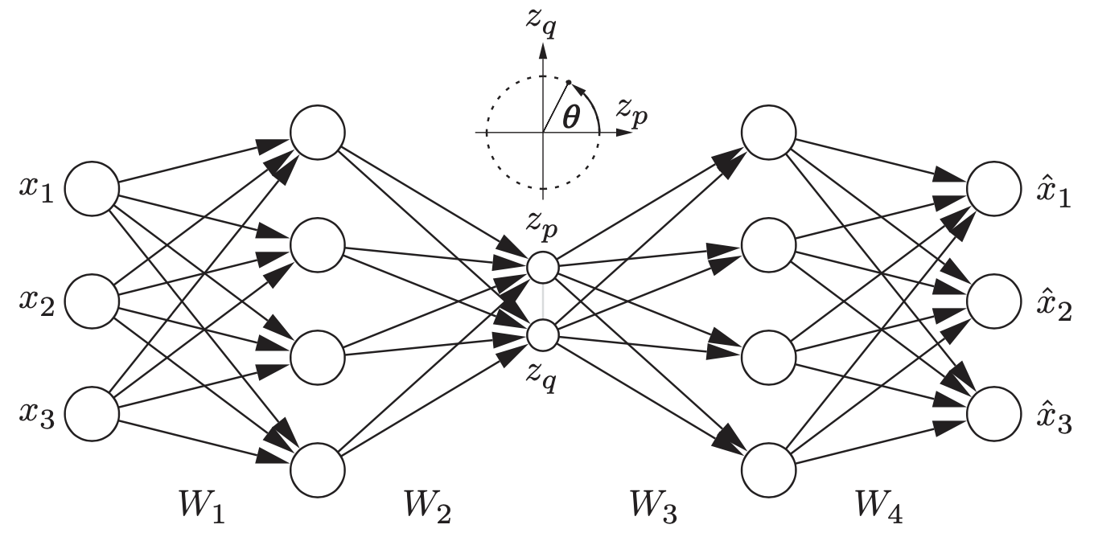
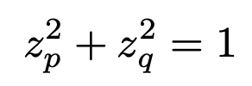
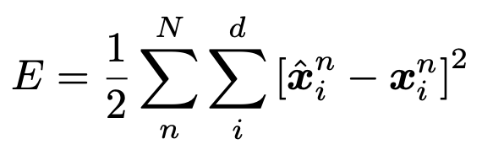
Circular PCA
Notes:
Circular PCA network. To obtain circular components, the auto- associative neural network contains a circular unit pair (p,q) in the component layer. The output values zp and zq are constrained to lie on a unit circle and hence can be represented by a single angular variable θ

Slide 18
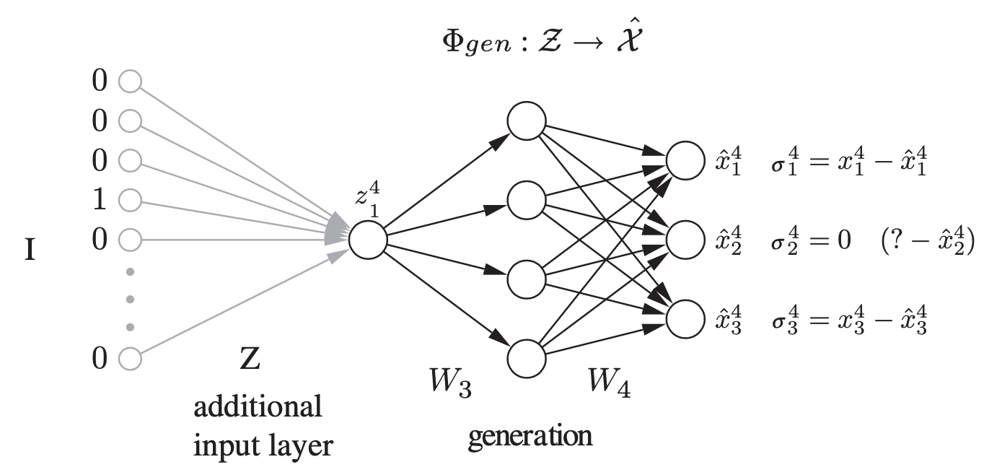

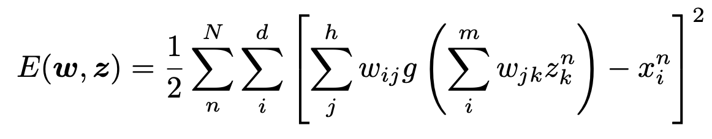
Inverse NLPCA
Notes:
The inverse NLPCA network. Only the second part of the autoasso- ciative network (Fig. 2.2) is needed, as illustrated by a 1-4-3 network (black). This generation part represents the inverse mapping Φgen which generates or reconstructs higher-dimensional samples x from their lower dimensional component representa- tions z. These component values z are now unknown inputs that can be estimated by propagating the partial errors σ back to the input layer z. This is equivalent to the illustrated prefixed input layer (grey), where the weights are representing the component values z. The input is then a (sample x sample) identity matrix I. For the 4th sample (n=4), as illustrated, all inputs are zero except the 4th, which is one. On the right, the second element x42 of the 4th sample x4 is missing. Therefore, the partial error σ24 is set to zero, identical to ignoring or non-back-propagating. The parameter of the model can thus be estimated even when there is missing data

Slide 19
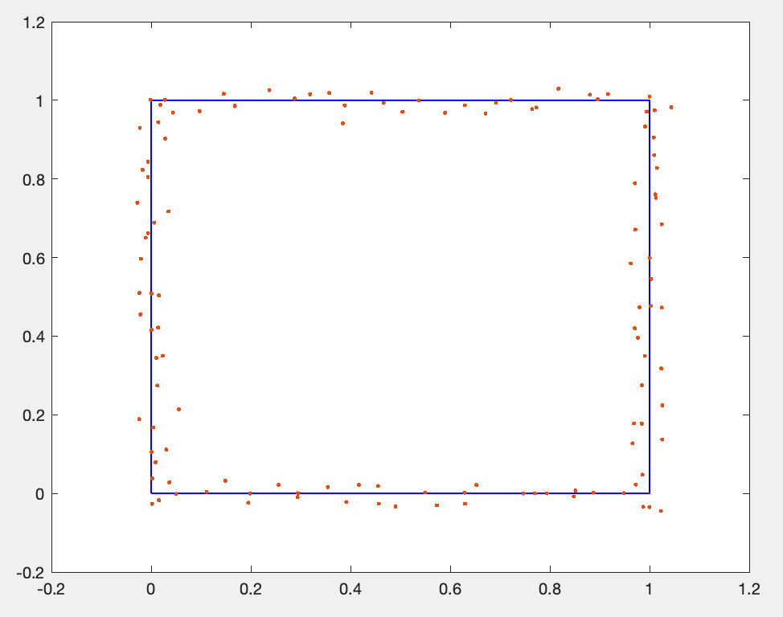
Non-normal simulated data
The true pattern is a square with length 1, and simulated data is 0.02 times of standard normal distribution.

Slide 20
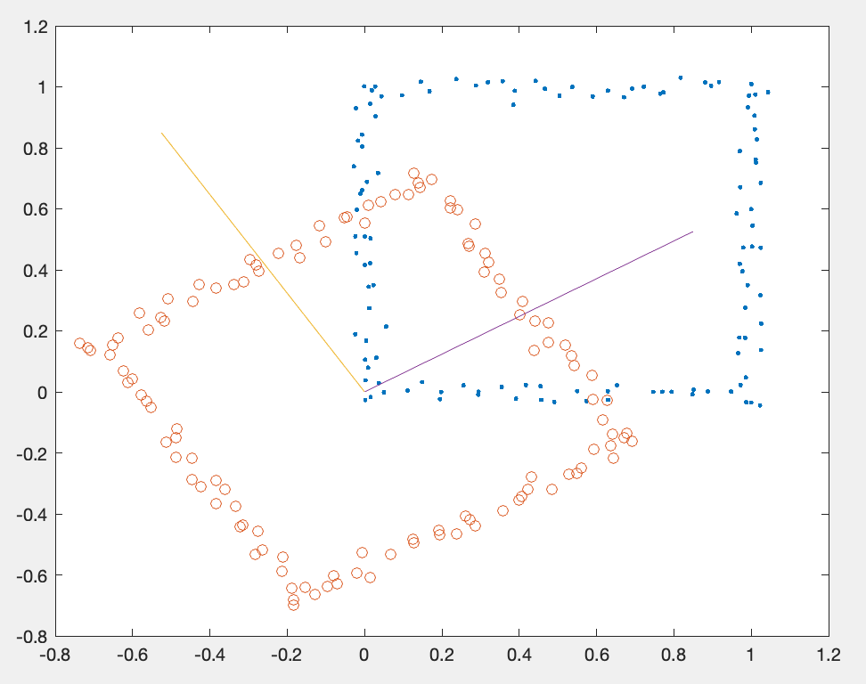
Non-normal data with ordinary PCA
The ordinary PCA only uses linear orthonormal vectors to extract PCs, the first PC explains only 50.24% variance and the second PC explains 49.75% variance.

Slide 21
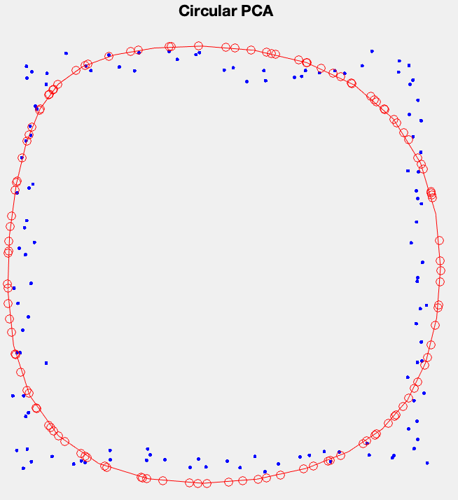
Non-normal data with circular NLPCA
The circular NLPCA uses non-linear transformation to extract the PC. The first PC can explain 98.49% variance by using this closed curve.

Slide 22
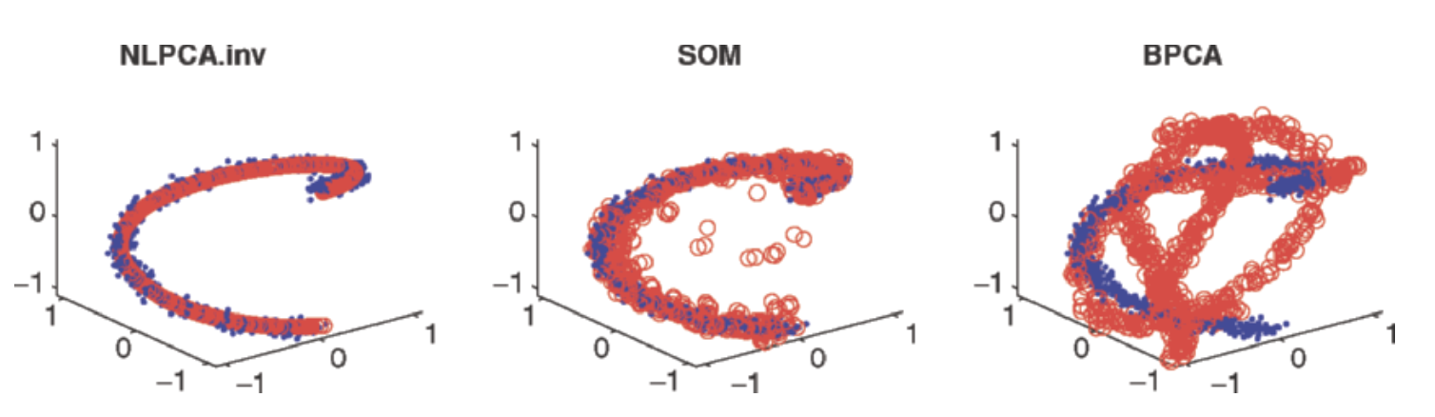
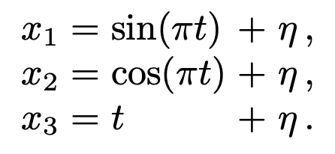
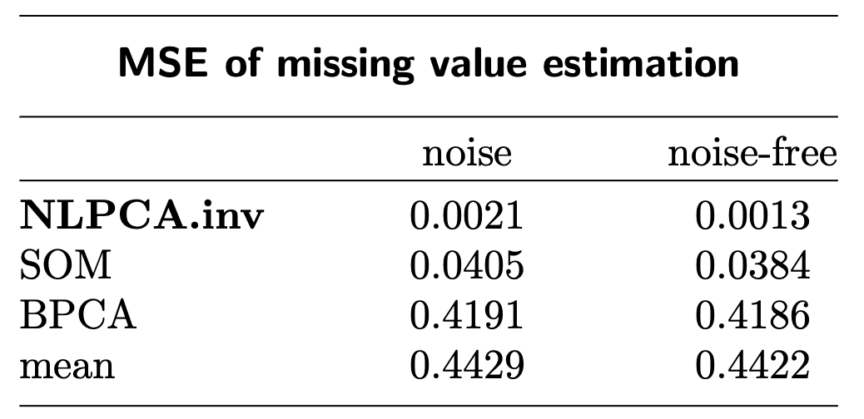
Missing data estimation by NLPCA
Comparison of different estimation methods
True helix loop
Notes:
Missing data estimation. Used is an artificial data set which describes a helical loop, plotted as dots (‘·’). From each sample, one of the three values is rejected and have to be reconstructed by different missing data estimation algorithms. The reconstructed samples are plotted as circles (‘◦’). The inverse NLPCA identifies the nonlinear component best and hence gives a very good estimation of the missing values. SOM also gives a reasonably good estimation, but the linear approach BPCA fails on this nonlinear test set

Slide 23
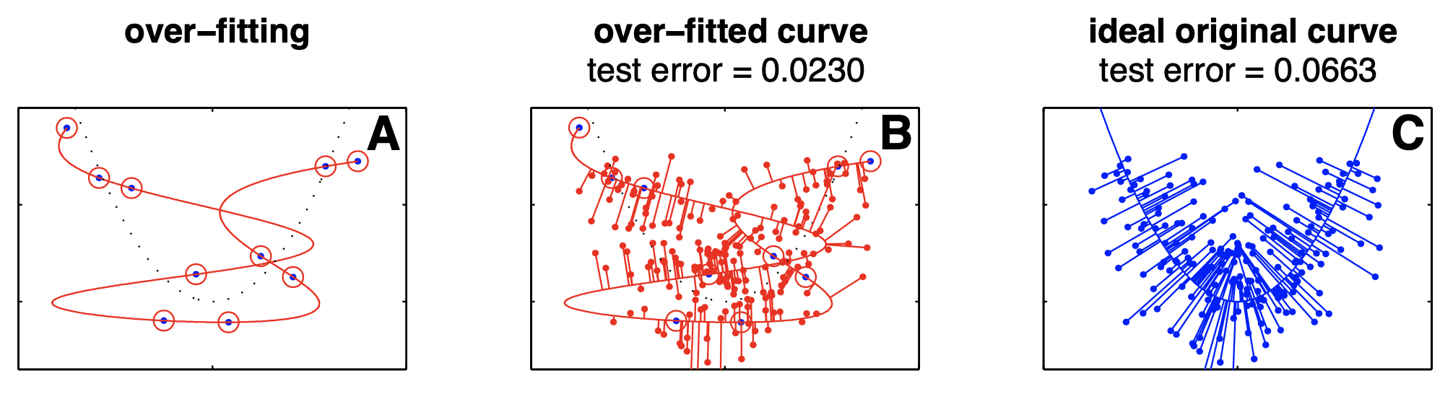
Validation of NLPCA
“The object is to find a model whose complexity is neither too small nor too large.”
https://link.springer.com/article/10.1007/s11063-012-9220-6
The conventional independent test set fails to validate non-linear PCA.
Notes:
But a more complex over-fitted curve covers more data space and hence can also achieve a smaller error on test data than the true original curve.
But a more complex over-fitted curve covers more data space and hence can also achieve a smaller error on test data than the true original curve.

Slide 24

How to vary NLPCA complexity?
A weight-decay penalty term, v
Notes:
By varying the coefficient ν, the impact of the weight-decay term can be changed and hence we modify the complexity of the model which defines the flexibility of the component curves in nonlinear PCA.

Slide 25
NLPCA Validation Procedure
“Choose a specific complexity parameter ν
Apply inverse nonlinear PCA to a training data set
Validate the nonlinear PCA model by its performance on missing data estimation of an independent test set”
https://link.springer.com/article/10.1007/s11063-012-9220-6
Notes:
To get a more robust result, for each complexity setting, nonlinear PCA can be repeatedly applied by using different weight-initializations of the neural network. The median can then be used for validation as shown in the following examples.

Slide 26
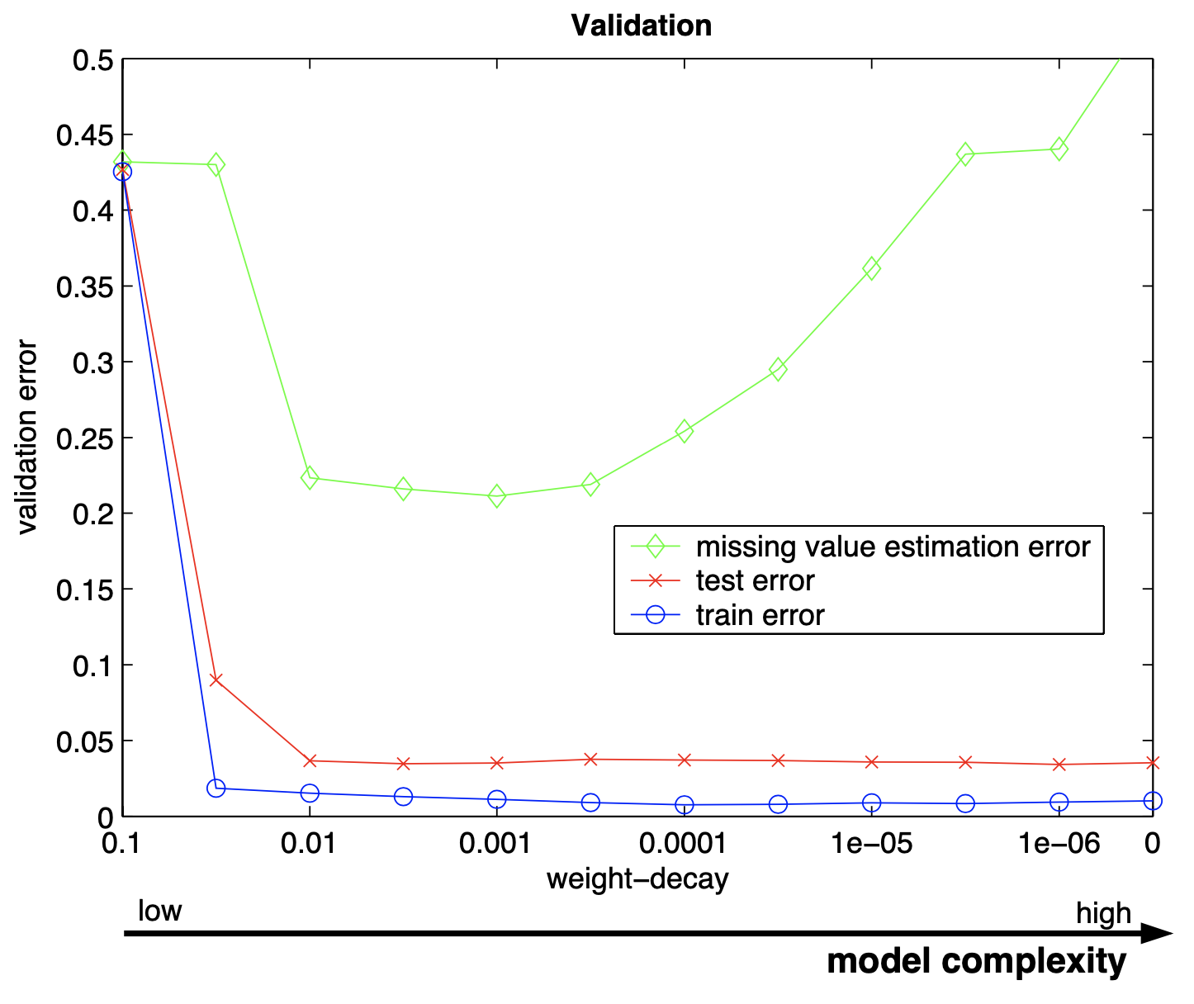
Model Selection
Notes:
Model selection. Missing data estimation is compared with standard test set validation by using the helical data set (Fig. 3). A nonlinear PCA network model of low complexity which is almost linear (left) results in a high error as expected for both the training and the test data. Only the missing data approach shows the expected increase in validation error for over-fitted models (right).

Slide 27
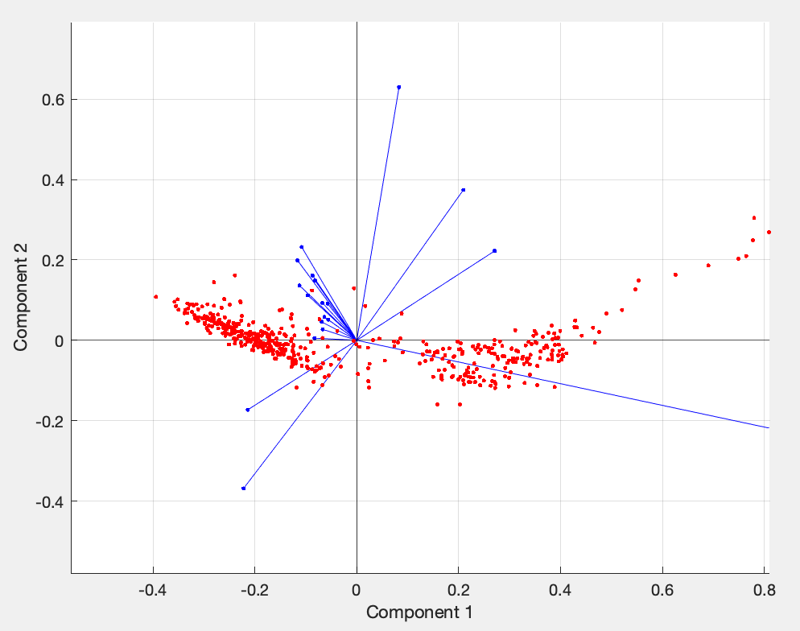
A toy example about spectral data of stars
This data has 487 observations and 19 variables with ordinary PCA
PC1 explains 88%
PC2 explains 5.5%

Slide 28
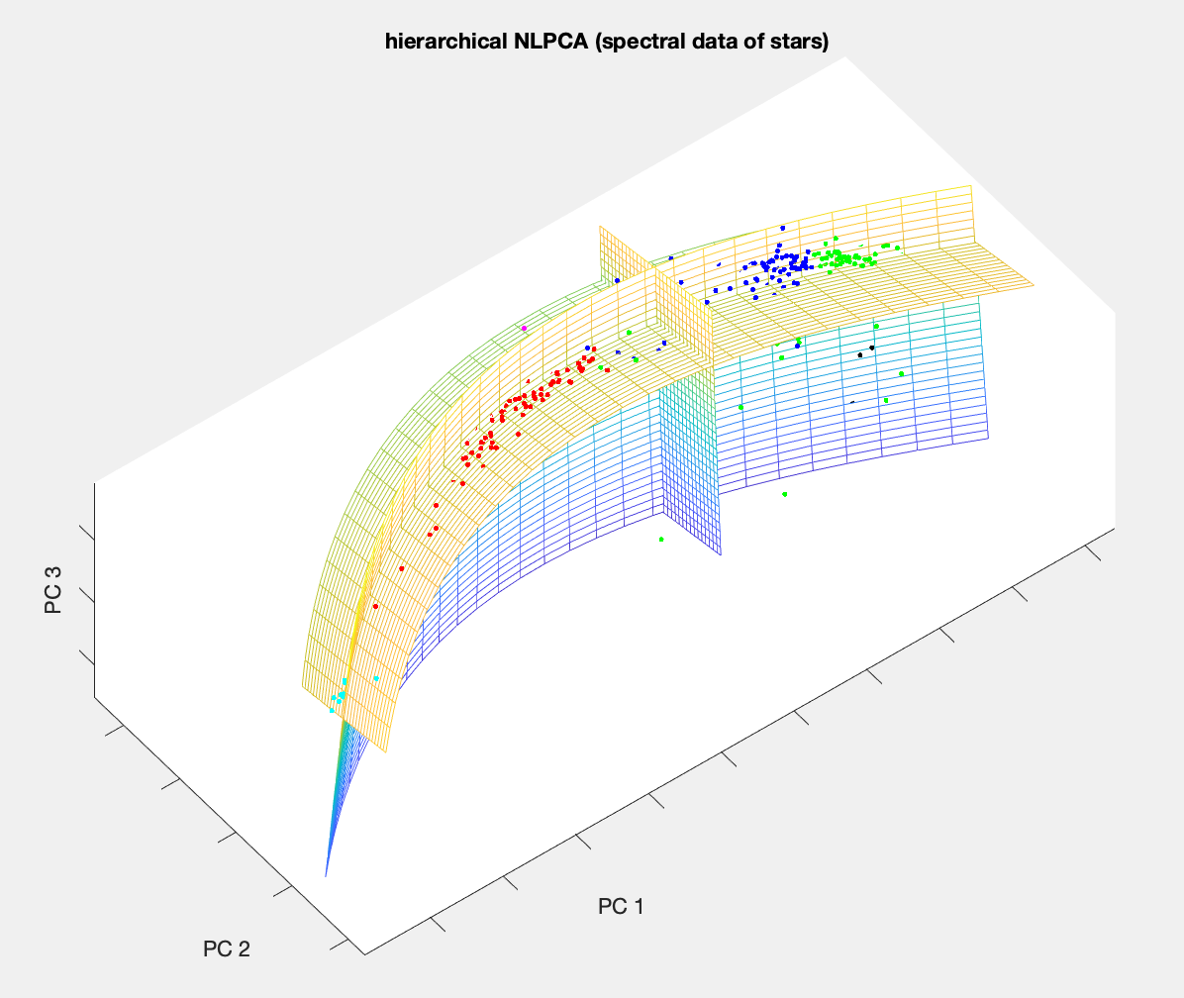
A toy example about spectral data of stars
Hierarchical NLPCA
PC1 explains 92.9%
PC2 exapins 2.2%

Slide 29
Limitations of NLPCA
It’s harder to interpret the coefficients and loadings because it is hidden neural network
NLPCA is very easy to over-fit the data, controlling the model complexity costs some efforts
Training a neural network takes longer time than ordinary PCA
It is still unable to have category variables as ordinary PCA

Slide 30
Resources and Publications
Matthias Scholz. Validation of nonlinear PCA, Doi: 10.1007/s11063-012-9220-6
https://link.springer.com/book/10.1007/978-3-540-73750-6
https://www.semanticscholar.org/paper/Nonlinear-PCA%3A-a-new-hierarchical-approach-Scholz-Vig%C3%A1rio/0ffb1e98e621ea262236bafdbd17b80c60834913
https://faq.nlpca.org/faq

Slide 31
Thanks for listening!
Questions & Answers
– Hunter and Leon

