Slide 1
Interactions between Defendants and Public Defenders in New York State
Consulting Final Project - STAT 6366
By Hunter and Léon
2023-12-04

Slide 2

Client:
Deason Criminal Justice Reform Center SMU School of Law
Dr. Caitlin Charles
Center’s new Research Specialist
Ph.D. Sociology - LSU 2023
M.A. Sociology - LSU 2020
B.A. Sociology - LSU 2017
Journal of Crime and Delinquency
Extensive original data collection, survey creation, and spatial mapping

Slide 3
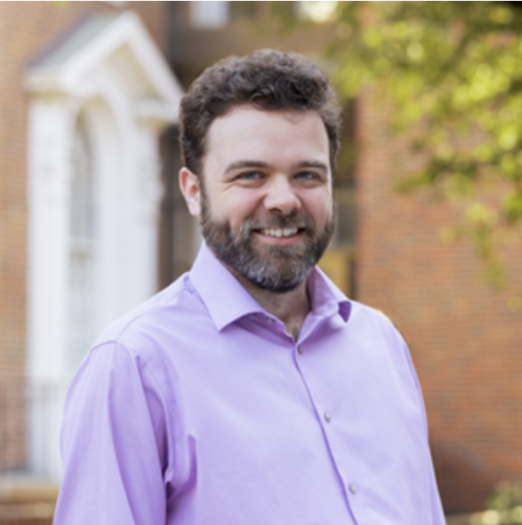
Client:
Deason Criminal Justice Reform Center SMU School of Law
Dr. Andrew Davies
Director of Research
Ph.D. Crim. Just. - SUNY Albany 2012
M.A. Crim. Just. - SUNY Albany 2006
M.Sc. Criminology - Oxford 2004
B.A. Modern History - Oxford 2002
Articles in:
Law and Society Review
Justice Quarterly
Ohio State Journal of Criminal Law
Albany Law Review

Slide 4
Data Problem
Link three different data sheets into one dataset by a shared primary key
Uncover frequency changes for purpose codes of interest over time
Separately assess the frequency changes for purpose codes of interest for felony and misdemeanor cases

Slide 5
Data Sheet Description
Case Table Query: 81256 obs, 144 vars
Event Table Query: 389030 obs, 31 vars
Name Search Query: 45139 obs, 53 vars
Data Dictionary
Purpose Code List
NYSDA Definition PDCMS
No predefined predictor variables or outcome variables.
We have to feature engineer on our own!

Slide 6
Final Deliverables
Complete dataset that links all three data sheets
Descriptive statistics including tables, graphs, and charts
All code for cleaning and analysis of data
Brief and simple method, results, and interpretations
The clients explicitly stated descriptive statistics were what they wanted and that models were not necessary.
However, to have a complete analysis and for project grade purposes, we still built some simple models.

Slide 7
Client Meeting and Interactions
Date | Agenda
10.6 | Initial Zoom Meeting
10.6-10.13 | Complete IRB certificate
10.13 | 2nd Zoom Meeting
10.31 | Access all data
11.26 | Email clients initial findings
11.27 | 3rd client responds to our findings
11.29 | Final Zoom Meeting

Slide 8
Full Join all three dataset
We used R with tidyverse to link all three dataset by the shared primary key:
cas_File_Number = evt_File_Number
cas_ClientID = nam_NameID
The complete linked dataset has:
392625 rows
213 columns
772.1MB
Case ID | Open Date | Closed Date | Case Purpose | Case Type
1 | 2019-01-01 | 2020-01-01 | Client Contact | Felony
1 | 2019-01-01 | 2020-01-01 | Sentence | Felony

Slide 9
Purpose Codes of Interest
Purpose | Description
CLCT | Client Contact
CLMT | Client Meeting
DISP | Disposition
EXPR | Expert Retained
INTR | Interpreter Retained
INVR | Investigator Retained
INTS | Initial Text Sent
DSC | Discovery
PH | Preliminary Hearing
PTH | Pre-Trial Hearing
PTC | Pre-Trial Conference
SENT | Sentence
ROW | Return on Warrant

Slide 10
Case Types of Interest
Detailed Case Type | Grouped Case Type
MISDEMEANOR | MISDEMEANOR
FELONY | FELONY
NVFO | FELONY
VFO | FELONY
Date Scope: 2008-2022
(Few cases and events before 2010)

Slide 11
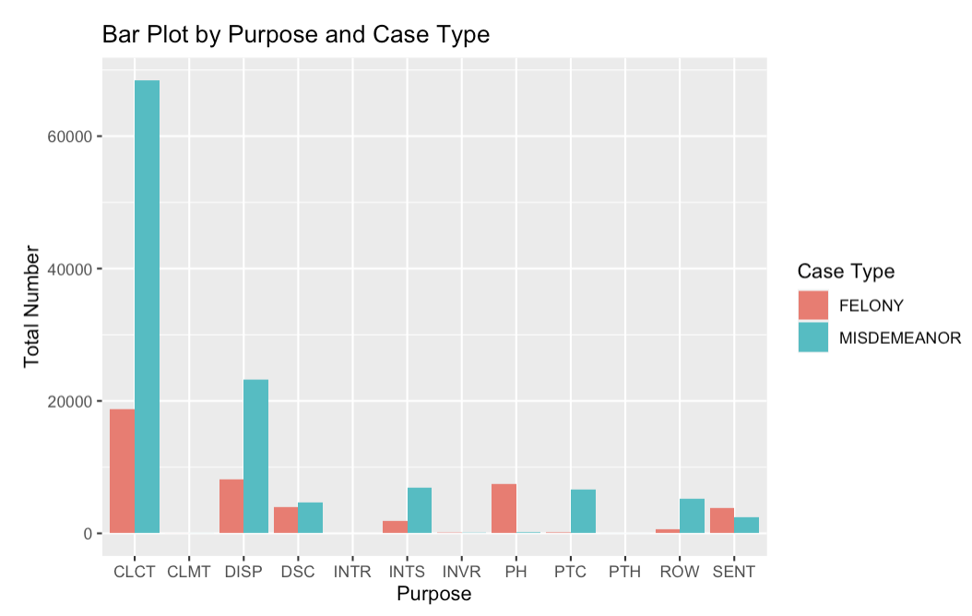
Sum of events by Purpose and Case Type

Slide 12
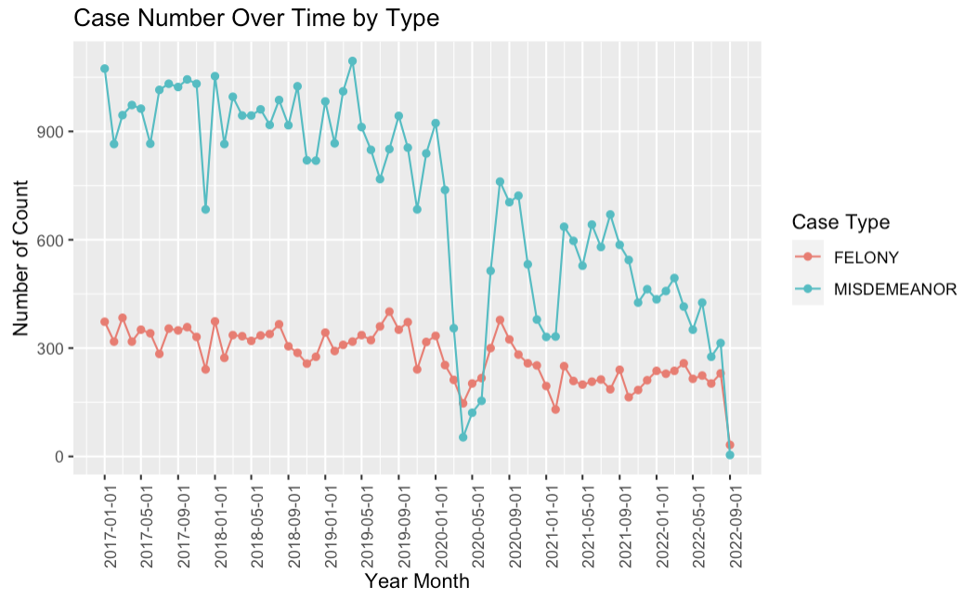
How many cases by Type from 2010-2022

Slide 13
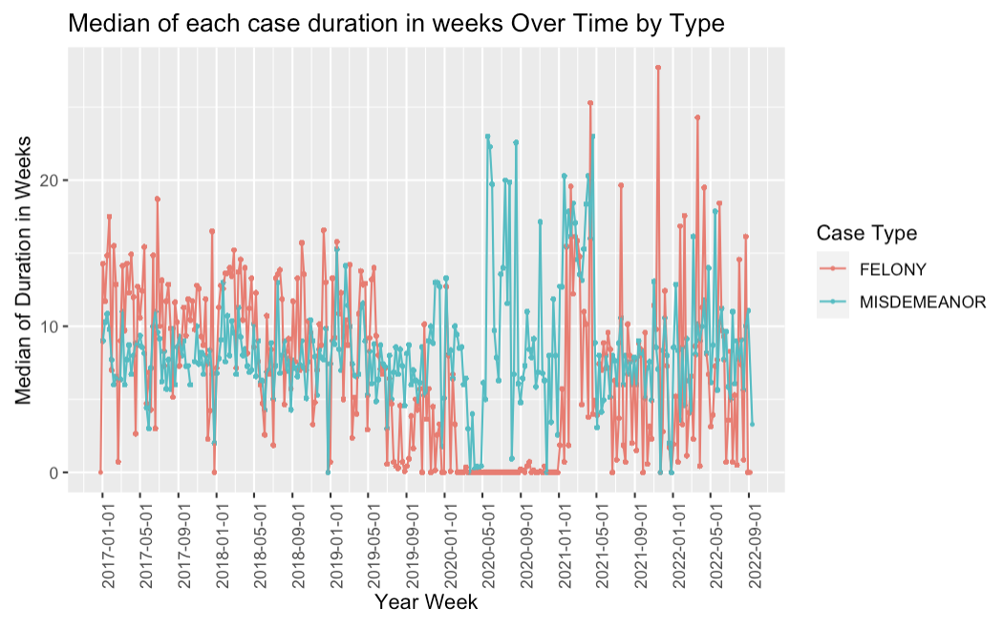
Median of each case duration in weeks Over Time by Type

Slide 14
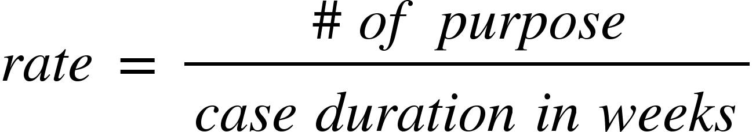
Defining frequency/rate of purpose codes per case
There are many ways to define frequency.
We have two ways to define:
Simply sum up all events of all cases closed at each date
Account for each case duration:
Calculate the median of such rates across all cases closed at each date

Slide 15
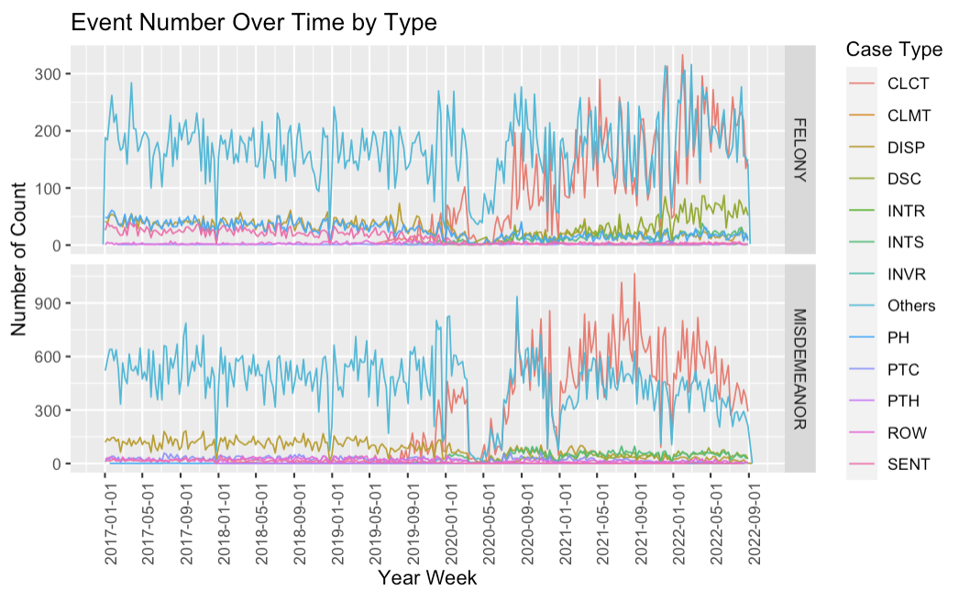
Sum up all events of all cases closed at each week

Slide 16
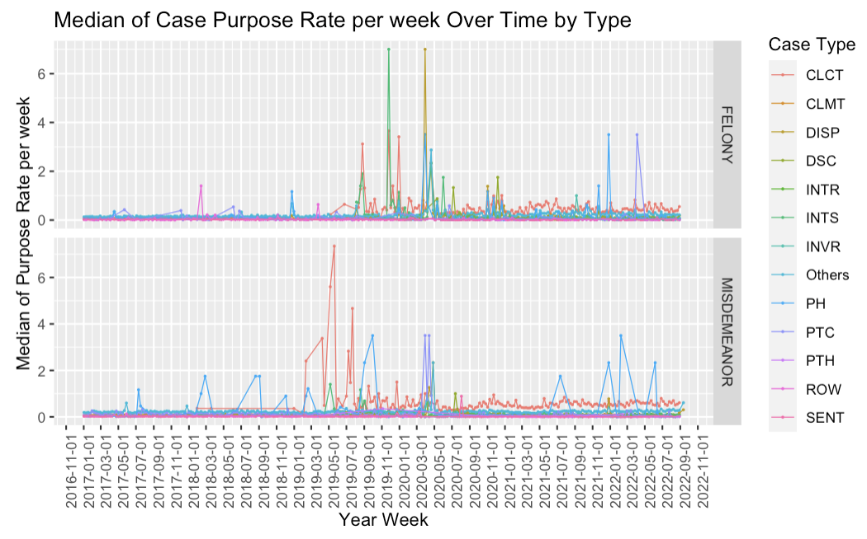
Median of Case Purpose Rate per week Over Time by Type

Slide 17
Time Series Modeling
The goal of this project is to assess the frequency changes of purposes over time by case type.
There are many ways to model such goal with different time series models.
We first model the median of all cases events as the outcome variables.
Then we model the rate (median of average events per case per week) as the outcome.
In presentation, we only showed models for one purpose under one case type.

Slide 18
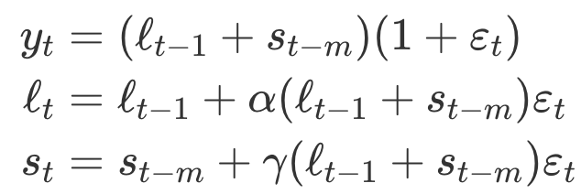
Exponential smoothing state space model
We found that Client Contact under misdemeanors has the most events and most fluctuations as compared to other purposes.
The date scope is from 2019 to 2022. Each analysis unit is one week.
We used previous observed values to impute only a few less than 10 missing observations.
After comparing the AICc, we chose seasonal period equal to 2.
The optimal model specification is multiplicative error, additive season without trend. ETS(M, N, A):
Alpha = 0.159
Gamma = 0.014
Sigma^2 = 0.144
AICc = 1272
m = 2

Slide 19
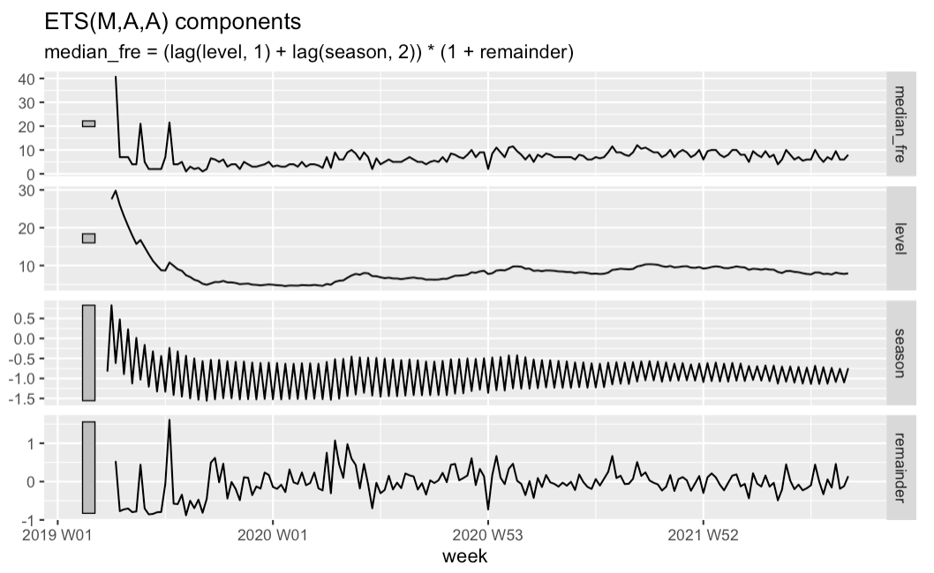
Model Decomposition
Frequency declined from the beginning of 2019 to the middle of 2019.
The median of frequency is very stable around 8 events per week after decline.

Slide 20
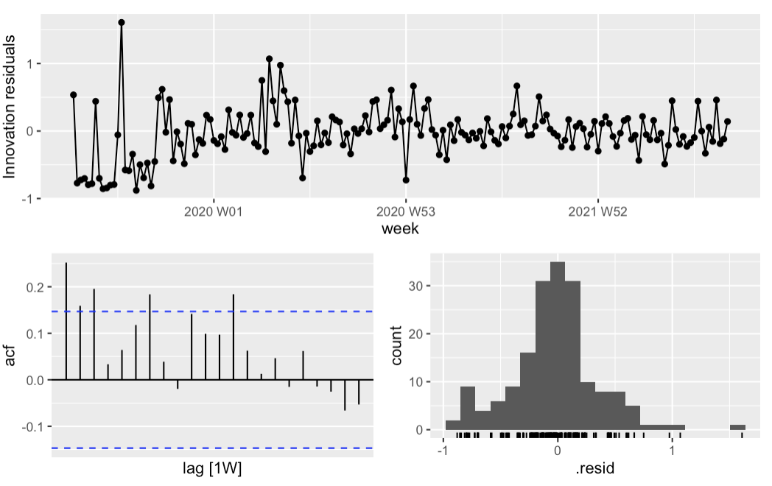
Model Diagnostics
The residuals from this model have high autocorrelations.
The residuals also does not show stationary thorough time.
The ljung_box statistical test shows very low p-value.
Overall, this model slightly violates the white noise assumption.

Slide 21
Poisson Time Series Regression
ETS model does not take case durations into consideration.
ETS model’s white noise assumption is slightly violated.
The outcome frequency of events are discrete.
We used the median of frequency as outcome to avoid the zero-inflated poisson distribution.
Week and case durations are two predictors.

Slide 22
Model Estimation
Coefficients | Estimation | Std. Error | Z Value | Pr(>|z|)
Intercept | -2.55 | 1.61 | -1.58 | 0.11
week | 0.00024 | 0.00009 | 2.56 | 0.01
median_diff | 0.019 | 0.0045 | 4.33 | 0.000014
Dispersion parameter for poisson family is 1.
AIC: 921.4
Take exponential algorithm on such coefficients:
If week increases by 1, the expected events/week multiples a factor 1, which means there is no changes at all.
If median_diff increases by 1, the expected events/week multiples a factor 1.019, which means there is only slightly increases.

Slide 23
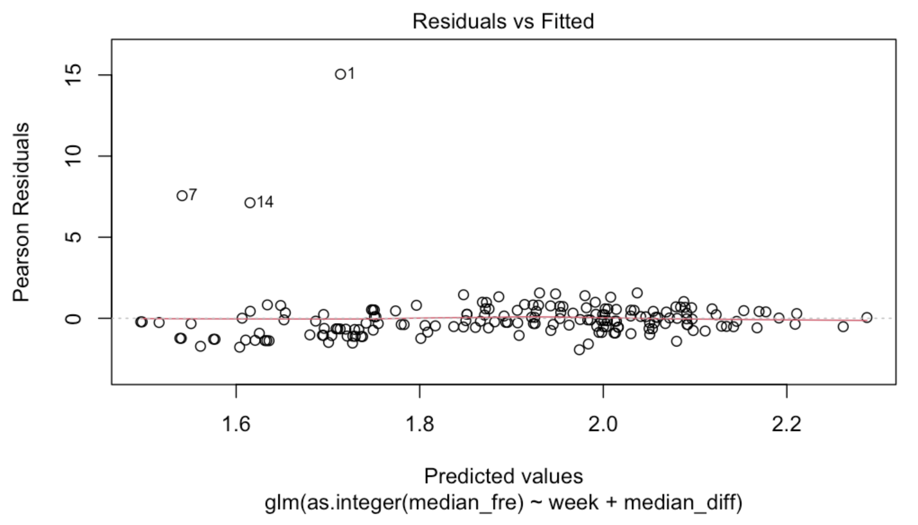
Model Diagnostics
Pearson Residuals plots shows most residuals spread around red line equally.
There is no overdispersion issues here.
Poisson time series regression model performs quite well.
The previous interpretation gets validated.

Slide 24
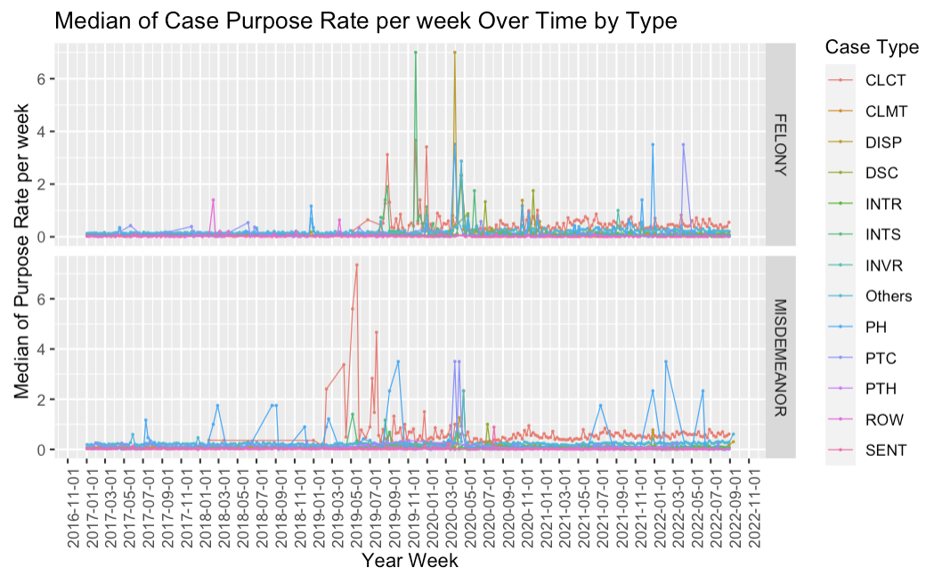
Grouped Crossed Time Series

Slide 25
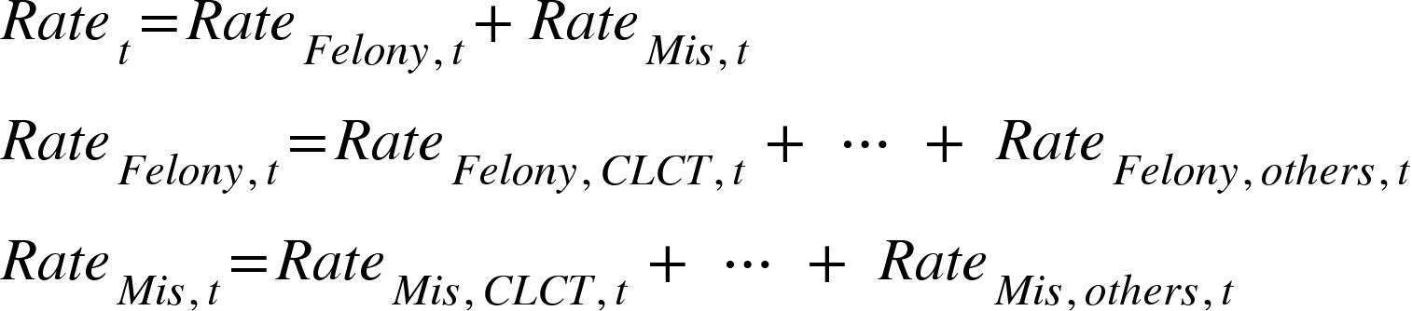
Grouped Crossed Time Series
Client Contact
FELONY
Others
Total Median Rate
Client Contact
MISDEMEANOR
Others

Slide 26
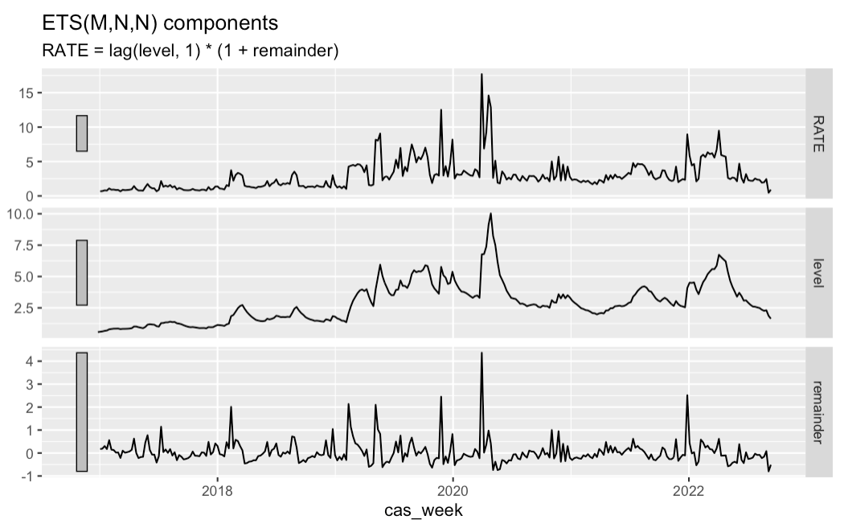
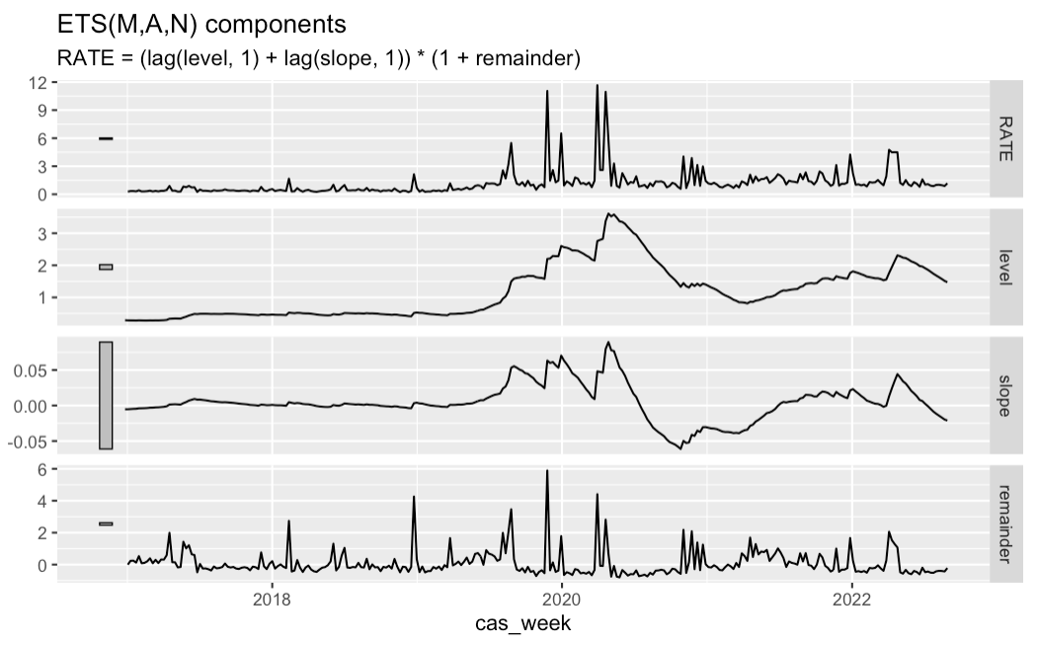
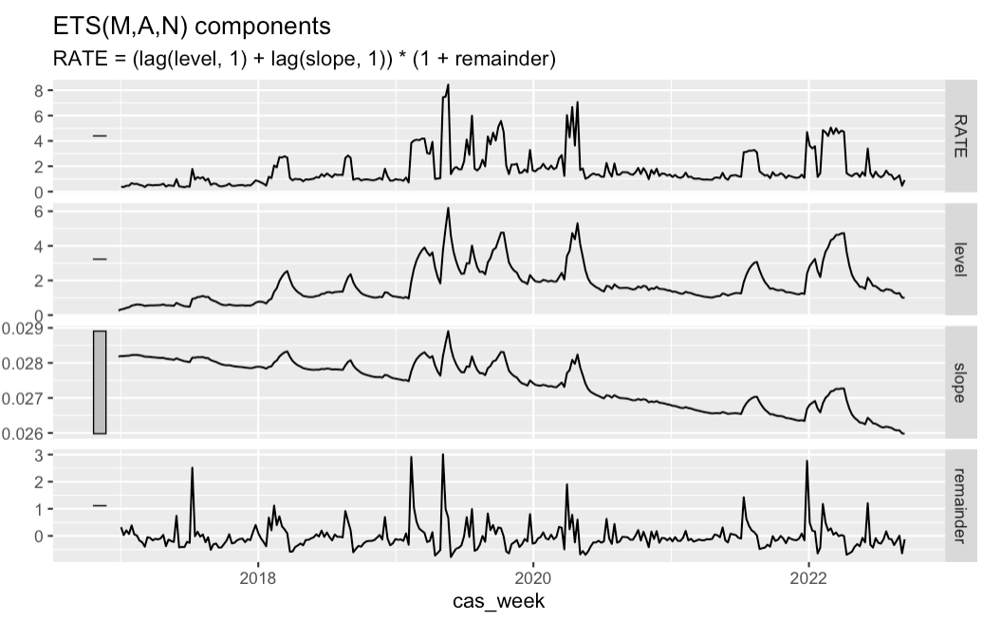
Model Decomposition
Top Level
FELONY
MISDEMEANOR

Slide 27
Grouped Crossed Time Series
When a group of time series share similar trends and under the same system, this method can pool the information across individual time series.
This method is able to reveal the hidden correlation between individual ones.
Model once from the bottom to top to avoid repeating modeling individual ones.
It is able to observe the aggregation level changes.
At individual level most rates are around less than 1 event per week on median and stable through time
Exception: Misdemeanor CLCT in 2019 has some sudden fluctuation to 7 events per week
The top level has some sudden fluctuations around 2019 but is otherwise stable and slowly increases to a median of 2 events per week.

Slide 28
Challenges
No access to the data until November
Clients only provided high-level goal and directions
Lack of regular meetings (they prefered email)
Not a well-defined problem - many possible directions
Required to feature engineer and propose a defined outcome
Many time series models to choose from and compare

Slide 29
Limitations of the analysis
We used median to calculate the frequency to avoid outliers, but this can’t represent the whole frequency distribution.
Exponential Smoothing Models slightly violate the white noise assumption which decreases the model interpretation accuracy.
Very few events prior to 2008 so they were discarded. However, they may impose minor changes to models.

Slide 30
Final recommendations for client
Overall, after taking case number and case duration, there are NOT many frequency changes in purpose codes for all case type and purposes.
Felony Case number is relatively stable after 2017, 300 cases per month.
Misdemeanor Case number is decreasing from around 900 cases per month to 400 case per month over time.
Felony Case median is 7 events per week. Misdemeanor Case median is 8 events per week.

Slide 31
7 Habits
Put First thing First:
We started with analyzing how frequency of purpose codes changed over time.
Think Win-Win:
Clients absorbed our modeling
We listened to their advice to improve our analysis by using closed date instead of open date
Be proactive:
We sent them our initial findings and then had a zoom meeting to an answer their questions

Slide 32
R Shiny App
We got permission from our clients to display aggregation level data and graphs.
We published it to R Shiny App.
https://e2jgp0-liyuan199701.shinyapps.io/law_consulting/

