Slide 1
Project Two -Geometric Data Analysis
Stat 6383
Leon Yuan
May 1st, 2025

Slide 2
Table of Contents
Research Motivation and Goal
Background Theory
Data Overview
Data Preprocessing
Shape Representation
Geodesic Distance Computation
Karcher Mean and Variance Computation
Classification of test set
Conclusion and Future Direction

Slide 3
Research Motivation and Goal
Research Motivation
Explore how the shape analysis using SRVF works in a real application
Validate the shape analysis theory
Research Goal
Measure the geodesic distance between curves
Classify the curves/images with geodesic distance and shape analysis

Slide 4
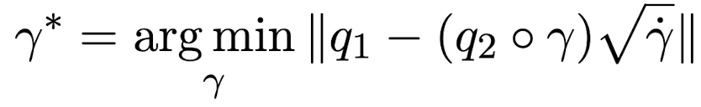
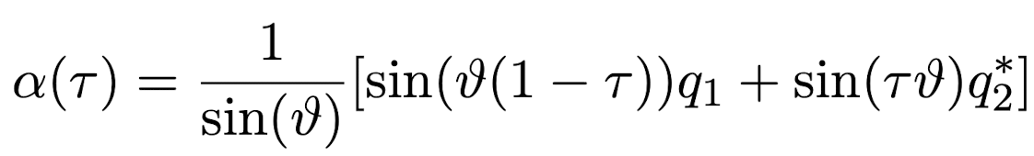
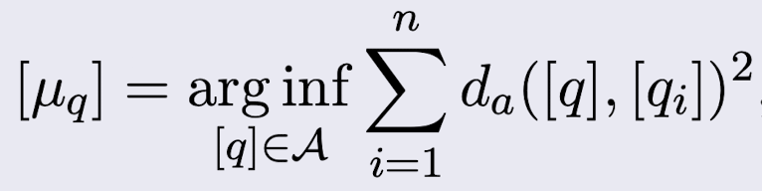
Background Theory
Statistical Shape Analysis
Represent curves as Square Root Velocity Function (SRVF)
Invariant Riemannian metric leads to an invariant distance
Registration between curves by SRVF
The registration is also separation of phase and amplitude
Geodesics of Shape Spaces
Karcher Mean

Slide 5
Data Overview
MNIST (Modified National Institute of Standards and Technology).
It’s a large dataset of handwritten digits.
It’s widely used for machine learning and image processing.
It has become a benchmark dataset for evaluating image classification algorithm.
It contains 60,000 training images and 10,000 testing images.
It has digits from 0 to 9.
Each image is 28 by 28 grayscale pixels.
Each image is labeled by the true number.

Slide 6
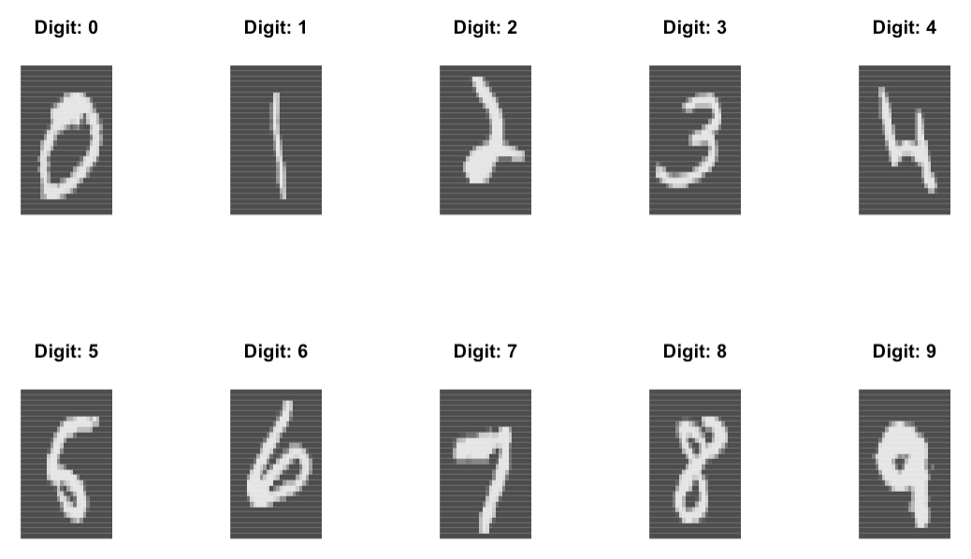
Data Example
R package “dslabs” which is a collection of dataset and functions used for data analysis practice provides the MNIST dataset.

Slide 7
Data Preprocessing
Separate images by each digit label
Binary images into 0 and 1
Extract contours from binary images
Resample points for all images for make equal points

Slide 8
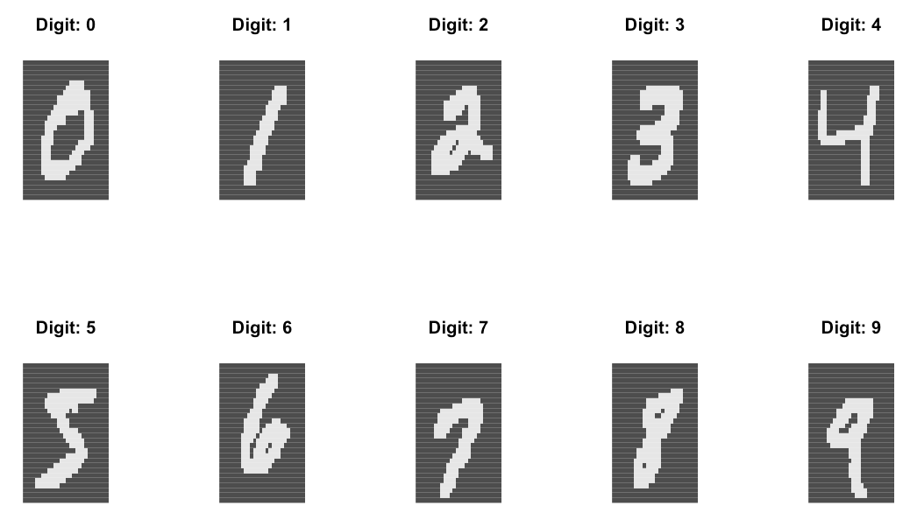
Binary Images

Slide 9
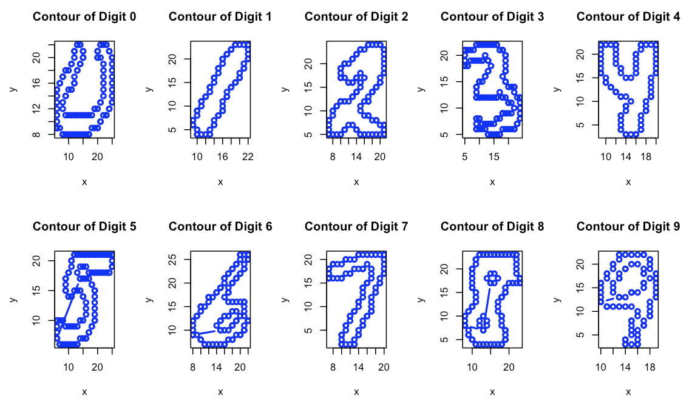
Contour Points for images
R package “imager” provides a function “contours()” to extract contour lines for images

Slide 10
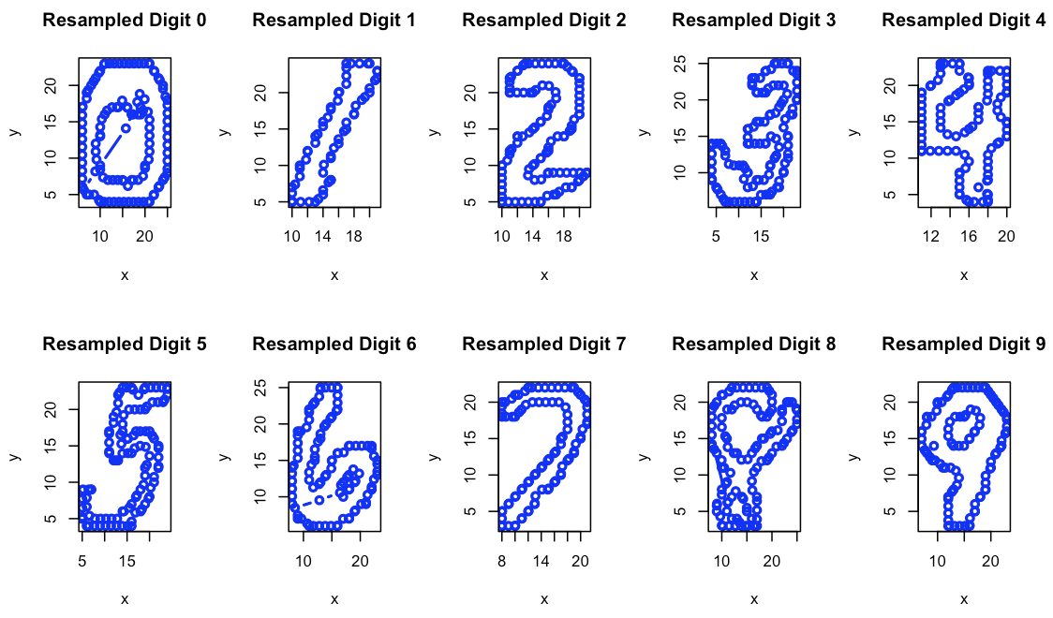
Resample Contour Points by linear interpolation
The basic R provides the function “approx()” to interpolate points linearly.

Slide 11
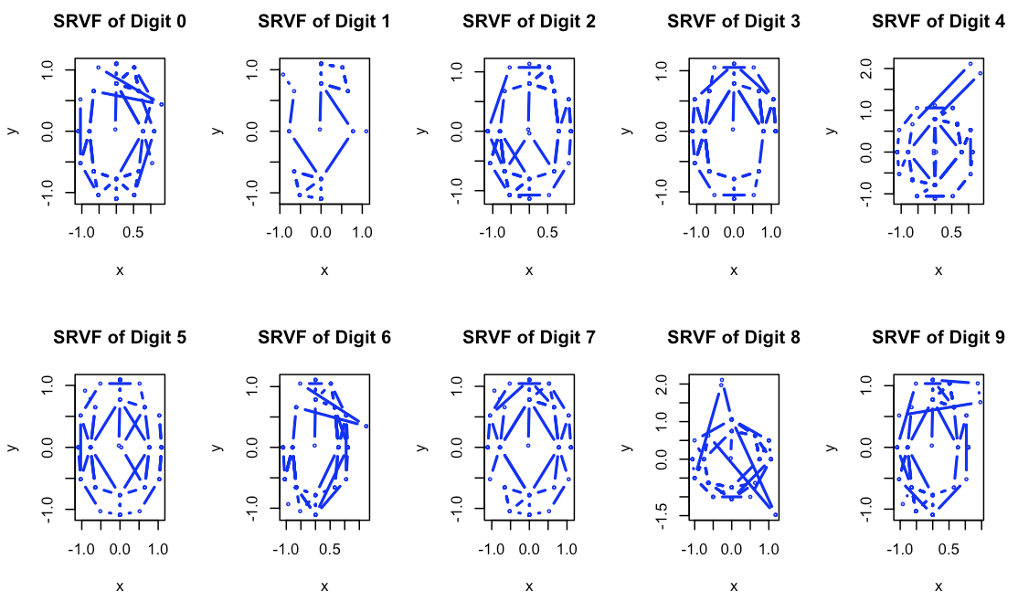
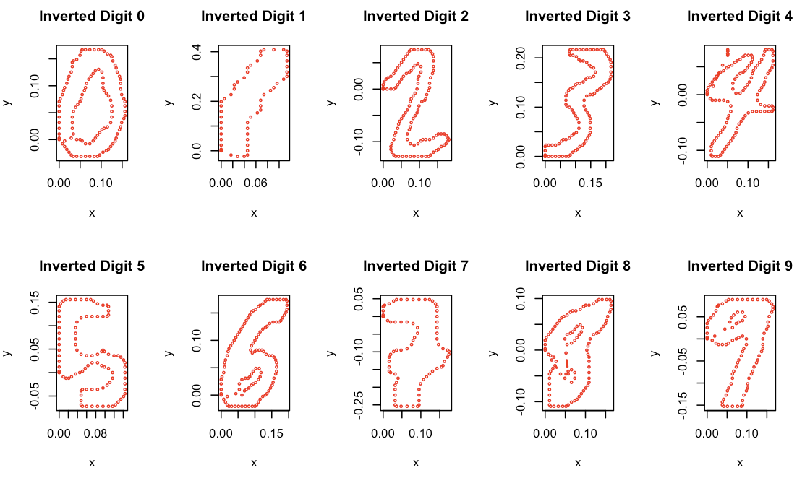
Calculate SRVF and Plot SRVF and Compare them with inverted digits

Slide 12
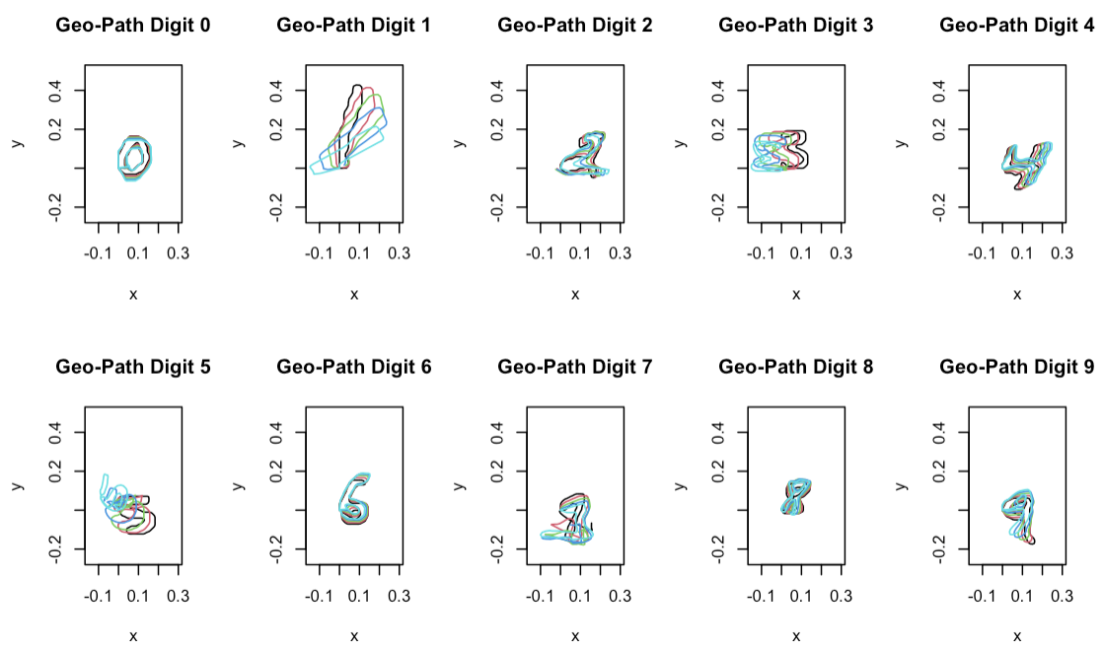
Calculate the Geodesic Path for each digit

Slide 13
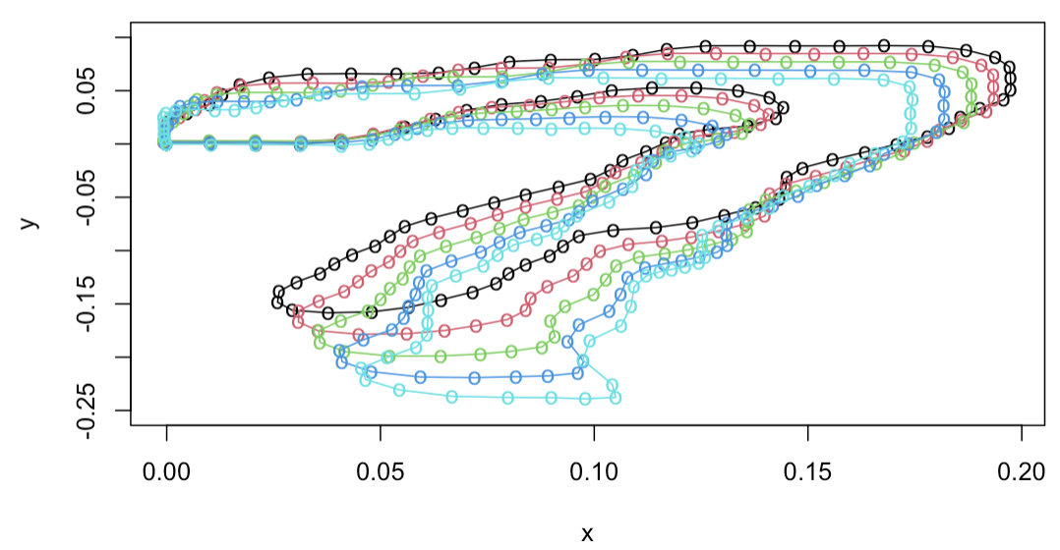
Magnify Geodesic Path for one Digit 7

Slide 14
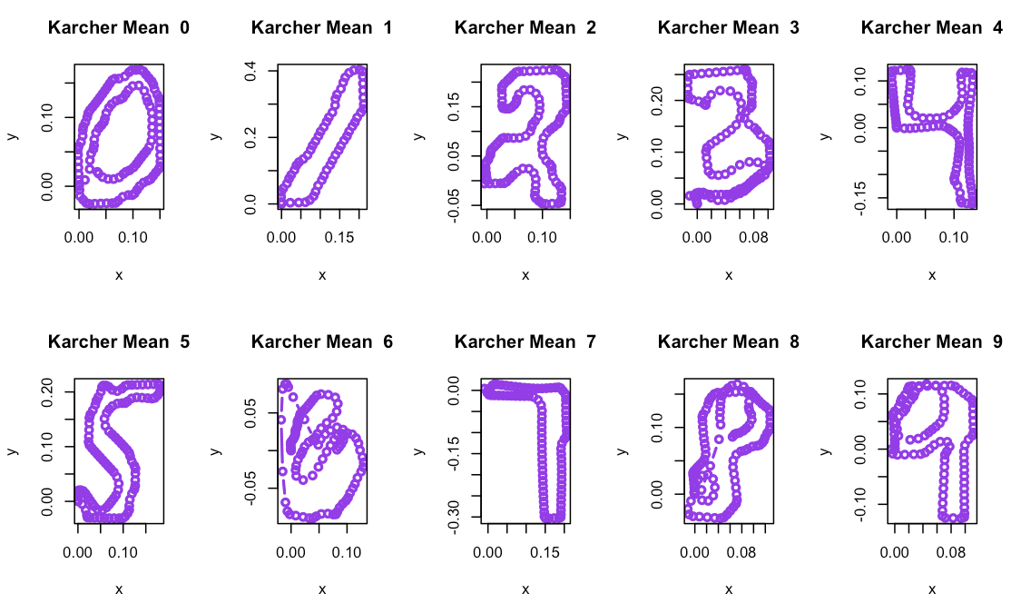
Calculate Karcher Mean for each digit

Slide 15
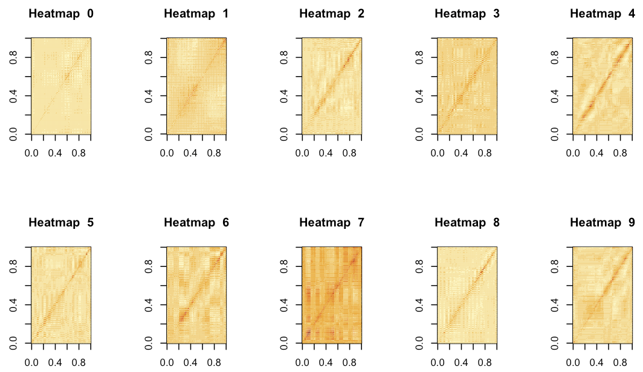
Calculate Karcher Variance for each digit

Slide 16
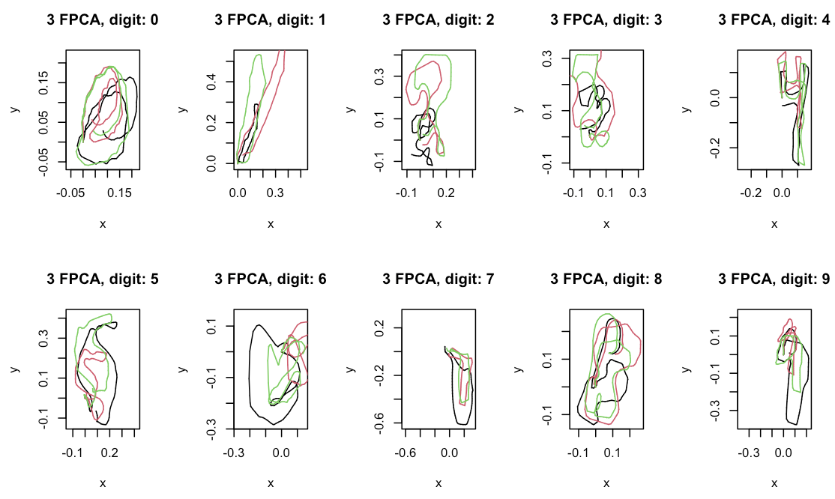
Calculate the Principal Direction for each digit

Slide 17
Classification of Test Images
Due to the very slow computation of elastic shape distance in R, only 100 test images for each digit are evaluated.
The R package future and furrr are used to build the double nested parallel processing to compute elastic distance.
In total 23 cores are used to do parallel computing.
In total 2.4 hours were took to finish computations.
Each new image is compared the elastic shape distance with 10 Karcher mean digits.
The minimum distance digit is the predicted number for this new image.

Slide 18
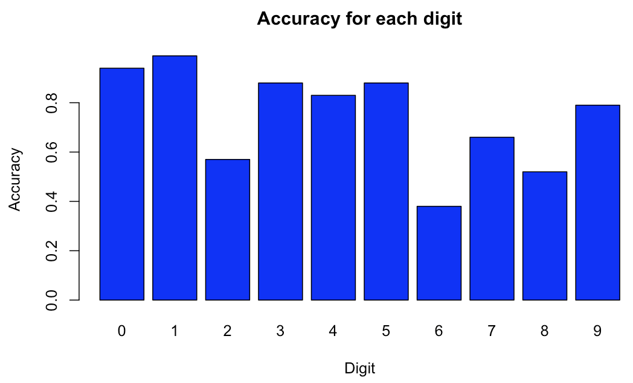
Classification Result on test set – total accuracy 74%

Slide 19
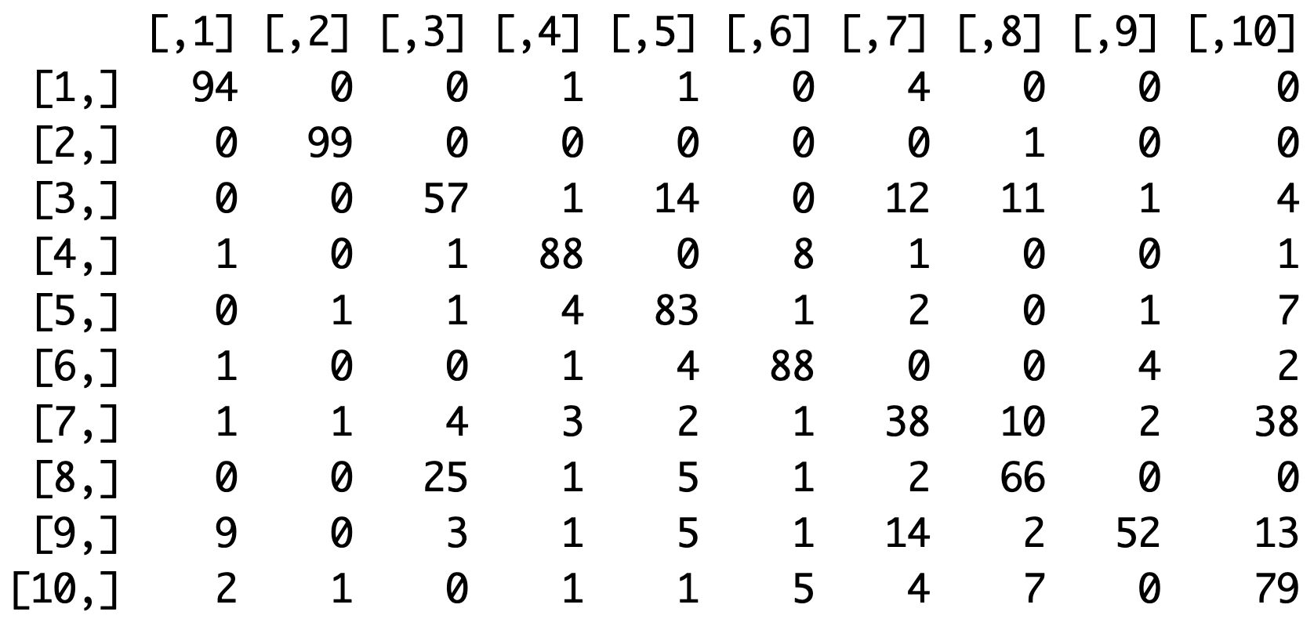
Confusion Matrix for all digits

Slide 20
Future Directions
This classification is very simple and basic way, a combing it with a machine learning method can be designed to improve the accuracy, such as KNN or SVM.
The computation time is very slow, an optimal algorithm needs to be designed to speed up.
Reduce number of resampled contour points
Further classify the training set of each digit to different subgroups to improve the Karcher mean.

Slide 21
Conclusions
Geodesic distance helps to reveal the difference between curves and measure the deformation between them.
Karcher mean can be a good representative description for each class.
However, these method is sensitive to the contour extractions.
This method is intensive computation.

Slide 22
Thanks & QA

