Slide 1
STAT 6390 Final Presentation
Leon Yuan
Dec. 9th 2024

Slide 2
Bayesian Neural Networks
The definition of BNN is a stochastic neural network trained using the Bayesian Inference.
Traditional NN can only give point estimates for weights and predictions.
Nowadays many applications needs uncertainty to make decisions.
Bayesian NN treats weights as random variables, so priors can be assigned to them.
BNN can give posterior uncertainty about predictions.

Slide 3
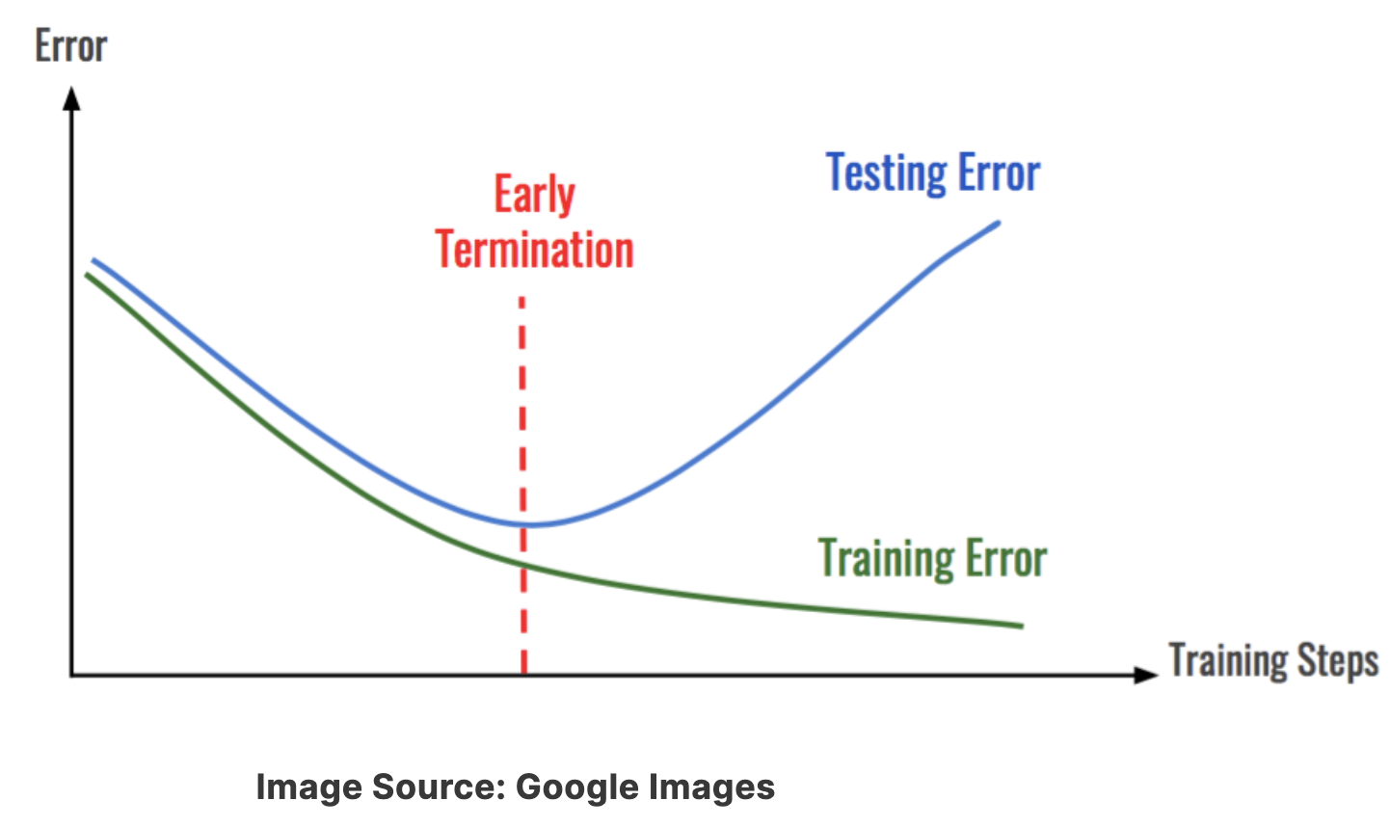
Traditional NN can easily overfit
Because of “Universal Approximation Theorem”.
“A single layer of neural network with a finite number of neurons can approximate any continuous function.”
https://www.analyticsvidhya.com/blog/2021/06/complete-guide-to-prevent-overfitting-in-neural-networks-part-2/

Slide 4
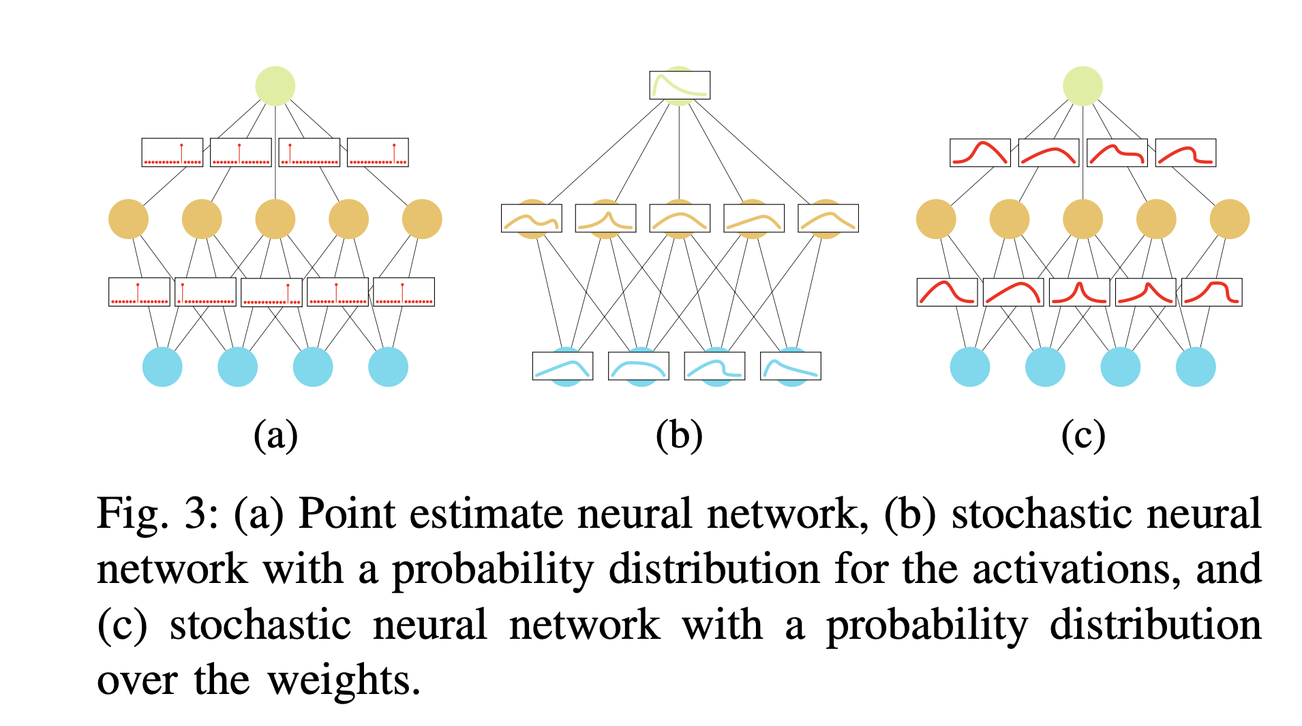
Comparisons between three types of NN
https://arxiv.org/abs/2007.06823

Slide 5
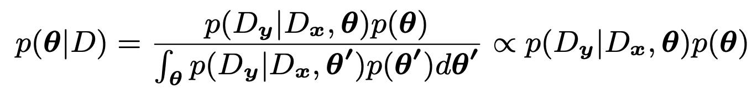
Core Bayesian formula in NN
D is the Data
theta is the weights
Dx is training data
Dy is training labels
p(theta) is the prior for weights
p(theta|D) is the posterior function
p(Dy| Dx, theta) is the likelihood function
p(D) is the marginal function of data

Slide 6
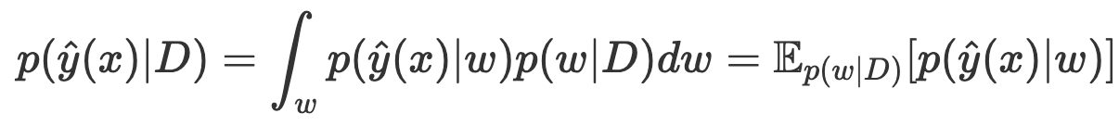
Posterior predictive function
Think BNN as an infinite collection of neural networks from the posterior.
BNN can also be an ensemble learning to improve point predictions.
The posterior prediction is the weighted average of each NN prediction.

Slide 7
The Biggest Advantage of BNN
BNN can give the uncertainty about the weights and predictions.
There are so many applications that needs uncertainty quantification such as healthcare, self-driving, finance.
BNN can make NN explainability instead of black-box.
The prior on weights naturally serves as regulation to prevent overfitting and underfitting.
BNN can also improve generalizations.
BNN is a combo of regulation and ensembling NN.

Slide 8
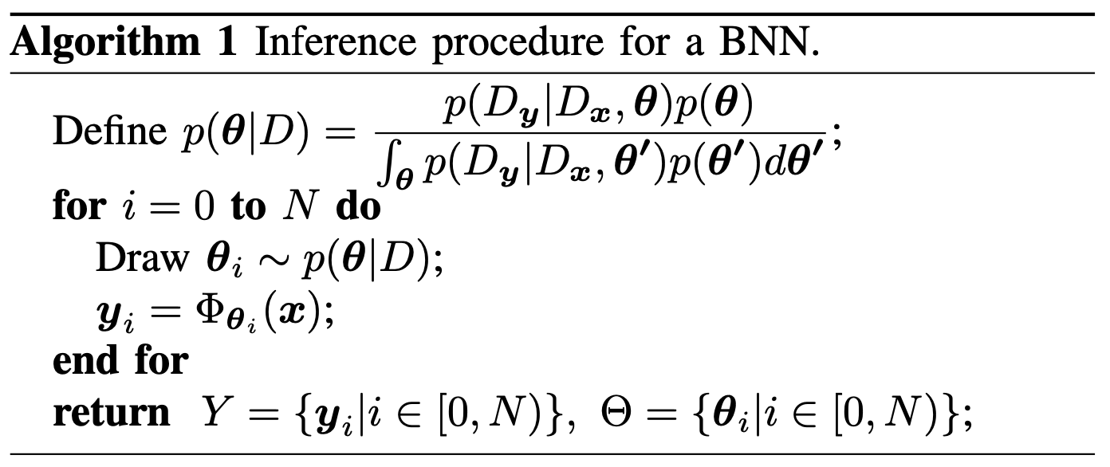
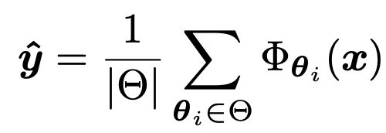
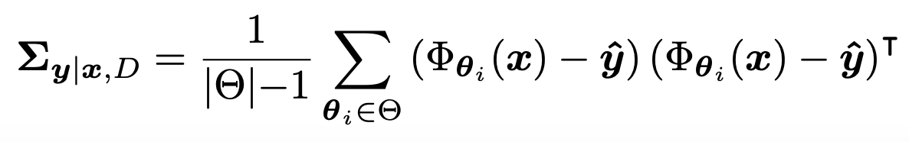
Monte Carlo Estimations for regressions

Slide 9
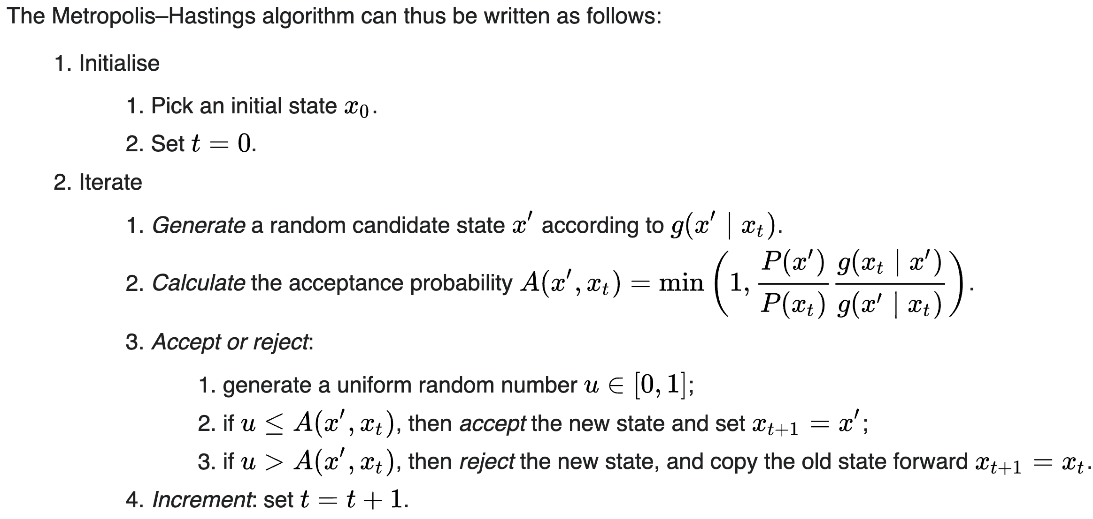
It’s very difficulty to calculate posterior distributions due to high-dimensional weights.
Sampling Methods
Monte Carlo Integration
The Metropolis-Hasting Algorithm
Variational Methods
MCMC is hard to scale up to a large data set in deep learning.
https://en.wikipedia.org/wiki/Metropolis–Hastings_algorithm

Slide 10
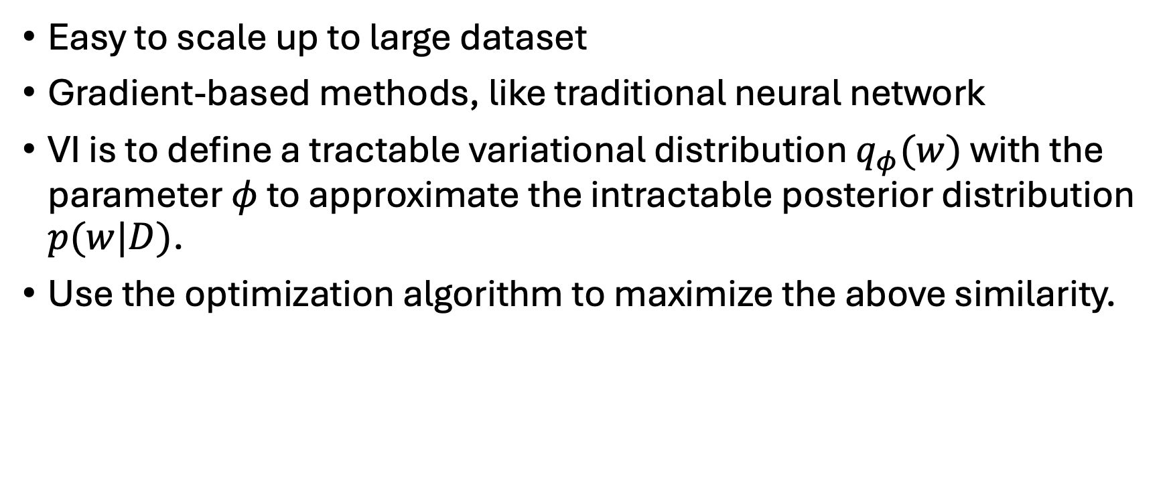
Variational Inference
Easy to scale up to large dataset
Gradient-based methods, like traditional neural network
VI is to define a tractable variational distribution $q_{φ}(w)$ with the parameter $φ$ to approximate the intractable posterior distribution $p(w|D)$.
Use the optimization algorithm to maximize the above similarity.

Slide 11
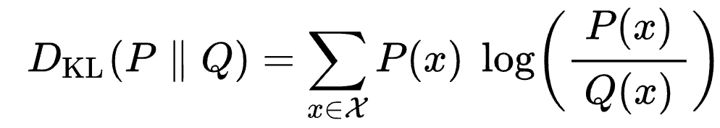
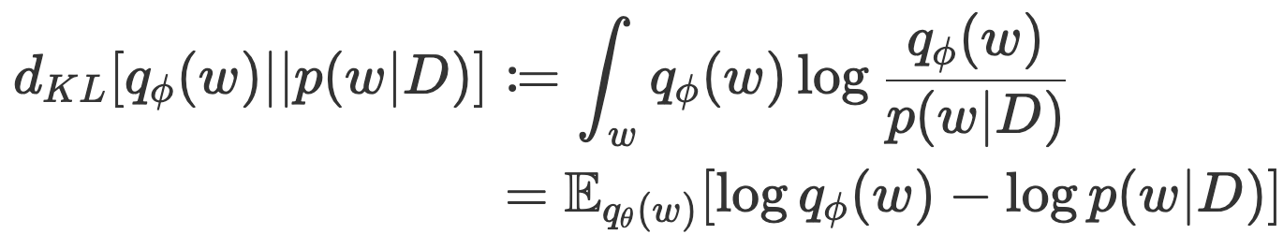
Kullback–Leibler divergence
The main idea of VI is to apply KL divergence to maximize their similarity.
KL formula from Wiki:
Apply KL to BNN:
https://en.wikipedia.org/wiki/Kullback–Leibler_divergence
https://www.cs.toronto.edu/~duvenaud/distill_bayes_net/public/

Slide 12
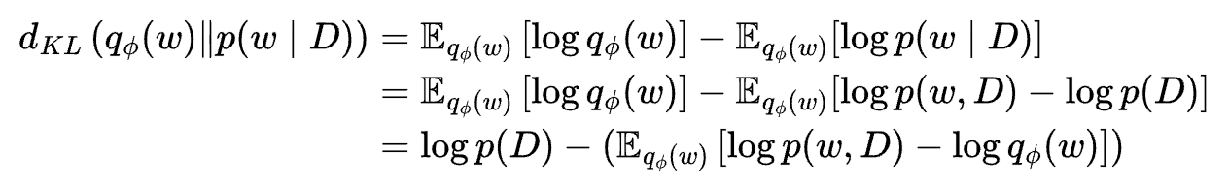
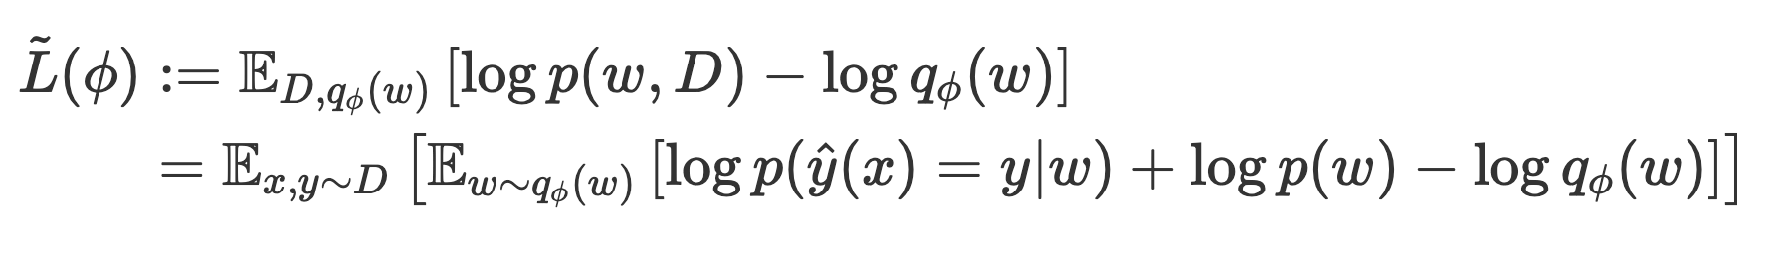

Make approximation into optimization:
Simplify the previous one:
Evidence Lower Bound (ELBO):
Maxmize w.r.t $φ$

Slide 13
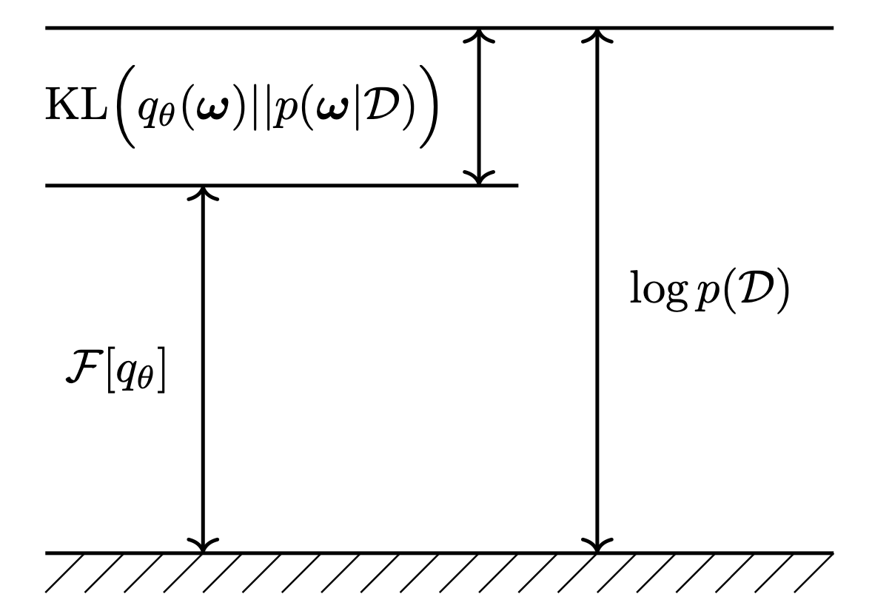
Evidence Lower Bound (ELBO)

Slide 14
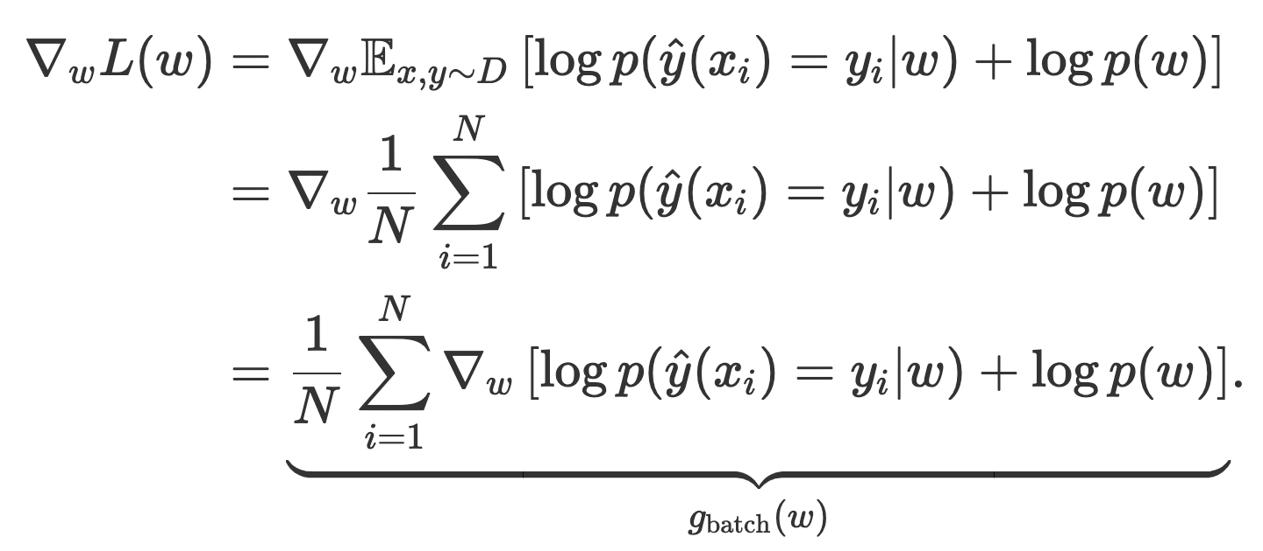
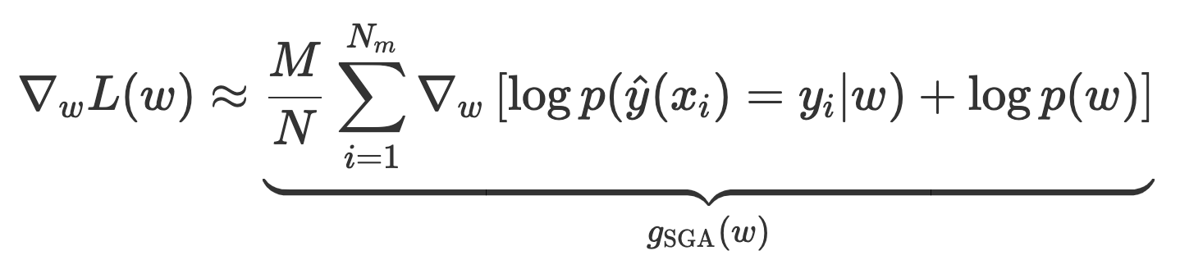
Stochastic Gradient Ascent for a normal NN
Batch Gradient Ascent:
Minibatch Gradient Ascent:

Slide 15
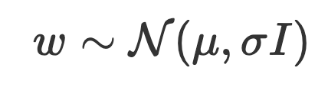

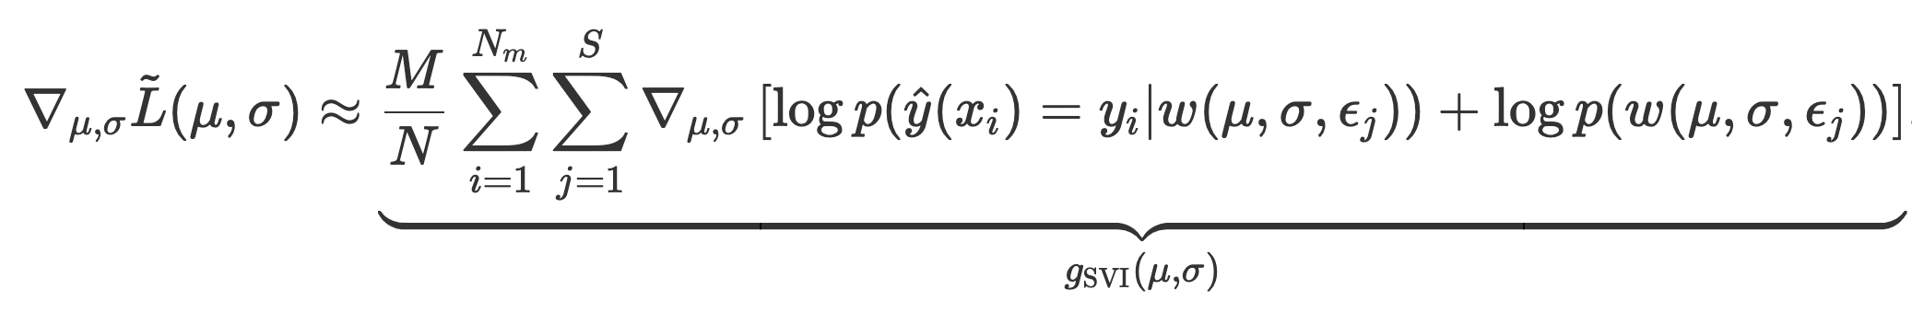
Reparameterization SGA for BNN
Maximize:
Take gradients:
Choose Normal as the prior for weights:
Re-parameter with $μ$ and $σ$ with minibatch SGA:

Slide 16
Pseudo Procedure for SVI
1:procedure SVI(x, y, w)
2:while training not converged do
3:ϵ∼N(0,I)
4:g=BACKPROP(x, y, u+ϵσ)
5:u=u + α * g
6:σ=σ + σ * g
7:end while
8:end procedure

Slide 17
Implementation for BNN
Currently R doesn’t have packages to support BNN
However, Python has well support packages to implement BNN
“Pyro is a universal probabilistic programming language (PPL) written in Python and supported by PyTorch on the backend. Pyro enables flexible and expressive deep probabilistic modeling, unifying the best of modern deep learning and Bayesian modeling.”

Slide 18
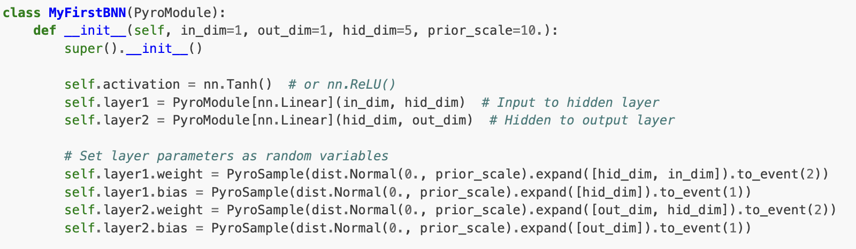
Toy Example from Pyro
https://uvadlc-notebooks.readthedocs.io/en/latest/tutorial_notebooks/DL2/Bayesian_Neural_Networks/dl2_bnn_tut1_students_with_answers.html

Slide 19
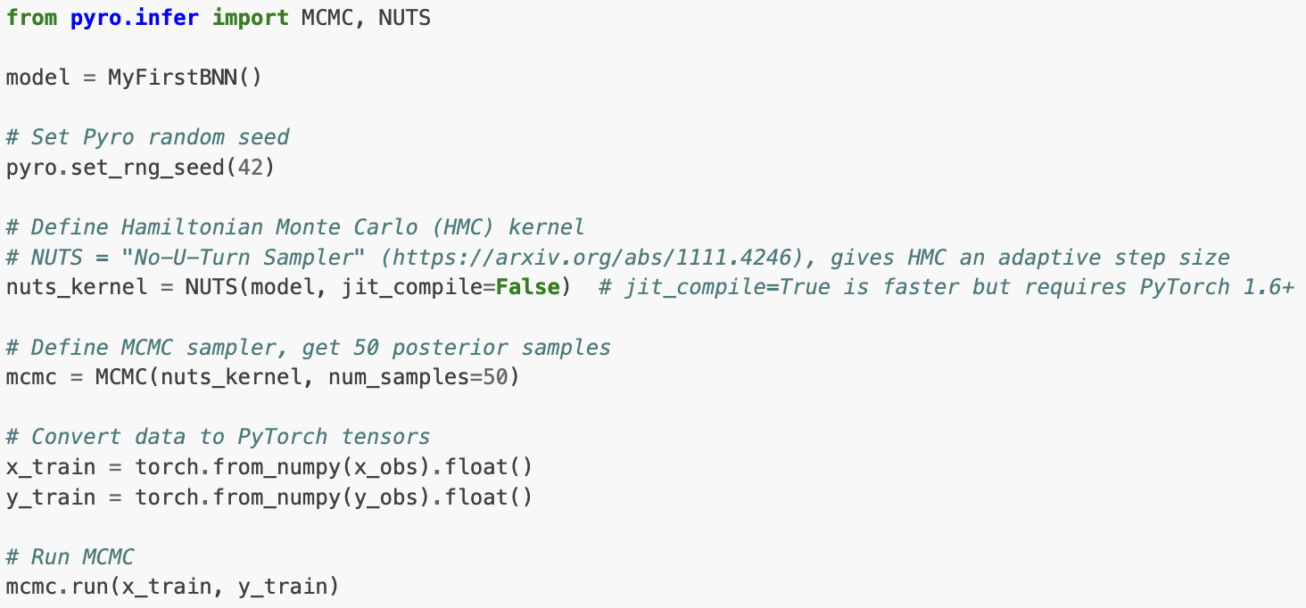
MCMC sampler for BNN
https://uvadlc-notebooks.readthedocs.io/en/latest/tutorial_notebooks/DL2/Bayesian_Neural_Networks/dl2_bnn_tut1_students_with_answers.html

Slide 20
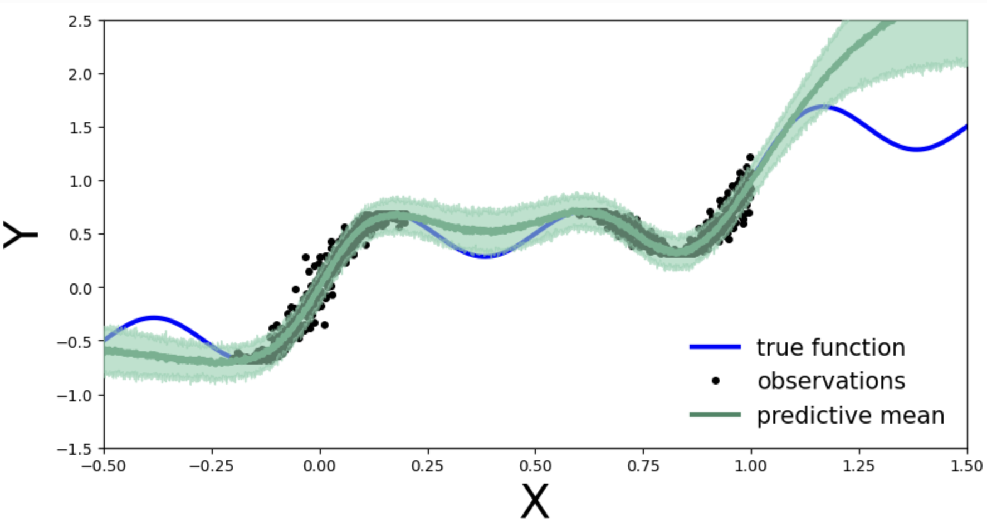
Posterior Predictions of BNN with MCMC
https://uvadlc-notebooks.readthedocs.io/en/latest/tutorial_notebooks/DL2/Bayesian_Neural_Networks/dl2_bnn_tut1_students_with_answers.html

Slide 21
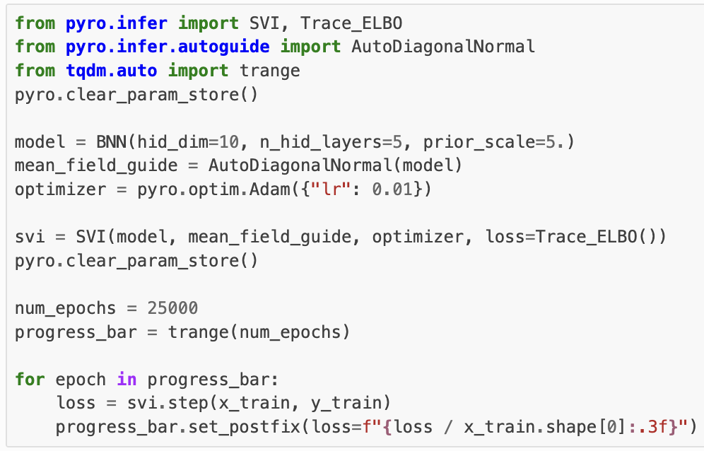
Stochastic Variance Inference
https://uvadlc-notebooks.readthedocs.io/en/latest/tutorial_notebooks/DL2/Bayesian_Neural_Networks/dl2_bnn_tut1_students_with_answers.html

Slide 22
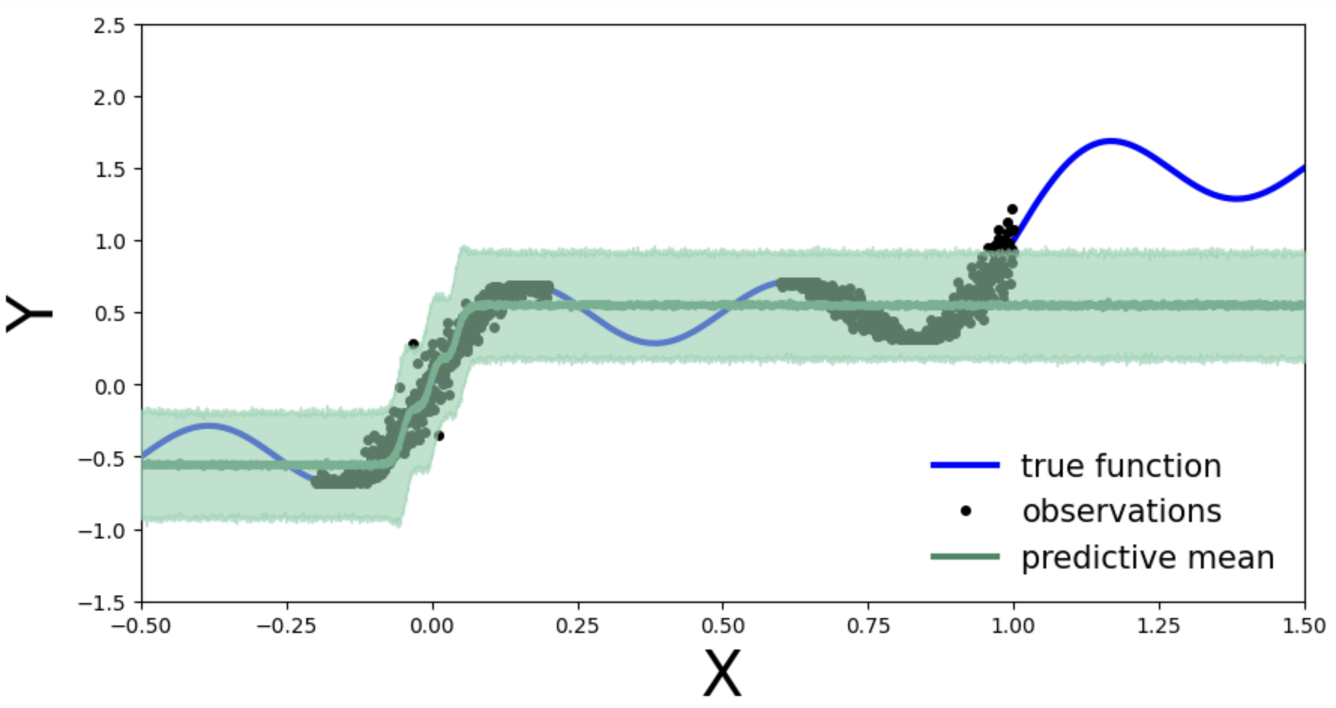
Posterior Predictions of BNN with Variance Inference
https://uvadlc-notebooks.readthedocs.io/en/latest/tutorial_notebooks/DL2/Bayesian_Neural_Networks/dl2_bnn_tut1_students_with_answers.html

Slide 23
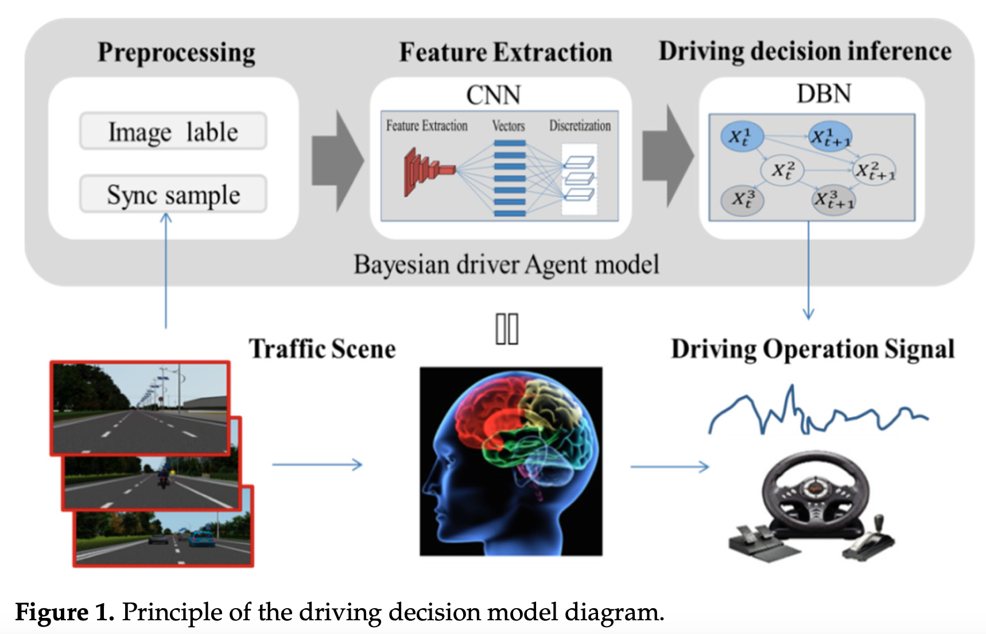
Applications of BNN
Autonomous Vehicle System
https://www.mdpi.com/1424-8220/21/2/331?utm_source=chatgpt.com

Slide 24
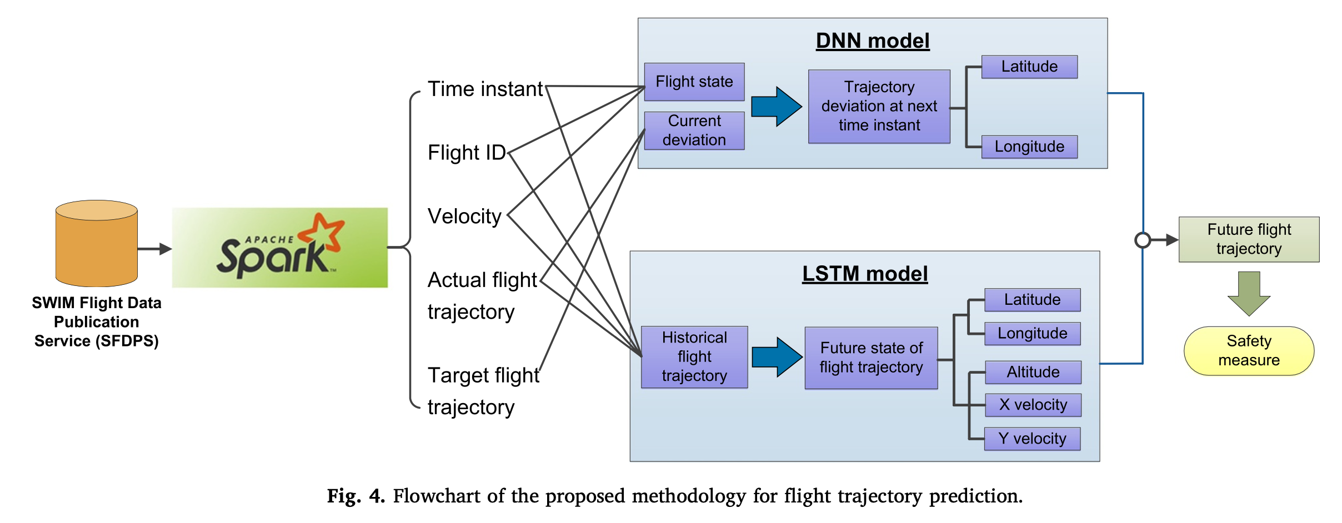
Flight Trajectory prediction with BNN
https://www.sciencedirect.com/science/article/pii/S0167923620300014

Slide 25
Reference to paper
Bayesian Neural Networks: An Introduction and Survey by Ethan Goan, Clinton Fookes
A Primer on Bayesian Neural Networks: Review and Debates by Julyan Arbel1, Konstantinos Pitas1, Mariia Vladimirova2, Vincent Fortuin3
Hands-on Bayesian Neural Networks – A Tutorial for Deep Learning Users by Laurent Valentin Jospin and so on
A Bayesian Driver Agent Model for Autonomous Vehicles System Based on Knowledge-Aware and Real-Time Data by Jichang Ma, Hui Xie, Kang Song and Hao Liu
https://www.cs.toronto.edu/~duvenaud/distill_bayes_net/public/ by Elliot Creager

