Slide 1
How to represent words? -2013: starting year of NLP with deep learning
https://arxiv.org/pdf/1310.4546.pdf
– Li Yuan

Slide 2
To perform NLP tasks, we need similarity and difference between words
We want to encode each work into a word vector that represents a point in a “word” space

Slide 3
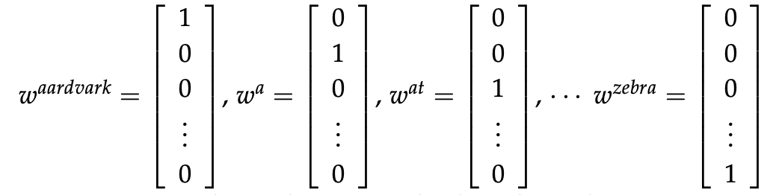
Naïve and Simplest way of word vector
Discussion topic1: What’s the problem of one-hot encoding here?
One-hot vector:

Slide 4
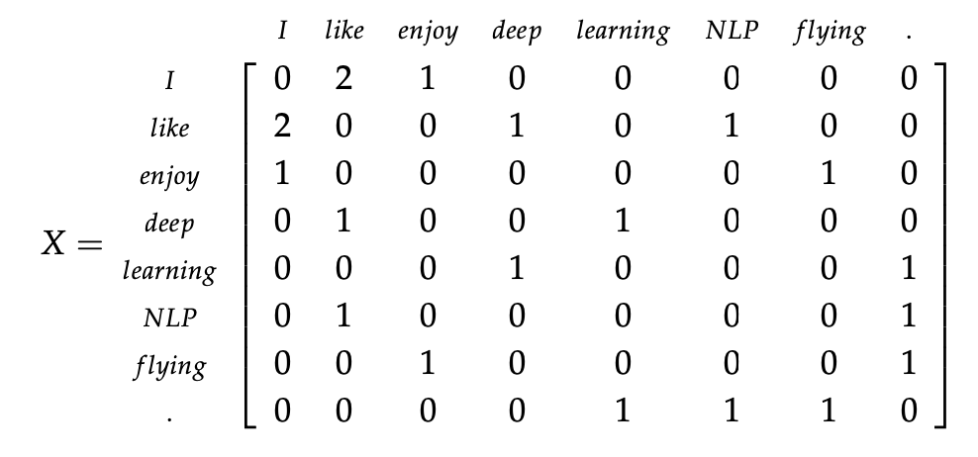
count the number of times each word appears inside a window of a particular size around the word of interest.
Window based Co-occurrence Matrix
I enjoy flying.
I like NLP.
I like deep learning.

Slide 5
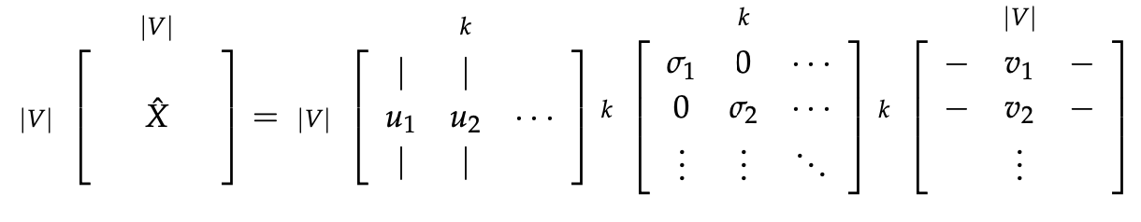
Reduce dimensionality by selecting first k singular vectors
Discussion topic2: What are issues with this method?
New words are frequently added and corpus size changes
The matrix is very sparse
The matrix is very high dimensional
Performing SVD costs a lot
Deal with imbalance in word frequency

Slide 6








Neural Network (Backpropagation) in NLP
1. continuous bag-of-words (CBOW):
The cat [jumped] over the puddle.
These two models of context of words rely on an important hypothesis in linguistic:
Distributional similarity: similarity words have similar context
2. Skip-gram:
[The cat] jumped [over the puddle.]

Slide 7
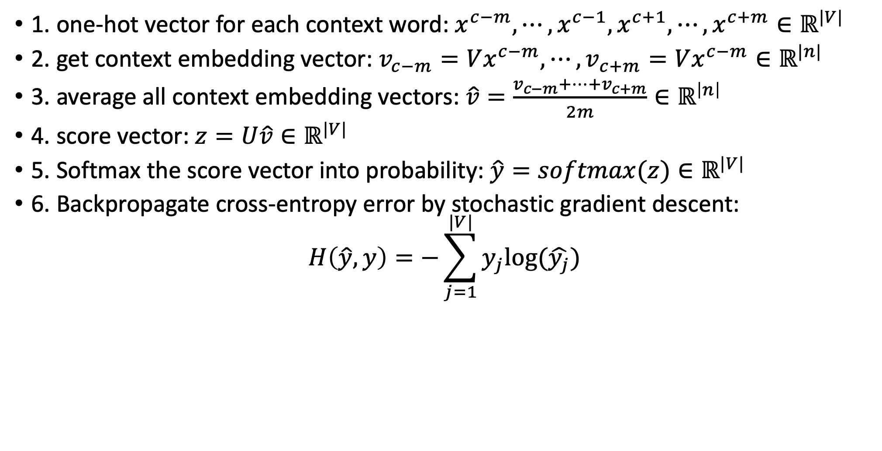
continuous bag-of-words (CBOW):
1. one-hot vector for each context word: $x^{c−m},⋯, x^{c−1}, x^{c+1}, ⋯, x^{c+m}∈ℝ^{|V|}$
2. get context embedding vector: $v_{c−m}=Vx^{c−m}, ⋯, v_{c+m}=Vx^{c−m}∈ℝ^{|n|}$
3. average all context embedding vectors: $\hat{v}=\frac{v_{c−m}+⋯+v_{c+m}}{2m}∈ℝ^{\left|n\right|}$
4. score vector: $z=U\hat{v}∈ℝ^{|V|}$
5. Softmax the score vector into probability: $\hat{y}=softmax(z)∈ℝ^{|V|}$
6. Backpropagate cross-entropy error by stochastic gradient descent:
$$H\left(\hat{y}, y\right)=−\sum_{j=1}^{|V|}{y_{j}log⁡(\hat{y_{j}})}$$
Discussion topic3: How does score vector/probability vector work in this backpropagate process? What error message does it transmit back?

Slide 8









Input layer: |V| dim
$$x^{c−m}$$
$$V_{\left|n\right|×|V|}$$
Hidden layer: n dim
Output layer: |V| dim
$$V_{\left|n\right|×|V|}$$
$$U_{\left|V\right|×|n|}$$
$$x^{c−1}$$
$$\hat{v}$$
$$\hat{y}$$
$$V_{\left|n\right|×|V|}$$
$$x^{c+m}$$

Slide 9
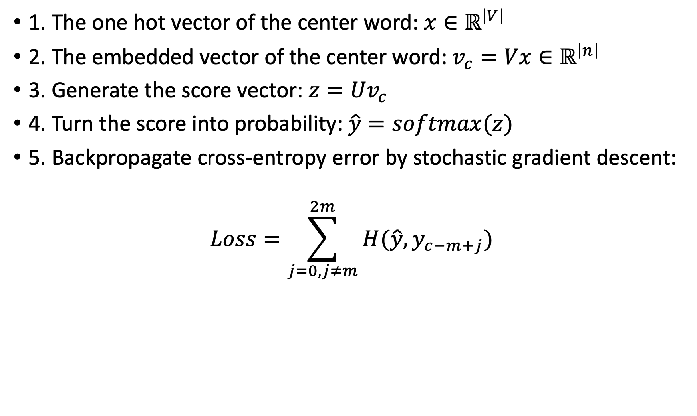
Skip-Gram Model the models computes the probability for each word of appearing in the context independently of its distance to the center word
1. The one hot vector of the center word: $x∈ℝ^{\left|V\right|}$
2. The embedded vector of the center word: $v_{c}=Vx∈ℝ^{\left|n\right|}$
3. Generate the score vector: $z=Uv_{c}$
4. Turn the score into probability: $\hat{y}=softmax(z)$
5. Backpropagate cross-entropy error by stochastic gradient descent:
$$Loss=\sum_{j=0, j≠m}^{2m}{H(\hat{y}, y_{c−m+j})}$$

Slide 10









$${\hat{y}}_{c−m}$$
Hidden layer: |n| dim
Input layer: |V| dim
$$U_{\left|n\right|×|V|}$$
Output layer: |V| dim
$$V_{\left|n\right|×|V|}$$
$${\hat{y}}_{c−1}$$
$$U_{\left|n\right|×|V|}$$
$$v_{c}$$
$$\hat{y}$$
$$U_{\left|n\right|×|V|}$$
$${\hat{y}}_{c+m}$$

Slide 11
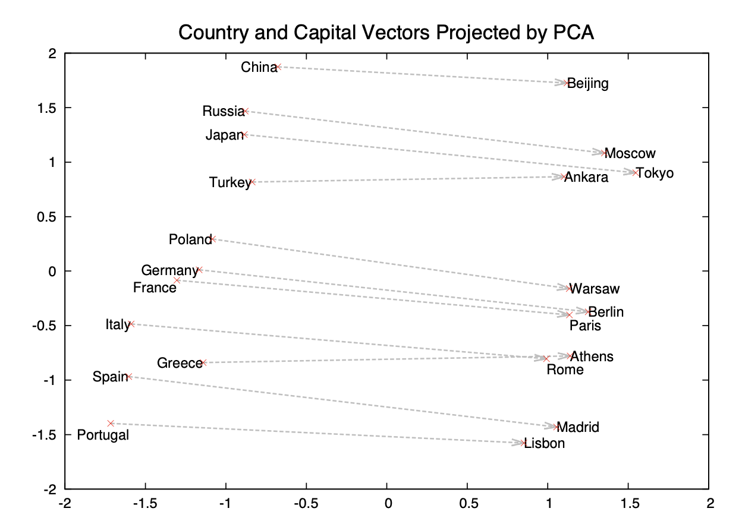
Advantages of Skip-gram model
1. Does not involve dense matrix multiplications, making training extremely efficient
2. learned vectors explicitly encode many linguistic regularities and patterns:
vec(“Madrid”) - vec(“Spain”) + vec(“France”) is closer to vec(“Paris”)
vec(“Germany”) + vec(“capital”) is close to vec(“Berlin”)

Slide 12
Critical Analysis: – What was overlooked by author?
Indifference to word order: This model doesn’t incorporate the spatial context into computations.
Good at Semantic but sometimes bad at Syntactic
– What could have been developed further?
inability to represent idiomatic phrases: Solver: phrase vector
– Disputed findings:
1. The big skip-gram model outperforms all the other models in the quality of the learned representations.

Slide 13
Resource Link
1. Original Paper link: https://arxiv.org/pdf/1310.4546.pdf
2. Efficient Estimation of Word Representations in Vector Space: https://arxiv.org/abs/1301.3781
3. GloVe: Global Vectors for Word Representation: https://nlp.stanford.edu/pubs/glove.pdf
4. A Latent Variable Model Approach to PMI-based Word Embeddings: https://arxiv.org/abs/1502.03520
5. word2vec Parameter Learning Explained: https://arxiv.org/abs/1411.2738
6. wevi: word embedding visual inspector: https://ronxin.github.io/wevi/

Slide 14
Code demonstration
https://github.com/LiYuan199701/skip_gram

Slide 15
Repo
https://github.com/LiYuan199701/skip_gram

Slide 16
Video Recoding

