Slide 1

Speed Dating Analysis
Statistical Analysis II 6337 Final Project
–– Léon Yuan

Slide 2
Introduction
From the past to now, human beings are a species in the world that most need to look for a mate or partner to live a life. In this context of human society, people name it dates. Then as more romantic emotions between mates become more robust, people name it relationships. After both mates and their aﬀiliated relatives agree on this relationship, both mates get married and form a formal social bond protected by laws designed by humans.

Slide 3
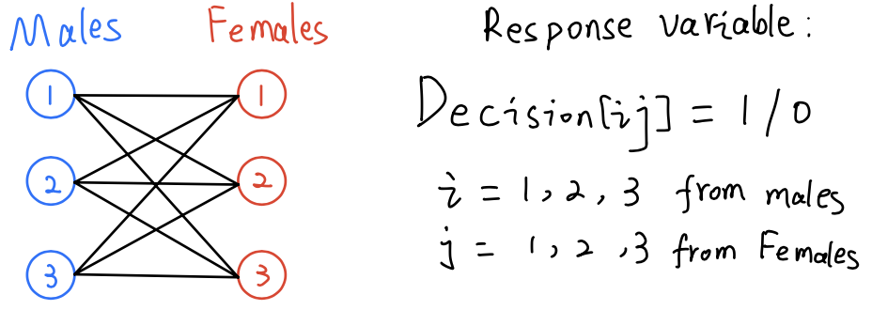
Design Experiments and Data Collection
The data were male and female subjects or graduate and professional students who studied at Columbia University from 2002 to 2004 and volunteered to participate in this social science dating study.

Slide 4
Hypothesis I want to test
Asian males are the least popular in the dating market among all races and genders, while White females are the most popular.
Females of all races prefer same-race dating more than males do.
Both males and females of all races emphasize physical attractiveness at the top.
Males emphasize physical attractiveness much more than females do.

Slide 5
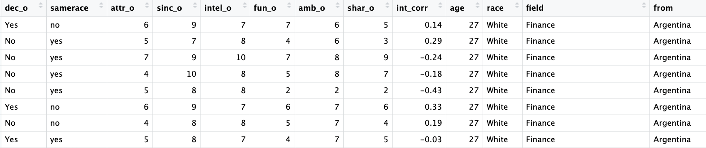
Data Description
The data set has 8378 rows and 195 variables
It contains 200 female participants and 201 male participants
The primary variables used in this analysis include decision, attractive, sincere, intelligence, fun, ambitious, shared interests, interest correlations, age, race, field, from

Slide 6
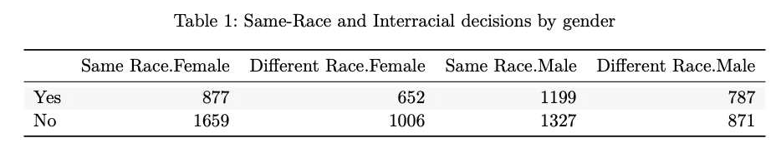
Cochran-Mantel-Haenszel Chi-Squared Test for Count Data for hypothesis two
I did some data manipulation to aggregate the same race and interracial dating results by gender
p-value is 0.0321, which is slightly less than 0.05; thus, I can tell that the odds ratio is not equal to 1 by gender. Females say more “Yes” to same-race dating compared with interracial dating than males do.

Slide 7
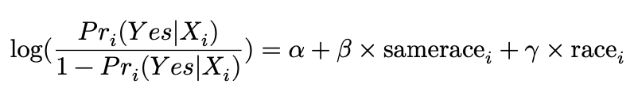
Ordinary logistic regression for hypothesis one
Asian males has the most significant p-value:0.008 in female to male mode and its coefficient is -4.89;
White females has the most significant p-value:0.09 in males to female model and its coefficient is 0.25
I conducted two logistic regressions separately for males and females. The reason I built two separate models for females and males is that there are some significant differences in dating behaviors between genders, and separate models are more accessible to interpret.
Notes:
First, I only care about how race affects females’ decisions to males, only including the samerace and race columns in this logistic classification model. From the summary of the model, we can tell that all females are likely to reject the Asian males because Asian males have a 0.008 p-value which is the most significant in this model. The log odds of saying “yes” to Asian males by all females is -0.48977 given other variables fixed, and this is a significant negative coeﬀicient meaning that Asian males are very unpopular when dating. Thus, the odd ratio of saying “yes” to Asian males is 𝑒−0.48977 = 0.6127673 which means when females date Asian males, they likely decrease 40% the probability of saying “yes” to Asian males. The opposite effect happens to white females, who only have a relatively significant p-value with a positive 0.25750 coeﬀicient. This shows white females are the most popular in the dating market.

Slide 8
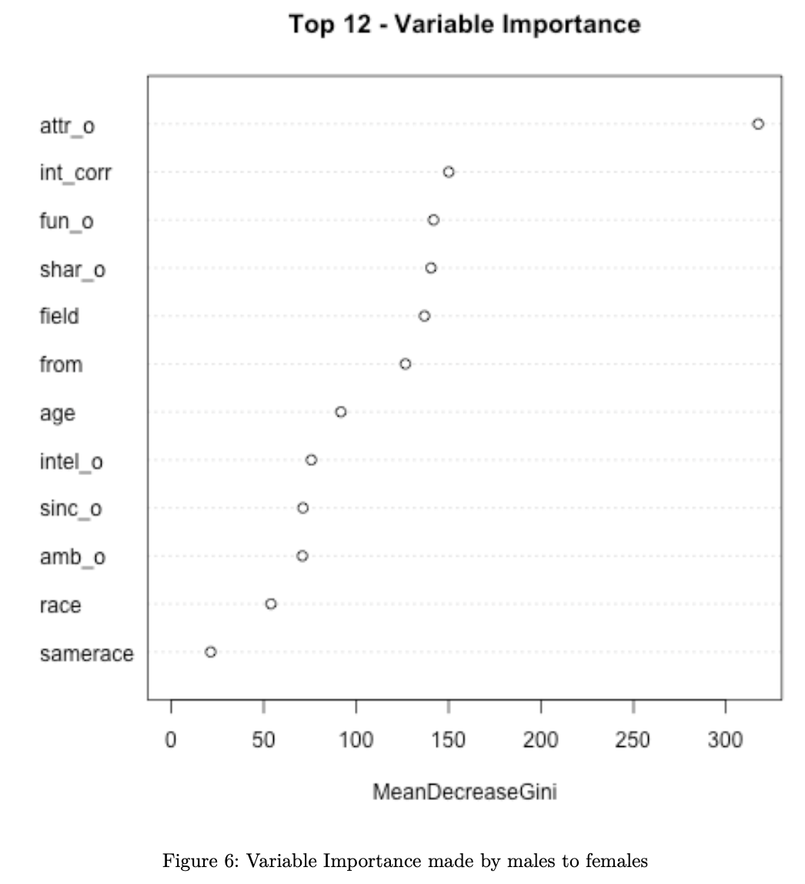
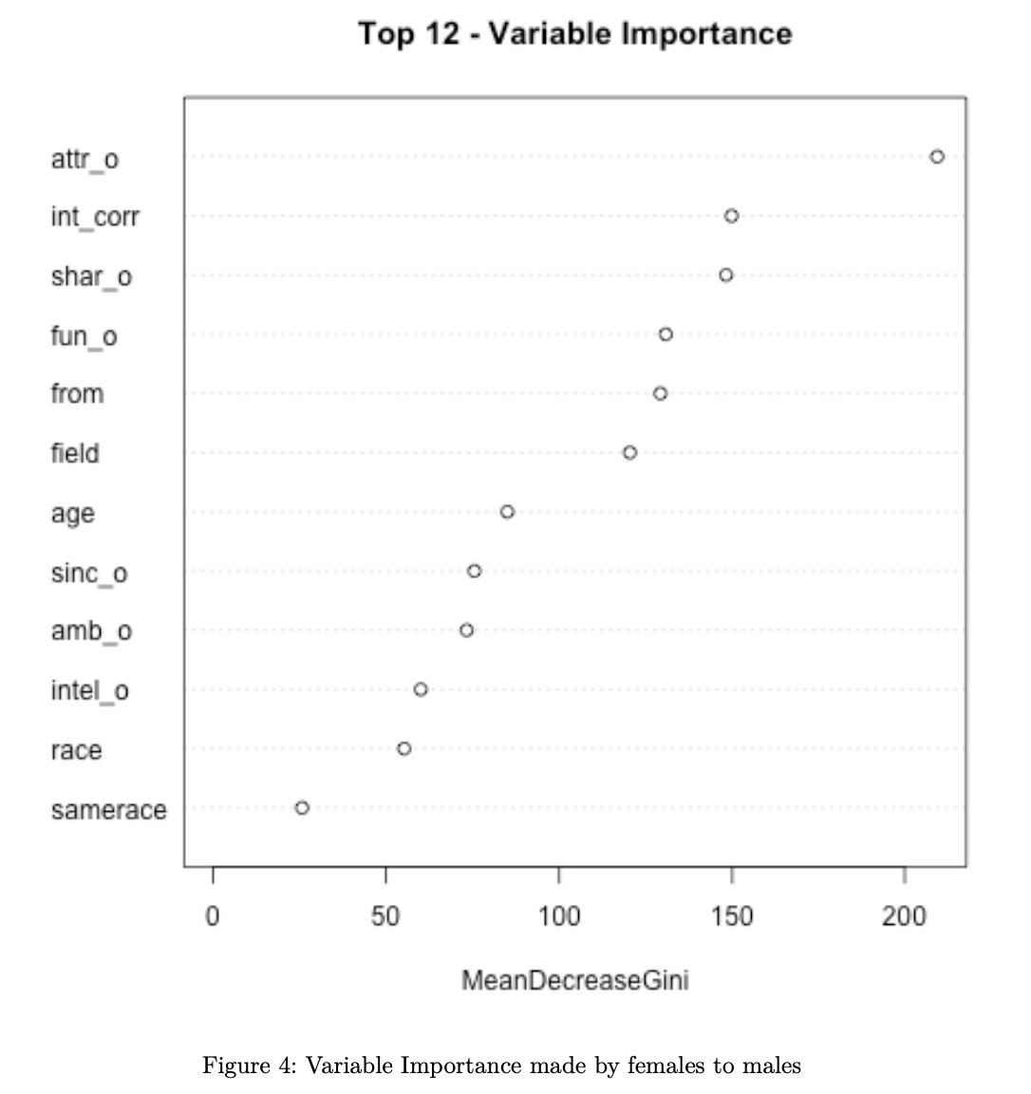
Random Forest for hypothesis 3 and 4
I randomly split data into 80% training and 20% test set. I chose 500 trees and four random predictors at each split.
The OOB estimate of error rate is 24.99% which has 75% accuracy on the training set, while on the test set, this RF has roughly 73% test accuracy
The true “Yes” rate is 138/(138 + 118) = 53.90, which is a little bit over 50% random guess rate. However, the true “No” rate is 347/(347 + 64) = 84.43
Both males and females place attractive at the top and males emphasize attractive much more than females do.

Slide 9
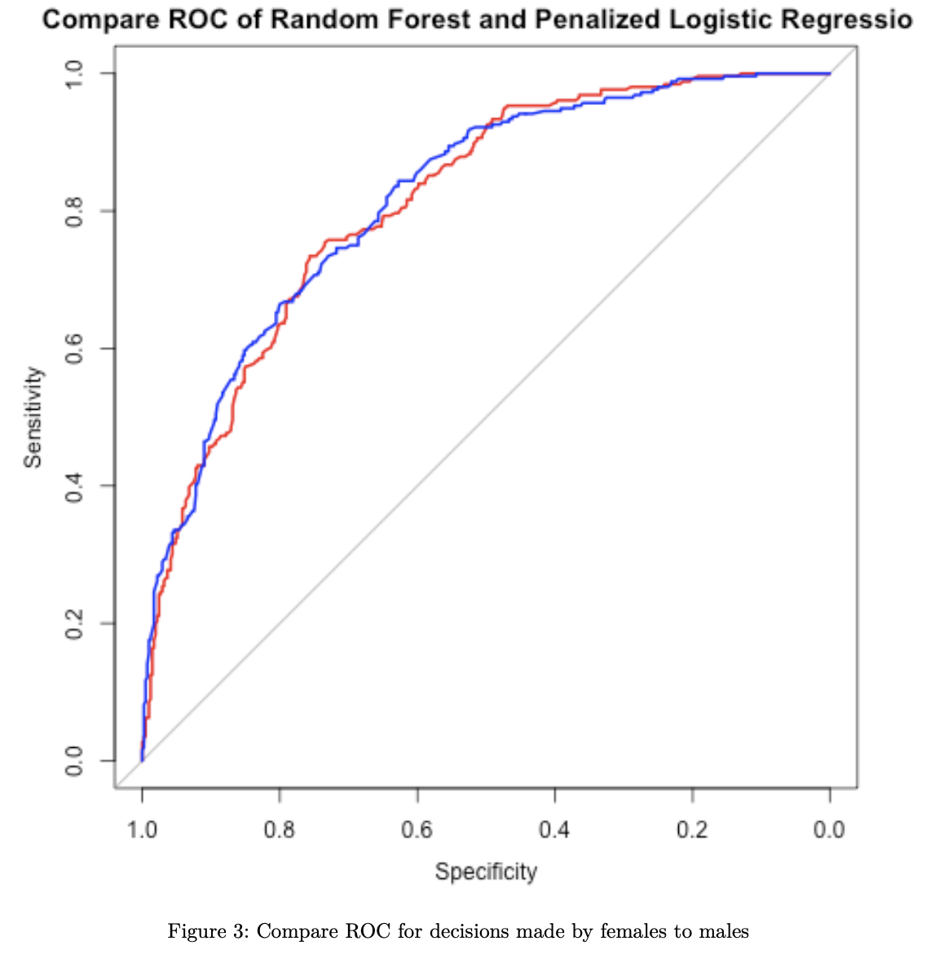
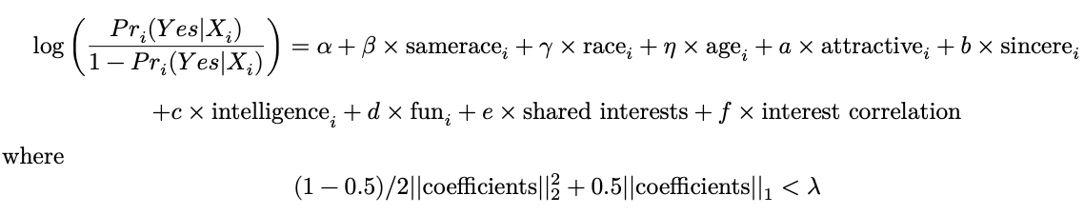
Penalized Logistic Regression for hypothsis 3 and 4
From the coeﬀicients, only 6 six attribute variables are kept in the model. All other variables, such as race and age, are filtered out by elastic net variable selection.
Age doesn’t play any role in this analysis mainly because all participants are about from 20 to 30, which are considered young people.

Slide 10
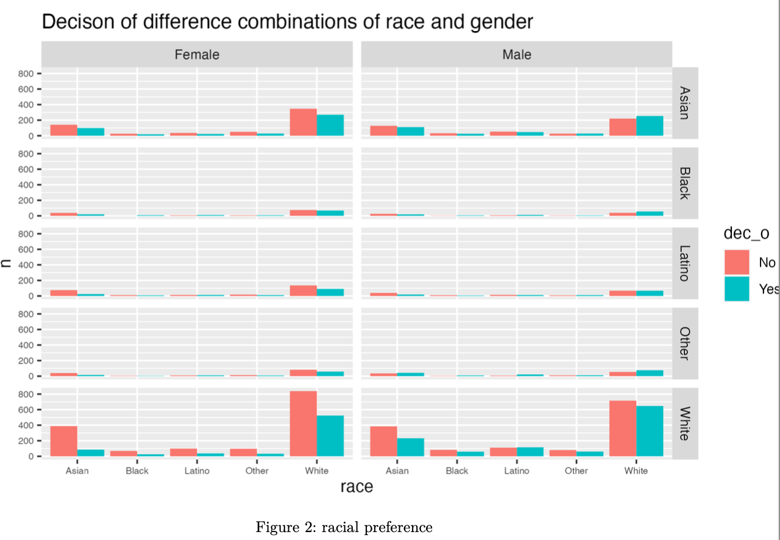
Proper and effective visualization of data

Slide 11
Conclusion and Scope of this analysis
Although Asian males are the least popular in dating and females of all races prefer the same race dating, improving physical attractiveness and having common interests can significantly dominate racial preference in dating.
All the participants from graduate and professional schools at Columbia University. The prediction and inference results may only be valid to that school and surrounding area, such as New York City. These experiments and subjects happened in a very international and diverse society. Thus inference may be generalized to other similar social structures like the “Big Blue State”: New York, California. This can not be extended to “Big red state” rural areas in the US.

Slide 12
Future Work
Dating Analysis on “big red state” rural area
Hypothesis: the same race and the same religious dating/marriage are expected to dominate all other attributes
Thank you!

