Slide 1

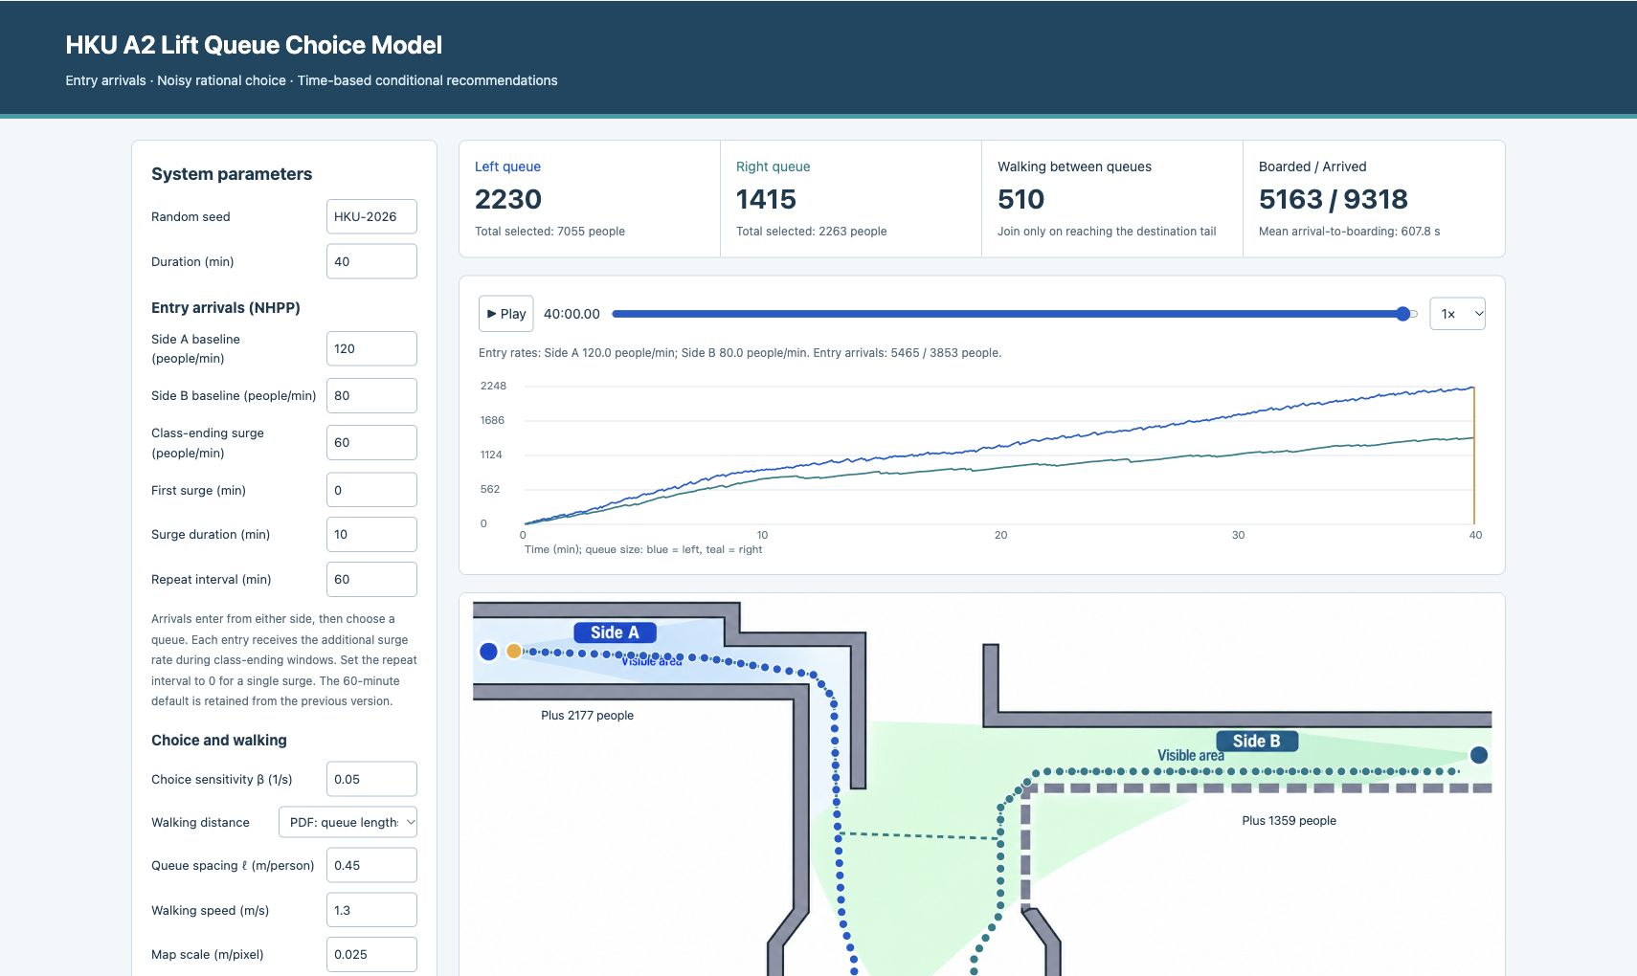
ACADEMIC SIMULATION WEBSITE
Parameter controls
Arrival rates, class surges, lift cycles and walking assumptions
Inspectable replay
See queues, walkers, lift events and the choice-cost breakdown
Reproducible exports
Seeded runs; parameter-tagged CSV / JSON
Public website: liyufei2004.github.io/hku-a2-queue-simulation/
1 / 4 · Li Yufei
Notes:
This website makes the queue-choice model inspectable. Users can change arrival and service assumptions, replay the resulting queues, and inspect how walking and expected position loss affect the choice. The computation is separated from drawing: the frontend calls a versioned Web Worker API with generate, inspect and collect operations. This is a JavaScript research prototype; it is not a claim that the team SimPy engine is deployed here. Source: local README.md and backend/API.md; screenshot captured from the local implementation.

Slide 2
CONDITIONAL DECISION SUPPORT
Entry + time window + local queue length
Estimate the hidden queue distribution
Compare conditional expected delays
Report support, or withhold a recommendation
1,000,000 paired snapshots
2,084 seeded trajectories · 5-second sampling · 5-minute bins
Fewer than 30 matches: no definite recommendation. Snapshots within a run are correlated.
2 / 4 · Li Yufei
Notes:
For a user who can observe only their local queue, the website indexes a simulated joint queue distribution by entry side, five-minute time window and observed local count. It averages the same full cost function over matching snapshots, rather than reading the hidden live queue. A fresh backend collection generated one million paired snapshots across 2,084 independently seeded trajectories, including a partial final trajectory. Fewer than thirty matches produces no definite recommendation. This is support under the generating full-information behaviour, not validation of widespread policy adoption. Source: analysis/conditional-summary.json; backend/simulation-service.js and frontend/batch-ui.js.

Slide 3
EXPERIMENT DESIGN
Four scenarios, 30 independent runs each
Baseline inflow
70 or 200 people per minute
Class-ending surge
None, or +60/min at each entry for minutes 0–10
Fixed assumptions
40-minute horizon; four lifts per bank
Mean cycles: 40 s / 200 s
Capacity limit: 20; mean trip capacity: 18
Nominal total service: 129.6 people/min
Illustrative scenarios, not calibrated field estimates. API/model checks and passenger conservation passed.
3 / 4 · Li Yufei
Notes:
We tested lower demand and the current default demand, each with and without an initial surge. All runs lasted forty minutes and used independent seeds. Each lift bank has four independent batch servers, with mean cycles of forty and two hundred seconds. Under the available-capacity distribution, the mean is eighteen, so the nominal service rates are 108 and 21.6 people per minute. The 200-person default therefore exceeds total service before adding a surge. These are model stress scenarios, not field-calibrated estimates. Source: analysis/run_experiments.cjs, analysis/summary.json; backend/model-core.js.

Slide 4
DEMAND AND CAPACITY
4,029 ± 42 people
not boarded at 40 min
(default + surge)
70/min can clear the surge backlog; 200/min cannot clear it within this horizon.
Mean across 30 runs; ±95% t interval. Includes queued + walking passengers. No claim of real-world delay savings.
4 / 4 · Li Yufei
Notes:
At lower demand, the initial surge cleared by forty minutes, with roughly fifteen people still not boarded. At default demand, the final backlog was roughly 2,816 without the surge and 4,029 with it. The default-plus-surge mean has a 95 percent replication-level t interval of plus or minus 42 people. End backlog includes both physical queues and people still walking. Mean arrival-to-boarding time among boarded passengers is censored: those still waiting have no completed time, so we do not present it as the mean of all arrivals. Routing cannot compensate for sustained inflow above capacity. Large queues also stretch the queue-length walking approximation beyond a credible corridor geometry, so these results are stress behaviour, not station forecasts. Source: analysis/summary.json and runs.csv.

