Slide 1
Models Summary

Slide 2
MLR (with feature selection)
Chose a random K (=9) as different K values didn’t make such a difference in the results.
 | Train | Test
rmse | 0.9615228986423675 | 0.9624053118173858
std | 0.9876521360514302 | 0.988269758329151
r2 | 0.05221098139430248 | 0.051642943981325864

Slide 3
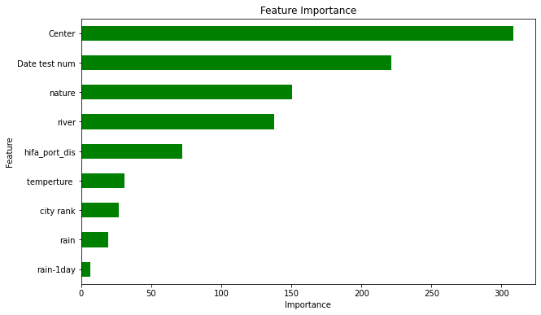
MLR (with feature selection)

Slide 4
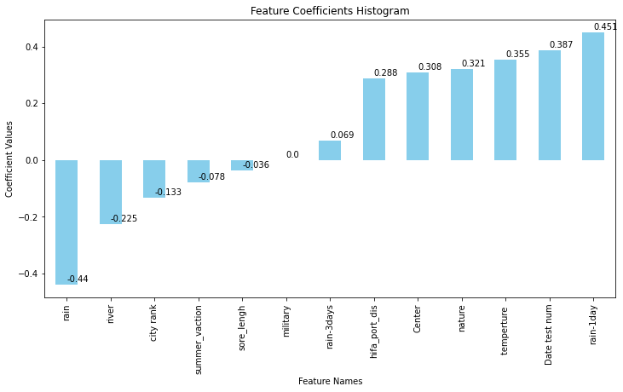
MLR Coefficients

Slide 5
Random Forests
 | Train | Test
rmse | 0.7626362907315902 | 0.7988426092587032
std | 0.9915126574576983 | 0.989368128767932
r2 | 0.4083752501770385 | 0.34800890884435587

Slide 6
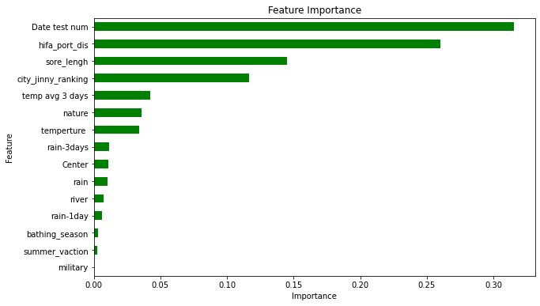
Random Forests

Slide 7
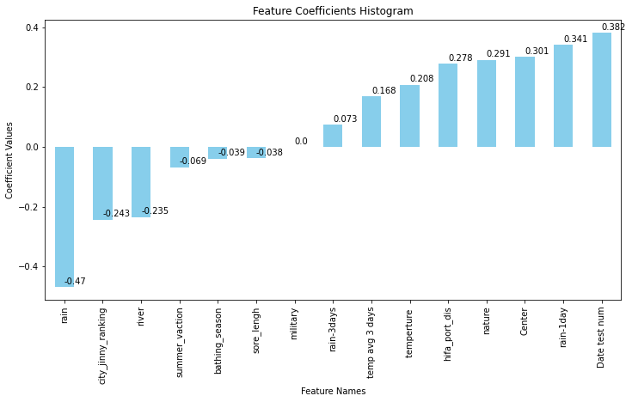
Random Forests Coefficients

Slide 8
NN
 | Train | Test
rmse | 0.8936846979978159 | 0.8907792276632833
std | 0.9898609517585045 | 0.979363398542771
r2 | 0.18430576601946377 | 0.17233886958869074

