Slide 1

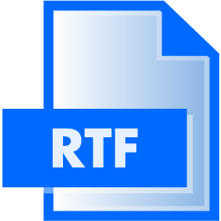

Detection Malicious RTF and JPG Files Using Machine Learning Methods
Alex Lerman
Liad Nahmias
Mr. Aviad Cohen

Slide 2



The Problem

Slide 3
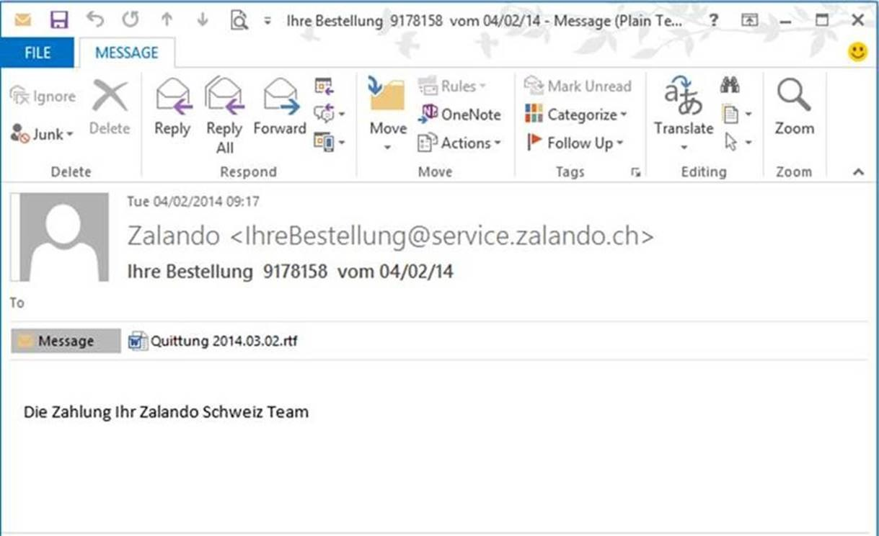
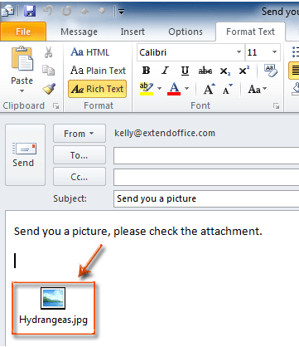
The Problem

Slide 4
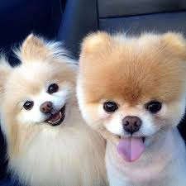
The Problem
Double-click

Slide 5
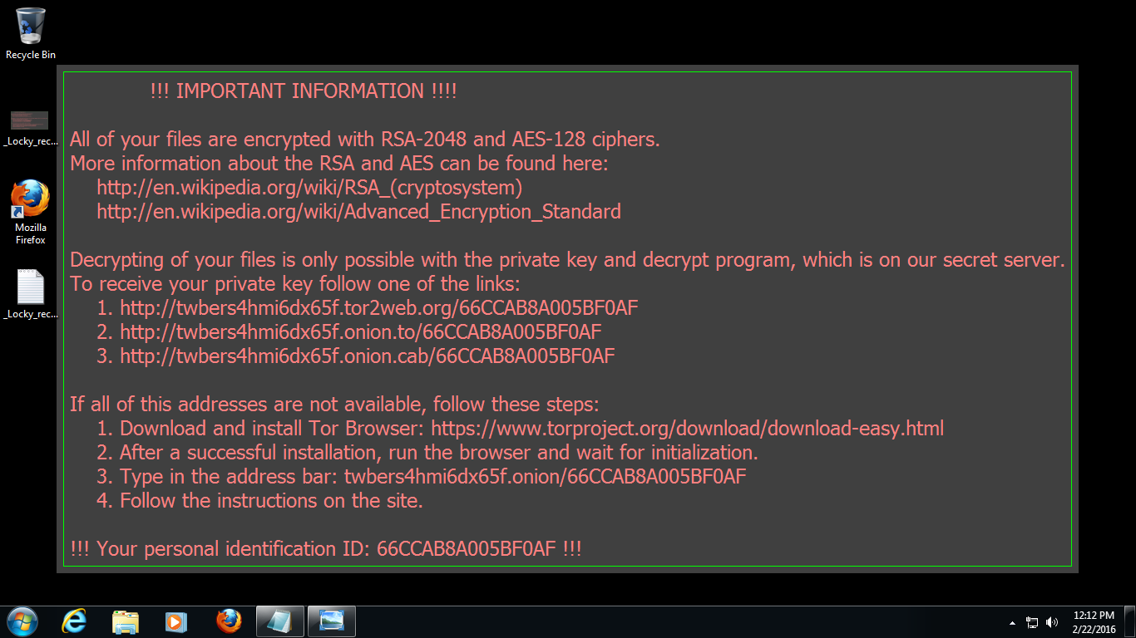
RANSOMWARE

Slide 6
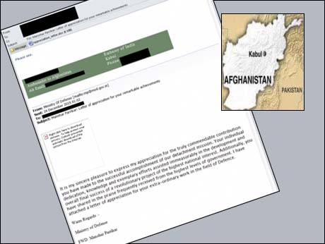
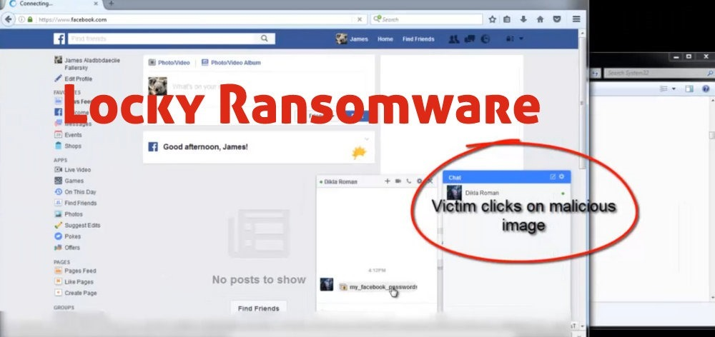
Former Attacks
Indian ambassador to Afghanistan - On December 24, 2015 was sent an email consists attachment of crafted RTF. The malware allowed taking photos from the web camera, recording audio etc.
Images on Facebook - On November 25, 2016 images were sent through Facebook, The images were a downloader of Locky Ransomware.

Slide 7

Two Main Theses
Improvement of former structural feature extraction method:
Top to Bottom, Bottom to Top, Single Joint
New method for feature extraction: Knowledge-Based
Learning former attacks, specification of the files

Slide 8

Technical Review
Programming language: Java
Analysis: Static
Method: Machine Learning
Feature extraction: Structural and Knowledge-based
Datasets: Malicious and Benign RTF and JPEG Files

Slide 9
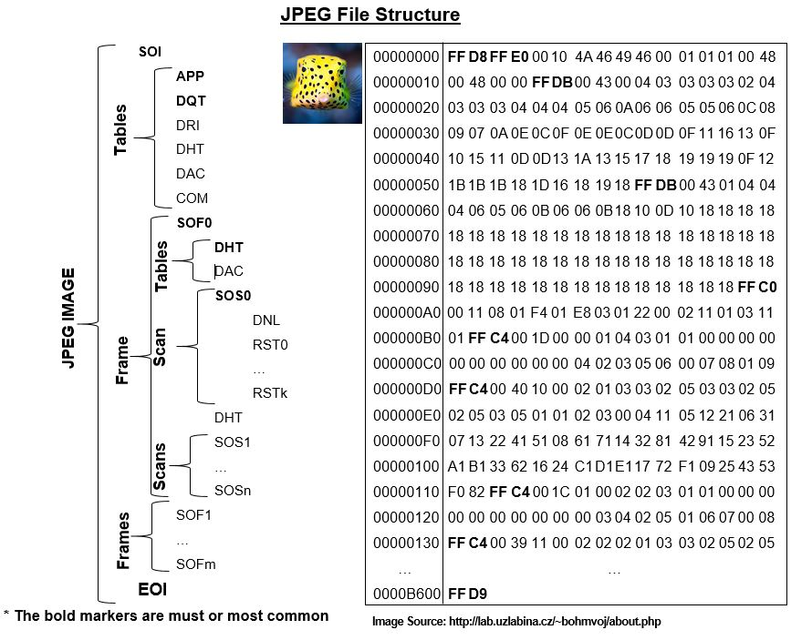
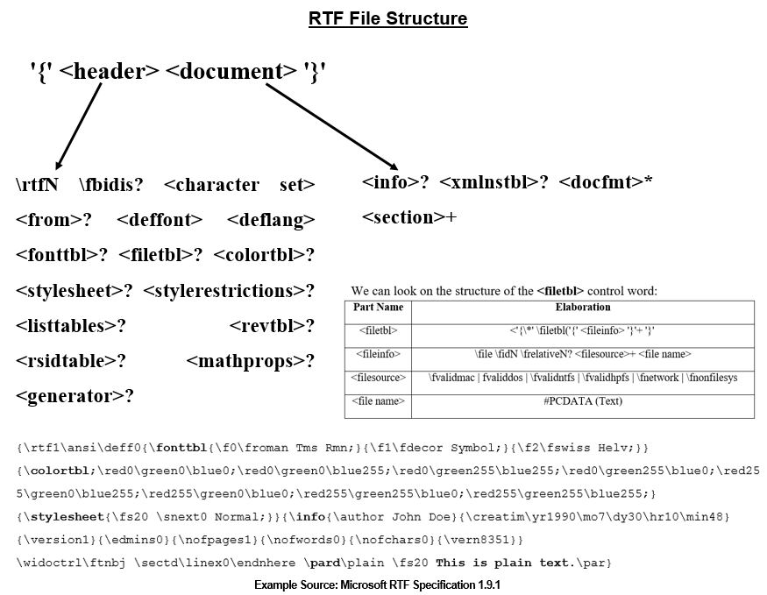
Files Structure

Slide 10
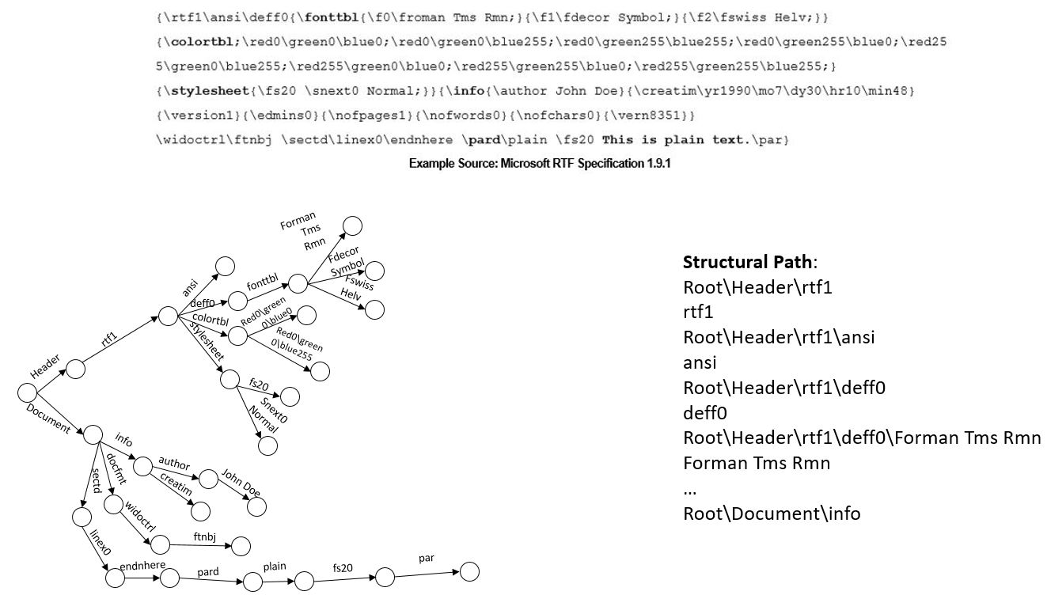
Structural method - RTF

Slide 11
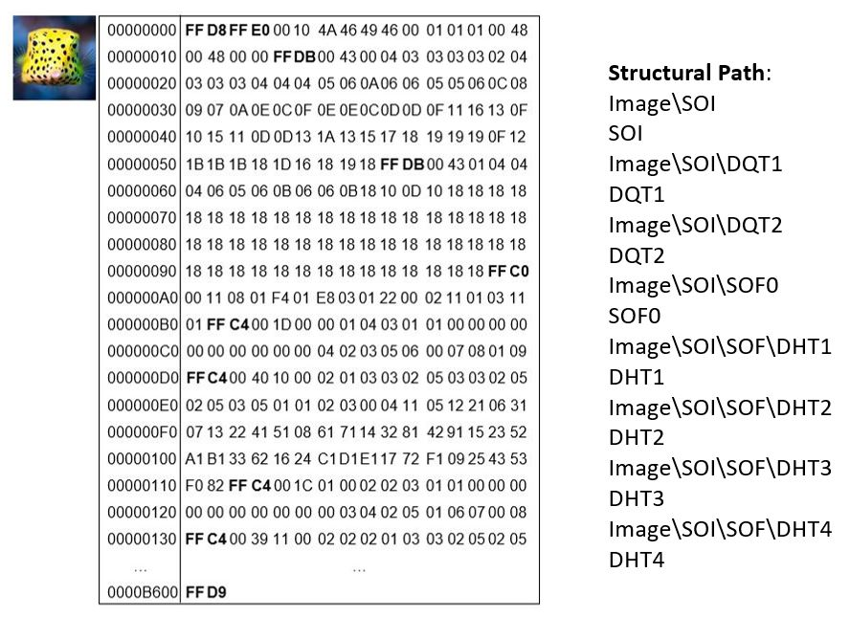
Structural method - JPG

Slide 12
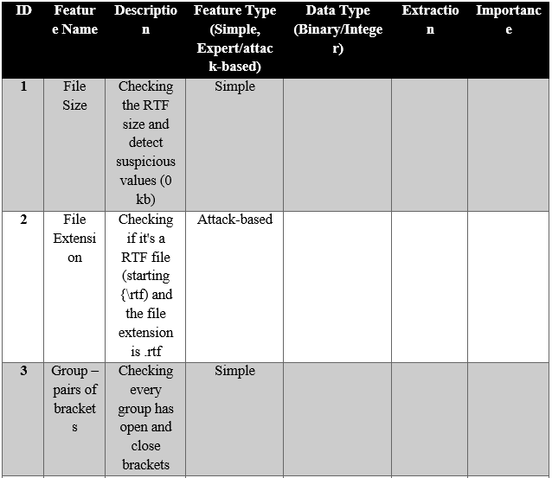
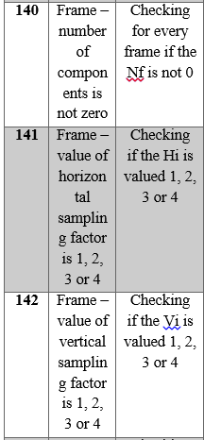

Knowledge-based Method
Features:
By Control words
By markers
File content

Slide 13
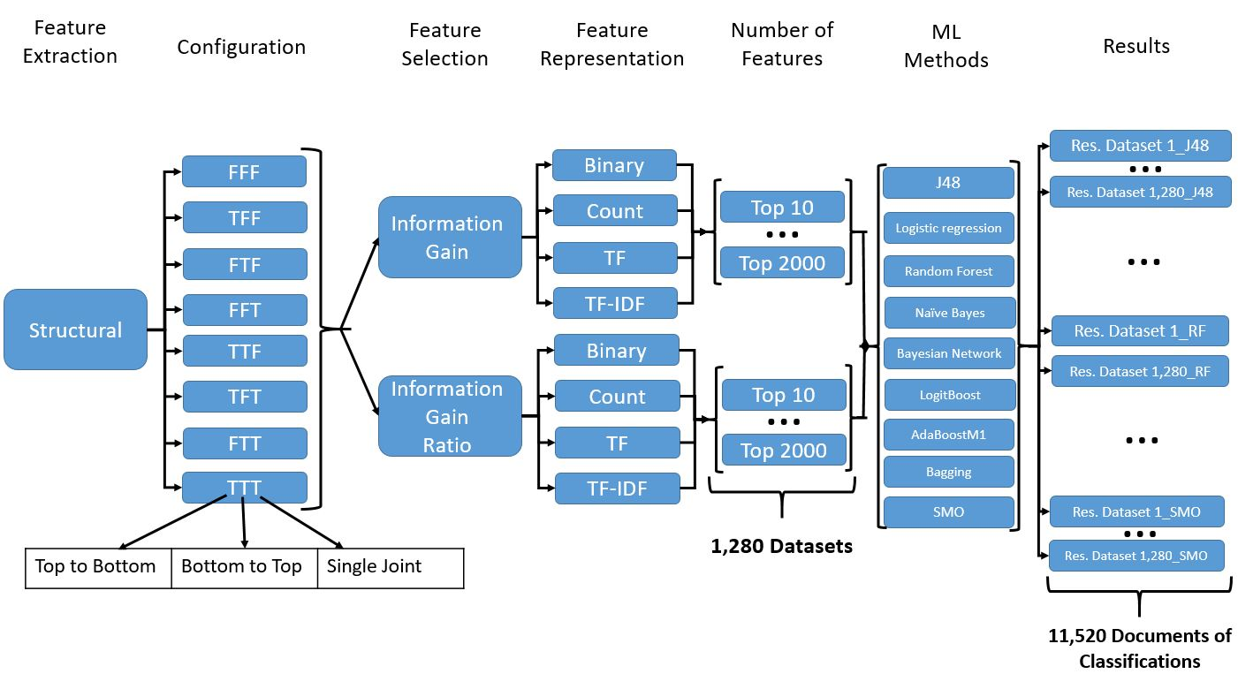
Feature Extraction – Whole Process

Slide 14
Datasets
JPEG | RTF
6,279 | 2,204 | Benign
819 | 1,224 | Malicious
7,098 | 3,428

Slide 15
Experiments
3 Types of Experiments:
1. Comparison between different components - structural
2. Comparison between different Classifiers- knowledge-based
3. Comparison between Structural, Knowledge-Based and Anti-Virus softwares

Slide 16
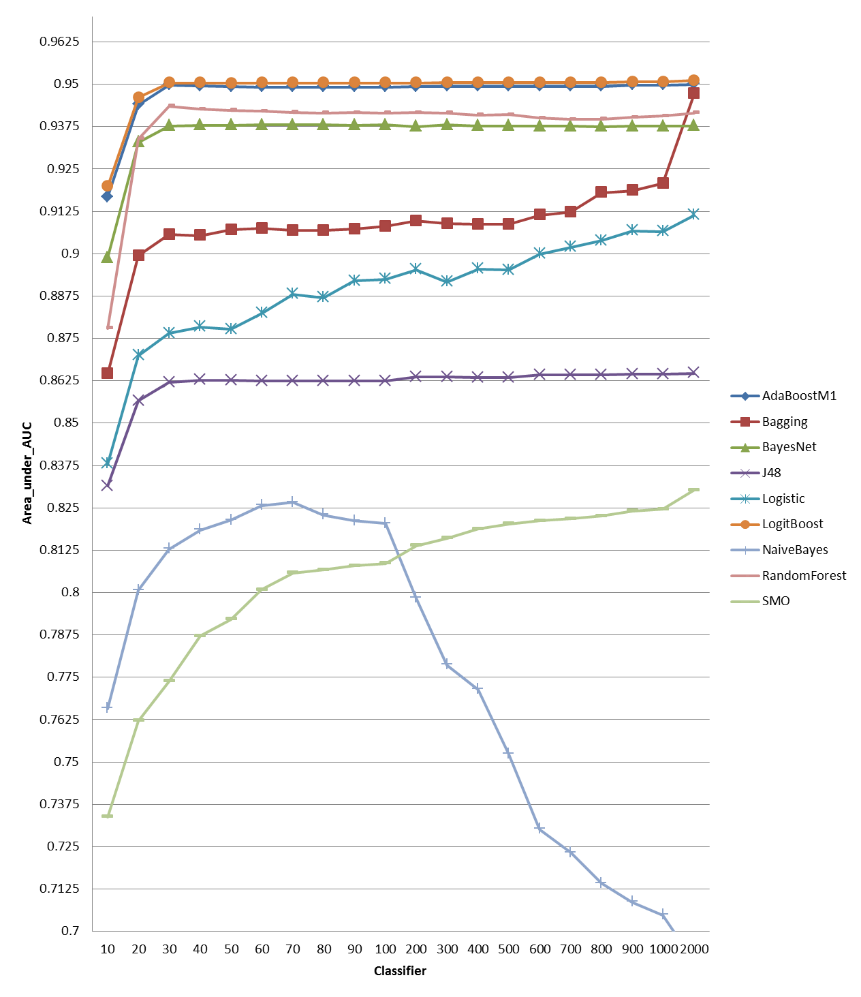
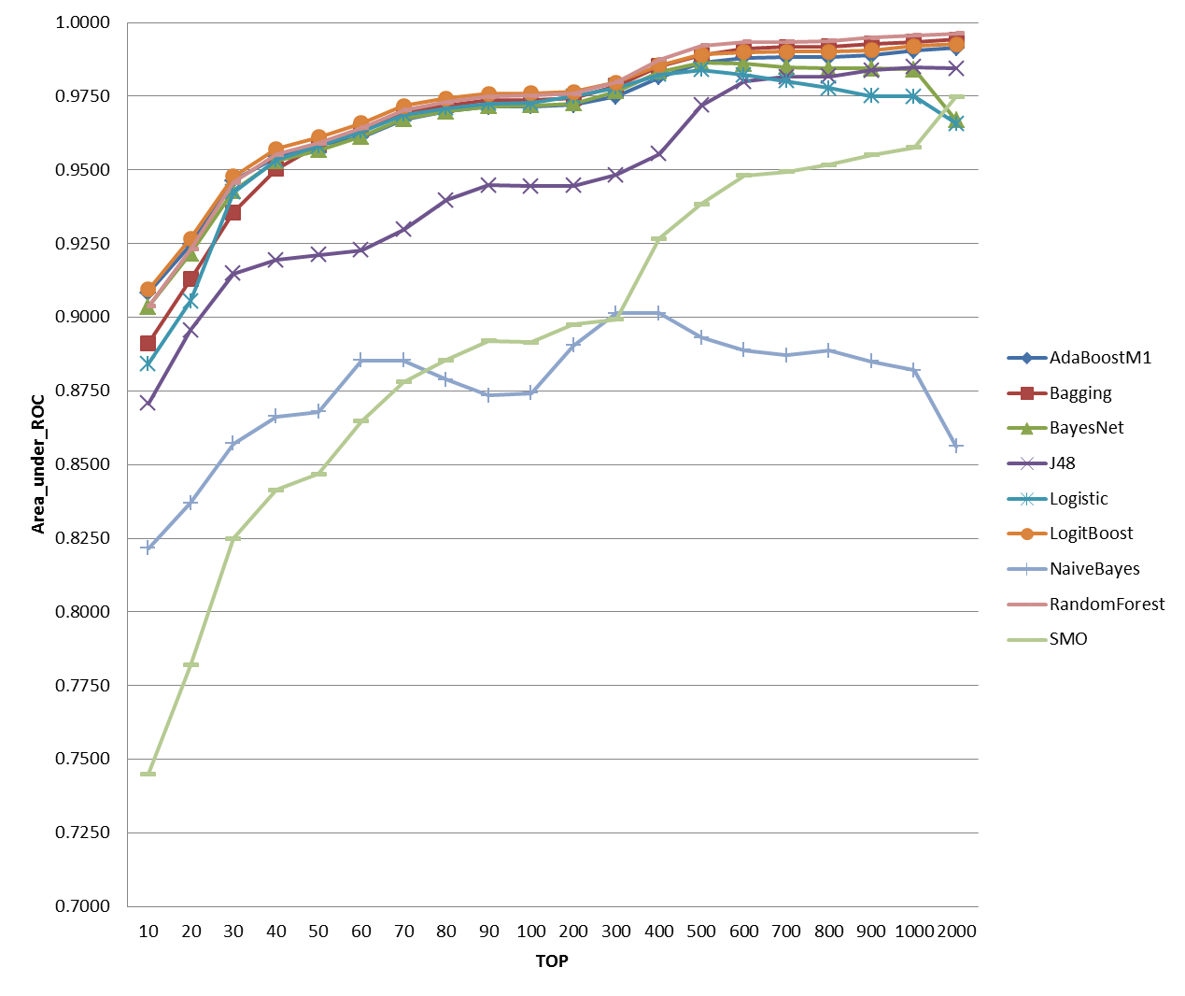
Results – Structural

Slide 17
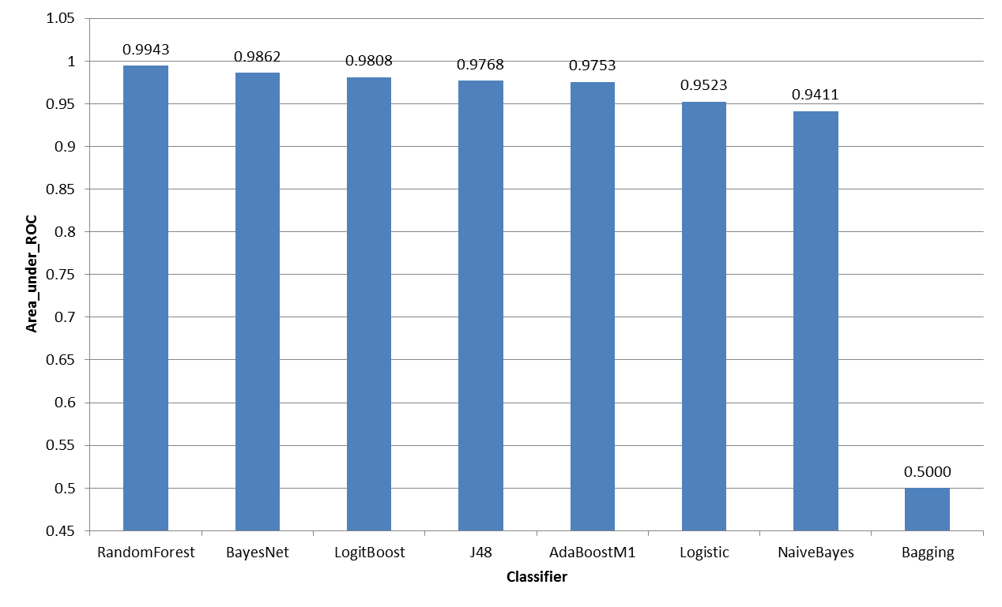
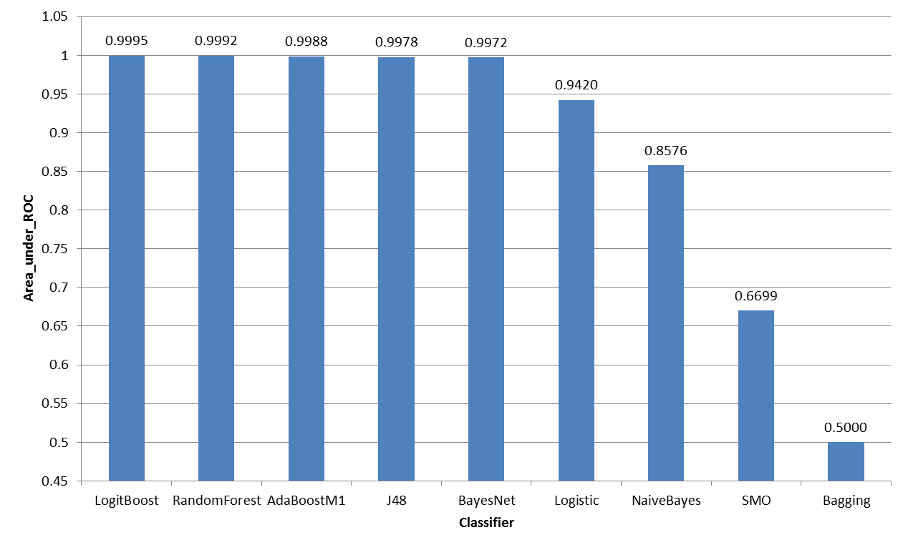
Results – Knowledge-Based
JPG
RTF

Slide 18
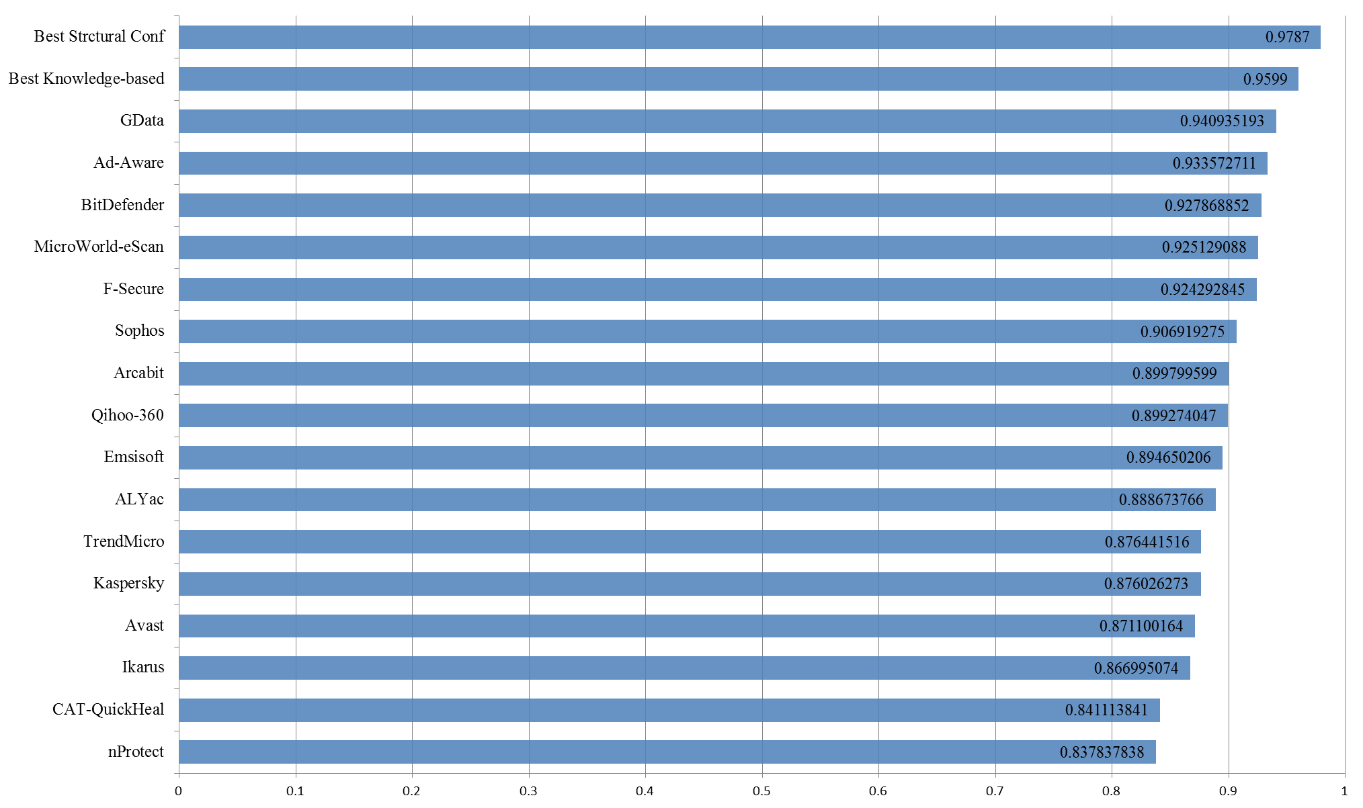
Results – Anti-Virus (RTF)

Slide 19
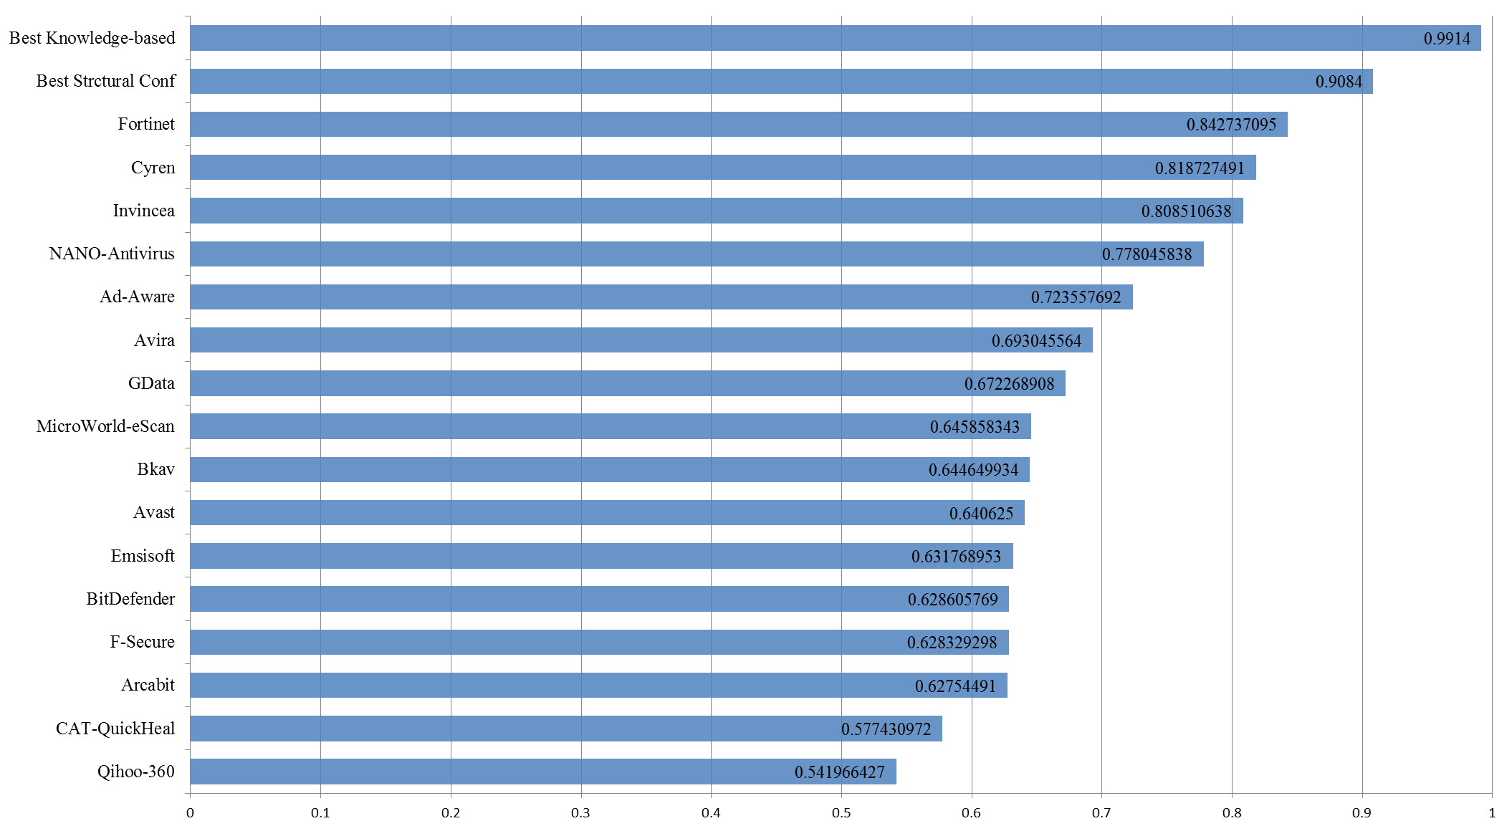
Results – Anti-Virus (JPG)

Slide 20
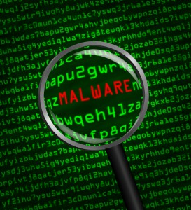
Summary
First Thesis (Structural):
using Single Joint
Not using Bottom to Top
Second Thesis (Knowledge-Based):
Learn the file structure – no need beginning dataset
Allow detection of Zero-day attacks
Very good Detection accuracy

Slide 21
Questions?

