Slide 1





$${30}^{o}$$
$${60}^{o}$$
$${90}^{o}$$
$${120}^{o}$$
$${150}^{o}$$

Slide 3
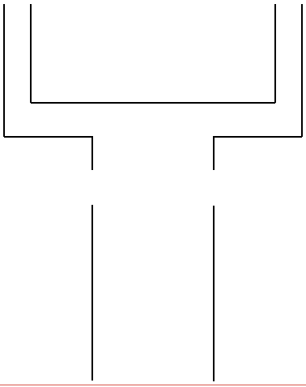
H_{fd}

Slide 5


Pot
$$θ=30$$
$$θ={30}^{o}$$
Fire

Slide 6
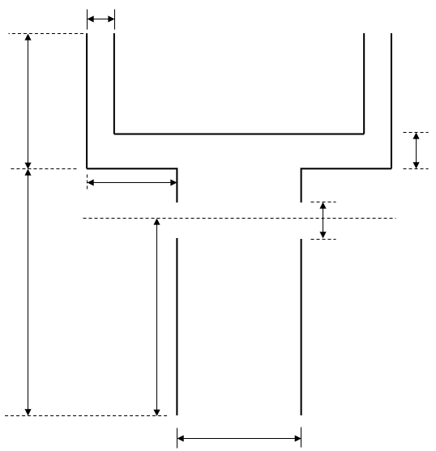
W_{c}
D_{fd}
L_{c}
H_{d}
L_{d}
H_{cc}
H_{fd}
D_{c}
D_{fd}

Slide 7
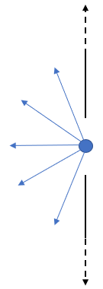
+y
90º
+x
120º
240º
270º

Slide 8
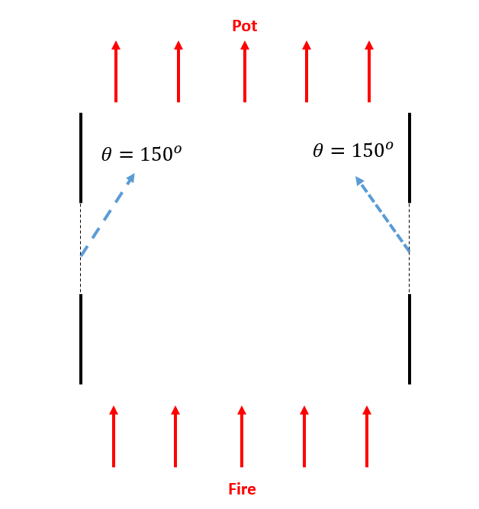
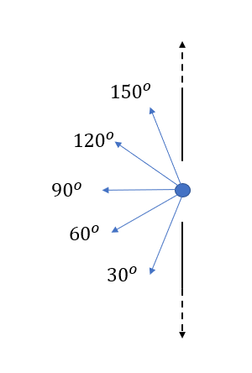

$$θ={150}^{o}$$

Slide 9
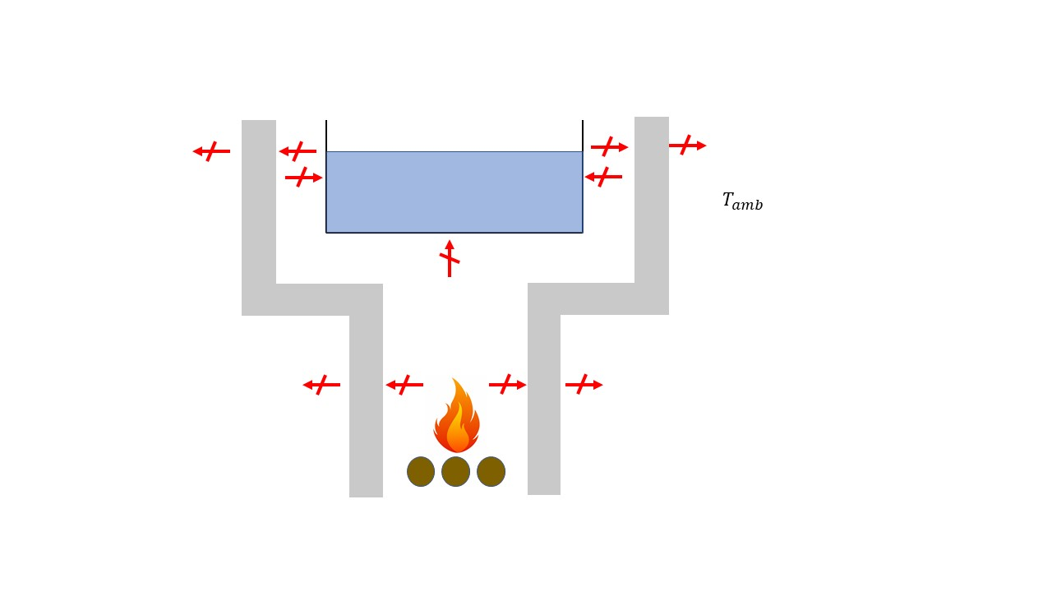
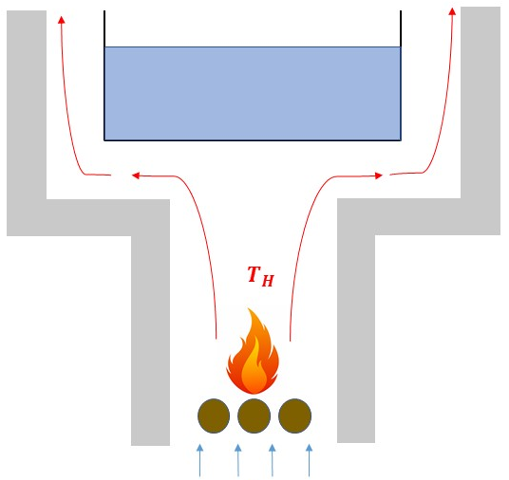


$$T_{amb}$$
$$T_{amb}$$

Slide 10
