Slide 1
COMP9311 Database Systems
Xuemin Lin
School of Computer Science and Engineering
Office: K17 503
E-mail: lxue@cse.unsw.edu.au
Ext: 6493
http://www.cs.unsw.edu.au/~lxue
WWW home address of 9311:
http://www.cse.unsw.edu.au/~cs9311

Slide 2
Course Information
Lectures: 18:00- 21:00 (Mon)
Location: Central Lecture Block 8 (K-E19-105)
Lab: weeks 2 – 13
Consultation Time
Time: TBA
Place: TBA

Slide 3
Course Information(cont)
3 assignments, 2 projects, final exam
Assessments (50%):
Ass 1: Data Modelling. Relational/Algebra (10%) (due by week 5)
Ass 2: DB design Theory (20%) (due by week 9)
Ass 3: DBMS (20%) (due by week 13)
Penalty for later submissions: 0 mark will be given to any later submission.
Projects (50%)
Proj1: 25% (due by week 8)
Proj2: 25% (due by week 12)
Penalty for later submissions: 10% reduction for the 1st day, then 30% reduction.

Slide 4

Course Information(cont)
Exam: 100%
If you are ill on the day of the exam, do not attend the exam.
I will not accept medical special consideration claims from people who have already attempted the exam.
Final Mark by Harmonic Mean:
Final mark = $\frac{2∗\left(ass1+ass2+ass3+proj1+proj 2\right)∗finalexam}{ass1+ass2+ass3+proj1+proj2+finalexam}$

Slide 5
Course Information(cont)
Text Book:
Elmasri & Navathe, Fundamentals of Database Systems, Benjamin/Cummings, 6th Edition, 2010.
Reference Books:
J. D. Ullman & J. Widom, A First Course in Database Systems, Prentice Hall, 1997.
R. Ramakrishan, Database Management Systems, McGRAW-HILL, 1997.
D. Maier, The Theory of Relational Databases, Computer Science Press, 1983.

Slide 6
Course Outline
Time | Contents
Week 1 | Subject Introduction, Conceptual DB Design (ER)
Week 2 | 1) Relational Data Model, 2) ER to Relational Data Model, 3) Relational Algebra
Week 3 | SQL
Week 4 | PLpgSQL, Functional Dependencies
Week 5 | Normal Forms, Relational DB design I
Week 6 | Relational DB design II, Disks, Files
Week 7 | Indexing Introduction, Tree Indexing
Week 8 | Hashing Indexing, External Sorting
Week 9 | Transaction Management I
Week 10 | Transaction Management II
Week 11 | Scalable Processing of Big Graph Data
Week 12 | Revision

Slide 7
Introduction
Database Applications:
Banking System,
Stock Market,
Transportation,
Social Network,
Marine Data Analysis,
Criminal Analysis and Control,
Now, BIG DATA....

Slide 8

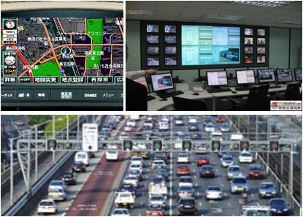




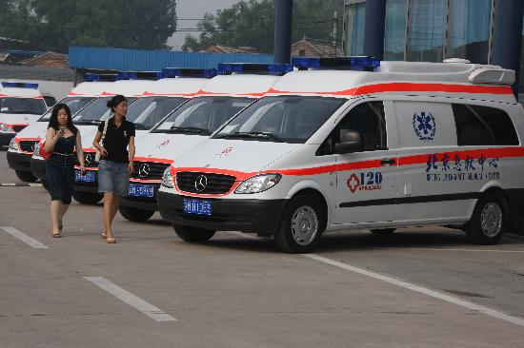
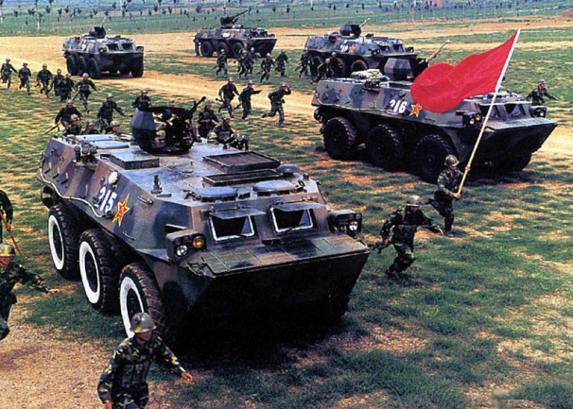

Intelligent Transportation
Business Services
Natural Disasters
Public Health
Modern Military
Tourism Development
Notes:
商业服务：手机加新浪微博

Slide 9


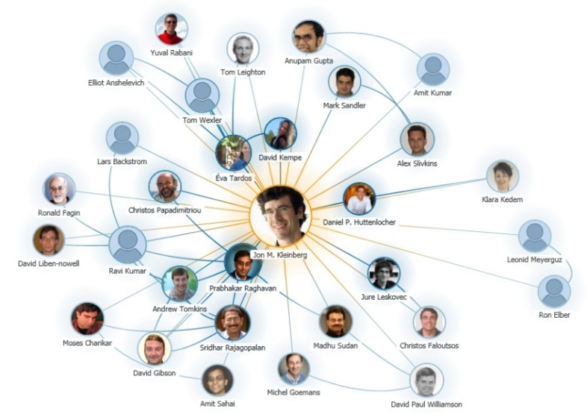
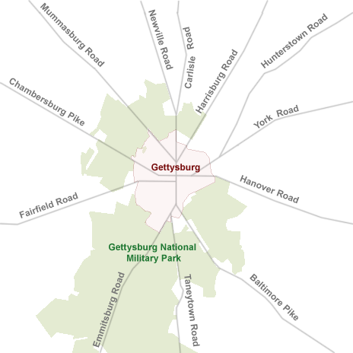
More Applications
Chemical Compounds
Social Network
Collaboration Graph
Road Network

Slide 10




Graphs Could be Big!
Big Graphs
2.1 billion webpages in 2000
15 billion links in 2000
1.23 billon active users in 2013
117 billion friendships in 2013
645 million users in 2013
1.7 billion tweets/month in 2013
1.4 billion webpages in 2002
6.6 billion links in 2002

Slide 11
Big Data Characteristics
Big Data
Volume
Velocity
Variety
Petabytes
Records
Transactions
Batch
Real time
Streaming
Structured
Unstructured
Semi-structured

Slide 12
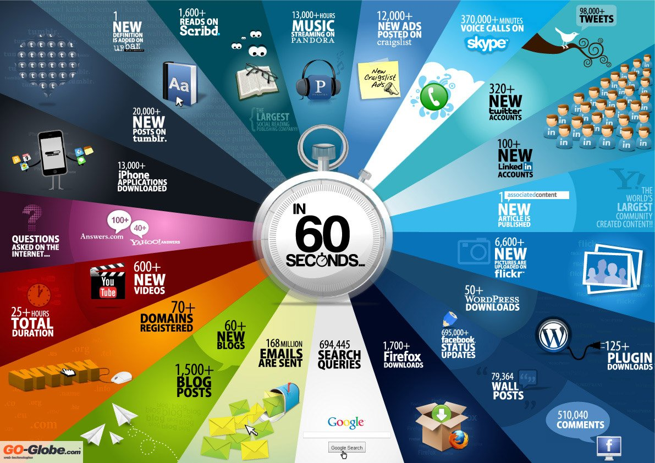
Graph in Big Data: Velocity
Fast flowing data
Evolving data structures and relationships

Slide 13
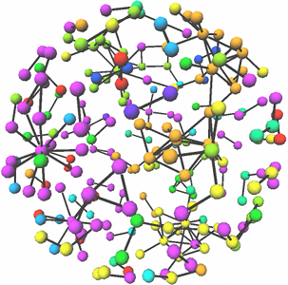
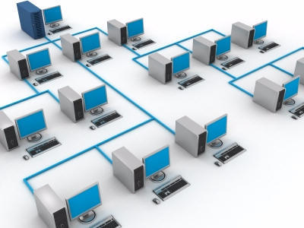
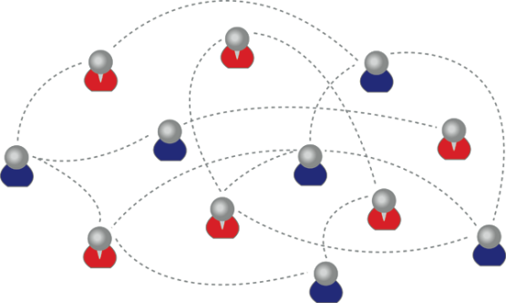

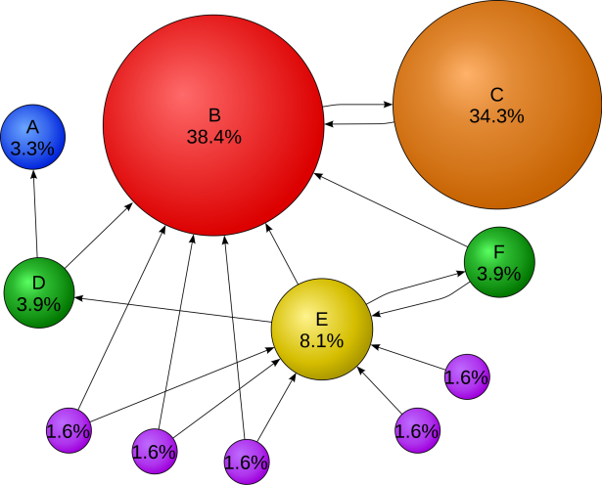
Graph in Big Data: Variety
Directed vs Undirected
Labeled vs Unlabeled
Weighted vs Unweighted
Heterogeneous vs homogeneous

Slide 14

Challenges and Opportunities
New Graph Semantics
New Query Processing Algorithms
New Indexing Techniques
New Computing Models

Slide 15







New Computing Models
Single Machine vs Multiple Machines
Internal Algorithms vs External Algorithms
Single Core vs Multiple Cores

Slide 16
Introduction(cont)
Develop a good database system:
Effectively organize data (database design).
Efficiently execute users queries (transaction management).
These are even more important in modern applications, e.g. internet:
Huge unstructured information is available in the internet.
Must access the information efficiently and effectively

Slide 17
What is data?
Data - (Elmasri/Navathe):
known facts that can be recorded and have explicit meaning . . .
Example - a student records database:
Contents - Information identifying students, courses they are enrolled in, results from past courses . . .
Item | Type of data | Stored as
Family name | String | Character strings?
Birthdate | Date | 3 integers?
Weight | Real number | Floating point number?
…

Slide 18
What is a database?
Elmasri/Navathe:
. . . a collection of related data . . .
Data items alone are relatively useless.
We need the data to have some structure.
Database can be manipulated by a database management system.

Slide 19
What is a database management system(DBMS)?
Elmasri/Navathe:
DBMS: . . . a collection of programs that enables users to create and maintain a database . . .
Database system: . . . The database and DBMS together . . .

Slide 20
Database requirements
Database system provides facilities to:
Define a database - specifying the data items to be stored and their types,
Construct a database - loading the data items and storing them on some storage medium (usually disk),
Manipulate a database
querying - i.e. retrieving relevant data,
updating - i.e. adding, deleting or modifying data items:
from one “correct” state to another “correct” state,
reporting

Slide 21
Database requirements(cont)
Database system must be
Timely - e.g. an airline database (fast response), a CAD system (must be interactive),
Multi-user - e.g. trading system,
Modifiable - must be able to be extended or reorganised, e.g. to cope with new laws, requirements, business conditions,
Secure - different classes of users may need different levels of access,
No redundancy,
Robust - e.g. power failure during an update - must be able to recover to a consistent state.

Slide 22
Database requirements(cont)
A database system must address these issues and provide solutions - DBMS:
a special purpose DBMS,
a general DBMS.
The DBMS solution vs meta-data
To allow a general DBMS to be applied to a particular database application, we need
meta-data

Slide 23
Database requirements(cont)
Meta-data: a definition and description of the stored database, such as structure of each file, type and storage format of each data item, constraints etc.
Stored in the system catalog.

Slide 24
Benefits of meta-data
program-data independence - DBMS access programs may be written independent of file structures and storage formats,
data abstraction - information hiding.
Users are provided with a conceptual representation of the data using a high level data model.
support for views - different users can have different views of the database. e.g.
salary details may be hidden from some users,
statistical summaries may be derived and appear as stored data for some users.

Slide 25
Database personnel
Database Administrator(DBA) - This person is responsible for the centralised control of the database:
authorising access
monitoring usage,
recovery,
identifying the data,
choosing appropriate structures to represent and store the data,
managing definitions of views . . .

Slide 26
Database personnel(cont)
End user - People requiring access to the database for querying, updating, reporting etc.
Naive (parametric) user - typically use the database via “canned transactions” - standardised queries and updates, often through a menu system of some kind,
Online user - has an understanding of the database system. May be capable of designing their own queries etc.

Slide 27
Database personnel(cont)
Systems analyst:
determine end users requirements,
develop specifications for canned transactions and reports,
may also take part in database design.
Application programmer - Implements the specifications given by analyst:
tests,
debugs,
maintains the resulting programs.

Slide 28
DBMS concepts
Data model: a set of concepts that is used to describe the allowed structure of a database. i.e. the structure of the meta-data.
May be classified as:
High-level or conceptual (e.g. ER model – concerns entities, attributes and relationships)
Implementation or record-based (e.g. Relational, Network, Hierarchical - suggests a physical implementation)
Low-level or physical (concerns record formats, access paths etc)

Slide 29
DBMS concepts(cont)
Database Schema: An instance of a data model, that is, a description of the structure of a particular database in the formalism of the data model. (Intention)
Database Instance (or State): The data in the database at a particular time. (Extension)
In these terms:
We define a database by specifying its schema.
The state is then an empty instance of the schema.
To create the initial instance we load in data.
After this, each change in state is an update.

Slide 30
ANSI-SPARC three level architecture
ANSI: American National Standard Institute.
SPARC: Standards Planning and Requirements Committee.
ANSI-SPARC three level architecture (1975-1977):
The external or view level includes a number of external schemas or user views.
The conceptual level has a conceptual schema, which describes the structure of the whole database for a community of users.
The internal level has an internal schema, which describes the physical storage structure of the database.

Slide 31
EXTERNAL VIEW 1
EXTERNAL VIEW 1
EXTERNAL VIEW 1
EXTERNAL_TO_CONCEPTUAL
MAPPINGS
CONCEPTUAL VIEW
CONCEPTUAL_TO_INTERNAL
MAPPINGS
INTERNAL VIEW

Slide 32
ANSI-SPARC three level architecture(cont)
3 levels of abstraction => 2 levels of data independence:
logical data independence: the ability to change the conceptual schema without changing external views. Must change the external-to-conceptual mapping though.
physical data independence: the ability to change physical storage paths and access structures without changing the conceptual view. Must change the conceptual-to-internal mapping though.

Slide 33
Database languages
In the three level architecture:
Data definition language (DDL): used to define the conceptual schema.
View definition language (VDL): used to define external schemas.
Storage definition language (SDL): used to define the internal schemas.
In DBMS where conceptual and internal levels are mixed up, DDL is used to define both schemas.

Slide 34
Database languages(cont)
Data manipulation language (DML): used to construct retrieval requests (queries) and update requests:
Low-level or procedural
embedded in a general purpose language,
record at a time
High-level or non-procedural
interactive and/or embedded
set at a time/ set oriented.
In most current DBMSs, a comprehensive integrated language is used; for example SQL.

Slide 35
Database components
See Fig2.3 in Elmasri/Navathe.
Run-time database processor - Receives retrieval and update requests and carries them out with the help of the stored data manager.
Stored data manager or file manager - Controls access to the DBMS information stored on disk:
may use the OS for disk access,
controls other aspects of data transfer, such as handling buffers.
Pre-compiler - Extracts DML commands from the host language program.
These are compiled by the DML compiler, the rest is compiled by the host language compiler, then they are linked to produce executable code with calls to the data manager.
Query processor (or Complier) - Parses high-level queries and converts them into calls to be executed by the data manager.

Slide 36
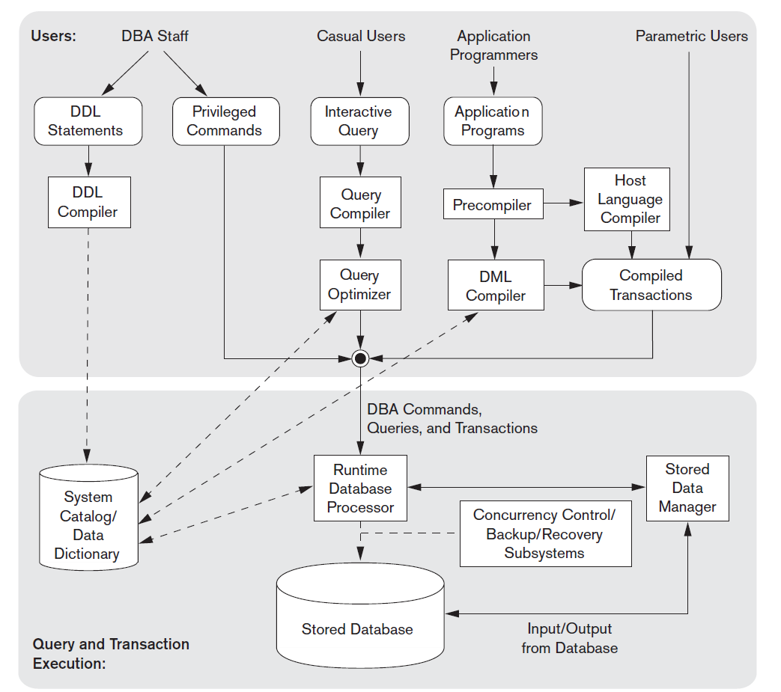
Database components

