Slide 1
Conceptual Database Design

Slide 2
1. Conceptual Database Design
Apply
E-R
Relational DB
Database Design

Slide 3
1.2 Entity-Relationship Model
The Entity-Relationship (ER) model is a high-level conceptual data model (Chen in 1966).
ER is used mainly as a design tool.

Slide 4
1.2 Entity-Relationship Model(cont)
Entity type: Group of object with the same properties
Entity: member of an entity type - analogous to an object.
Attribute: a property of object
Relationship: among objects
ER can model “n-way” relationship,
ER models a relationship and its inverse by a single relationship.

Slide 5
1.2.1 Entity and Attributes
Entities represent things in the real word.
Attributes describe properties of entities.
Attributes may be
simple(atomic) e.g. sex = ’Female’, or
composite e.g. name consists of title (Dr), Initials (C.C.), family name (Chen).

Slide 6
1.2.1 Entity and Attributes(cont)
Each entity has values for each attribute.
Attributes may be
single-valued e.g. student number, name, or
multivalued e.g. keywords = neural networks, computer graphics, databases.

Slide 7
1.2.1 Entity and Attributes(cont)
Each simple attribute has a value set (domain): the set of possible values for that attribute.
In a composite attribute A = (A₁, . . . , A_{n}), suppose that V₁, ..., V_{n} are the domains of A₁, . . . , A_{n}.
The domain V of A is V₁ × . . . × V_{n}.
Mathematically, an attribute A of an entity type E is a function
A : E → ℘(V ) .
where V is the domain of A, and ℘(V ) is the power set of V
For single-valued attributes, A(e) must be a singleton.

Slide 8
1.2.1 Entity and Attributes(cont)
An attribute can have a null value if, for example:
there is no suitable value e.g. a student may have no interests: keywords = NULL
the true value is not known e.g. the marriage date of a person is not known: marriage date = NULL.
A derived attribute is one whose value can be derived from other attributes and entities. e.g. number of students.

Slide 9
1.2.1 Entity and Attributes(cont)
An entity type is a set of entities with the same attributes.
It is described by an entity schema: a name and a list of attributes.
The set of individual entity instances at a particular moment in time is called an extension of the entity type.

Slide 10
1.2.1 Entity and Attributes(cont)
Schema (Intension) | RESEACHER Name, Payroll_no, No_of_students, Keywords | DEPARTMENT Name
Instances (Extension) | (Dr C.C. Chen, 230-0013, 3, Neural Networks) (Dr R. Wilkinson, 231-0091, 1, Databases) | Computer Science Psychology Management

Slide 11
1.2.1 Entity and Attributes(cont)
An entity type usually has a key: a set of attributes that uniquely identifies an entity. For example:
{payroll number} is a key of RESEARCHER,
{name} is a key of DEPARTMENT.
There may be more than one possible key.
An important constraint is the key constraint: in any extension of the entity type, there cannot be two entities having the same values for their key attributes.

Slide 12
1.2.1 Entity and Attributes(cont)
We can describe schemata with composite attributes using ()’s and with multi-valued attributes using {}’s. e.g.

Slide 13
1.2.1 Entity and Attributes(cont)
CAR Registration(Registration No, State), Make, Model, Year, {Colour}
((ARQ) 595, Vic), Datsun, 120Y, 1972, {green}) ((8HR) 696, WA), Mazda, 929, 1979, {grey, black})

Slide 14
1.2.1 Entity and Attributes(cont)
Entities and their attributes can also be described with Entity-Relationship Diagrams (ERDs). e.g.
Registration
Number
State
Registration
CAR
Colour
Make
Model
Year

Slide 15
1.2.2 Relationships
A relationship represents an association between things.
A relationship type R among n entity types E₁, . . . , E_{n} is a set of associations among entities from these types.
Mathematically, a relationship type R among entity types E₁, . . . , E_{n} is a subset of E₁ × . . . × E_{n}.
Each instance r = (e₁, . . . , e_{n}) in R is a relationship.
Notes:
1

Slide 16
1.2.2 Relationships(cont)
We say that E₁, . . . , E_{n} participate in R.
Similarly if r = (e₁, . . . , e_{n}) is an instance of R, we say that each e_{i} participates in r.
The degree of R is the number of participating entity types. For example,
ENROLMENT could be a ternary (degree 3) relationship between RESEARCHER, STUDENT and COURSE.
We can illustrate this using an occurrence diagram:

Slide 17
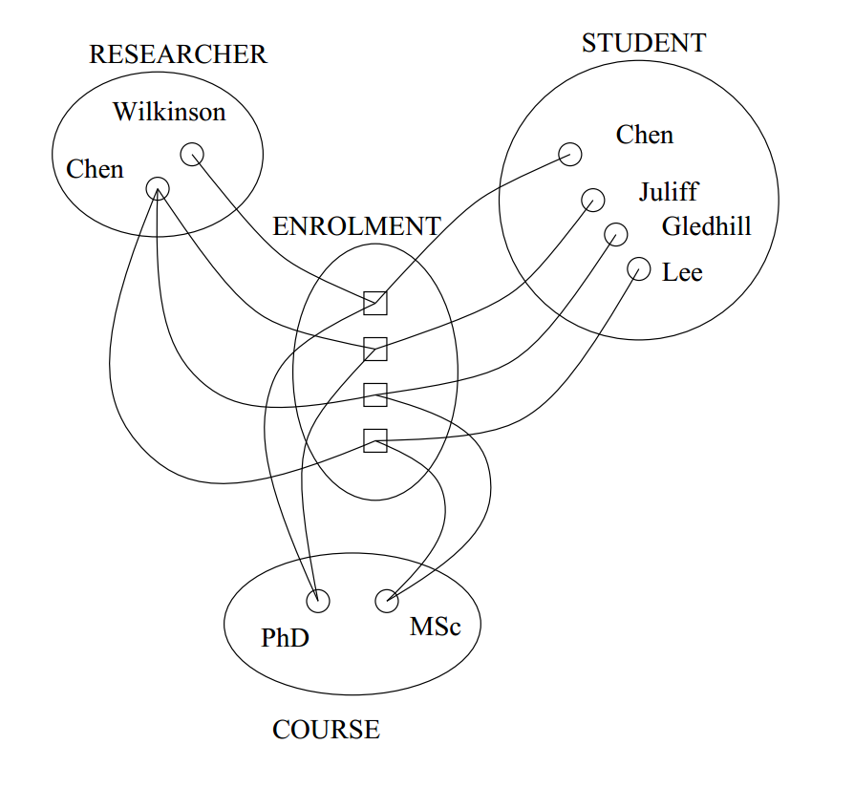

Slide 18
1.2.2 Relationships(cont)
Entities and their relationships can also be represented using Entity-Relationship diagrams:
RESEARCHER
STUDENT
ENROLMENT
COURSE

Slide 19
1.2.2 Relationships(cont)
Each entity type that participates in a relationship plays a particular role in the relationship.
An entity type can play
different roles in different relationships, or
more than one role in a relationship.
A role name can be used to distinguish these.
For example, ENROLMENT could be a relationship between PERSON(as researcher), PERSON(as student) and COURSE as in the diagram below:

Slide 20
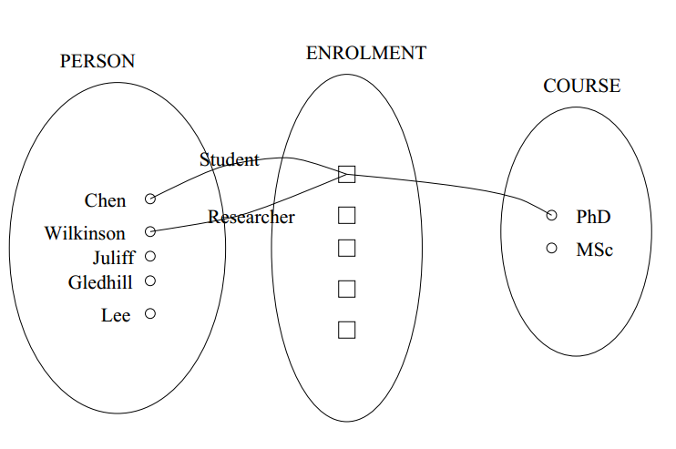

Slide 21
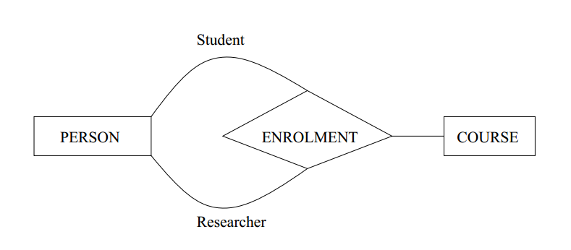
1.2.2 Relationships(cont)
Or, using an ERD:
This is called a recursive relationship.

Slide 22
1.2.3 Weak entity types
Some entity types do not have a key of their own.
Such entity types are called weak entity types.
Entities of a weak entity type can be identified by a partial key and by being related to another entity type - owner.
The relationship type between a weak entity type to its owner is the identifying relationship of the weak entity type.

Slide 23
1.2.3 Weak entity types(cont)
For example, a TAX PAYER entity may be related to several DEPENDENT, identified by their names.
In this example, DEPENDENT is called a weak entity, {Name} is a partial key for it. The identifying relationship between DEPENDENT and TAX PAYER is IS DEPENDENT OF. TAX PAYER is said to own DEPENDENT.

Slide 24
1.2.4 Constraints on relationship types
Relationship types usually have certain constraints that limit the possible combinations of entities participating in relationship instances.
They should reflect the correct factors
Cardinality ratio constraint: specifies the number of relationship instances an entity can participate in.
Example: A research grant supports only one research project, but a research project may be supported by many grants. PROJECT:GRANT is a 1 : N relationship.

Slide 25
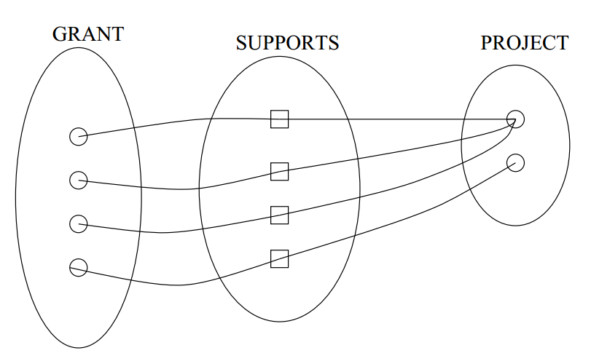
1.2.4 Constraints on relationship types(cont)
This is illustrated in the occurrence diagram below:

Slide 26
1.2.4 Constraints on relationship types(cont)
We can also show this in an ERD:
SUPPORTS
1
GRANT
N
PROJECT

Slide 27
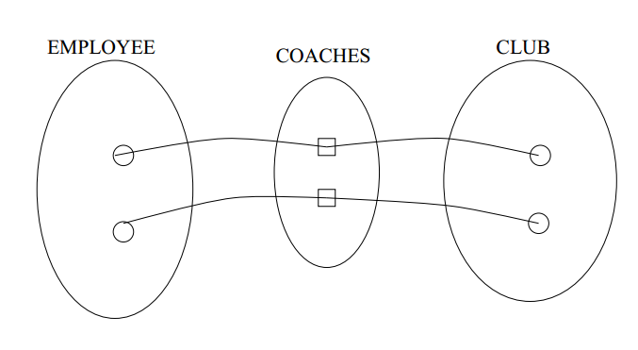
1.2.4 Constraints on relationship types(cont)
Example: Consider a database of AFL (here substitute your favourite team sport) statistics. The relationship of head coaches to clubs is an example of a 1 : 1 relationship.

Slide 28
1.2.4 Constraints on relationship types(cont)
With an ERD:
COACHES
1
EMPLOYEE
1
CLUB

Slide 29
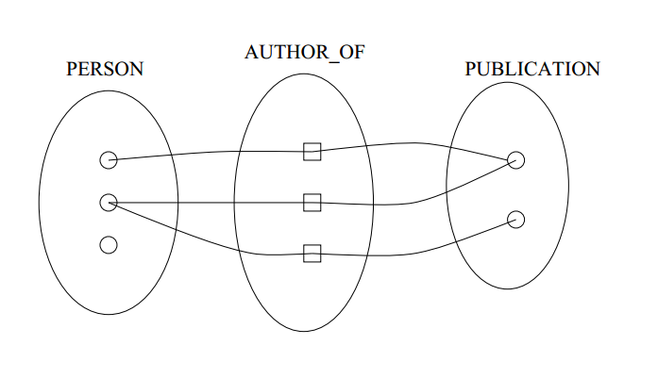
1.2.4 Constraints on relationship types(cont)
Example: An example of an N : M relationship is authorship of publications:

Slide 30
1.2.4 Constraints on relationship types(cont)
The equivalent ERD:
AUTHOR_OF
M
PERSON
N
PUBLICATION

Slide 31
1.2.4 Constraints on relationship types(cont)
Another kind of constraint that can be represented using the ER model is a
Participation constraint: participation of an entity in a relationship can be:
total: every entity must participate e.g. every publication has an author.
partial: not necessarily total. e.g. not every person has publications.

Slide 32
1.2.4 Constraints on relationship types(cont)
This can be shown with an ERD like the one below:
AUTHOR_OF
M
PERSON
N
PUBLICATION

Slide 33
1.2.5 Attributes of relationship types
Relationship types can have attributes – for example,
a researcher may work on several projects. The fraction of her time devoted to a particular project could be an attribute of the WORKS ON relationship type.
This can be shown in an ERD as below:

Slide 34
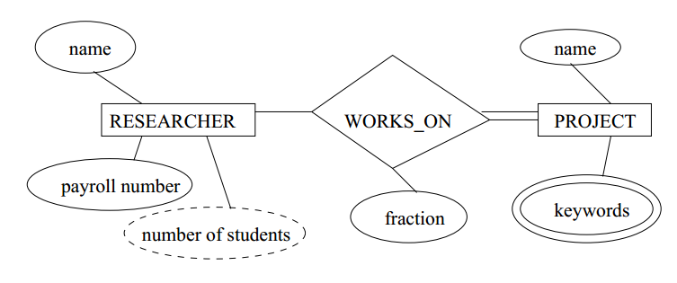
1.2.5 Attributes of relationship types(cont)

Slide 35
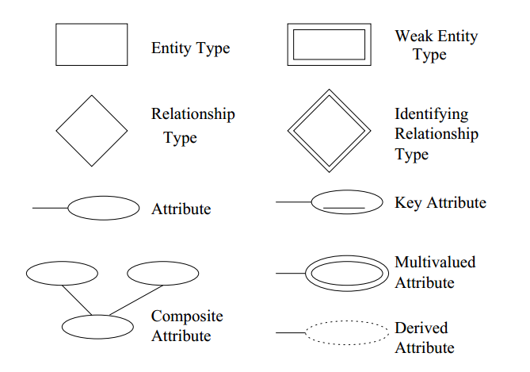
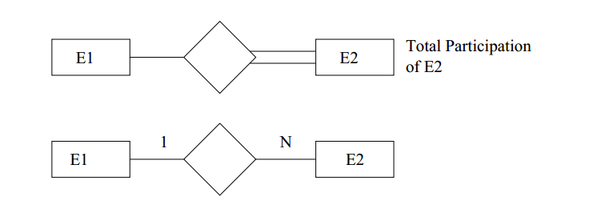
1.2.5 Attributes of relationship types(cont)
The notation used for ERDs is summarised in Elmasre/Navathe Figure 3.15.

Slide 36
1.2.6 Enhanced ER (EER) model
Designers must use additionally modelling concepts to
represent the requirements from applications as accurately and explicitly as possible.

Slide 37
1.2.6 Enhanced ER (EER) model(cont)
There are many extensions to the ER model. We will look at one:
Specialisation: the process of defining a set of subclasses of an entity type; this entity type is called the superclass of the specialization.
Generalisation: a reverse process of specialisation.
A subclass inherits all the attributes of the superclasses.

Slide 38
1.2.6 Enhanced ER (EER) model(cont)
A specialisation involves the following aspects:
Define a set of subclasses of an entity type.
Associate additional specific attributes with each subclass.
Establish additional specific relationship types between each subclass and other entity types, or other subclasses.
A subclass may have multiple superclasses.
A specialisation:
may be either total or partial; and
may be either disjoint or overlapping.

Slide 39
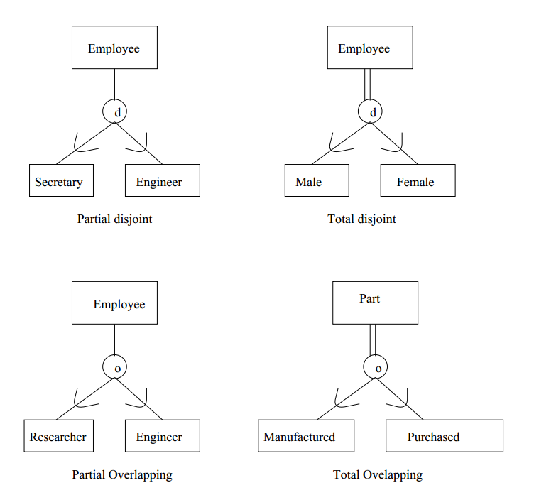

Slide 40
1.2.7 Design Principles
Faithfulness: reflect reality.
Avoid redundancy.
Picking the right kind of element.

