Slide 1
Relational Algebra

Slide 2
3. Relational Algebra
Relational Algebra is a procedural DML.
It specifies operations on relations to define new relations:
Select, Project, Union, Intersection, Difference, Cartesian Product, Join, Divide.

Slide 3
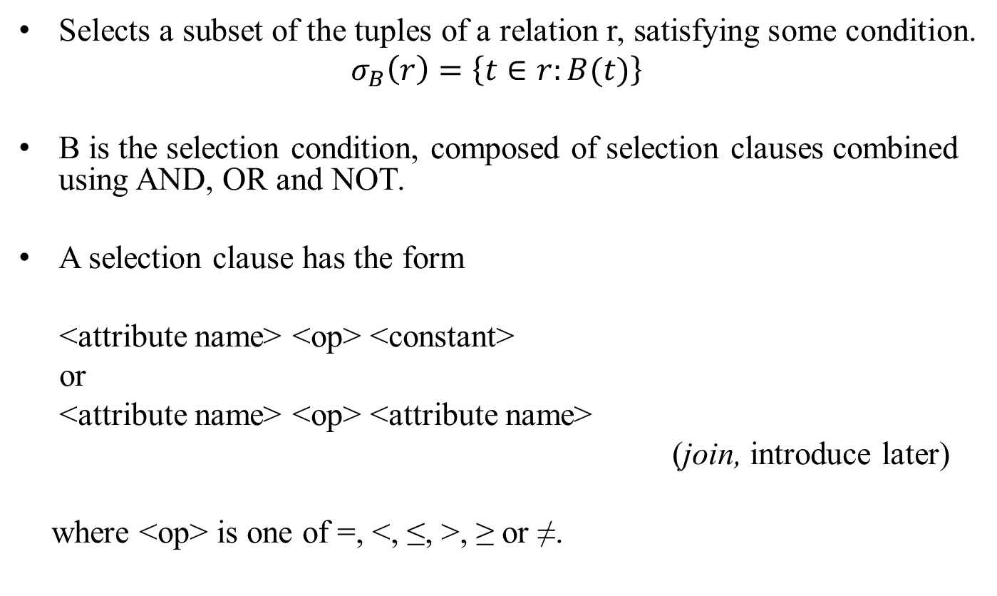
3.1 SELECT
Selects a subset of the tuples of a relation r, satisfying some condition.
$$σ_{B}\left(r\right)=\left\{t∈r:B(t)\right\}$$
B is the selection condition, composed of selection clauses combined using AND, OR and NOT.
A selection clause has the form
<attribute name> <op> <constant>
or
<attribute name> <op> <attribute name>
(join, introduce later)
where <op> is one of =, <, ≤, >, ≥ or ≠.

Slide 4
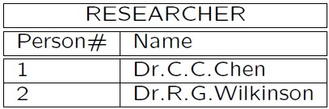
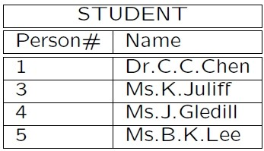
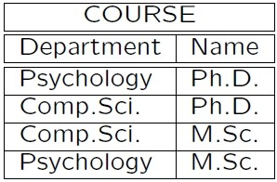
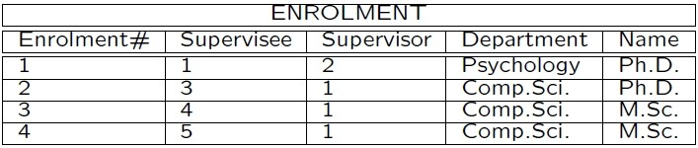

Slide 5
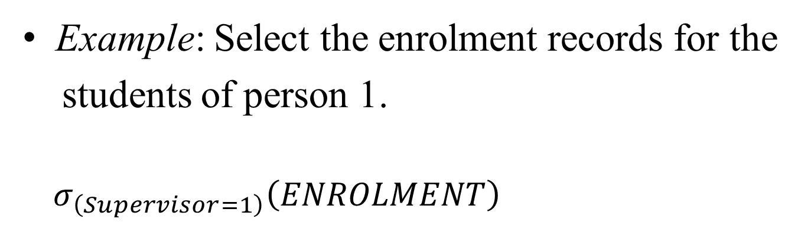
Example: Select the enrolment records for the
students of person 1.
$${ σ}_{\left(Supervisor=1\right)}\left(ENROLMENT\right)$$
Enrolment# | Supervisee | Supervisor | Department | Name
2 | 3 | 1 | Comp.Sci | Ph.D.
3 | 4 | 1 | Comp.Sci | M.Sc.
4 | 5 | 1 | Comp.Sci | M.Sc.

Slide 6
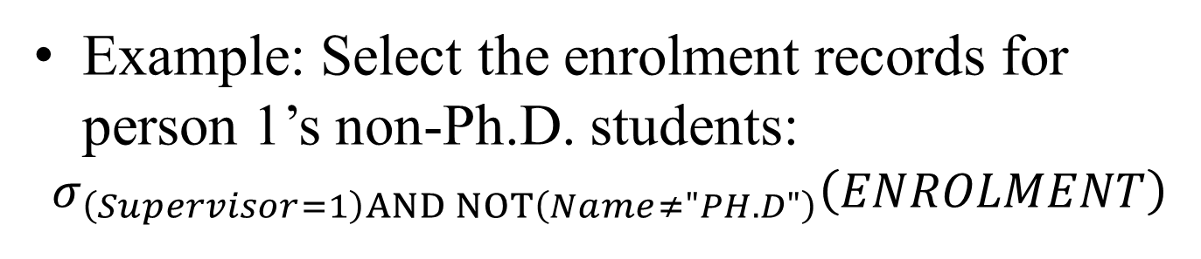
Example: Select the enrolment records for person 1’s non-Ph.D. students:
$$σ_{\left(Supervisor=1\right)AND NOT\left(Name≠"PH.D"\right)}\left(ENROLMENT\right)$$
Enrolment# | Supervisee | Supervisor | Department | Name
3 | 4 | 1 | Comp.Sci | M.Sc
4 | 5 | 1 | Comp.Sci | M.Sc

Slide 7
Properties:
• Commutative:
σ _{<cond1>} (σ _{<cond2>} (R)) =
σ _{<cond2>} (σ _{<cond1>} (R))
• Consecutive selects can be combined:
σ _{<cond1>} (σ _{<cond2>} (R)) =
σ _{<cond1>} AND _{<cond2>} (R))

Slide 8
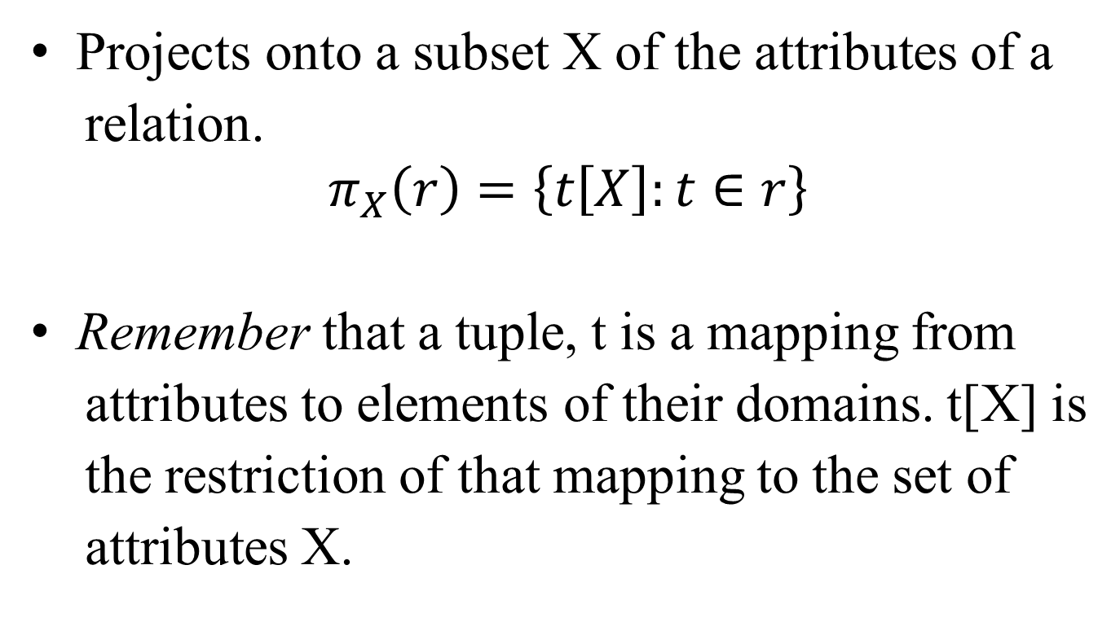
3.2 PROJECT
Projects onto a subset X of the attributes of a
relation.
$$π_{X}\left(r\right)=\left\{t\left[X\right]:t∈r\right\}$$
Remember that a tuple, t is a mapping from
attributes to elements of their domains. t[X] is
the restriction of that mapping to the set of
attributes X.

Slide 9
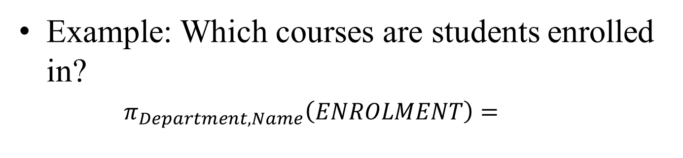
Example: Which courses are students enrolled in?
$π_{Department,Name}\left(ENROLMENT\right)=$
Department | Name
Psych. | Ph.D.
Comp.Sci | Ph.D.
Comp.Sci | M.Sc.

Slide 10
Properties:
• if <list2> contains all the attributes in <list1> then
π _{<list1>} (π _{<list2>} (R)) = π _{<list1>} (R)
else
The operation is not well defined.
• commutes with selection:
π_{X} (σ_{B}(R)) = σ_{B} (π_{X}(R))
Exercise: Verify the above with:
π_{{Department}} (σ _{(Department=“Psychology”)}(ENROLMENT)).

Slide 11
Properties:
• if <list2> contains all the attributes in <list1> then
π _{<list1>} (π _{<list2>} (R)) = π _{<list1>} (R)
else
The operation is not well defined.
• commutes with selection: B cannot be specified outside of X
π_{X} (σ_{B}(R)) = σ_{B} (π_{X}(R))
Exercise: Verify the above with:
π_{{Department}} (σ _{(Department=“Psychology”)}(ENROLMENT)).

Slide 12
Questions
1) π (R U S)) = π (R) U π (S)?
2) π (R ∩ S)) = π (R) ∩ π (S)?

Slide 13
Answer:
2) π (R ∩ S)) ≠ π (R) ∩ π (S)
Example:
R = (Animal, Cat), S = (Animal, Dog)
π: project on the first column
π (R ∩ S)) = {}
π (R) ∩ π (S) = {Animal}

Slide 14
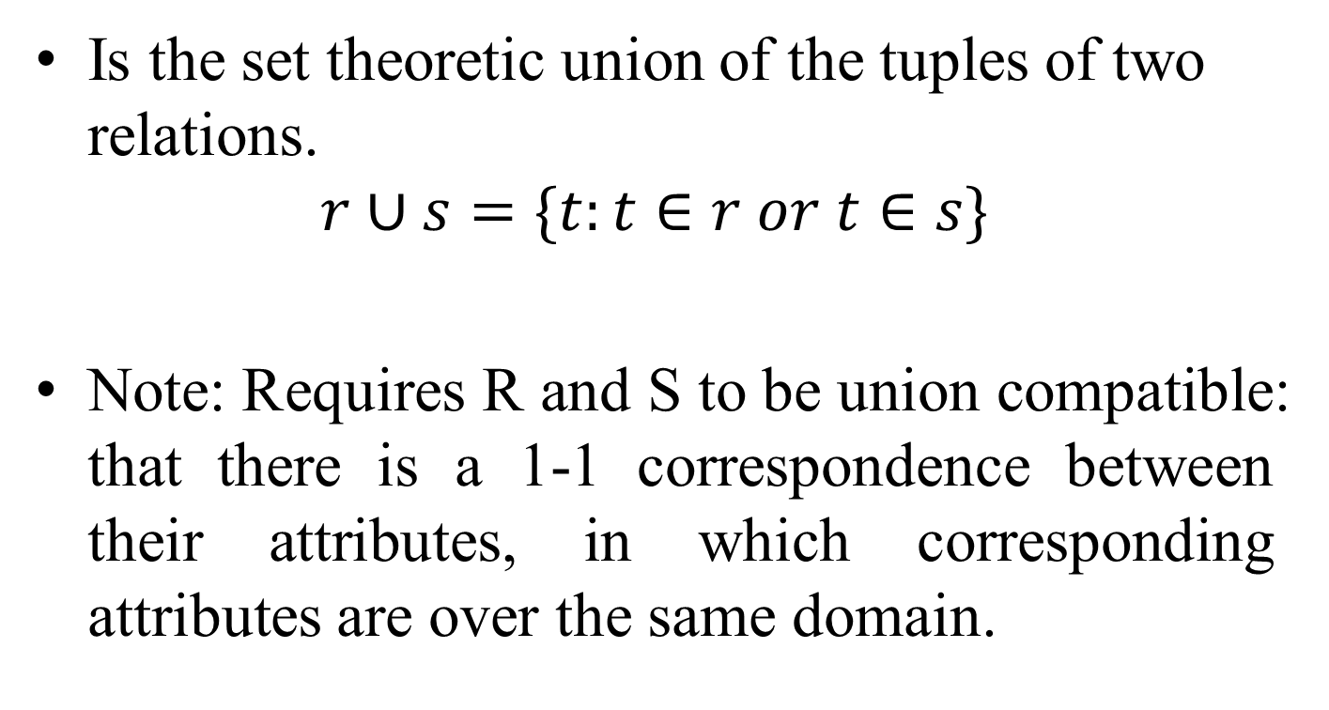
3.3 UNION
Is the set theoretic union of the tuples of two relations.
$$r∪s=\{t:t∈r or t∈s\}$$
Note: Requires R and S to be union compatible: that there is a 1-1 correspondence between their attributes, in which corresponding attributes are over the same domain.

Slide 15
Example:
R1 ← σ _{(Supervisor=2)} (ENROLMENT)
R2 ← σ _{(Name=“M.Sc′′)} (ENROLMENT)
R1 ∪ R2 =
Example: STUDENT ∪ RESEARCHER =
Enrolment# | Supervisee | Supervisor | Department | Name
1 | 1 | 2 | Psych. | Ph.D.
3 | 4 | 1 | Comp.Sci | M.Sc
4 | 5 | 1 | Comp.Sci | M.Sc
Person# | Name
1 | Dr C.C.Chen
3 | Ms K.Juliff
4 | Ms J.Gledhill
5 | Ms B.K.Lee
2 | Dr R.G.Wilkinson

Slide 16
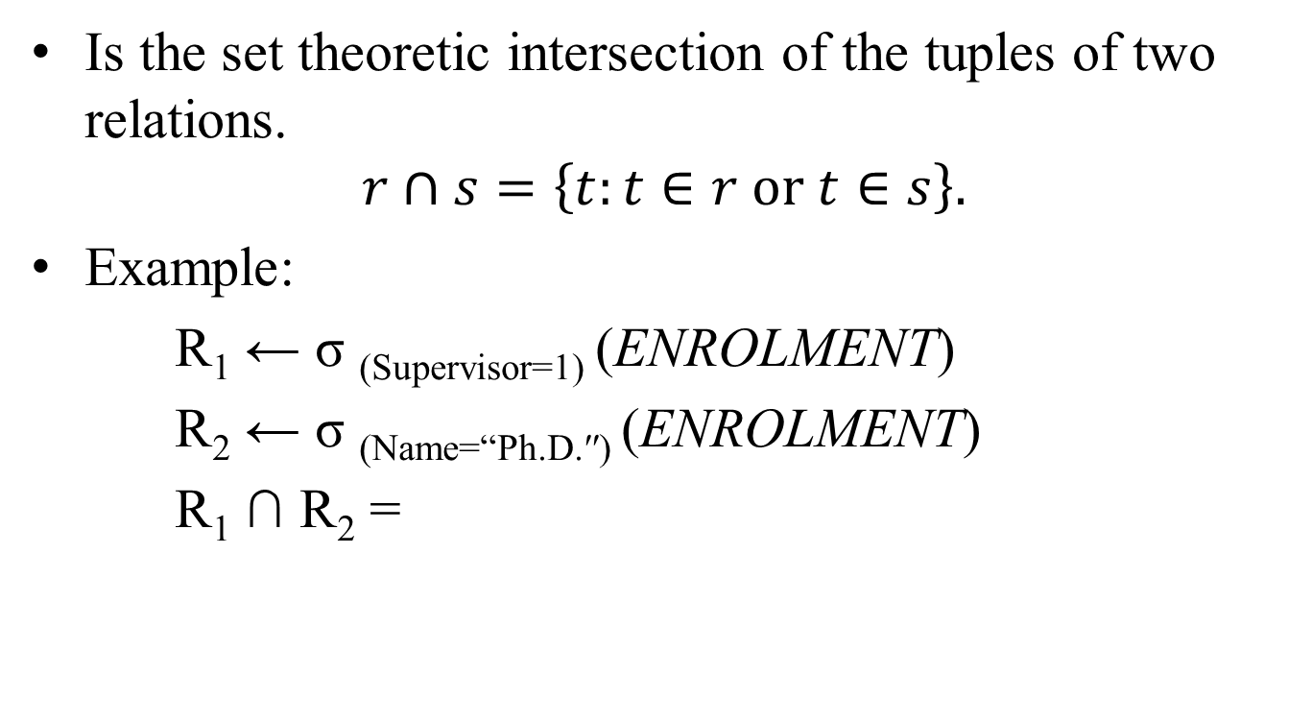
3.4 INTERSECTION
Is the set theoretic intersection of the tuples of two relations.
$$r∩s=\left\{t:t∈r or t∈s\right\}.$$
Example:
R₁ ← σ _{(Supervisor=1)} (ENROLMENT)
R₂ ← σ _{(Name=“Ph.D.′′)} (ENROLMENT)
R₁ ∩ R₂ =
Enrolment# | Supervisee | Supervisor | Department | Name
2 | 3 | 1 | Comp.Sci. | Ph.D.

Slide 17
Example: STUDENT ∩ RESEARCHER =
Person# | Name
1 | Dr C.C. Chen

Slide 18
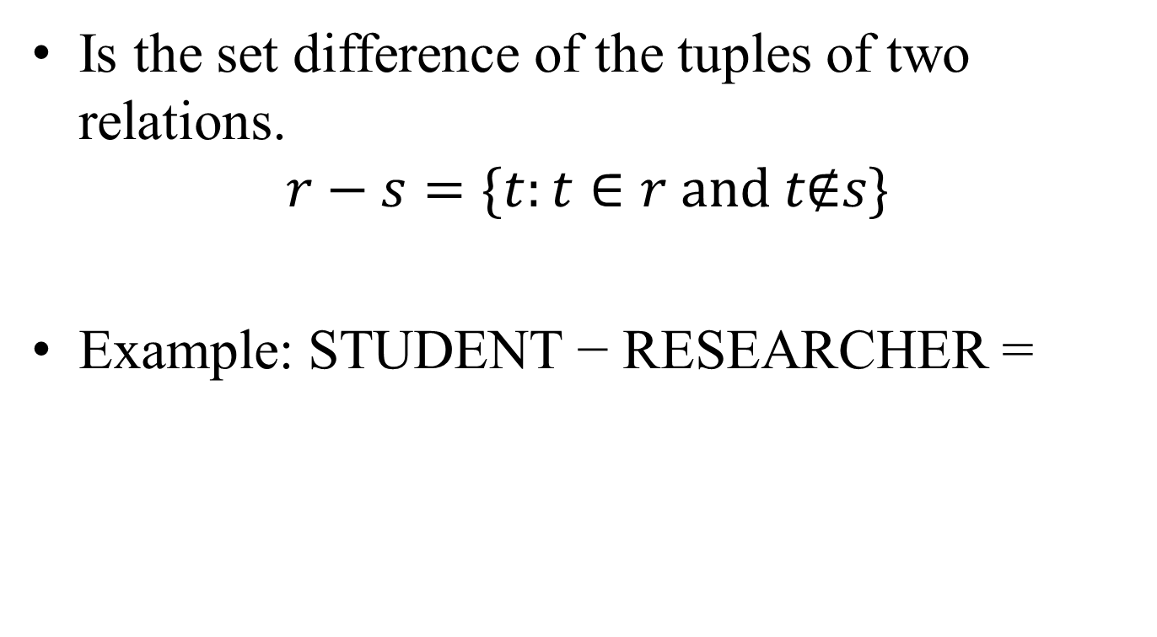
3.5 DIFFERENCE
Is the set difference of the tuples of two relations.
$$r−s=\{t:t∈r and t\text{∉}s\}$$
Example: STUDENT − RESEARCHER =
Person# | Name
3 | Ms K. Juliff
4 | Ms J. Gledhill
5 | Ms B.K. Lee

Slide 19

3.6 CARTESIAN PRODUCT
$$r×s=\{t_{1}||t_{2}:t_{1}∈r and t_{2}∈s\}$$
Where $t_{1}||t_{2}$ indicates the concatenation of tuples.
Example:
ENROLMENT$×$RESEARCHER
E’ment# | S’ee | S’or | D’ment | E’ment. Name | Person# | R’cher. Name
1 | 1 | 2 | Psych. | Ph.D. | 1 | Dr C.C. Chen
1 | 1 | 2 | Psych. | Ph.D. | 2 | Dr R.G.Wilkinson
2 | 3 | 1 | Comp.Sci | Ph.D. | 1 | Dr C.C. Chen
2 | 3 | 1 | Comp.Sci | Ph.D. | 2 | Dr R.G.Wilkinson
3 | 4 | 1 | Comp.Sci | M.Sc. | 1 | Dr C.C. Chen
3 | 4 | 1 | Comp.Sci | M.Sc. | 2 | Dr R.G.Wilkinson
4 | 5 | 1 | Comp.Sci | M.Sc. | 1 | Dr C.C. Chen
4 | 5 | 1 | Comp.Sci | M.Sc. | 2 | Dr R.G.Wilkinson

Slide 20

More useful is:
R1 ← ENROLMENT $×$ RESEARCHER
$$σ_{\left(Supervisor=Person\#\right)}\left(R1\right)=$$
E’ment# | S’ee | S’or | D’ment | E’ment. Name | Person# | R’cher. Name
1 | 1 | 2 | Psych. | Ph.D. | 2 | Dr R.G.Wilkinson
2 | 3 | 1 | Comp.Sci. | Ph.D. | 1 | Dr C.C. Chen
3 | 4 | 1 | Comp.Sci. | M.Sc. | 1 | Dr C.C. Chen
4 | 5 | 1 | Comp.Sci. | M.Sc. | 1 | Dr C.C. Chen

Slide 21
or even better:
R1 ← ENROLMENT × RESEARCHER
R2 ← σ(Supervisor=Person#)(R1) =
π{E′ment#,S′ee,S′or,R′cher.Name,D′ment,E′ment.Name}(R2) =
The last of these is also known as natural join, the next to last is equi-join.
E’ment# | S’ee | S’or | R’cher. Name | D’ment | E’ment. Name
1 | 1 | 2 | Dr R.G.Wilkinson | Psych. | Ph.D.
2 | 3 | 1 | Dr C.C. Chen | Comp.Sci. | Ph.D.
3 | 4 | 1 | Dr C.C. Chen | Comp.Sci. | M.Sc.
4 | 5 | 1 | Dr C.C. Chen | Comp.Sci. | M.Sc.

Slide 22
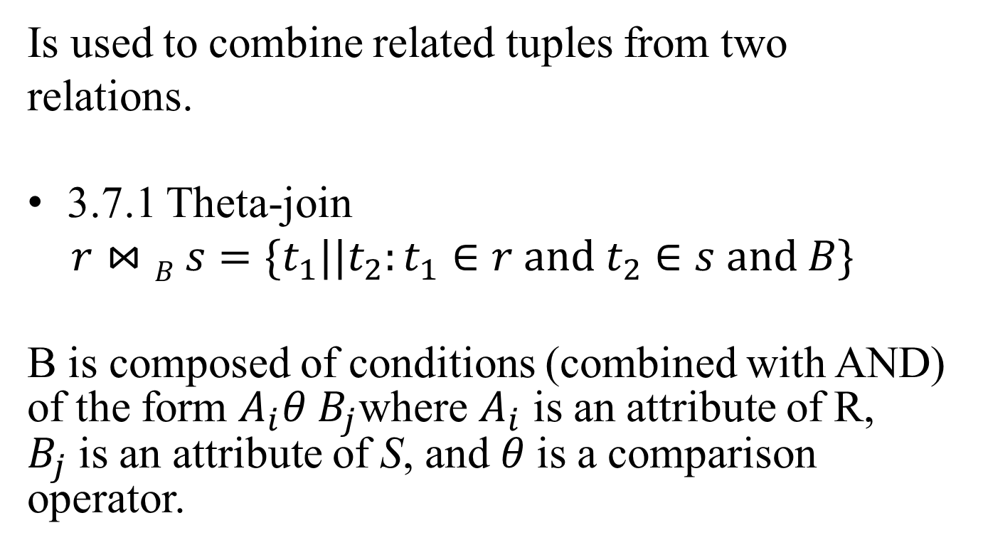
3.7 JOIN
Is used to combine related tuples from two
relations.
3.7.1 Theta-join
$r⋈B s=\{t_{1}||t_{2}:t_{1}∈r and t_{2}∈s and B\}$
B is composed of conditions (combined with AND) of the form $A_{i}θ B_{j}$where $A_{i}$ is an attribute of R, $B_{j}$is an attribute of S, and$θ$ is a comparison operator.

Slide 23

3.7.2 Equi-join
Is a theta-join where each comparison operator is “=”.
Example:
$${}_{}^{\begin{aligned}ENROLMENT⋈ \\ RESEARCHER \end{aligned}(Supervisor=Person\#)}{}$$

Slide 24

3.7.3 Natural join
Is an equi-join where only one attribute from each comparison is retained.
Example:
Question: If two relations have no join attributes,
how do you define the join result? Why?
$${}_{}^{\begin{aligned}ENROLMENT⋈ \\ RESEARCHER \end{aligned}\left(Supervisor\right),(Person\#)}{}$$

Slide 25
3.7.3 Natural join
Is an equi-join where only one attribute from each comparison is retained.
Example:
Question: If two relations have no join attributes,
how do you define the join result? Why?
R (A, B) ⋈ S (B, C) ⋈ T (C, D)
$${}_{}^{\begin{aligned}ENROLMENT⋈ \\ RESEARCHER \end{aligned}\left(Supervisor\right),(Person\#)}{}$$

Slide 26
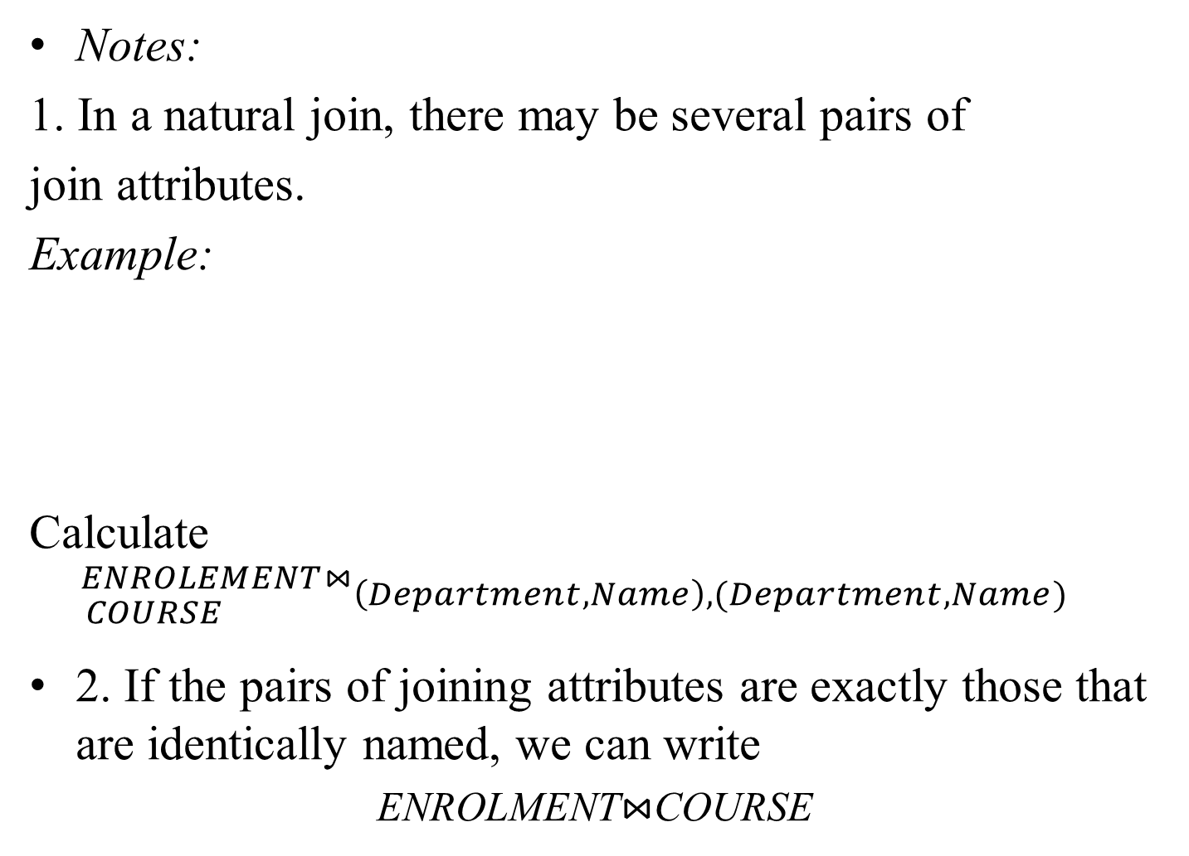
Notes:
1. In a natural join, there may be several pairs of
join attributes.
Example:
Calculate
$${}_{}^{\begin{aligned}ENROLEMENT⋈ \\ COURSE \end{aligned}\left(Department,Name\right),(Department,Name)}{}$$
2. If the pairs of joining attributes are exactly those that are identically named, we can write
ENROLMENT⋈COURSE
COURSE
Department | Name | By
Comp.Sci | Ph.D. | Research
Comp.Sci. | M.Sc. | Research
Psychology | M.Sc. | Coursework

Slide 27
3.8 DIVIDE
Suppose R is a relation over Z, S over X with
X ⊆ Z. Let Y = Z − X. Then R ÷ S is a relation over Y ,
R ÷ S = {t : t × S ⊆ R }

Slide 28

Example:
P
A | B
a₁ | b₁
a₁ | b₂
a₂ | b₁
a₃ | b₂
a₄ | b₁
a₅ | b₁
a₅ | b₂
Q
B
b₁
b₂
A
a₁
a₅
$$P÷Q=$$

Slide 29
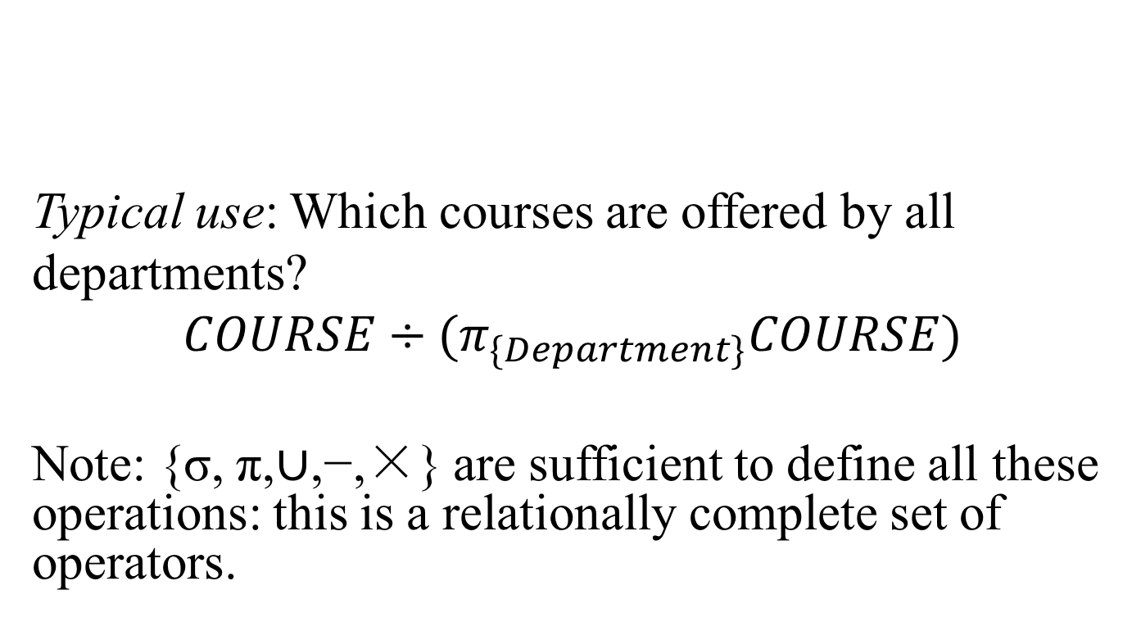
Typical use: Which courses are offered by all
departments?
$$COURSE÷(π_{\{Department\}}COURSE)$$
Note: {σ, π,∪,−,×} are sufficient to define all these operations: this is a relationally complete set of operators.

