Slide 1


Integration Service

Slide 2
Architecture
Capabilities
Use cases
Upcoming developments
FpML Training
Rich Client Training
ISAC

Slide 3


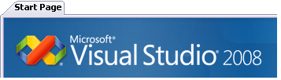




Architecture
Interfacing
Trades,
Instruments
Third parties
Valuations
Web Designer
Allows remote access to selected features of Sophis application
3 logical tier architecture
Data tier :
existing sophis production database
Business Logic tier :
Sophis servers allowing realtime feed, and
consistency between users.
Application deployed inside IBM WebSphere Application Server allowing to interact with Sophis data using standard Web Services
Presentation tier :
Customer specified interface allowing to render and present business data into a bespoke format (Web portal for html pages, excel spreadsheets, rich clients…)
Presentation Tier
Business Logic Tier
Data Tier
Secured Web Service request
Integration Service
Proxy
WSDL
DataExchange
ORACLE
database
Proxy
WSDL
Valuation
Sophis Middleware
Proxy
WSDL
SOA Web Designer
MQ Connector
File connector
Value users
Business & performance
Cache Servers
Calculation Servers
Core services

Slide 4



Architecture
SOAP
Snd queue
EJB JMS listener
Http server
JMS
Web Service Engine
Rcv queue
Router component
EJB Session
JNI Bridge
WSDL publish
FpML Engine
Sophis API
Toolkit

Slide 5
IS and Specific Development: 2 Sophis SDK tools for specific usage
Integration Service
Strengths
Lighten your architecture
Less license usage (cost)
Less memory consumption (hardware)
Scalability enforced by WebSphere Application Server
Deploy clusters of services.
Easy to add more cores on one cluster
Security enforced by WebSphere Application Server
https available
Credential based on Sophis user/password (per Web Service)
Handle Sophis user rights based on the user
Integration
3 Tier architecture development of light interfaces
Web Service integration: cross platform
java applications
.Net components / applications (COM)
web portals : any technology that can connect a Web Service
Eclipse (Java )
ASP.Net (Microsoft)
RAD (IBM) installed with websphere
Rich client : Silverlight (Microsoft)
Weaknesses
Can not modify existing functionalities (new columns, pricing, workflow, …)
Specific development (API based)
Strengths
Enrich the application
Add new portfolio columns
Back Office check
Pricing model
Instrument validation
Access to more functionnalities
Weaknesses
Memory consumption
License consumption
Starting time
Maintenance
Enrich by Specific Development
Access by Integration Service

Slide 6
Capabilities
Data exchange : Import data into Sophis / Export data from Sophis
Instruments
Equities, Issuers, Indices, Baskets
Swaps
Options, Futures, Forward
Packages
Bonds, Convertible bonds
Debts
Cap floor
Commodities, Commodity futures, Commodity Indices
Funds
TRS
Trades
Standard, Listed Options, Forex, FxSwap, Advanced Stock loan (Initiation, Margin Call)
Cfds
Orders
Third parties
Portfolios
Market data
volatilities
dividends
yield curves
correlations
fixings
Toolkit entities

Slide 7
Capabilities
Valuations
Instruments (real and virtual instruments)
Fair value
Greeks (add your own Greek by toolkit)
Bid, Ask, Last
Forward price
Portfolios
Retrieves all positions and columns values)
Same on defined or dynamic extractions
Scenarios
Risk matrix…
Develop your own scenario with XML input/output
Overloading of market data
volatilities, forex, spots, dividends, pricing preferences
Can use Sophis grid for computations
Queries
Request a list of entities matching a given query
Trades
Instruments
Third parties

Slide 8
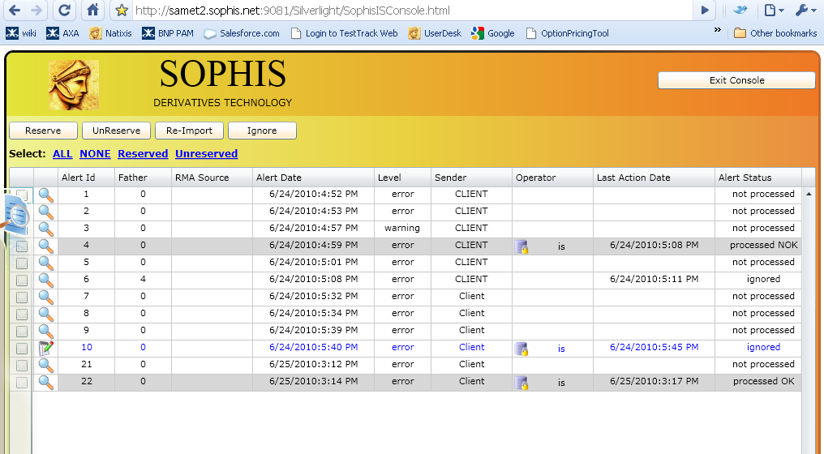
Capabilities
SOA Web Designer Designed in 6.0
Extended data coverage
Create new methods based on Reporting Module Sources, even for non-developper
Users can reuse all existing business XML sources (Performance calculation source, Cash balance source, SQL source, Scenario source, Account posting source, Toolkited sources, etc…)
Define new methods based on new sources (toolkit), and remotely access / modify any
Integration Service Alert Console
Integration Service Web Service
Diplay all the alerts
Re-submit requests

Slide 9

Use case: data exchange (1/3)
Basic architecture
1. Entity (trade, instrument,…) is created/ modified in an external system and sent to Value
By a scheduled Batch job or real time
Middleware: Sophis or Tibco EMS
Sophis users
Citrix® servers
Core server
External
FO systems
Interfacing
Core services
Distributed real time
External
data store
ORACLE
database
Data

Slide 10
Use case: data exchange (2/3)
Basic architecture
2.The interfacing service execute the message
Creates the entity in the database
Sends notification to all the users
Middleware: Sophis or Tibco EMS
Sophis users
Citrix® servers
Core server
External
FO systems
Interfacing
Core services
Distributed real time
ORACLE
database
Data

Slide 11
Use case: data exchange (3/3)
Basic architecture
Middleware: Sophis or Tibco EMS
Sophis users
3.The user gets the updated data
Data only downloaded if required
P&L is updated in real-time
Citrix® servers
Core server
External
FO systems
Core services
Interfacing
Distributed real time
ORACLE
database
Data

Slide 12
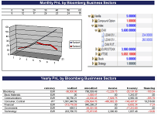
Use case: online trading (1/3)
Basic architecture
Middleware: Sophis or Tibco EMS
Business & performance
Sophis users
1. The Web Portal (client created *)
Proposes any product from simple vanilla to customisable derivatives
Citrix® servers
Core server
Web service requests
Interfacing
Core services
Distributed real time
ORACLE
database
Data
Sophis provides some web services that can be used by the client to build its own portal. Sophis doesn’t provide a portal. From 4.2 Sophis will provide some clients.

Slide 13
Use case: online trading (2/3)
2. Product selection / structure
The user composes its own OTC product on the portal.
Basic architecture
Middleware: Sophis or Tibco EMS
Business & performance
Sophis users
3. Valuation
The user request a pricing of the product (eventually with help of the grid)
Citrix® servers
Core server
Web service requests
Interfacing
Core services
4. Purchase
The user agrees on the price, and purchase the product
Distributed real time
ORACLE
database
Data

Slide 14
Use case: online trading (3/3)
Basic architecture
Middleware: Sophis or Tibco EMS
5. Instrument creation
The product is created in Sophis.
Business & performance
Value users
Citrix® servers
Core server
Web service requests
Interfacing
Core services
6. Hedging
The trade and instruments are sent to a trader’s book and can be hedged for instance.
Distributed real time
ORACLE
database
Data

Slide 15
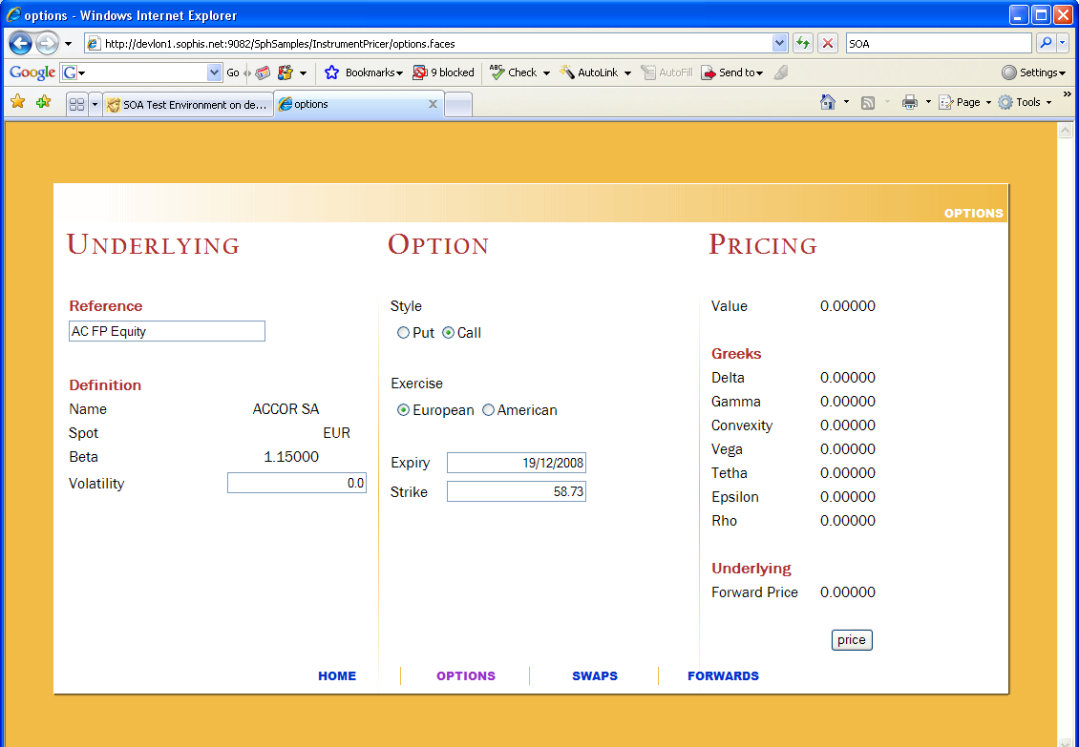
Use case: Java Web Page Pricing Tool

Slide 16
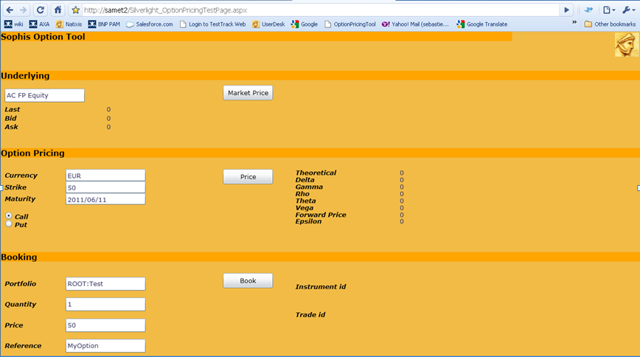
Use case: Silverligth Web Page Pricing Tool

Slide 17
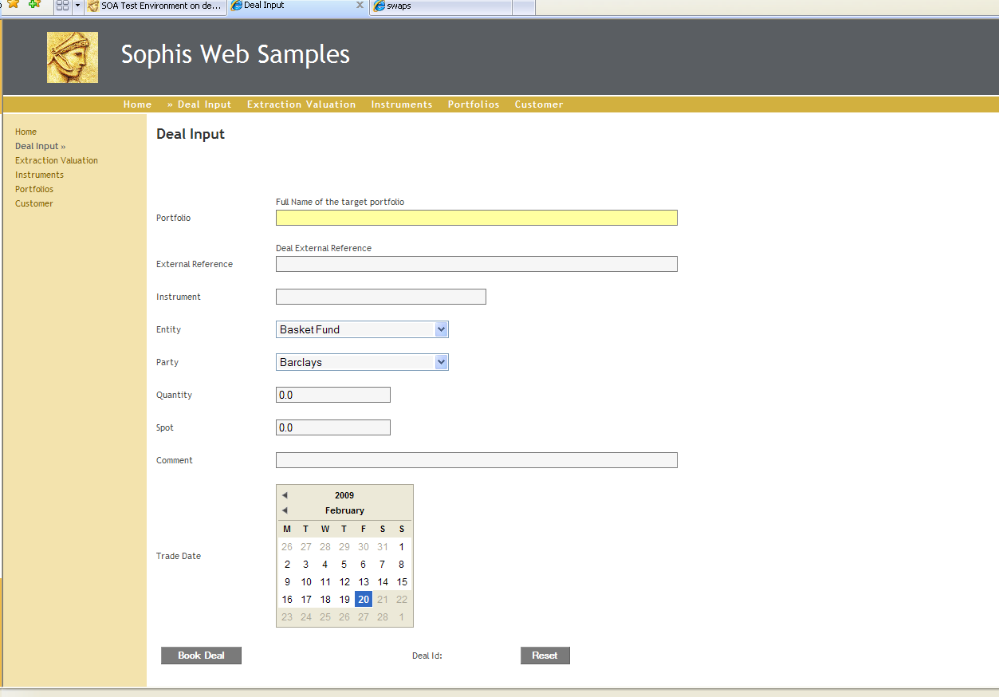
Use case: Jave Web Page Reporting

Slide 18
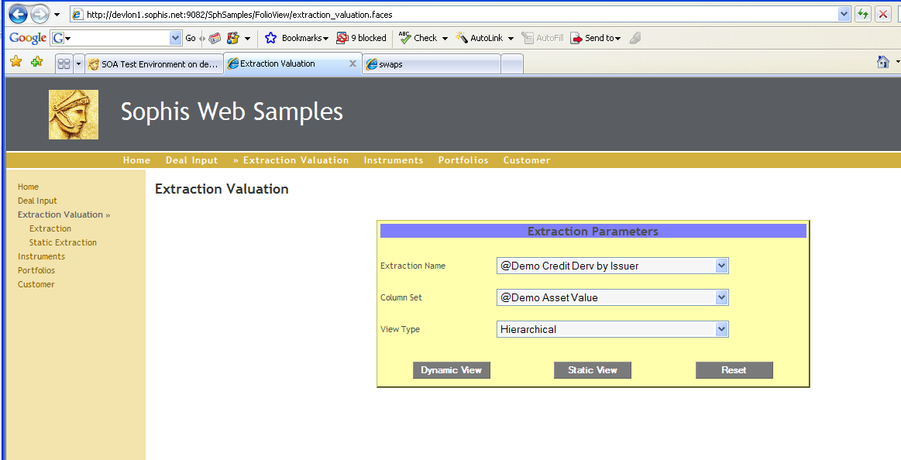
Use case: Jave Web Page Reporting

Slide 19
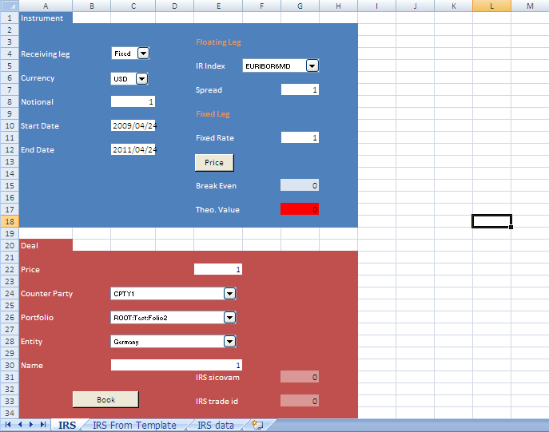
Use case: Excel IRS Pricing / Booking

Slide 20
Upcoming developments (Rich client)
Until 6.2 Sophis provides the server, not the client.
From 6.3 Sophis will provide Rich Clients:
Not fully defined yet
Clients proposal are welcome
Partnership to develop Rich Clients possible (Toolkit Team/Client IT development, maintained by Sophis).

Slide 21
Financial product Markup Language
Sophis XML is based on FpML
Sophis XML Message structure
Based on xml schemas
fpml.xsd
common.xsd
dataExchange.xsd
sophis.xsd
...
Optional Header
6 messages kind
import
export
valuationRequest
queryMessage
soaMethodsExportMessage
soaMethodsRequest
How to design an XML request
Using samples provided in the IS data/samples folders
XML copy/paste from a Value client
Use schema files
That’s the best way to learn how to write correct xml files.
They are well documented.

Slide 22
FpML Messages: Import
Import one or more entities to import into Sophis
Entities are:
Instruments
Trades
Folio
ThirdParty
Market data
Orders
Any custom namespace (SDK, C++ only)
Batch modes : NoSession, Session, AllOrNothing
Persistence Types :
For each entity, defined the persistence type:
Create
FindOrCreate
UpdateOrCreate
CheckOrCreate
Server response :
ImportMessageAccepted
MessageRejected
ImportMessagePartiallyAccepted
Handle custom elements (SDK)
<?xml version="1.0"?>
<exch:import version="4-2"
xmlns:xsi= http://www.w3.org/2001/XMLSchema-instance
xmlns:exch="http://sophis.net/sophis/gxml/dataExchange"
xmlns:fpml="http://www.fpml.org/2005/FpML-4-2"
xmlns:dsig="http://www.w3.org/2000/09/xmldsig#"
xmlns:common=http://sophis.net/sophis/common
xmlns:xsd=http://www.w3.org/2001/XMLSchema
xmlns:party=http://www.sophis.net/party
xmlns:trade="http://www.sophis.net/trade"
xmlns:instrument=http://www.sophis.net/Instrument
xmlns:sph="http://www.sophis.net/Instrument"
xmlns:folio=http://www.sophis.net/folio
xmlns:user="http://www.sophis.net/user"
exch:batchType="Session">
<fpml:header>
<fpml:conversationId conversationIdScheme=""/>
<fpml:messageId messageIdScheme="http://www.sophis.net/gxml/exchange/messageIdScheme/simple">001
</fpml:messageId>
<fpml:sentBy partyIdScheme="http://www.sophis.net/party/partyId/name">CLIENT</fpml:sentBy>
<fpml:sendTo partyIdScheme="http://www.sophis.net/party/partyId/name">SOPHIS</fpml:sendTo>
<fpml:creationTimestamp>2010-06-24T13:52:00</fpml:creationTimestamp>
<fpml:expiryTimestamp>2010-07-24T22:53:00</fpml:expiryTimestamp>
</fpml:header>
<sph:sobj1>
</sph:obj1>
<sph:sobj2>
</sph:obj2>
</exch:import>

Slide 23
Import: import entities
Create an instrument
Get a stock definition from the GUI
Check the schema
Create a new share
Naming convention (instrument references)
Reference types are defined in “Data/Universal Reference”.
They are mapped
<sph:identifier>
<sph:sophis>67312729</sph:sophis>
<sph:reference sph:modifiable="UniquePrioritary" sph:name="ExternalReference">616077</sph:reference>
<sph:reference sph:modifiable=« OnlyForUpdate" sph:name="MyRef">TypeShareA</sph:reference>
<sph:reference sph:modifiable="UniquePrioritary" sph:name="Ric">2318.HK</sph:reference>
<sph:reference sph:modifiable="UniquePrioritary" sph:name="Bloomberg">B2318.HK</sph:reference>
</sph:identifier>
Modifiable attribute :
UniquePrioritary: define an instrument from a unique reference .
UniqueNotPrioritary: define an instrument from a unique reference.
OnlyForUpdate: define a not unique reference.
To find an instrument the algorithm is to check the uniqueness of the sicovam associated to all the ‘UniquePrioritary’ references.
Create a new share with specific name
Create entities
Get entities from the GUI
Check the schema
Create a folio, thirdparty, trades, marketdata

Slide 24
Import
Persistence type (Common.sxd)
For each entity define a persistence type
Create: creation only.
FindOrCreate: creation and use as an underlying.
UpdateOrCreate: creation or if already created update.
CheckOrCreate: creation or if already created returns the modifications.
Import modified XML of an instrument with different “persistence types” and see the result.
Change the BO status of a trade.
Batch type (DataExchange.xsd)
NoSession
In this mode, any entity causing a failure is skipped and the batch is continued, and a ImportMessagePartiallyAccepted is issued.
Each entity is committed if successful. The message contains all the successful entities identifiers, as well as the faulty ones (either directly or due to dependency).
If no error occurs, an ImportMessageAccepted is issued containing all the entities identifiers.
If a very early error occurs (invalid fpml or xml) or if the connector couldn't contact the gateway, and if no entity could be processed, a
message MessageRejected is still issued.
Session
For RMA
AllOrNothing
All entities are processed even if there is a failure.
If all succeed, all is commited one times at the end of the session. In this case, A ImportMessageAccepted is issued containing all the entities identifiers.
If at least one fails, all is rolled back. A ImportMessagePartiallyAccepted is issued with attribute commited=false and the list of errors
Dependencies (id/href)
In the same import message define dependencies between entities (ex: to create a new trade on a new instrument)
Import several trades (with or without errors) on a new instrument, with different batch type, and see the result.

Slide 25
FpML Messages: Export
Export request one or more entities to import out from Sophis
Entities are (same as import):
Instruments
Trades
Folio
ThirdParty
Market data
Any custom namespace (SDK, C++ only)
Export an instrument, a trade, a thirdparty
Batch modes
NoSession, Session, AllOrNothing
Capability to follow dependencies
Export a trade with dependencies
Server response:
ExportMessageAccepted
MessageRejected
ExportMessagePartiallyAccepted
Handle custom elements (SDK)
Export a customized trade and check the custom fields
<?xml version="1.0"?>
<exch:export version="4-2"
xmlns:xsi= http://www.w3.org/2001/XMLSchema-instance
xmlns:exch="http://sophis.net/sophis/gxml/dataExchange"
xmlns:fpml="http://www.fpml.org/2005/FpML-4-2"
xmlns:dsig="http://www.w3.org/2000/09/xmldsig#"
xmlns:common=http://sophis.net/sophis/common
xmlns:xsd=http://www.w3.org/2001/XMLSchema
xmlns:party=http://www.sophis.net/party
xmlns:trade="http://www.sophis.net/trade"
xmlns:instrument=http://www.sophis.net/Instrument
xmlns:sph="http://www.sophis.net/Instrument"
xmlns:folio=http://www.sophis.net/folio
xmlns:user="http://www.sophis.net/user"
exch:batchType="Session">
<fpml:header>
<fpml:conversationId conversationIdScheme=""/>
<fpml:messageId messageIdScheme="http://www.sophis.net/gxml/exchange/messageIdScheme/simple">001
</fpml:messageId>
<fpml:sentBy partyIdScheme="http://www.sophis.net/party/partyId/name">CLIENT</fpml:sentBy>
<fpml:sendTo partyIdScheme="http://www.sophis.net/party/partyId/name">SOPHIS</fpml:sendTo>
<fpml:creationTimestamp>2010-06-24T13:52:00</fpml:creationTimestamp>
<fpml:expiryTimestamp>2010-07-24T22:53:00</fpml:expiryTimestamp>
</fpml:header>
<sph:sobj1>
</sph:obj1>
<sph:sobj2>
</sph:obj2>
</exch:export>

Slide 26
FpML Messages: Valuation
Request a pricing on instruments
Fair value
Greeks (add your own Greek by toolkit)
Bid, Ask, Last
Forward price
Request a pricing on portfolios
Retrieves all positions and columns values
Scenarios (Risk matrix, …etc.)
Overloading of market data
Volatilities
Forex
Spots
Dividends
Pricing
Preferences
Can use Sophis grid for computations
<?xml version="1.0>
<exch:valuationRequest version="4-2"
xmlns:xsi="http://www.w3.org/2001/XMLSchema-instance"
xmlns:fpml="http://www.fpml.org/2005/FpML-4-2"
xmlns:dsig="http://www.w3.org/2000/09/xmldsig#"
xmlns:common="http://sophis.net/sophis/common"
xmlns:xsd="http://www.w3.org/2001/XMLSchema”
xmlns:valuation="http://www.sophis.net/valuation"
xmlns:preferences="http://www.sophis.net/preferences">
<fpml:header>
<fpml:messageId messageIdScheme="http://www.sophis.net/gxml/exchange/messageIdScheme/simple">001</fpml:messageId>
<fpml:sentBy partyIdScheme="http://www.sophis.net/party/partyId/name">BARCLAYS</fpml:sentBy>
<fpml:sendTo partyIdScheme="http://www.sophis.net/party/partyId/name">SOPHIS</fpml:sendTo>
<fpml:creationTimestamp>2005-09-19T13:52:00</fpml:creationTimestamp>
</fpml:header>
<valuation:valuationSet>
<valuation:pricingInput>
←!What to price-->
</ valuation:pricingInput>
<valuation:market>
←!Specific market data-->
</valuation:market>
<valuation:valuation>
←!How to price-->
</valuation:valuation>
</valuation:valuationSet>
</exch:valuationRequest>

Slide 27
Valuation
<valuation:valuationSet>
<valuation:instrumentAsset valuation:id="Option">
<instrument:instrumentIdentifier> <instrument:reference instrument:name="Ticker">xxx
</instrument:reference>
</instrument:instrumentIdentifier>
</valuation:instrumentAsset>
<valuation:derivativeAssetValuation>
<valuation:objectReference valuation:href="Option" />
</valuation:derivativeAssetValuation>
</valuation:valuationSet>
Pricing on instruments
fairValueAssetValuation: Fair value
derivativeAssetValuation: Fair value + Greeks
basicAssetValuation: Bid, Ask, Last (for underlying)
forwardPriceValuation: Forward price (for underlying)
Price an instrument with each type of valuation
SDK valuation item
See the SDK code to add IRS break even and the result (C++ only, will be soon available in .Net)
Market data and preferences modifications
For the valuation context only, modify some market data or preferences
Price an instrument modifying the underlying dividends
Price an instrument modifying a preference
Scenario valuation
Run a scenario with XML input parameters
Custom scenarios with XML implementation can be run this way
Run a scenario

Slide 28
Valuation
<valuation:valuationSet>
<valuation:portfolioAsset valuation:id="Folio1">
<folio:folioReference> <folio:portfolioName >ROOT:XXX
</folio:portfolioName> </folio:folioReference>
</valuation:portfolioAsset>
<valuation:portfolioValuation> <valuation:objectReference valuation:href="Folio1" /> <valuation:viewType>HierState</valuation:viewType> <valuation:columnSet>Configuration</valuation:columnSet>
</valuation:portfolioValuation>
</valuation:valuationSet>
Portfolio valuation
Define a portfolio
Overload market data if needed
View type:
HierState
FlatState
UnderlyingState
Columns:
Defined columns set
Define columns
Processing date:
Specify the processing (execute a prices date)
Price portfolios
Extraction valuations
Same as portfolio but define an extraction
From its name
Define it dynamically
Price extractions
<valuation:extractionAsset valuation:id="Extraction1">
<valuation:extraction xsi:type="folio:Criteria">
<folio:name>Counterparty</folio:name>
<folio:filteredDeals>NotLoaded</folio:filteredDeals>
<folio:sqlFilter>1 = 1</folio:sqlFilter>
<folio:criteriumList folio:filterUndefined="false" folio:hierarchic="true" folio:keepPositionID="false" folio:unique="false">
<folio:criterium>Counterparty</folio:criterium> <folio:criterium>Depositary</folio:criterium>
</folio:criteriumList>
<folio:folders folio:excludeEntryPoint="false"> <folio:folder xsi:type="folio:StandardPortfolio"> <folio:id>3713</folio:id>
</folio:folder>
</folio:folders>
</valuation:extraction>

Slide 29
FpML Messages: Queries
Define entities by SQL requests
Do not use for massive requests, prefer reporting sources
Portfolio valuation
Method designer
<?xml version="1.0"?><exch:queryMessage version="4-2"
xmlns:xsi="http://www.w3.org/2001/XMLSchema-instance" xmlns:exch="http://sophis.net/sophis/gxml/dataExchange"
xmlns:fpml="http://www.fpml.org/2005/FpML-4-2"
…
xmlns:user="http://www.sophis.net/user”>
<fpml:header>
…
</fpml:header>
<exch:trade>SELECT REFCON from HISTOMVTS where DATECOMPTABLE > TO_DATE('20100101','yyyymmdd')</exch:trade>
<exch:instrument>SELECT SICOVAM from TITRES where type = 'A'</exch:instrument>
<exch:folio>SELECT IDENT from FOLIO</exch:folio>
<exch:party>select IDENT from tiers</exch:party>
</exch:queryMessage>

Slide 30
FpML Messages: Method Designer
Design Web methods
From Sophis client (specific license needed), create a new Web
method
Bind sources parameters with method parameters
Export all the methods and find your new method
Use export/import to move from a dev to prod environment
Get design methods
Use a web method
Call a method and check the result
< <?xml version="1.0"?>
<exch:soaMethodsExportMessage version="4-2"
…
>
<fpml:header>
…
</fpml:header>
</exch:soaMethodsExportMessage>

Slide 31
Create a Web Service Client
Locate the Service from the application server
https://wshost:9444/exchange/DataExchangeService
https://wshost:9444/ValuationWS/ValuationService
https://wshost:9444/SoaMethodDesignerWS/SoaMethodDesignerService
Once a Service provider has been located get the Web Services Description Language (WSDL):
?WSDL
or directly from the service directory
Create a binding
Once a Service Provider has been located, and its WSDL description retrieved, it is necessary to generate a binding.
A Binding is a collection of language specific objects, automatically generated from the Service Description, and providing transparent access
to a service operations, parameters and type definitions.
A binding is usually composed of:
A set of type definition classes, organized in a namespace, matching the schemas defined by the service provider. These classes can be transparently serialized to / deserialized from XML by the underlying Web Service framework. This allows the client code to manipulate standard object instances instead of dealing with complex XML parsing
A service interface definition, usually an interface or an abstract class defining the service operations
A set of concrete classes providing the glue between the Service interface definition and the underlying Web Service framework implementation performing all the real work (XML / SOAP (de)serialization, HTTP exchanges, TCP connections). The top level class is usually called a “Proxy” and is the concrete implementation of the service interface definition used by the developer to consume the Service.

Slide 32
Create a Web Service Client
Create a WebReference
In .net use
add web reference
add service reference
wsdl.exe
Use the proxy
Generate the proxy once for all the projects
WebApi is coming soon
Create a new transaction from a .Net exe.
Method designer: create a Toolkit Source
Rich client
Using Method Designer and DataExchange, create a FX deal window.

Slide 33
ISAC
Integration Service Alert Console
Use filters to find error requests
Reserve the request
Correct it
Re-submit it

