Slide 1
Sparse and group regression models in portfolio optimization
Project Supervisor: Professor Mahesan Niranjan
Second Examiner: Professor Vladimiro Sassone

Slide 2

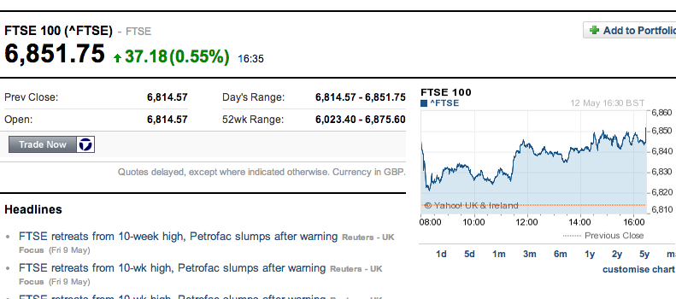
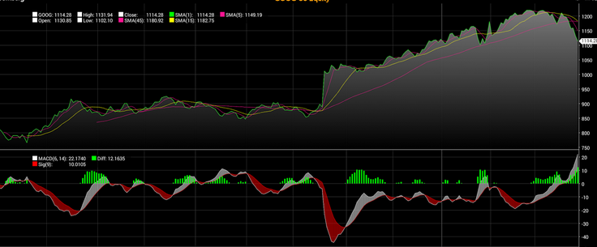
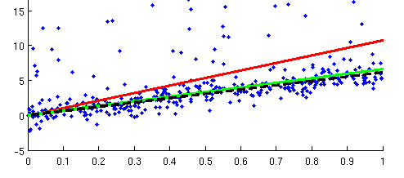
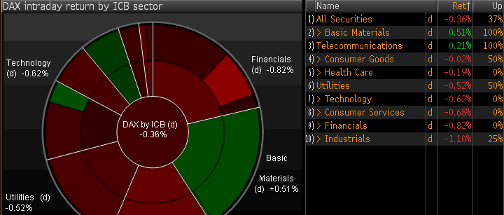
Abstract Portfolio Optimization
Choose Portfolio
(Market Index)
Portfolio Selection
(Optimization - Index Tracking)
Numerous Approaches
(Revenue, Tracking Error, Cost, etc)
Stock Groups/Classifications
(Industry, Sector, Rating, Type, etc)

Slide 3
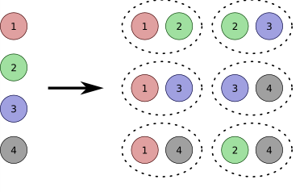
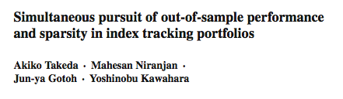


Initial Goals
(Semester 1) Portfolio Selection - Forward Search
Model Selection through a Greedy Forward Search approach.
Ridge, Squares, CVaR and Abs
(Semester 2) Portfolio Selection – Sparse Regression Models
Group Level Regression model approach.
Lasso, Group Lasso & Sparse Group Lasso

Slide 4
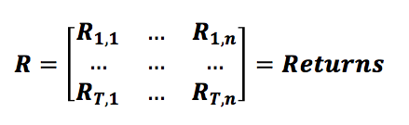
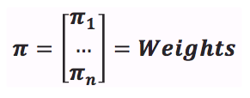
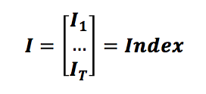






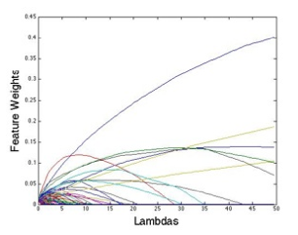
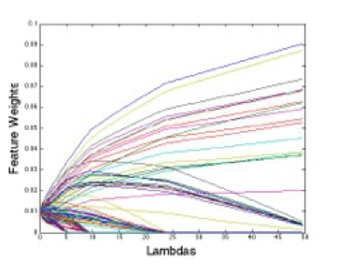
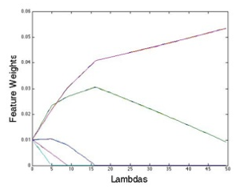
Intuition
Lasso
Sparse Group Lasso
Group Lasso

Slide 5
Research Objectives
Design, implement and test regression models
Implement feature level and group level regression models (Ridge, Squares, SGL, etc.)
Evaluate performance: Feature vs. group level approach
Present visual and intuitive results in order to provide concrete conclusions
Encourage Research in group sparsity models
Multiple Sparse Group Regression concept proposed to encourage further research
Build an intuitive, reusable programming library
Provide the code used for the implementation in a presentable and structured manner

Slide 6



Motivation
Opportunity to contribute to current research
Successful applications in genetics
Novel approach to portfolio optimization
Extremely relevant to previous and future projects

Slide 7


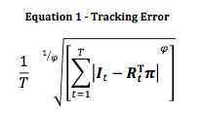





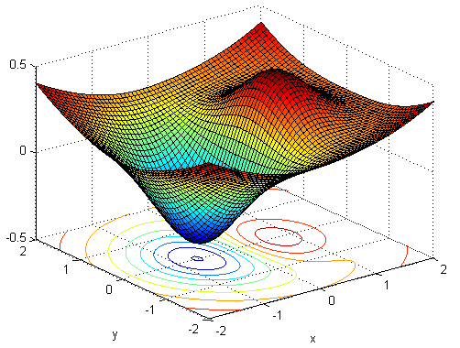
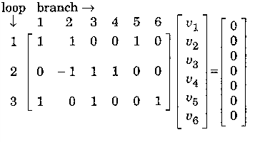
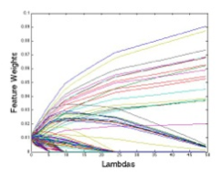
Main Challenges
Financial Concepts
Machine Learning Understanding
Programming
Convex Programming Libraries
Matrix Notation Algorithms
Implementation of ZCSGL

Slide 8

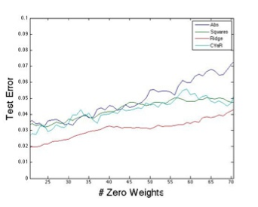
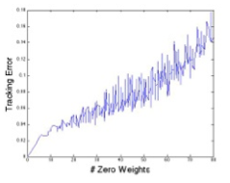
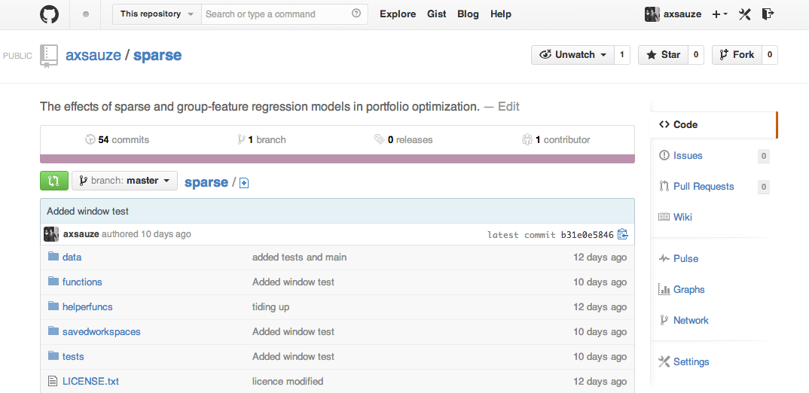
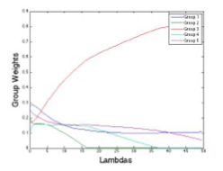
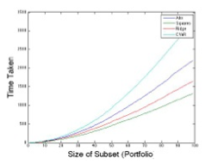
Achievements
Zero-Constrained Sparse Group Lasso
Algorithmic Implementations
Time Series Modeling (p.6)
Lasso, Ridge, Squares, Abs
Spectral Clustering Algorithm
Zero-Constrained-GL (p. 16)
Zero-Constrained-SGL (p. 16)

Slide 9
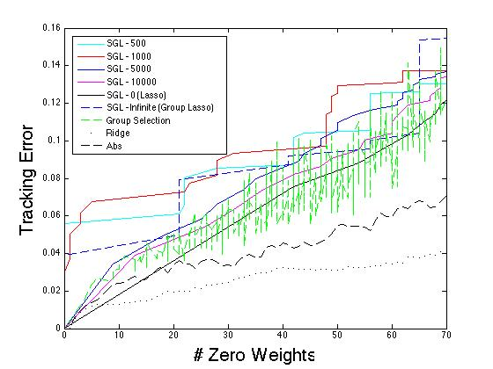
Final Results (Tracking Error – All Data p.18-22)

Slide 10
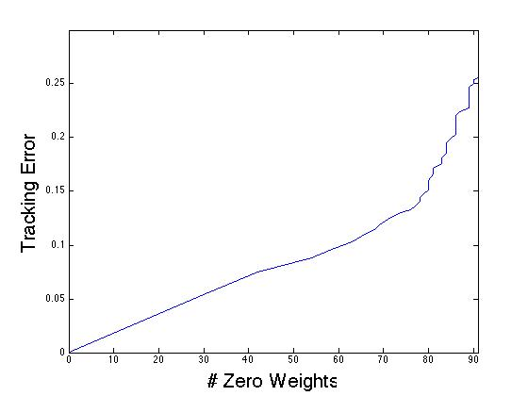
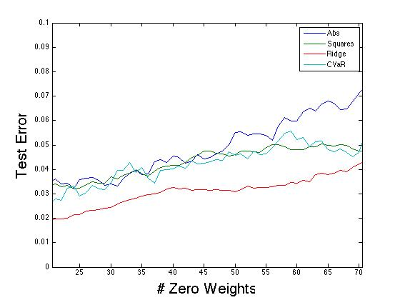
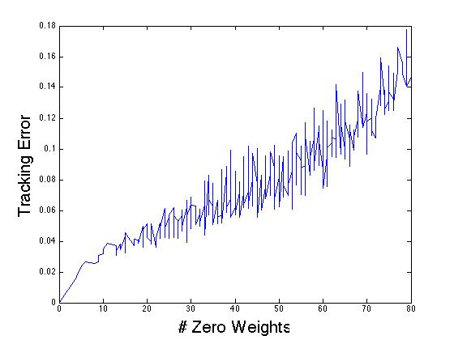
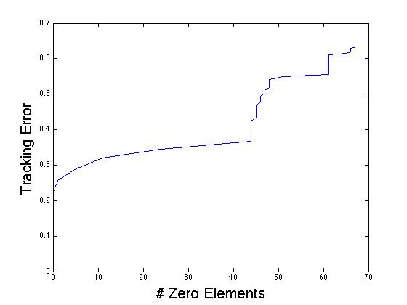
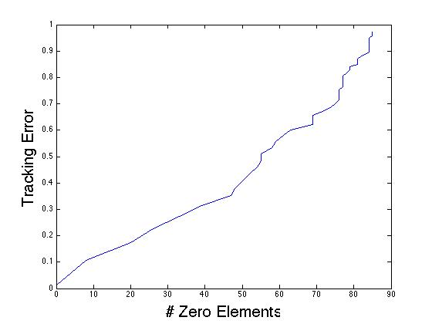
Final Results (Tracking Error – All Data p.18-22)
Lasso
Feature Model Selection
Group Model Selection
Group Lasso
Sparse Group Lasso

Slide 11
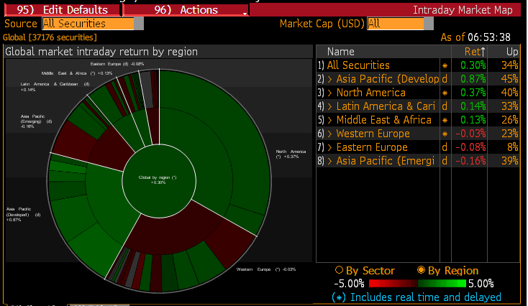
Expansion
Observation
Objective
Modelling chaotic systems such as financial stock markets requires consideration of complex correlations between groups of stocks.
Enable regression models to induce sparsity based on multiple groupings of the data.
Proposed Solution
Multiple-SGL Concept

Slide 12
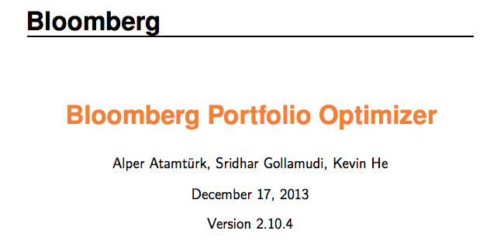
Professional Opinion
Denver Trouton
FX Options Applications Lead
Bloomberg LP
“Several Teams working on similar principles”
Multi-asset class support (equities, FX, commodities, bonds, CDS, IRS)
Support for portfolios of composite securities (e.g. ETFs, mutual funds, indices)
Efficient frontier optimization
Long-only as well as long-short optimization
Risk (volatility), Value-at-Risk, Conditional Value-at-Risk goal and/or constraints, possibly relative to benchmark
Weight constraints on groups of securities (e.g. sectors, countries, issuers, ratings, etc)
Bounding number of trades, buy, sells, positions, longs, shorts (potentially per grouping)

Slide 13
Thank you very much!
Sparse and group regression models in portfolio optimization
Project Supervisor: Professor Mahesan Niranjan
Second Examiner: Professor Vladimiro Sassone

