Slide 1
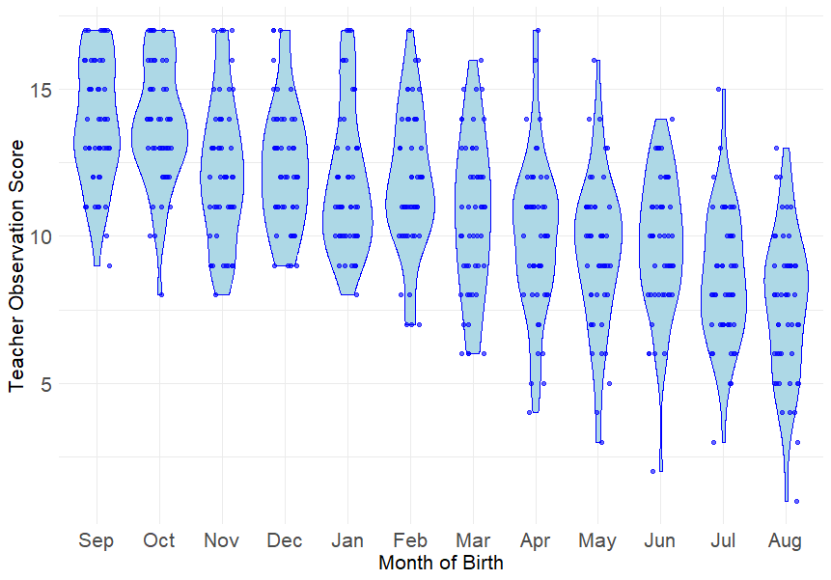
Section 1: Correlations
What is the strength of the linear relationship on display here?
What is it’s direction?

Slide 2

What’s the test-statistic and null-hypth?
Correlation is a standardized unit of measurement that represents the ratio between the Covariance and the Variance of the 2 variables:
Covariance between 1st and 2nd year exam scores
$$r=\frac{{Cov}_{xy}}{s_{x }s_{y}}$$
=
r is a ratio, ranging from -1 to 1
Variance in 1st yr exam scores
Variance in 2nd yr exam scores
at ±1 variance = covariance
x
Farther away from 0 the stronger the correlation
H₀ tests hypothesis that r = 0:
“When calculating covariance x and y are so weakly related you might as well enter a random value for y”
+ or – indicates positive or negative relationship

Slide 3
Is it positive or negative
The direction of the relationship
Statistical Significance
Not the same thing as Effect Size!
r = - .473, p <.001
The type of correlation test
If pearson correlation coefficient then probably examining:
2 normally distributed continuous variables
Effect size
-.1 < r > .1 (small)
-.3 < r > .3 (medium)
-.5 < r > .5 (large)
Coefficient of determination/ proportion shared variance (r²)
± 0.1 = 1%
± 0.3 = 9%
± 0.5 = 25%

Slide 4
Lots of specific Correlational Methods…
Pearson’s Correlation Coefficient (r)
Two continuous variables, both normally distributed
Spearman’s Rank Correlation (r_{s})
Conservative (non-parametric), treats data as ordinal
Kendall’s Tau (τ)
Like r_{s} but more suitable for smaller sample sizes
Point Biserial & Biserial correlation (r_{pb} or r_{b})
The best option when one variables is dichotomous
Robust (bootstrapped) correlations
Sampling your sample
Remember Assumptions
These will vary depending on the type of correlation you use!

Slide 5
Exercises
Recap with a bit of assumption checking
Perform several bivariate Pearson’s correlation
An optional extra exercise on standardising variables and deriving (computing) new variables from existing ones in your SPSS dataset.

