Slide 1


An introduction to inferential statistical tests CAP Pathway: Intro to Statistics
Dr Liam J.B. Hill
MA Psychology | MSc Public Health | PhD Child Health
@liamjbhill.bksy.social liam.hill@ed.ac.uk Research Profile: ORCID.ORG/0000-0002-4069-5121

Slide 2
In this session
Going to focus on three of how to do three simple forms/types of statistical test in SPSS:
 | Test type | 1x IV | 1x DV
Part 1 | Correlations | Continuous | Continuous
Part 2 | T-tests | Categorical | Continuous
Part 3 | Chi-squared tests | Categorical | Categorical

Slide 3
More generally: Choosing a model
Choosing the specific type of Inferential Statistical Test to use depends on a few factors, defined by your projects’ hypothesis and its variables:
The number of Dependent Variables (DV) specified in our Hypothesis
The number of Independent Variables (IV) specified in our Hypothesis
How each of these variables are operationalised
Are they continuous or categorical scales of measurement?
For categorical variables:
How many categories (binary or multi-category)?
Sidenote:
In the following slides, I’m going to briefly discuss cases where you have 1x DV but methods do exist for testing multiple DVs in a single model
(e.g. MANOVA)
Notes:
MANOVA = Multiple Analysis of Variance
Prof Andy Field has some good materials on this type of analysis and how to do it in SPSS. To start you may want to look at this webcast by him: https://www.youtube.com/watch?v=m0zV_wFGA1I

Slide 4
A Garden of Forking Paths!
Is your Dependent Variable measured on a Continuous or Categorical scale?
Categorical
Are your Independent Variables:
Measured on a Categorical Scale?
Measured on a Continuous Scale?
A mixture (i.e. when you have more than one IV)?
Option 1
Option 2 or 3
Continuous
See next slide
Go to slide 32
Go to slide 33

Slide 5
Categorical DV with Categorical IV(s)
 | Binary DV | Non-Binary DV
1x Binary IV
1x Non-Binary IV
>1 IV
Fisher’s Exact test*
Chi-Squared test
Loglinear Analysis
Is having additional support needs (ASN) in primary school (Yes or No?) associated with your likelihood of being excluded in secondary school (Excluded vs. Not Excluded)?
Is having additional support needs (ASN) in primary school (Yes or No?) associated with level of degree classification at University (Distinction, Merit, Pass or Fail)?
Is there a relationship between having ASN in primary school (Yes or No?) , whether you are later excluded in high school (Excluded vs. Not) and subsequent degree classification at University (Distinction, Merit, Pass or Fail)?
* If the DV and IV are not independent (repeated measures) then use a McNemar’s test instead.
Notes:
An example of where your data for the DV and IV are not independent, and a McNemar’s test would be appropriate, would be examining if Additional Support Need status in primary school was predictive of Additional Support Need status at University (i.e. the exact same variable binary variable measured at two points in time).

Slide 6
Categorical DV with continuous IV(s)*
 | Binary DV | Ordinal Non-binary DV | Nominal Non-binary DV
At least one continuous IV*
Binary
Logistic Regression
Ordinal
Logistic Regression
Multinomial
Logistic Regression
Are the odds of someone obtaining a University Degree (Has a Degree vs. Does not have a degree) associated with their grade point average (GPA, 0-100) whilst at Secondary School?
Are the odds of someone choosing to study within a specific discipline at University (Arts, Medicine, Engineering) associated with their grade point average (GPA, 0-100) whilst at Secondary School?
Are the odds of someone obtaining a higher Degree Classification at University (Fail > Pass > Merit > Distinction) associated with their grade point average (GPA, 0-100) whilst at Secondary School?
* If more than one IV, these types of model can come with a mixture of categorical AND continuous IVs

Slide 7
For a Continuous Dependent Variable
Are any of your Independent Variable(s) measured on a Continuous scale?
No (all Categorical)
Do you have:
One independent variable?
More than one independent variable?
Option 1
Option 2
Yes
See next slide
Go to slide 35
Go to slide 36

Slide 8
Continuous DV with only 1 Categorical IV
No. of Levels in Categorical IV? | Are Levels Independent? | Test
2 | Y
>2 | Y
2 | N
>2 | N
Independent Samples t-test
One-way between-subjects ANOVA
Paired Samples t-test
One-way within-subjects ANOVA
Do Teacher’s self-reported stress levels (0-100 scale) vary depending on the age group they teach (Primary vs. Secondary education)?
Do Teacher’s self-reported stress levels (0-100 scale) vary depending on the age group they teach (Primary, Secondary or Tertiary education)?
What is the effect of participating in a Mindfulness Based Stress Reduction Program on Teacher’s self-reported stress levels (stress measured twice: pre- vs. post-program)?
Do Teacher’s self-reported stress levels vary across the academic year (stress measured four times: Autumn, Winter, Spring, Summer Semesters)?

Slide 9
Continuous DV with more than 1 Categorical IV*
Are Levels Independent in first IV? | Are Levels Independent in second IV? | Test
Y | Y
N | N
Y | N
Factorial Independent Groups ANOVA
Factorial Repeated Measures ANOVA
Factorial Mixed ANOVA**
Is school absence level (No. of days) associated with whether a student has caring responsibilities (Yes or No) and/or is experiencing food insecurity (family uses food bank? Yes or No?)***
Does on-task behaviour (0-100%) during a lesson associate with the time of the lesson during the day (AM vs. PM) and/or whether learning is active or passive within the lesson (i.e. 4 lessons: Act-AM, Pass-AM; Act-PM; Pass-PM) ?***
What is the effect of participating in a Mindfulness Based Stress Reduction Program on Teacher’s self-reported stress levels (pre- vs. post-program) and does this depend on how it is delivered (online vs. in-person)?***
* All examples here are 2-way models (i.e. only 2 IVs) but you can build more complex models with >2 IVs.
** If using SPSS, this is usually still run using the Factorial Repeated Measures ANOVA function (line above).
*** These models can test if the effects of these IVs on the DV are independent or whether they interact too.

Slide 10
Continuous DV with Continuous IVs*
No. of Continuous IVs? | Test
1
>1*
What is the relationship between a students’ relative age within their year group (week of birth relative to school year start date) and their grade point average (GPA) at graduation?
Simple Linear Regression
Multiple Linear Regression (MLR)
What are the relationships between a students GPA at graduation and the following variables: relative age within their year group, their family household income and their IQ score (0-100)?
“Single-step” or “Standard” MLR (all IVs entered in a single step)
What is the relationship between a students relative age within their year group and their GPA at graduation, and is this significant even after controlling for their household income and IQ Score?
“Sequential” or “Hierarchiacal” MLR (IVs entered in Blocks)
* If more than one IV then some of these can be categorical as well as continuous variables.

Slide 11
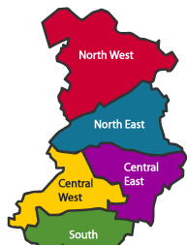
We can go further still!
High SES
Multi-level Modelling
Lifetime Earnings (£)
Good for when you have dependent structures in your data.
Avg. SES
Low SES
School 1
Intervention
Control
IQ
School 2
Academic Attainment
School 3
School 4
Family SES
Lifetime
Earnings
School 5
School 6
Notes:
MODERATION: Useful when you are interested in the relationship between (at least one) independent variable (e.g. Cognitive Abilities) and a dependent variable (e.g. Lifetime Earnings) but, based on theories or evidence, you suspect the strength and nature of that relationship might be complicated by other factors (e.g. Household SES). In other words, there isn’t a simple effect of your IV on your DV because the effect of the IV on the DV varies depending on another factors, which “moderates” the relationship between the IV and DV (e.g. amplifies, attenuates, inverts).
MEDIATION: Useful when you want to test causal predictions about why an independent variable (e.g. Gestational Age) may be associated with a dependent variables (e.g. School Readiness). You may already have evidence, from prior research, for the IV and DV’s relationship. The aim in testing for a mediating effect is to try and understand an intervening step in this relationship (e.g. is one of the reasons gestational age impacts on school readiness because it affects cognitive development, which is important for school readiness?).

Slide 12
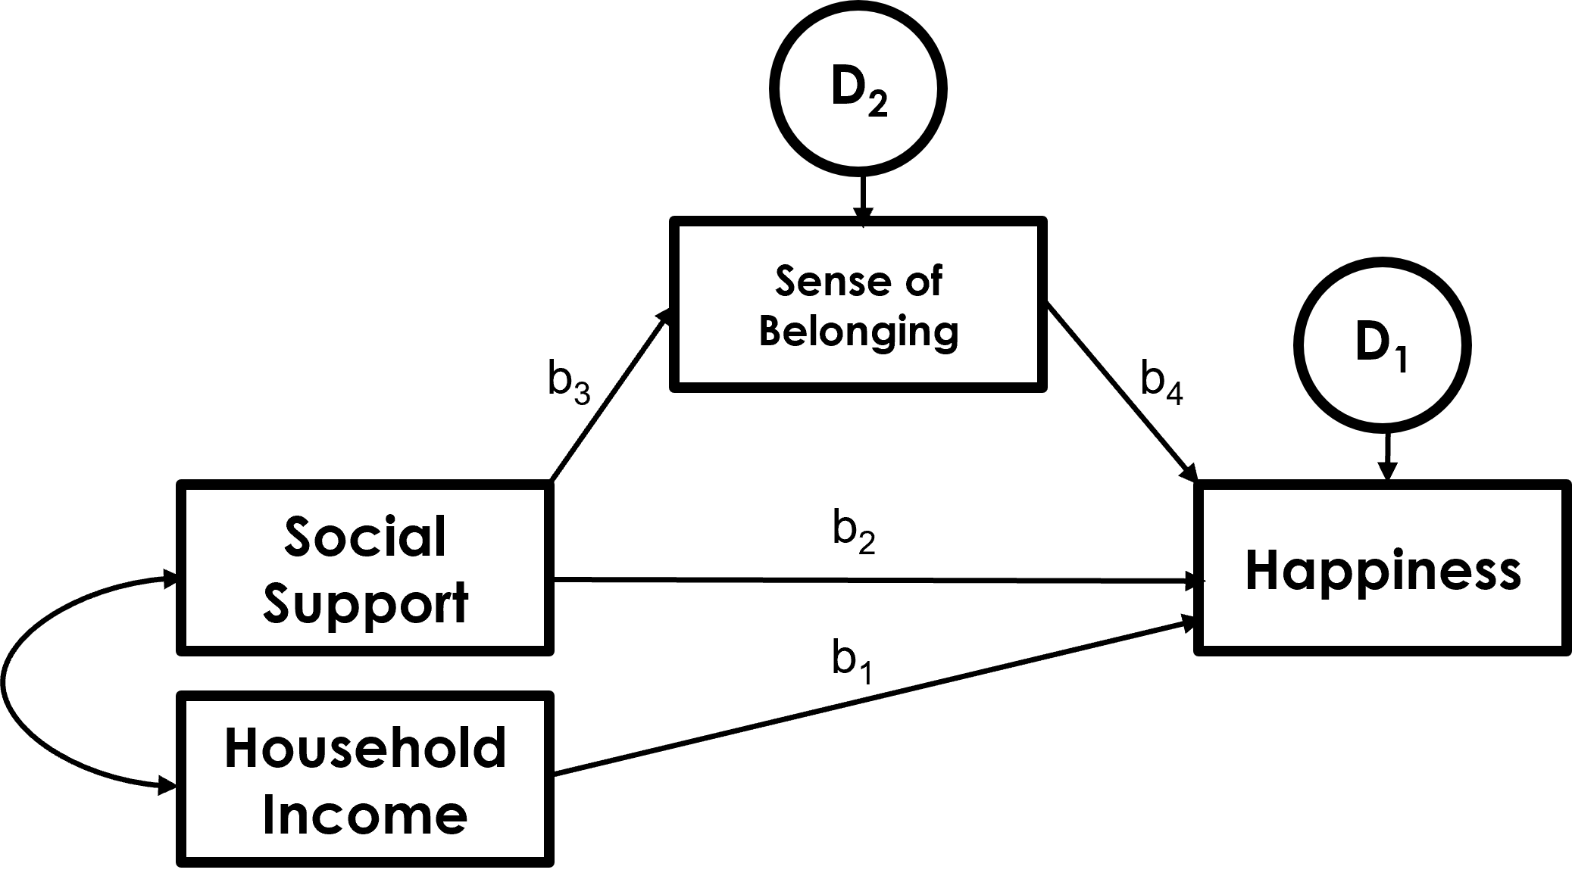
Some (even more) advanced models
Multi-level Modelling
Structural Equation Modelling
Good for when you have dependent structures in your data.
Good for exploring complex relationships hypothesis in path diagrams.
School 1
Intervention
Control
School 2
School 3
School 4
School 5
School 6

Slide 13
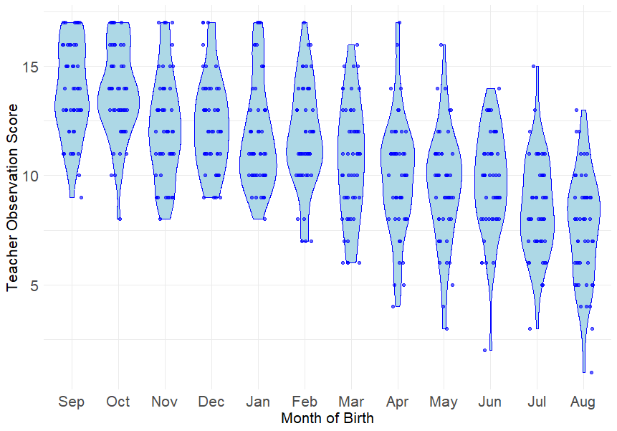
Section 1: Correlations
What is the strength of the linear relationship on display here?
What is it’s direction?

Slide 14

What’s the test-statistic and null-hypth?
Correlation is a standardized unit of measurement that represents the ratio between the Covariance and the Variance of the 2 variables:
Covariance between 1st and 2nd year exam scores
$$r=\frac{{Cov}_{xy}}{s_{x }s_{y}}$$
=
r is a ratio, ranging from -1 to 1
Variance in 1st yr exam scores
Variance in 2nd yr exam scores
at ±1 variance = covariance
x
Farther away from 0 the stronger the correlation
H₀ tests hypothesis that r = 0:
“When calculating covariance x and y are so weakly related you might as well enter a random value for y”
+ or – indicates positive or negative relationship

Slide 15
Is it positive or negative
The direction of the relationship
Statistical Significance
Not the same thing as Effect Size!
r = - .473, p <.001
The type of correlation test
If pearson correlation coefficient then probably examining:
2 normally distributed continuous variables
Effect size
-.1 < r > .1 (small)
-.3 < r > .3 (medium)
-.5 < r > .5 (large)
Coefficient of determination/ proportion shared variance (r²)
± 0.1 = 1%
± 0.3 = 9%
± 0.5 = 25%

Slide 16
Lots of specific Correlational Methods…
Pearson’s Correlation Coefficient (r)
Two continuous variables, both normally distributed
Spearman’s Rank Correlation (r_{s})
Conservative (non-parametric), treats data as ordinal
Kendall’s Tau (τ)
Like r_{s} but more suitable for smaller sample sizes
Point Biserial & Biserial correlation (r_{pb} or r_{b})
The best option when one variables is dichotomous
Robust (bootstrapped) correlations
Sampling your sample
Remember Assumptions
These will vary depending on the type of correlation you use!

Slide 17
Exercises
Recap with a bit of assumption checking
Perform several bivariate Pearson’s correlation
An optional extra exercise on standardising variables and deriving (computing) new variables from existing ones in your SPSS dataset.

Slide 18
Section 2: T-Tests

Slide 19
Tests of “mean difference” (t-tests)
Group vs. Grand mean
Can also use a regression model approach (GLM)

Slide 20
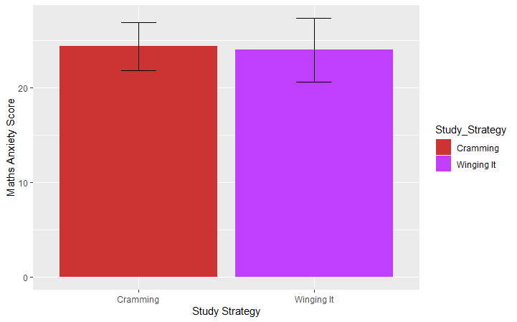
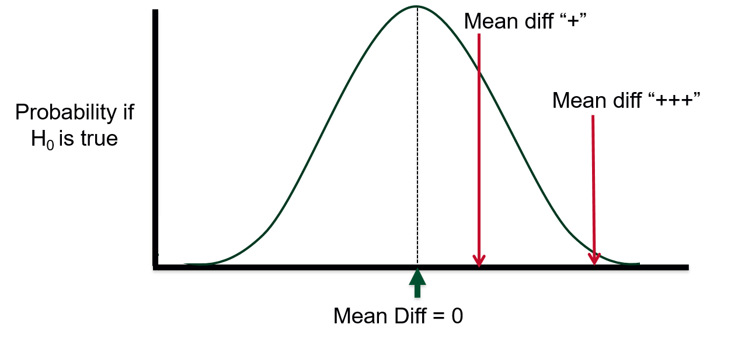
Differences between 2 levels: Testing H₀ when not significant
Parameter estimates relate to differences between group means on a Dependent Variable under different levels of a categorical independent variable
Null Hypothesis (H₀) is systematic variation in the dependent variable related to the Independent Variable is equal to zero
Expressed in this special case:
Null Hypothesis (H₀) the mean group difference in response to the dependent variable will not differ between levels/groups within the independent variable
This is just how ‘systematic variation’ is operationalised when the IV is categorical

Slide 21
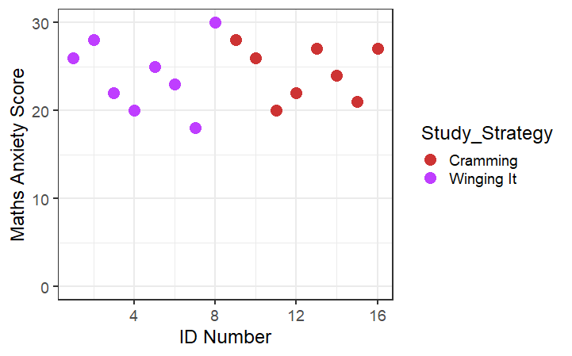
Differences between 2 levels: Testing H₀ when not significant
Parameter estimates relate to differences between group means on a Dependent Variable under different levels of a one categorical independent variable
Null Hypothesis (H₀) is systematic variation in the dependent variable related to the Independent Variable is equal to zero
This fits with our expectation of how a regression line ‘fits’ under H₀ too!
When we can’t reject the Null Hypothesis (H₀) in a regression model we get a flat line, which equates to the mean group difference being equal to zero
Mean Difference = 0
b₁ = 0

Slide 22
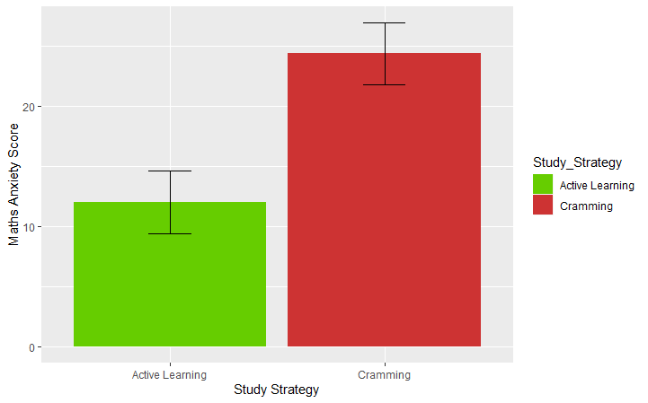
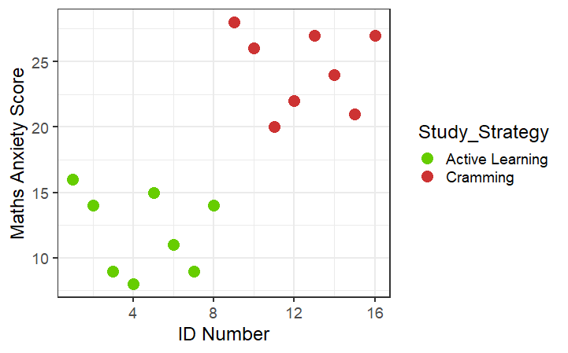
Differences between 2 levels: Testing H₀ when significant
Parameter estimates relate to differences between group means on a Dependent Variable under different levels of a categorical independent variable
Null Hypothesis (H₀) is systematic variation in the dependent variable related to the Independent Variable is equal to zero
The regression approach holds up when we want to reject H₀ too!
Now when mean group difference clearly aren’t equal to zero the slope of the line between these group is clearly not flat too!
Mean Difference ≠ 0
b₁ ≠ 0
This is often referred to as the General Linear Model approach to analysing groups-based effects

Slide 23
So will we keep using regression models in our analysis?
What will differ?
Effects sizes for specific pairwise differences are…
Lower bound of 95% CI for bigger estimated population mean
Upper bound of the 95% CI for the smaller est. pop. mean
Effect size for simple pairwise comparisons?
Cohen’s d (0.2 = small; 0.5 = med; 0.8 = large)
(see Field Textbook, Chapter 3, 3.7.1)
This is the Effect size in t-tests but not in more complex designs…

Slide 24
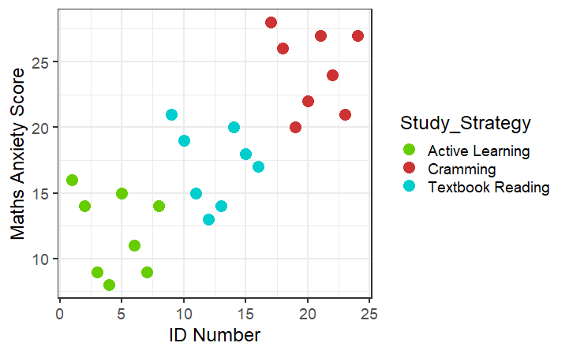
Another way to think about this
Group means vs. Grand means (an alternative to regression line slopes)
The Group Means
The Grand Mean
AKA the ‘flat’ regression line that doesn’t reject H₀ because b₁ = 0
In other words, if you knew the values for the grand means and group means and only a ptps group membership would that knowledge (i.e. which group within the IV they were in) help you predict their performance on the outcome better than simply guessing it’ll be close to the Grand Mean?

Slide 25
Section 3: Chi-squared Test

Slide 26
Tests of difference in frequency dist.

Slide 27
Thanks for Listening! Any questions?
@liamjbhill.bsky.social liam.hill@ed.ac.uk

