Slide 1
Section 3: Chi-squared Test

Slide 2
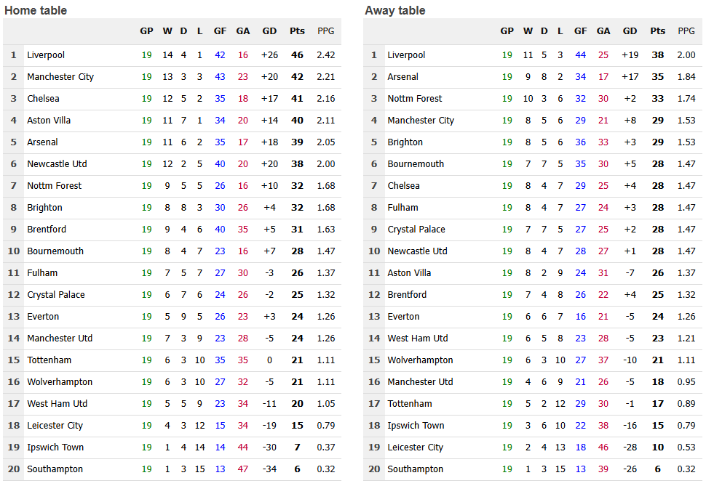
Hypotheses with categorical dependent variables?
Do these distributions differ?
Is there a “home” vs. “away” advantage in professional sports?
The DV here is categorical, 3 levels:
Result [Win, Lose or Draw]
The IV is categorical too, 2 levels: Location [Home or Away]
Why is there such an advantage?
(McCarrick et al., 2021)
Data source: https://www.soccerstats.com/homeaway.asp?league=england

Slide 3
Exercises
Example 1 – Introduced with “by hand” calculation
Example 2 – Implemented in SPSS

