Slide 1


The theory underpinning frequentist inferential statistical methods CAP Pathway: Intro to Statistics
Dr Liam J.B. Hill
MA Psychology | MSc Public Health | PhD Child Health
@liamjbhill.bksy.social liam.hill@ed.ac.uk Research Profile: ORCID.ORG/0000-0002-4069-5121

Slide 2
Hypotheses as Models
The plan for this session
Parameters within Models
Sampling to Estimate Parameters
Will touch upon
Effect Sizes here
Will finish with a few points about:
Assumptions and
QRPs
From Parameters to Test Statistics
Using test statistics for NHST
NHST’s
role in
‘Significance’
‘significance’
AND
Effect Size

Slide 3




Using Statistical Models to test Hypotheses
Think of statistical models a simplified descriptions of complex relationships:
SES
Relative age in
school year predicts…
“All (statistical) models are wrong but some are useful.”
(George Box)
Parenting Practices
School Readiness

Slide 4
When are such models “useful”?
When a Model has predictive validity (i.e. helps us make better choices)
i.e. Models that increase our understanding of output values based on input values:
Prediction based on these “Wrong” models is never perfect though!
Partly to do with fact models are often trained on samples from a larger population
How old is Human X?
Guess based on average human life-span?
Human X is my son (Logan)
Better guess based on knowing age of Father?
Logan was born in 2022
Better guess based on knowing year of birth?

Slide 5
Why are models “Always wrong”?
Models try to explain as much systematic variation in the outcome (dependent) variables (DV) as possible, based on knowledge of variation in the predictor (independent) variable(s) (IV(s))
There will always be some degree of non-systematic variation (AKA Error) in predicting the outcome e.g. due to other factors we haven’t measured and entered as predictors.
IV(s)
DV
Equivalent
to …
Model
Error

Slide 6
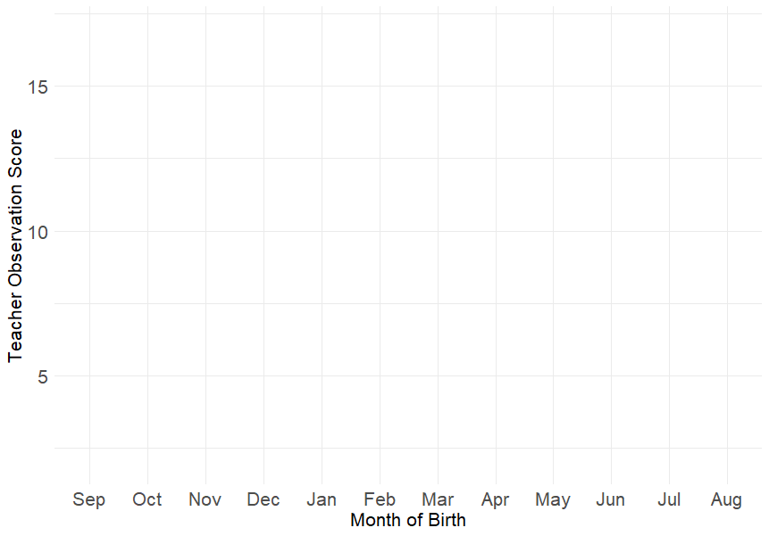
How can we present our Models?
Verbally
Visually
Mathematically
As a written hypothesis:
“Teachers will, on average, rate children who are born later in the school year as performing less well on an observational checklist of their school-readiness skills, after their first term of their first year of primary school”
As a line on a plot
By an equation
Y = b₀ + b₁ X + e
Y = Teacher Obs. Score
Error!
X = Month of Birth relative to start of school year
When we get to this stage we can see that our models contains “parameters”

Slide 7
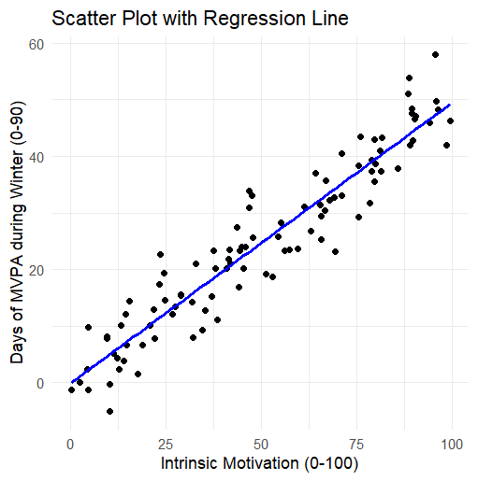
What is a parameter?
An example: in a simple regression model:
High School mathematics: y = mx + c
…dressed up into…
Regression equations: Y = b₀ + b₁X + e
Parameters are important because we can use data in our sample to estimate them, comparing this value against what we predicted it to be in our hypothesis (H₁)
SS_{M}
SS_{R}
Remember this notation
The slope of this line is the main Parameter here!
Notes:
Definition of a statistical parameter: In statistics, as opposed to its general use in mathematics, a parameter is any quantity of a statistical population that summarizes or describes an aspect of the population, such as a mean or a standard deviation.
(https://en.wikipedia.org/wiki/Statistical_parameter)

Slide 8

We have a problem though!
Our Sample
A “Small” world
Parameter estimates derived from our sample can only a “guess” at the true value of this parameter in the wider population.
In other words, our predictions contain a degree of sampling error!
The Target
Population
A “Big” world
In the wider population
17% Pigtails
In our sample
25% Pigtails
Image source

Slide 9
How do we overcome this?
First step: imagine what it’d be like if you could collect data from the whole target population?
That would mean we’d know our models parameters exactly (i.e. no sampling error).
Allowing an unbiased comparison between our predictions and reality.
If that were the case life would be a lot simpler!
At this point all we’d have to talk about is Effect Size.
A measure of the strength/size of the relationship between variables in your models
(based on the parameters)
Do our predictor variables explain a lot of variation in the outcome variable?
Important Questions to do with Effect Size
…or only a small proportion?
…how much is enough?

Slide 10
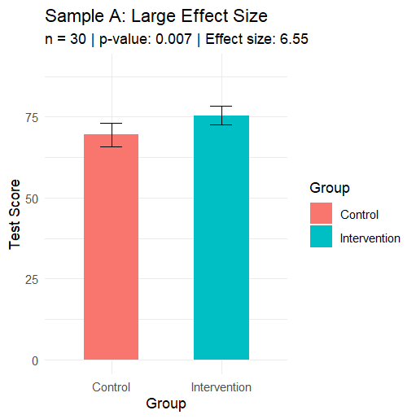
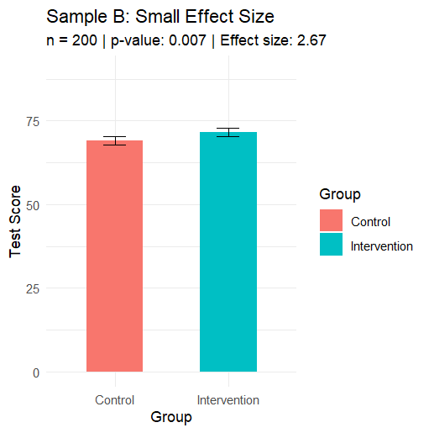
Illustrating variation in effect size:
We’ll come back to Effect Size and estimates of it briefly at the end but please keep in mind:
What makes a meaningful effect size is project specific.
Effect Size is often forgotten or wrongly confused with ‘Statistical Significance’.
Which we’ll talk a lot more about later!
Notes:
e.g. how big a mean-difference do I need to see between teaching method A and B for it to be meaningful? The answer should not be “a statistically significant one”, you can find VERY small differences that are statistically significant, with a large enough sample!

Slide 11
Okay, I was stalling, how do we ACTUALLY address sampling bias?
We can’t collect data from the entire target population!
We make assumptions about the parameter estimates within our sample…
… specifically, we assume things about how this “example sample” might sit within a wider sampling distribution of many samples from the same population.
… we also use information from our sample to make educated guesses about what that wider sampling distribution might look like.
Examples on the next slide…
Notes:
Note: the think we assume is that our sample’s parameter estimate it’ll be positioned somewhere within a normal distribution around the true population parameter (see next slide for illustration).

Slide 12
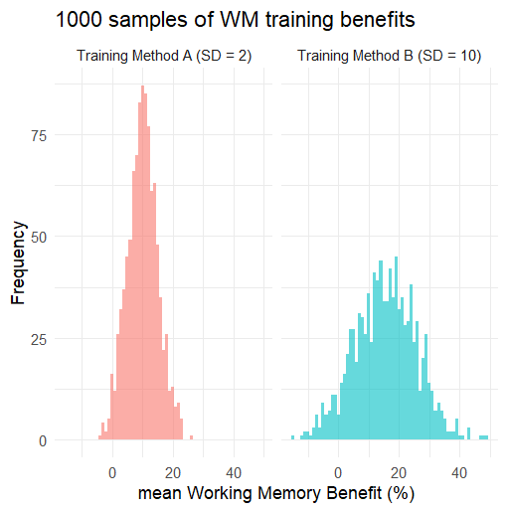
Examples of sampling distributions:
Imagine we ran 1000 thousand studies of the effects of two working memory training methods.
If we group all these samples together, noting the mean benefit observed in each, we see certain values occur more frequently.
i.e. All these samples give us a better estimate of the true parameter might be
In the case of Method A the average benefit across these samples centres on +10%, for Method B it’s about +15%.
Both distributions also vary in their dispersion too. Method A’s benefits are much more tightly clustered around the centre than Method B’s.

Slide 13
Understand link between population and sample estimate for a parameter.
No one sample nails the true mean in the target population but most are close.
This is because the error in each sample’s mean is influenced by both systematic (in the model) and non-systematic error (varies between samples).
2
4
3
3
3.00
3.75
3
6
5
5
Pop. Mean = 3.50
4.75
4
2
3
2
3.75
2.75

Slide 14

Why is assuming a normally distributed sampling distribution relevant?
If we assume our sample is coming, randomly, from a wider “normal” distribution…
We can estimate how much variation there is in a parameter across a population by looking at an equivalent measure of this variance around its estimate within our sample.
We can quantify this using something called Standard Error ≈
Key Takeaways:
Less variance within our sample¹ means a lower Std. Error
More participants in our sample means a lower Std. Error
The size of the sample standard deviation
$$\frac{σ_{x}}{\sqrt{n}}$$
The number of participants in your sample
¹ As measured by the Standard Deviation
Notes:
Definition of Std. Deviation, as it is somewhat ‘skipped over on this slide

Slide 15
Joining this all together dots…
If we know sample size and how much variability to expect within a sampling distribution…
There are then lawful rules about how much ‘margin for error’ we should put around our parameter estimate, …
… which is what we’re trying to use to understand this relationship in the wider pop.
Simple example:
Hypothesis: There is a positive increase in mean concentration within our sample (a class of pupils) after a bout of physical exercise.
Parameter estimate: here is the sample mean for the difference between pupils mins on task in the lesson before the bout of exercise and their mins on task after.
Notes:
Dispersed normally, centred around the true population value for the parameter

Slide 16
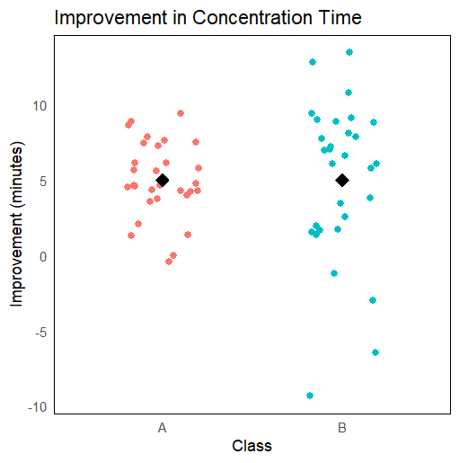
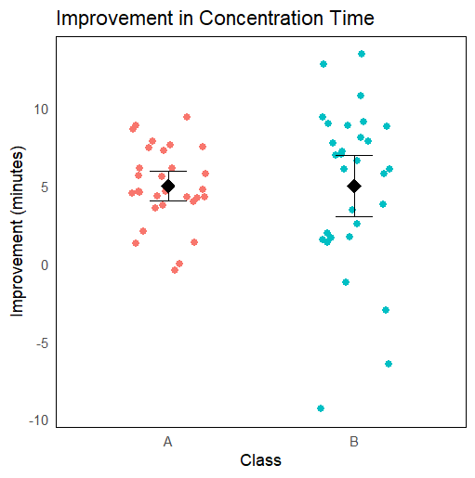
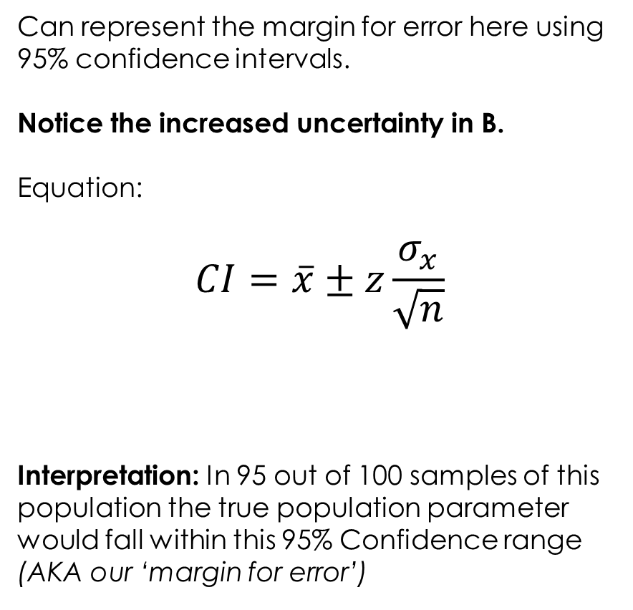
Can represent the margin for error here using 95% confidence intervals.
Notice the increased uncertainty in B.
Equation:
$$CI=\overline{x}±z\frac{σ_{x}}{\sqrt{n}}$$
Interpretation: In 95 out of 100 samples of this population the true population parameter would fall within this 95% Confidence range (AKA our ‘margin for error’)
Level of confidence required (e.g. 95%, 99%?)
Our parameter
(i.e. mean improvement)
Look familiar?
This is the SE!

Slide 17
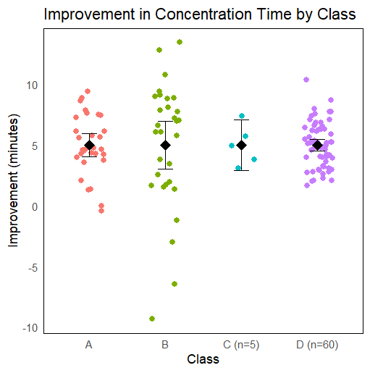
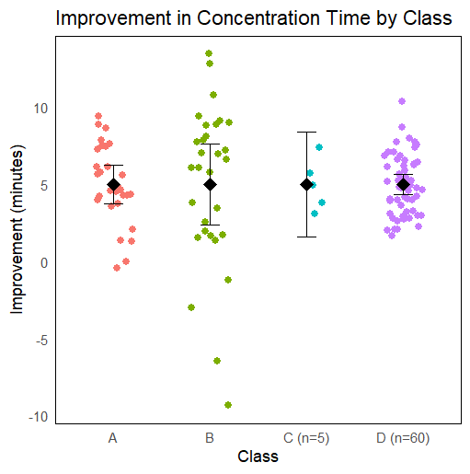
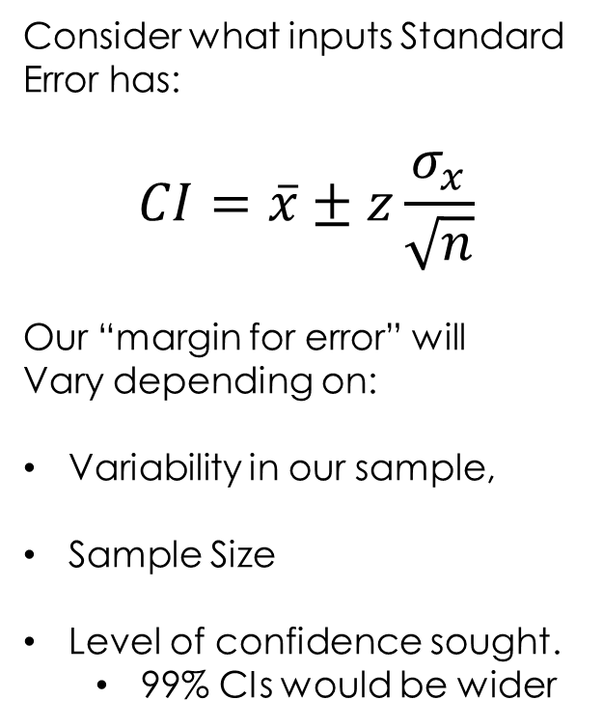
Consider what inputs Standard Error has:
$$CI=\overline{x}±z\frac{σ_{x}}{\sqrt{n}}$$
Our “margin for error” will
Vary depending on:
Variability in our sample,
Sample Size
Level of confidence sought.
99% CIs would be wider

Slide 18

Standardising the sample distribution
Slightly abstract concept (for the time being):
Moving from Parameter Estimate to Test Statistic
Statistical tests take these parameter estimates (which are project specific) and calculate test-statistics from them (e.g. t, f, chi).
These are standardised, unitless, equivalents that also have a known sampling distribution.
They include within their calculation adjustment for the issues of sample variance (bias) and sample size we’ve just been talking about.
The parameter estimate bit
$$t=\frac{({\overline{x}}_{1}−{\overline{x}}_{2})}{\sqrt{\frac{s_{1}^{2}}{n_{1}}+\frac{s_{2}^{2}}{n_{2}}}}$$
But combining with measures of sample variance and size to standardise!

Slide 19
Break!!!

Slide 20
Let’s recap a little…
We started with a hypothesis…
Which we represented mathematically as a model…
More specifically, parameters in that model represent relationships we made predictions about…
Because we’re stuck sampling from a wider population we only have parameter estimates though (i.e. imperfect predictions)
Further information about our sample (e.g. variance within it, its size) can help us model the margin for error in that prediction though (i.e. the Standard Error associated with our Parameter Estimate)
In fact, recall, you can use the SE in calculating confidence intervals around your parameter estimate!

Slide 21
Where to now?
You have a parameter estimate with a confidence interval around it from our sample.
Can we do anything further to formally test how likely that value is given our original predictions about it (i.e. our hypothesis)?
Unfortunately, no!
At least on using traditional (Frequentist) Statistical Modelling Methods.
So what do (most) people do at this point?
They use these methods to carry out Null Hypothesis Significance Testing instead…

Slide 22
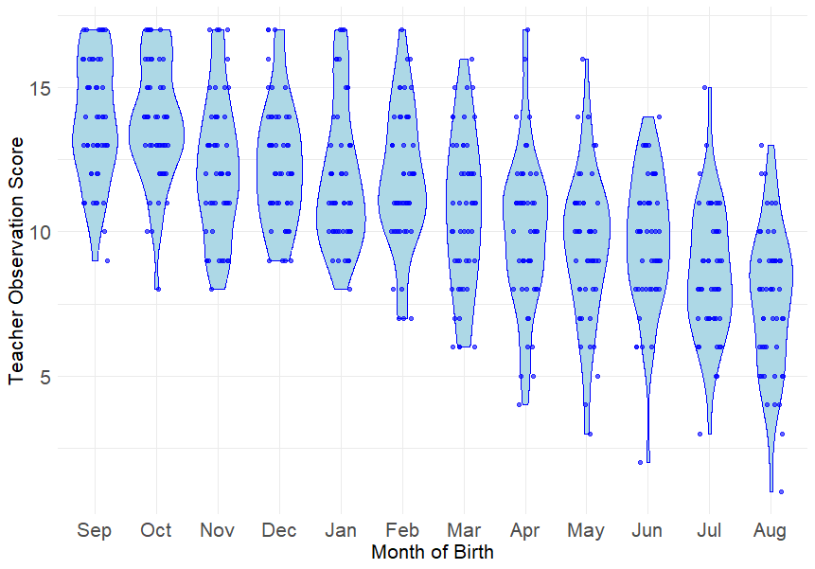

Testing there’s not nothing going on?
Is H₀ a good fit with our data?
What is the null hypothesis here?
This is how I think of it, with the help of Sherlock…
H₀: b₁ = 0
H₁: b₁ is a negative value
“When you have eliminated the impossible, whatever remains, however improbable must be the truth”
(Sherlock Holmes)
Image source

Slide 23
How does this work in practice?
In NHST we define our hypothesis as an Alternative Hypothesis (AKA H₁) – then shelve it
Instead, we focus on a Null Hypothesis (AKA H₀) and use the data we’ve collected to evaluate if we can reject this competing hypothesis. Some examples of an H₀:
A correlation that is a flat line (i.e. H₀: b₁ = 0 )
A mean difference before and after intervention that is zero (i.e. H₀: X_{after} - X_{before} = 0 )
The test statistic in our model (derived from parameter estimates generated from our data) can be interpreted, along with some other information, to determine if it is large enough to mean our data is a poor fit with the null hypothesis?
In other words, does H₀ have a low (p)robability value (AKA p-value)?
If that p-value is below a threshold that we pre-specify, we say we reject the H₀ ...
More on what happens next in a moment

Slide 24
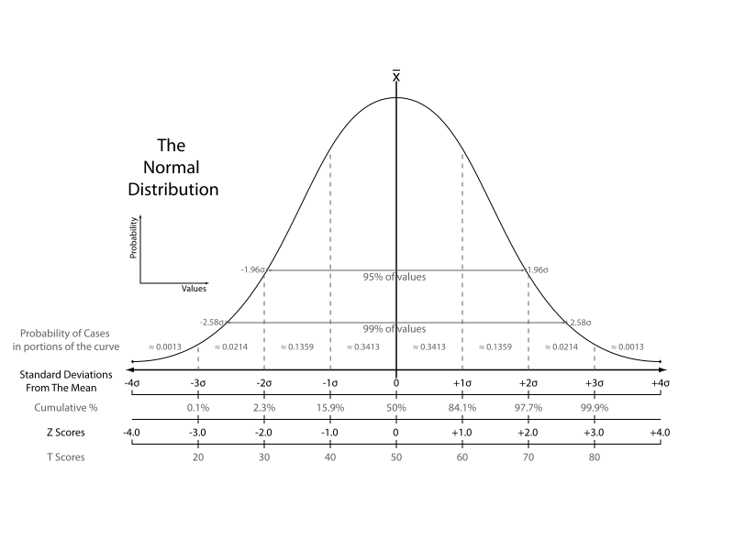
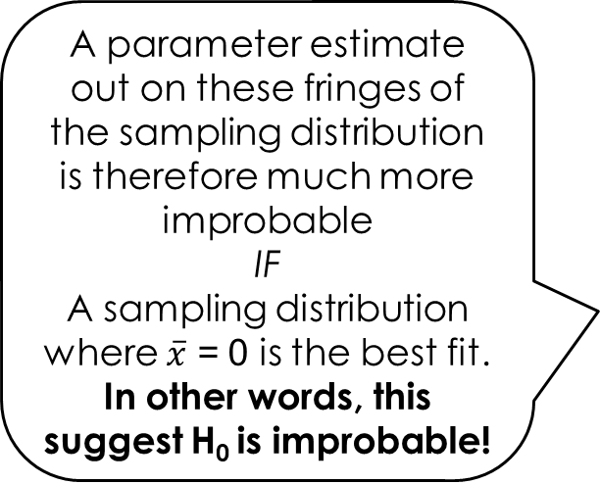
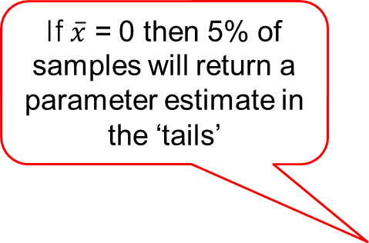
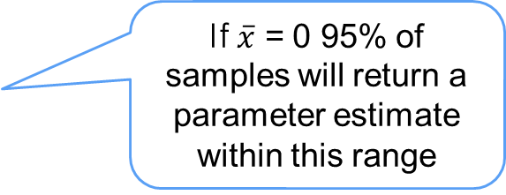

What does this look like on a sampling distribution?
This is our true population parameter
Remember: H₀ predicts this is 0
A parameter estimate out on these fringes of the sampling distribution is therefore much more improbable
IF
A sampling distribution where $\overline{x}$ = 0 is the best fit. In other words, this suggest H₀ is improbable!
If $\overline{x}$ = 0 95% of samples will return a parameter estimate within this range
If $\overline{x}$ = 0 then 5% of samples will return a parameter estimate in the ‘tails’
P-values
How far distant is our prediction from expectation (i.e. if $\overline{x}$ = 0) ?
Example test statistcs
Notes:
Extreme values in samples are less likely if null hypothesis is true. This is also where tests statistics come back in. These are derived from our parameter estimates and the test-statistic can then be used to work out the p-values. If we know the value of a test statistic for a statistical model and the degree of freedom in that model (another way of representing sample size) then we can attach a p-value under the null-hypothesis for a sample producing that test-statistic value.

Slide 25
Where does rejection lead?
If the p-value of our test-statistic under the null is very low it means:
The sample of data we collected is ‘improbable’ if H₀ is true in the wider population.
The parameter we had predictions about (back in our H₁) is therefore probably not 0!
Keep in mind
It is not definitely not zero, we still accept a level of risk:
Risk level depends on the p-value threshold we set (e.g. p < 0.05), referred to as our ‘alpha’.
So what’s potentially more likely if the null hypothesis looks like it should be rejected?
That’s right, your Alternative Hypothesis (H₁)!

Slide 26
Some additional considerations
Keep in mind
Rejecting does not prove the pop. parameter is definitely not zero.
The usage of the p-value means we still accept a level of risk.
Level depends on the p-value threshold we set (e.g. p < 0.05), referred to as our ‘alpha’.
Rejecting the null hypothesis also does not prove our alternative hypothesis
Because of the remaining degree of uncertainty mentioned above
Also, because the relationship represented by your parameter may not be zero but it doesn’t have to be in the direction you predicted either.
Check it’s not something unexpected by looking again at your descriptives!

Slide 27
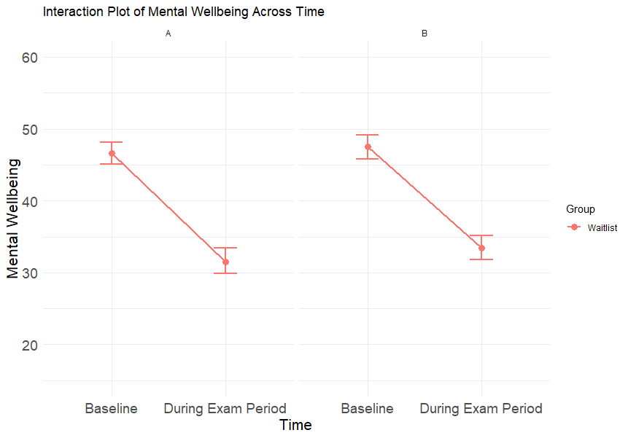
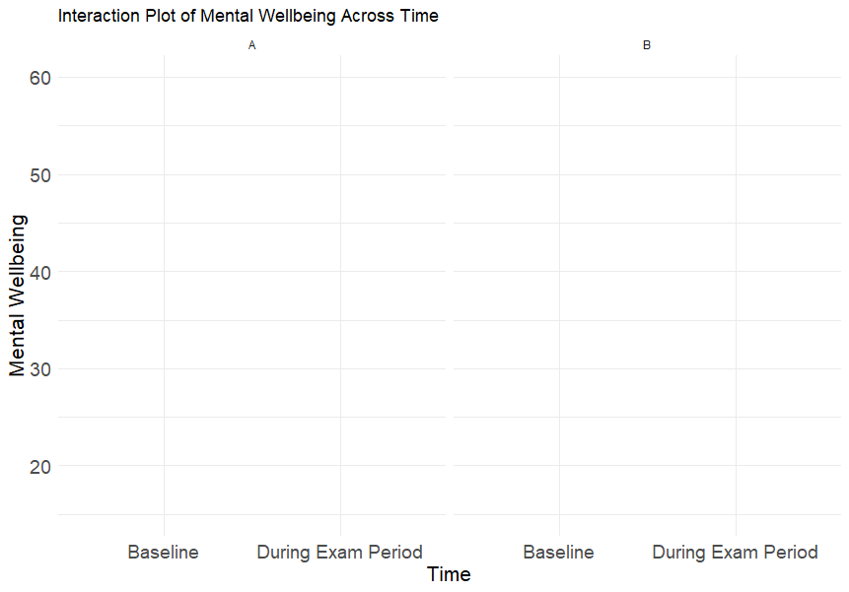
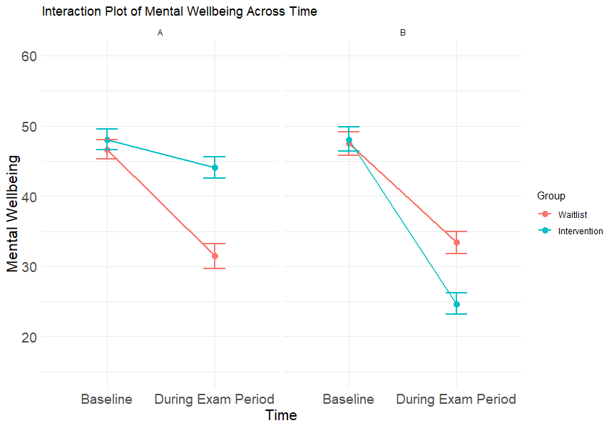
Illustrating this problem…
In both scenario A and B statistical analysis will tell you there’s a statistical association (i.e. a relationship) between Group and Time for Mental Wellbeing.
Looking at the plots, only in one scenario is the data showing a pattern in the direction we might expect though!
(i.e. a beneficial effect of intervention). Which one?
Notes:
Finding a significant interaction will only tell you that the group you are in influences the effect of moving into an exam period on your Mental Wellbeing. It doesn’t tell you anything about the direction of that effect, which you will have specified and have held expectations about in your hypothesis. In reality, where you interested in testing more complicated relationships like this, you would normally want to plan your analysis in phases, starting with a general predication that a significant interaction would arise, then exploring that interaction, using further (post hoc) tests, to try and verify if the ‘shape’ of that interaction differed or was consistent with your original predictions about the form it would take.

Slide 28


A few final things: Effect Size
Effect Size (ES) estimates
Your statistical model ruled out the null hypothesis
Re-checking of your descriptives confirmed an effect in the direction you predicted
But what’s the size/strength of it?
Note: Can interpret this in relative terms or absolute terms (Standardised ES) measures)
An analogy:
Same probability, differing effect size!
5/10
6/10
90%
90%

Slide 29
A few final things: Assumptions
Different test statistics require different assumptions to be met in order to validly interpret their results. Violating assumptions can lead to biases in your parameter estimates!
A few common ones:
Minimum sample size requirements, so you can reliably extrapolate to the population.
Independence of observations, so you’re randomly sampling from the population.
Ideally, learn about and test that your data meets all the assumptions for the specific statistical tests you are using.
Notes:
Note: different statistical models use different test statistics to test significance. Therefore, they do not have the same assumptions because they are all designed to derive slightly different types of parameter estimates to describe slightly different type of relationships between different types of data (e.g. response distributions for categorical variables don’t look like the distributions for continuous ones, so what’s a ‘normal’ sampling distribution in each of these cases also look very different!).

Slide 30
A few final things: QRPs
Questionable Research Practices (QRPs)
This is a broad category of practices that can undermine the integrity of research results. There are two to be particularly mindful of when analysing your research:
P-Hacking – running lots and lots of statistical tests in the hope something will come back significant (anything).
HARK-ing – running statistical tests after you’ve looked at/worked-with your data which you did not initially intend to run but presenting them as if you did!
Both these increase the risk of type-1 errors in your reporting (i.e. reporting findings that are due to unsystematic variance in your sample) – which are unreplicable!
Notes:
Embassy of Good Science, full definition: QRPs are actions that concern trespassing "methodological principles that threaten the relevance, validity, trustworthiness, or efficiency of the study at issue".^{[5]} QRPs can be divided over four main areas of the research process: the study design, data collection, reporting and collaboration. QRPs are estimated to occur far more frequently then serious misconduct, and therefore pose a threat to trust and truth in science.

Slide 31
Hypotheses as Models
To recap…
Parameters within Models
Sampling to Estimate Parameters
Finished with a few pointer about:
Assumptions and
QRPs too!
From Parameters to Test Statistics
Using test statistics for NHST
NHST’s
role in
‘Significance’
‘significance’
AND
Effect Size

Slide 32
Thanks for Listening! Any questions?
@liamjbhill.bsky.social liam.hill@ed.ac.uk

