Slide 1
Section 1: Describing your Data

Slide 2

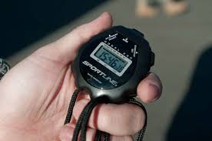
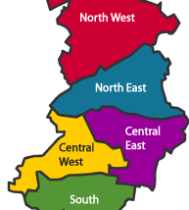
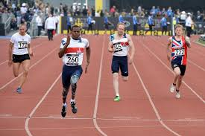
Primarily working with 2 types of data
Continuous (Scale) Data or Categorical (Nominal/Ordinal) data?
Type of measurement | Scale of measurement | Coded in Variable View as…
Continuous | interval, ratio | “scale”
Categorical | nominal, ordinal | “nominal”, “ordinal”
Categorical Variables can also be binary
Con-Interval:
No. of Catches
Con-Ratio:
Change in RT after training
Cat-Nominal: School District
Cat-Ordinal:
Race placing

Slide 3
Summarising Continuous Data
Summarising using measures of Central Tendency and Dispersion!
Use: Analyze > Descriptives > Explore
On variable: Gest_Age_Wks
Mean
5% Tirmmed Mean
Median
Std. Error
95% Confidence Intervals
Variance
Std. Deviation
Range (Min to Max)
Interquartile Range
Skewness
Kurtosis

Slide 4
Summarising Categorical Data
Summarising using Counts and/or Frequencies.
(e.g. proportions, percentages)
Use: Analyze > Descriptives > Frequencies
On variable: p_confidence
In this exercise you’ll also learn a little bit about how to handle missingness in your data.

Slide 5
Summarising Combinations
Comparing a Continuous Outcome across levels within a Categorical Variable:
Use: Analyze > Descriptives > Explore
On variables: Gest_Age_Wks by Sex_at_birth
Comparing categorical distribution of one variable across levels of a second Categorical Variable
Use: Analyze > Descriptives > Crosstabs
On variables: p_confidence by ethnicity

