Slide 1
Section 3: Exploring your Data

Slide 2
Exploring IS IMPORTANT
BEFORE we get on to Hypothesis Testing we need to explore our data thoroughly. Some things I’d always check for:
Extreme Values (i.e. outliers)
More subtle ‘Skewness’
Low cell counts
All of the above are example of things that can lead to our data “violating assumptions” that increase the risk of our parametric inferential statistical tests results being biased.
But not always!

Slide 3
Extreme Values
Check for them using boxplots (again!)
Use: Graphs > Chart Builder
Choose: Boxplot
On variables: prosocial_sum by Sex_at_birth
How would you handle the outliers we’re seeing here?

Slide 4
Skewness
How you handle skew is very case specific.
Ask me more about this later in the day, if you want!
Check for visually
Use: Analyze > Descriptives > Explore
On variable: Gest_Age_Wks
This time: Ask for Statistics & Plots in the output
Check for using normality tests too?

Slide 5
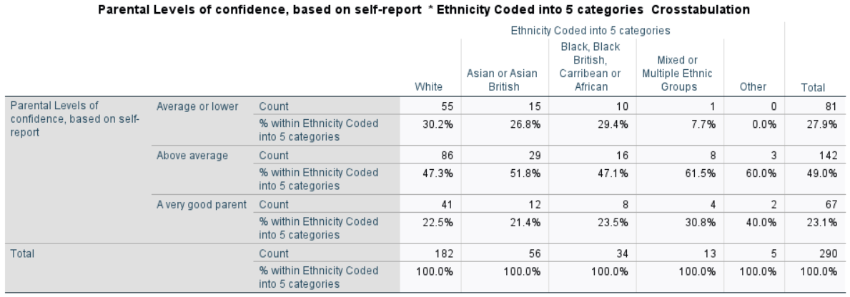
Low Cell counts
Check for in your descriptive statistics.
We already sort of looked at this, when we used Crosstabs earlier.
Cells with fewer than 5 cases in them are something we’ll talk about this afternoon too, when looking at chi-squared tests.

